Slide 1
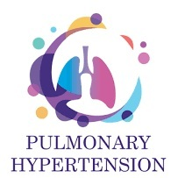
PULMONARY HYPERTENSION
Dr Arun Jude Alphonse
DM Cardiology Resident
Govt TDMC Alappuzha

Slide 2
How we will go about
History
Definition
Classification
Pathogenesis
Etiology
Previous questions asked
Take home message

Slide 3
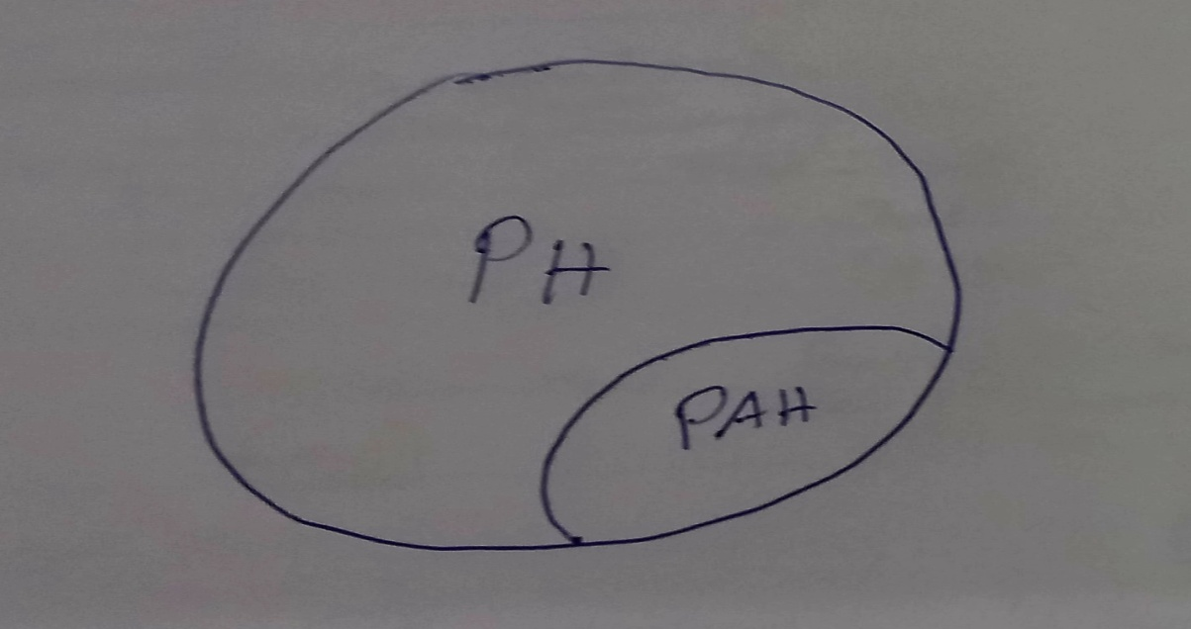
PH vs PAH

Slide 4
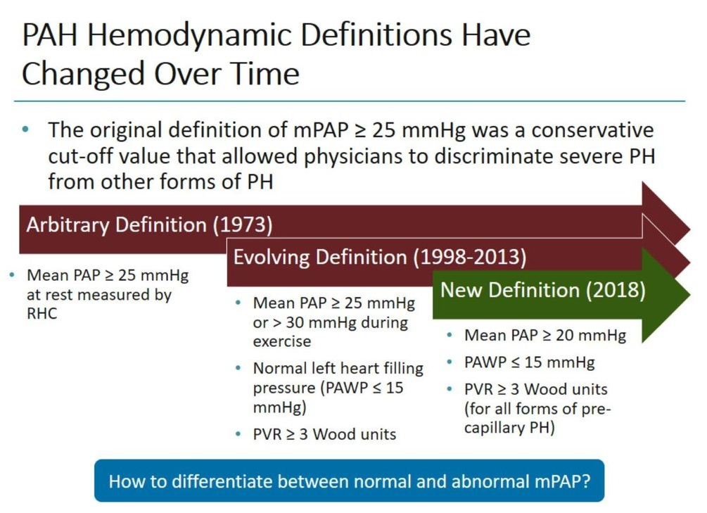

Slide 5

“His word was law. We didn’t always like it”.

Slide 6
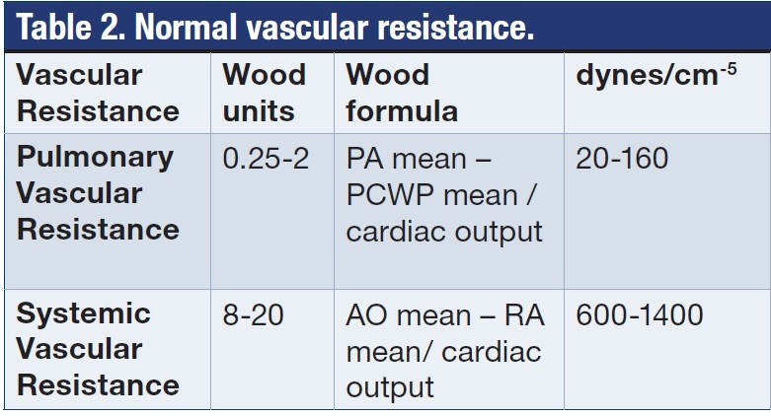

Slide 7
CLASSIFICATION’S OF PH
1.Clinical Classification
2. Histopathological classification

Slide 8
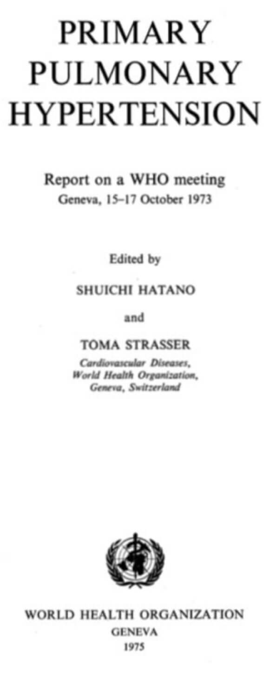
WHO Geneva, Switzerland 1973
In 1973 WHO was first to attempted the classification of pulmonary hypertension into two categories.
1. Primary PH (Histopathological pattern)
  Arterial plexiform
  Veno-occlusive and
  Thromboembolic
2. Secondary PH

Slide 9
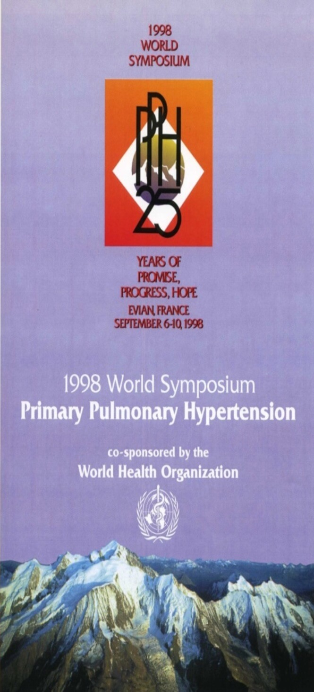
Evian Classification 1998
Expanded prior 1973 classification from 2 groups to 5 major groups.
Based on defining categories of PH that shared similar histopathology, clinical characteristics & therapeutic options.

Slide 10
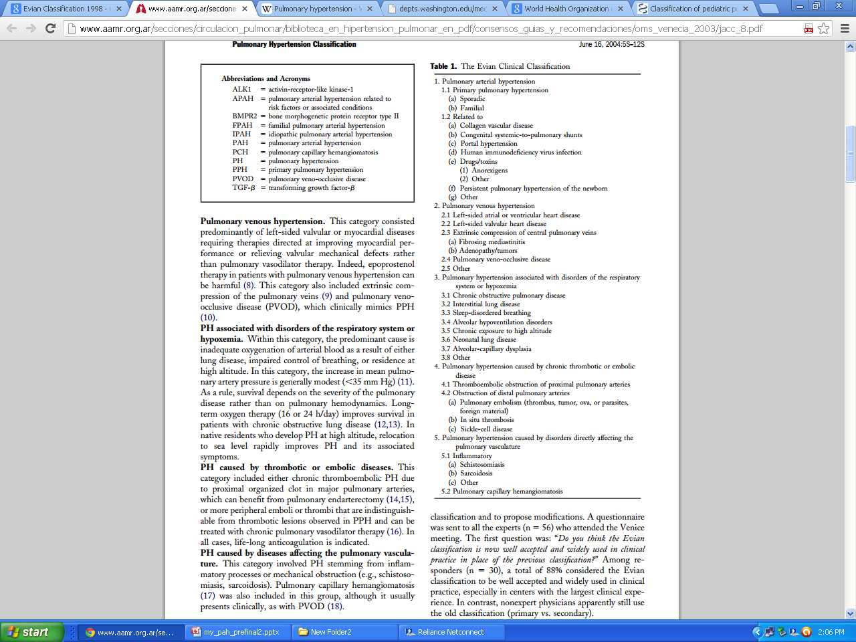
Avoided term “secondary PH”
Retaining
“PPH”

Slide 11
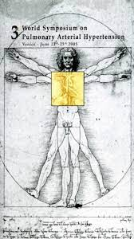

Slide 12
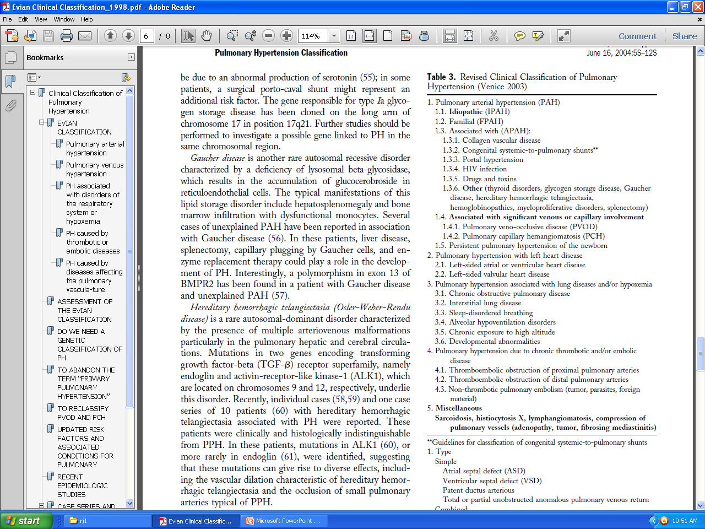
Venice 2003 classification; revised from Evian 1998
Group 1. Pulmonary artery hypertension (PAH)
1.1 Idiopathic (IPAH)
1.2 Familial (FPAH)
1.3 Associated with (APAH)
1.3.1 Collagen vascular disease
1.3.2 Congenital systemic-to-pulmonary shunts
1.3.3 Portal hypertension
1.3.4 HIV infection
1.3.5 Drugs and toxins
1.3.6 Other (thyroid disorders, glycogen storage disease, Gaucher disease, splenectomy, hereditary haemorrhagic telangiectasia, haemoglobinopathy)
1.4 Associated with significant venous or capillary involvement
1.4.1 Pulmonary veno-occlusive disease
1.4.2 Pulmonary capillary haemangiomatosis
1.5 Persistent pulmonary hypertension of the newborn
Group 2. Pulmonary hypertension with left heart disease
Group 3. Pulmonary hypertension associated with lung disease and/or hypoxaemia
Group 4. Pulmonary hypertension due to chronic thrombotic and/or embolic disease
Group 5. Miscellaneous (sarcoidosis, histiocytosis X, lymphangiomyomatosis, compression of pulmonary vessels)
Modest change (Mechanism based )
Abandon term PPH
Moved pulmonary venoocclussive
disease & pulmonary hemangiomatosis
to under PAH.
4. Miscellaneous group added
2
3
4
Notes:
Pulmonary hypertension is usually classified as primary or secondary pulmonary hypertension. However, some of the secondary pulmonary hypertension have the same histopathological features and response to treatment as primary pulmonary hypertension. So, WHO classified pulmonary hypertension into 5 groups on the basis of mechanisms rather than associated conditions.

Slide 13
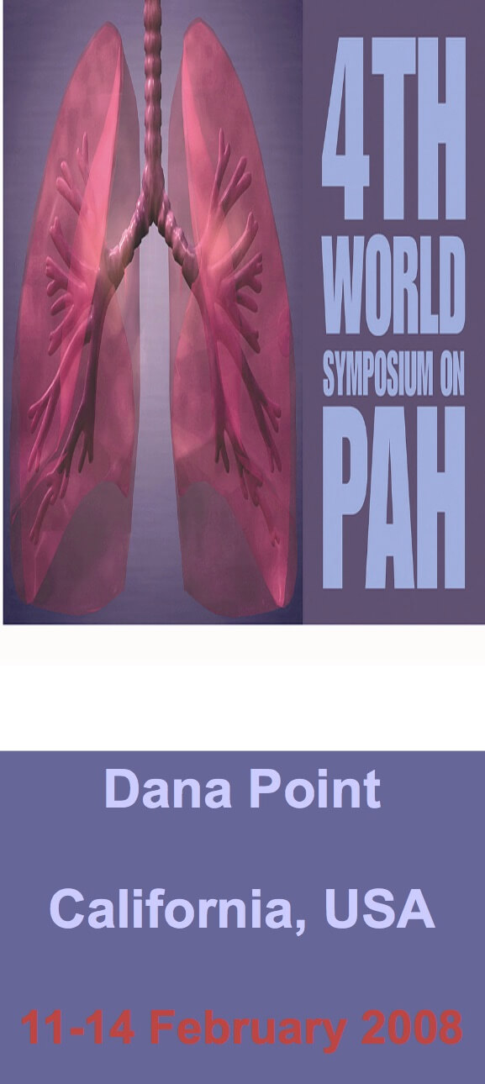

Slide 14
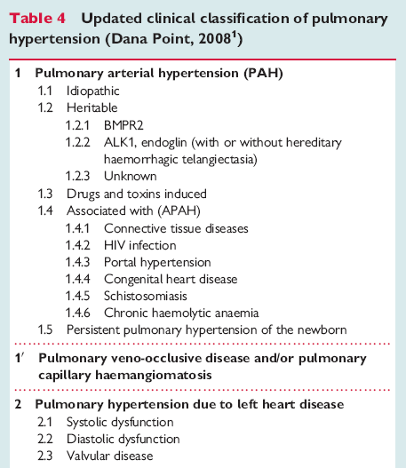
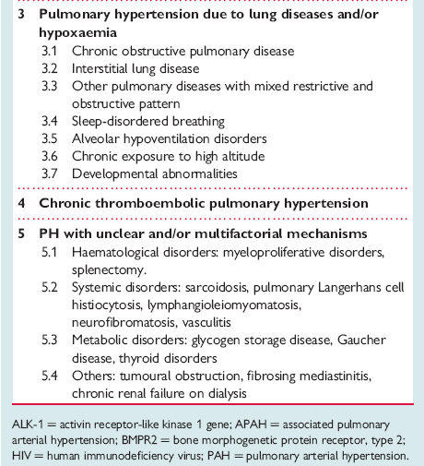
Dana Point Classification of PH,2008
PAH
Non PAH PH
Galiè N et al. Eur Heart J 2009; 30:2493-537
Galiè N et al. Eur Resp J 2009; 34:1219-63

Slide 15
Fallacies of Dana Point, 2008
Pulmonary arterial hypertension is not limited to Group I (this is inappropriately suggested by its designation as ‘pulmonary arterial hypertension)
    It may be associated with pulmonary venous hypertension
    It may be posttrombotic (Group IV) or hypoxic (Group III).
The group ‘miscellaneous’ includes: compression of pulmonary veins, which should be in Group II (pulmonary venous hypertension).
Application to pediatric PAH sometimes difficult. Facts not addressed
  Fetal origin of PVD.
  Developmental mechanism.
  Inconsistent approach of neonatal PVD & importance of perinatal mal-adaptation, mal-development & pulmonary hypoplasia.
  Heterogeneity of risk factors compared to adult.

Slide 16
Pulmonary Vascular Research Institute (PVRI) Panama Classification (2011) for pediatric pulmonary hypertensive vascular disease
Recognition that application of Dana Point Classification to pediatric PAH sometimes difficult.
Aim: to improve diagnostic strategies promote appropriate clinical investigations and improve understanding of disease pathogenesis, physiology and epidemiology.

Slide 17
Panama Classification (2011) continue….
“Pediatric Pulmonary Vascular Hypertensive Disease” –
term used & not pulmonary HT.
Excludes patients with pulmonary hypertension but without elevated pulmonary vascular resistance – ie patients with large systemic to pulmonary connections.
Such patients do not require drug Rx for PHT but rather closure of defect.

Slide 18
Definition: PVRI Panama Classification 2011
Definition of pediatric pulmonary hypertensive vascular disease:
  mPAP > 25mmHG
  PVR index >3.0 Wood units m2

Slide 19
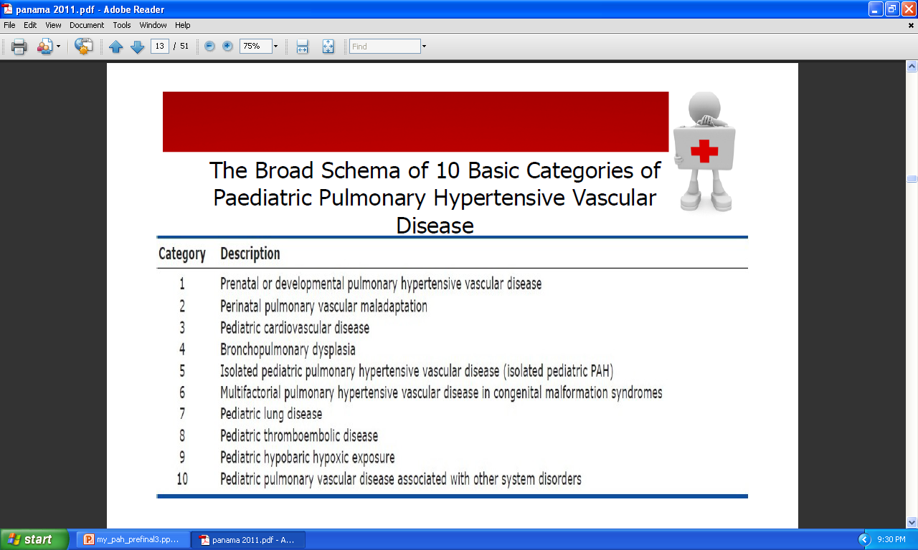
Panama Classification 2011

Slide 20
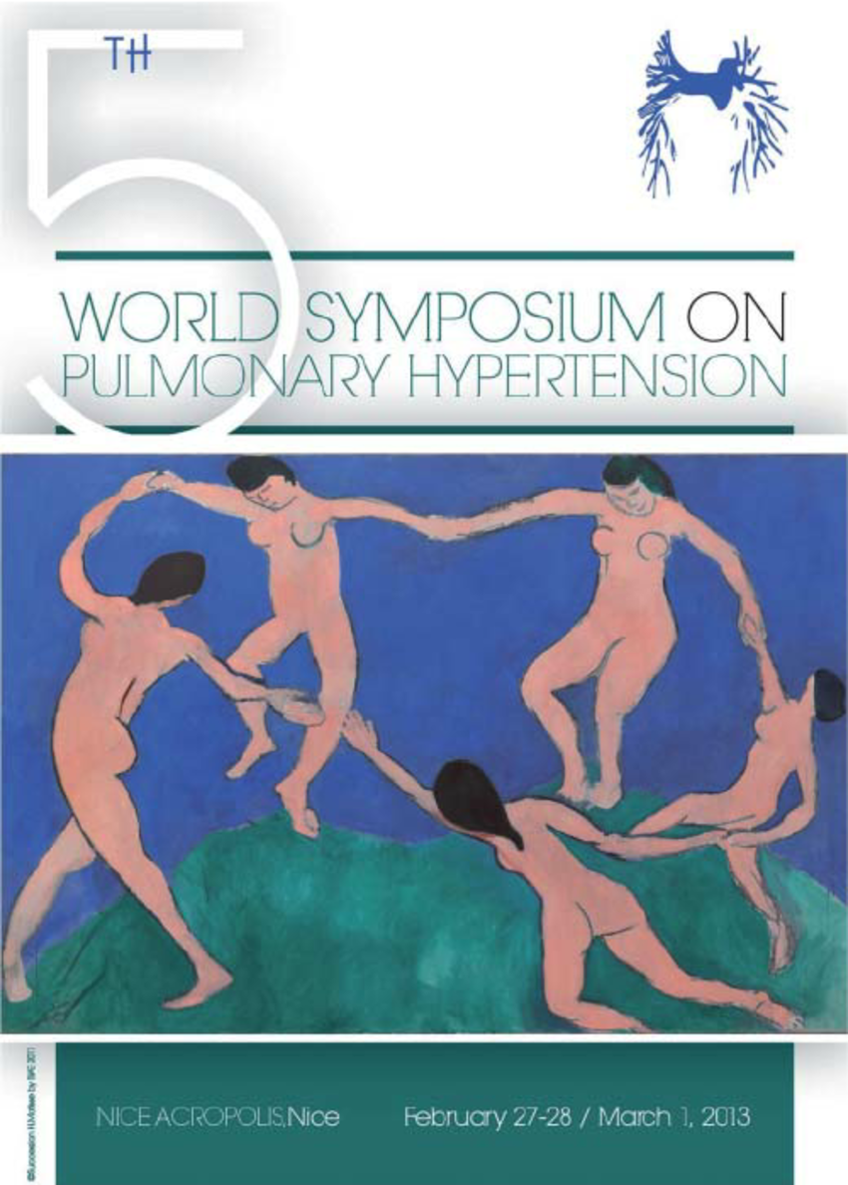
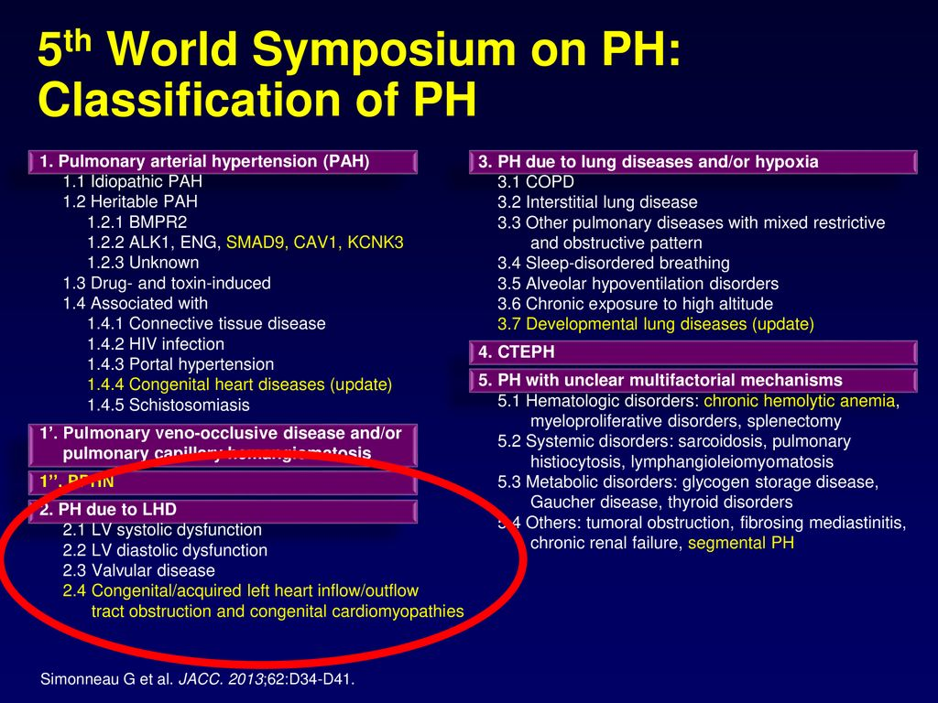

Slide 21
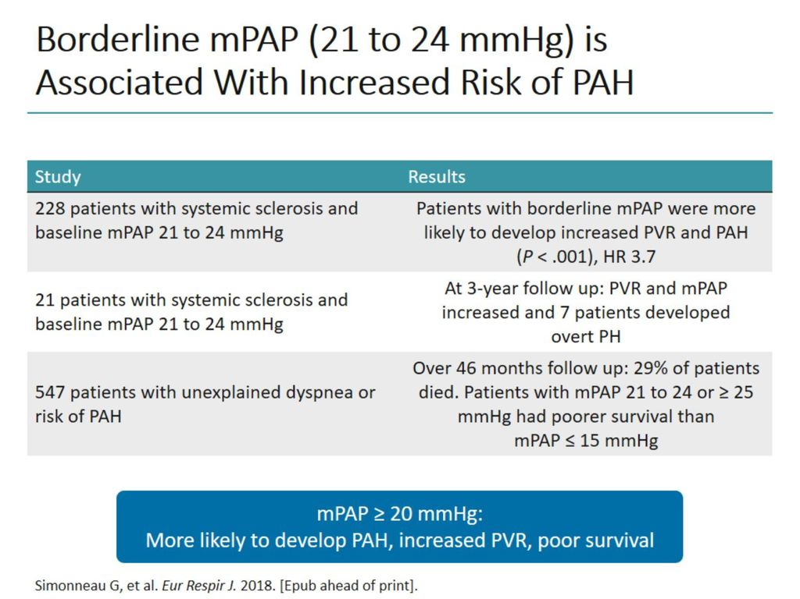

Slide 22
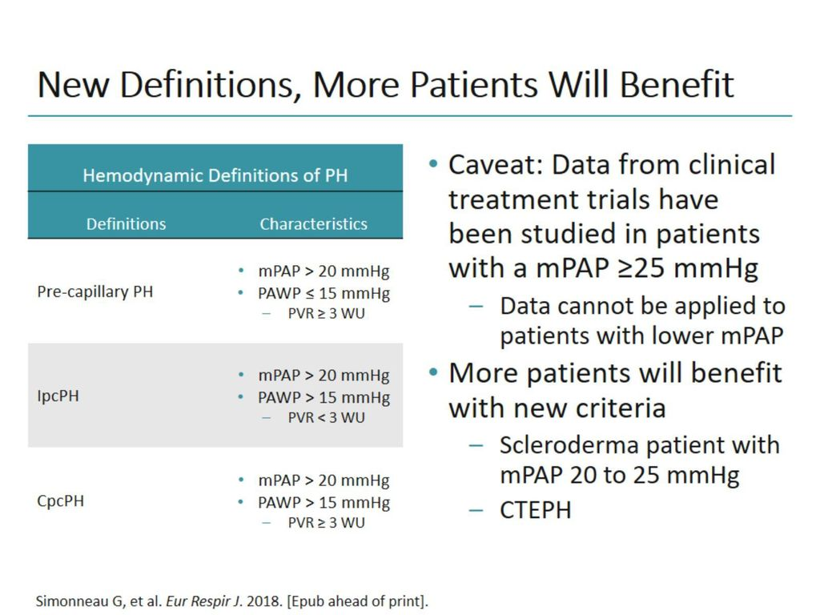
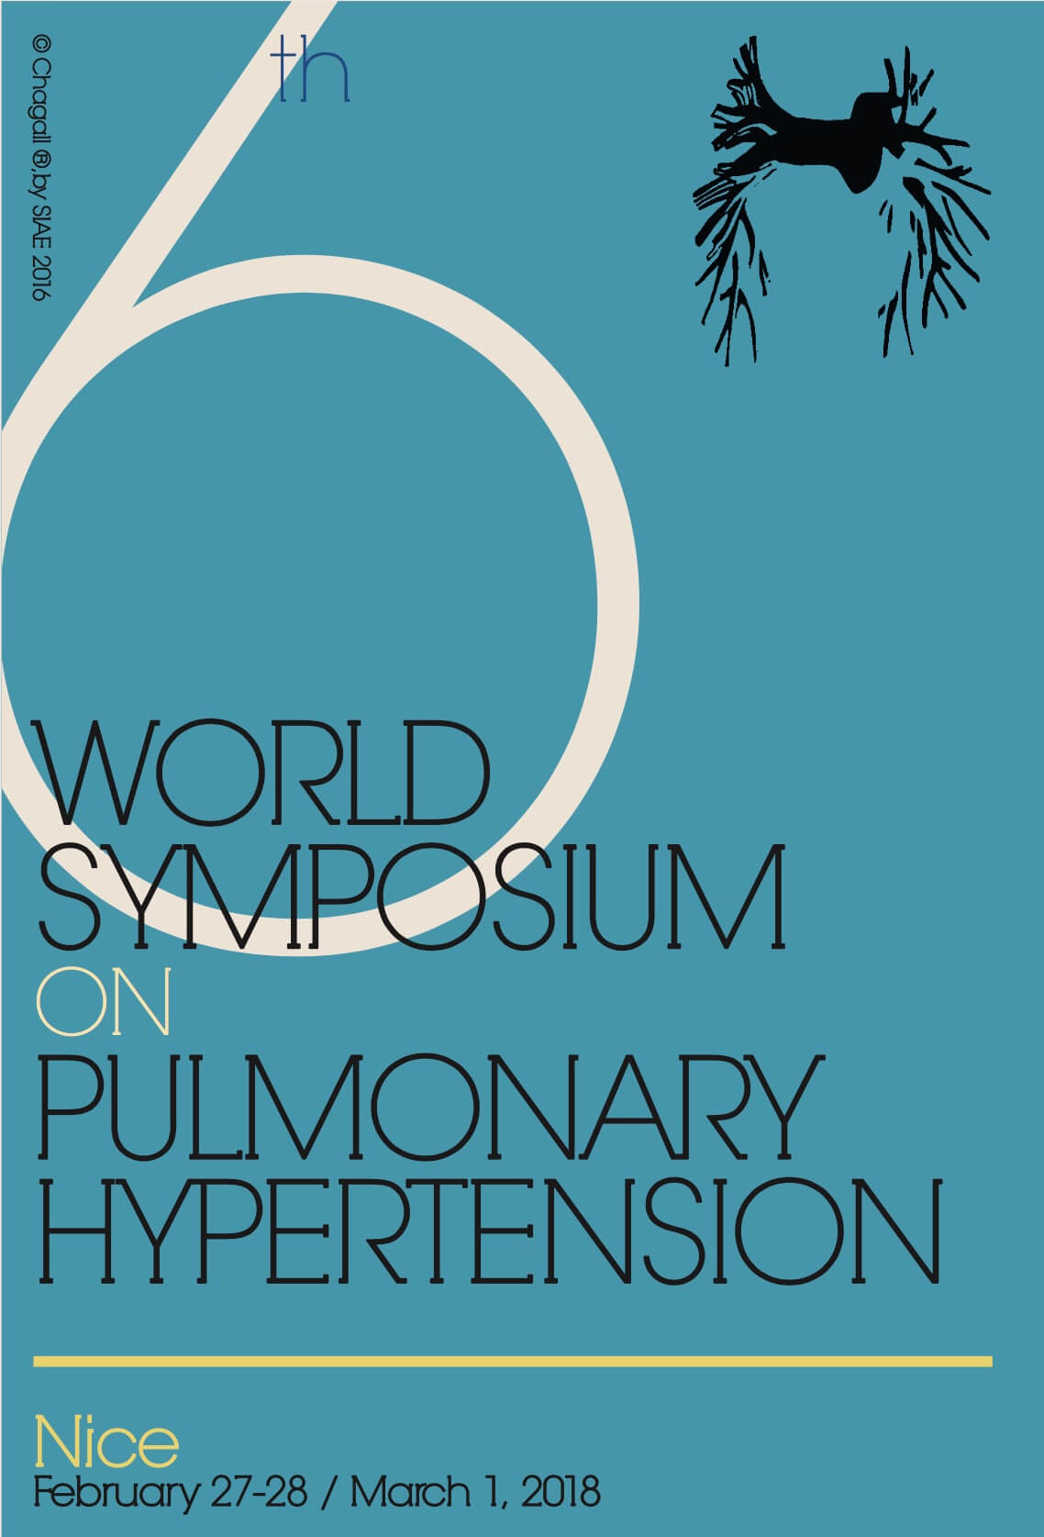

Slide 23
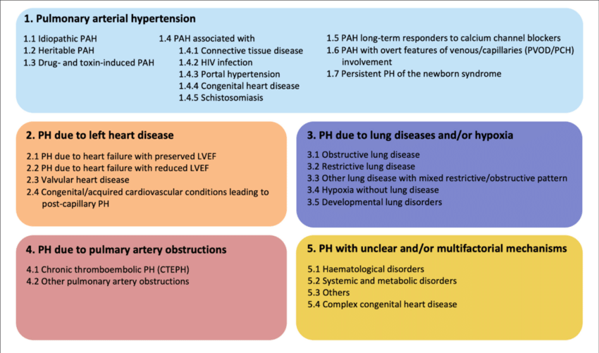

Slide 24
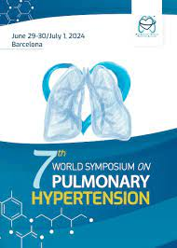
On it’s way

Slide 25
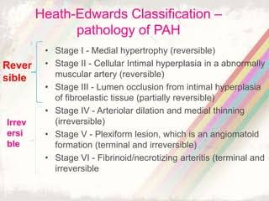
Histopathological Classification

Slide 26
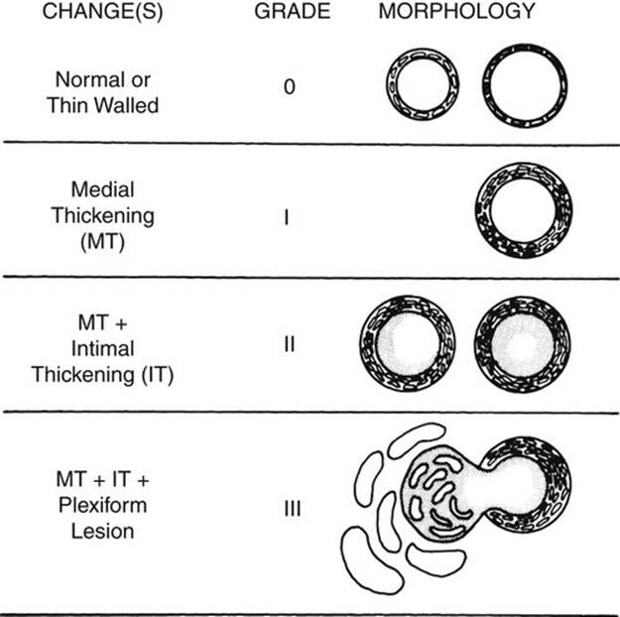

Slide 27
PATHOPHYSIOLOGY

Slide 28
Normal pulmonary circulation
High flow, low pressure and low resistance circulation
Unique double arterial blood supply
Pulmonary arteries:
  Elastic: conducting vessel, ≥ 500 μm, highly distensible
  Muscular: 100-500 μm, no elastin, non distensible
  Arterioles: ≤ 100 μm, thin intima and single elastic lamina
Bronchial arteries: nutrition to the airways

Slide 29
PATHOPHYSIOLOGY OF PAH
Panvasculopathy predominantly affecting small PA
Exact mechanism is unknown, abnormalities in pulmonary artery endothelial & smooth muscle cells (PASMCs) with varying degrees of
  Vasoconstriction,
  Vascular proliferation,
  Thrombosis, and
  Inflammation
  contribute to the development of pulmonary hypertension

Slide 30
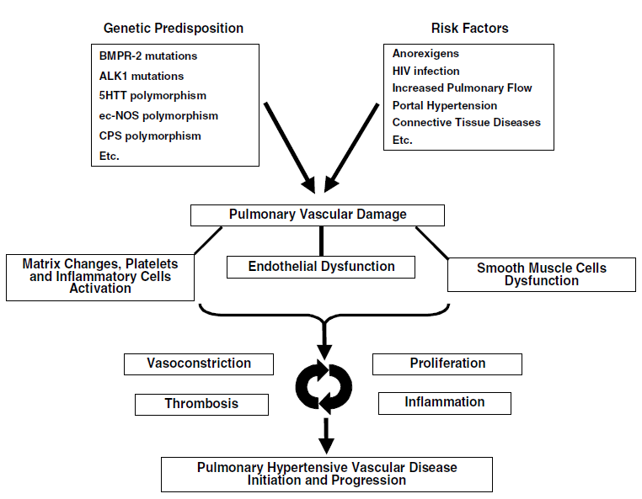
Postulated pathophysiology in PAH

Slide 31
VASOCONSTRICTION
  Genetic predisposition for increased pulmonary vascular reactivity and vasoconstriction.
  Voltage-dependent and calcium-dependent potassium channels (PASMCs) modulate pulmonary vascular tone.
  Abnormal functions PASMCs.
  are involved in the initiation or progression of pulmonary hypertension.

Slide 32
VASCULAR PROLIFERATION
Striking feature is intimal proliferation (May cause complete vascular occlusion).
Enhanced growth factor release and intracellular signaling lead to
  PASMC proliferation and migration.
  ↑ extracellular matrix synthesis (elastin, collagen, and fibronectin)

Slide 33
PASMCs favor ↓ apoptosis and ↑ proliferation.
Impaired apoptosis: multifactorial
  ↑ expression of antiapoptotic protein survivin
  activation of transcription factors such as HIF-1α
  mitochondrial and ion channel dysregulation.
Enhanced proliferation:
  ↑ serotonin
  ↑ Transforming growth factor-β (TGF-β)

Slide 34
Serotonin (platelet-dense granules) having key role in PAH acting through serotonin transporter (SERT)
SERT is abundantly expressed in the lung and appears specific to PASMCs.
It causes
  vasoconstrictor
  ↑ SMC hypertrophy and hyperplasia

Slide 35
THROMBOSIS
Widespread occlusion of arteries/arterioles and thrombosis in situ.
Studies of pulmonary vascular histopathology in IPAH showed the prevalence rates of thrombotic lesions in > 50%.
Chronic warfarin anticoagulation has been associated with a marked survival advantage in several longitudinal studies.

Slide 36
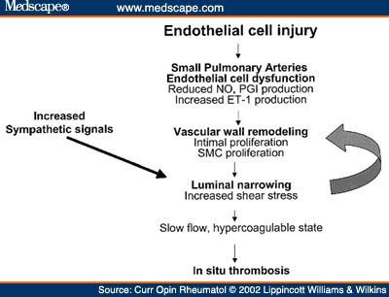

Slide 37
Role of Genetics in Pulmonary Arterial Hypertension
Reported in approximately 6% to 10% of patients with PAH.
Mutations in 3 receptors of the TGF-ß family identified in heritable PAH
  Bone morphogenetic protein receptor 2 (BMPR 2)
  Activin receptor-like kinase type 1, and
  Endoglin
50% to 90% of mutations in BMPR2.

Slide 38
BMPR2 (bone morphogenetic protein receptor type II gene)
Chromosome 2q33, codes for BMPR-II receptor
Genetic anticipation and incomplete penetrance (20%).
BMPR2 mutations
  70% with familial PAH
  25% with IPAH
  15% of PAH related to fenfluramine use
Normally, it modulate vascular cell growth & is critical for the maintenance and/or normal response to injury of the pulmonary vasculature.
Haploinsufficiency for BMPR-II leads to
  EC proliferation
  PASMC hypertrophy, and
  fibroblast deposition.

Slide 39
ALK1 gene (activin-like kinase 1) & endoglin
Rare mutations
Also members of TGF-β superfamily
Associated with PAH in
  Hereditary hemorrhagic telangiectasia and
  IPAH

Slide 40
The role of Endothelin-1 (ET-1)
Elevated levels are seen in PAH patients.
Levels correlate with disease severity & prognosis.
Deleterious effects mediated through ETA and ETB receptors
  Fibrosis
  Hypertrophy and cell proliferation
  Inflammation
  Vasoconstriction

Slide 41
The role of Prostacyclin and Thromboxane A2
Arachidonic acid metabolites
Prostacyclin: low levels in patients with PAH
  potent vasodilator
  inhibits platelet activation
  Antiproliferative properties
Thromboxane A2: high levels in patients with PAH
  potent vasoconstrictor
  promotes proliferation
  platelet activation
In PAH, the balance between these 2 molecules is shifted toward thromboxane A2, favoring thrombosis, proliferation, and vasoconstriction.

Slide 42
The role of nitric oxide
Potent vasodilator
Inhibitor of platelet activation
Possesses anti-proliferative properties
Vasodilatory effect is mediated by cGMP
Rapidly degraded by phosphodiesterases (PDEs-5)
Decreased endothelial NOS (NOS3) has been observed in PAH patients

Slide 43
Vasoactive intestinal peptide (VIP)
A member of glucagon-growth hormone-releasing superfamily
Pharmacologic profile similar to prostacyclins.
Serum and lung tissue VIP levels decreases in PAH results in
  platelet activation, and
  PASMC proliferation.

Slide 44
CAUSES OF PULMONARY HYPERTENSION

Slide 45
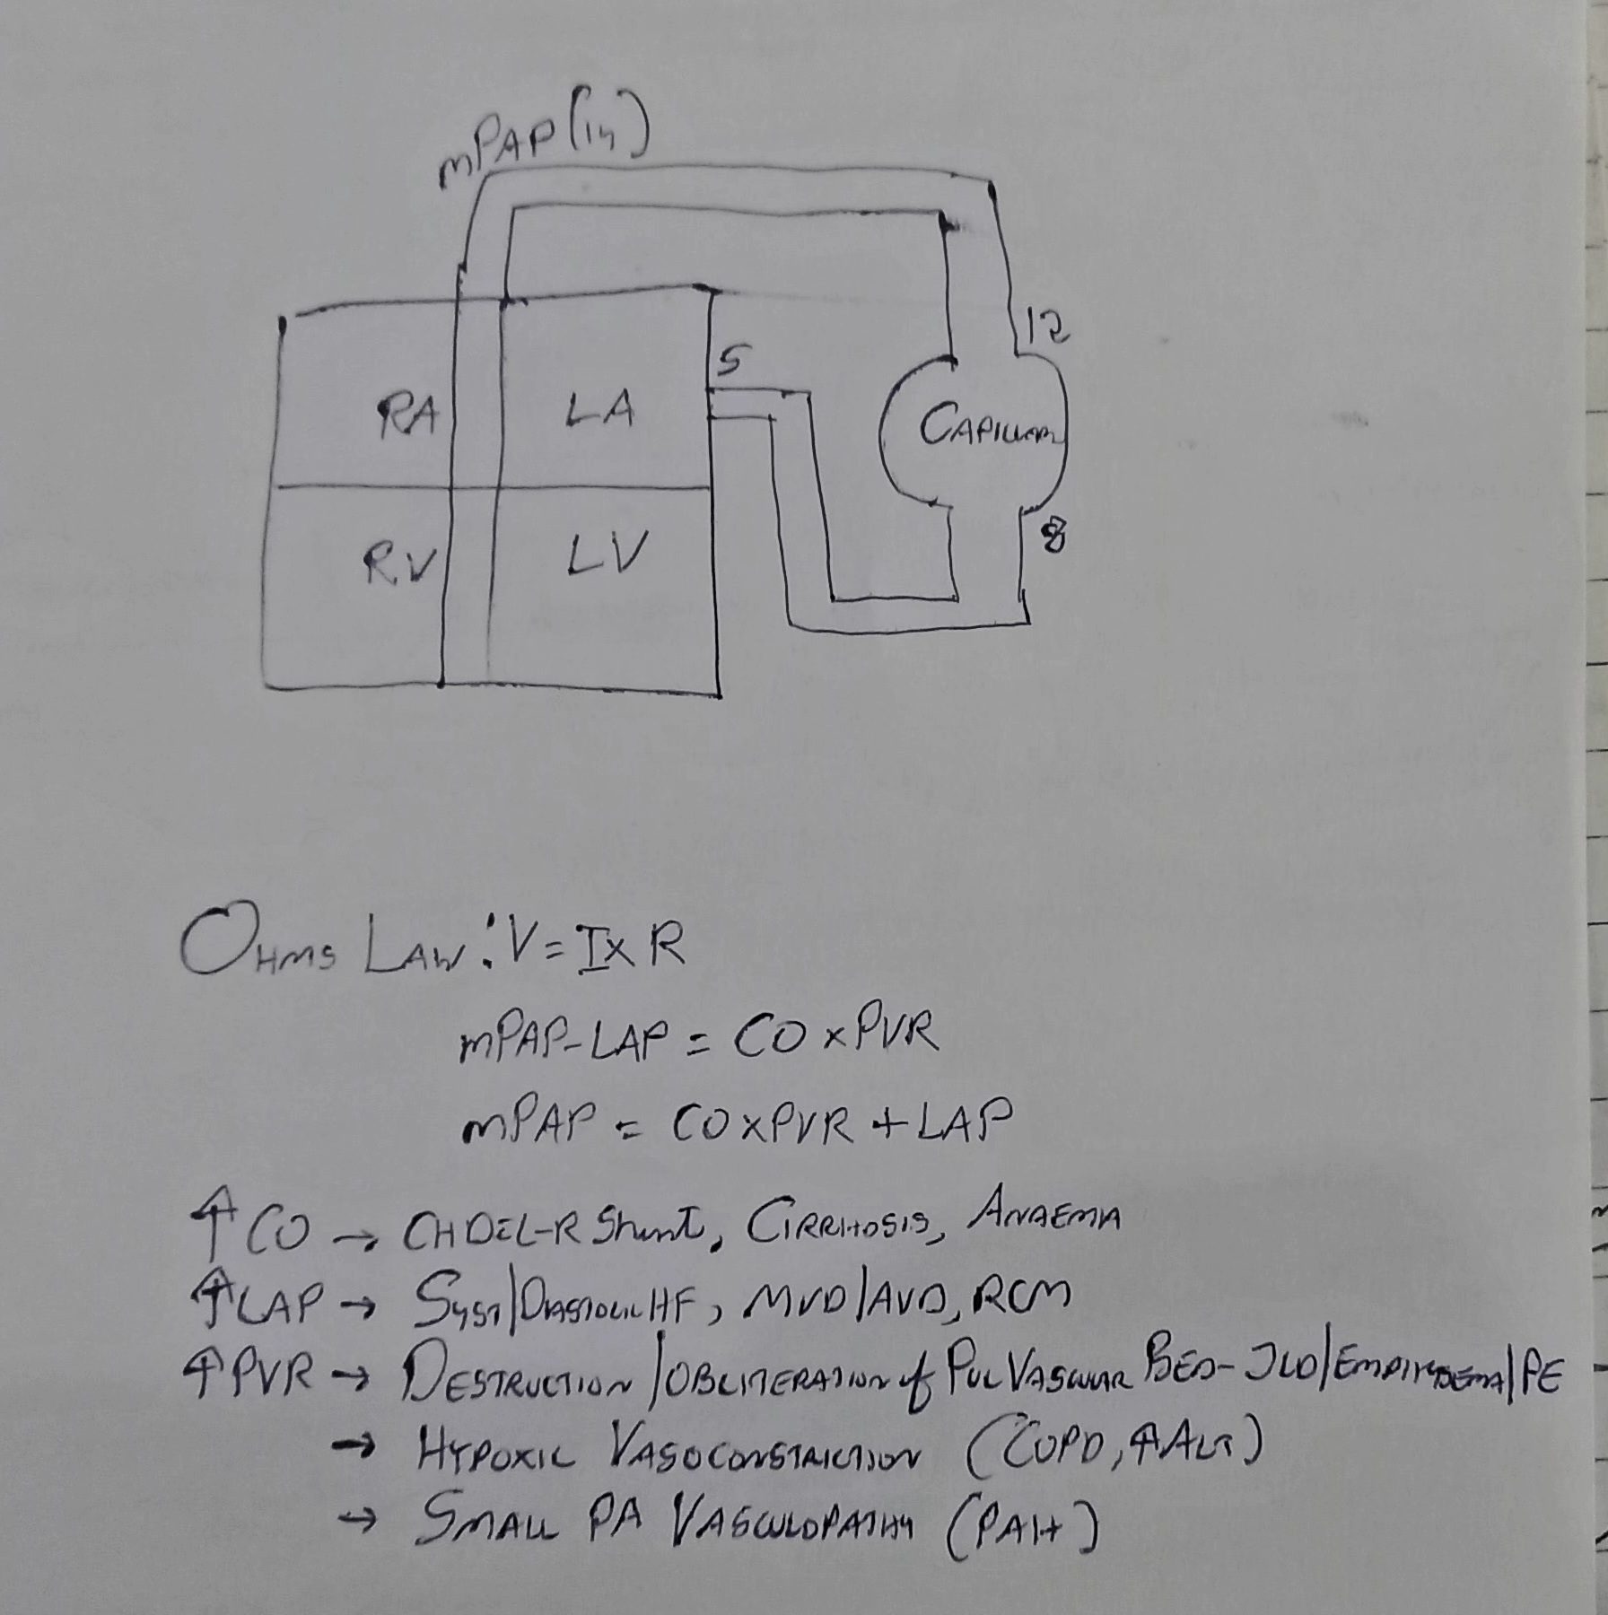

Slide 46
1) PVR
2) LAP
3) PVR
4) PVR
5) ?

Slide 47
Same disease can cause PH by different mechanisms
Eg – SCLERODERMA
1)Pul small vessel artery vasculopathy – Type 1
2)LV Fibrosis –DD- Inc LAP – Type 2
3) Pul Fibrosis – Type 3
4) APLA-DVT-PE –Type 4

Slide 48
Distribution of PH types
No Dx
6.8%
Gabbay E, PAH an uncommon cause of pulmonary Hhypertension :the Armadale echocardiography study. Am J Resp Crit Care Med 2007;175:A713.
Notes:
483 cases with PH 78.7% had left heart
disease (group 2), 9.7% had lung diseases and hypoxia (group 3),
4.2% had PAH (group 1), 0.6% had CTEPH (group 4), and in
6.8% it was not possible to define a diagnosis

Slide 49
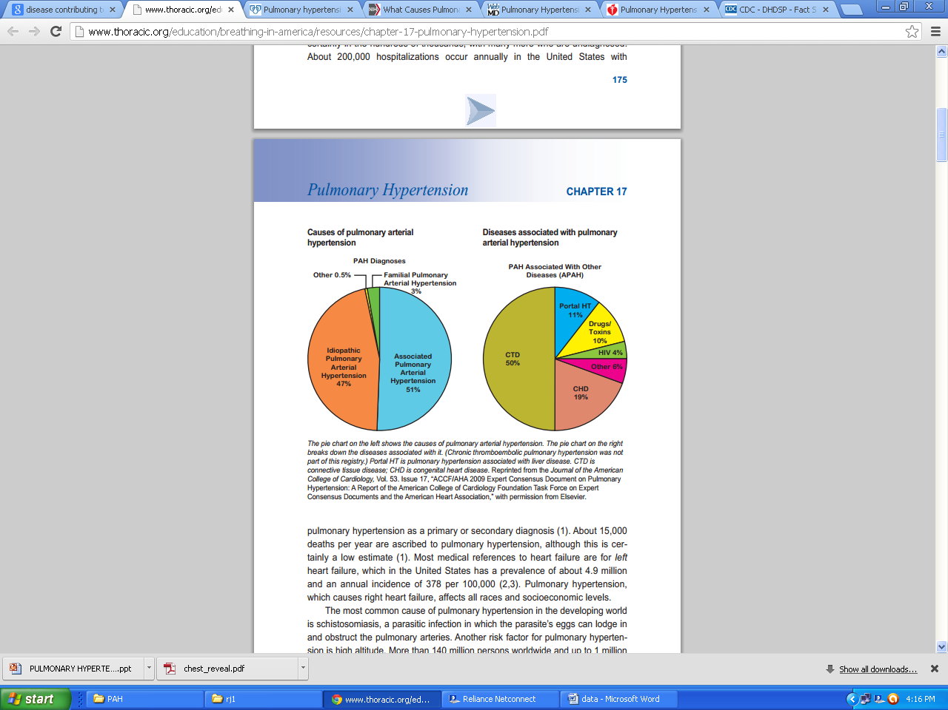

Slide 50
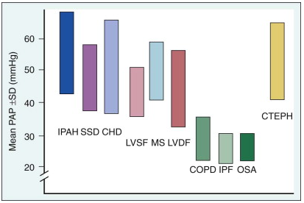
Mean PAP in patients with different causes of pulmonary hypertension (PH)

Slide 51
Survival in PAH
1.0
0.9
Congenital heart disease
0.8
0.7
0.6
Percent
survival
0.5
IPAH
0.4
CTD
0.3
0.2
HIV
0.1
0
0
1
2
3
4
5
Years
McLaughlin VV et al. Chest. 2004;126:78S-92S.
Notes:
In the absence of effective therapy, prognosis of idiopathic PAH (idiopathic PAH [iPAH], and other forms of PAH) is very poor.
Median survival 2.8 yrs from diagnosis
Over 50% of untreated patients will die within 5 yrs.
Prognosis over the first 3 years is particularly poor in patients with PH secondary to connective tissue disease (CTD) and human immunodeficiency virus (HIV).
Over the past 10 years, 7 approved therapies for PAH have become available, and additional agents and classes of drugs are currently being evaluated.
This slide emphasizes how deadly a disease PAH can be, and why it is imperative that clinicians actively screen for it so as to improve outcomes.

Slide 52
Idiopathic Pulmonary Arterial Hypertension (IPAH)
Reserved for patients with neither a family history nor an identifiable risk factor.
Rare disease
prevalence ~ 6 per million
Female/male ratio of 1.7:1
Mean age 37 years.

Slide 53
Heritable Pulmonary Arterial Hypertension
Approximately 6% to 10% of patients with PAH¹
50% to 90% mutations is in BMPR2²
Family history may or may not be present.
PAH associated with BMPR2 mutations have more severe disease with less vasoreactivity than those with IPAH without BMPR2 mutations.³

Slide 54
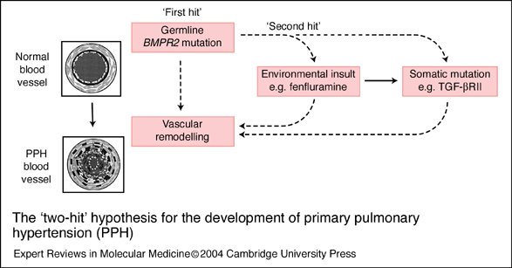
Familial/Heritable Pulmonary Arterial Hypertension: The ‘Two-Hit’ Hypothesis
According to the hypothesis, vascular abnormalities characteristic of PAH are triggered by accumulation of genetic and/or environmental insults in a susceptible individual. A combination of germline BMPR2 mutation (‘first hit’) and the ingestion of appetite suppressants (‘second hit’) were used to generate the clinical disease.
Notes:
The ‘two-hit’ hypothesis for the development of primary pulmonary hypertension (PPH). According to this hypothesis, the vascular abnormalities characteristic of PPH are triggered by the accumulation of genetic and/or environmental insults in a susceptible individual. For example, to generate clinical disease, the combination of a germline BMPR2 mutation (the ‘first hit’) with either (1) a somatic mutation in the BMP pathway, or one of the related pathways regulating cell growth and apoptosis, or (2) an environmental insult such as the ingestion of appetite suppressants (the ‘second hit’) might be required for vascular remodelling. Abbreviations: BMP, bone morphogenetic protein; BMPR, BMP receptor; TGF-bRII, transforming growth factor b receptor II.

Slide 55
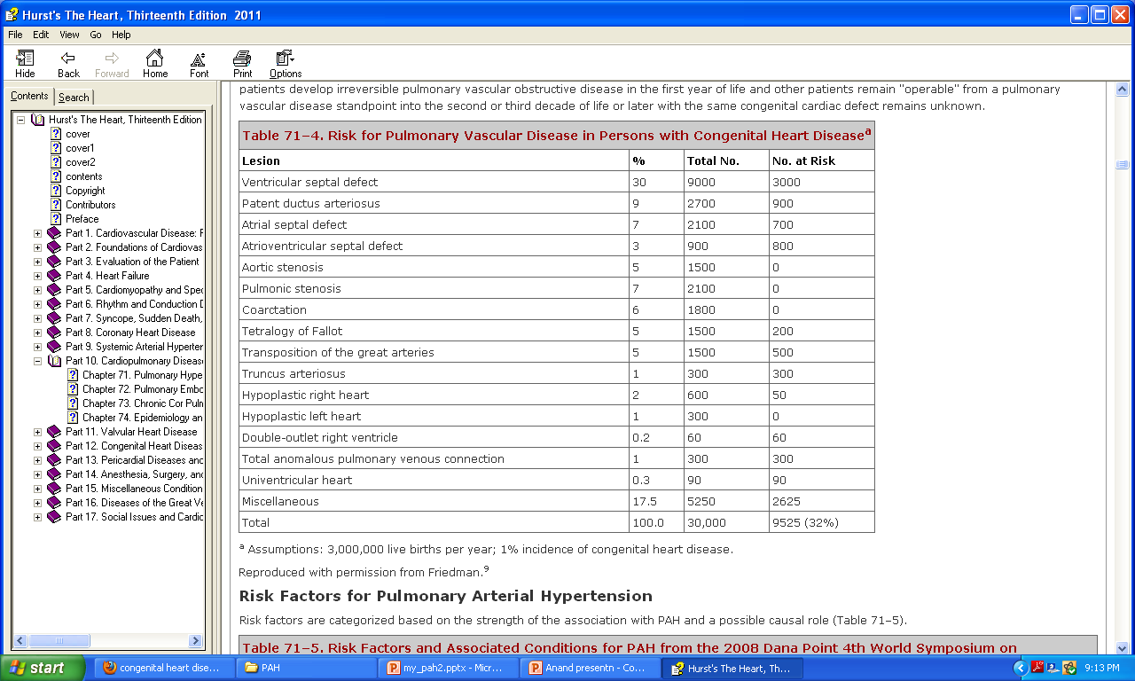
Pulmonary Arterial Hypertension Associated With Congenital Heart Disease
.

Slide 56
PAH associated with heart Defects with Increased Pulmonary Blood Flow
more frequently when PBF is extremely high.
Especially true for L→R shunt entering RV or PA directly (i.e. post-tricuspid shunt, such as VSD or PDA), experiencing higher incidence of severe & irreversible pulmonary vascular damage than pre-tricuspid shunt, as in ASD.
Important feature is RV well adaptive, sustaining an increased afterload for many years or decades.

Slide 57
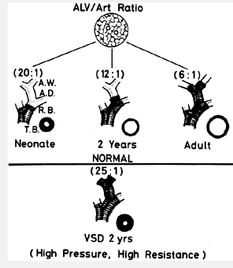
PAH PATHOPHYSIOLOGY
chronic high flow and high pressure
Stretching of pulmonary arteries
Endothelial dysfunction smooth muscle cell dysfunction
(↓NO ,↓PGI2,↑ET , TxA2)
Vasoconstriction vascular SMC proliferation and migration
(↑ S100A4/Mrs1 calcium binding protein)
PAH
Peripheral pulmonary arterial development through morphometric changes: extension of muscle into peripheral arteries, percent wall thickness, and artery number (alveolar-arterial [ALV/Art] ratio) as they relate to age.
Platelet dysfunction
↑Serotonin

Slide 58
EISENMENGER SYNDROME
“Eisenmenger syndrome” was coined by Paul Wood.
Defined as CHD with initial large systemic-to-pulmonary shunt that induces progressive pulmonary vascular disease and PAH, with resultant reversal of the shunt and central cyanosis.
Represent most advanced form of PAH associated with CHD
Histopathologic and pathobiologic changes are similar to idiopathic.

Slide 59
PAH associated with heart Defects with Decreased Pulmonary Blood Flow
Condition like
  PA with intact IVS
  TOF
Associated because of
  Hypoplasia of pulmonary arteries.
  Intra-acinar pulmonary arteries are small and few in number.
  Alveolar development is impaired (mostly reduction in alveolar number)
  ↑ Hematocrit resulting in in-situ thrombus.

Slide 60
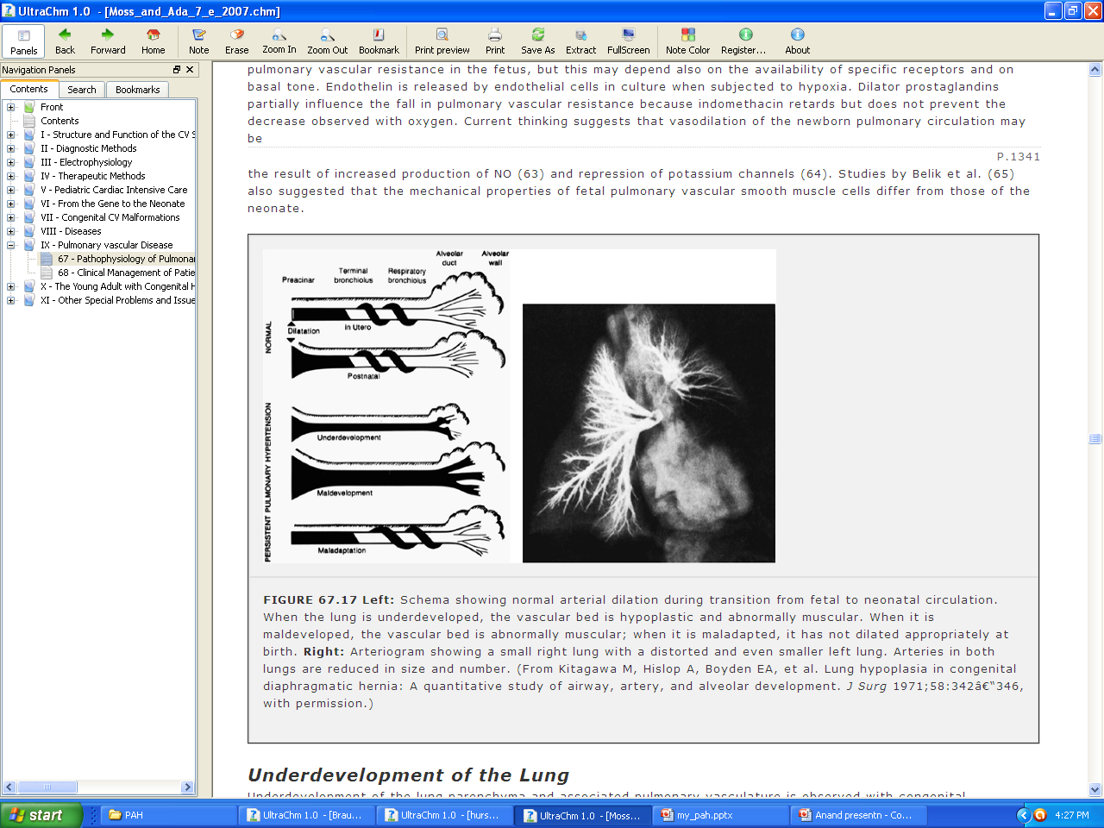
Persistent Pulmonary Hypertension of the Newborn
Normal: arterial dilates during transition from fetal to neonatal circulation (NO dependent)
3 types of PPHN
Hypoplastic type:Lungs underdeveloped, vascular bed is hypoplastic & abnormally muscular. Ex: congenital diaphragmatic hernia or Oligohydraminos
Hypertrophic type: Lung is maldeveloped, vascular bed is abnormally muscular. Ex: chronic fetal distress
Reactive type: Lung is maladapted, vessels not dilated appropriately at birth. Ex ↑ vasoconstrictive [TxA2,NE, leukotrienes] may be responsible and may result from streptococcal infection or acute asphyxia at birth

Slide 61
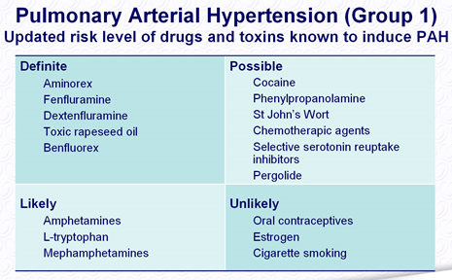
Pulmonary Arterial Hypertension Associated
With Drugs¹

Slide 62
Pulmonary Arterial Hypertension Associated with Connective Tissue Diseases
CTD’s associated
  Scleroderma & CREST syndrome ( 8-12%)¹
  SLE (1% to 14%)
  Mixed CTDs ( 30-40 %)
  Polymyositis
  Dermatomyositis
  Rheumatoid arthritis
  Sjogren syndrome

Slide 63
Pulmonary vasculature with histological features resemble those of IPAH.
Coexisting interstitial fibrosis is extremely common and contributes to hypoxemia.
Pathophysiology: Prevailing hypothesis is
  Endothelial injury +immune defect → peri and intravascular inflammatory response (↑ET, ↑Antibody to PDGF receptor) →PASMC proliferation → vascular lesions and progressive PAH.

Slide 64
Pulmonary Arterial Hypertension Associated with HIV
Prevalence is ~ 1/200 (0.5%)¹.
Severe PH has been associated with AIDS, even in absence of lung parenchymal disease
Diagnosed in all stages of HIV infection
unrelated to the CD4 cell counts².

Slide 65
Pathophysiology: Direct pathogenic role of HIV seems unlikely as no viral constituents have been detected in the vascular endothelium.
Hypothesis are :
  Function of Inflammation & immunogenetic background (HLA Class II)
  More recently, HHV-8 (kaposi sarcoma) stimulates lysosomal mediated degradation of BMPR2, a receptor which is mutated & dysfunctional in IPAH.
  HIV- nef gene has been implicated in development of plexogenic pulmonary vascular lesions.
  HIV envelop gene gp120 stimulate endothelin dependant vasoconstriction¹

Slide 66
Pulmonary Arterial Hypertension Associated with Portal Hypertension
Portopulmonary hypertension is progressive with no reports of spontaneous resolution.
Unrelated to the severity of hepatic dysfunction.
Estimated prevalence is 2% to 6% with 5-year survival of 10% to 30%.
Pathophysiology is similar to PAH without cirrhosis, with features characteristic of the cirrhotic state ( high CO, lower systemic and pulmonary vascular resistance).

Slide 67
Mechanism is unknown but severe structural changes, consisting of
  medial hypertrophy,
  occlusive cellular intimal hyperplasia, and
  plexiform lesions
  occur in the peripheral pulmonary arteries leads to postulate that toxic liver is unable to degrade a certain vasoconstrictor substance that then circulates through the lung in high concentration, causing structural damage to the vessels.

Slide 68
Pulmonary Hypertension Associated left heart disease
Most common cause of PH
As a consequence of
  Left ventricular dysfunction (MC) ¹
  Mitral and aortic valve disease
  Cardiomyopathy
  Cor-triatriatum and
  Pericardial disease

Slide 69
Pathophysiology
Increase in LA pressure
Backward transmission of the pressure to PV/PC
Initially, PVR & pressure gradient across the lungs falls
(reflecting distention of compliant small vessels, recruitment of additional vascular channels, or both)
Further increases in LA pressure
↑ PAP & PVP, constant PBF, PG between PA & PV and PVR remains constant
When PVP ≥20 mmHg chronically
Abnormal formation and thickening of a neointima, medial hypertrophy,
thickening and rupture of the basement membranes , Pulmonary hemosiderosis
extensive fibrosis, Pulmonary lymphatics may become markedly distended
↑PVR
Disproportionate elevation in PAP, PG between PA & PV ↑, PBF ~ or ↓

Slide 70
Pulmonary Hypertension Associated with Hypoxic Lung Diseases
Common cause of mild pulmonary hypertension
Conditions associated are
  Chronic Obstructive Pulmonary Disease
  Interstitial Lung Diseases
  Sleep-Disordered Breathing
  Alveolar Hypoventilation Disorders
Mechanism: Hypoxia induces
  vasoconstriction & muscularization of distal vessels
  medial hypertrophy of more proximal arteries
  loss of vessels & lung parenchyma
  Intimal thickening (appears to be an early event).
The development of plexiform lesions is not observed.

Slide 71
Pulmonary Hypertension Associated with Chronic Obstructive Pulmonary Disease
Exact prevalence is uncertain, heavily influenced by disease severity.(~ 50% in severe COPD)¹
mPAP is usually <30 mm Hg (typically lower IPAH)
RV failure occurs more likely as a result of an ischemic right ventricle than a pressure-loaded right ventricle.
Patients who present with severe pulmonary hypertension (mPAP >40 mmHg) should
be evaluated for another disease process responsible for the high pulmonary arterial pressures before it is attributed to the COPD (prevalence ~ 1.1 %)¹

Slide 72
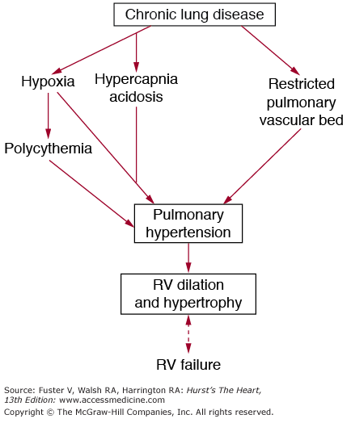
PATHOGENESIS
Multiple causative factors, including
  alveolar hypoxia induced pulmonary vasoconstriction
  Acidemia & hypercarbia
  compression of pulmonary vessels by high lung volume
  loss of small vessels in regions of the emphysema and lung destruction
  ↑blood viscosity (polycythemia).
  Of these, hypoxia is the most important
  factor.
Recently a genetic predisposition as a result of 5-HTT polymorphism, may predispose to more severe PH in
hypoxemic patients with COPD ¹.
1. Circulation. 2003;108:1839–44

Slide 73
Pulmonary Hypertension Associated with Interstitial Lung Diseases
Prevalence uncertain, ~ 40% in IPF & 60% planned for LTx¹
Mechanism
  hypoxemia
  loss of effective pulmonary vasculature from lung destruction
The hemodynamic profile is distinct from IPAH.
It is uncommon for the mean PA pressure ever to exceed 40 mm Hg in these patients, whereas it is unusual for the mean PA pressure to be less than 40 mm Hg in patients with IPAH.

Slide 74
Pulmonary Hypertension Associated with Sleep Disordered Breathing (SDB)
Prevalence: 20% to 40% of patients with SDB.
Mild to moderate in severity.
Mechanism: combination of precapillary and postcapillary factors.
  primary mechanism is repetitive nocturnal arterial oxygen desaturation, which reflexively increases PA pressures.
  others are
  pulmonary arteriolar remodeling
  hyperreactivity to hypoxia
  left ventricular diastolic dysfunction
RV failure in SDB appears to be uncommon.

Slide 75
Pulmonary Hypertension Associated with Alveolar Hypoventilation Disorders
Causes
  Central alveolar hypoventilation (Ondine's curse)
  Obesity hypoventilation syndrome (OHS)
  Chest wall deformities
  Neuromuscular disorders
Mechanism: Chronic alveolar hypoventilation can lead to hypoxemia, hypercapnia and acidosis and cause pulmonary hypertension

Slide 76
Pulmonary Hypertension Caused by Chronic Thromboembolic Disease (CTEPH)
Underdiagnosed disorder
Pulmonary embolism is thought to be the typical initiating process.
≥ 50% of pts do not have clinically overt pulmonary embolism.
Incidence of PH as much as 5% after first episode¹
Cumulative incidence of CTEPH is after acute PE¹
  1.0% at 6 months,
  3.1% after 1 year
  3.8% after 2 years
Hypercoagulable state: in only a minority of patients
  lupus anticoagulant ~ 10% to 20%
  protein C, protein S, and antithrombin III deficiencies: ~ 5%

Slide 77
PATHOGENESIS
Pulmonary embolism (either single or recurrent)
Thromboemboli fail to resolve adequately
Undergo organization and incomplete recanalization
Incorporated into the vascular wall
(subsegmental, segmental, and lobar vessels)
Slowly progressive vascular obstruction including distal
pulmonary vasculopathy of both occluded and nonoccluded
pulmonary vasculature characterized by lesions considered
typical for IPAH, including plexiform lesions.
CTEPH

Slide 78
Pulmonary Arterial Hypertension Associated with Schistosomiasis
Occurs in endemic areas for schistosomiasis.
10% of pts with schistosomiasis develop portal hypertension and only 10% of these i.e. 1% of total will have develop PAH.
Mechanism: ¹
Chronic infection → ova embolize to the lungs → induce formation of delayed hypersensitivity granulomas → extensive lung vascular remodeling, fibrosis and PAH.

Slide 79
Pulmonary Arterial Hypertension Associated with Sickle Cell Disease and other Hemoglobinopathies
Increasingly recognized with a prevalence <10 % ¹
Histopathology is similar to PAH with different hemodynamic parameters (PAP & PVR are often lower and CO is high).
Other Hb pathy² associated with PAH are
  Homozygous beta-thalassemia and
  Hereditary spherocytosis
  Whether the PH is the cause of the increased mortality or is a surrogate marker remains unclear; however, the 2-year mortality rate in these patients is approx 50%.³
Am J Respir Crit Care Med. 2007;175:1272–9
Blood. 2001;97:3411–6
N Engl J Med. 2004;350:886–95.

Slide 80
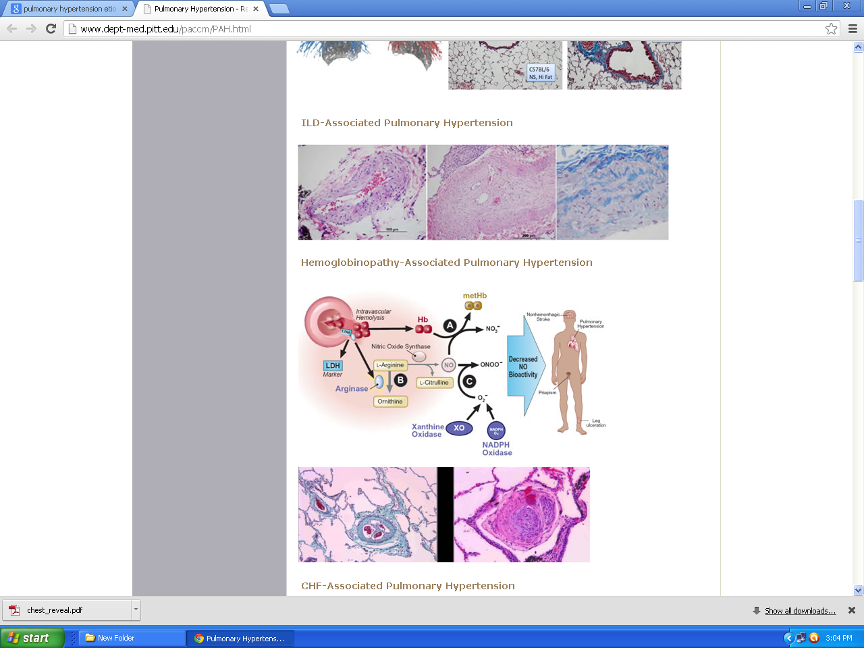
Pathobiology: likely multifactorial
  Hemolysis-induced endothelial dysfunction and subsequent dysregulation of arginine metabolism and reduced NO bioavailability¹
  Pulmonary parenchymal and vascular injury from acute chest syndrome
  Increased oxidant burden
  Impaired LV diastolic function

Slide 81
Pulmonary Arterial Hypertension Associated with Pulmonary Venoocclusive Disease
Rare form of PAH
The histopathologic diagnosis is based on the presence of obstructive eccentric fibrous intimal pads in the pulmonary veins and venules.
Other findings are
  Pulmonary venous hypertension (increased PCWP)
  Pulmonary hemosiderosis
  Interstitial edema, and
  Lymphatic dilation

Slide 82
TAKE HOME MESSAGE
Though the exact mechanism of PH is unknown, dysfunction of endothelial and PSMC along with varying degree thrombosis are usually implicated.
Among genetic factors associated with PH, BMPR II is most commonly associated (50-90 %).
Most common cause of PH is left sided heart diseases.
COPD associated PH is usually mild, if it is severe, other causes of PH should be ruled out first.
It is uncommon for the mean PA pressure ever to exceed 40 mm Hg in ILD/COPD patients, whereas it is unusual for the mean PA pressure to be less than 40 mm Hg in patients with IPAH.
HIV associated PH is not related to level of CD4 count.

Slide 83
Previous questions asked
Pulmonary vascular resistance(Aug22)
Classification of Pulmonary Hypertension(Aug22)
Pathophysiology of Pulmonary Hypertension(Jan16)

Slide 84
PART 2
Evaluation & Management

Slide 85

THANK YOU

