Slide 1
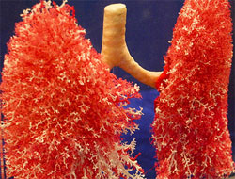
EVALUATION & MANAGEMENT OF PULMONARY HYPERTENSION
Dr Arun Jude Alphonse
DM Cardiology Resident
Govt TDMC Alappuzha

Slide 2
OUTLINE
EVALUATION
Clinical diagnosis of PAH
Diagnostic work up : 1) Initial , 2) Elaborate
Prognostic work up
Strategic work up - AVT
MANAGEMENT
Current pharmacological armamentarium
Surgical measures
Follow up
PREVIOUS QUESTIONS ASKED

Slide 3
Case scenario....
A 36 year old female
No significant past medical history
c/o progressive DOE from NYHA I to II over previous 6 months.
Tiredness, fatigue
O/E : Tachypnoeic, Tachycardia,
, Mild pedal edema, Loud P2, Pulmonary ESM, Pulmonary phasic EC

Slide 4
DD,s
BA, Pneumonia, ILD, RHD, CHD, Anaemia, Thyroid disorders, HTN, CAD, Psychogenic.....PAH

Slide 5
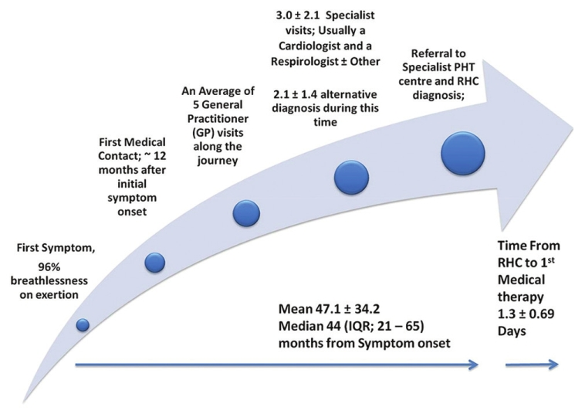
Delay in diagnosis of IPAH
>85 % patients are diagnosed when they reach WHO III / IV symptoms
Notes:
32 patients with IPAH were studied from 4 tertiary centres in Australia
5

Slide 6
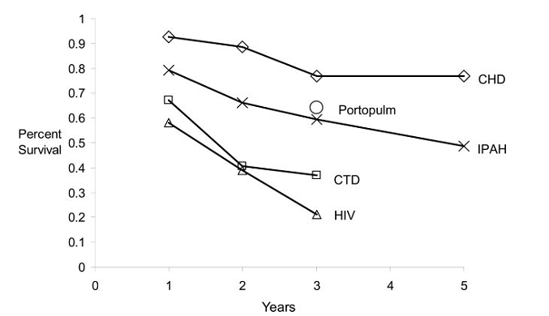
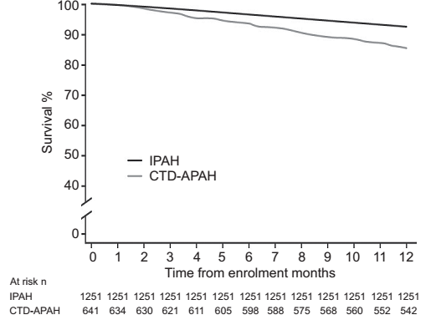
Natural history of PAH
Median survival for PAH is 2 to 3 years (NIH registry (1984) ) –PPH(IPAH)
However, the more recent REVEAL registry shows improved survival
M.D. McGoon* and D.P. Miller.REVEAL: a contemporary US pulmonary arterial hypertension registry Eur Respir Rev 2012; 21: 123, 8–18

Slide 7
ESTABLISHING THE CLINICAL DIAGNOSIS
History:

Slide 8
Dyspnea in PH
1)PHTN – Reduced cardiac output –(Length –tension mismatch)
2)Reverse Bernheim effect
3)Coronary vascular turgor effect
4)Pulmonary artery stsretch receptors (C fibres in pulmonary vasculature and vagal innervations of RA are activated causing rapid shallow breathing)
5)RV hypertrophy/RV ischaemia
6)Reduced LV compliance
7)Fixed physiological dead space due to reduced perfusion

Slide 9
Fatigue – Reduced/fixed cardiac output
Angina – RV ischaemia , RV hypertrophy, Reduced LV compliance

Slide 10
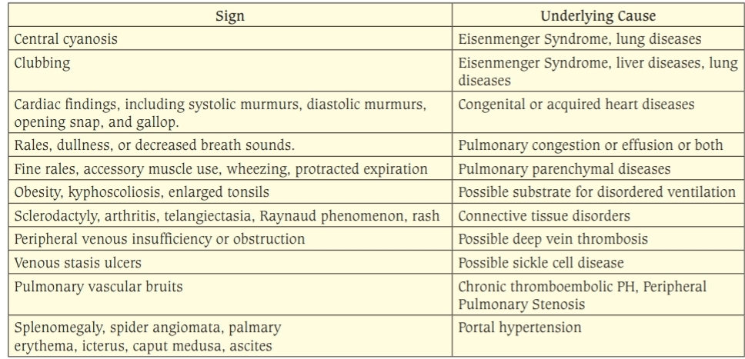
Physical signs that suggest possible underlying mechanisms of PH

Slide 11
Arterial Pulse & Blood Pressure-
Normal in mild PH
Inappropriate/unexplained tachychardia- Impending RV failure
Syst HTN – DD/OSA cause of PH
Severe PH – low volume pulse with narrow pulse pressure
- Reduced BP but tolerated
Wide pulse pressure – Eisenmenger PDA with severe PR

Slide 12
JVP
Prominent “a” wave is the characteristic finding in JVP.
“a” wave is absent in patients with atrial fibrillation
In Eisenmenger ventricular septal defect (VSD),JVP is usually normal because RV systolic pressure cannot exceed the systemic level, and the RV copes with this pressure without any help from RA
A large “v” wave may appear when there is increasing tricuspid regurgitation (TR) which attenuates the “x” descent and exaggerates the “y” trough.

Slide 13
Precordial examination in PH

Slide 14
LPH
Systolic elevation of left costal cartialges due to contraction of a hypertrophied RV/dilated left atrium
3 Grades
1)Visible impulse but not palpable
2)Visible & Palpable but obliterable with pressure
3)Visible & Palpable but not obliterable with pressure

Slide 15
Palaption in second left intercostal space
2 important events
Systolic impulse of a dilated hypertensive PA
Loud pulmonary component of second heart sound(P2)
In general Palpable P2 corresponds to PASP>75 mm Hg
(In MS palpable P2 corresponds to PASP >50mm Hg)

Slide 16
8 Auscultatory findings in PH

Slide 18
LOUD P2
Of all the auscultatory signs , loud P2 is the most consistent finding of PH and comes closest to being unique for PH

Slide 19
Functional TR vs Organic TR –
JVP elevated(v wave),Hepatomegaly/pedal edema, RV dilation/PAH,RVSP>50mm hg
Hypertensive PR vs Normotensive PR-
Starts right after P2, Loud P2, doesn’t increase with inspiration

Slide 20
S2 Splitting in PH
Net effect of two variables:
1. Decreased capacitance and increased resistance in the
pulmonary vascular bed due to PH, which decreases
hang out interval and narrows the split due to early
P2.
2. Prolongation of RV systole in RV dysfunction
increases the split due to delayed P2.
When RV function is normal, inspiratory splitting is
usually preserved.

Slide 21
S2 split in various conditions with PH

Slide 22
Influence of PH on coexisting Congenital/ Acquired Heart Diseases
Shunt lesions: With advancing PAH,
Shunt/flow murmur reduces in duration/intensity
Mitral stenosis (MS): When PH causes RV hypertrophy
-LV tends to rotate away from the chest wall and may no longer form the apex.
High PVR may decrease cardiac output and
Auscultatory signs of MS may be attenuated or even abolished, resulting in “silent MS”

Slide 23
PH due to intrinsic lung diseases
Emphysema is the most common cause of chronic parenchymal lung disease associated with PH.
2 factors influence clinical analysis of the PH:
1. Wheezes, rhonchi and rales in the distended
emphysematous lung may make cardiac auscultation
almost impossible.
2. Large, over expanded chest may obscure the heart so
that cardiac dullness is absent, precordial pulsations
are imperceptible, and heart sounds and murmurs are
difficult to hear.
Precordial auscultation may improve, if the patient sits
and leans forward.

Slide 24
Physical signs that suggest moderate to severe PH

Slide 25
Advanced PH with RV Failure

Slide 26
INITIAL DIAGNOSTIC WORK UP
ECG
CXray
2D Doppler Echo +/- contrast
PFT
CT chest
Lung perfusion scan
CPET/ 6MWT/TMT – To assess baseline functional status & CP-metabolic function before initiating treatment.
Establishing the diagnosis
of PAH
Grading the severity
Assessing RV function
Ruling out left heart/structural
cardiac causes
Ruling out respiratory causes
Detect additional respiratory
pathology
Ruling out CTEPH

Slide 27
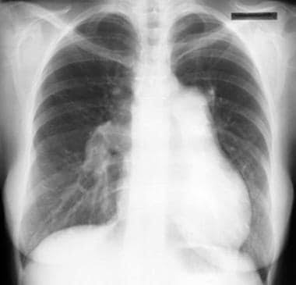
ECG/CXR(of our patient) :

Slide 28
Basis of ECG abnormalities in PH
- RV forces are normally masked by dominant LV
- PH causes elevated RV wall stress which leads to RVH ,
both result in ECG changes.
-Since V1 is the lead closest to RV , it is the lead which is most sensitive to changes in PH, similarly leads V3R and V4R may also be useful in detection of RVH .
- The ECG changes depend on the degree of the PA pressure, the degree of hypertrophy of RV and aetiology of PAH.

Slide 29
In congenital heart disease sensitivity of ECG to detect PH is over 90%,
In mitral stenosis it is 65% and in COPD it is
only 30%.
RVH in presence of COPD is most difficult to
diagnose.

Slide 30
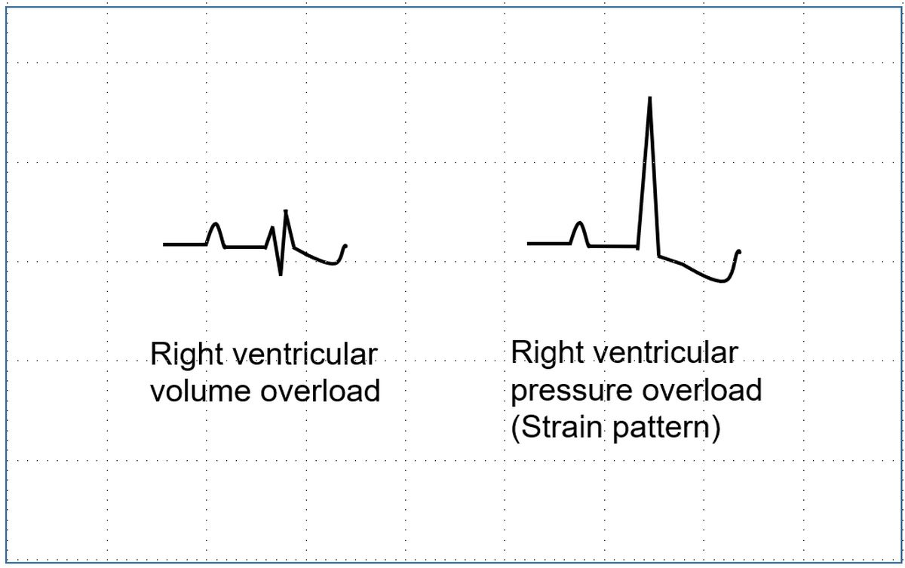
Type of RV hemodynamic loads from ECG.
1. RV systolic overload
a. Tall R with inverted T in right precordial leads
b. D iminished/inverted U in right leads
2. RV diastolic overload
a. Incomplete/complete RBBB

Slide 31
RVH diagnosis (WHO criteria)

Slide 32
Soklov Lyon criteria for RVH
R V1 + SV5/V6 >10.5mm
R in V1 >7mm
R in aVR >5mm
S in V1<2mm
Cabrera Index
Cabrera Index = RV 1/ (RV 1 + SV1)
Values greater than 0.5 suggest the presence of RVH .
Values near1 indicates severe degree of RVH .
In RHD, Cabrera Index near 1 indicates complicating severe PAH.

Slide 34
Types of RVH (Chou Types)
Type A -RVH occur in severe PH, critical valvular PS
and severe MS. It is characterised by Tall R in V1 and
prominent S in V5,6.
Type B -RVH occur in volume overload states like ASD
and moderate forms of MS. It is suggested by incomplete
RBBB pattern, normal QRS in V5,6.
Type C RVH- has no classical signs of RVH . RAE and a
vertical QRS axis suggest the diagnosis. rS in V1 and RS
in V5,6 are the only QRS findings.

Slide 35
Diagnosing RVH in presence of RBBB
a. A high amplitude R’ wave exceeding 15 mm in V1
b. Clockwise rotation, transition shifted to V5/V6
c A very wide S wave in lead I

Slide 36
RVH in Newborn
a. Pure R (without S) in V1 > 10mm
b. R in V1 > 25mm, R in aVR > 8mm
c. qR in V1
d. U pright T in V1 more than 3 days of age with upright T in V6
e. RAD > +180 degrees
For children aged between 2 and 20 years
RVSP : 5 x R in mm in V1 or V3R

Slide 37
ECG findings of Right Atrial Enlargement
1. qR morphology in V1 (without infarction)- specificity is 100%
2. P wave > 2.5 mm in lead II
3. P wave > 1.5 mm in V1
4. Mean P wave axis > +75 degrees
5. Early terminal negativity in V1 < 0.03 second.

Slide 39
Predicting region of RV hypertrophied in RVH from ECG
1. Dominant free wall hypertrophy
a. Tall R in right precordial leads.
b. Mean QRS axis towards 120 degrees.
2. Dominant right paraseptal hypertrophy
a. Tall R of RS complex in transition zone
b. Mean QRS axis +90 to +120
3. Dominant right basal hypertrophy
a. rS complexes in V1 – V6 with deep S in V5,6
b. qR in aVR
c. S I SII SIII syndrome
d. Mean QRS axis in right superior quadrant

Slide 40
Diagnosing Biventricular Hypertrophy
a. Right axis deviation in LVH
b. Clockwise rotation with LVH
c. Relatively tall R(Right precordial lead) in presence of LVH
d. Katz-Wachtel phenomenon (large amplitude equiphasic QRS complexes in V2, V3, V4 reflecting RV systolic and LV diastolic overload)
e. P wave reflecting LA abnormality in combination
with any of following
1. R:S ratio in V5/V6 < 1
2. S in V5/6 > 7 mm
3. Right QRS axis beyond + 90 degrees

Slide 41
RVH in COPD can be diagnosed by
S1Q3 pattern
(2)RAD > 110 degree
(3) S1S2S3 pattern
(4) R/S ratio in V6 < 1.0

Slide 42
Sensitivity of commonly used ECG criteria for RVH
Criteria based on V1 are the most specific but least sensitive
Including criteria involving left leads improve sensitivity.
Predicting RV pressure from ECG in PAH
The ECG pattern with the highest positive predictive
value for severe pulmonary hypertension (PASP≥60 mm Hg) is right axis deviation with the QRS axis≥110°

Slide 43
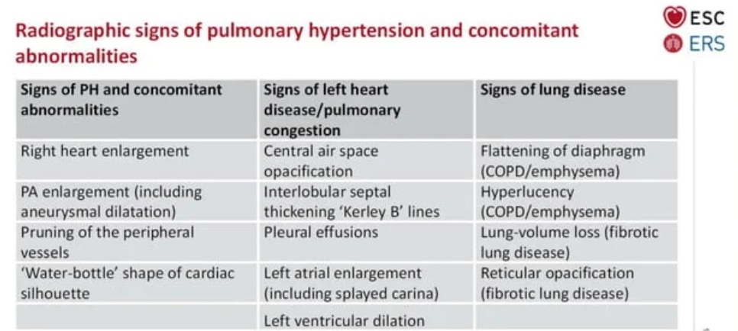
Chest Xray

Slide 44
Chest Xray -Assessment of pulmonary artery hypertension
Chest xray may be normal in initial stage
On progession - Prominent Main pulmonary Artery
Right descending pulmonary artery
> 17 mm in males and > 16 mm in females.
Pruning of peripheral pulmonary artery.
Reduced retro-sternal space on lateral views due to RV dilatation
Echo criteria for dilated pulmonary artery > 22 mm
CT criteria for dilated pulmonary artery > 26 mm

Slide 47
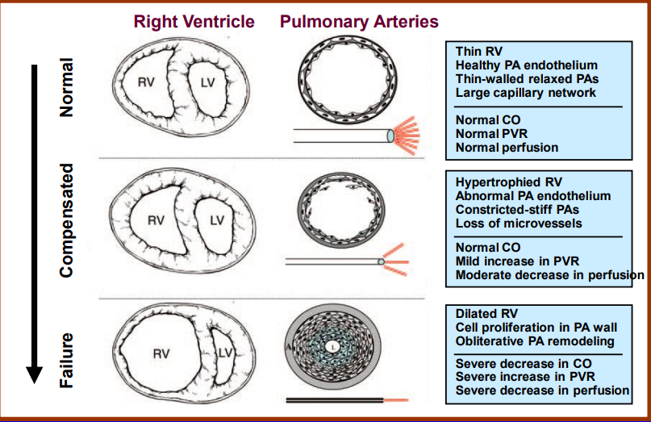
ECHOCARDIOGRAPHY IN PAH
ventricular remodelling- a result of chronic progressive pressure loading

Slide 48
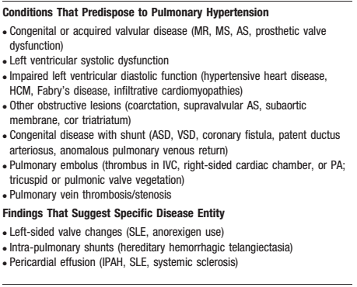
Specific diagnostic capability of Echo in PH
(Contrast echo may be required)

Slide 49
Assessment of PAH
DIRECT EVIDENCE
1)PASP = 4 V²_{(TR gradient)} + RAP
TR in 80% of patients with PASP > 35 mmHg
~ 96% of those > 50 mmHg¹.
Variable correlation between TTE and RHC measurements of PASP depending co-morbidities-- ranging from 0.96-0.98 in patients with cardiac disease to 0.69 in patients with advanced lung disease²
TR may not always be analyzable ( ~20% -- contrast echo may help)
Only ~ 50 % of PAH due to respiratory disease are gradable
Erroneous estimations also result from poor RAP assumptions
Age >50 yrs, obesity, athletes and males may have mild PAH without actual disease ---PAH diagnosis must be complimented by clinical scenario and RV function assessment.

Slide 51
2) RAP Estimation
The subcostal view
IVC viewed in its long axis.
The measurement is made at end-expiration
- just proximal to the junction of the hepatic veins that lie approximately 0.5 to 3.0 cm proximal to the ostium of the right atrium
In patients ventillated using positive pressure, IVC collapse cannot be used to reliably estimate RA pressure. – CVP must be used
In the same group if IVC<12mm, is suggestive of RAP <10mm Hg

Slide 52
RVSP = 4V² + RAP
Assessing RA pressure:
Secondary measures of RA pressure:
Restrictive filling – tricuspid E/A >2.1, with deceleration time <120 ms
Tricuspid E/E’>6
Diastolic flow predominance in hepatic vein (systolic filling fraction <55%)
Parameters | 0-5 mm Hg (3mmHg) | 5-10 mm Hg (8mm Hg) |  | >15 mm Hg
IVC diameter | ≤2.1cm | ≤2.1 | >2.1 | >2.1 cm
Respiratory collapse | >50% | <50% | >50% | <50%
Notes:
recent ESC guidelines suggest just using the TRmax without additional RAP, as IVC assessment is error prone.
- If PH was defined by an SPAP in excess of 30 or 40 mm Hg, this corresponded to an MPAP in excess of 20 or 26 mm Hg. If PH was defined by an MPAP of > 25 mm Hg, this corresponded to an SPAP of > 38 mm Hg.
Hepatic vein normally has a ssytolic predominance- Vs>Vd, Vs/Vd>1. In elevated RA pressure, the Vs/Vs+Vd % is less than 55%, indicating diastolic flow predominance. It is accurate for ventillated patients, provided 5 consecutive beats are averaged.

Slide 53
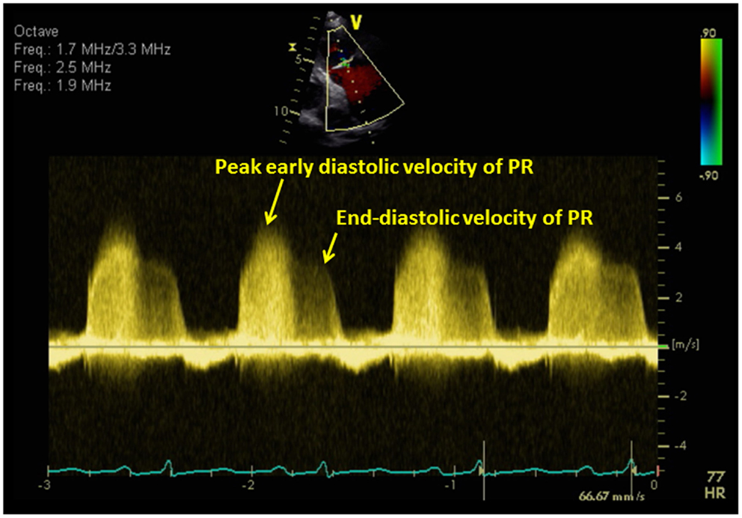
3)Mean Pulmonary Artery pressure(mPAP) Evaluation of the PR signal
PR velocity reflects the pressure gradient between pulmonary artery and right ventricle during diastole.
Notes:
End diastolic velocity represents the end diastolic pressure gradient between pulmonary artery and the right ventricle. If RV EDP is added to this gradient, then we wil ge the PADP.

Slide 54
Estimation of pulmonary artery diastolic pressure from peak end-diastolic velocity
PADP = 4 (V_{PR-ED} )² + RVEDP
In the absence of tricuspid stenosis, RVEDP = RAP
PADP = 4 (V_{PR-ED} )² + RAP

Slide 55
Estimation of mPAP from peak PR velocity
Peak velocity of PR Doppler signal in early diastole correlates with mean PAP
mPAP = 4 (V _{early} _{PR} ) ² + RAP
Method has been validated against gold standard catherisation measurements

Slide 56
mPAP can also be measured from systolic and diastolic pulmonary artery pressure
mPAP = 2/3 (PADP) + 1/3 (PASP)
Measured from end diastolic PR velocity
From TR peak velocity

Slide 57
Mean PAP from RVOT acceleration time
RVOT acceleration time is the time interval between the onset of flow to the peak systolic flow.
As the PA pressure increase, resistance to blood flow from RV into PA increase, resulting in shortening of the RVOT acceleration time.

Slide 58
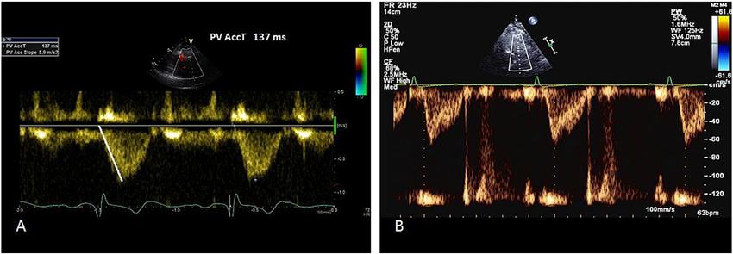
RVOT acceleration time measurement; rapid rise and mid-systolic notching s/o elevated PAP
Normal PW of RVOT – dome shaped
Pulmonary hypertension- rapid rise to peak shorter acceleration time;
mid-systolic notching

Slide 59
Interpretation: RVOT _{AT} :
Value >130 ms - normal
value < 100ms – PH
MPAP = 90-(0.62 * RVOT _{AT} ), when RVOT _{AT} < 120ms
MPAP = 79- (0.45* RVOT _{AT} ), when RVOT _{AT} >120ms

Slide 61
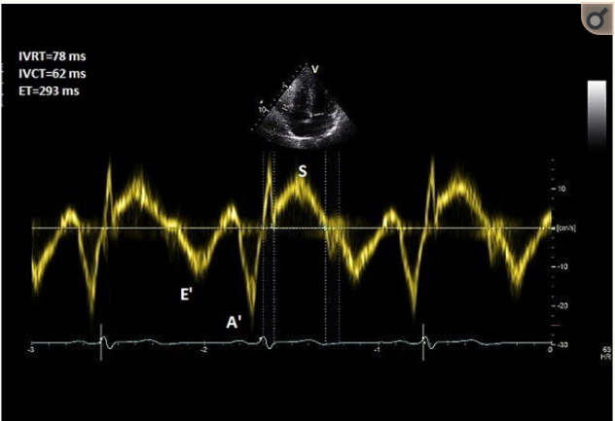
Right ventricular isovolumic relaxation time (_{r}IVRT)
TDI deployed at lateral tricuspid annulus
PW doppler with a 6mm sample window obtained
_{r}IVRT – measured from the offset of S’ wave to onset of E’ wave
Notes:
time from pulmonary valve closure to tricuspid valve opening and can be measured either by pulsed-wave Doppler from tricuspid inflow or with tissue Doppler imaging of the RV free wall.

Slide 62
_{r}IVRT > 75 ms – reliably predicts pulmonary hypertension
_{r}IVRT <40 ms – high negative predictive value for PH

Slide 63
Indirect 2D echo signs in PH
RV wall thickness
> 5mm
Measure of RVH, usually secondary to increased RVSP
Measured at end-diastole
M-mode/ 2D echo
Subcostal window- at the level of tip of anterior tricuspid leaflet
Left parasternal window
Exclude trabeculation, papillary muscle and epicardial fat

Slide 64
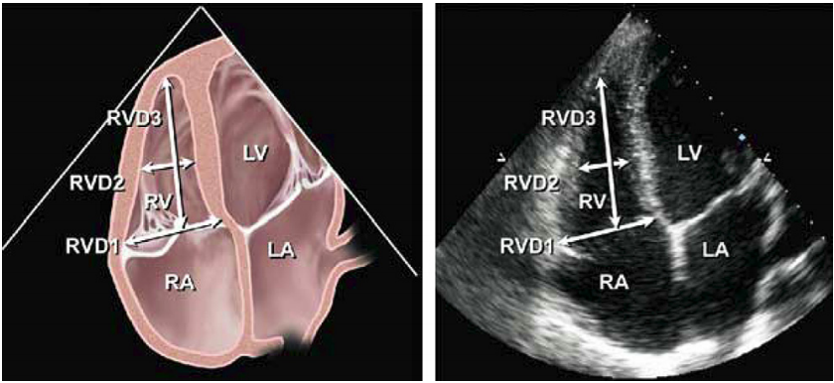
2. RV dilation :
level | Diameter
Base | >42 mm
Mid level | >35mm
Longitudinal | >86mm
RV focused apical 4 chamber view
Notes:
Recommendations: Patients with echocardiographic evidence of right-sided heart disease or PH should ideally have measurements of RV basal, mid cavity, and longitudinal dimensions on a 4-chamber view. In all complete echocardiographic studies, the RV basal measurement should be reported, and the report should state the window from which the measurement was performed (ideally the right ventricle–focused view), to permit interstudy comparison

Slide 65
3. RVOT dilation
Best viewed from the left parasternal and subcostal view.
RVOT distal diameter, just below pulmonary valve- most reproducible
PSAX- distal RVOT diameter >27mm is RVOT dilation
Pitfalls: -oblique imaging – under/overestimate the size
-cant be used in those with chest and spine deformity

Slide 66
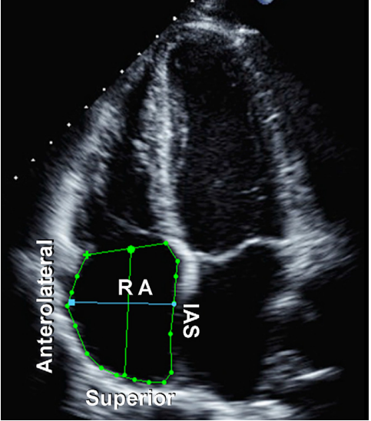
4. RA dilation
Estimated from A4C
upper limit for:
Major axis dimension-53mm
Minor axis dimension- 44mm
- RA area (end- ventricular systole) 18 cm²
Notes:
RA area is traced at the end of ventricular systole (largest volume) from the lateral aspect of the tricuspid annulus to the septal aspect, excluding the area between the leaflets and annulus, following the RA endocardium, excluding the IVC and superior vena cava and RA appendage (Figure 3).5 Note that RA dimensions can be distorted and falsely enlarged in patients with chest and thoracic spine deformities.
Because of the paucity of standardized RA volume data by 2D echocardiography, routine RA volume measurements are not currently recommended.

Slide 67
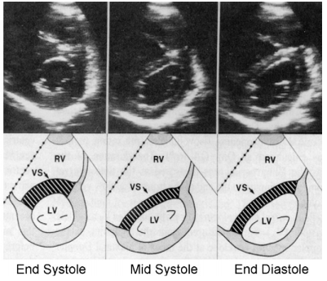
5. LV eccentricity index:
the degree of distortion of the LV and IVS arising due to increased pressure in the RV during diastole and systole ; can be quantified using a short-axis view at the level of left ventricular papillary muscles.
PRESSURE OVERLOAD
VOLUME OVERLOAD

Slide 68
LV eccentricity index
Ratio between the LV anteroposterior dimension(D2) and the septolateral dimension(D1)
Ratio >1.0 suggest RV overload

Slide 69
RV functional assessment - RV fractional area change:
( end-diastolic area - end-systolic area/ end-diastolic area) *100
- Measure of RV systolic function
- Correlate with RV EF by MRI
- Limited by endocardial definition of RV
- Lower reference value- 35%

Slide 70
TEI INDEX and TR measured PASP
Tei index / RIMP/MPI– doppler derived marker of both systolic and diastolic ventricular function
Method: A4C , TDI is deployed on RV free wall and pulse wave doppler is obtained approx 1cm from tricuspid annulus
Tei index = IVRT + IVCT/ET
= TCO-ET/ET
Notes:
RIMP- Right ventricular index of myocardial performance

Slide 71
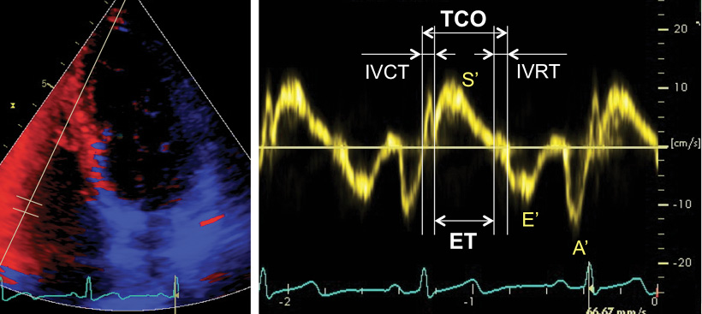
Tei index
>0.4 by PWD
>0.55 by DTI
Notes:
In the pulsed Doppler method, the ET is measured with pulsed Doppler of RVoutflow (time from the onset to the cessation of flow), and the tricuspid (valve) closure-opening time is measured with either pulsed Doppler of the tricuspid inflow (time from the end of the transtricuspid A wave to the beginning of the transtricuspid E wave) or continuous Doppler of the TR jet (time from the onset to the cessation of the jet)

Slide 72
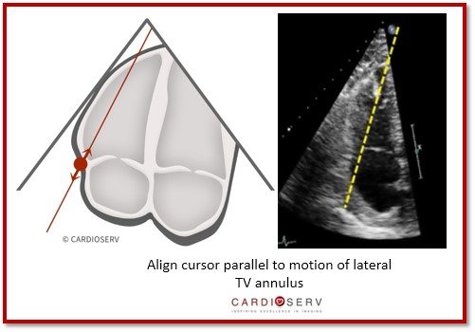
TAPSE
TRICUSPID ANNULAR PLANE SYSTOLC EXCURSION/ TAM – tricuspid annular motion
reflection of the movement of base to apex shortening of the RV in systole
derived from the four-chamber view –M-mode

Slide 73
TAPSE -prognostic indicator in PAH for the assessment of disease severity and response to therapy
<16 – higher mortality
highly load dependent-
-become pseudonormalised in the presence of significant volume loading
-e.g. left-to-right shunting or severe functional tricuspid regurgitation
Notes:
n. As with other regional methods, it assumes that the displacement of the basal and adjacent segments in the apical 4-chamber view is representative of the function of the entire right ventricle, an assumption that is not valid in many disease states or when there are regional RV wall motion abnormalities

Slide 74
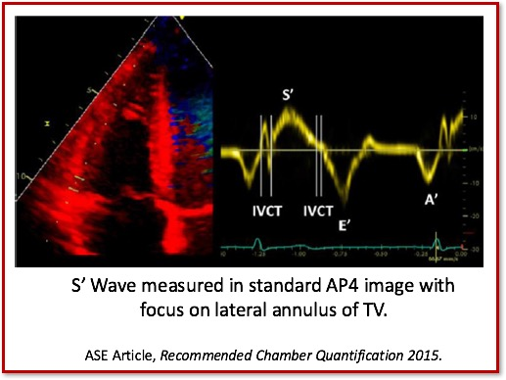
S’ Wave: TDI-Derived Tricuspid Lateral Annular Systolic Velocity
average of three TDI signals from different cardiac cycles
<10 cm/s – impaired RV function
load dependent and may be pseudonormal under conditions of increased volume loading
S' wave velocity requires correction when heart rate is >100 bpm or falls to <70 bpm.

Slide 75
Strain imaging
Strain : Percentage change in myocardial deformation
Strain rate: rate of deformation of myocardium over time
RV strain and strain rate is significantly reduced as a consequence of increased afterload with or without RV contractile dysfunction
LPSS- longitudinal peak systolic strain – >19% indicates RV dysfunction
Notes:
One-dimensional strain is acquired using Doppler tissue imaging and is consequentially angle dependent. It is most reproducible in the apical 4-chamber view, interrogating the basal, mid, and, to a lesser degree, apical segments of the RV free wall. As a result, one is limited to mostly longitudinal strain
To calculate strain, high frame rates are required, ideally $150. o align the segment in the center of the sector to avoid errors due to the angle dependence of Doppler. A maximum tolerance of 10 to 15 off the axis of contraction is recommended.130 Imaging is in color-coded tissue Doppler mode, and $3 beats are acquired with suspended respiration. Values for strain and SR are then derived offline on the system or workstation using equipment-specific algorithms by placing sample volume(s) or regions of interest of varying sizes in the mid portion of the segment(s

Slide 76
M-mode echocardiography
Three abnormalities of the pulmonary valve :
Absent or diminished ‘a’ wave
Midsystolic notching or closure of the pulmonary valve
Increased right ventricular pre-ejection period to ejection time (RVPEP/RVET) ratio

Slide 77
‘a’ – depth of the posterior deflection of pulmonary valve immediately following atrial contraction; correlates with the peak pressure gradient across pulmonary valve; normally measures 2-7mm
Limitation: 1. atrial fibrillation
2. no correlation between a wave amplitude and actual PAP
3. normalisation of ‘a’ wave in those with coexistant RV failure
Notes:
Normally theres a minimal difference between the RVEDP & PAEDP. Therefore a small increase in I RVEDP will be transmitted to the PV resulting I a defelcetion. In PH, the increase in PAEDP is much greater than RVEDP.

Slide 78
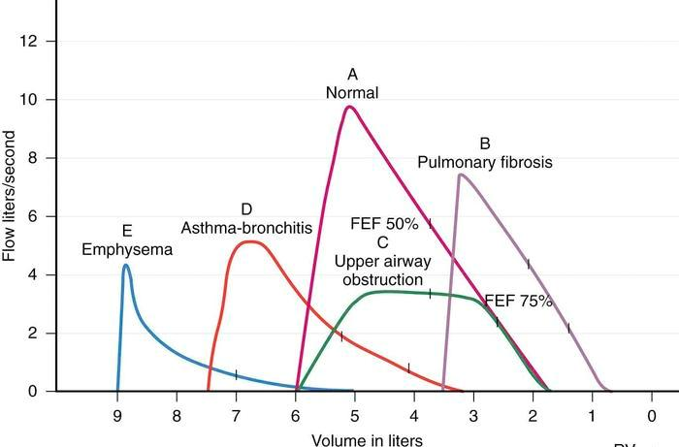
PULMONARY FUNCTION TEST
– to r/o restrictive/ obstructive airway diseases
- DLco may be decreased to 40-80% in PAH

Slide 79
CT CHEST – HRCT +/- CECT
PAH assessment
Respiratory causes
(ILD, COPD)
CTEPH : Especially,
for those whose lung
perfusion scans cannot
be reliably interpreted

Slide 80
LUNG PERFUSION SCAN -- Tc99m MAA
Sensitivity and Specificity approaches 100% .

Slide 81
FUNCTIONAL WORK UP
Median survival:
WHO I : 6 years
WHO II : 6 yrs
WHO III : 2.5 yrs
WHO IV : 6months

Slide 82
6 MINUTE WALK TEST
Most important baseline functional assessment.
Prognostification as well as patient follow up
< 200m -- worse prognosis and mortality
HR chronotopic responses are to be assessed.
Advance therapy trials for PAH show improvements varying from 30 to 50m correlating with a clinically significant benefit.

Slide 83
CARDIO-PULMONARY EXERCISE TESTING
Simultaneous measurement of respiratory gas exchange parameters along with upright bicycle ergometry stress testing
Valuable predictor of prognosis and improvement with Rx
PkVO2>10.4ml/kg/min – better 1 yr survival
However methodological inconsistencies in various centres make it unattractive
TMT using Naughton-Balke protocol also compares well with 6MWT and CPET in assessing the functional capacity.

Slide 84
ADVANCED DIAGNOSTIC WORK UP
Elaborate diagnostic work up
Cardiac MRI
Cardiac catheterization

Slide 85
Elaborate diagnostic work up
CBC, Sickling test, LDH
ABG
CTD work up – ANA, ds DNA Scl70, anti-centromere Abs, U3RNP, RA
LFT, USG abdomen
HIV, HBsAg, HCV
BNP
S. Uric acid
Thrombophilia work up
TFT
Overnight oximetry --- Polysomnography
BMPR2 mutation

Slide 86
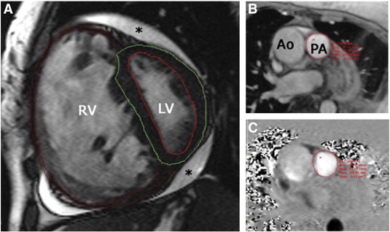
cMRI
Assess RV morphology and function
RV systolic & diastolic dysfunction--- poor prognostic indicator
Pulmonary artery stiffness :
Relative cross-sectional area change <16% -- Inc mortality in PAH patients
- RV SV </= 25ml/m²
- RV-EDV >/= 84ml/m²
- LV-EDV</= 40ml/m² ,predictors of mortality and Rx failure¹
1 . van Wolferen SA, et al. Prognostic value of right ventricular mass, volume, and function in idiopathic pulmonary arterial hypertension. Eur Heart J. 2007;28:1250–7 .
2. Gan CT et al. Noninvasively assessed pulmonary artery stiffness predicts mortality in pulmonary arterial hypertension. Chest. 2007;132:1906 –12.
3. Shehata M et al. Myocardial delayedenhancement in pulmonary hypertension: pulmonary hemodynamics, right ventricular function, and remodeling. AJR Am J Roentgenol.2011;196:87-94

Slide 87
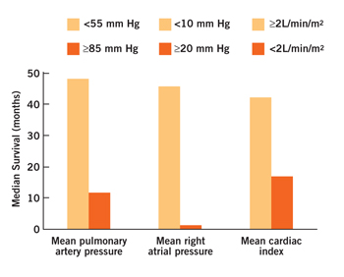
RIGHT HEART CATHETERIZATION
Not routinely recommended.
However ACC 2009 advises RHC to confirm diagnosis and define accurate hemodynamic profile in PAH patients– gold standard
IC recommendation by ECS 2009 for all PAH patients
Important for vasodilator testing and also suggested before CHD correction
Complications – 1.1% , Mortality – 0.05%
mPAP, mRAP and CI significantly correlate with survival

Slide 88
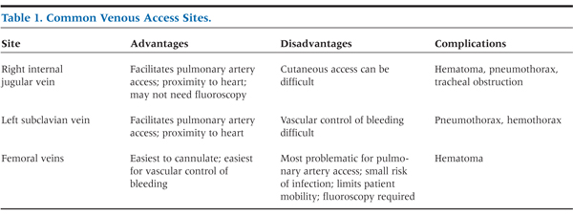
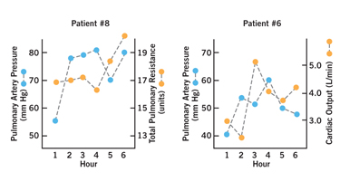
RHC- procedure pearls and pitalls
Staff experience, sedation, procedure related complications, temporal variations in hemodynamics.
Measurements must be at end-expiration
Limiting factors : Accuracy and errors in PCWP, method of COP estimation, complex structural heart disease

Slide 89
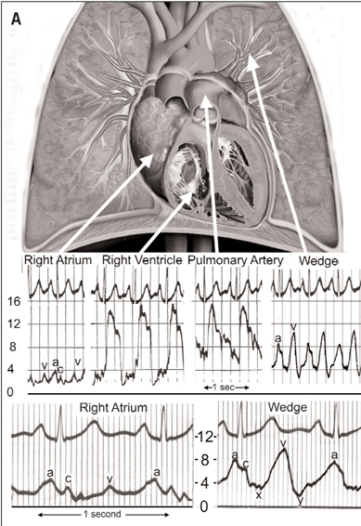
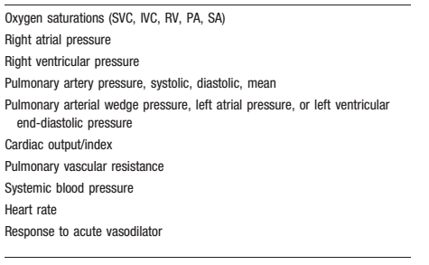
BASIC DATA FROM A RHC

Slide 90
Basic calculations from a RHC in PAH
mPAP = PAP_{diastolic}+ (PAP_{systolic}- PAP_{diastolic}) / 3
CO_{FICK} = Oxygen consumption(ml/min)/ (CaO2 –CvO2)
(Ca O2 = 1.36 * Hb * 10 * Sa O2 )
PVR = 80 * (mPAP – PCWP) / CO dyne.sec.cm⁻⁵
SVR = 80 * (mBP-RAP) / CO dyne.sec.cm⁻⁵ (TPR = mBP/CO)
PVRI = PVR * BSA

Slide 91
STRATEGIC WORK UP -Acute vasodilator testing
~ 10% of IPAH patients have predominant vasoconstriction – CCB responsiveness
Responders have an excellent prognosis – 95% at 5 yrs
Vasodilator testing in PAH patients improves overall survival by selective CCB treatment².
ESC 2009 – IC for IPAH & IIB for other forms of PAH
(Not recommended for Group 2-5)

Slide 92
Response to AVT – Decrease in mPAP by at least 10mmHg to a value </= 40mmHg, with an unchanged or increase in COP
(ESC, ACCP & AHA guidelines)
( Decrease of >20% in mPAP & >30% in PVR – favourable response)
~ 10-20% (12.6%) ¹ of IPAH patients are “ AVT responders” -- However only less than half of these are long term CCB responders.
Positive AVT criteria should be met before long term CCBs are considered for PAH Rx
AVT is less useful for 1) other Group 1 subtypes of PAH
2) for NYHA 3 & 4 patients
Notes:
The AVT criteria for response is primarily based on a series by Sitbon et al...
Sitbon O, Humbert M, Jais X,et al.Long-term response tocalcium channel blockers in idiopathic pulmonary arterial hypertension.Circulation2005; 111: 3105–3111
92

Slide 93
AVT technique
NO is most commonly used and best available agent– however is costly and requires costly equipment.
Epoprostenol is next most commonly used agent
Started at low doses with gradual uptitration
Careful BP monitoring & discontinuation if SBP < 85mmHg
Measurements repeated every 10-15mins till:
1) SBP drop by 30% or < 85 mm Hg
2) HR increase by 40% or greater than 100/min or HR drop to less than 65/min + symptomatic hypotension
3) Intolerable side effects--headache, lightheadedness, nausea.
4) Target response achieved
5) Maximum dose of vasodilator agent given

Slide 94
DIAGNOSTIC APPROACH IN PH
R/O Type 2, Type 3-(Easiest to do-ECG/CXR/ECHO/CT/PFT/SPIROMETRY/SLEEP STUDY)
If R/O – CTPA/VQ scan –R/O CTEPH
If R/O – Evaluate in detail for Group 1/Specialized evaluation

Slide 95
PROGNOSTICATION OF PAH
BNP >150pg/ml
NT-proBNP >1400pg/ml

Slide 96
CONCLUSION
PAH is commonly a secondary manifestation of an underlying disease process which needs to be corrected.
Failure to correct the underlying pathophysiology may lead to progression of PAH severity and ultimately RV dysfunction----mortality.
Diagnosis should be approached in a structured manner with careful exclusion of treatable causes
IPAH is a diagnosis of exclusion.
A careful estimation and prognostication of PAH is mandatory by functional testing, 2D-Echo and RHC

Slide 97
PREVIOUS QUESTIONS ASKED
1)Echocardiographic assessment of RV function(July 16)
2)Echo assessment of pulmonary hypertension

Slide 98
Every image has a story that brings it to life. And the power to inspire. Kathleen Sheffer received a heart-lung transplant on the 1st of July 2016, after a 17 year long fight with Idiopathic Pulmonary Hypertension. Now 24, she follows her passion for photography in San Francisco, California (Kathleen Sheffer Photography) and shares her experience in her column, Life after PH. The image on the cover page is an abstract rendering of her explanted heart that she commissioned with the artist Rachel Wadlow (www.rachelwadlowart.com), on the occasion of Valentine’s Day, 2019.
THANK YOU

