Slide 1
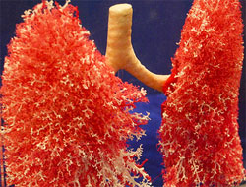
MANAGEMENT OF PULMONARY HYPERTENSION
Dr Arun Jude Alphonse
DM Cardiology Resident
Govt TDMC Alappuzha

Slide 2
DIAGNOSTIC APPROACH IN PH
R/O Type 2, Type 3-(Easiest to do-ECG/CXR/ECHO/CT/PFT/SPIROMETRY/SLEEP STUDY)
If R/O – CTPA/VQ scan –R/O CTEPH
If R/O – Evaluate in detail for Group 1/
Specialized evaluation

Slide 3
TREATMENT OF PH
Baseline assessment of the disease severity
General measures and supportive care
Primary therapy-directed at the the pathophysiology
of the disease
Advanced therapy- directed at PH “per se”

Slide 4
FUNCTIONAL WORK UP
Median survival:
WHO I : 6 years
WHO II : 6 yrs
WHO III : 2.5 yrs
WHO IV : 6months

Slide 6
AIM OF TREATMENT IN PH
To achieve a low risk status , which is usually associated with good exercise capacity, good quality of life, good RV function and a low mortality risk.
Bringing and/or keeping the patient in WHO-FC II whenever possible.
6 minute walk distance (6MWD) of >440 metres is widely regarded as the threshold for good exercise capacity on treatment(5th world symposium)

Slide 7
2)General Measures
Low level graded aerobic exercises as tolerated
Avoid heavy exertion & isometric exercises
Caution at high altitudes (>1500-2000m)
Oxygen therapy if paO2 < 60/Sp02<90% @ RA
Influenza and pneumococcal vaccinations (Class IC –ESC )
Na restriction < 2.4g/d
Avoid pregnancy/ early termination if conceived – 30-50% maternal mortality. ( Class IC – ESC )
Contraceptive advise
Diuretics (Judicious use)

Slide 8
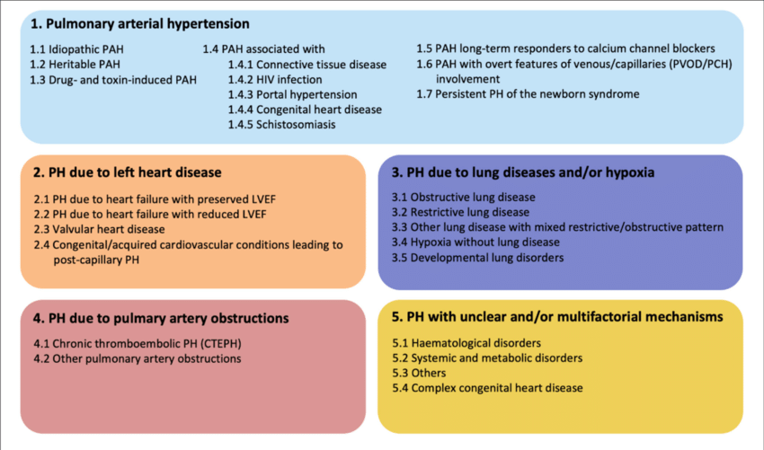
3. Primary therapy for PH- directed at the pathophysiology of disease

Slide 9
1) PVR
2) LAP
3) PVR
4) PVR
5) ?

Slide 10
PH in LHD

Slide 11
There are no effective therapies directed at the pathophysiology of the disease available currently for group 1 PH (PAH). Hence most of these patients will require advanced therapy.
Patient in WHO FC I generally do not require advanced treatment.
Careful and periodic re-assessment must be done in all such patients to diagnose clinical deterioration at the earliest.

Slide 12
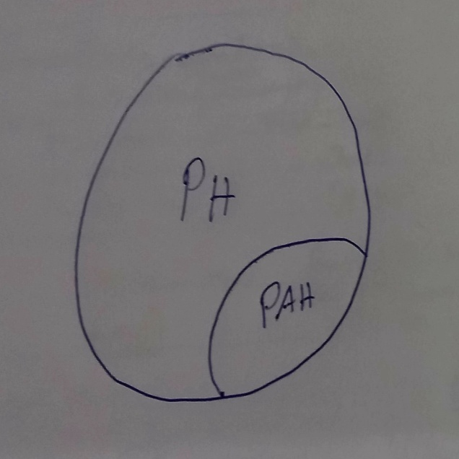
4)ADVANCED THERAPY- Aimed at PAH per se
1. CCBs
2. Advanced vasodilator therapies:
Prostacyclins
PDE-5 inhibitors
ET receptor antagonists
3. RHF specific therapy

Slide 13
Acute vasoreactivity testing
Vasoreactivity testing is done in two groups of patients.
1. To know the response to pulmonary vasodilators who will respond to CCB’s
–Only in subset of idiopathic PAH / drug /
toxin induced PAH(ESC 1C)
2) In patients with pre- and post-tricuspid systemic-to pulmonary shunts, acute vasodilatory testing is used to assess operability.

Slide 14
Agents used
1)Inhaled nitric oxide (iNO) at 10 to 40 ppm is the “gold standard”
2) Intravenous adenosine = 50–250 μg/kg/min dose titration: 50 μg/kg/min every 2 min
3) 100% oxygen(A tight mask with O2 flow at 10L/min)
Oral Sildenafil - Single dose of 25 mg of oral sildenafil.(Pulmonary hemodynamics to bemeasured every 15 minutes for 60 minutes after the administration of sildenafil)
5) Intravenous Sildenafil - 10 mg intravenous sildenafil

Slide 15
Start at low doses with gradual uptitration
Careful BP monitoring & discontinuation if SBP < 85mmHg
Measurements repeated every 10-15mins till:
1) SBP drop by 30% or < 85 mm Hg
2) HR increase by 40% or greater than 100/min or HR drop to less than 65/min + symptomatic hypotension
3) Intolerable side effects--headache, lightheadedness, nausea.
4) Target response achieved
5) Maximum dose of vasodilator agent given

Slide 16
Response to acute vasodilatory response
1)Sitbon criteria for a positive response- decrease in mean pulmonary arterial pressure of>10 mmHg reaching <40 mmHg, with no decrease in cardiac output
2) In patients with intracardiac shunts,
PVRI below 4 Wood units (WU)•m2 –closure of shunt can be done
PVRI between 4 and 8 WU•m2 - balloon occlusion of the shunt during catheterisation, and reassessment of thepressures and shunt

Slide 17
CCBs for PAH
Only for those with a positive AVT / other indications for CCBs ( ~10-20%) -- 12.6% ¹
95% five year survival (if AVT+ve) ~ 5-10% -- ~7% ¹
Long acting nifedipine, diltiazem, amlodipine
(Verapamil should not be used)
Choice based on HR of patient (>/< 80/min)
- Nifedipine SR- 30mg bd to 120-240mg/d
- Diltiazem - 60mg tds to 240- 720mg/d
- Amlodipine – 2.5mg od to 20mg/d
.

Slide 18
w/f hypotension, pulmonary edema, peripheral edema
Reassessment after 3-4 months
- Responder : Improvement in WHO class (to NYHAI/II) along with improvement in hemodynamics
Non-responder – consider other advanced PAH therapy
In 2 large series of patients who were acute responders, the characteristics of those who had near perfect survival on CCBs for up to 18 years --- acute fall in mean PAP of 39% & PVR of 50%.
CCBs usually not useful outside the cohort of IPAH/FPAH !!

Slide 19
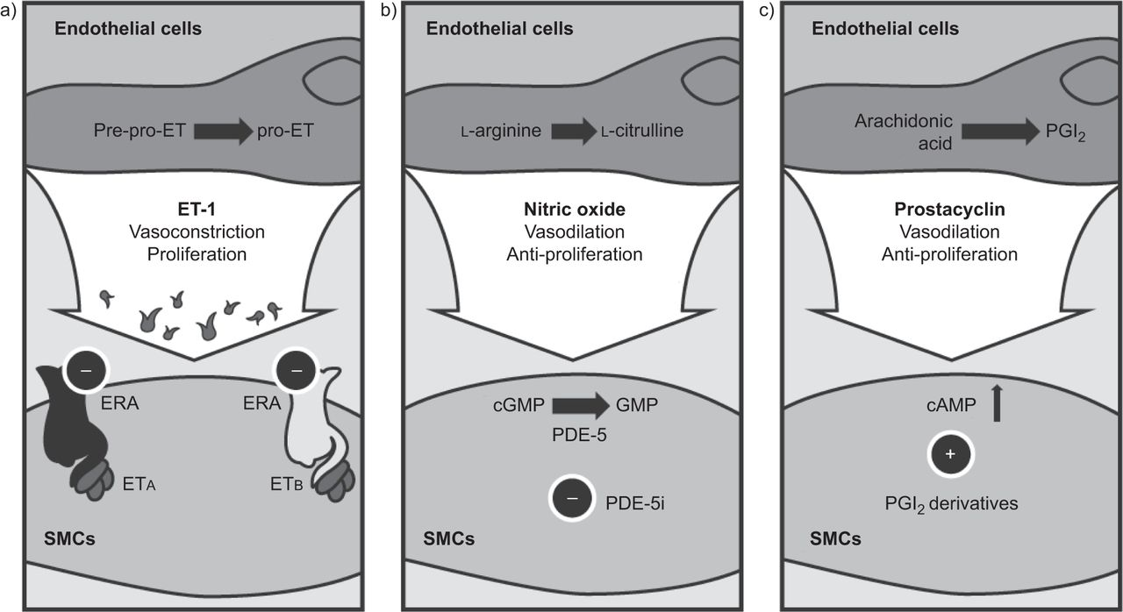
SPECIFIC THERAPY FOR PAH THE THREE PATHS

Slide 20
And how we target them

Slide 23
PROSTANOIDS
1.EPOPROSTENOL:
- Improves WHO class, hemodynamics, exercise tolerance & survival in PAH
Mean improvement in 6MWT ~ 30 -40m & PAP by 20-30%
CV catheter implanted surgically – continuous infusion
Huge learning curve and self-care responsibility for patient
Has to be prepared daily
Typical dose – 25-40 ng/kg/min by slow uptitration
Interruption by pump malfunction/catheter blockage may be catastrophic (T_{1/2} – 3-6 mins) -- REBOUND PH
S/E – Flushing, headache, diarrhoea, foot pain, rash, myalgias, jaw claudication, high output cardiac failure& pulm edema in PVOD/PCH
relaxation of vascular smooth muscle cell,
inhibition of platelet aggregation,
healing of endothelial injury,
inhibition of smooth cell proliferation,
-facilitating reverse remodelling

Slide 24
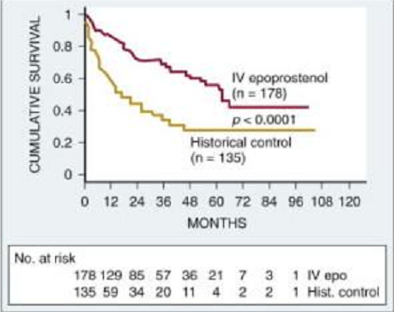
Experience of > 25 years with epoprostenol
(FDA Approved- 1995)
Only PAH drug other than CCB to show a survival improvement in a RCT(FIRST trial)
Also been studied with beneficial results in APAH (CHD, Porto-pulm HTN & HIV-associated) and inoperable CTEPH
Bridge to lung transplantation
Should be administered at experienced centres.
Not the ideal drug --- non-curative, expensive

Slide 25
2. TREPROSTINIL:
More convenient usage than Epoprostenol (longer T_{1/2} -4hrs and stability)
75-150ng/kg/min
Injection site pain, headache, diarhoea, flushing
Gram negative sepsis ! (low threshold for empiric antibiotics)
- S/c approved in 2002, I/V approved in 2004
3. ILOPROST:
Inhalation -- ~ 6-12 nebulizations/day (T_{1/2} – 20-30min) , also oral/i.v
Approved in 2004
However no proven benefit in the long term as monotherapy.
Similar S/E profile as epoprostenol
4. BERAPROST:
Oral , rapid action
Doubtful long-term efficacy ( Benefits lasting only 3-6months)
Approved in Japan

Slide 27
GRIPHON

Slide 29
NITRIC OXIDE PATHWAY A)PDE-5 inhibitors
SILDENAFIL :
By decreasing cGMP degradation – decreased proliferation & increased apoptosis of PASMCs
Increases RV inotropy)
20 mg tds is the recommended starting dose – titrated to 80mg tds as tolerated
Onset ~ 45-60min
Approved for PAH in 2005
Even though used off-label for paediatric PAH, FDA in 2012 recommended against their use.
Long term beneficial effects have recently been reported in the SUPER-2 study

Slide 30
S/E of Sildenafil –
Headache, flushing, visual blurring, cyanopsia, hypotension, MI, optic neuropathy, hearing loss, priapism, increased IOP, nasal congestion.
- Caution while usage with ART
C/I in CLD, CKD, nitrate usage, retinal degenerative disorders, recent CVA/MI
Has been studied and validated for combination therapy with Bosentan and epoprostenol .
Preferable 1st drug to start for WHO I &II in Indian patients.

Slide 31
2. TADALAFIL :
PHIRST study in IPAH – similar to Sildenafil
Recent PHIRST-2 shows good long term results
40mg od dose
FDA approved in 2009
3. VARDENAFIL:
5mg bd
Has additional antioxidant effects

Slide 32
Only PAH specific drug for CTEPH

Slide 33
CHEST -1 trial
multicenter, randomized, double blind, placebo controlled study .
261 patients with inoperable chronic thromboembolic pulmonary hypertension or persistent or recurrent pulmonary hypertension after pulmonary endarterectomy were randomly assigned to receive either placebo or riociguat.
6 minute walk distance increased by a mean of 39 m in the riociguat group as compared to a mean decrease of 6 m in the placebo group.
Pulmonary vascular resistance decreased by 226 dyn·sec·cm^{–5} in the riociguat group while it increased by 23 dyn·sec·cm^{–5} in the placebo group.
Significant improvements were noted in NT-proBNP level and WHO functional class. Serious adverse events were similar in both groups

Slide 34
POSITIVE TRIALS
CHEST -2 TRIAL –long term benefits of Riociguat in CTEPH
RIVER study – RV size & Function improvement in CTEPH with Riociguat
EXPosurE Registry RiociguaT in patients with pulmonary hypertension (EXPERT) study

Slide 35
NEGATIVE TRIALS (Group 2)
SOCRATES REDUCED(Vericiguat)
SOCRATES PRESERVED (Vericiguat)
DYNAMIC /DILATE 1/LEPHT(Riociguat)

Slide 36
Endothelin antagonists
1. BOSENTAN:
Nonselective(ET_{A}+ET_{B} )ET1-R blocker:62.5mg to 125mg bd
Mean improvement of 6MWT by ~50- 75m
Improvements in mPAP and PVR
FDA approved in 2001
Beneficial in APAH(HIV, CTD), inoperable CTEPH (BENEFIT trial) and congenital heart disease (BREATHE-5 trial)
Also found beneficial in early symptomatic PAH (WHO –II)
( EARLY study) - FDA approval in 2009

Slide 37
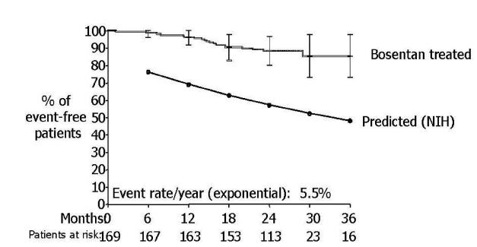
Survival benefit not proved by placebo controlled studies yet
But improved survival rates when compared with the NIH registry

Slide 38
S/E :
Significant transaminitis – 10-15% (monthly LFT)
Anaemia (?dilutional) – 10% ( 3monthly CBC)
Bosentan withdrawal –death
Headache, hypotension, flushing, peripheral edema
? Male infertility
CYP 450 inducer
C/I in pregnancy and lactation (teratogenic)

Slide 39
2. SITAXSENTAN :
Selective ET_{A} antagonist
STRIDE-1 & -2
100mg od
FDA(Europe) - 2006
Increases INR with warfarin (CYP2C9 inhibitor)
3. AMBRISENTAN :
Selective ET_{A} antagonist
Less hepatotoxicity
ARIES-1 & -2
5mg - 10mg od
FDA(USA) – 2007
4. MACITENTAN :
Dual ET_{A/B} receptor with high lipophilicity
SERAPHIN study

Slide 42
COMBINATION THERAPY for PAH
ADVANCED PAH THERAPY USE IN THE ‘REVEAL’ REGISTRY

Slide 44
AMBITION TRIAL

Slide 46
TRITON

Slide 47
SUPPORTIVE THERAPIES -Warfarin in PAH
Recommended for IPAH – INR 1.5 - 2.5 (ESC IIa for IPAH,FPAH and anorexigen-PAH ; IIb for APAH)
(based primarily on observational studies in IPAH and anorexigen-PAH)
Suppresses the development of new thrombotic lesions
Particularly beneficial along with long term epoprostenol infusion
Possible interaction (inconsistent) with Bosentan to be kept in mind --- more frequent monitoring
( Bosentan is a CYP inducer)
Risks of bleeding to be weighed appropriately
No evidence in other PAH subgroups
Lack of RCTs for Class I recommendations

Slide 48
Other supportive therapies for PAH
Diuretics
Oxygen therapy when there is PO2 <60mmHg
LTOT may be considered when necessary
Digoxin may be considered for RVF/ atrial tachyarrhythmias.
Management of arrhythmias

Slide 49
SURGICAL MEASURES
Failure to respond – inevitable result of RV failure – rapid deterioration
Atrial septostomy
Heart-lung transplantation
Thrombo-endarterectomy for CTEPH
RV mechanical assist ( under research)

Slide 50
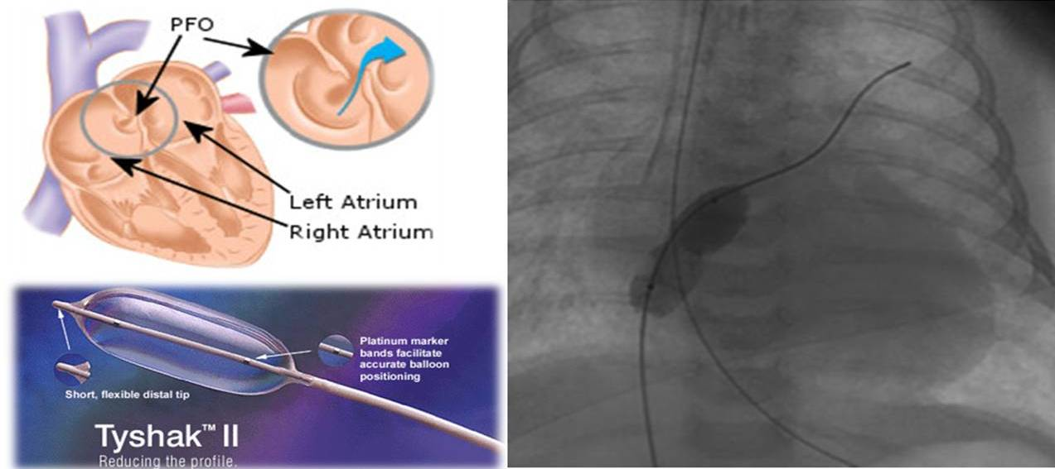
ATRIAL SEPTOSTOMY
1) In severe intractable RHF with syncopal symptoms on maximal advanced PAH therapy and inotropes.
(avoided when RAP>20mmHg, PVR>55WU & SpO2<80%-- end-stage)
2) When advanced medical therapy is not available.
3) Bridge to transplantation
Mainly improves COP (~ 1 l/min) & systemic O2 transport--improves symptoms and functional status
~ 5-15% procedural mortality
Kothari et al (AIIMS) , 11 patients, IPAH
---improvement in symptoms/hemodynamics-- 18.6% mortality --- recommended early in the course.

Slide 51
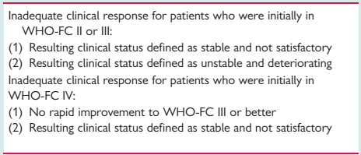
HEART-LUNG TRANSPLANTATION
Poor response to advanced therapies ~ 25%
SLTx/DLTx/HLTx
The International Society for Heart and Lung Transplant registry reports 1-, 3-, 5-,and 10-year survivals of 66%, 57%, 47%, and 27%, respectively in post-transplant PAH patients.

Slide 52
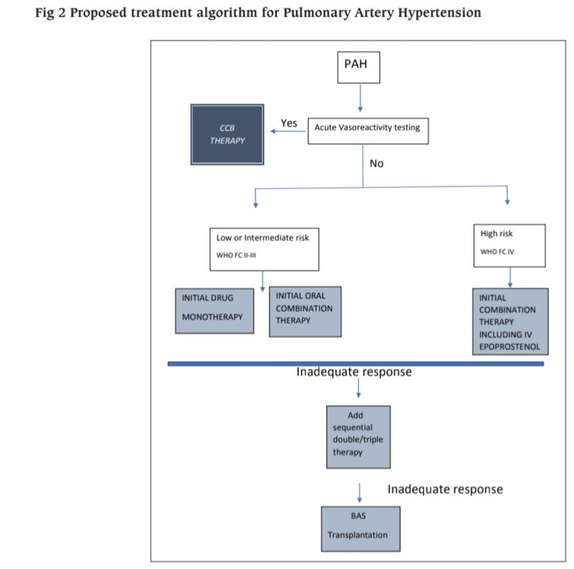

Slide 53
Scope of ATs for other conditions than IPAH
Heart failure – Sildenafil beneficial at 12 weeks. No long term studies
COPD – Sildenafil – no significant benefit
-- Bosentan – no definite benefit
ILD -- Sildenafil – may be beneficial
-- Bosentan –no definite benefit
CHD -- Sildenafil – beneficial in short term studies ASD> VSD
-Bosentan -- BREATHE-5 trial : Symptomatic benefit at 40 months
[ IB (ESC ) for WHO III Eisenmenger’s ]
**PAH-AT for Eisenmenger’s has significant benefits in terms of symptoms, QOL, hemodynamics as well as survival.
Notes:
VSD – both laminar as well as circumferential strain of slow........ASD—only laminar strain of flow...Therefore PAH is more severe in posttricuspid
53

Slide 54
CONCLUSION
PH is commonly a secondary manifestation of an underlying disease process which needs to be corrected.
Failure to correct the underlying pathophysiology may lead to progression of PH severity and ultimately RV dysfunction----mortality.
Diagnosis should be approached in a structured manner with careful exclusion of treatable causes
IPAH is a diagnosis of exclusion.
A careful estimation and prognostication of PAH is mandatory by functional testing, 2D-Echo and RHC

Slide 55
AVT should be done for all IPAH patients where CCB therapy may improve survival.
Several advanced therapies are now available for PAH which may improve symptoms and survival.
Detailed patient counselling, lifestyle measures and individualization of therapeutic protocols, are necessary i/v/o of the overall progressive nature of the disease.

Slide 56
PREVIOUS QUESTIONS ASKED
1)Drugs used in treatment of pulmonary hypertension(Sep 13)
2)Treatment of primary pulmonary hypertension(Jan 17)
3)Pharmacotherapy of Pulmonary artery hypertension(Aug 22)

Slide 57
Every image has a story that brings it to life. And the power to inspire. Kathleen Sheffer received a heart-lung transplant on the 1st of July 2016, after a 17 year long fight with Idiopathic Pulmonary Hypertension. Now 24, she follows her passion for photography in San Francisco, California (Kathleen Sheffer Photography) and shares her experience in her column, Life after PH. The image on the cover page is an abstract rendering of her explanted heart that she commissioned with the artist Rachel Wadlow , on the occasion of Valentine’s Day, 2019.
THANK YOU

