Slide 1
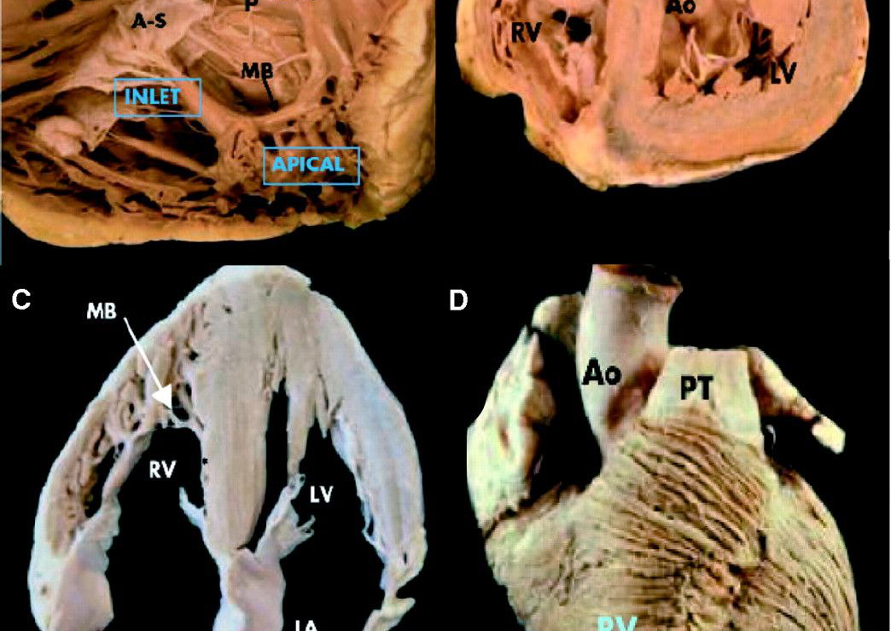
Echo Assessment of RV function
Dr Sanchna Dev S
DEPT OF CARDIOLOGY
TDMC

Slide 2
Contents
RV ANATOMY
RV PHYSIOLOGY
RV ANATOMIC EVALUATION
ASSESSMENT OF RV SYSTOLIC FUNCTION
ASSESSMENT OF RV DIASTOLIC FUNCTION

Slide 3
RV EXTERNAL ANATOMY
most anteriorly situated cardiac chamber ,lies immediately behind the sternum, rests inferiorly on the diaphragm
Posteriorly wraps the obliquely oriented LV
SAX – Asymmetric crescent ; LAX – triangular appearance
3D – flexible triangular pouch
Myofibre architecture
superficial (circumferential) , deep (longitudinal)
continuity between the muscle fibers of the RV and LV-functionally binds the ventricles together—> free wall traction ; ventricular interdependence

Slide 4
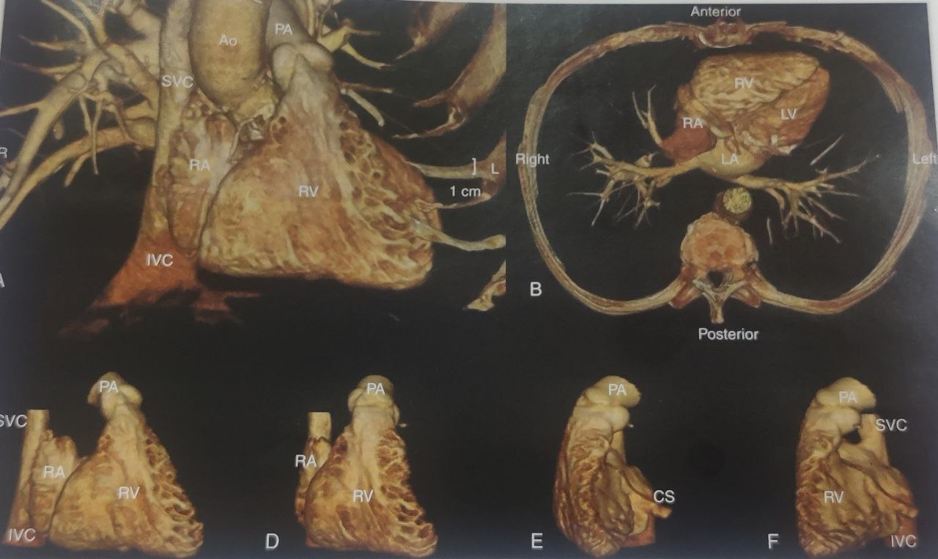

Slide 5
RV INTERNAL ANATOMY
delimited by the annulus of the tricuspid valve and by the pulmonary valve
3 components:
inlet, which consists of the tricuspid valve, chordae tendinae, and papillary muscles
trabeculated apical myocardium
infundibulum/conus —> smooth myocardial outflow region
Three prominent muscular bands - parietal ,septomarginal, moderator band.
Crista supraventricularis

Slide 8
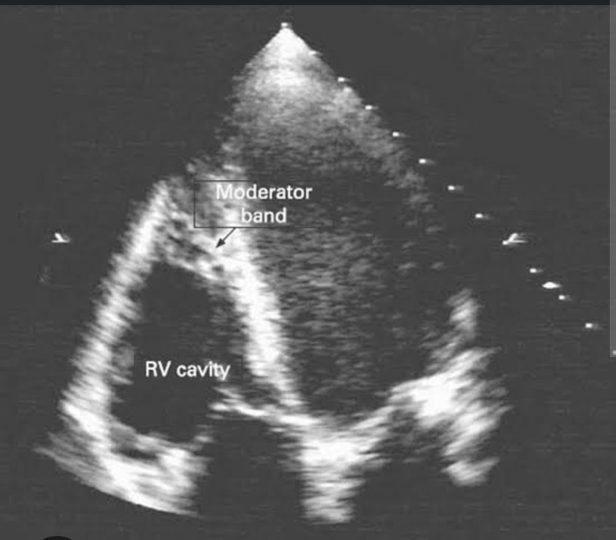
Distinguishing Anatomic Features of the RV
1) the more apical hinge line of the septal leaflet of the tricuspid valve relative to the anterior leaflet of the mitral valve
(2) the presence of a moderator band
(3) the presence of more than 3 papillary muscles
(4) the trileaflet configuration of the tricuspid valve with septal papillary attachments
(5) the presence of coarse trabeculations ( LVNC ; CCTGA)

Slide 9
RV- PHYSIOLOGY
primary function -receive systemic venous return and to pump it into the pulmonary arteries
RV is connected in series with the LV —> same effective stroke volume
RV contraction –sequential : inlet —> apical —> outlet.
(25-50ms)
contracts by 3 separate mechanisms:
inward movement of the free wall
contraction of the longitudinal fibers - draws the tricuspid annulus toward the apex
traction on the free wall at the points of attachment secondary to LV contraction.
Shortening of the RV is greater longitudinally than radially

Slide 11
ASSESSMENT OF RV

Slide 12
Challenges of RV assessment due to
complex geometry of RV
limited definition of RV endocardial surface caused by the heavily trabeculated myocardium
retrosternal position of the RV ,which can limit echocardiographic imaging windows
marked load dependence of indices of RV function

Slide 13
Segmental anatomy of RV

Slide 14
Essential Imaging Windows and Views

Slide 19
RV ANATOMIC EVALUATION

Slide 20
QUALITATIVE EVALUATION
Evaluation of RV size begins with qualitative impression of the RV relative to LV
A4C –RV should not exceed 2/3 of the LV size or total length
RV = LV size —> RV moderately dilated
RV > LV size —> RV severely dilated

Slide 21
RIGHT VENTRICULAR WALL THICKNESS
End diastole
Subcostal view
Zoomed M-mode or (2D)
RV wall thickness ≤5mm

Slide 22
DISADVANTAGES
ADVANTAGES
Single site measurement
Overestimated by harmonic imaging and oblique M mode
Challenging with thickened visceral pericardium
Easy to perform
Recommendations – abnormal RV wall thickness should be reported in patients suspecting of having RV or LV ysfunction using the normal cut off of 5 mm

Slide 23
RV LINEAR DIMENSIONS
End diastole
Basal diameter (RVD1) - maximal short-axis dimension in the basal one third of the RV in A4C
Mid cavity diameter(RVD2) – middle third of RV at the level of the LV papillary muscles
longitudinal dimension ( RVD3)-from the plane of the tricuspid annulus to the RV apex.
*RV dimensions can be distorted and falsely enlarged in patients with chest and thoracic spine deformities

Slide 24
RVD1 > 41mm & RVD2 >35mm —>RV DILATATION
RVD3 > 83mm —> RV DILATATION

Slide 25
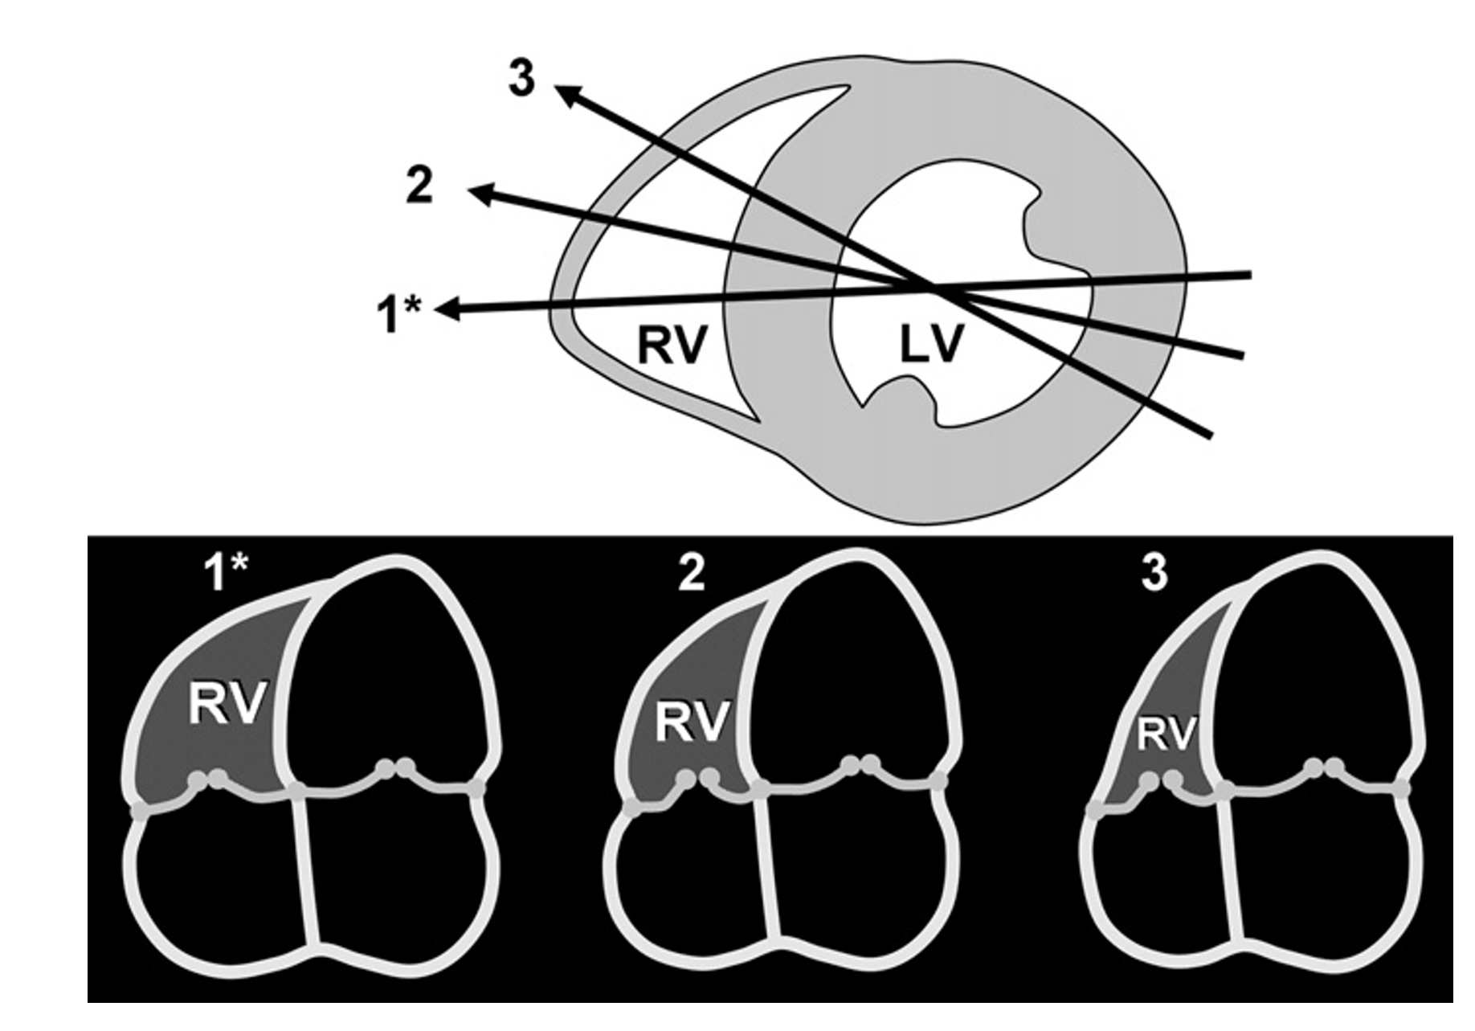
ADVANTAGES
DISADVANTAGES
easily obtained on an apical 4-chamber view
markers of RV dilatation
highly dependent on probe rotation by the user, which can result in an underestimation of RV width.

Slide 26
RVOT DIMENSIONS
RVOT — include the subpulmonary infundibulum and PV
Sub pulmonary infundibulum —> cone shaped muscular structure that extends from crista supraventricularis to the PV
Distinct from rest of RV in origin and anatomy
First segment of RV –to show diastolic inversion in the setting of tamponade
Measured at end diastole

Slide 27
RVOT distal is preferred (MOST REPRODUCIBLE)–especially when measuring right-sided stroke volume for the calculation of Qp/Qs or regurgitant fraction PLAX view of the RVOT is used in particular in the evaluation for arrhythmogenic RV dysplasia
RECOMMENDATONS –
In CHD or arrhythmia potentially involving the RVOT, proximal and distal diameters of the RVOT should be measured from PSAX OR PLAX VIEWS
UPPER REFERENCE LIMIT –
PSAX distal RVOT is 27 mm
PLAX prox RVOT is 30 mm
PSAX prox RVOT is 35mm

Slide 28
DISADVANTAGES
ADVANTAGES
Limited normative data
Window for measurement of RVOT size has not been standardized, and oblique imaging of the RVOT may underestimate or overestimate its size
Endocardial definition of the anterior wall is often suboptimal.
Easily obtained
Certain lesions can primarily affect the RVOT

Slide 29
RV SYSTOLIC FUNCTION ASSESSMENT

Slide 30
QUALITATIVE EVALUATION
Begins with visual impression
difficult and requires experience
Assess global and focal RV function
Example – Acute pulmonary embolism – McConnells sign
ARVD – regional wall akinesia or hypokinesia

Slide 31
QUANTITATIVE EVALUATION
With clinical utility and value based on studies are
Right ventricular index of myocardial performance (RIMP)
Tricuspid annular plane systolic excursion (TAPSE)
2D fractional area change (FAC)
Tricuspid annulus systolic velocity (S’)
Need more data to demonstrate clinical utility
dP/dT
2D RV ejection fraction
3D RV ejection fraction
RV longitudinal strain and strain rate

Slide 32
QUANTITATIVE EVALUATION
Global Function
Pulsed Doppler RIMP
Tissue Doppler RIMP
Global Systolic Function
Fractional Area Change (RVFAC)
3D RVEF
Longitudinal Systolic Function
TAPSE
Pulse Tissue Doppler S’ wave (Tricuspid annulus systolic velocity)
Global Longitudinal Strain (GLS)

Slide 33
1. RIMP (Right Ventricular Index of Myocardial Performance)
Index of global RV performance
The value represents the relationship between the ejection and non-ejection time of the heart
The “non-ejection” times are the periods of time when all heart valves are closed
Non-ejection time: (very small increments of time):
Just after the tricuspid/mitral valve closes and before the pulmonic/aortic valves open
Likewise, just after the pulmonic/aortic valve closes and before the tricuspid/mitral valves open again

Slide 34
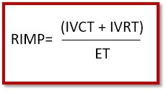
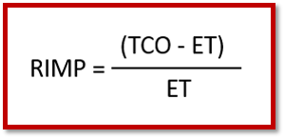

Slide 35
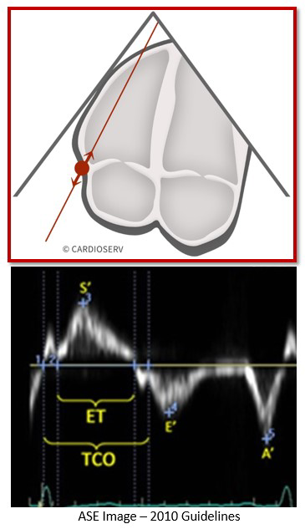

Slide 36
DISADVANTAGES
ADVANTAGES
Difficult to get clear TDI reading
RIMP varies with pressure and volume status
Unreliable when RA pressure is elevated
Shortens the IVRT
RR interval matching of 2 separate recordings (pulse Doppler method)
Reproducible
Avoids geometric assumptions of complex RV geometry
Allows for measurement of RIMP and S’ Wave from a single image
Less affected by heart rate

Slide 37
Recommendations
used for initial and serial measurements of RV function in complement with other quantitative and non quantitative measures
upper reference limit for the right-sided MPI is 0.43 using the pulsed Doppler method and 0.54 using the pulsed tissue Doppler method
It should not be used as the sole quantitative method for evaluation of RV function and should not be used with irregular heart rates.

Slide 38
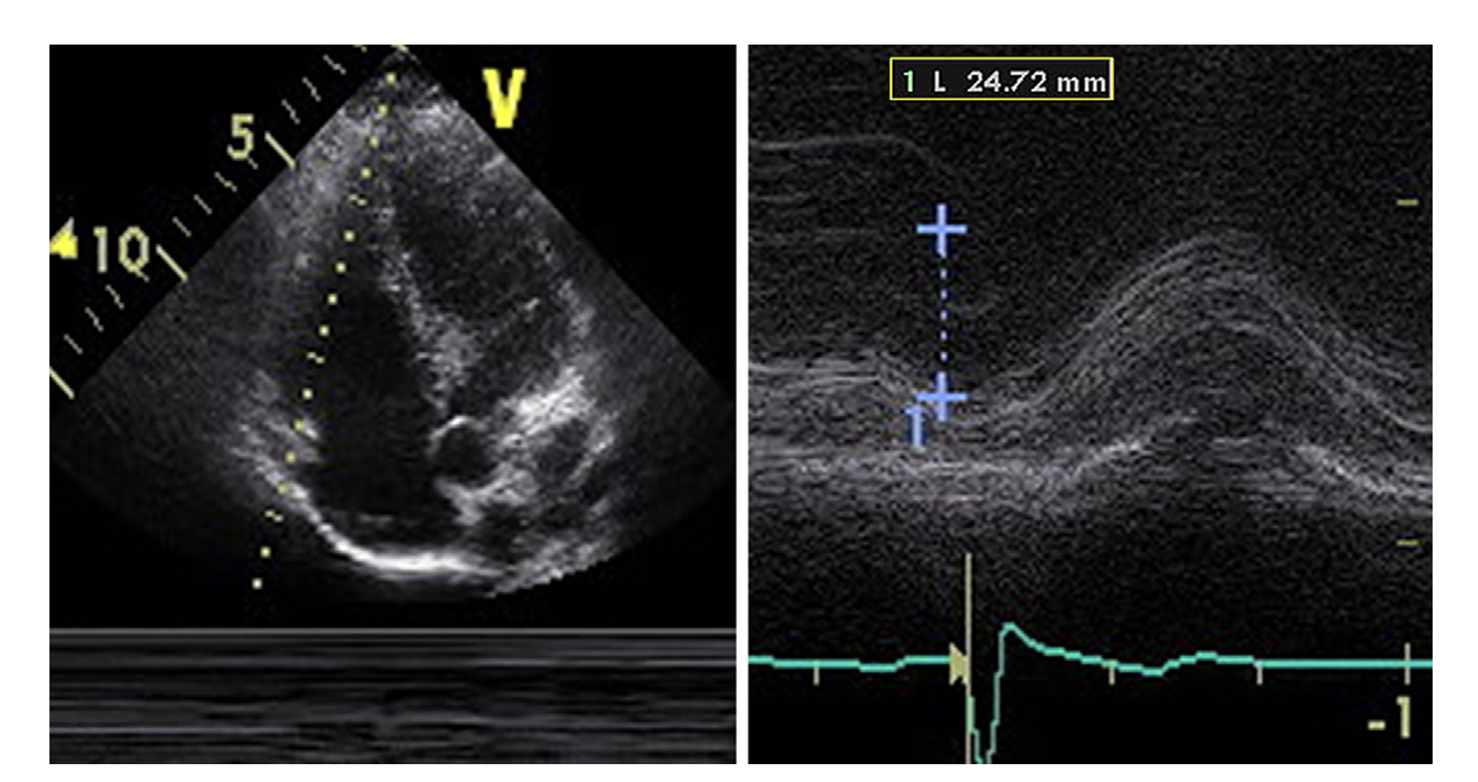
2. TAPSE
RV focused View
M-mode of the tricuspid lateral annulus
Excursion from end-diastole to peak systole
Abnormal <17 mm

Slide 39
ADVANTAGES
DISADVANTAGES
Established prognostic value
Validated against radionuclide EF
Recommendation:
TAPSE should be used routinely as a simple method of estimating RV function, with a lower reference value for impaired RV systolic function of 17 mm.
Angle dependency
Partial representation of RV GlobalFunction

Slide 40
3. 2D RV Fractional Area Change (RVFAC)
RV focused apical 4 C view
RV area end diastole and end systole
RVFAC(%)=100x(EDA-ESA)/EDA • Abnormal <35%

Slide 41
ADVANTAGES
DISADVANTAGES
Established prognostic value
Reflects both longitudinal and radial RV contraction
Correlates with RVEF by CMR
Recommendations:- one of the recommended methods of quantitatively estimating RV function, with a lower reference value for normal RV systolic function of 35%.
Neglects contribution of RV outflow tract to overall systolic function

Slide 42
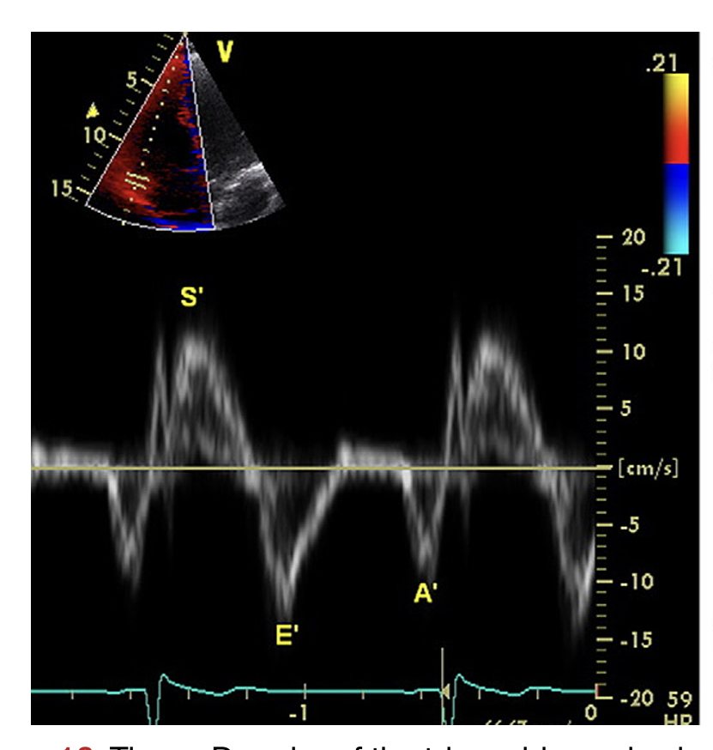
4. Tricuspid Annulus Systolic Velocity (S’)
Pulse wave DTI of the lateral tricuspid annulus
Apical 4C view with parallel alignment of Doppler beam with RV free wall longitudinal excursion
Systolic Velocity <9.5 cm/sec is abnormal

Slide 43
ADVANTAGES
DISADVANTAGES
easily measured, reliable and reproducible
correlates well with other measures of global RV systolic function
Validated against radionuclide EF
Established prognostic value
Angle dependency
Not fully representative of RV global function after thoracotomy, pulmonary thromboendarterectomy or heart transplantation

Slide 44
QUANTITATIVE EVALUATION
With clinical utility and value based on studies are
Right ventricular index of myocardial performance (RIMP)
Tricuspid annular plane systolic excursion (TAPSE)
2D fractional area change (FAC)
Tricuspid annulus systolic velocity (S’)
Need more data to demonstrate clinical utility
dP/dT
2D RV ejection fraction
3D RV ejection fraction
RV longitudinal strain and strain rate

Slide 45
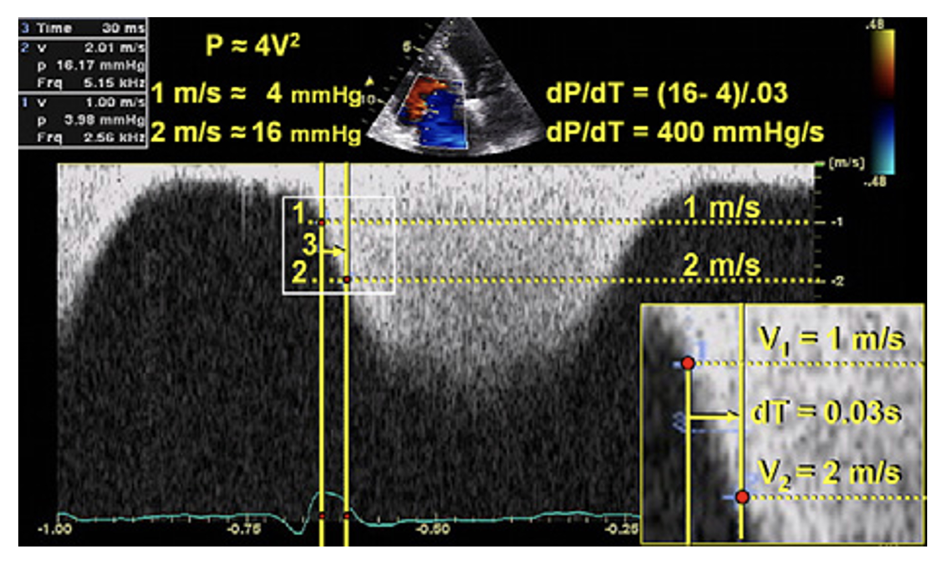
1. RV dP/dT
Ascending limb of the TR continuous- wave Doppler signal
Mark 1 and 2 m/sec (4 and 16 mmHg)
dP=12mmHg ; dT =time required for the TR jet to increase in velocity from 1 to 2 m/s.

Slide 46
ADVANTAGES
DISADVANTAGES
simple technique with sound physiologic basis
Recommendations:
RV dP/dt < 400 mm Hg/s is likely abnormal
cannot be recommended for routine use
can be considered in subjects with suspected RV dysfunction.
Lack of data in normal subjects
Load dependent

Slide 54
RV DIASTOLIC FUNCTION

Slide 55
MEASUREMENT
From the apical 4-chamber view, the Doppler beam should be aligned parallel to the RV inflow.
The sample volume should be placed at the tips of the tricuspid leaflets.
Care must be taken to measure at held end-expiration and/or take the average of ≥ 5 consecutive beats.
presence of moderate to severe TR or atrial fibrillation could confound diastolic parameters, and most studies excluded such patients.

Slide 57
CLINICAL RELEVANCE
A small number of studies have evaluated the clinical impact of RV diastolic dysfunction
An E/E` ratio ≥ 4 had high sensitivity and specificity for predicting RA pressure ≥ 10 mm Hg in non–cardiac surgery intensive care unit patients
E/E` ratio > 8 had good sensitivity and specificity for predicting RA pressure ≥ 10 mm Hg in cardiac transplantation patient

Slide 58
Grading of RV diastolic dysfunction
tricuspid E/A ratio < 0.8 suggests impaired relaxation
tricuspid E/A ratio of 0.8 to 2.1 with an E/E` ratio > 6 or diastolic flow predominance in the hepatic veins suggests pseudonormal filling
tricuspid E/A ratio > 2.1 with a deceleration time < 120 ms suggests restrictive filling
Further studies are warranted to validate the sensitivity and specificity and the prognostic implications of this classification

Slide 59
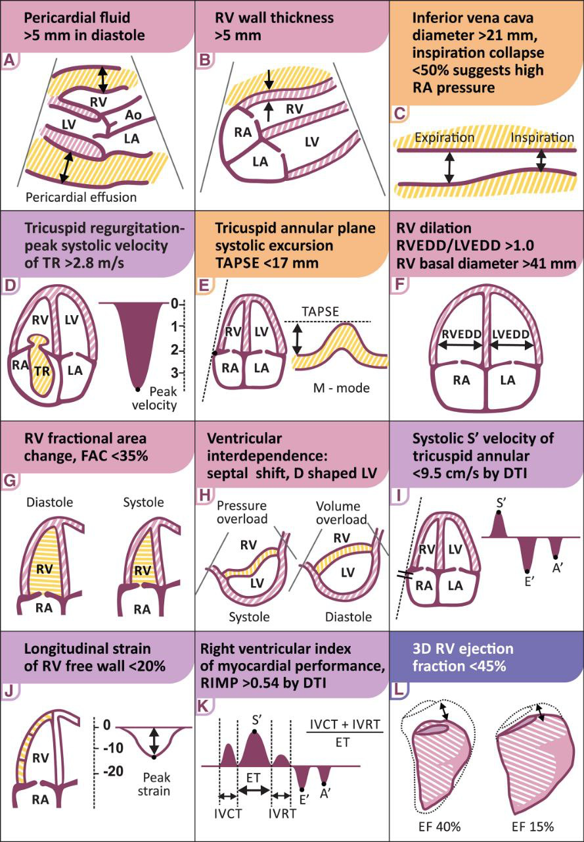

Slide 60
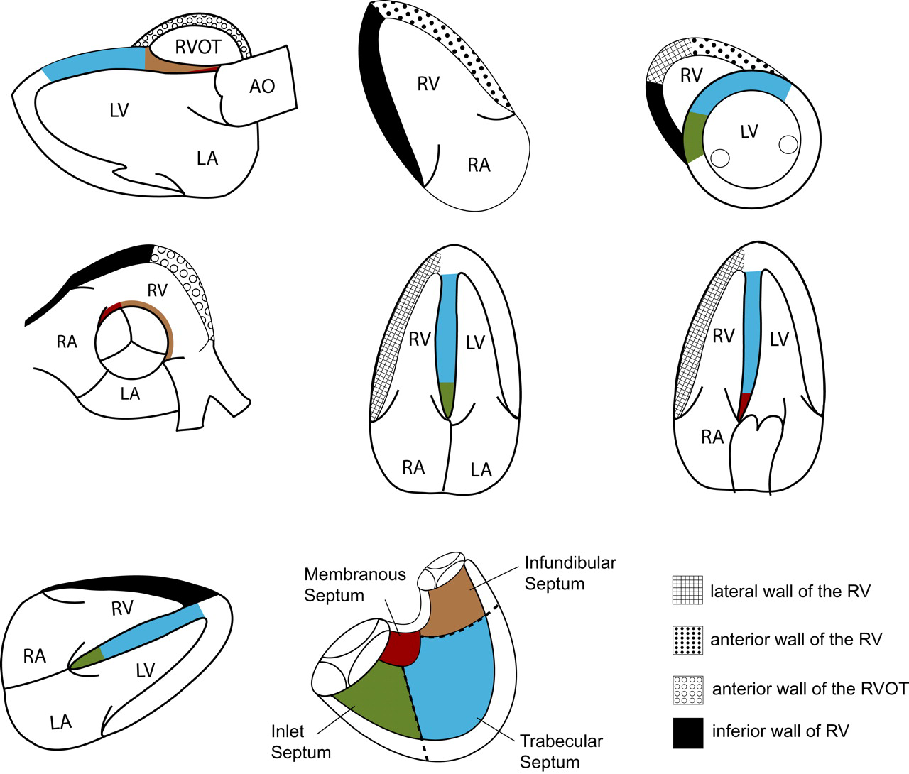
Q1.ALL ARE FALSE EXCEPT
A- ANTERIOR WALL
B- INFERIOR WALL
C-LATERAL WALL
NONE

Slide 61
Q2. Which is not a morphological criteria of RV
the more apical hinge line of the septal leaflet of the tricuspid valve relative to the anterior leaflet of the mitral valve
the presence of a moderator band
the presence of more than 3 papillary muscles
the trileaflet configuration of the tricuspid valve with absent septal papillary attachments
the presence of coarse trabeculations

Slide 62
Q3. Systemic ventricle is heavily trabeculated in
LVNC
CcTGA
D TGA
Both A and B

Slide 63
Q4. RIMP cut off is -
0.43
0.54
Both
None

