Slide 1
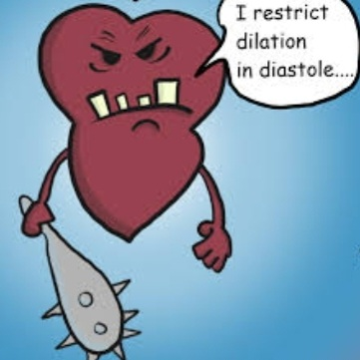
Restrictive cardiomyopathy
Dr Arun Jude Alphonse
DM Cardiology Resident
Govt TDMC Alappuzha

Slide 2
Outline :
Definition
Epidemiology
Classification
Genetics & Etiology of RCM
Clinical characteristics
Diagnostic evaluation
Restriction vs Constriction
Management
Previous questions

Slide 3
definition
Disease of heart muscle with restrictive physiology
Stiffened or non-compliant ventricle → severe diastolic dysfunction & ↑ ventricular filling pressures
Normal systolic function
Normal or ↑ wall thickness ( in infiltrative causes)
Normal or reduced ventricular cavity & biatrial enlargement

Slide 4
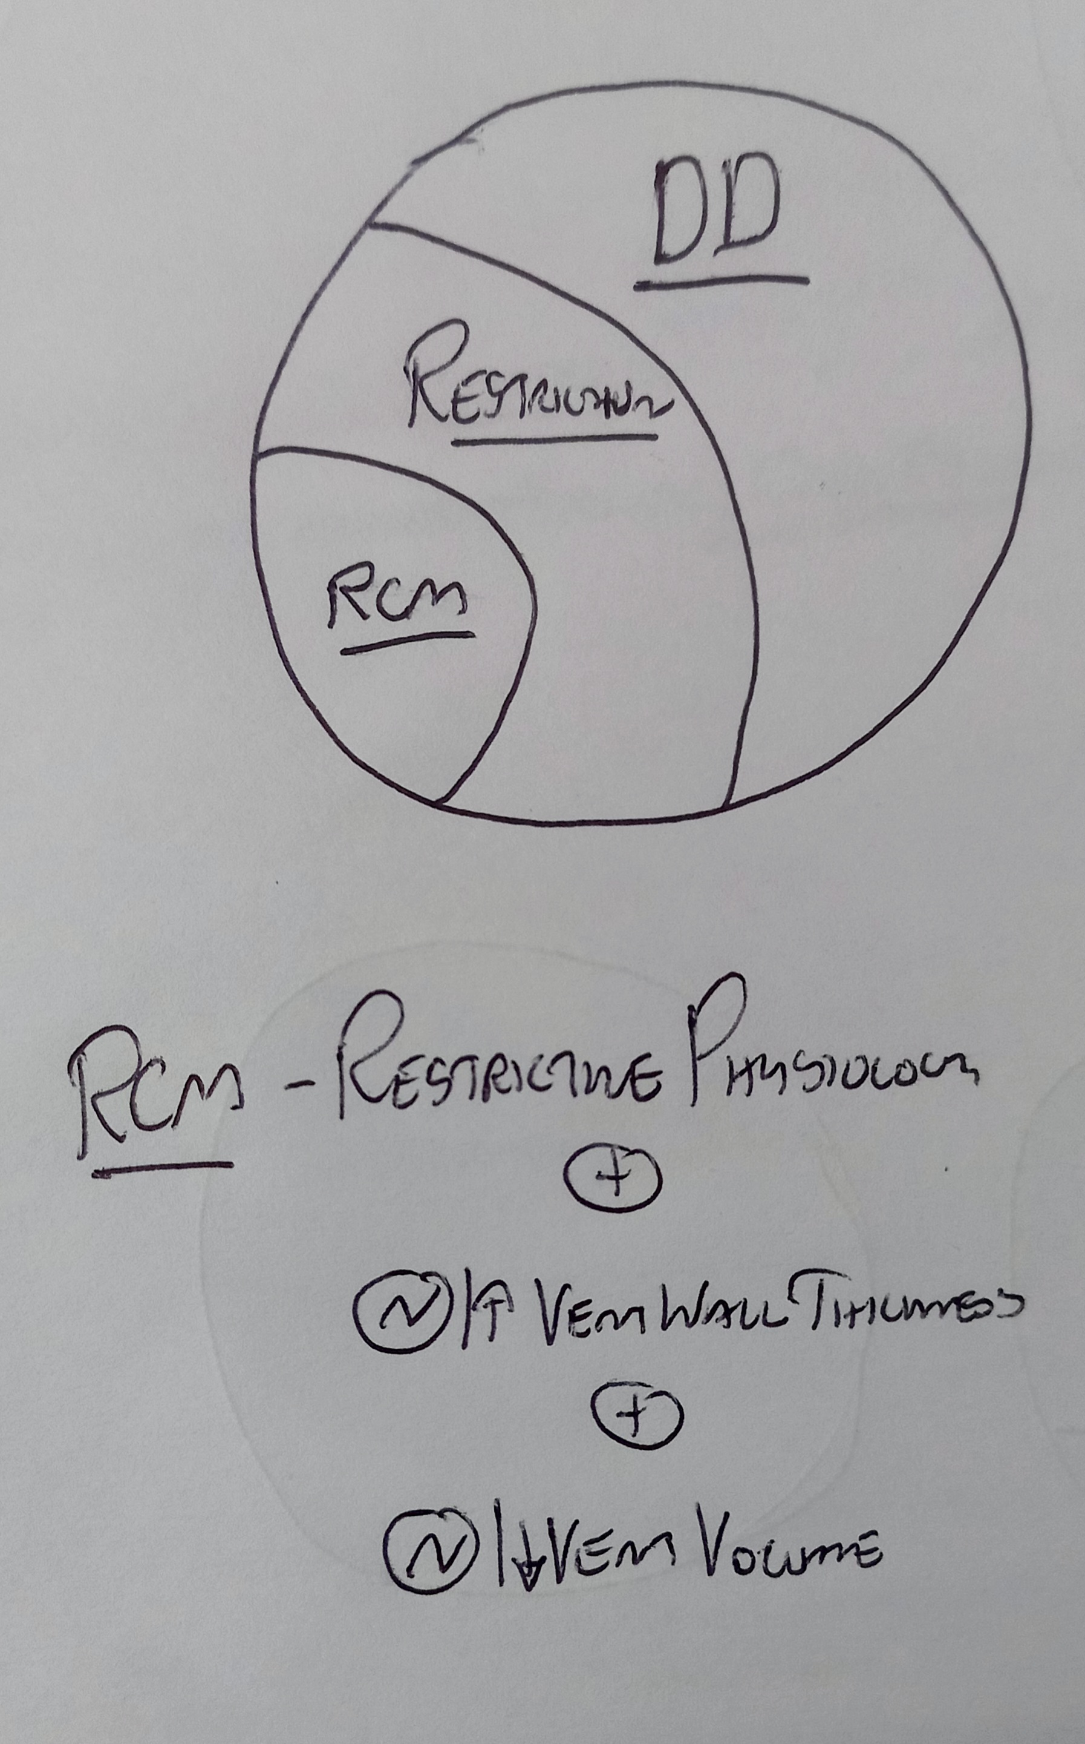

Slide 5
Epidemiology
Least common form of cardiomyopathy
5% in adults & 2.5 to 5 % in children – of all CMP’S
Prevalance depends on regional distribution
Endomyocardial fibrosis (m.c in world & tropical / subtropical countries)
Amyloidosis (m.c in united states)
More female preponderance

Slide 6
Classification
Based on etiology – primary & secondary
Primary include idiopathic, familial & endomyocardial fibrosis
Secondary forms include infiltrative diseases, storage disorders, metastatic & iatrogenic causes

Slide 7
Notes:
Toxic effects of anthracycline; Drugs causing rcm serotonin, methysergide, ergotamine, mercurial agents, busulfan

Slide 8
Genetics of rcm
Gene Mutations associated with RCM phenotype include Sarcomeric & Non-sarcomeric protein defects
Modes of inheritance: AD, AR, X-linked & denovo ( rare)
Many families have common gene defect but different phenotypic expression ( eg: TNNI3 – Troponin I mutation – express RCM and HCM phenotype)

Slide 9
Mutations reported in association with rcm
Notes:
Troponin t (TNNT2); ACTC ;

Slide 10
Etiologies :
Idiopathic RCM
Seen from infancy to adulthood
Poor prognosis especially in children
Genetically determined or familial in most cases
Atrial fibrillation is common

Slide 11
Cardiac amyloidosis:
Infiltrative cardiomyopathy
MC types associated with cardiac amyloidosis – AL; ATTRw; ATTRm and Localised atrial amyloidosis
Clinical pattern, prognosis & management depend on type

Slide 12
AL Amyloidosis
Clonal cells of lymphocytes-light chains-aggregate-amyloid fibrils-deposited
50% have cardiac involvement of which 75% are significant-m/c Biventricular failure(r>l)
Rapidly progessive heart failure along with systemic disease (survival time ≤ 9 m)
Nephrotic syndrome , peripheral,autonomic neuropathy,hepatomegaly,macroglossia

Slide 13
Familial amyloidosis (ATTRm) –autosomal dominant
Involve both heart and peripheral nervous system
Young pts – predominant peripheral nervous system
Middle age pts –predominant cardiomyopathy

Slide 14
Senile systemic amyloidosis( ATTRw)
Almost always involve the heart..m/c cause of cardiac amyloidosis
Mostly seen in elderly (>70 yrs)
Male to Female ratio is almost 20:1..Elderly men
Biventricular failure..only extra cardiac-Capal tunnel syndrome
Isolated atrial amyloidosis(IAA) involve cardiac atria of diseased hearts

Slide 17
Sarcoidosis:
Predominant & MC phenotype is DCM ; but RCM is frequently described
Women > Men
Most pts have evidence of non-cardiac disease(m/c-pulmonary sarcoidosis)
Vent Myocardium>Atrial..(Basal/mid septal..patchy involvement)
Isolated cardiac disease is rare and presents AV block & ventricular arrhythmias

Slide 18
Storage disorders
Fabry’s disease :
Lysosomal storage disorder; X linked recessive
Deficiency of alpha-galactosidase A enzyme
Manifests with acroparesthesias, angiokeratomas, TIA/ Stroke due small vessel disease
Cardiac involvement apparent in 3rd to 4th decade
Manifests as LV hypertrophy , worsens with age

Slide 19
Hemochromatosis : primary & secondary forms
Multiple organ involvement is seen
Cardiac involvement begin with restrictive non-dilated progressing to systolic dysfunction
and eventually develop DCM
Associated with arrhythmias and conduction system disease

Slide 20
ENDOMYOCARDIAL FIBROSIS (EMF)
MC cause of RCM worldwide (more in Africa , south asia)
Males > females; Bimodal age distribution
Characterized by fibrosis of the RV and LV apices and subvalvular apparatus
No unifying cause is found
Pathology resemble similar to eosinophilic cardiomyopathy

Slide 21
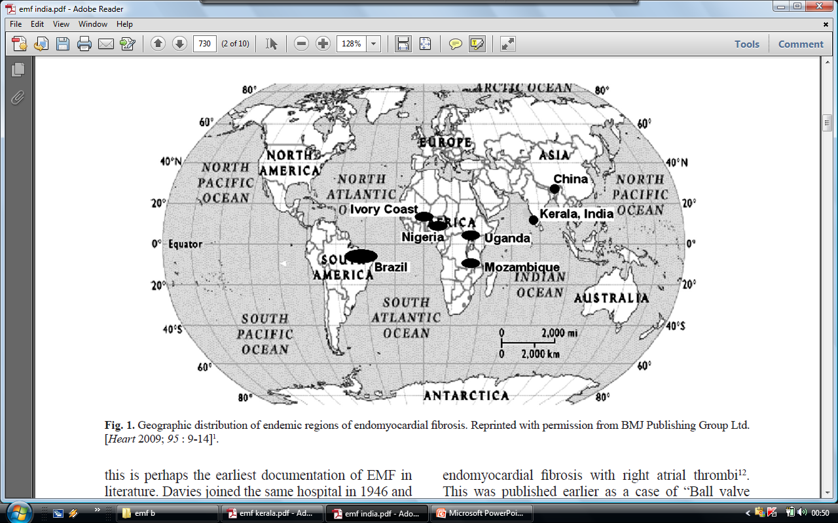
Notes:
Uganda, Nigeria, and Mozambique. The disease is increasingly recognized in other tropical and subtropical regions within 15 degrees of the equator, including India, Brazil, Colombia, and Sri Lanka.^{[52]} Importantly, it is also recognized in the Middle East, particularly Saudi Arabia

Slide 22
In India its prevalence is highest in Kerala with very few cases reported from northern India
Kerala was once ‘the hot spot’ for this enigmatic disease
The epidemiology of endomyocardial disease, is a ‘vanishing mystery’ in the southern districts of India especially in the coastal belt of Kerala state
Notes:
CK Gopi, in 1962, from Trivandrum, described the specimen kept in the hospital autopsied in 1950s as a case of right ventricular endomyocardial fibrosis with right atrial thrombi1

Slide 23
PATHOPHYSIOLOGY
Cause of the underlying fibrotic process of EMF is largely unknown
Major hypotheses
  Eosinophilia
  Infectious
  Environmental exposure
  Malnutrition
  Immunologic
  Genetic
  Toxic agents
Notes:
Malnutrition Protein deficiency [79]
Magnesium deficiency [23]
Toxic agents Cerium [23]
Cassava [79,91]
Thorium [

Slide 24
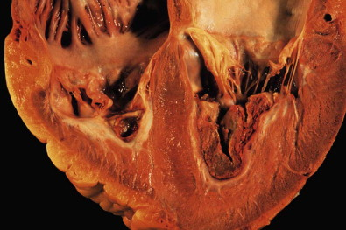
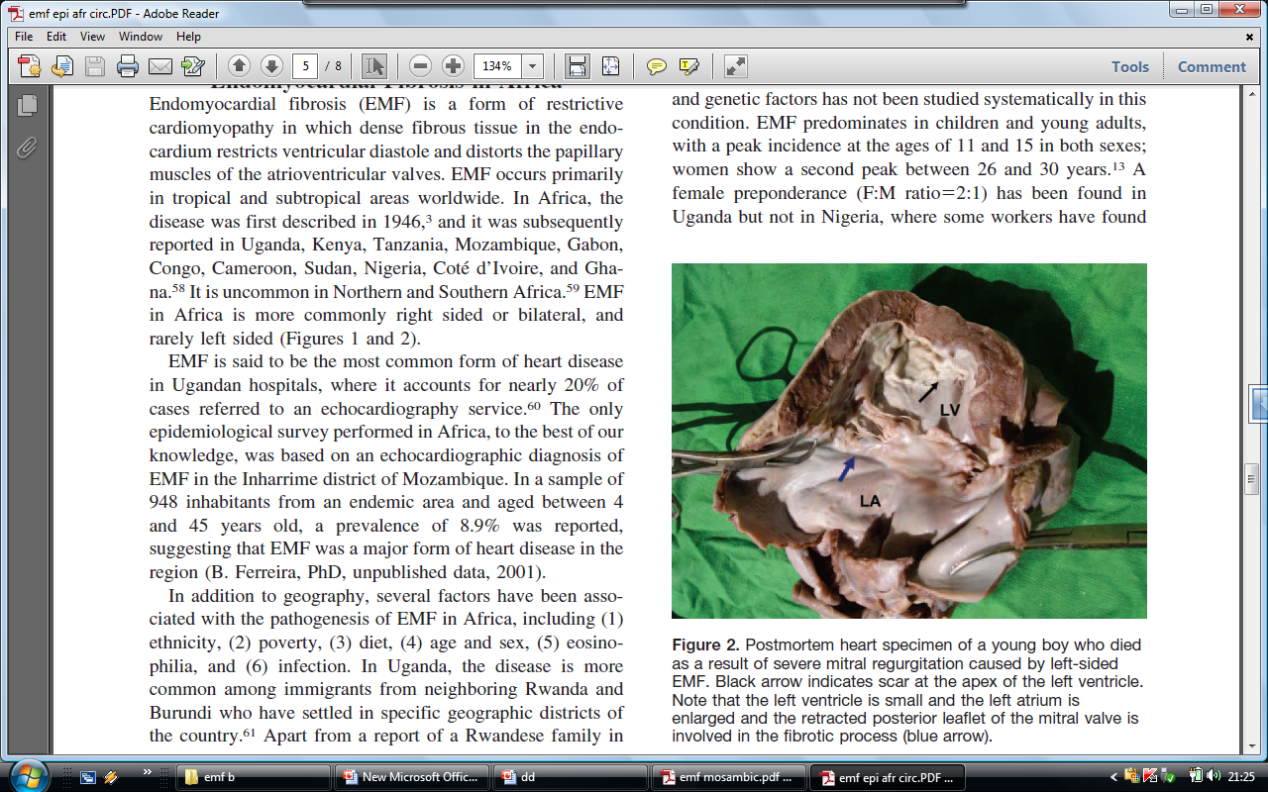
PATHOLOGY
Fibrosis of the right and/or left apical endocardial surfaces which leads to restrictive physiology
Tethering of the AV valve papillary muscles leads to significant AV valve regurgitation
Atrium of the affected ventricle is often dramatically enlarged
No primary involvement
of extra-cardiac organs
In LVEMF fibrosis extends from
apex to PML usually sparing AML
Notes:
Postmortem heart specimen of a young boy who died
as a result of severe mitral regurgitation caused by left-sided
EMF. Black arrow indicates scar at the apex of the left ventricle.
Note that the left ventricle is small and the left atrium is
enlarged and the retracted posterior leaflet of the mitral valve is
involved in the fibrotic process (blue arrow).

Slide 25
Ventricular chamber affected..
Africa – LV – 40%
RV – 10 %
Bi V – 50 %
India - South ( vijayaraghavan etal ) –
RV – 60 %
LV – 20 %
BiV – 20 %
- North (wahi etal ) –
RV – 20 %
LV – 40 %
Bi V – 40 %
Notes:
25

Slide 26
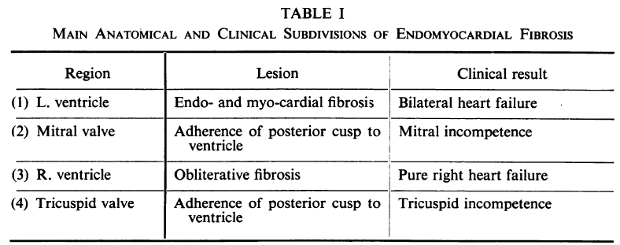

Slide 27
Loffler (Eosinophilic) endocarditis
Occurs within spectrum of hypereosinophilic syndromes
Hypereosinophilia defined as chronic AEC > 1500 cell/ml for at least 1 month
Cardiac involvement categorized into acute, intermediate and fibrotic stages
Causes -helmimthic and parasitic infections, malignancy, leukemia, allergy and drug reactions
Notes:
Causes are helmimthic and parasitic infections, malignancy, leukemia, allergy and drug reactions

Slide 28
Acute phase : few or no signs/ symptoms; myocardial inflammation & necrosis
ECHO will be normal; Only CMR with contrast can detect disease along with ↑ cardiac biomarkers

Slide 29
Intermediate stage : thrombus favouring endocardium at apices; mitral / tricuspid regurgitation & heart failure
Thromboembolism to brain & other organs is common
Fibrotic stage : diffuse scarring → endomyocardial fibrosis & RCM
Scarring also involve mitral/ tricuspid sub-valvular & leaflet structures → regurgitation

Slide 30
Carcinoid heart disease
Part of carcinoid syndrome – metastatic neuroendocrine tumor
Hepatic mets release elevated vasoactive substances especially 5-HT
Involve Rt heart predominantly (Lung destroys and filters seratonin)
If PFO/R-L shunt- Lt heart may be involved

Slide 31
Myofibroblast proliferation & collagen deposition →right sided valve thickening and retraction
High levels of 5-HT in Rt heart causes progressive fibrotic endocardial plaque
Organic,low pressure TR

Slide 32
Notes:
Tricuspid valve in carcinoid heart disease. Left panel, Transesophageal echocardiogram showing thickened tricuspid valve (TV) leaflets and endocardial
thickening as a result of carcinoid plaque (dashed arrow). Right panel, Surgical specimen of the TV showing thickened, retracted papillary muscle as a result of carcinoid
plaque and thickened chordae (dashed arrow)

Slide 33
Pathophysiology :
↑Ventricular stiffness & compliance→ impaired relaxation & restrictive filling → marked pressure increase with small vol. rise → diastolic dysfunction
Rapid rise in ventricular filling pressures during exercise → limited stroke vol. → syncope/ angina / DOE

Slide 34
Atrial enlargement → development of atrial arrhythmias & secondary AV valve regurgitation
Thromboembolic complications seen with or without AF

Slide 35
Clinical features:
Symptoms of heart failure – DOE, exercise intolerance, fatigue, syncope and angina (rare)
Physical findings: predominant right heart failure features –
Raised JVP with prominent X and Y descent (Kussmauls sign)
Irregular pulse- atrial fibrillation

Slide 36
Apex beat – usually palpable, may be mildly displaced
Heart sounds- S1, S2 normal, S4 gallop frequently heard except in amyloidosis
Murmurs- usually not heard, MR & TR seen in some
Hepatomegaly, ascites and marked pedal edema

Slide 37
Diagnostic evaluation
ECG :
Right and left atrial enlargement (MC); Non-specific ST-T changes; conduction abnormalities
Atrial fibrillation is common;
Low voltage limb leads with Pseudo-infarction pattern in inferior & septal leads seen in cardiac amyloidosis

Slide 38
Approximately 15% of pediatric population had arrhythmias & conduction disturbances
Atrial flutter was MC reported followed by high degree second and third degree heart block
Longer PR interval and longer QRS duration were associated with acute cardiac events

Slide 39
echocardiography
Intial step in the diagnosis
2D ECHO:Typical features in RCM incudes :
Normal RV and LV EF;
Normal RV and LV chamber volumes & wall thickness ;
(exception → wall thickness increased in infiltrative conditions)
Biatrial enlargement
Notes:
Increased early diast. Filling velocity E & decreased atrial filling velocity A

Slide 40
Doppler ECHO findings (s/o restrictive filling parameters) are as follows:
Increased E/A ratio > 1.5
Decreased mitral deceleration time (DT < 120ms)
Decreased IVRT (isovolumetric relaxation time)
Decreased PVs/PVd ratio (pulmonary venous flow velocities)
Augmented atrial reversal velocity (PVAr)

Slide 41
Doppler tissue imaging (DTI):
Reduced mitral anular velocities (e’)
Increased E/e’ ratio
Hepatic vein doppler:
Increased diastolic forward flow reversal with inspiration

Slide 42
Echocardiographic Findings in Restrictive Cardiomyopathy
Notes:
(Upper left panel) Pulsed-wave Doppler of the mitral inflow, which demonstrates a restrictive pattern, with early diastolic mitral inflow
Doppler velocity (E) greater than late velocity (A) and short deceleration time. (Upper right panel) Hepatic vein pulsed-wave Doppler
showing increased inspiratory forward velocities (arrow), inspiratory diastolic flow reversals (arrowhead), and minimal expiratory diastolic
flow reversals (rounded arrow). (Lower left panel) Lateral mitral annulus tissue Doppler demonstrating markedly reduced early diastolic
velocity (eʹ). (Lower right panel) Apical 4-chamber 2-dimensional echocardiogram revealing marked biatrial enlargement

Slide 43
Disease specific ECHO findings:
Amyloidosis : ↑ RV and LV wall thickness
very fine granular or scintillating echobright appearance of myocardium with preserved LVEF
Diffuse thickened AV valves with severe biatrial enlargement (owl eye appearance)
Doppler tissue imaging- severly impaired longitudinal LV systolic function with normal EF
Speckle tracking – regional longitudinal dysfunction with apical sparing

Slide 44
Notes:
Echocardiogram in a patient with AL amyloidosis. Parasternal (left) and apical four-chamber (right) views in the
same patient as in A are shown. Concentric wall thickening and biatrial enlargement with a pericardial effusion are evident

Slide 45
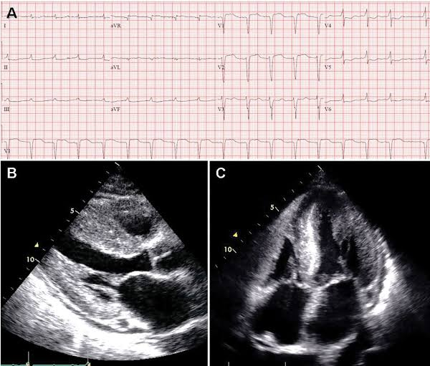

Slide 46
This appearance represents a gradient of longitudinal strain from the apex to the base with relatively well-preserved apical strain and severely impaired basal strain.

Slide 47
Echocardiogram demonstrating biventricular myocardial thickening and biatrial enlargement.
(B) Strain imaging with markedly reduced global averaged
peak longitudinal systolic strain with apical preservation (‘bullseye”) pattern, typical of cardiac amyloidosis.
(C) Cardiac magnetic resonance with
global subendocardial LGE
(D) PYP scan shows severely increased myocardial uptake (grade 3, greater than bone) consistent with ATTR cardiac
amyloidosis

Slide 48
Haemochromatosis:
LA, LV dilatataion
Normal LV wall thickness
Global hypokinesia
Initially restrictive pattern progressing to systolic dysfunction

Slide 49
Fabrys disease:
Concentric LVH
Mitral leaflet thickening with significant MR

Slide 50
Endomyocardial fibrosis:
Hallmark feature- formation of diffuse thrombi along the endocardium in apices
Thrombus obliterating the ventricular cavity
Retraction of AV valves → incompetence

Slide 51
4 chamber view with thrombosis/fibrosis obliterating the right ventricular apex in EMF
4 chamber view with severe mitral regurgitation due to deformed valve

Slide 52
Cardiac MRI
Important diagnostic tool for assessment of pericardial and myocardial disease
Typical features of RCM on CMR- normal volume ventricles with marked atrial enlargement

Slide 53
Disease specific CMR features
Cardiac amyloidosis:
Diffuse circumferential subendocardial LGE
Shows restrictive morphology with reduction of systolic thickening in LGE segments
Absent myocardial edema with diffuse perfusion defects seen
Thickened atrial valves with atrial LGE
Loss of atrial contraction (absent S4 clinically)

Slide 54
Endomyocardial fibrosis:
Dilated hypocontractile LV and RV
Absence of myocardial edema
Normal myocardial perfusion
Diffuse subendocardial LGE of LV/RV with/without thrombus
Obliterative LV or RV apex

Slide 55
Cardiac sarcoidosis:
Multifocal intense LGE often in septum inferolateral valve of LV, right atrium and RV free wall
RWMA with hypocontractile LV/RV
Patchy bright regions s/o myocardial edema
Normal myocardial perfusion

Slide 56
Haemochromatosis:
Hypocontractile LV with dark myocardium
Absence of myocardial edema
Normal myocardial perfusion
Normal LGE mapping

Slide 57
Fabrys disease:
Concentric LVH
RWMA with wall thinning
Absence of myocardial edema
Normal myocardial perfusion
Midwall LGE in inferolateral wall

Slide 58
Cardiac catheterization
Elevation of right and left filling pressures with reduction in cardiac index
RAP is elevated with prominent X and Y descents
Square root sign (early decrease followed by rapid rise to plateau phase in ventricular diastolic pressure)
LVEDP ≥ 5mm Hg than RVEDP : RVSP > 50mm Hg
Concordance of intracavitary and intrathoracic pressures

Slide 59
HEMODYNAMICS OF CONSTRICTION.
Primary hemodynamic consequence of constriction is limitation of the total volume of blood that can be accommodated by the heart during diastole across the respiratory cycle, with equalization of right- and left sided cardiac filling pressures
Accentuated early rapid ventricular filling occurs due to high atrial driving pressures and unimpeded ventricular relaxation, followed by a sudden rapid rise in pressure from pericardial restraint
→ rapid “y” descent on the atrial pressure waveform and “square root” sign on ventricular pressures.

Slide 60
Reduced pericardial compliance limits myocardial stretch during diastole
Although diastolic pressures are high, there is a paradoxically low stroke volume from low preload
Preserved atrial relaxation, as well as an exaggerated ventricular longitudinal contraction, result in an exaggerated “x” descent on atrial pressure tracings

Slide 61
With inspiration, there is a reduction in intrathoracic pressures not fully transmitted to the cardiac chambers
Because the pulmonary veins are Intrathoracic, inspiratory reduction in pulmonary capillary and venous pressures reduces the flow between the pulmonary veins and left-sided cardiac chambers

Slide 62
In the setting of a noncompliant pericardium with a relatively fixed intrapericardial volume, reduced LV filling allows increased RV filling
Accompanied by inspiratory interventricular septal motion towards the LV

Slide 63
Increased inferior vena cava flow during inspiration, augmented by increased trans diaphragmatic pressure, competes with flow from the superior vena cava into the high-pressure RA
The resultant increase in jugular venous pressure with inspiration is termed Kussmaul’s sign
The converse is seen in expiration

Slide 64
Increased ventricular interdependence directly translates to an alteration in ventricular systolic pressures
Although these pressures rise and fall in parallel with respiration in normal physiology, systolic pressures become discordant in CP, a marker that is both sensitive and specific
Loss of pericardial compliance amplifies the effect of adjacent cardiac chambers, with resultant equalization of intracardiac diastolic pressures

Slide 65
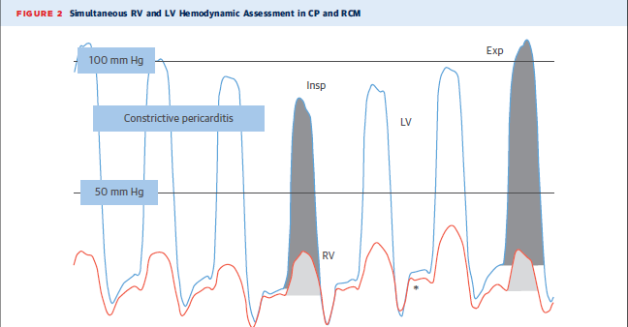

Slide 66
HEMODYNAMICS OF RESTRICTION
Unlike the complex interplay of pulmonary and systemic pressures associated with CP, RCM is the result of abnormalities intrinsic to the myocardium, which are unchanged during respiration

Slide 67
As with CP, there is early rapid filling of the ventricles in early diastole, due to high atrial pressures, followed by limitation in filling from the stiff myocardium
This results in a prominent “y” descent on the atrial pressure curves, as well as the “square root” sign on ventricular pressure curves

Slide 68
The stiff, noncompliant ventricles are unable to easily accept additional increments in volume during atrial contraction, and thus the contribution from atrial contraction is often minimal
Unlike CP, the “x” descent is frequently blunted, given poor atrial relaxation and a limited descent of the annulus towards the apex

Slide 69
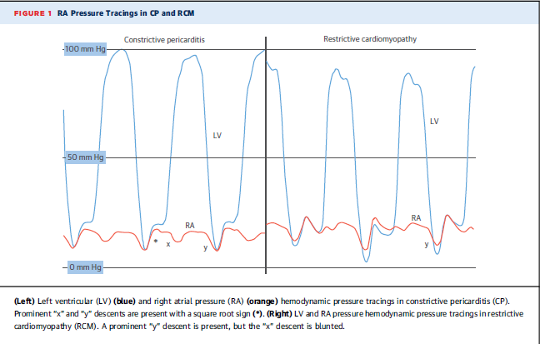

Slide 70
Unlike CP, there is no discordance of intracavitary and intrathoracic pressures

Slide 71
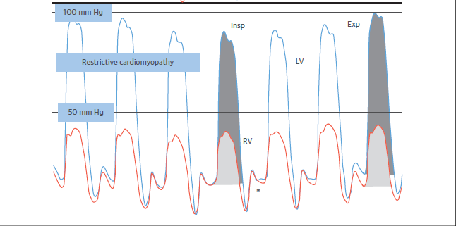

Slide 72
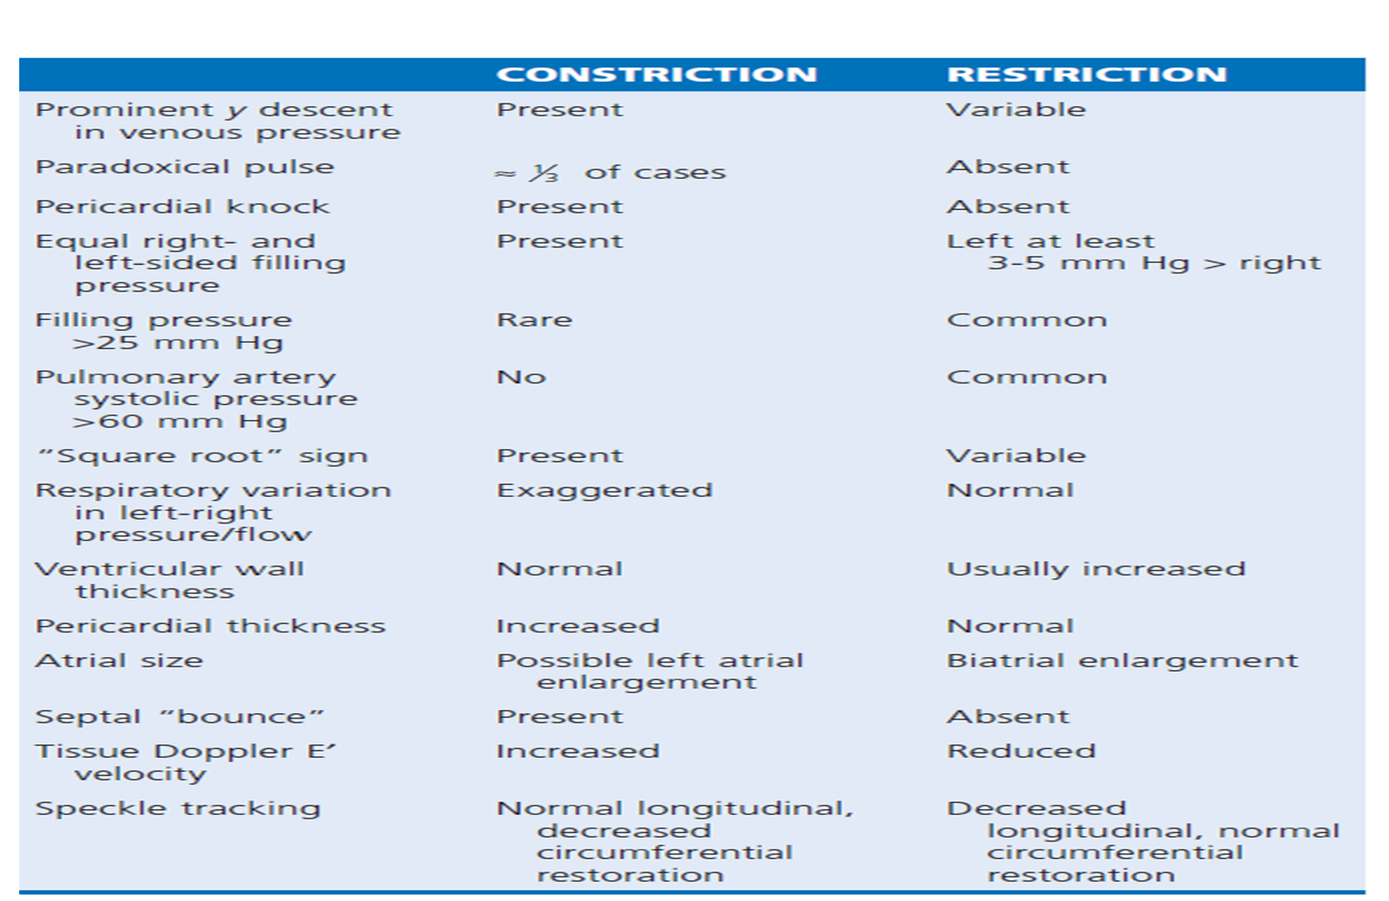

Slide 73
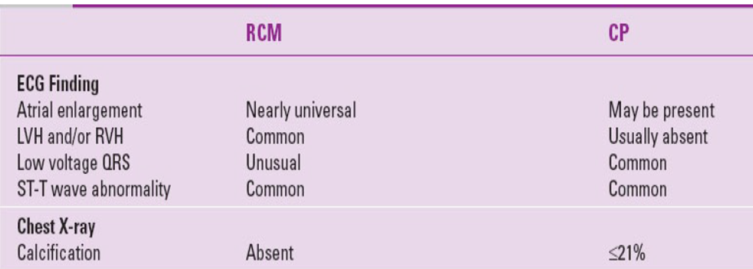
Restrictive cardiomyopathy VS constrictive pericarditis

Slide 74
Endomyocardial biopsy
Important role in the diagnostic evaluation of diseases with restrictive physiology
Class II a recommendation by AHA/ ACC
RV biopsy is most commonly done
Useful in identifying the exact etiology of RCM for targeted therapy

Slide 75
Management
General Treatment Principles:
Relieve congestive symptoms and avoid hypotension
Diuretics
Salt restriction (2-4 gms/day), fluid restriction to less than 2 litres
Rx of AF with rhythm control rather than rate control improves diastolic filling
No pharmacological treatment prolongs survival

Slide 76
Disease specific treatment
Cardiac amyloidosis:
AL amyloidosis- chemotherapy, autologous stem cell transplantation and monoclonal antibodies (daratumumab) targeted against plasma cell dyscrasias
Beta blockers, ACEI/ ARBs poorly tolerated
CCBs contraindicated (worsens heart failure)
High degree AV block may require permanent pacemaker- biventricular pacing preferred

Slide 77
Familial amyloidosis (ATTRm):
Liver/ heart-liver transplantation and tafamidis (TTR stabilizer)
Senile systemic amyloidosis (ATTRw):
Gerneral treatment principles + tafamidis

Slide 78
Cardiac sarcoidosis:
In patients with heart failure Prednisolone 1mg/kg tapered over several months is recommended
High degree AV block require ICD- pacemaker implantation
Heart transplantation in treatment refractory pts

Slide 79
Fabry’s disease : enzyme replacement will reverse phenotype
Hemochromatosis : iron chelation therapy ; frequent phlebotomies
Carcinoid heart disease: hepatic mets debulking ; use of octreotide – tumor shrinkage; advanced valve disease is surgically corrected
Hypereosinophilic syndromes: early stage-steroids are useful;
advanced valve disease – surgically corrected

Slide 80
Previous questions
July 19- Haemodynamic and clinical differences of constrictive pericarditis vs restrictive cardiomyopathy

Slide 81

Thank you

