Slide 1
STATIN ASSOCIATED MUSCLE SYMPTOMS
Dr.Anjos

Slide 2
SAMS(Statin Associated Muscle Symptoms)
SAMS are by far the most prevalent with up to 72% of all statin adverse events being muscle related.
The prevalence of statin intolerance is also widely debated.
Observational studies suggest it occurs in 10% to 15%
In randomized controlled trials, the incidence is thought to be 1.5% to 5% of patients, although this is believed to be an underestimation as most studies exclude patients with a history of statin intolerance.

Slide 3
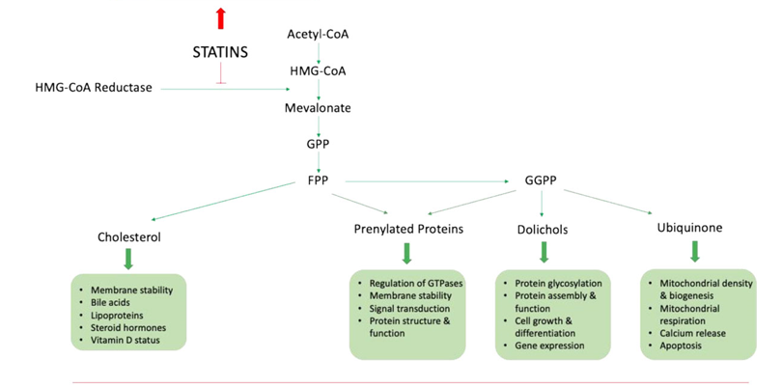
Pathogenesis

Slide 4
Pathogenesis
Mechanism not well understood
Genetic association
Variation in CytochromeP450-CYP3A4,3A5,2D6
SCLCO1B1 gene-gene product needed for hepatic uptake of statin
Loss of function mutation-high plasma level of statin.
Statin associated autonomic myopathy-HLA based
Autoantibodies recognize HMG CoA reductase

Slide 5
Pathogenesis
Ubiquinone(Co Q)-individual statin has distinct effect on synthesis of CoQ( important in muscle cell energy production)
Reduction of Ubiquinone in muscle cell-statin induced muscle injury.
Statin-intolerant patients demonstrate increased fatty acid oxidation (FAO) in response to lovastatin--intrinsic FAO abnormality
. Statins increase the expression of mitochondrial carnitine acylcarnitine translocase-alteration in FAO .

Slide 6
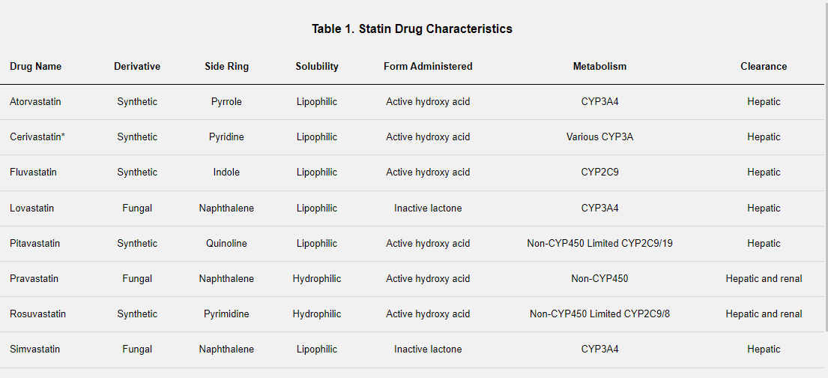

Slide 7
DEFINITIONS
2014 National Lipid Association Statin Muscle Safety Task Force
●Myalgia –
A symptom of muscle-discomfort, including muscle aches, soreness, stiffness, tenderness, or cramps with or soon after exercise, with a normal creatine kinase (CK) level.
Myalgia symptoms can be described as similar to what would be experienced with a viral syndrome such as influenza.
●Myopathy –
Muscle weakness (not due to pain), with or without an elevation in CK level.
●Myositis – Muscle inflammation.

Slide 8
DEFINITIONS
Myonecrosis
Elevation in muscle enzymes compared with either baseline CK levels (while not on statin therapy) or the upper limit of normal that has been adjusted for age, race, and sex:
•Mild – Three- to 10-fold elevation in CK
•Moderate – 10- to 50-fold elevation in CK
•Severe – 50-fold or greater elevation in CK
Clinical rhabdomyolysis –
myonecrosis with myoglobinuria or acute renal failure (an increase in serum creatinine of at least 0.5 mg/dL [44 micromol/L]).

Slide 9
RISK FACTORS
Statin characteristics
lowest with fluvastatin, pravastatin, and pitavastatin
not metabolized by cytochrome P450 3A4 (CYP3A4) and are thus less likely to be involved with drug interactions .
increased when taking statins extensively metabolized by CYP3A4 such as lovastatin, simvastatin, and atorvastatin.
The risk of muscle injury is greater at higher doses.
Simvasatin-
the incidence of myositis in clinical trials was 0.02 percent at 20 mg/day, 0.07 percent at 40 mg/day, and 0.3 percent at 80 mg/day

Slide 10
The safety of pravastatin (40 mg/day) was confirmed in an analysis of more than 112,000 patient-years of experience in three large trials.
The incidence of serum creatine kinase (CK) elevations was not different from placebo, and there were no cases of confirmed clinical myositis or rhabdomyolysis.
In an observational study of over 7000 patients on high-dose statin therapy, fluvastatin had the lowest rate of muscle symptoms among the statins .
. Pitavastatin is not catabolized by CYP3A4 and also has a low risk of muscle injury

Slide 11
The safety of rosuvastatin was demonstrated in a trial in 17,802 apparently healthy adults, in which rates of muscle toxicity with rosuvastatin 20 mg/day were similar to placebo
But, there have been reports of rhabdomyolysis with rosuvastatin, particularly in myopathy-prone patients treated with doses higher than those recommended by the
(FDA) product labeling, and product labeling in Europe highlights this risk, particularly at the highest dose of 40 mg/day

Slide 12
RISK FACTORS
Preexisting neuromuscular disorders
Increased risk of toxicity in patients with known underlying neuromuscular disorders or the development of clinically apparent disease in patients who had likely had preclinical disease before statins were initiated.
deleterious effects in patients with amyotrophic lateral sclerosis (ALS) .
it is considered reasonable to withdraw statins and other hypolipidemics in patients who develop ALS.

Slide 13
Hypothyroidism, hypovitaminosis D, and other disorders
susceptibility to statin-associated myopathy occurs in patients with hypothyroidism, acute or chronic renal failure, and obstructive liver disease.
Patient characteristic
Common variants of the SLCO1B1 gene, which encodes the (OATP1B1) that mediates hepatic uptake of most statins, substantially increased or decreased the risk of myopathy in patients treated with simvastatin.

Slide 14
RISK FACTORS
Other patient factors associated with an increased risk of statin-associated adverse muscle events include advanced age (greater than 80 years), frailty, female sex, small body frame, acute or decompensated liver disease, and severe renal disease.

Slide 15
RISK FACTORS
Concurrent drug therapy
concurrent use of a drug or drug class that is independently considered a risk factor for myopathy.
(glucocorticoids, cyclosporine, daptomycin, zidovudine, and colchicine)
Simvastatin, lovastatin, and to a lesser extent atorvastatin are metabolized by CYP3A4
Fluvastatin clearance is partly dependent upon CYP2C9
rosuvastatin, pitavastatin, and pravastatin are cleared primarily by non-CYP450 transformations-affected by fewer significant interactions

Slide 16
CYP3A4 drugs
Drugs and substances that inhibit CYP3A4
Cyclosporine , macrolide antibiotics , systemic-azole antifungals HIV/hepatitis C virus (HCV) protease inhibitors.
Calcium channel blockers
Diltiazem and verapamil are moderate inhibitors of CYP3A4 metabolism.
Simvastatin dose of 20 to 80 mg/day, there is a 0.6 percent incidence of myopathy in patients also treated with verapamil.
Risk is also increased when simvastatin is taken with amlodipine, which is metabolized by CYP3A4

Slide 17
Concurrent drug therapy
HIV and HCV protease inhibitors
HIV protease inhibitors and pharmacologic boosters (eg, ritonavir, cobicistat) and some HCV protease inhibitors (eg, simeprevir,) are potent inhibitors of CYP3A4.
Statins that are not highly dependent upon CYP3A4 for clearance (eg, pravastatin, pitavastatin) have been usual choices for patients receiving protease inhibitors who require statin treatment.
When using statins that are metabolized by CYP3A4, low doses of atorvastatin and rosuvastatin are recommended.
Simvastatin and lovastatin are contraindicated statins for patients treated with HIV protease inhibitors and cobicistat-containing coformulations

Slide 18
Concurrent drug therapy
Amiodarone – Amiodarone and its metabolites can moderately inhibit CYP3A4 metabolism.
The risk of rhabdomyolysis in patients treated concurrently with amiodarone appears to be higher with simvastatin than with other statins
Fibrates –
Fibrates are independently associated with muscle toxicity. An increased risk of muscle toxicity, as high as 1 to 5 percent, has been described with the administration of some statins (eg, lovastatin, simvastatin, and atorvastatin) with gemfibrozil

Slide 19
RISK FACTORS
Colchicine – Myopathy is an infrequent adverse effect of colchicine treatment and several cases have been reported following its coadministration with a statin, particularly in the setting of renal insufficiency

Slide 20
RISK FACTORS
Exercise —
Although exercise may be a trigger for SAMS and increases in CK levels, patients who are taking statins need not eliminate exercise.
Unaccustomed vigorous exercise in those on statins may increase the risk for muscle injury.
Therefore, a graduated training program affords time for metabolic adaptation that can mitigate this risk

Slide 21
CLINICAL FEATURES
Cramping ,stiffness and tendon pain.
Proximal, symmetric muscle weakness and/or soreness
Raising the arms above the head, arising from a seated position, or climbing stairs; these symptoms are often described as fatigue or tiredness by the patient
The onset of muscle symptoms is usually within weeks to months after the initiation of statin therapy but may occur at any time during treatment.
Mean duration of therapy before symptom onset of 6.3 months (range 0.25 to 48.0 months)
Approximately two-thirds of patients had onset of symptoms within six months of starting therapy

Slide 22
CLINICAL FEATURES
Myalgias and weakness usually resolve and serum CK concentrations return to normal over days to weeks after discontinuation of the drug.
The mean time to resolution of symptoms in 43 patients who discontinued statin therapy was 2.3 months
58 percent had resolution of symptoms within one month, and 93 percent had resolution within six months

Slide 23
Immune-mediated necrotizing myopathy (IMNM)
Suspected when statin-associated muscle symptoms (SAMS) fail to resolve several weeks after statin discontinuation
SAMS worsens after statins are discontinued.
Patients typically have mild to moderate symmetric proximal muscle weakness.
  Rarely Mild joint pain or rash may be present
  the rash may affect the face, chest, or dorsal hand and therefore resemble dermatomyositis

Slide 24
Immune-mediated necrotizing myopathy (IMNM)
Antibodies to hydroxymethylglutaryl (HMG)-CoA reductase (HMGCR) in regenerating muscle, and possibly other proteins .
Histologically characterized by a macrophagocytic infiltrate engulfing necrotic muscle fibers.

Slide 25
Other statin related Muscle Effects
Mononeuritis multiplex
Statin-induced extraocular muscle myopathy mimicking Graves' ophthalmopathy
Increased risk for having malignant hyperthermia susceptibility

Slide 26
DIAGNOSIS
Diagnosis of symptomatic and more severe myositis and myonecrosis with laboratory abnormalities (ie, increased serum creatine kinase [CK]) is typically straightforward and based on a temporal association for both onset with initiation of statin therapy and resolution with statin withdrawal.

Slide 27
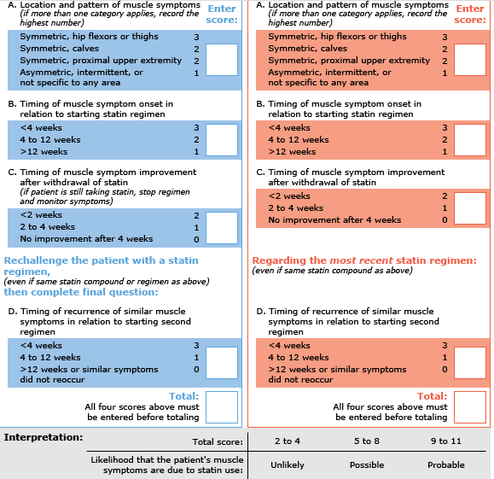
SAMS-CI Score

Slide 28
MANAGEMENT
No other treatment, aside from statin cessation, is necessary in most cases of statin-associated muscle symptoms (SAMS).
Two notable exceptions are clinical rhabdomyolysis which always requires careful monitoring and supportive care, nearly always in an in-patient setting, and immune-mediated necrotizing myopathy-Immunosuppressive therapy is required

Slide 29
MANAGEMENT
Rhabdomyolysis
discontinue therapy immediately
Patients with a history of statin-induced rhabdomyolysis should generally not be treated with another statin because of the risk of recurrence.

Slide 30
MANAGEMENT
Immune-mediated necrotizing myopathy
oral steroid, methotrexate, intravenous immunoglobulin (IVIG), and/or rituximab appears to be reasonable and safe

Slide 31
MANAGEMENT
low SAMS-CI score (2 to 4)
Discontinue the statin.
Wait for symptom resolution.
After symptom resolution:
•If patient was on a high-intensity statin, restart the same statin at a lower dose.
•. If the patient experiences adverse muscle symptoms on the alternative high-intensity statin, we recommend switching to fluvastatin, pravastatin, or pitavastatin or Rosuvastatin.
•If the patient was already on a low daily dose of a statin, consider alternate-day dosing

Slide 32
MANAGEMENT
high SAMS-CI score (5 to 11)
Discontinue the statin.
•Assess for drug interactions
•Assess for comorbidities which may account for or exacerbate symptoms
Correct hypothyroidism or low vitamin D level if present.

Slide 33
MANAGEMENT
If patient was on a high-intensity statin, restart the same statin at same or lower dose.
If patient was already on the lowest dose, consider alternate-day dosing, although this may result in lower efficacy.
•If patient was on a high-intensity statin, switch to an alternative high-intensity statin (atorvastatin, rosuvastatin) and address concerns about side effects.
If the patient experiences adverse muscle symptoms on the alternative high-intensity statin-to fluvastatin, pravastatin, or pitavastatin.

Slide 34
Therapies of uncertain benefit
Coenzyme Q10
there is little published evidence showing benefit of CoQ10 supplements for the treatment of myalgia or myopathy

Slide 35
THANK YOU

