Slide 1
TRIALS ON BEMPADOIC ACID
Dr Shreyas Samaga

Slide 2
The consistent linear association – pharmacologic lowering of LDL-C levels and reduced CV risks– development of novel drugs
Bempedoic acid is an oral, once-daily, first-in-class drug being developed for the treatment of hyperlipidemia.
Bempedoic acid is a prodrug activated in the liver to bempedoyl-CoA, which subsequently inhibits ATP-citrate lyase, an enzyme upstream of HMG CoA reductase, the target of statins.
Inhibition of cholesterol synthesis triggers up-regulation of hepatic LDL receptor expression, thus increasing clearance of LDL particles and lowering circulating LDL-C levels.

Slide 3
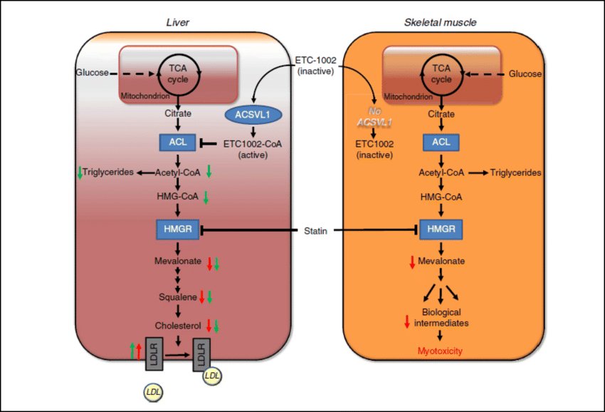

Slide 4
Bempedoic acid and statins both inhibit cholesterol synthesis in the liver, but bempedoic acid is not activated in skeletal muscle.

Slide 5
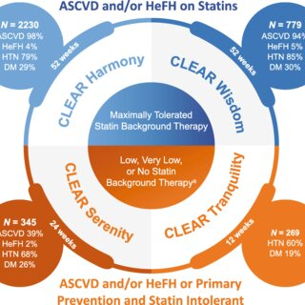

Slide 6
Randomized, double-blind, placebo-controlled clinical trial was conducted from November 2016 to September 2018.
Patients were screened at 91 clinical sites in North America and Europe

Slide 7
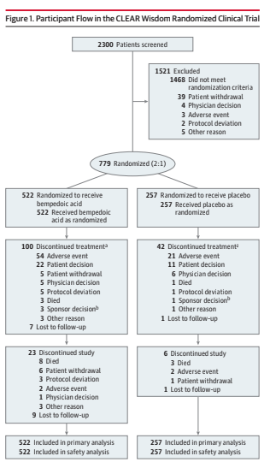

Slide 10
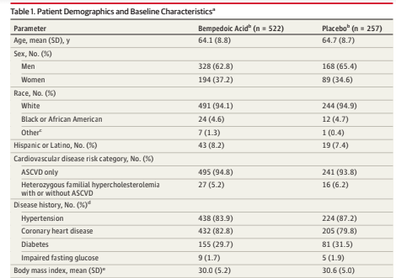

Slide 11
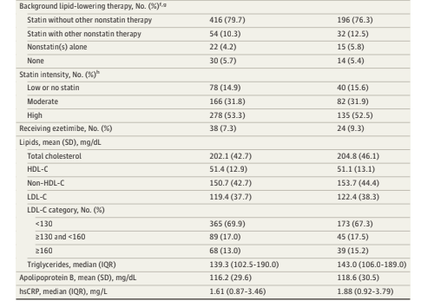

Slide 15
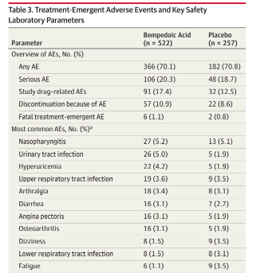

Slide 16
In this population of patients at high cardiovascular risk, addition of oral bempedoic acid (180 mg) once daily to maximally tolerated lipid-lowering therapy significantly lowered LDL-C levels compared with placebo.
This study reinforce observations from the similarly designed CLEAR Harmony clinical trial.
In both studies, LDL-C lowering was maintained through week
52, significant improvements were observed in secondary efficacymeasures, and treatment effectswere consistent across patient subgroups.

Slide 17
Despite prevalent background statin use, rates of adverse events associated with statin therapy such as muscle-related adverse events and new-onset or worsening diabetes were generally low.
The current study required that patients be receiving maximally tolerated lipid-lowering therapy, which may have included no statin or no background lipid-lowering therapy, whereas patients in CLEAR Harmony were required to be receiving a maximally tolerated statin.

Slide 18
Inclusion of these different groups allowed for analysis of the effects of background therapies on lipid changes and revealed considerable LDL-C lowering among patients in the bempedoic acid treatment group who were not receiving statin therapy or not receiving any background lipid-lowering therapy.
The screening LDL-C threshold in the current study (≥100 mg/dL) was also higher than that in CLEAR Harmony (≥70mg/dL),which resulted in greater baselinemean LDL-C values (120.4 and 103.2mg/dL, respectively).

Slide 19
In CLEAR Harmony, new-onset or worsening diabetes occurred in 3.3% of patients who received bempedoic acid vs 5.4% of patients who received placebo.
These observations formed the basis for additional exploration in the current study,which revealed improvement or less worsening of glycemic control among patients receiving bempedoic acid.

Slide 20
The treatment strategy applied in the current study, wherein an additional agent is added to maximally tolerated lipid-lowering therapy in patients at high cardiovascular risk who have not achieved sufficient LDL-C lowering, is consistent with cholesterol management guideline recommendations.

Slide 22
LIMITATIONS
First, although adherence to study drug was monitored, adherence to background therapy was not.
The study was only 52 weeks in duration; further data on long-term efficacy and safety are needed .
Third, the study was not powered to evaluate cardiovascular outcomes.
Greater clarity regarding event risk reduction with bempedoic acid will come from the ongoing 12 600-patient cardiovascular outcome trial (CLEAR Outcomes

Slide 24
CLEAR HARMONY TRIAL
2230 PATIENTS- 2:1
Patients with LDL70 or more with statins(max tolerated)
Primary end point-safety
Secondary endpoint- percentage change in LDL at week 12 of 52week.

Slide 25
Mean LDL- 103.2 +/- 29.4
The incidence of adverse events (1167 of 1487 patients [78.5%] in the bempedoic acid group and 584 of 742 [78.7%] in the placebo group)
serious adverse events (216 patients [14.5%] and 104 [14.0%], respectively) did not differ substantially between the two groups during the intervention period
the incidence of adverse events leading to discontinuation of the regimen was higher in the bempedoic acid group than in the placebo group (162 patients [10.9%] vs. 53 [7.1%]),
as was the incidence of gout (18 patients [1.2%] vs. 2 [0.3%]).

Slide 26
At week 12, bempedoic acid reduced the mean LDL cholesterol level by 19.2 mg per deciliter, representing a change of −16.5% from baseline (difference vs. placebo in change from baseline, –18.1 percentage points; 95% confidence interval, –20.0 to –16.1; P<0.001).
Safety and efficacy findings were consistent, regardless of the intensity of background statin therapy.

Slide 28
CLEAR TRANQUILITY

Slide 29
CLEAR TRANQUILITY
double-blind, placebo-controlled, parallel-group study was conducted at 90 sites in the United States, Canada, and Europe from November 29, 2016, to January 11, 2018.

Slide 31
Bempedoic acid added to background lipid-modifying therapy that included ezetimibe reduced LDL-C by 28.5% more than placebo (p < 0.001; 23.5% bempedoic acid, þ5.0% placebo).
Significant reductions in secondary endpoints, including non-high-density lipoprotein cholesterol (23.6%), total cholesterol (18.0%), apolipoprotein B (19.3%), and high-sensitivity C-reactive protein (31.0%), were observed with bempedoic acid vs. placebo (p < 0.001).
Bempedoic acid was well tolerated; rates of treatment-emergent adverse events, muscle-related adverse events, and discontinuations were similar in the bempedoic acid and placebo treatment groups.

Slide 32
CLEAR SERENITY

Slide 33
double-blind, placebo-controlled CLEAR (Cholesterol Lowering via Bempedoic acid, an ACL-Inhibiting Regimen) Serenity study
randomized 345 patients with hypercholesterolemia and
a history of intolerance to at least 2 statins (1 at the lowest available dose)
2:1 to bempedoic acid 180 mg or placebo once daily for 24 weeks.
The primary end point was mean percent change from baseline to week 12 in low-density lipoprotein cholesterol.

Slide 34
The mean age was 65.2 years,
Mean baseline low-density lipoprotein cholesterol was 157.6 mg/dL, and
93% of patients reported a history of statin-associated muscle symptoms.
Bempedoic acid treatment significantly reduced low-density lipoprotein cholesterol from baseline to week 12 (placebo- corrected difference, 21.4%
Significant reductions with bempedoic acid versus placebo were also observed in non–high-density lipoprotein cholesterol (17.9%), total cholesterol (14.8%), apolipoprotein B (15.0%), and high-sensitivity C-reactive protein (24.3%; P<0.001 for all comparisons).
Bempedoic acid was safe and well tolerated.
The most common muscle-related adverse event- myalgia,

Slide 37
ACC 2022

