Slide 1
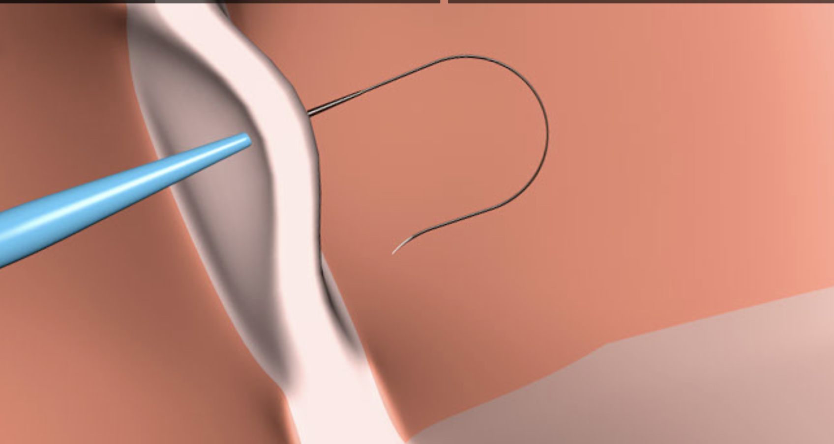
Trans Septal Puncture
Dr Sanchna Dev S
Dept of Cardiology
TDMC

Slide 2
To be covered
Gross Anatomy
Fluoroscopic Anatomy
Echocardiographic Anatomy
Intracardiac Echo Anatomy

Slide 3
Gross anatomy –anterior view

Slide 4
Development of the atrial septum

Slide 5
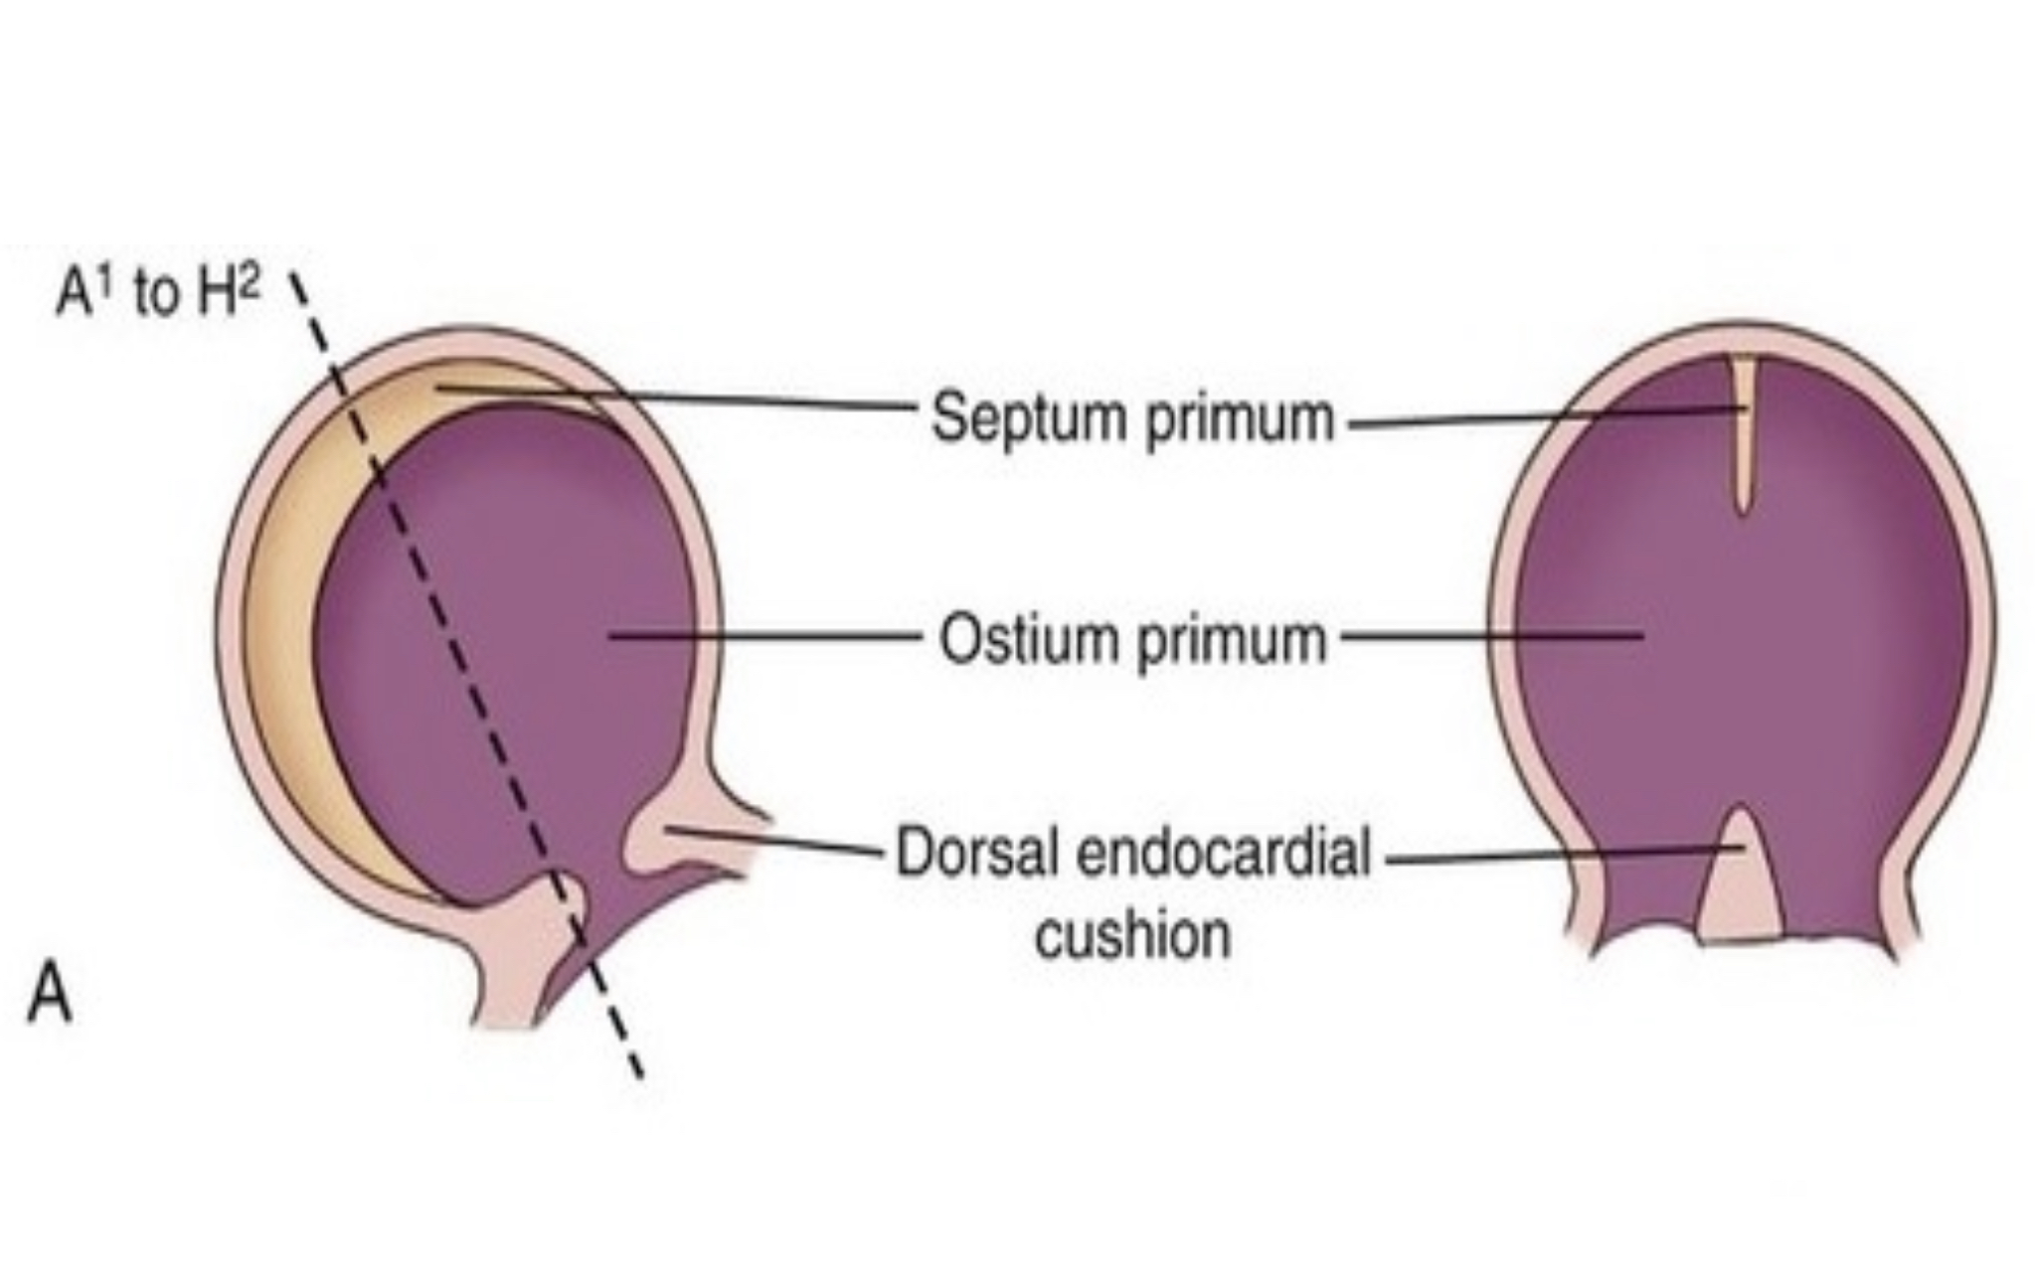
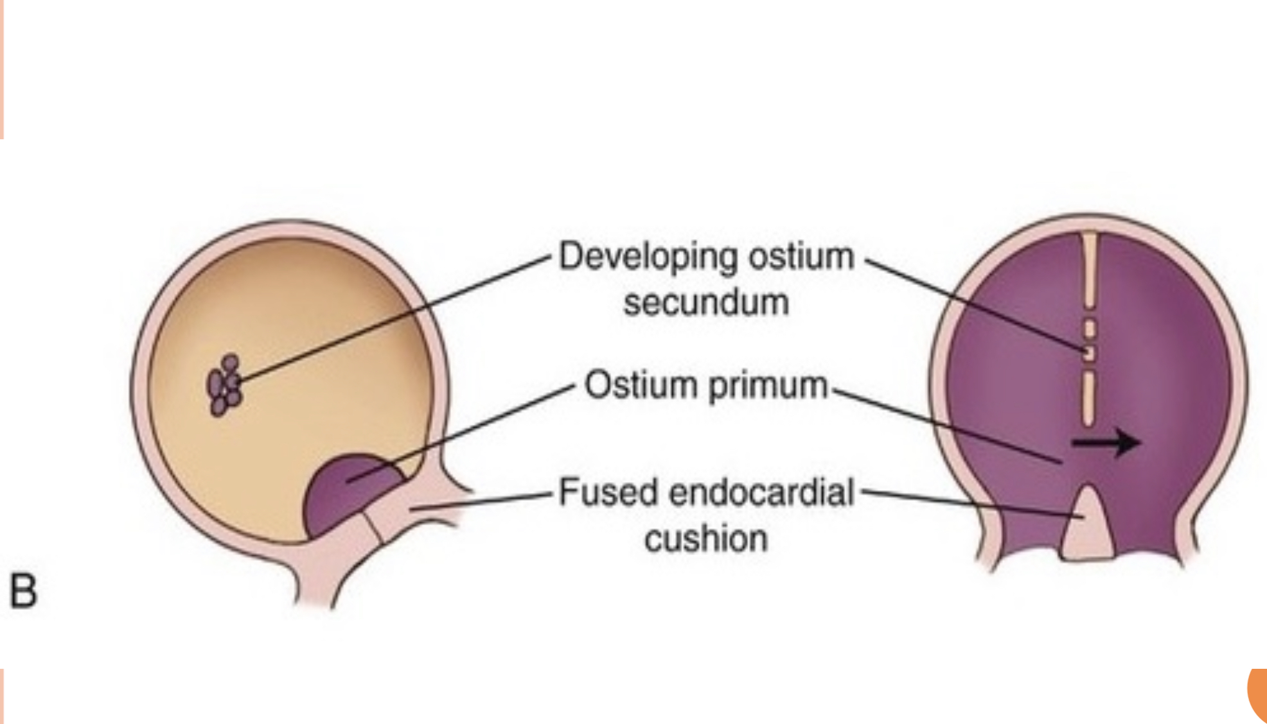
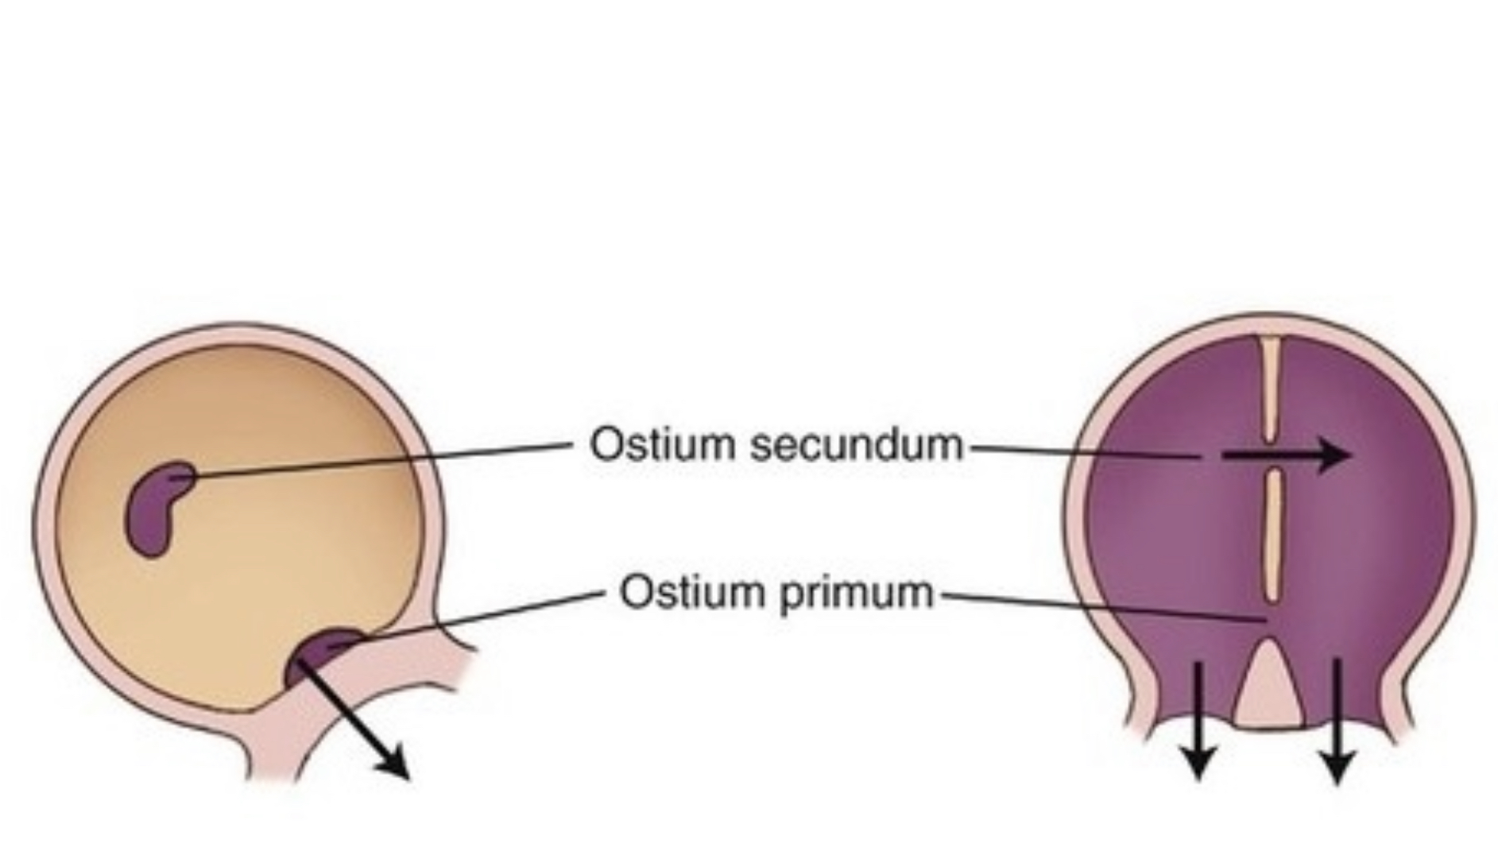
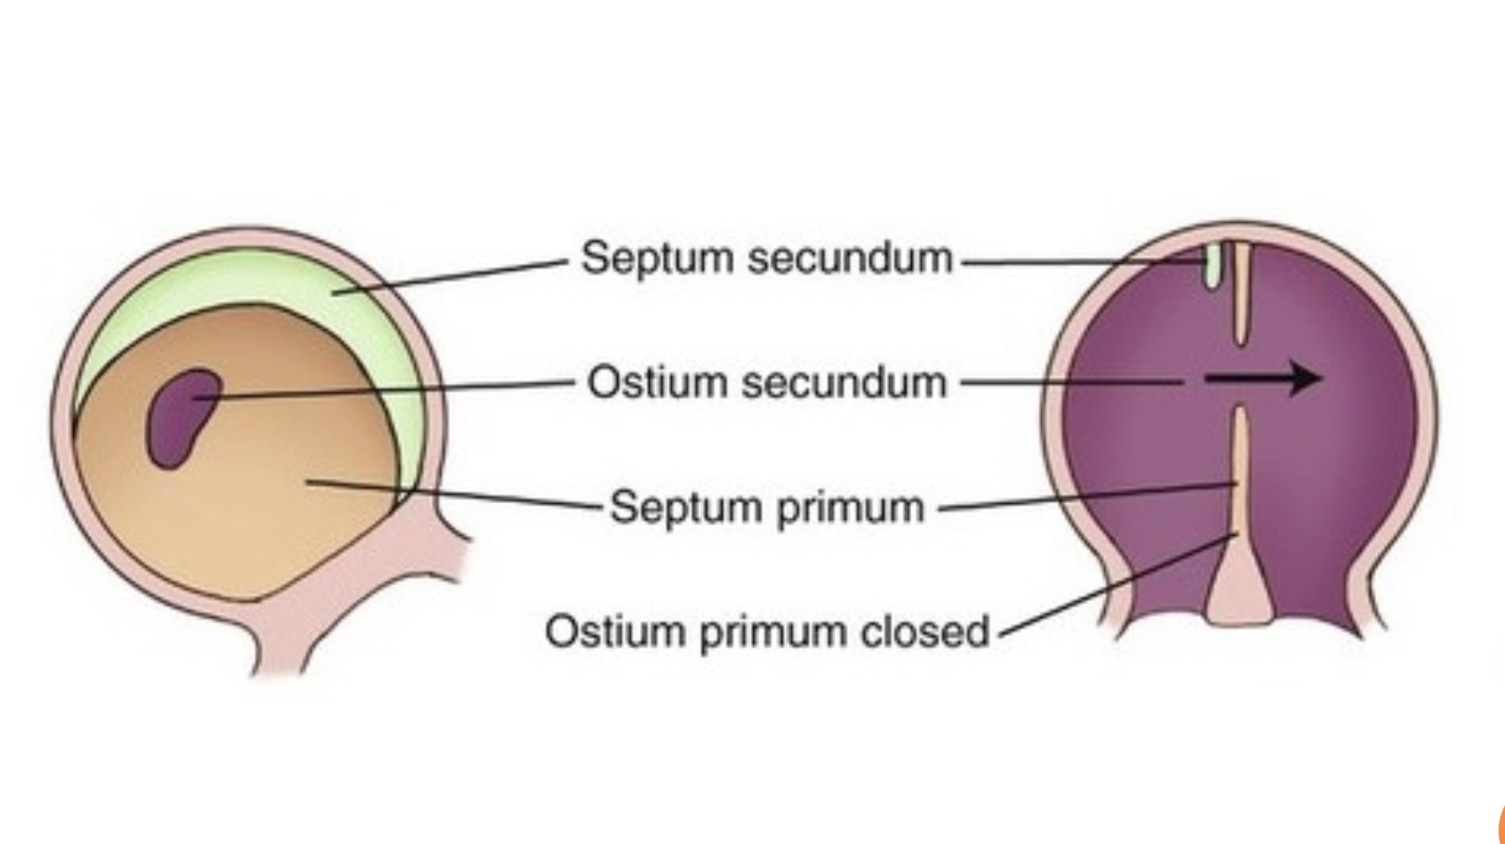

Slide 6
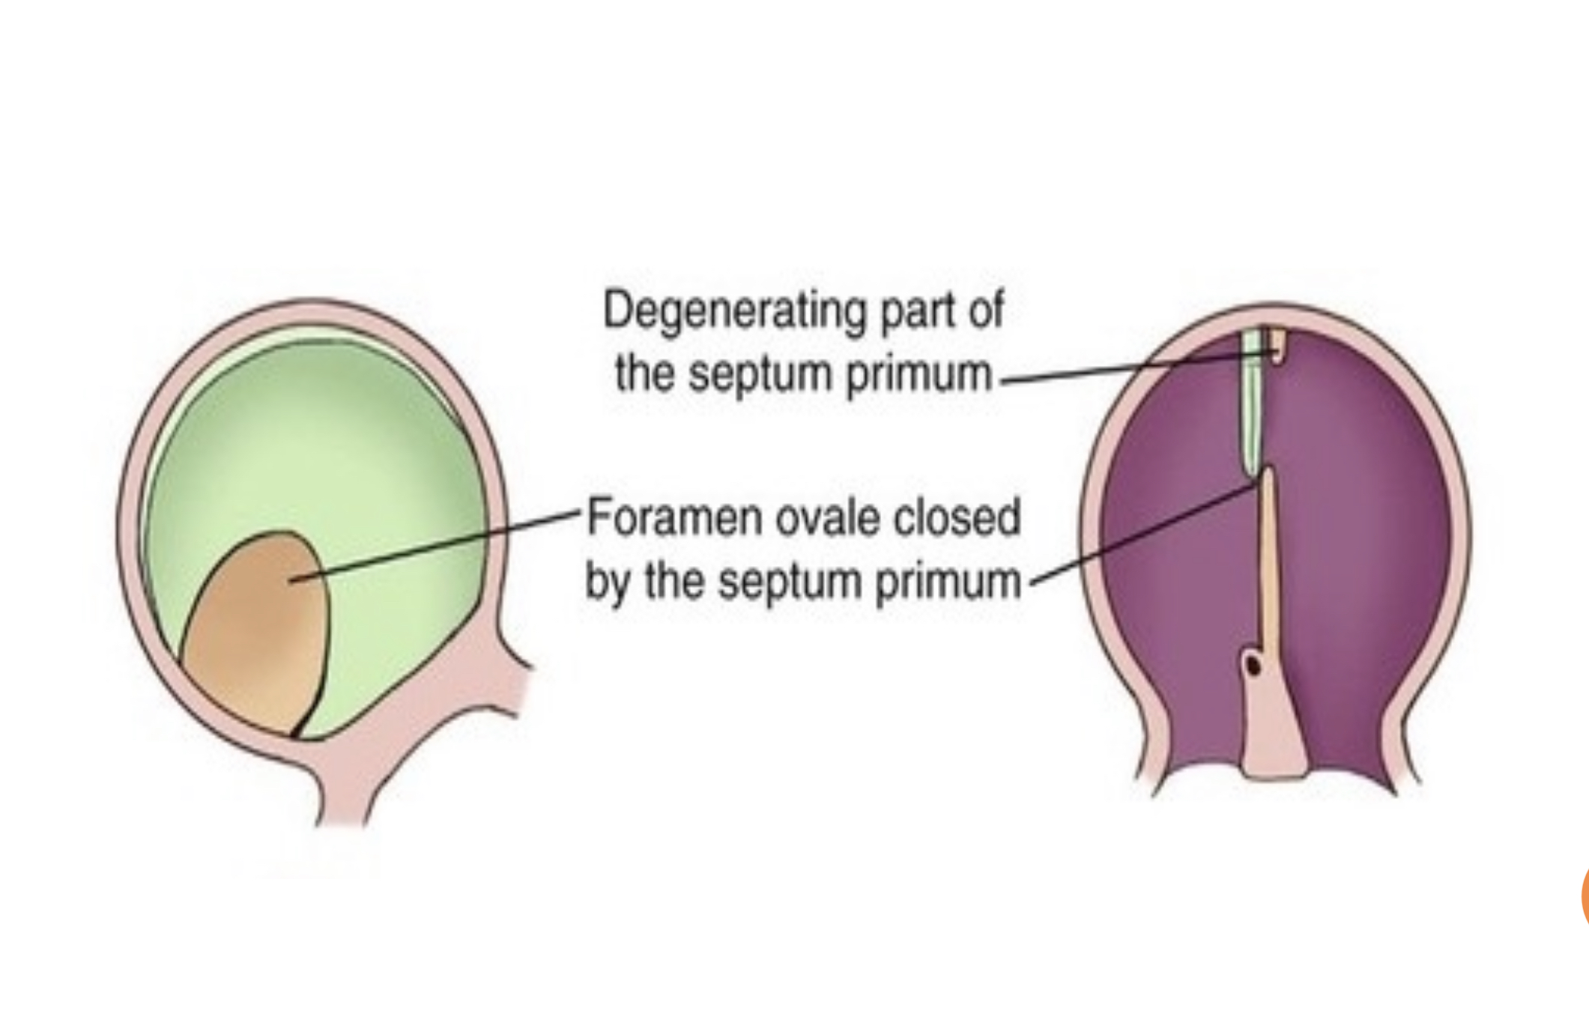
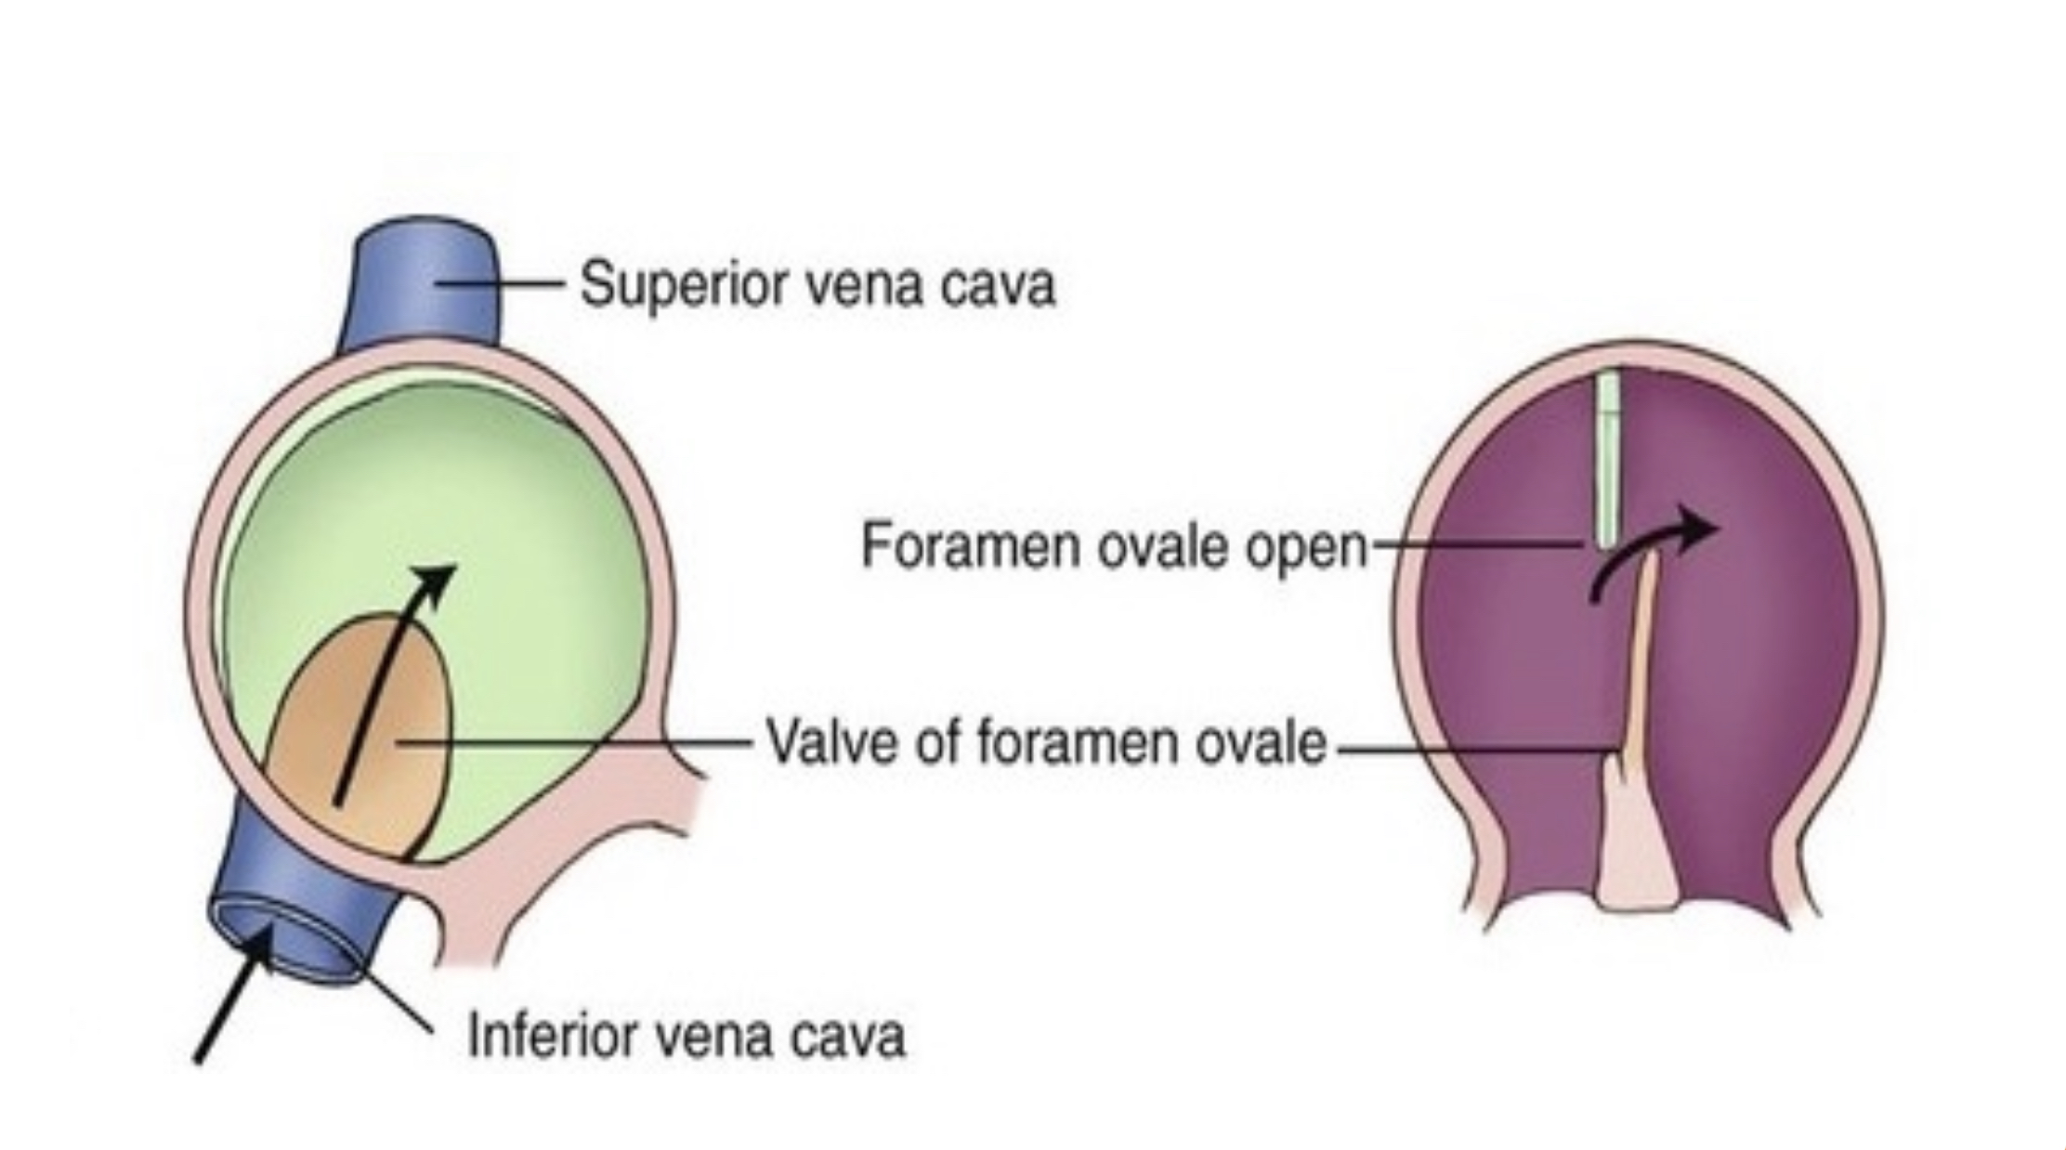
Fossa ovalis <— septum primum
Annulus ovalis <—septum secundum free edge

Slide 7
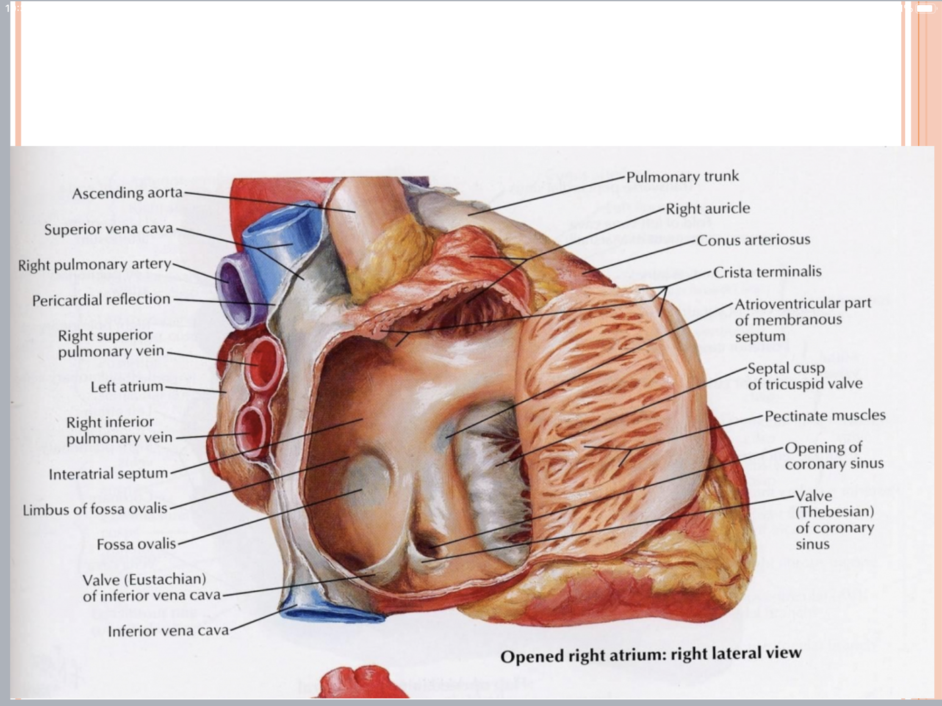

Slide 8
History lesson

Slide 9
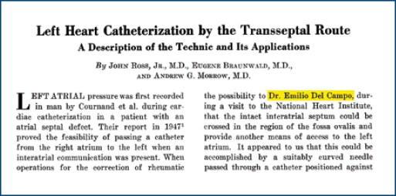
History lesson
The technique of transseptal puncture (TSP) was developed by Ross, Braunwald, and Morrow in 1959 to allow direct measurement of left atrial (LA) pressure.

Slide 10
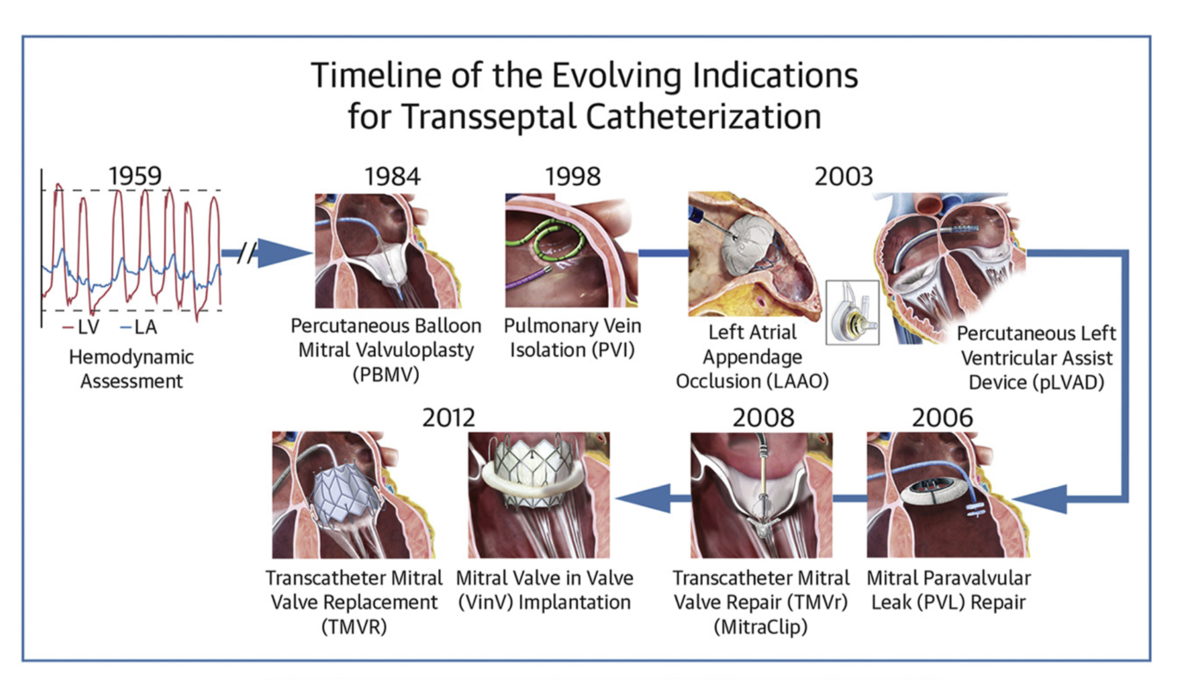

Slide 11
Indications
Percutaneous balloon mitral valvuloplasty (PBMV)
Transcatheter mitral valve repair( MitraClip)
Mitral valve-in-valve implantation
Transcatheter MV replacement
Mitral paravalvular leak (PVL) repair
Pulmonary vein isolation (PVI)
Percutaneous LVAD – TandemHeart, transseptal extracorporeal membrane oxygenation
LAA closure –watchman device
Anterograde treatment of LV and AV disease – “ no access patients”
—>Transcatheter AV replacement …..balloon aortic valvuloplasty

Slide 12
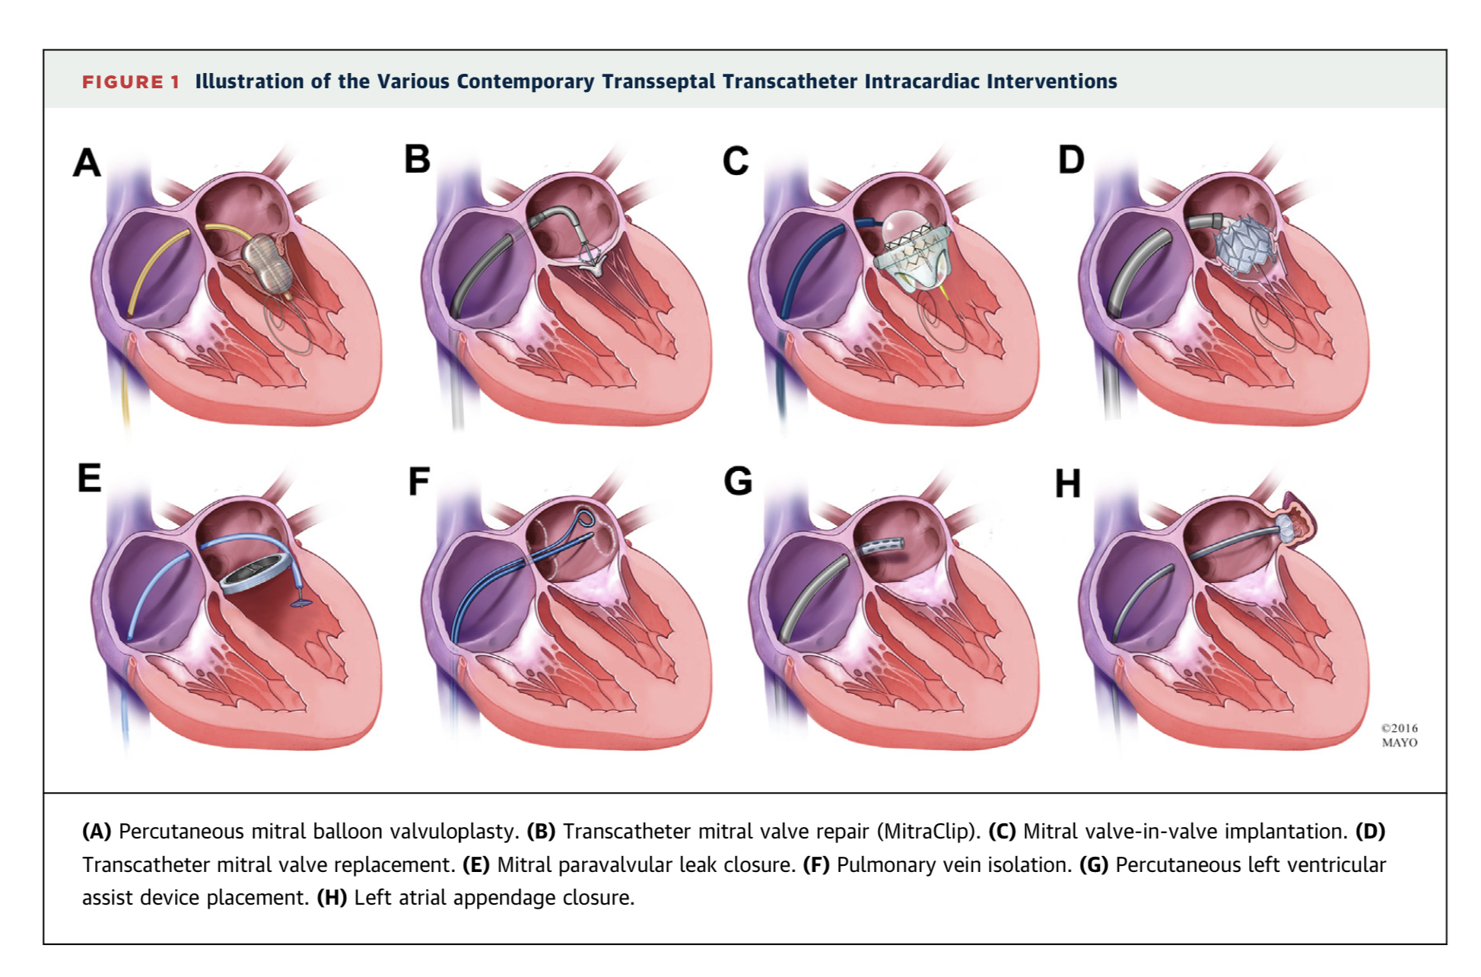

Slide 13
Other indications
hemodynamic assessment (LA -indirect by Swan-Ganz catheter), (transaortic gradient - mechanical aortic prosthesis)
Closure of PFO with long tunnel
Carotid artery stenting in pts with acutely angulated arch-branch vessels and those with Takayasu arteritis.
In rare occasions, transseptal access may provide an alternative route for coronary interventions in pts with no suitable peripheral access
balloon atrial septostomy is another indication for TSP in patients with severe pulmonary hypertension who do not respond to medical therapy or are awaiting lung transplantation
Transapical route

Slide 14
Fluoroscopic guided transseptal puncture
Fluoroscopy antedates echocardiography
2D technique - so always at least 2 views are mandatory

Slide 15
RA angiography to guide TSP
No longer performed unless there is gross structural abnormality of heart , skeleton

Slide 16
Basics of septal puncture
Access the systemic venous system
Perform the septal puncture around the fossa ovalis
Place a catheter into the LA for further interventions

Slide 17
Access
Right femoral vein – straight course to RA
Rarely –left femoral vein
Even jugular access is reported

Slide 18
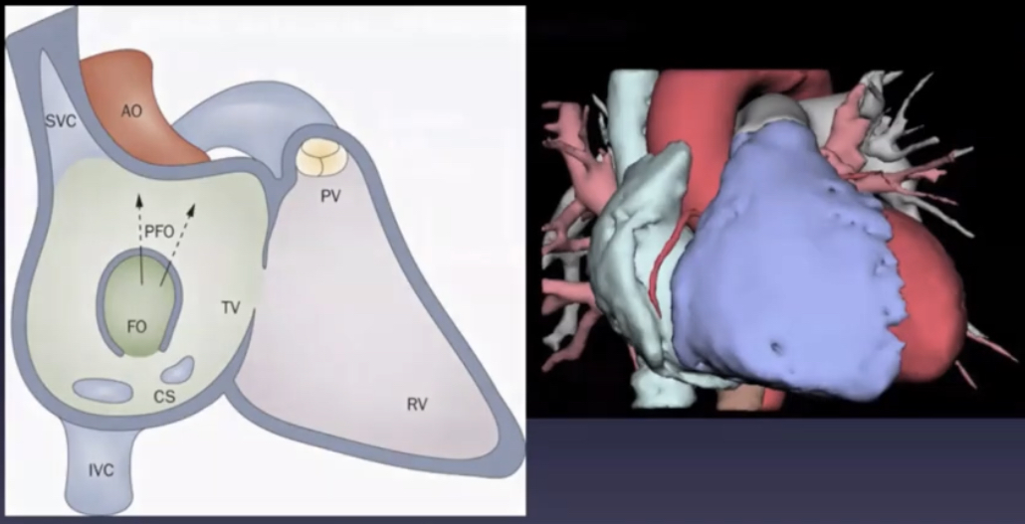

Slide 20
Drag
Three movements
1st – SVC to RA , slight movement to right
2nd – Over limbus, slight movement to right
3rd – abrupt movement medial (left)

Slide 22
Equipment

Slide 23
BRK -XS

Slide 28
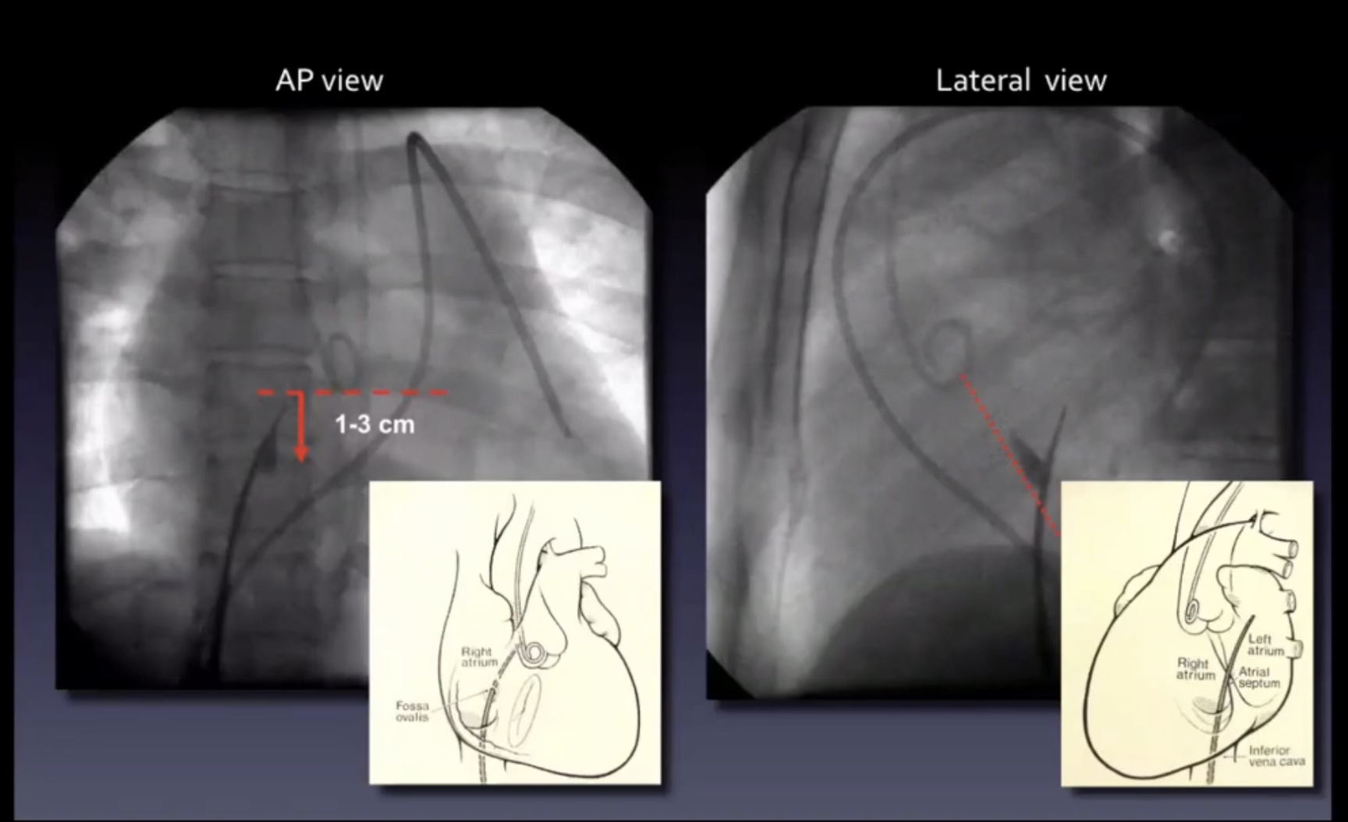
Transseptal puncture

Slide 30
Aortic pulsations maybe palpable
Short sharp movement with the distance between hub of catheter and needle maintained
Ensure that needle in LA

Slide 31
How do we know that the needle is in left atrium?
Colour of blood aspirated is bright red
Inject contrast
Pressure tracing is of the left atrium

Slide 32
Withdraw the needle and advance the dilator
Place a wire in LA
SafeSept wire if available ( 120cm Nitinol guidewire with 0.014 “ diameter + sharp and floppy “ J tip”
Advance the Mullins catheter over the needle
Advance
Anticoagulation only after safe puncture

Slide 33
Alternatives to septal puncture needle
Reverse end of 0.014 “
Use RFA (bovie cautery) to the hub of the septal puncture needle

Slide 34
Potentially difficult patients
1.Distorted anatomy
Chest /spine deformity
CHD
Severe valve abnormalities
2.ASD closure device/patch
3.Floppy septum- lateral wall of LA
4. Previous TSP (fibrotic)

Slide 35
Helpful tools in difficult puncture
Tattoo of the fossa ovalis by contrast medium injection (visualisation of FO tenting)
RA angiography
Antegrade LA angiography
ICE
TEE
RF ablation

Slide 36
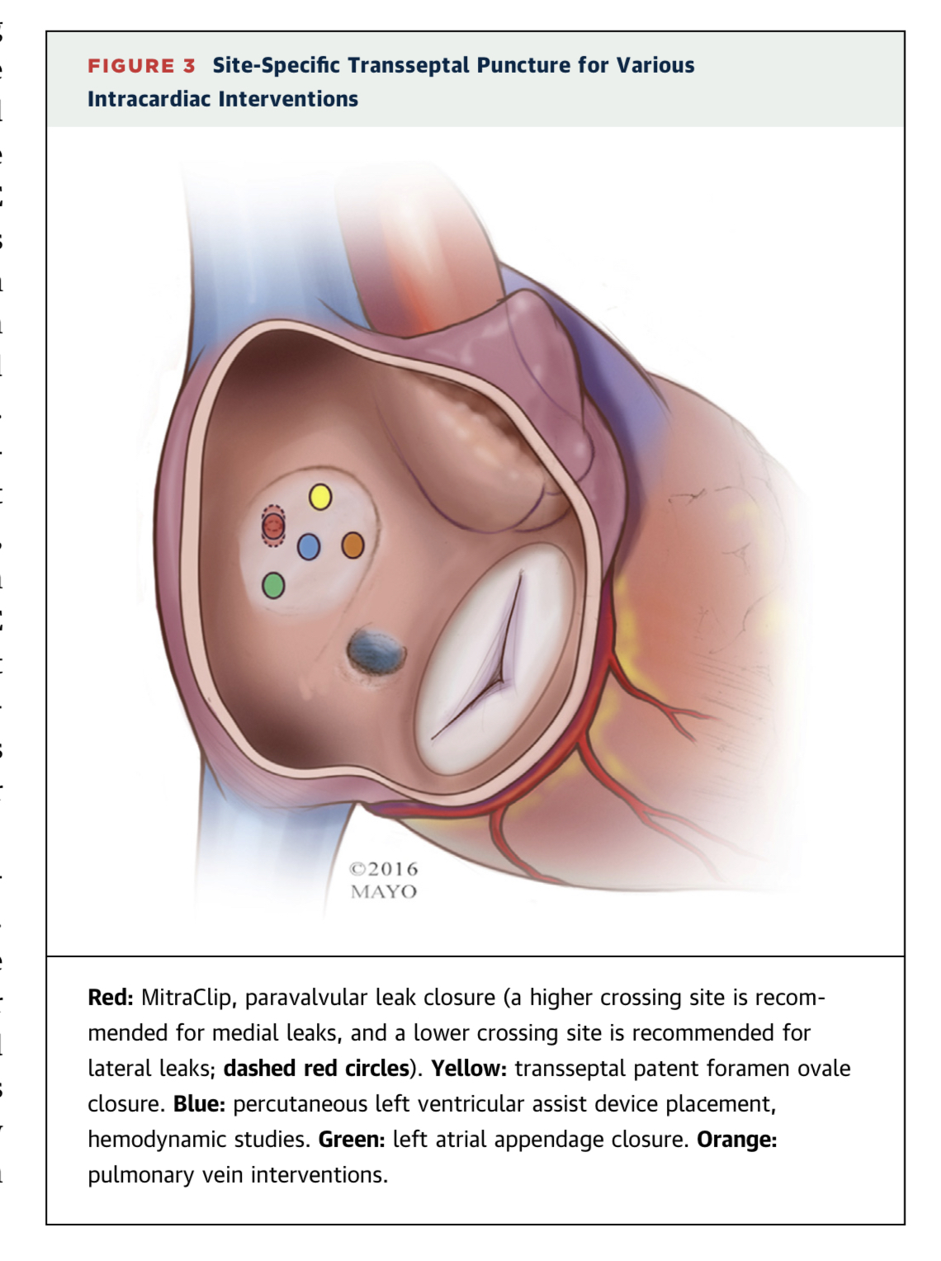
Site specific TSP
1.MV interventions
for central MR jet –posterior and slightly superior
Medial jet – higher
Lateral jets - lower
2. LAA closure– posterior TSP
3. PV interventions –anterior > posterior
4. LVAD – mid FO

Slide 37
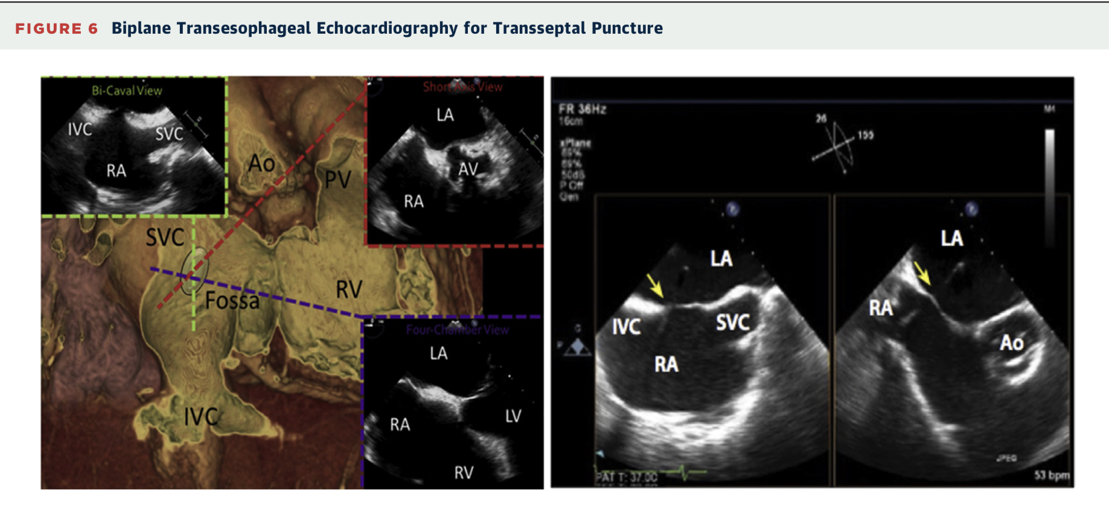
TEE guided TSP
Superior and inferior localization is seen best in the bicaval view (90)
anterior and posterior localization is seen best in the short-axis (30) and 4-chamber (0) views.
An x-plane view that displays both the bicaval and the short-axis view is extremely helpful in puncturing the IAS at the desired location

Slide 38
Intracardiac Echocardiography(ICE) for TSP
In ICE-guided procedures, a phased-array intra- cardiac echocardiographic catheter is advanced to the right atrium and manipulated to identify the “home” view
The initial survey of the IAS is then performed; from the home view, a posterior tilt of the transducer and a clockwise rotation of the catheter bring the IAS and FO into view (septal view)
After successful TSP, ICE allows direct visualization of the needle tip and its relationship to the surrounding cardiac structures

Slide 40
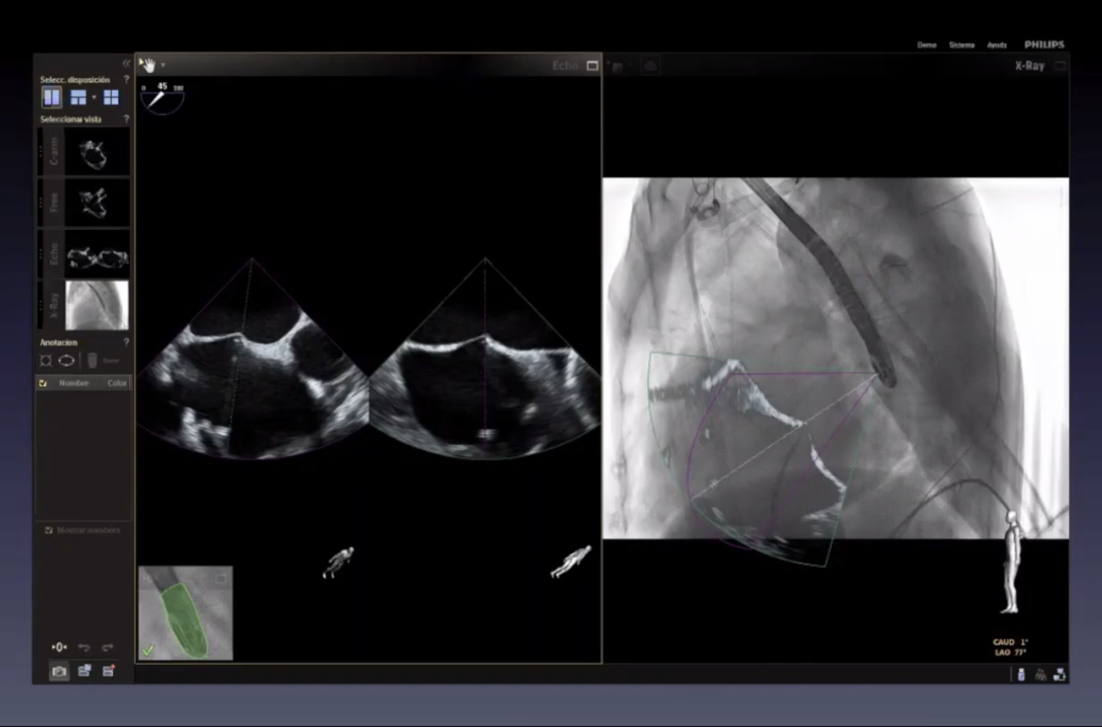
Fusion of different imaging modalities
TEE + fluoroscopy (echo navigator system)

Slide 42
ICE
Adv
Identifies right atrial structures
Identifies fossa and aortic root at the same time
Not in the way of X-ray equipment
No obstruction of fluoro
Disadvantage
Small field of view
May move during manipulation of transseptal sheath

Slide 44
Complications
Pericardial effusion/tamponade
RA and LA needle puncture
Aortic puncture /perforation
Air embolism/TIA
Persistent ASD
Transient ST elevation
Potentially fatal

Slide 48
Conclusion
Knowledge of the anatomy of IAS + Knowledge of associated structures
Safe and appropriate transseptal puncture

Slide 49
Thank you

Slide 50
Identify?
William Rashkind

Slide 54
Intracardiac Echocardiography (ICE) is used to guide which of the following procedures ?
(i) Transseptal puncture (ii) Percutaneous closure of ASD (iii) Closure of PFO (iv) Electrophysiological procedures A:-(i) only B:-(ii) and (iii) only C:-(i), (ii) and (iii) only D:-All of the above

Slide 55
Limbus of fossa ovalis derived from
septum primum
Septum secundum
Both
None
Ans :2

