Slide 1
UNIVENTRICULAR HEART REPAIR- The fontan pathway
PART 2
Dr Shreyas samaga
Dept of cardiology
Govt td medical college alappuzha

Slide 3
Recap…. MANAGEMENT PLAN
Initial palliation
Definitive palliation
followup
Currently total cavopulmonary Fontan circulation done in two stages :
To allow body to adapt to different hemodynamic states
Reduce overall surgical morbidity and mortality
Allows a better patient selection and intermediate preparatory interventions
Reduced PBF- BT shunt
Increased PBF- PA banding
6M-Glenn
3Y- Fontan completion

Slide 4
At birth, impossible to create a Fontan circulation
PVR is still raised for several weeks
Caval veins and pulmonary arteries - too small

Slide 6
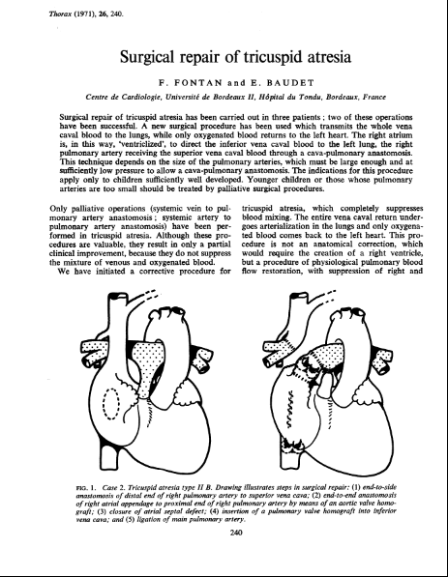
25th April 1968 12y girl with ta
20th jan 1970 36y female with ta
March 1970
23y female

Slide 7
AGENDA
Evolution of Fontan
Interstage managements
Surgical strategies
Treatment of circulatory failure
Fontan physiology
Complications of Fontan

Slide 8
Evolution of the Fontan Procedure
1987
The original procedure consisted of division of the right pulmonary artery from the main pulmonary artery and anastomosis of the superior vena cava to the right pulmonary artery.
Lateral tunnel Fontan
De Leval et al
1990
Extra cardiac Fontan
FONTAN & BAUDET
Marcellati
1968
1970
First atriopulmonary Fontan anastomosis with 6mm fenestration
Dr. Guillermo Kreutzer and team

Slide 9
Maintains systemic and pulmonary circulation - not connected in series but in parallel
Many complex cardiac malformations - one functional ventricle (univentricular heart)
Major disadvantages
arterial desaturation
chronic volume overload to single ventricle(SV) – in due course impairs ventricular function
Advantages of a Fontan circuit:
(near) normalisation of the arterial saturation
abolishment of chronic volume overload on SV

Slide 10
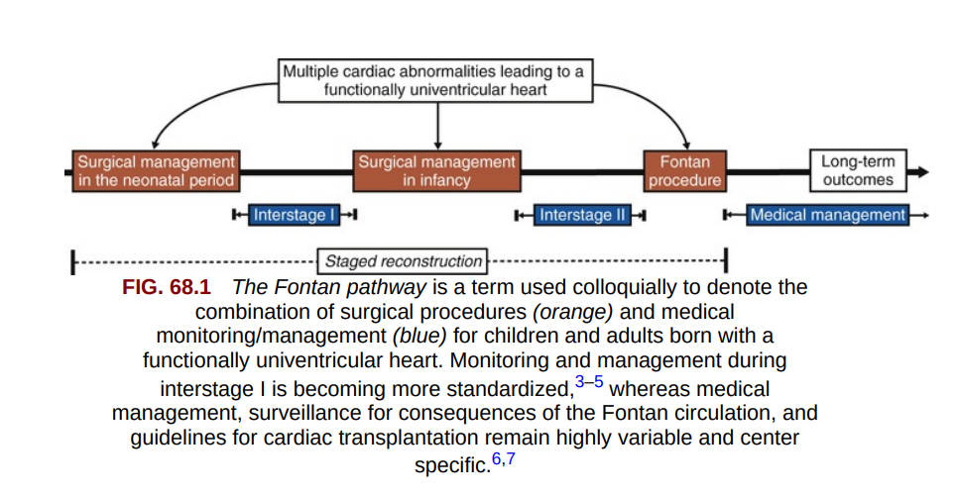

Slide 11
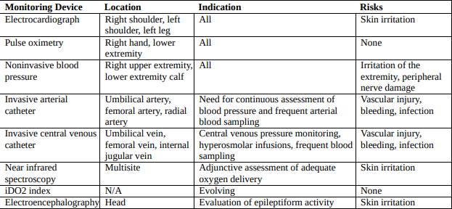
Peripheral Vs indwelling central venous catheter.
The peripheral catheter can be used to administer infusions of PGE1 and low-concentration glucose.
Carry low insertion complication rates and minimize the risk for thromboembolism, vascular occlusion, and infection complications.

Slide 12
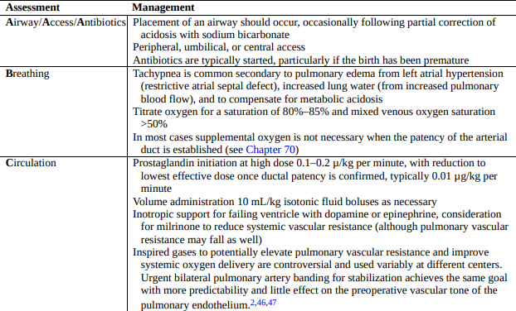

Slide 13
INTERSTAGE-1 MANAGEMENT
RED FLAG
Pulse oximetry
Historically, growth failure during the interstage period was common.
A minimum of weekly reassessment of weight trends, volume and caloric intake, and growth velocity is recommended during the interstage period.
Due to the metabolic demands of stage I palliation physiology, most infants will require a minimum of 100 mL/kg per day for adequate hydration and between 100 and 130 cal/kg per day to demonstrate consistent weight gain.
SpO2 less than 75% or greater than 90%
Weight loss of 30 g or failure to gain 20 g over 3 days
Enteral intake less than 100 mL/kg per day
Fever, cough, congestion, change in breathing pattern, vomiting, diarrhea, irritability.

Slide 14
bdg
Pre op evaluation:
Cardiac catheterization
echo

Slide 15
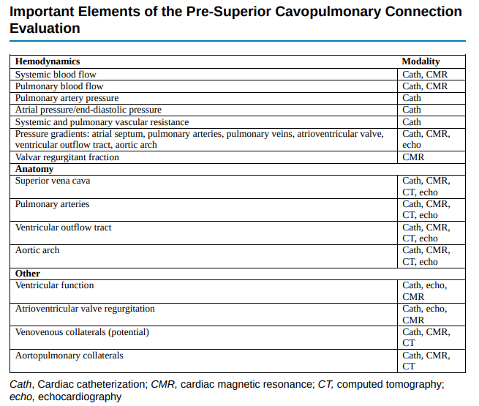

Slide 16
Post op
With transition from a multidistribution circulation to the SCPC, the volume load, CO requirement, and myocardial VO2 are reduced.
The acute decrease in ventricular volume creates a mismatch between the ventricular volume and muscle mass, causing diastolic dysfunction.
Watch for pleural effusion, HR, RR, pulse oximetry.
Arterial hypoxemia following the SCPC- AVM, obstruction at anastomosis
Systemic HTN- catecholamines/angiotensin II/aldosterone
DONOT treat aggressively
SVC syndrome- POD 2-4, irritable child, plethora &edema in upper extremity

Slide 17
POST OP
Arrhythmia- not common, if present- atrial tachycardia/ sinus node dysfunction
Pleural effusion/chylothorax-
The lymphatic vessels coalesce to form the thoracic duct and carry lymph toward the central venous system in the thorax.
When CVP elevates- obstruction to lymphatic drainage- chylothorax. Usually resolves POD 2-3.
If it persists >1wk, look for anatomic causes- thrombus/obstruction in SVC, thoracic duct injury
If not- low fat diet/TPN/octreotide/ steroid/Aldactone/thoracic duct ligation/pleurodesis

Slide 18
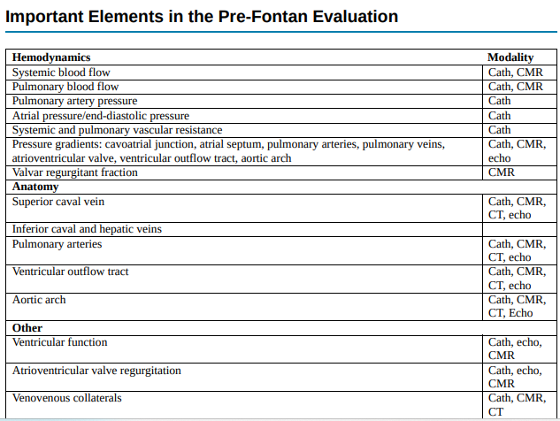
The third stage of reconstruction and the ultimate goal for the patient with fUVH is the
modified Fontan procedure.

Slide 19
With increasing experience, criteria have become more flexible
2 most important commandments in present era:
Pre-op impaired ventricular function and
Elevated PA pressures

Slide 20
Cardiac Catheterization For Pre-fontan Evaluation :
Patency of glenn shunt with analysis of PA anatomy :
Good sized PA without distortion
Confluence stenosis (stenosis > 50% as compared to adjacent segment)
Presence or absence of anomalously draining pulmonary veins
Any significant decompressing venovenous collaterals (>2 mm)

Slide 21
IVC angiogram :
Rule out interrupted IVC
Rule out stenosis / duplication of IVC
Drainage pattern of hepatic veins
Ventriculogram :
Ventricular contractility
AV valve regurgitation
Systemic outflow obstruction
Presence or absence of antegrade flow from ventricle to PA

Slide 22
Hemodynamic evaluation :
PA pressures (systolic / diastolic / mean)
PVR
Ventricular end diastolic pressures
2 most important cath data (both mandatory)
PA pressure
PVR

Slide 23
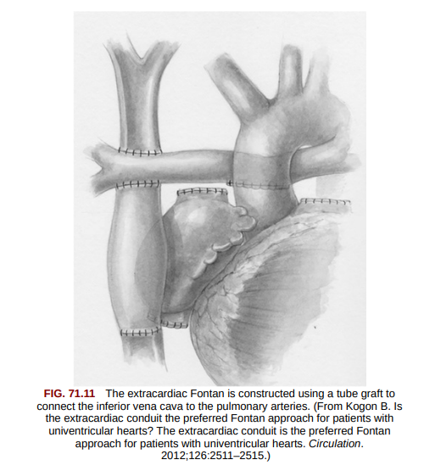
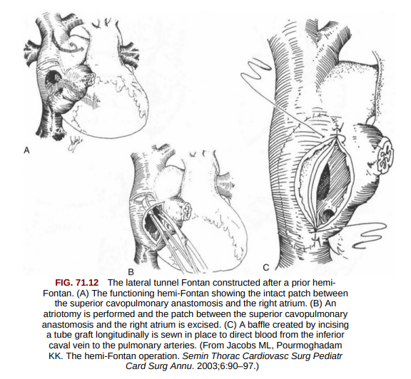
SURGICAL STRATEGIES
EXTRACARDIAC FONTAN
MARCELLATI in 1990
2. LATERAL TUNNEL FONTAN
DE LEVAL ET AL in 1987

Slide 25
Intra-atrial Tunnel Method
Conduit is constructed with both the lateral wall of the RA and prosthetic material
Inferior aspect of the tunnel is anastomosed to the IVC
superior aspect is anastomosed to the pulmonary arteries

Slide 26
Intra-atrial Tunnel Method
Advantages :
Conduit enlarges as the child grows - may be used in children as young as 1 year old
Decreased blood stasis and risk of thrombosis
Limited portion of RA exposed to high venous pressures (reduces risk of arrhythmias)
Coronary sinus remains in low pressure atrium (allows unimpended myocardial venous drainage)

Slide 27
Extracardiac Conduit Method
Usually performed only in pts. > 3 years
PTFE tube graft is placed between the transected IVC and the PA , bypassing RA.

Slide 28
Extracardiac Conduit Method
Advantages :
No or minimal CPB
Entire atrium is left with low pressure - less atrial distention, arrhythmia, and thrombosis.
Avoids RA incisions and extensive atrial sutures
Reduces risk of sinus node injury
Reduces incidence of post op arrhythmias
Disadvantages :
Cannot enlarge as the child grows
Performed only in child large enough to accept a graft of adequate size to allow adult IVC blood flow.
Risk of obstruction by thrombus formation or neo intimal hyperplasia

Slide 29
THE COMPLETION FONTAN
The last planned operation in the Fontan pathway.
It separates systemic and pulmonary venous drainage and restores in-series circulation, eliminating hypoxemia.
the optimal Fontan outcome will most consistently be achieved by providing the highest possible cardiac output, at rest and with exertion, at the lowest possible central venous pressure.
By 2 years of age, the pulmonary vasculature is developed such that the cardiac output can be accommodated at a modest elevation of central venous pressure.
In the current era, the timing of the completion Fontan is not critical and in general occurs at 18 months to 4 years of age.

Slide 30
FENESTRATION
The fenestration will shunt right to left, lowering central venous pressure and augmenting ventricular preload.
An intentional defect created within the Fontan pathway that connects it to the pulmonary venous atrium.
Incomplete relief of hypoxemia
Paradoxic embolism and stroke
As a consequence of surgery and cardiopulmonary bypass, all patients in the early postoperative period will experience a transient period of increased PVR.
A fenestration may be most beneficial in the early postoperative period.
The combination of lower central venous pressure and increased ventricular preload will improve systemic output and the lower central venous pressure, reducing hydraulic factors leading to persistent pleural effusions.

Slide 31
FENESTRATED FONTAN
small opening or fenestration may be created between the conduit and the right atrium
Functions as a pop-off valve (a right-to-left shunt)
prevent rapid volume overload to the lungs
Limit caval pressure
Increase preload to the systemic ventricle
Increase cardiac output
cyanosis may result from the right-to-left shunt

Slide 34
AT THE COMPLETION OF FONTAN…
At the completion of an uncomplicated Fontan procedure, central venous pressure will be elevated.
saturations should be greater than 90% in those patients without a fenestration and greater than 80% among those with a fenestration.
Prior to weaning from cardiopulmonary bypass, the team should make certain that ventilation is satisfactory and that electrolytes, particularly calcium, have been normalized.
Low to moderate inotropic support is common and milrinone is commonly used as a first-line inotropic agent due to its pulmonary vasodilatory action.
It is prudent to place chest tubes in both pleural spaces as pleural effusions are the rule following the Fontan.

Slide 35
AT THE COMPLETION OF FONTAN…
Placement of temporary pacing wires is essential, even if the initial rhythm is satisfactory.
Arrhythmias are common postoperatively.
Temporary sinus node dysfunction is common following a lateral tunnel Fontan and is reported with extracardiac Fontan as well.
Low cardiac output following Fontan:
CVP & atrial pressures high- Cardiac tamponade/ PPV/ ventricular dysfunction

Slide 36
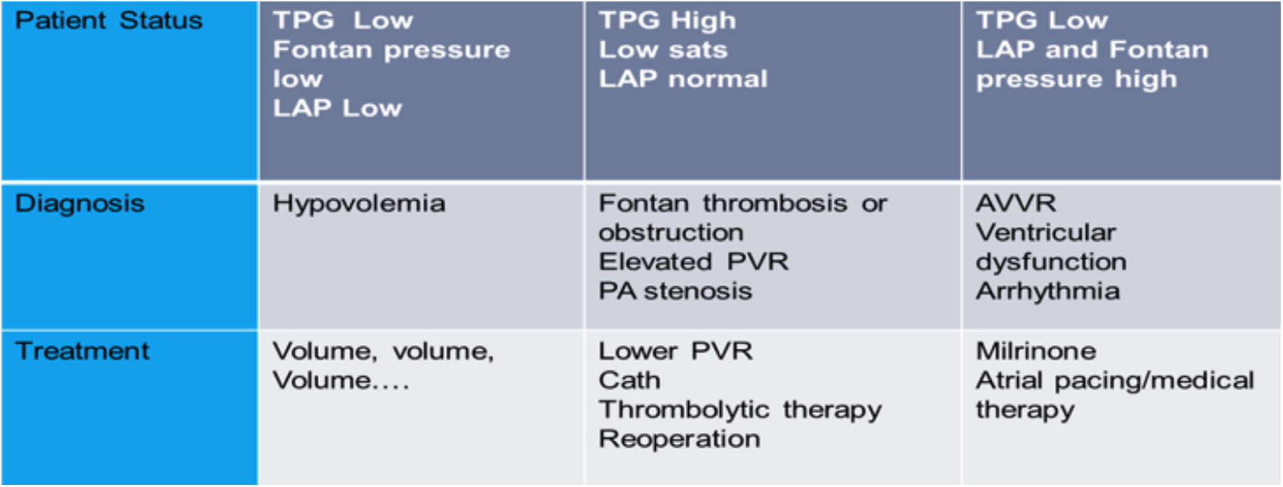
Evaluation and Management of Low Cardiac Output Early After Surgery

Slide 37
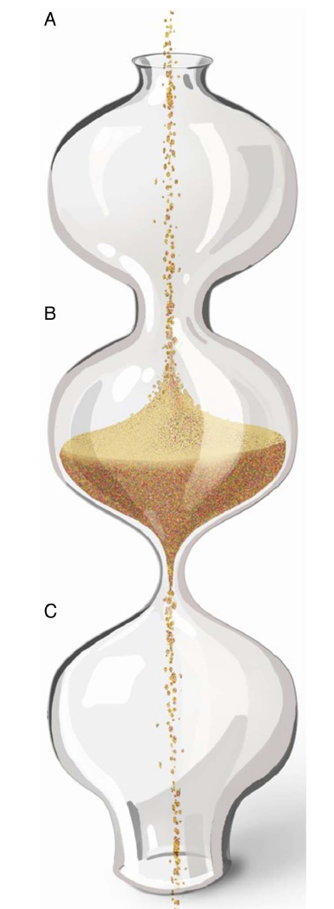
FONTAN PHYSIOLOGY
Man-made neoportal system, where one capillary bed pools blood into another capillary bed without receiving energy from a pump.
critical bottleneck within this circulation.
Output through a bottleneck is determined by
pressure just above (systemic veins) and below (pulmonary veins) the bottleneck
resistance within the bottleneck (PVR)
Bottle neck concept

Slide 38
Role of ventricle in fontan circuit
no longer controls the cardiac output
nor decreases the extent of congestion in the systemic veins
Only pumps the output allowed by Fontan circuit
Deteriorates over time by increasing its end-diastolic pressures
Further worsens systemic venous congestion and reduces output

Slide 39
Throughout the Fontan strategy, the ventricle is exposed to different and extreme loading conditions.
During fetal life and the initial palliation, the SV is volume overloaded (250%–350% for BSA)
At the time of Glenn shunt, the volume load on the SV is reduced to about 90% for BSA.
At completion of Fontan circuit reduces down to 50%–80% for BSA
Volume overloaded and overstretched → overgrown and severely deprived.

Slide 40
Chronically decreased preload leads to arterial vasoconstriction and increased afterload for the ventricle
Hence shows both systolic and diastolic dysfunction
vicious cycle : low preload → remodelling → reduced compliance and increasing filling pressures → decreases preload
The ventricle - not the critical bottleneck, but the diastolic suction required for forward flow.
diastolic dysfunction evolves from a minor to a major contributor of the failing circulation

Slide 41
Use of ACE inhibition in Fontan patients
Enalapril or placebo was given for 10 weeks in 18 pts. approx. 14 yrs after Fontan operation
Tendency to worsen exercise performance
Reduced incremental cardiac index during exercise in the patients receiving enalapril
Kouatli et al ,Enalapril does not enhance exercise capacity in patients after Fontan procedure. Circulation Sep 2 1997;96(5):1507–12.

Slide 42
Many patients continue to receive ACE inhibition, in the hope of a beneficial effect when given chronically
It is possible that there are subgroups that may benefit e.g. severe systolic dysfunction
Presently no evidence for this therapy being beneficial

Slide 43
SEQUELAE OF FONTAN OPERATION
Perioperative mortality : 3-5 % (< 2 % in recent data)
Overall survival
5 yrs – 86%
10 yrs – 81%
15 yrs – 73%
20yrs- 60-80%
10 yr survival (lateral tunnel) – 87%
10 yr survival (extracardiac) – 92.4%

Slide 44
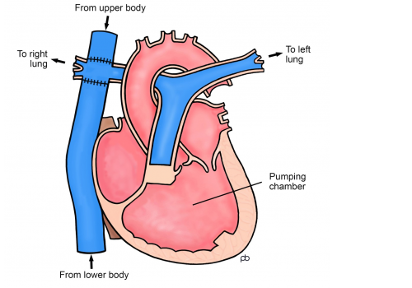
COMPLICATIONS OF FONTAN
CARDIAC
EXTRA CARDIAC
RA
Dilatation
Poor,turbulent blood flow
clots
PULMONARY CIRCULATION
Stenosis, dilatation, leak, pulm HTN
Increased IVC pressure
VENTRICULAR FAILURE

Slide 45
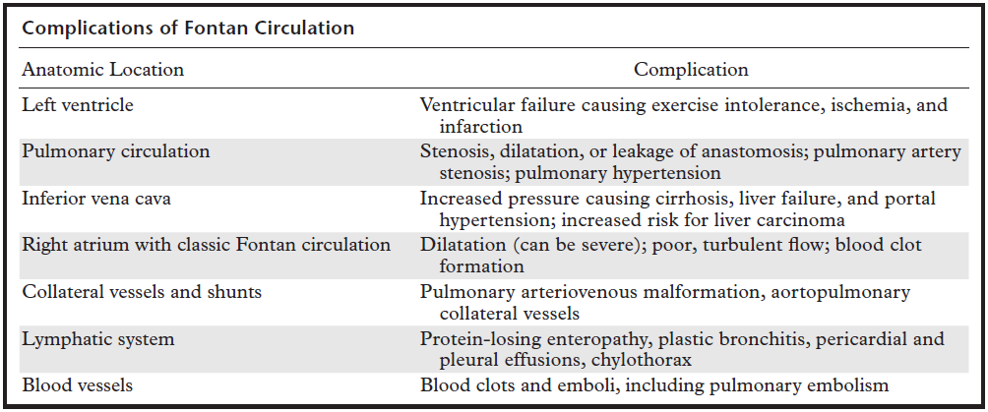

Slide 46
Right Atrium (Classic Fontan Operation)
Dilatation – leads to
Arrhythmias
Blood stasis – poor PBF and thrombosis
Atriotomy – injury to sinus node and conducting fibers
Treatment :
Conversion to extra cardiac cavopulmonary circuit
right atrial maze procedure (to reduce arrhythmia),
right atrial reduction plasty,
pacemaker

Slide 47
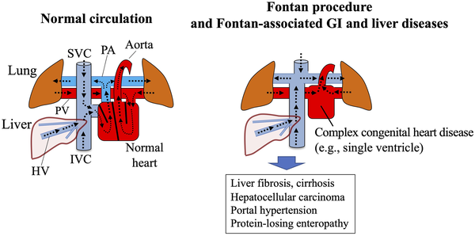

Slide 48
Chronic venous hypertension leads to :
increased hepatic sinusoidal pressure and loss of venous pressure gradient
portal venous hypertension and hepatic dysfunction
Portal hypertension - splenomegaly and portosystemic shunts.
Hepatic encephalopathy
Cardiac cirrhosis
Hepatocellular carcinoma

Slide 49
Thankyou…
References
Anderson’s pediatric cardiology 4th Ed
Park’s pediatric cardiology 7th ed
Fontan F, Baudet E. Surgical repair of tricuspid atresia. Thorax. 1971 May;26(3):240-8. doi: 10.1136/thx.26.3.240.
Kouatli et al ,Enalapril does not enhance exercise capacity in patients after Fontan procedure. Circulation Sep 2 1997;96(5):1507–12.
Riad B.M. Hosein and others, Factors influencing early and late outcome following the Fontan procedure in the current era. The ‘Two Commandments’?, European Journal of Cardio-Thoracic Surgery, Volume 31, Issue 3, March 2007, Pages 344–353, https://doi.org/10.1016/j.ejcts.2006.11.043
To be covered..
Complications of Fontan
Management of “Well” Fontan
Management of Fontan failure

Slide 50
1. Regarding the two statements
Pulmonary and systemic circulations are connected in series normally.
In univentricular heart, they are connected in parallel.
Both a & b are false
Option a is true but b is false
Option a is false but a is true
Both a and b are true

Slide 51
2. Which of the following statements is true regarding ten commandments of Fontan procedure?
mean PAP ≤15mmHg
EF > 40%
Minimum age 6y
All of the above

Slide 52
Red flag sign in the interstage 1 management includes all except
SpO2 less than 75% or greater than 90%
Weight loss of 30 g or failure to gain 20 g over 3 days
Enteral intake less than 75 mL/kg per day
Fever, cough, congestion, change in breathing pattern, vomiting, diarrhea, irritability.

Slide 53
4. Pleural effusion after SCPC, true is
When CVP elevates, lymphatic obstruction occurs and it has to be treated with steroids /octreotide immediately.
If effusion persists for >1 week, anatomic causes has to be investigated.
Pleurodesis to be done on POD 2-3 for pleural effusion after SCPC
None of the above

Slide 54
5. Effects of chronic volume overload on SV are all except
Dilatation of atrium and ventricle
Eccentric hypertrophy
Spherical remodelling with reorientation of wall fibers
Annular dilatation causing progressive MV valve regurgitation

Slide 55
6. identify the false statement regarding management of univentricular heart
Initial palliation of babies with reduced PBF- BT shunt + PGE1
Neonates with increased PBF- palliative therapy done initially with PA banding and anticongestive therapy
BDG procedure is done between 1-3weeks after delivery.
If a prior BT or Sano shunt is present, it is ligated at the time of bidirectional Glenn.

Slide 56
7. Perioperative mortality of Fontan procedure is
10-12%%
8-10%
6-8%
3-5%

Slide 57
8. Low cardiac output noted early after Fontan procedure. Identify the correct statement.
Low TPG, Low LA pressure, Low fontan pressure managed with volume replenishment.
Fontan thrombosis/obstruction will produce high TPG, low saturation and normal LA pressure
High LA pressure and fontan pressure , low TPG is seen when there is arrhythmia
All the above

Slide 58
9. Fenestrated Fontan- all are true except
An intentional defect created within the Fontan pathway that connects it to the pulmonary venous atrium.
The fenestration will shunt right to left, lowering central venous pressure and augmenting ventricular preload.
Paradoxic embolism and stroke are adverse events of fenestrated Fontan
Produces rapid volume overload in the lungs

Slide 59
Identify the procedure done
BDG
BT shunt
Completion Fontan
Damus Kaye Stansel

