Slide 1
Mavacamten in Adults With Symptomatic Obstructive HCM Who Are Eligible for Septal Reduction Therapy - VALOR-HCM
Author/Summarized by Author:Dharam J. Kumbhani, MD, SM, FACC
Summary Reviewer:Deepak L. Bhatt, MD, MPH, FACC
Trial Sponsor:MyoKardia , Inc.Date
Presented:04/02/2022
Original Posted Date:04/02/2022
Source: www.acc.org
Dr Shreyas Samaga

Slide 2
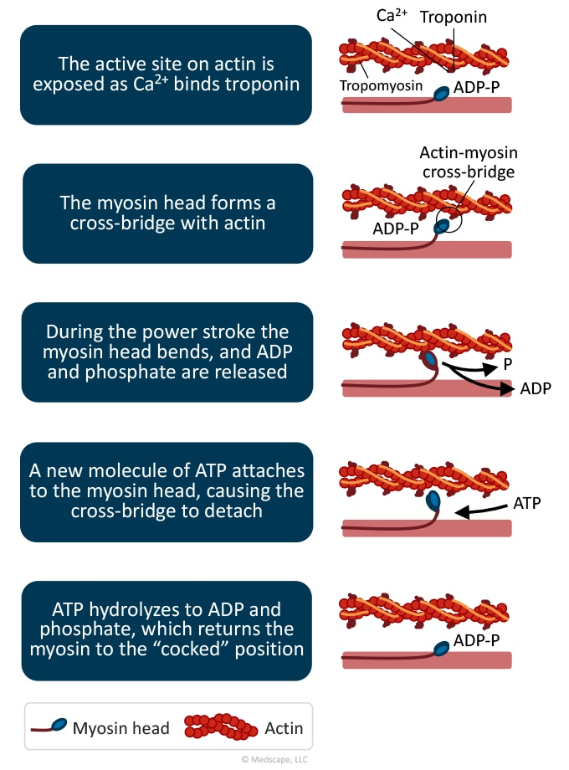

Slide 3
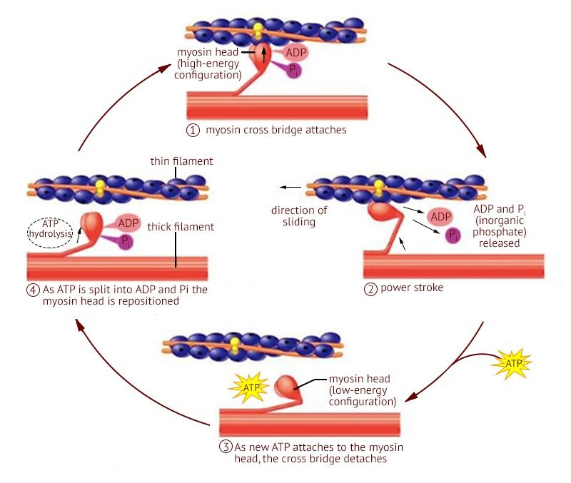

Slide 5
Goal of the trial
To assess the safety and efficacy of adding mavacamten to maximally tolerated medical therapy among patients with obstructive hypertrophic cardiomyopathy (HCM).

Slide 6
Study Design
Total number of enrollees: 112
Eligible patients were randomized in a 1:1 fashion to mavacamten (n = 56) or placebo (n = 56).
Mavacamten was started at a dose of 5 mg, and titrated using core laboratory measured left ventricular ejection fraction (LVEF) and left ventricular outflow tract (LVOT) gradient at rest and with Valsalva provocation.

Slide 7
Study Design
Duration of follow-up: 16 weeks
Mean patient age: 60 years
Percentage female: 49%

Slide 8
Inclusion Criteria
Age ≥18 years
Documented HCM with maximum septal wall thickness ≥15 mm or ≥13 mm with family history of HCM (determined by a core echocardiography laboratory)
Severe symptoms despite maximally tolerated medical therapy
New York Heart Association (NYHA) functional class III/IV or class II with exertional syncope or near syncope

Slide 9
Maximal medical HCM therapy could include disopyramide and/or combination beta-blockers and calcium channel blockers
Dynamic LVOT gradient at rest or with provocation (Valsalva maneuver or exercise) ≥50 mm Hg
Documented LVEF ≥60%
Must have been referred within the past 12 months for SRT and actively considering scheduling the procedure

Slide 10
Principal Findings:
Primary end point
septal reduction therapy
Guideline-based eligibility for septal reduction therapy at 16 weeks.
2 patients from each group

Slide 11
The primary endpoint occurred in 17.9% of the mavacamten group compared with 76.8% of the placebo group (treatment difference, 58.93; 95% CI, 43.99-73.87; P < .0001).
Proceeded with SRT: 3.6% vs. 3.6%
Guideline eligible for SRT but did not proceed: 14.3% vs. 69.6%.

Slide 12
Secondary outcomes for mavacamten vs. placebo:
Improvement in NYHA class ≥I class: 63% vs. 21% (p < 0.05)
Resting LVOT gradient at 16 weeks: 14 vs. 46 mm Hg (p < 0.05)
Valsalva LVOT gradient at 16 weeks: 28 vs. 78 mm Hg (p < 0.05)
Kansas City Cardiomyopathy Questionnaire (KCCQ)-23 clinical summary score at 16 weeks: 80 vs. 67 (p < 0.05).

Slide 13
Safety outcomes for mavacamten vs. placebo:
Nonsustained ventricular tachycardia: 0% vs. 9.1%
Nausea: 7.1% vs. 1.8%
No patients had chronic heart failure, syncope, or sudden cardiac death

Slide 14
Outcome
Mavacamten improved symptoms and significantly reduced eligibility for needing SRT among symptomatic patients with obstructive HCM who were considering SRT.

Slide 15
Other trials on Mavacamten
Mavacamten for treatment of symptomatic obstructive hypertrophic cardiomyopathy (EXPLORER-HCM)
THE LANCET Volume 396, issue 10253, p759-769, september 12, 2020
Phase 3, randomised, double-blind, placebo-controlled trial in 68 clinical cardiovascular centres in 13 countries.
251 were enrolled and randomly assigned to mavacamten (n=123 [49%]) or placebo (n=128 [51%]).

Slide 16
EXPLORER-HCM
The primary endpoint
≥1·5 mL/kg/ min increase in peak oxygen consumption (pVO₂)
Mavacamten group had greater increase compared to placebo
at least one NYHA class reduction
More patients in Mavacamten group had NYHA class reduction

Slide 17
MAVACAMTEN
EXPLORER-HCM- treatment with mavacamten improved exercise capacity, LVOT obstruction, NYHA functional class & health status in patients with obstructive HCM.
VALOR-HCM- Mavacamten improved symptoms and significantly reduced eligibility for needing SRT among symptomatic patients with obstructive HCM who were considering SRT.

Slide 18
THANKYOU

