Slide 1
ECG DIAGNOSIS OF VENTRICULAR TACHYCARDIA
Dr.Ashis Ranjan
29-12-2016

Slide 2
Ventricular Tachycardia
Ventricular Tachycardia is Defined as Three or more consecutive PVC’s
VT arises distal to the bifurcation of the His bundle in the specialized conduction system, ventricular muscle, or combinations of both types of tissue
rate is usually Between 100-200 BPM
Sustained VT
  Episodes last at least 30 seconds/ req intervention for termination
Non-sustained VT
  Episodes last at least 6 beats but < 30 seconds

Slide 3
Electrocardiographic Recognition
The electrocardiographic diagnosis of VT is suggested by the occurrence of a series of three or more consecutive, abnormally shaped PVCs whose duration exceeds 120 milliseconds, with the ST-T vector pointing opposite the major QRS deflection
The R-R interval can be exceedingly regular or can vary.
QRS contours during the VT can be unchanging (uniform, monomorphic) or can vary randomly (multiform, polymorphic, or pleomorphic) in a more or less repetitive manner (torsades de pointes), in alternate complexes (bidirectional VT), or in a stable but changing contour (i.e., right bundle branch contour changing to a left bundle branch contour)

Slide 4
ECG :VT
>3 Consecutive PVC with ST segment and T WAVE opposite in direction to abnormal QRS complex
QRS duration >0.14S
Ventricular rate>100 regular ,<200
LAD with Superior axis (-90to -180),positive deflection in lead 1
AV DISSOCIATION
RETROGRADE VA CONDUCTION
FUSION /DRESSLERS BEATS
SINUS CAPTURE BEATS

Slide 5
DIAGNOSIS OF VT
D/D OF WIDE COMPLEX TACYCARDIA
SVT OR VT

Slide 6
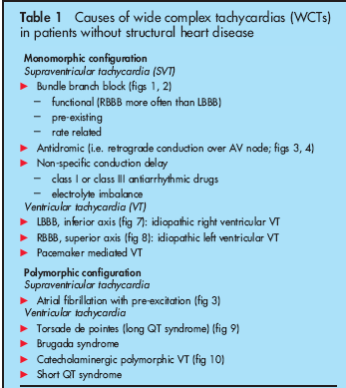

Slide 7
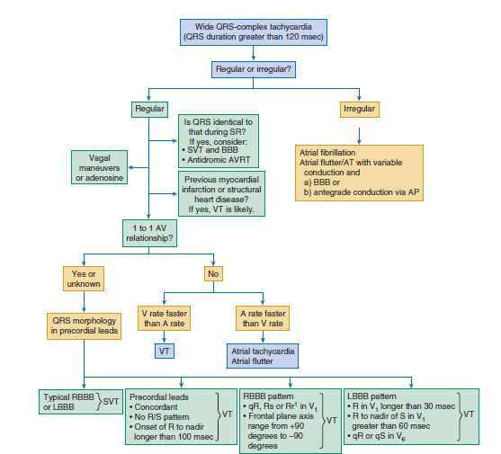

Slide 8
An Approach to WCT
(Is the patient stable or unstable?)
What is the rate?
Is the rhythm regular or irregular?
Are there p waves?
  Are they related to the QRS?
  Are they flutter waves?
  Are the p waves of the same morphology?
Is the QRS morphology consistent?

Slide 9
WCT
Regular WCT
VT (monomorphic)
SVT + accessory pathway
SVT + BBB
Irregular WCT
Polymorphic VT
  Torsades de Pointes
A fib + accessory pathway
A fib + BBB
A flutter + variable block + BBB
MAT + BBB
V Fib

Slide 10
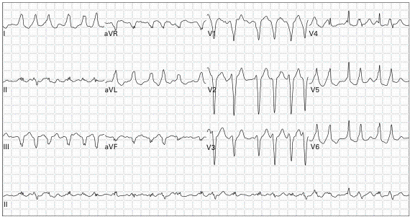
35M palpitations, lightheaded
Irregular WCT, marked variation in QRS morphology, no P waves = AF + WPW
Notes:
Irregular WCT, marked variation in QRS morphology = AF + WPW

Slide 11

57M weakness, palpitations
Irregular WCT, consistent QRS morphology, no P waves = AF + RBBB
Notes:
Irregular WCT, consistent QRS morphology, no P waves = AF + RBBB
PVCs, LAD from old MI

Slide 12
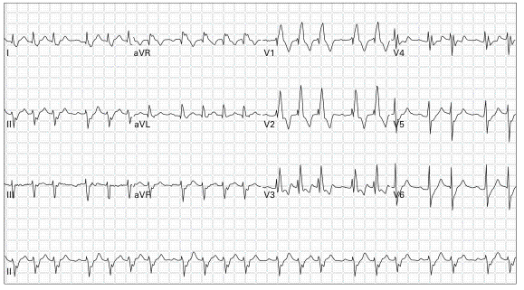
47M palpitations
Irregular WCT, consistent QRS morphology, P waves, consistent R-R in groups = A flutter + variable block + RBBB
Notes:
Irregular WCT, consistent QRS morphology, P waves, consistent R-R in groups = A flutter + RBBB

Slide 13
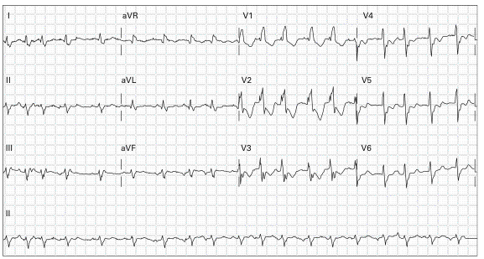
60M dyspnea, palpitations, hx COPD
Irregular WCT, consistent QRS morphology, irregular P waves, inconsistent R-R = MAT + RBBB
Notes:
Irregular WCT, consistent QRS morphology, irregular P waves, inconsistent R-R = MAT + RBBB

Slide 14
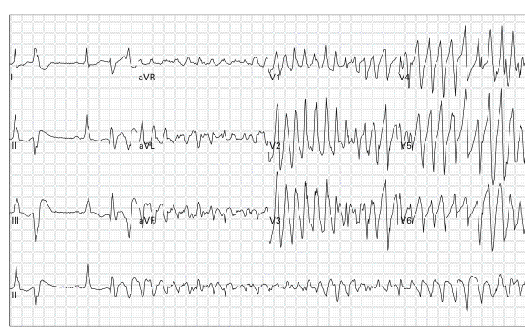
44M chronic alcoholic, unresponsive
Irregular WCT, varying QRS morphology (undulating) = Torsades de Pointes
Notes:
Irregular WCT, varying QRS morphology (undulating) = Torsades de Pointes

Slide 15
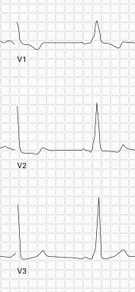
Wolff-Parkinson-White Syndrome
Most common ventricular pre-excitation syndrome (bundle of Kent)
Triad:
  Short PR (<0.12 sec)
  QRS prolongation (>0.10 sec)
  Slurred QRS upstroke (delta wave)
If WCT
  Rates can approach 300bpm
  Significant QRS morphology variation

Slide 16
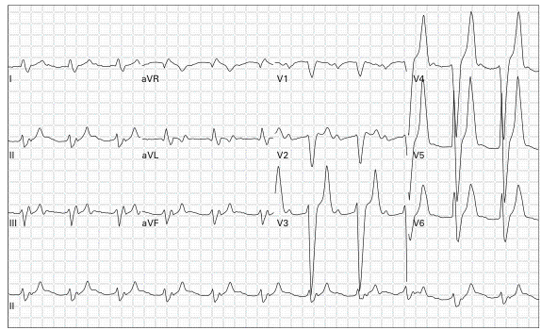
41M weakness
Irregular wide complex rhythm, peaked T, no P = hyperkalemia
Notes:
PMH: CRF
HK (K=8.7)

Slide 17
Summary Irregular WCT – The Bad
AF + WPW
  QRS morphology variation
  Rates can approach 300bpm
AF + BBB
  Consistent QRS morphology
  Rate limited by AV node (usually < 200bpm)
Polymorphic VT
  QRS morphology variation (more chaotic than WPW)
  Rates consistently rapid (often > 300bpm)
  Unstable
Notes:
More likely to deteriorate into unstable rhythms

Slide 18
Summary Irregular WCT – The Good
Atrial flutter with variable block + BBB
  P waves present, some not conducted
  Consistent QRS morphology
  Consistent R-R interval in groups
MAT + BBB
  Irregular P waves of different morphology
  Consistent QRS morphology
  Inconsistent R-R interval
Notes:
Less likely to deteriorate into unstable rhythms

Slide 19
VT vs. SVT With Abberancy
Angina, MI, CABG, valvular dz, or CHF → PPV 95% for VT
Hemodynamic stability not useful
ECG findings
  A-V dissociation (discernable in 20%)
    PPV 100%
    AV association not helpful (present in 50% VT)
  Fusion beats, capture beats (discernable in 5-10%)
    PPV 100%

Slide 20
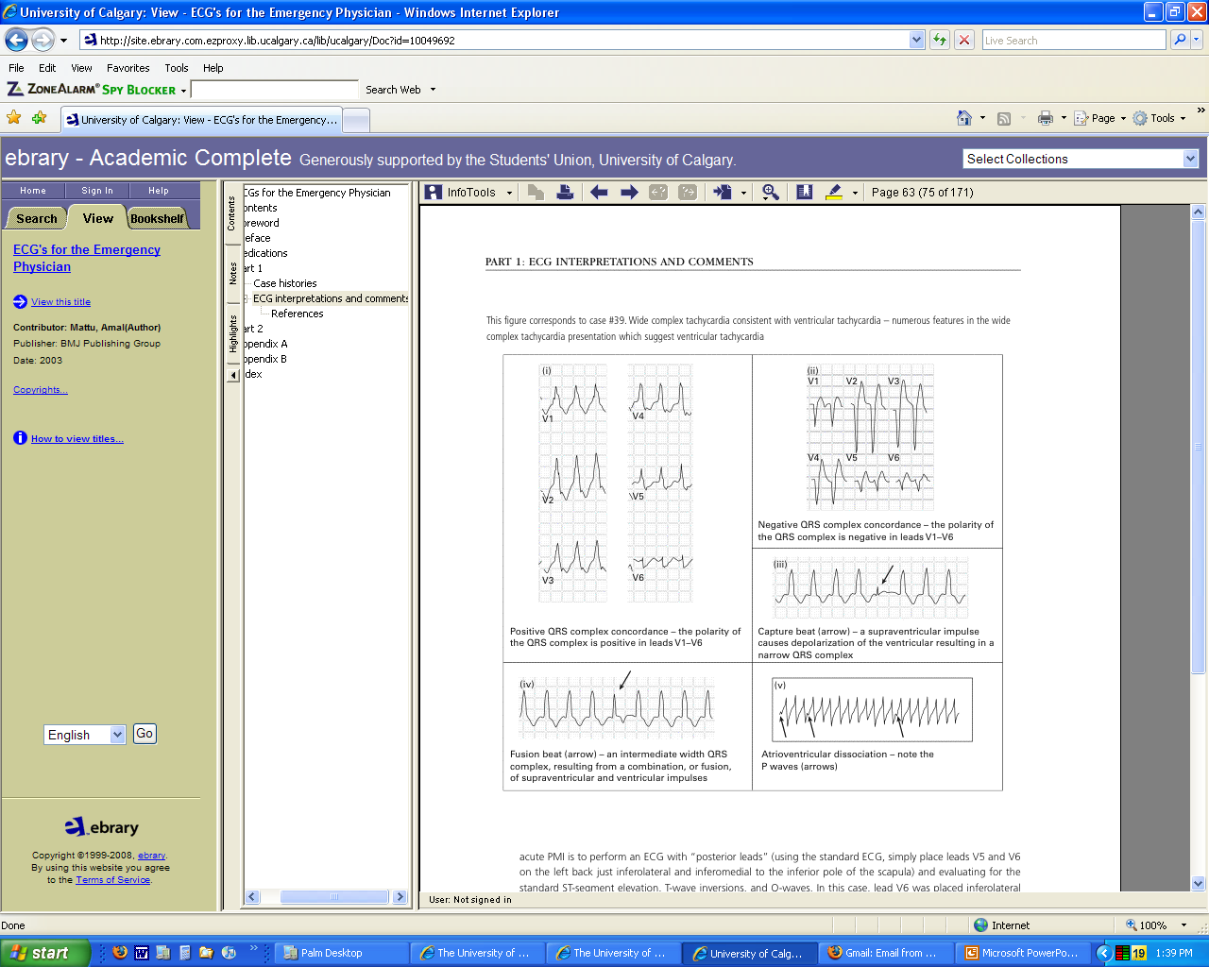

Slide 21
VT vs. SVT With Abberancy
Wellens criteria
  Many criteria
  Wellens HJJ, Bar FWHM, Lie KI. The value of the electrocardiogram in the differential diagnosis of a tachycardia with a widened QRS complex. Am J Med 1978;64:27-33.
Brugada criteria
  4-step approach using Wellens
  SN 98.7%, SP 96.5% for VT (original study)
    Brugada P: A new approach to the differential diagnosis of a regular tachycardia with a wide QRS complex, Circulation 83:1649, 1991.
  EP’s: SN 79-83%, SP 43-70%, K = 0.54-058
    Isenhour et al. Wide Complex tachycardia: continued evaluation of diagnostic criteria. Academic Emergency Medicine. Jul 2000;7(7): 769-773.
    Herbert et al. Failure to agree on the electrocardiographic diagnosis of ventricular tachycardia. Ann Emerg Med. 1996;27(1):35-8.
Notes:
Bottom line, these criteria may help, but remember fusion beats, capture beats, AV dissociation

Slide 22
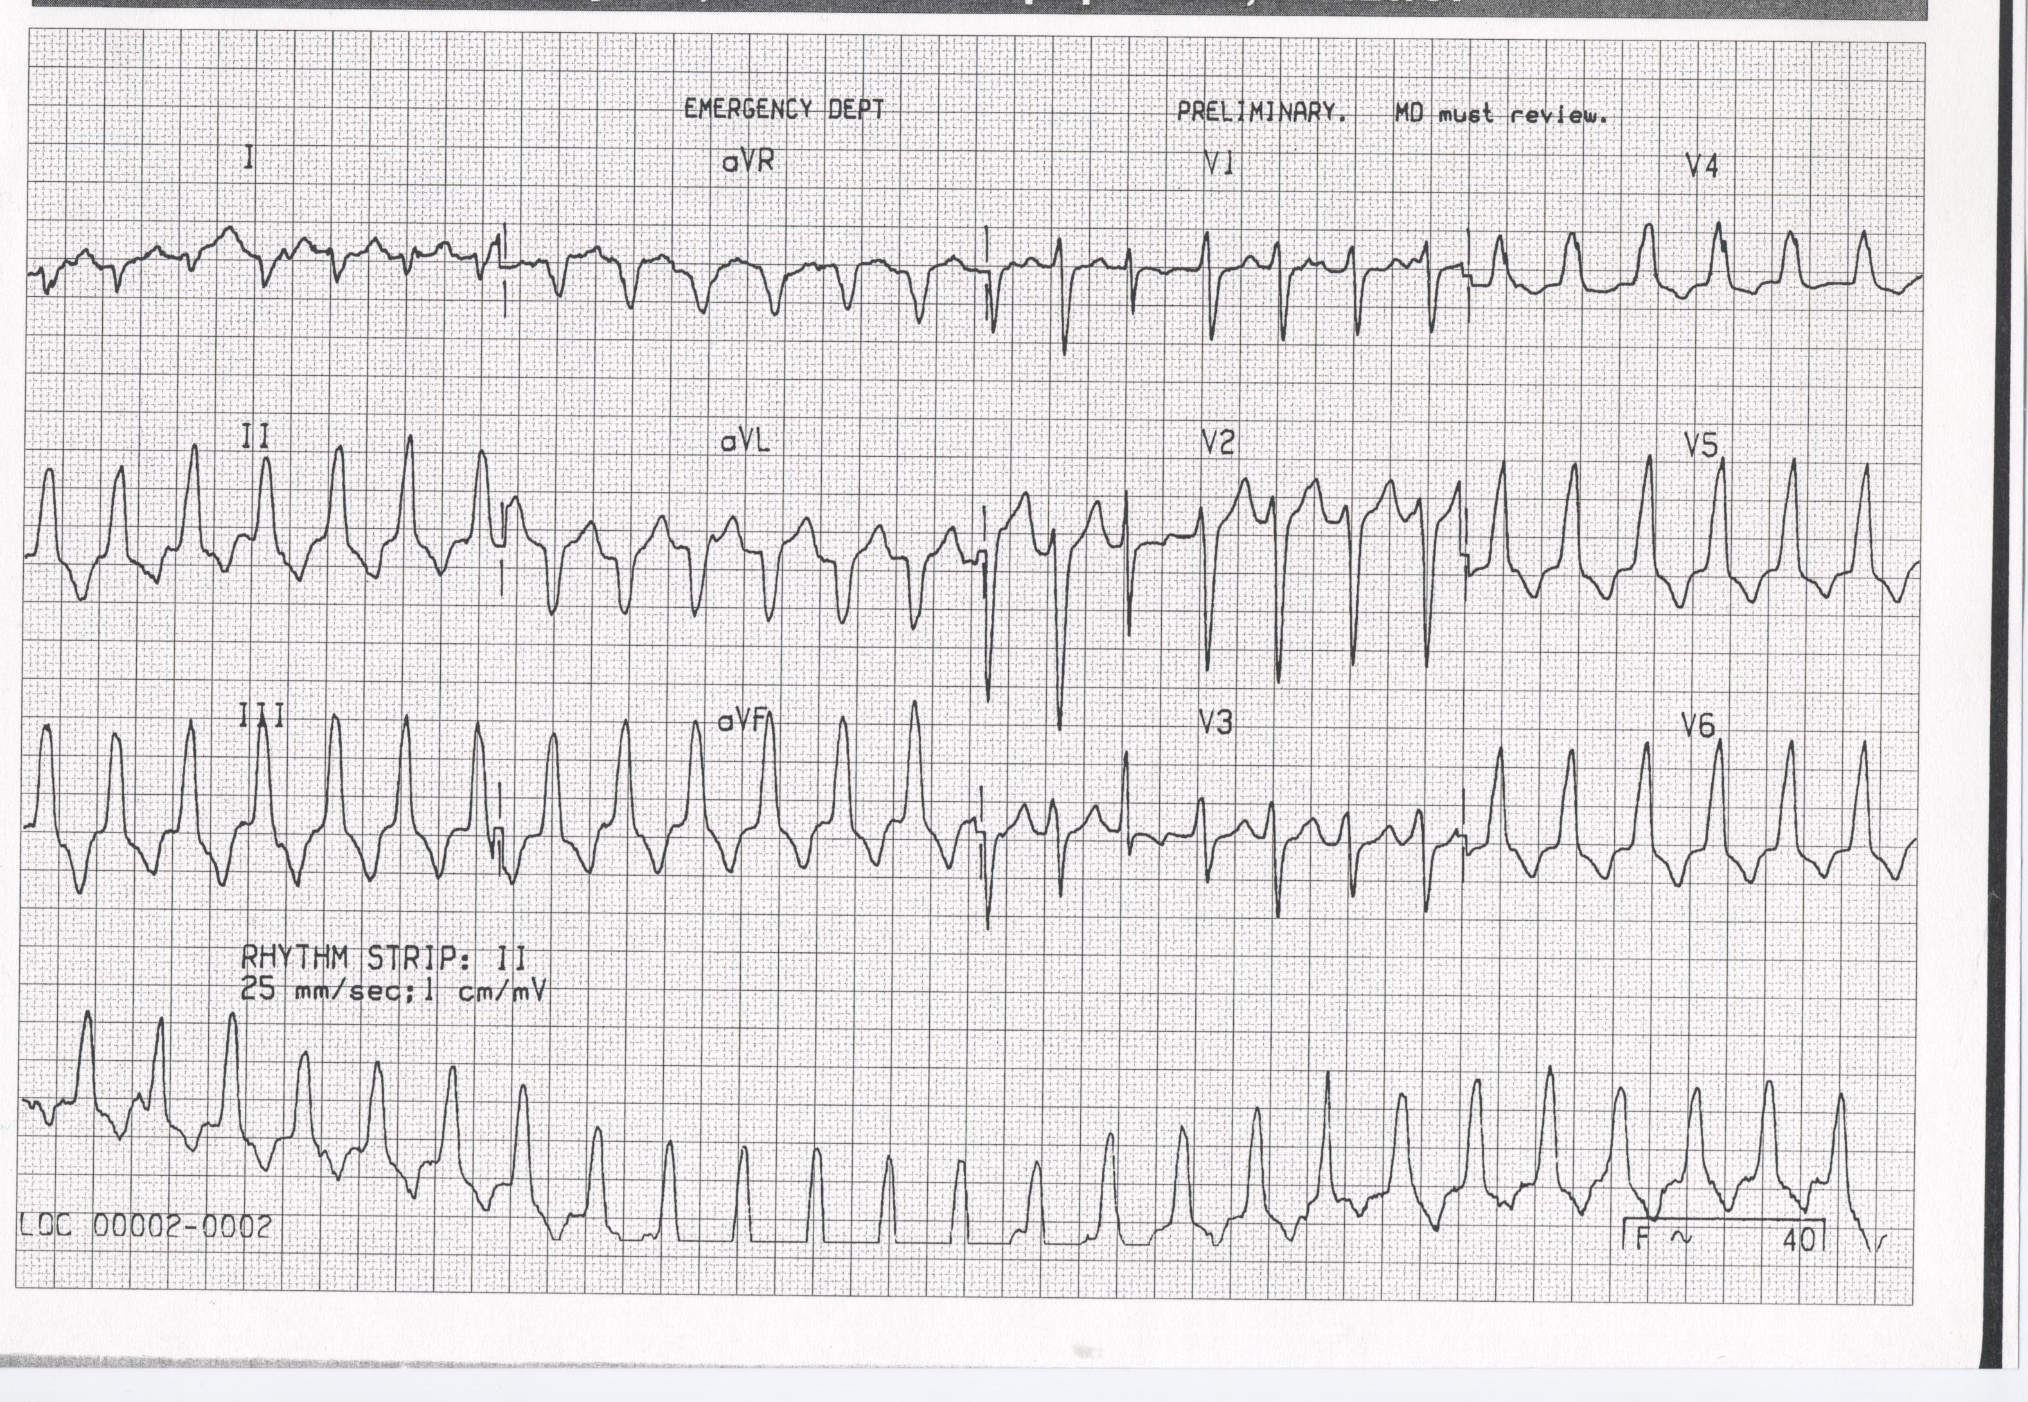
72F SOB, PMH: recent MI
Regular WCT, AV dissociation & fusion beat (rhythm strip), capture beat (V1) = VT
Notes:
Regular WCT, AV dissociation & fusion beat (rhythm strip), capture beat (V1) = VT

Slide 23

61M fever, cough, dyspnea
Regular WCT, P waves in V1 = atrial tachycardia + LBBB
Notes:
Regular WCT, P waves in V1 = atrial tachycardia + LBBB (need upright P in II, III, aVF, V1 to say sinus tachy)

Slide 24
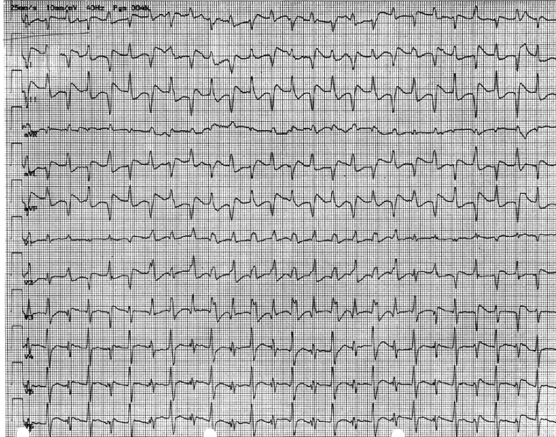
64F SOB, hypotension, PMH: a fib
Regular WCT, bidirectional = Digoxin toxicity

Slide 25
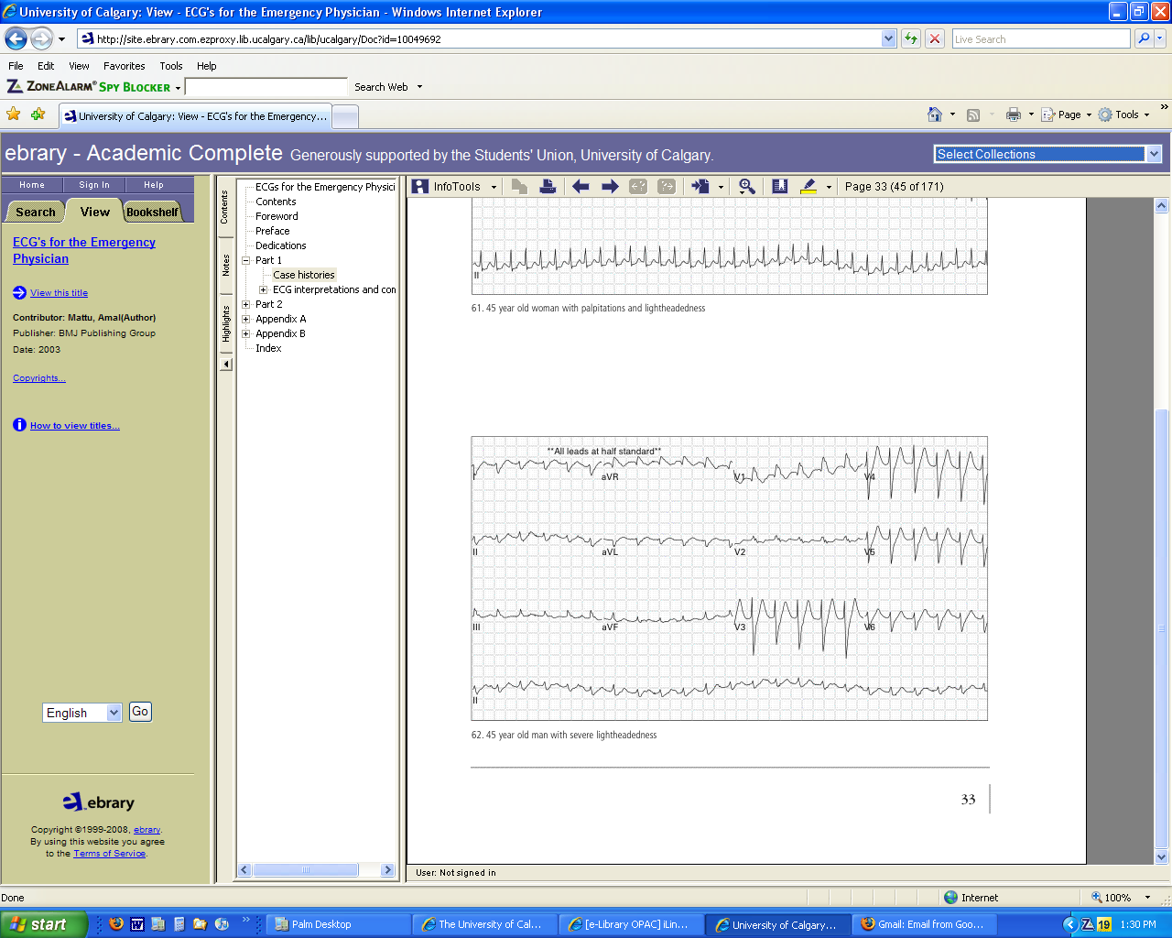
62F lightheaded, PMH: MI x 2
Regular WCT, no P waves = VT

Slide 26
Summary Regular WCT
VT
  Fusion beats, capture beats, AV dissociation
  PMH: cardiac disease
SVT + BBB
  Absence of fusion/capture beats and AV dissociation
  Pre-existing BBB
SVT + accessory pathway
  Absence of fusion/capture beats and AV dissociation
  Pre-existing accessory pathway

Slide 27
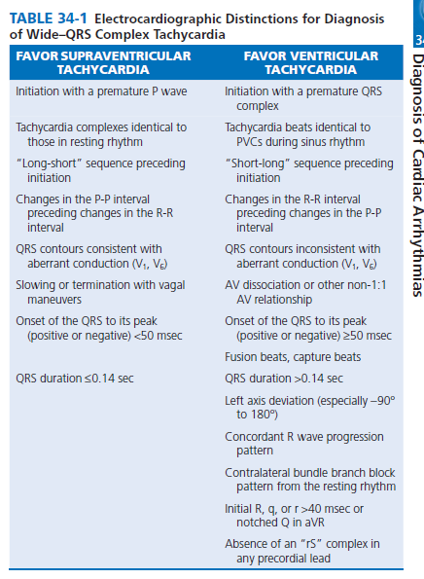
SVT/VT

Slide 28
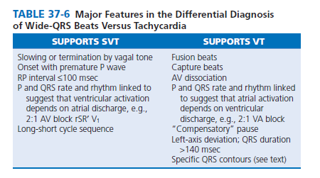

Slide 29
SVT vs VT
ECG criteria
-A fundamentally simple approach: If WCT is due to SVT with aberration, the QRS must be compatible with some form of BBB or FB.
-QRS duration:70% of VTs have QRS duration >140, but no SVT has it. VT is probable when QRS> 140 with RBBB and >160 with LBBB pattern.Anti arrhythmic drugs may prolong QRS. Some patients with VT may have QRS of 120-140 specially in those without structural heart disease.

Slide 30
SVT vs VT
ECG criteria contd,
-QRS axis:
*The more leftward the axis , the more probable VT.
* The quadrant between -90 and 180 (northwest )can’t be achieved with any combination of FB or BBB.
*Some has suggested that if the axis in sinus rhythm is more than 40 degrees different with WCT the diagnosis is VT , but it is not widely accepted.

Slide 31
SVT vs VT
ECG criteria contd
-Specific morphologies ;
If with RBBB pattern:
*In V1:During aberration there is no change in initial portion of QRS so we may see rSr’ ,rR’ , rsr’ or rSR’. But a monophasic R wave , or a broad (> 30 msec) R with any following terminal QRS forces or qR are highly suggestive of VT.
* In V6 :During aberration qRs , Rs ,or RS (with R/S ratio >1) are seen but in VT we may see rS,Qrs , QS or QR or monophasic R wave. If RS pattern is present R/S must be less than 1.

Slide 32
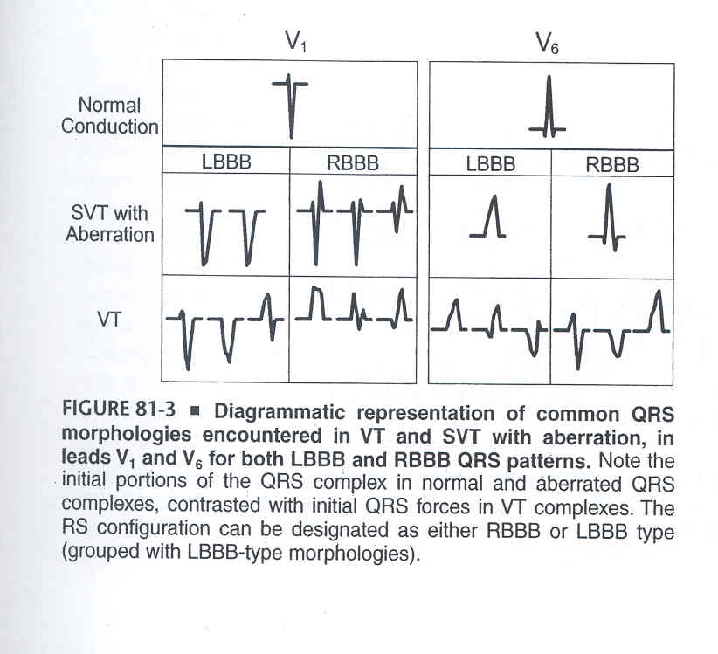

Slide 33
SVT vs VT
ECG criteria contd
LBBB pattern:
* In V1 :Either rS or QS with rapid initial forces (narrow R with rapid smooth descent to S )is seen in LBBB type aberration. Any other pattern such as broad R/deep S or QS with slow descent to S wave nadir will imply VT.
If the initial R is wider than 30 msec it suggest VT , the wider the R , the greater the likelihood of VT.
Notching in the down-stroke of S or interval from the onset of QRS to the S wave nadir greater than 60 msec strongly suggest VT.
*In V6 :In aberrancy there is no initial Q wave and we see RR’, or monophasic R. During VT common patterns are QR ,QS ,QrS ,or Rr’ although patterns compatible with SVT may also be seen.

Slide 35
SVT vs VT
ECG criteria contd
Combination of LBBB and RAD is almost always due to VT .
RBBB with a normal axis is very uncommon in VT.
Concordant pattern in precordial leads is uncommon in SVT ,with the exception of pre-excited tachycardia .The specificity of concordant pattern for VT is >90% but sensitivity is low(20%).
Negative concordance in limb leads is another way of describing NW axis and suggests VT.

Slide 36
SVT vs VT
ECG criteria contd
Q waves during WCT show old MI and are in favor of VT. Generally patients with old Q waves maintain it during WCT .
Some patients with DCM may have Q during VT while they don’t show it in SR.
Pseudo Q waves may be seen in some SVTs with aberrancy. (AVNRT or pre-excited with a posterior AV connection ).

Slide 37
SVT vs VT
Precordial RS absent criteria
Brugada: Most SVTs with aberrancy have an RS complex in at least one precordial lead. VT need not have so in the absence of it the probable diagnosis is VT.
In the presence of RS if the interval from onset of R to nadir of S was greater than 100 msec ,VT was diagnosed.
These criteria are an extension of the dictum that if the ECG doesn’t look like aberration , it is most likely VT.

Slide 38
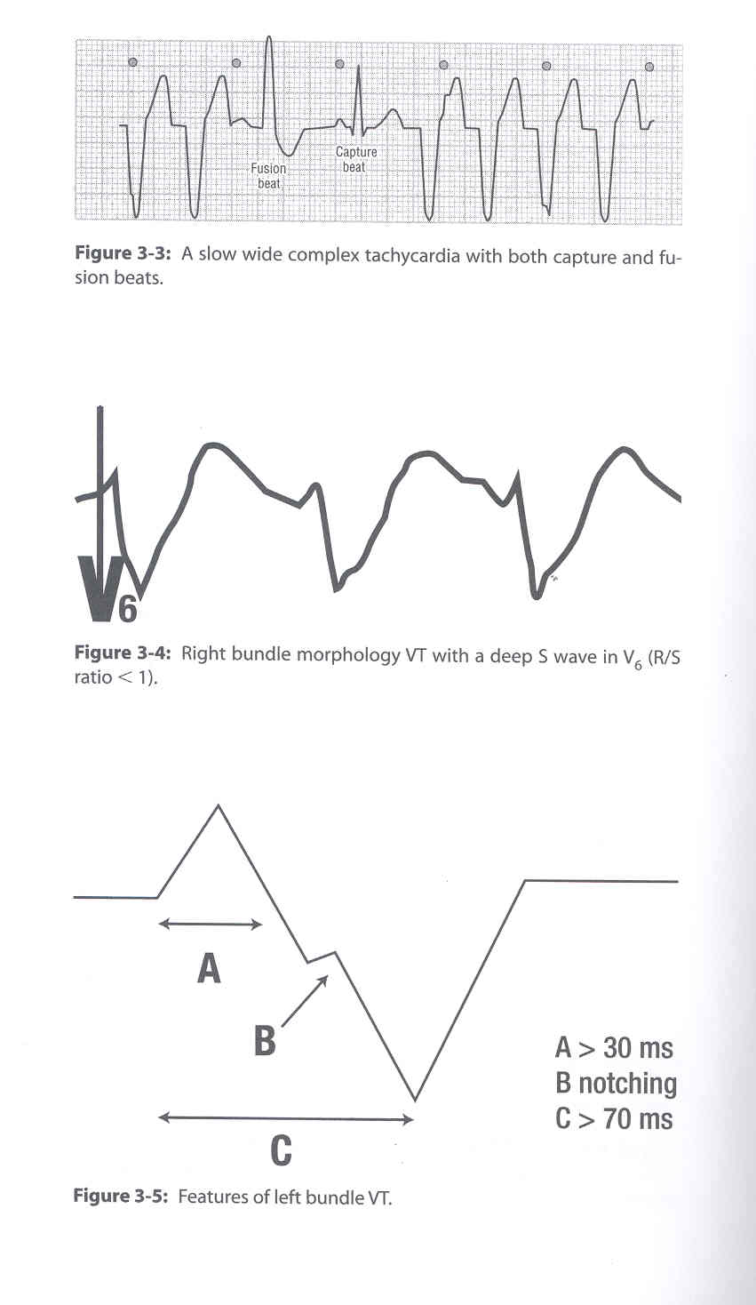

Slide 39
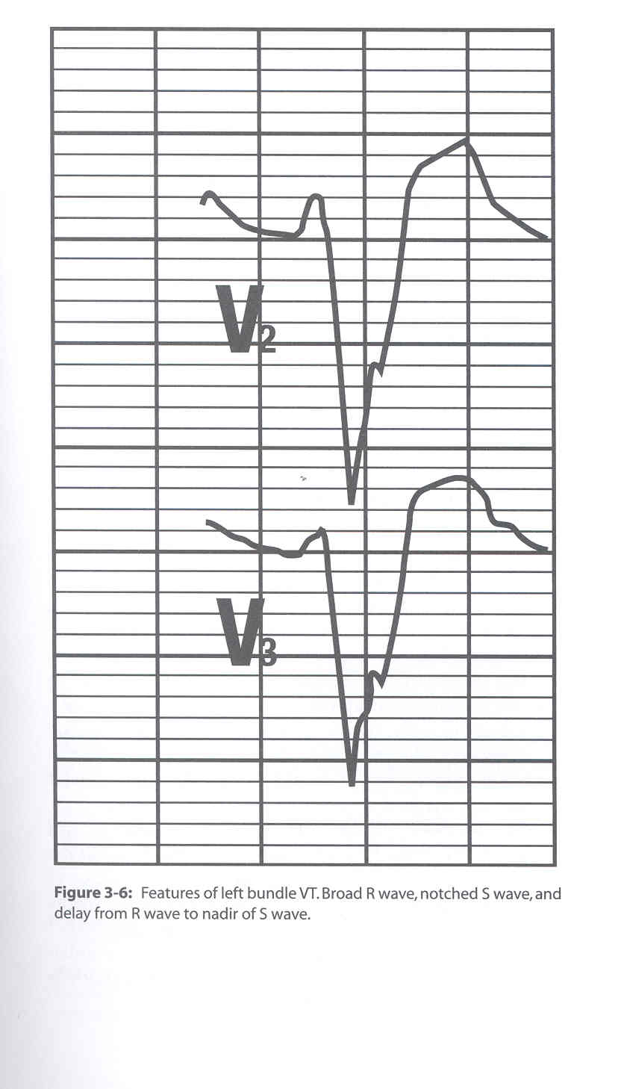

Slide 40
Narrow QRS complex VT
VT can have QRS duration less than the cutoff of 140 msec. Possible explanations are:
1-Septal origin of VT.
2- Early penetration in the His- Purkinje system.

Slide 41
BRUGADA CRITERIA
(D/D VT VS SVT with Aberrant Intraventricular Conduction)
1. Most Helpful with 99% Sensitivity and 96.5% Specificity Without Pre Existing BBB Pre-
2. Stepwise Approach

Slide 42
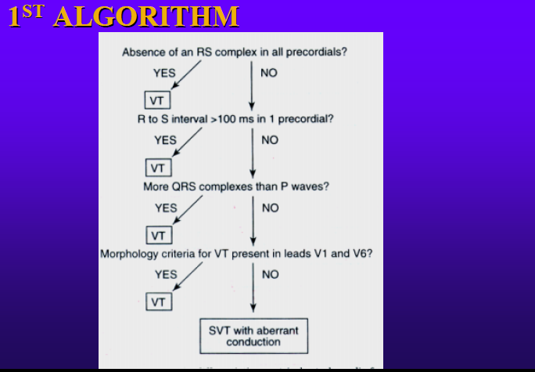

Slide 43
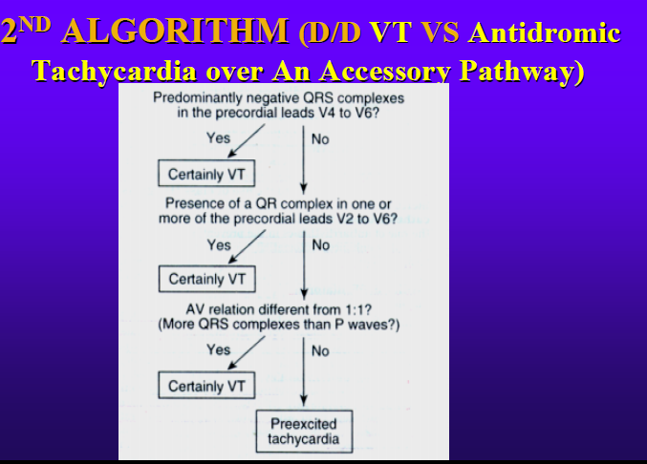

Slide 44
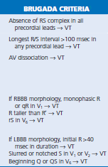

Slide 45
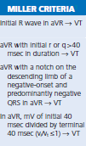
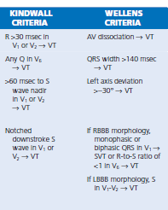

Slide 46
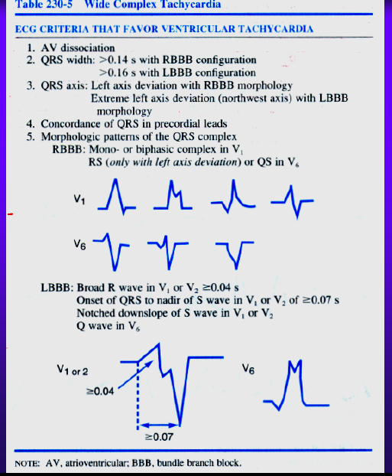

Slide 47
Monomorphic VT
Heart rate: 100 bpm or greater
Rhythm: Regular
Mechanism
  Reentry
  Abnormal automaticity
  Triggered activity
Recognition
  Broad QRS
  Stable and uniform beat-to-beat appearance
Notes:
Monomorphic VT is regular, with uniform beat-to-beat morphology. It can be sustained, nonsustained, idiopathic or caused by bundle branch reentry.

Slide 48
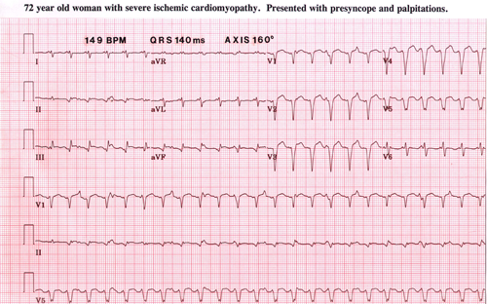
Sustained Monomorphic VT

Slide 49
Monomorphic VT
RBBB Pattern
VARIENT BBB reentry tachycardia
Isthmus tachycardia
Idiopathic LV
LBBB PATTERN
RVOT VT
BBB REENTRY
ARVD

Slide 50
Polymorphic VT
Heart rate: Variable
Rhythm: Irregular
Mechanism:
  Reentry
  Triggered activity
Recognition:
  Wide QRS with phasic variation
  Torsades de pointes
Notes:
A second classification of VT is polymorphic VT.

Slide 51
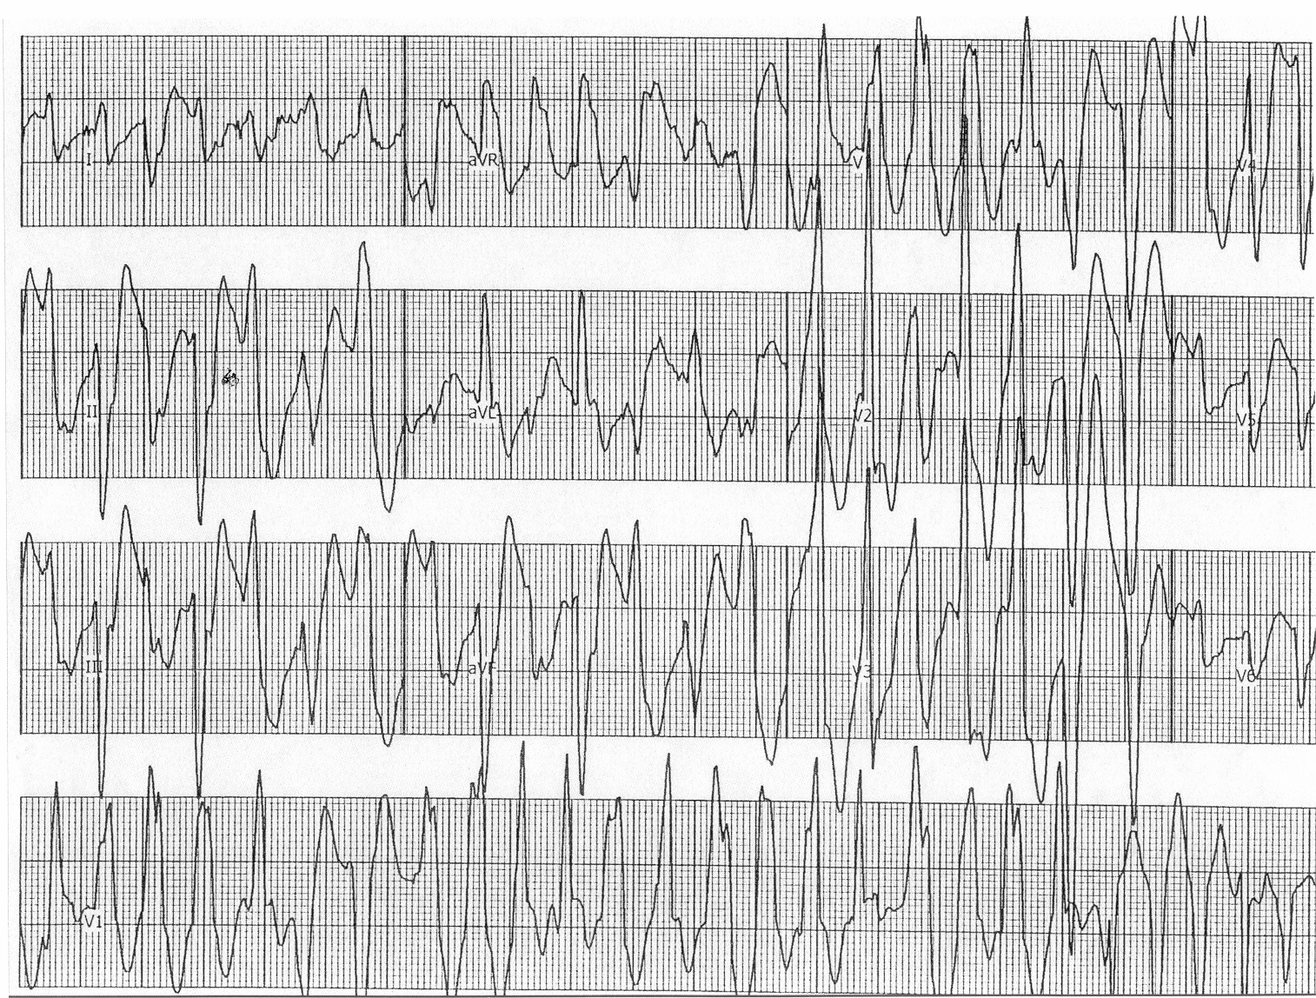
Sustained Polymorphic VT
Exercise induced in patient with no structural heart disease

Slide 52
POLYMORPHIC VT WITH NORMAL QT
VF
ACUTE ISCHEMIA
POLYMORPHIC VT WITH INCREASED QT
LONG QT
DRUGS
OP POISIONING
HYPOKALEMIA
ICH HYPOTHYROIDISM
BIDIRECTIONAL
DIGITALIS TOXICITY

Slide 53
Torsades de Pointes (TdP)
Heart rate: 200 - 250 bpm
Rhythm: Irregular
Recognition:
  Long QT interval
  Wide QRS
  Continuously changing QRS morphology
Notes:
TdP is a rapid and distinct VT with a twisting configuration of the QRS morphology, associated with prolonged repolarization. It may be acquired or congenital. It is a very deadly form of VT.

Slide 54

ECG Recognition
QRS morphology continuously changes
Complexes alternates from positive to negative
Notes:
Torsades de pointes (twists of points) is a unique VT in which the QRS complexes change from positive to negative and appear to twist around the isoelectric line.

Slide 55
Ventricular Flutter
Heart rate: 300 bpm
Rhythm: Regular and uniform
Mechanism: Reentry
Recognition:
  No isoelectric interval
  No visible T wave
  Degenerates to ventricular fibrillation
Treatment: Cardioversion
Notes:
Rarely seen, ventricular flutter may occur just prior to the onset of ventricular fibrillation. It degenerates into ventricular fibrillation in a matter of seconds.

Slide 56
Ventricular Fibrillation
Heart rate: Chaotic, random and asynchronous
Rhythm: Irregular
Mechanism: Multiple wavelets of reentry
Recognition:
  No discrete QRS complexes
Treatment:
  Defibrillation
Notes:
Ventricular fibrillation (VF) will convert to fine VF and then no electrical activity will be seen. Patients resuscitated from VF are deemed sudden cardiac death survivors.

Slide 57

ECG Recognition
P waves and QRS complexes not present
Heart rhythm highly irregular
Heart rate not defined
Notes:
The following ECG findings help electrophysiologists to diagnose VF:
P waves and QRS complexes are not present.
Heart rhythm is highly irregular.
The heart rate is not defined (without QRS complexes).

Slide 58
Bundle Branch Reentry
Reentry circuit is confined to the left and right bundle branches
Usually LBBB, during sinus rhythm
Presents with:
  Syncope
  Palpitations
  Sudden cardiac death
Treatment: RF ablation of right bundle
Notes:
Bundle branch reentry tachycardia is another VT that is treatable with RF ablation. With this type of tachycardia, the HV interval is increased.
Ablation of the right bundle does cure this form of reentry. However, given the underlying LBBB, ablation of the RBBB results in either very impaired His/Purkinje function or in complete heart block. A pacer is usually required.

Slide 59
VT Due to Bundle
Branch Reentry
Notes:
The most helpful criteria to consider when diagnosing VT due to bundle branch reentry is the comparison of this LBBB morphology to the LBBB seen in sinus. The morphology does not have to be exactly the same (if there is some conduction down the left bundle) but it should be really similar.

Slide 60
HOW TO RECOGNISE SITE
The tachycardia's QRS morphology on surface electrocardiogram (ECG) predicts the site of origin .
as right ventricular tachycardia
left ventricular tachycardia

Slide 61
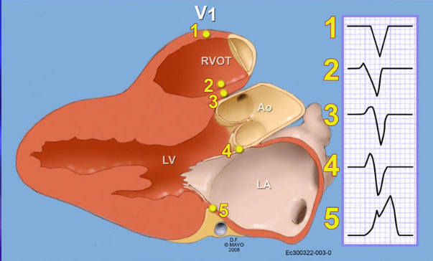
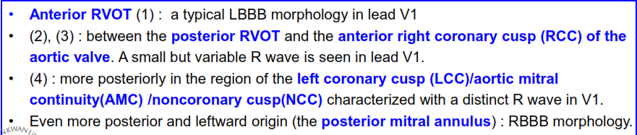

Slide 62
IDIOPATHIC VT
Type of VT | QRSmorphology/axis | Pharmacoterapy sensitivity | Treatment
RVOT VT /monomorphic extrasystoles | LBBB/ inferior axis | Adenosine, B-blocker, verapamil (or diltiazem) B-Blocker, verapamil | RF ablation
LVOT VT | S wave in lead I, R-wave transition in V1 or V2 | Adenosine, B-blocker, verapamil (or diltiazem) B-Blocker, verapamil, | RF ablation
Fascicular VT | RBBB/ left superior axis (exit posterior fascicle); RBBB/right inferior axis (exit anterior fascicle) | Verapamil | RF ablation

Slide 63
VTs from the left ventricular free wall typically exhibit a right bundle branch block contour,
VT from the right ventricle or septum have a left bundle branch block contour .
Septal VTs typically have narrower QRS complexes than free wall VTs do.
Apical VTs exhibit negative precordial lead concordance, whereas more basal sites typically have positive concordance.
VTs from the posterior (inferior) left or right ventricle often have predominately negative QRS complexes in leads II, III, and aVF (Fig. 37-29B), whereas outflow tract VTs frequently exhibit predominately positive QRS complexes in these leads.
Epicardial VTs have a delayed intrinsicoid (initial) deflection that slurs the early portion of the QRS complex; an intrinsicoid deflection exceeding 55% of the QRS duration is likely to be epicardial

Slide 64
VT
MONOMORPHIC POLYMORPHIC
RBBB LBBB
STRUCTURALLY NORMAL HEART STRUCTURALLY
ABNORMAL HEART

Slide 65
RBBB
NORMAL HEART
Outflow tract VT
mitral annulus,
epicardium of out flow
Ao mitral cont
ILVT
- RAD- LAF
- LAD – LPF
AUTOMATIC / PROP SEN
ABNORMAL HEART
POST MI
- septum/free wall- inf
- apex- sup + RAD
BBR VT
-ante LB -retro-RB
FASCICULAR VT
- RAD –ante –LAF
- LAD – ante - LPF

Slide 66
LBBB
NORMAL HEART
OUTFLOW TRACT VT
- RVOT
- LV SITE OF THE SEPTUM
AUTOMATIC / PROP SENS
ABNORMAL HEART
POST MI
ARVD
UHL’S ANOMALY
POST SX –TO
DCM
- LV VT
-BBR VT
ante-RB.retro-LB

Slide 67
THANK YOU

