Slide 1
Wide Complex Tachycardia
Dr.Aju Ajay

Slide 2
Definitions
Wide QRS complex tachycardia is a rhythm with a rate of ≥100 b/m and QRS duration of ≥ 120 ms
80% Tachycardia
SVT with abberancy 15 to 20%
SVT with bystander preexcitation and antidromic reentrant tachycardia – 1% to 6%

Slide 3
Causes of wide complex tachycardia
  Ventricular tachycardia
  Supraventricular tachycardia with aberrancy.
  Antidromic reciprocating tachycardia
  Supraventricular tachycardias with pre-excitation
  Orthodromic reciprocating tachycardia with BBB

Slide 4
Causes of regular WCT
Ventricular tachycardia-
  MC cause of WCT in general population(80%)
  95% of WCT in pts with structural heart disease
Supraventricular tachycardia with abnormal interventricular conduction(15% to 20% of WCT)
  SVT with BBB aberration;
    fixed(present during normal rhythm)
    functional(present only during WCT)

Slide 5
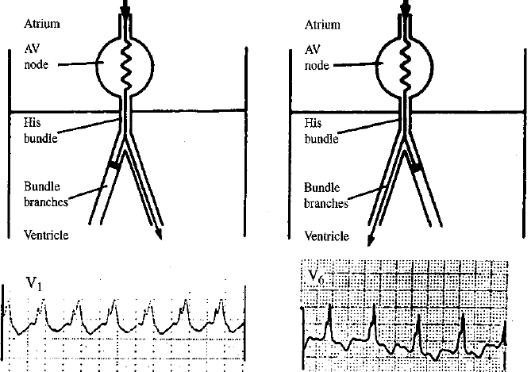

Slide 6
Functional aberration
Functional aberration results from sudden change in cycle length when parts of the His-Purkinje system are partially or wholly unexcitable
Functional RBBB commoner because of longer RP
Linking phenomenon -Functional BBB may persist for several successive impulses because the bundle branch that is blocked antegradely may be activated trans-septally via its contralateral counterpart

Slide 7
POSSIBLE MECANISMS
Each new anterograde impulse (An) blocks due to refractoriness engendered by retrograde concealed penetration from the previous beat (Rn l).
Block is dynamically maintained instead by successive actual collisions between each new anterograde impulse (An) and each returning retrograde impulse (Rn l)

Slide 8
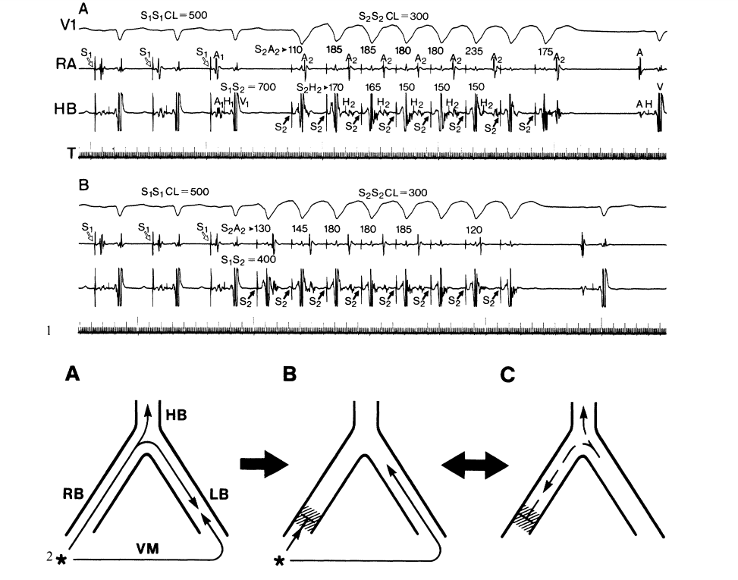
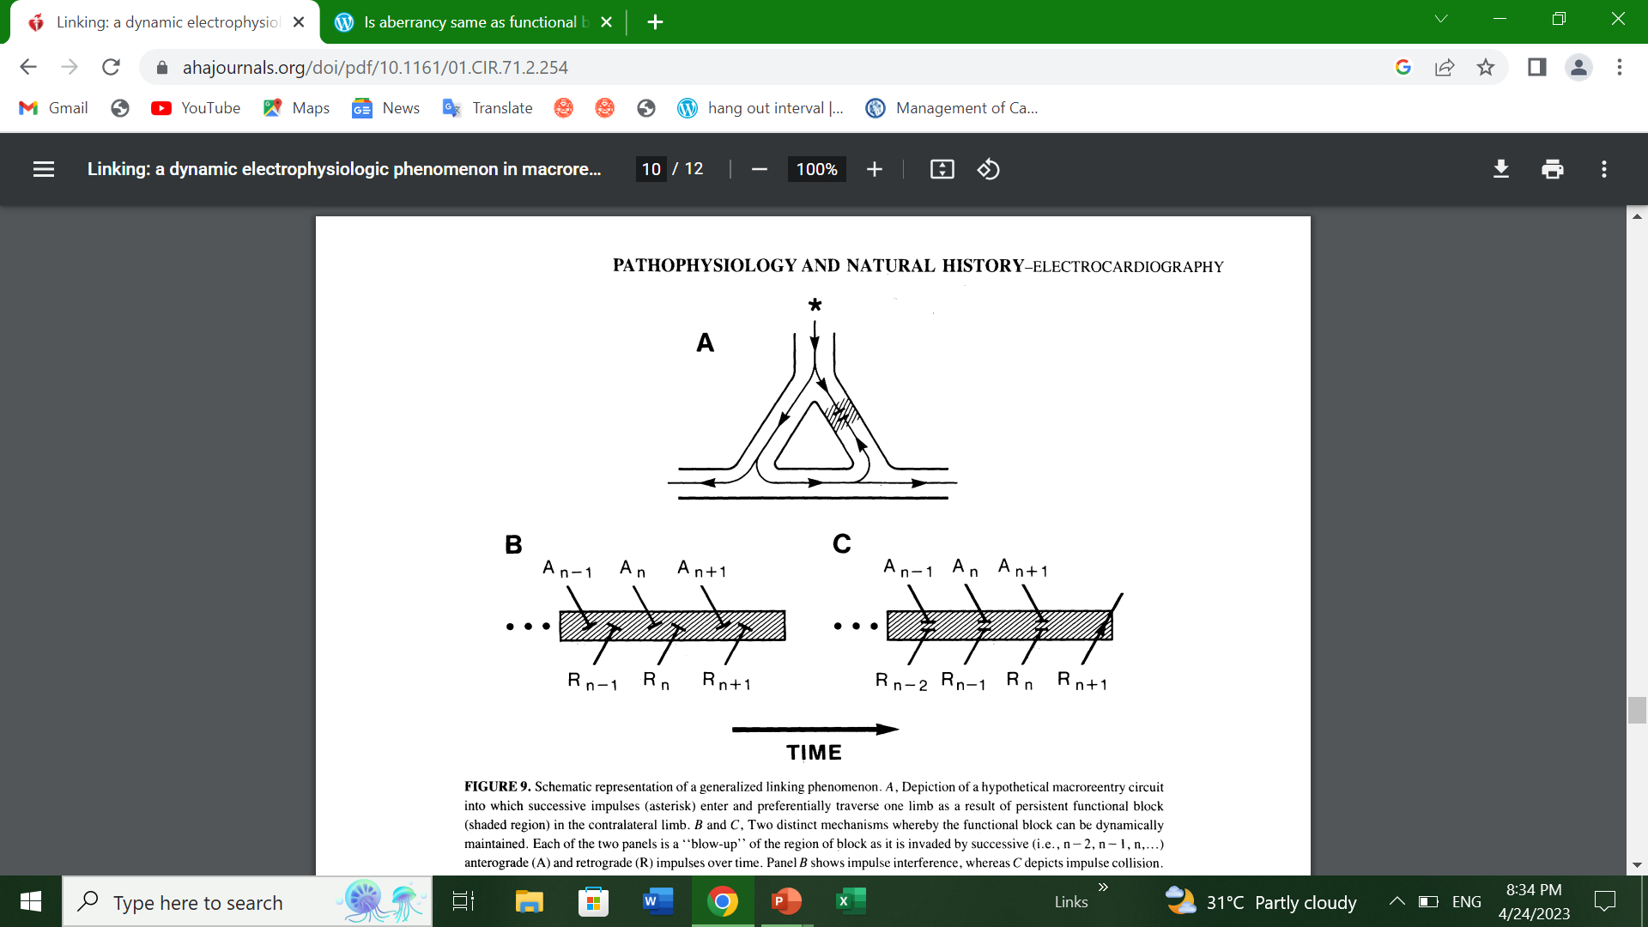

Slide 9
AV reentrant tachycardia (AVRT)
  Orthodromic AVRT – antegrade conduction over the AV node and retrograde conduction through accessory pathway.WCT occurs in aberrant conduction,either rate related or preexisting
  Antidromic AVRT – antegrade conduction over the accessory pathway and retrograde conduction over the AV node result in WCT
Pre-excited tachycardia- SVT with ventricular activation occurs predominantly via accessory pathway

Slide 10
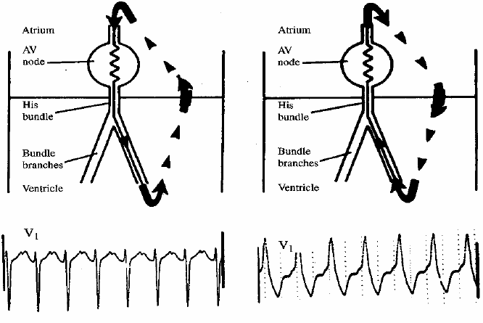
ORTHODROMIC
ANTIDROMIC

Slide 11
Mahaim pathway mediated tachycardia
  Antegrade conduction through mahaim pathway and retrograde through AV node
  Tachycardia with LBBB morphology and left axis
  Wide QRS complex tachycardia occur because absence of retrograde conduction over accessory pathway.
  Near normal ECG in sinus rhythm

Slide 12
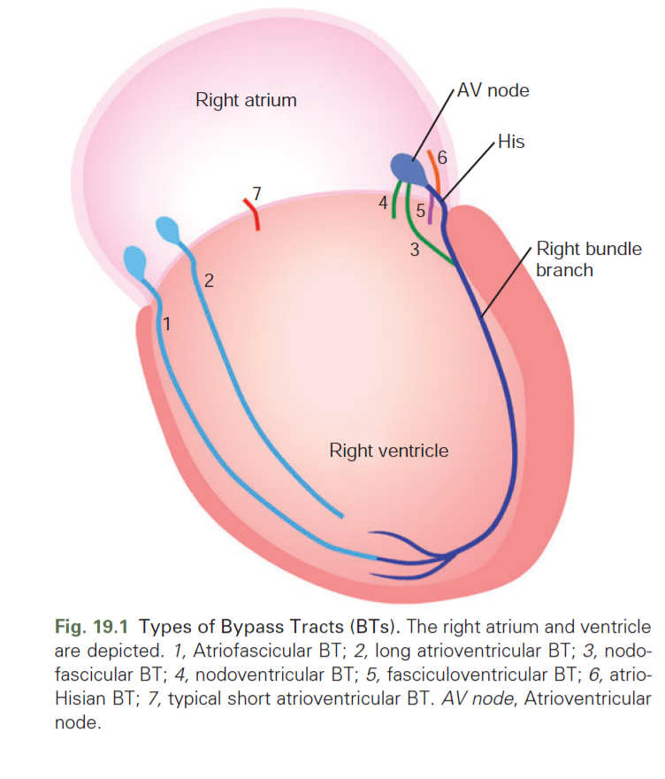

Slide 13
SVT with a wide complex due to abnormal muscle spread of impulse
  RBBB in pts undergone rt.ventriculotomy
  LBBB in pts with DCM
SVT with wide complex due to drug or electrolyte induced changes
  Ι A, Ι C,amiodarone,TCAs
  Hyperkalemia
Ventricular paced rhythms
  LBBB with left axis

Slide 14
Hypermagnesemia
Hypothermia
ECG artifact

Slide 15
Causes of irregular WCT
Any irregular supraventricular rhythm(AF,EAT or atrial flutter with varying conduction) with aberrant ventricular conduction
AF with ventricular preexcitation-if the ventricular rate in AF is >220/min or shortest R-R int is <250 msec bypass tract should be considered
Polymorphic VT
Torsade de pointes

Slide 16
SVT vs VT Clinical history
Age- ≥ 35 ys → VT (positive predictive value of 85%)
Underlying heart disease:Previous MI → 90% VT
Pacemakers or ICD.Increased risk of ventricular tachyarrhythmia
Medication
Digoxin-induced arrhythmia → [digoxin] ≥2ng/l or normal if hypokalemia
Duration of the tachycardia — SVT is more likely if the tachycardia has recurred over a period of more than three years

Slide 17
Examination
AV dissociation- VT
Varying pulse volume
IRREGULAR cannon A waves
-variable intensity of S1
Carotid sinus massage
Termination of WCT in response to maneuvers like Valsalva, carotid sinus pressure, or adenosine favor SVT

Slide 18
ECG
Rate→Limited use in distinguishing VT from SVT
Regularity
Marked irregularity of RR interval occurs in AF with aberrant conduction and polymorphic VT
VT- slight irregularity (mainly in first 30s and in pts treated with AADs)
QRS duration-
  >160 with LBBB
  >140 WITH RBBB
  Narrower QRS during tachy than in NSR
AV dissociation
Septal and fascicular VT

Slide 19
AXIS
Right superior axis - strongly suggests VT .(Sn 20%,sp 96%)
Compared to the axis during NSR, an axis shift during the WCT of more than 40º suggests VT .
With a RBBB-like WCT, a QRS axis to the left of -30º suggests VT.
With an LBBB-like WCT, a QRS axis to the right of +90º suggests VT

Slide 20
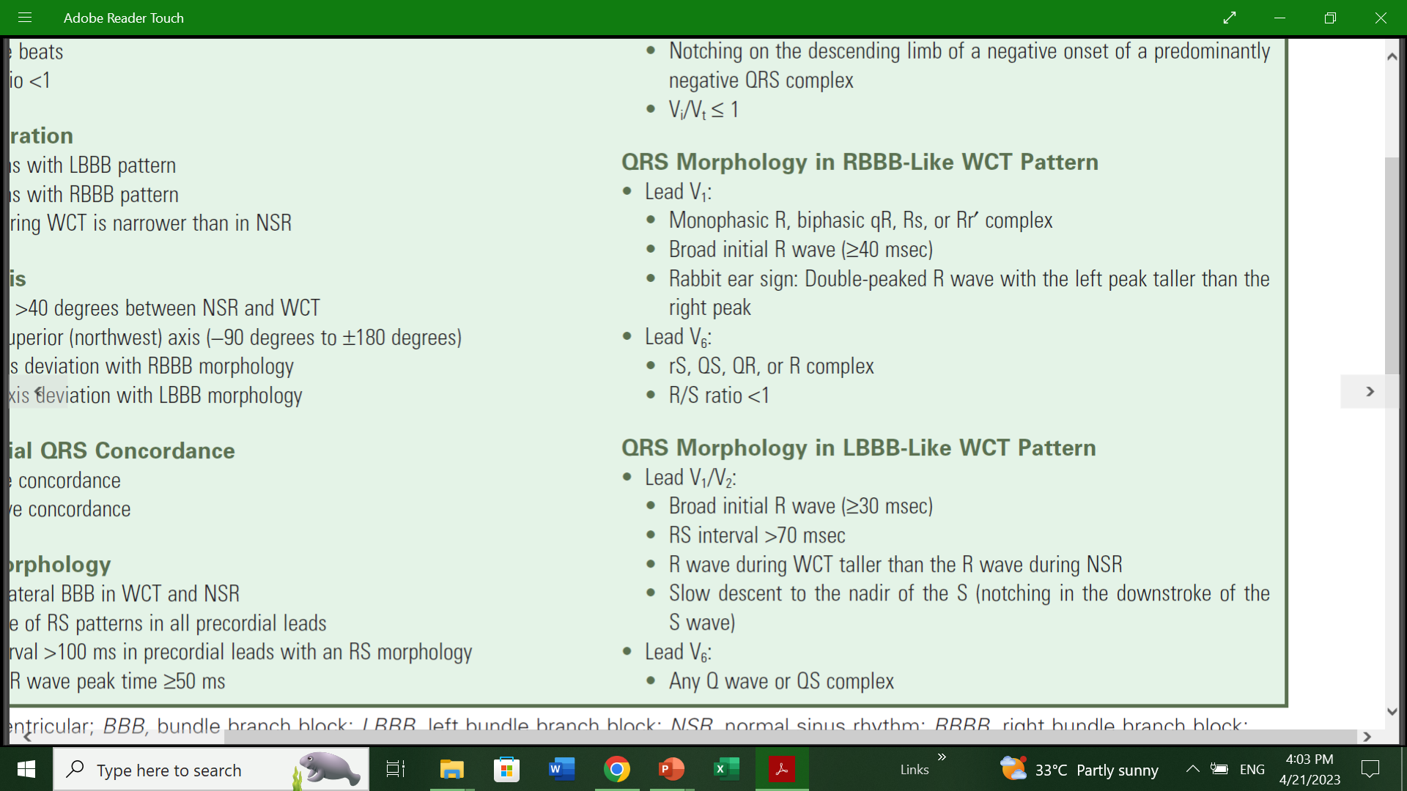
QRS Morphology
RBBB
LBBB

Slide 21
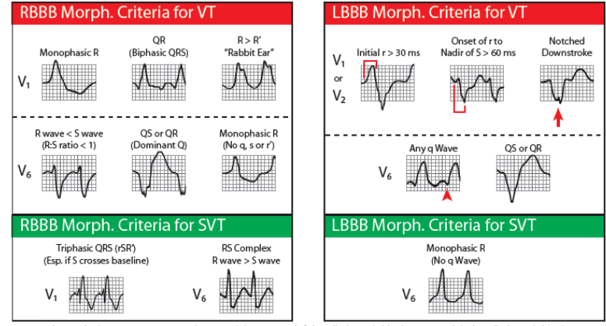

Slide 22
ALGORITHMS

Slide 23
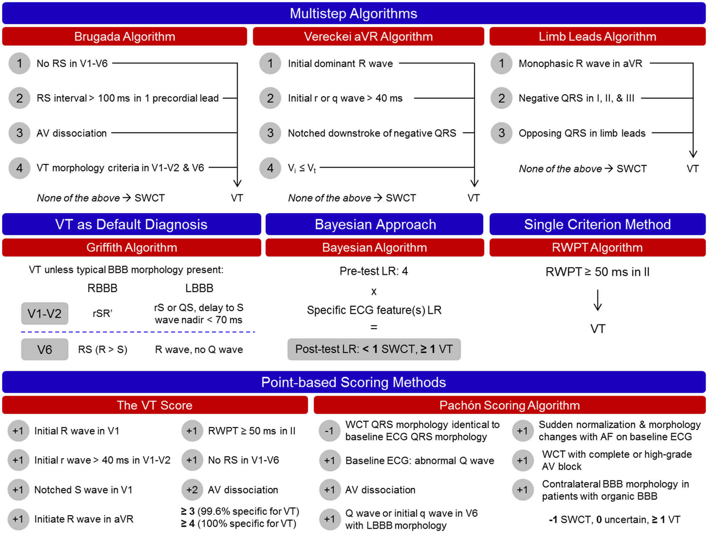

Slide 24
History..
In 1965 Sandler and Marriott first to differentiate between VEB with RBBB like morphology
  92% of VEB with RBBB morphology have a monophasic or biphasic pattern in lead V1, whereas a triphasic pattern (rsR′, rSR′, RsR′) was only found in 6% of VEB
  concordant precordial pattern.
  Marriott in 1971 gave term ‘Rabbit ears’ for a double peaked R-wave in lead V1.
In 1978 Wellens used His bundle recording for the first time to determine the site of origin of tachycardia
AV dissociation
Put forth classical criteria.
Notes:
Ventricular ectopic beat

Slide 25
Kindwall’s (1988) ECG criteria for VT in LBBB
1. R wave in V1 or V2 of >30 ms duration
2. Duration of >60 ms from the onset of the QRS to the nadir of the S wave in V1 or V2
3. Notching on the downstroke of the S wave in V1 or V2
4. Any Q wave in V6

Slide 26
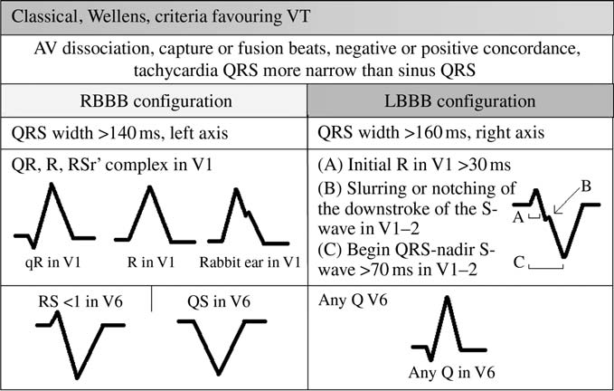
Pioneering works put forth by Sandler and Marriott,Wellens et al, and Kindwall et al—collectively known as the “classical morphological criteria”
If a WCT demonstrates a QRS configuration incompatible with typical right or left bundle branch block patterns, VT is the most likely diagnosis

Slide 27
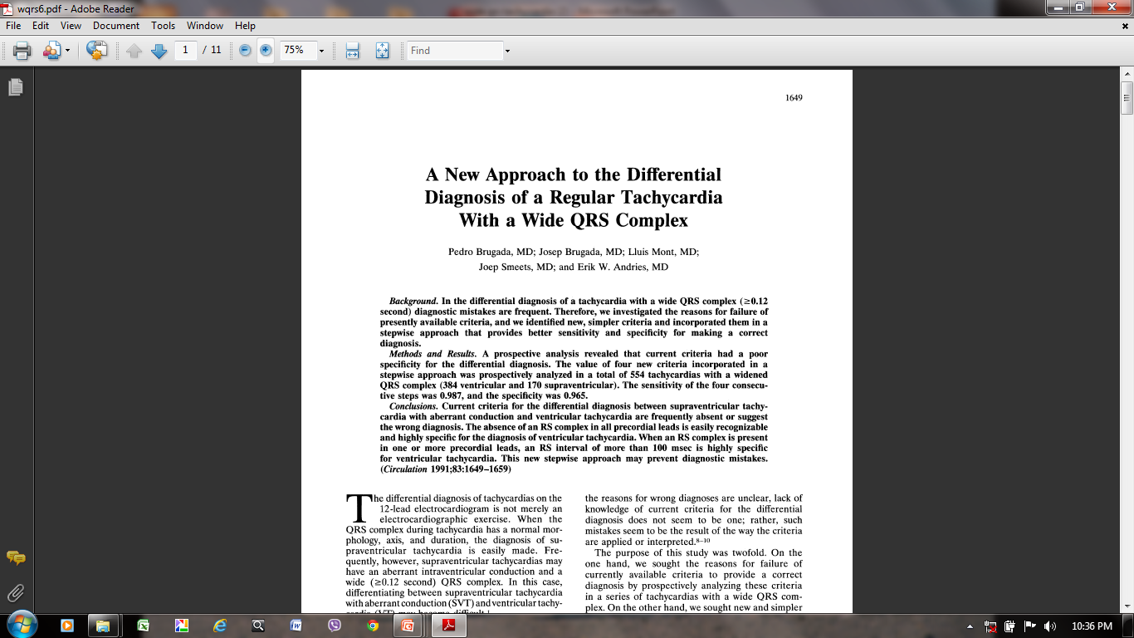

Slide 28
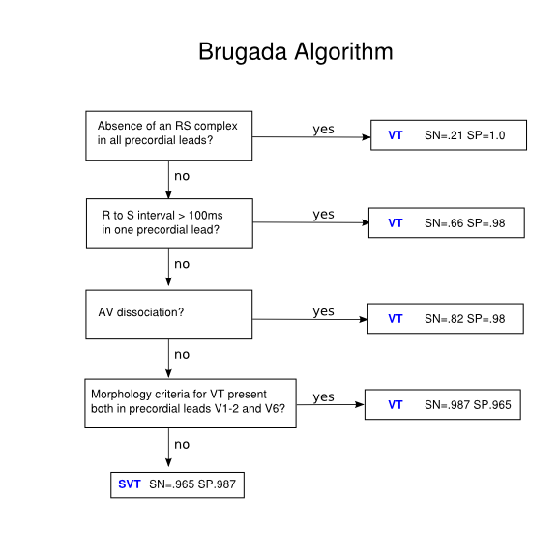
Brugadas algorythms

Slide 29
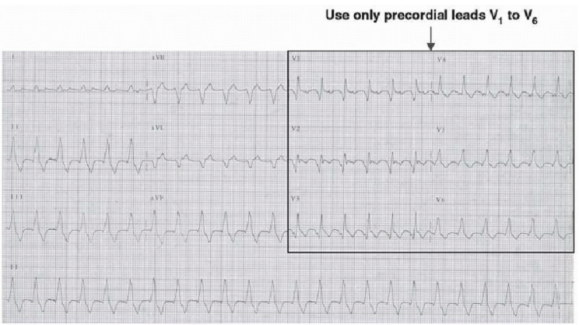
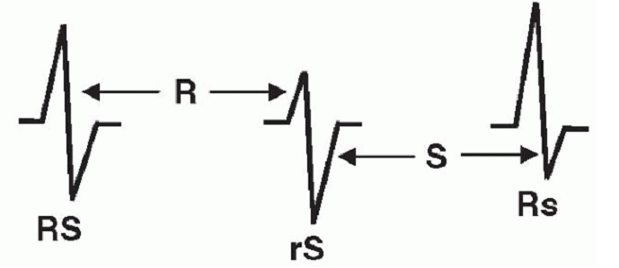
STEP1

Slide 30
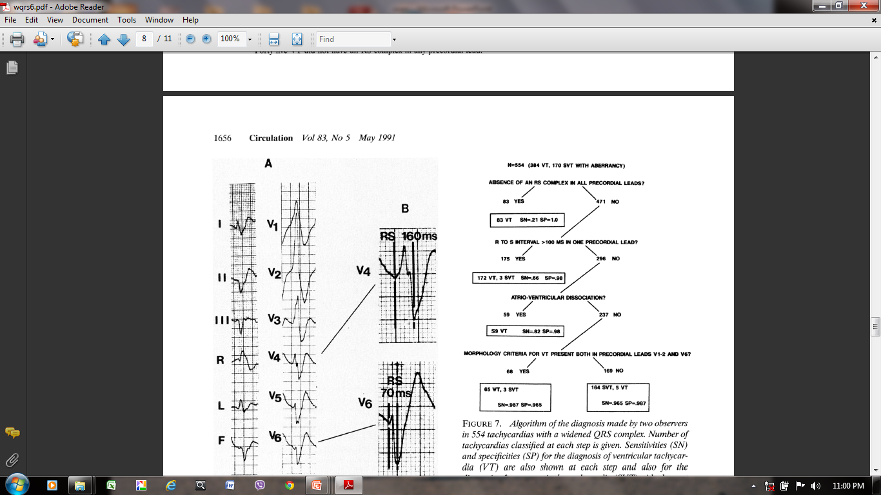
STEP 2

Slide 31
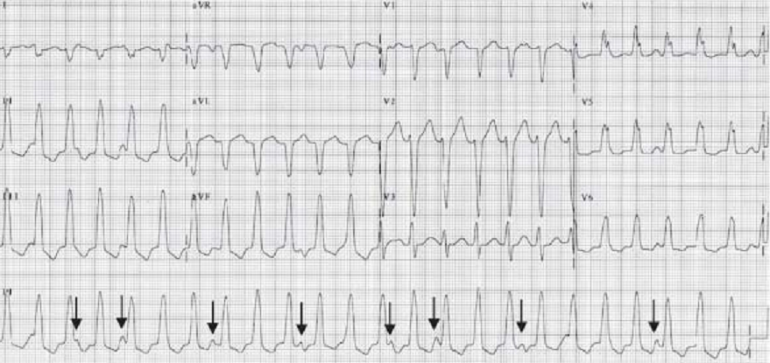
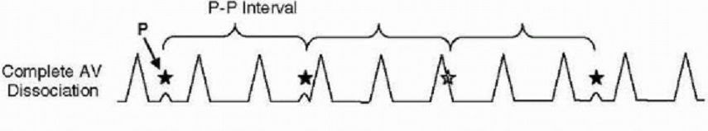
Step 3

Slide 32
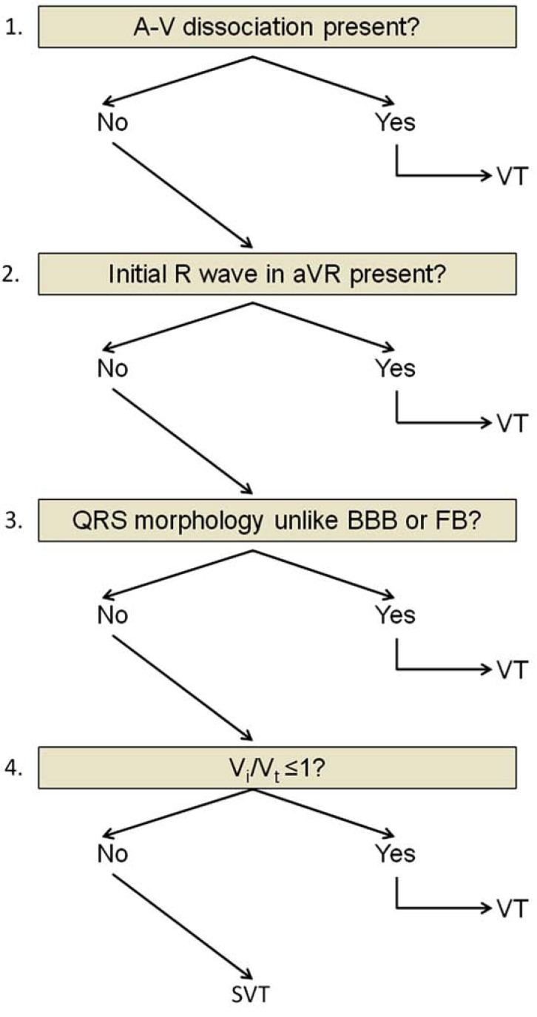
Vereckie algorithms
In 2007 Vereckei proposed algorithm. This also consists of four steps:
If AV dissociation is present diagnosis of VT is made and analysis stopped.
If an initial R wave is present in lead aVR- VT is made and analysis stopped
If morphology of wide QRS tachycardia does not correspond to BBB or fascicular block diagnosis of VT is made and analysis is stopped.
In the last step when the initial (vi) and terminal (vt) ventricular activation velocity ratio (vi/vt) is ≤1, diagnosis of VT is made if vi/vt is >1, the diagnosis is SVT is made.

Slide 33
Sensitivity Specificity PPV NPV
Brugada 89% 73% 92% 67%
Vereckei 97% 75% 93% 87%
Vereckei A, Duray G, Szénási G, Altemose GT, and Miller JM.
Application of a new algorithm in the differential diagnosis of wide QRS complex tachycardia. Eur Heart J 2007 Mar; 28(5) 589-600.

Slide 34
In 2008 Vereckei et al. proposed another new algorithm based on the direction and velocity of initial and terminal ventricular activation
It also consists of four steps

Slide 35
Why new
Selection of lead aVR - make it simple
Classification of VT into two main groups:
VT arising from apical region of ventricle- initial R wave in lead aVR
VT arising from other regions- lacking an initial R wave in aVR but with slowing of the initial part of the QRS complex so v_{i} / v_{t} < 1
Elimination of the AV dissociation criterion.

Slide 36
aVR algorithm
Criteria looks ONLY at lead aVR (if answer is yes, then VT):
1. Is there an initial R wave?
2. Is there an r or q wave > 40 msec
3. Is there a notch on the descending limb of a negative QRS complex?
4. Measure the voltage change in the first (v_{i}) and last 40 msec (v_{t}).
v_{i} / v_{t} < 1?
Senstivity and specficity of this is 88% and 53%.
Vereckei et al, Heart Rhythm 2008

Slide 37
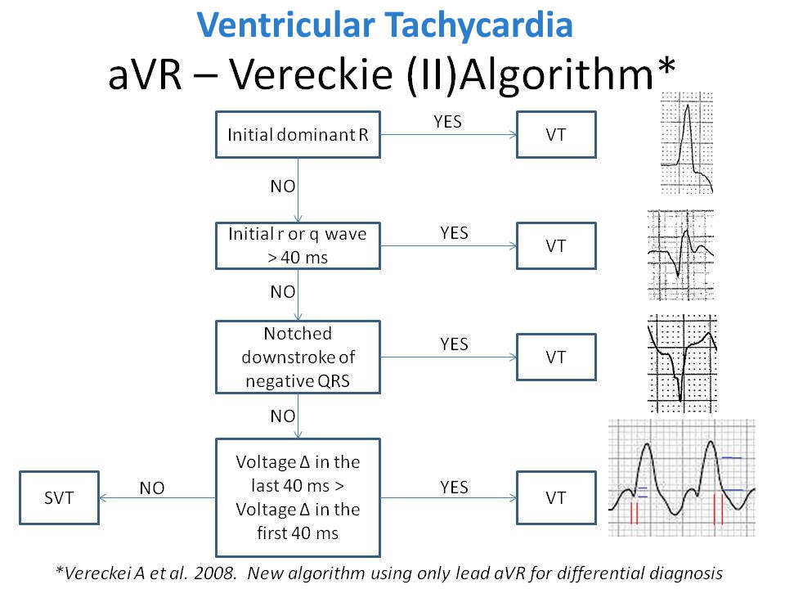
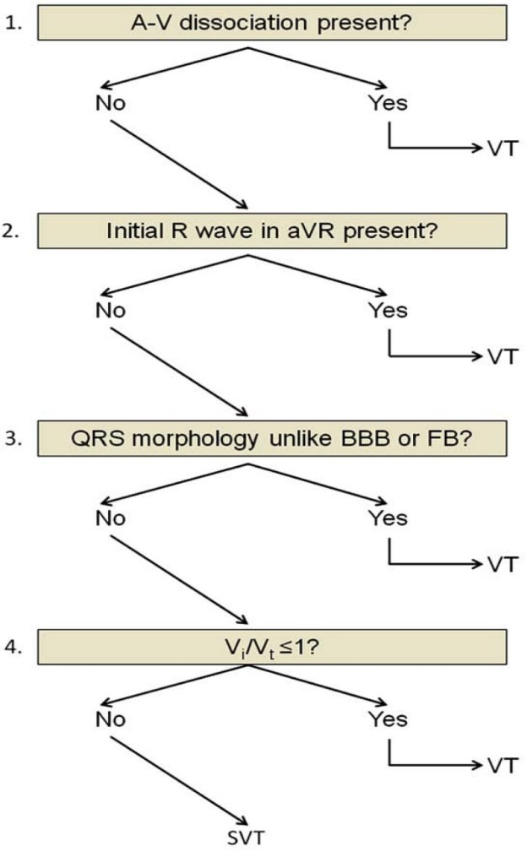
VERECKIE FIRST ALGORITHM

Slide 38
Ultrasimple Brugada criterion
Joseph Brugada - 2010
R wave peak time in Lead II
Rationale for this criterion is that conduction is slower in myocardial tissue than via His-Purkinje system so it can be used to distinguish a ventricular from supraventricular
Duration of onset of the QRS to the first change in polarity in lead II.
If the RWPT is ≥ 50ms the likelihood of a VT very high (positive likelihood ratio 34.8)
Pava LF, Perafán P, Badiel M, Arango JJ, Mont L, Morillo CA, and Brugada J. R-wave peak time at DII: a new criterion for differentiating between wide complex QRS tachycardias. Heart Rhythm 2010 Jul; 7(7) 922-6.

Slide 39
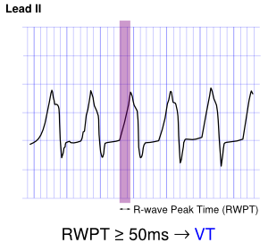

Slide 40
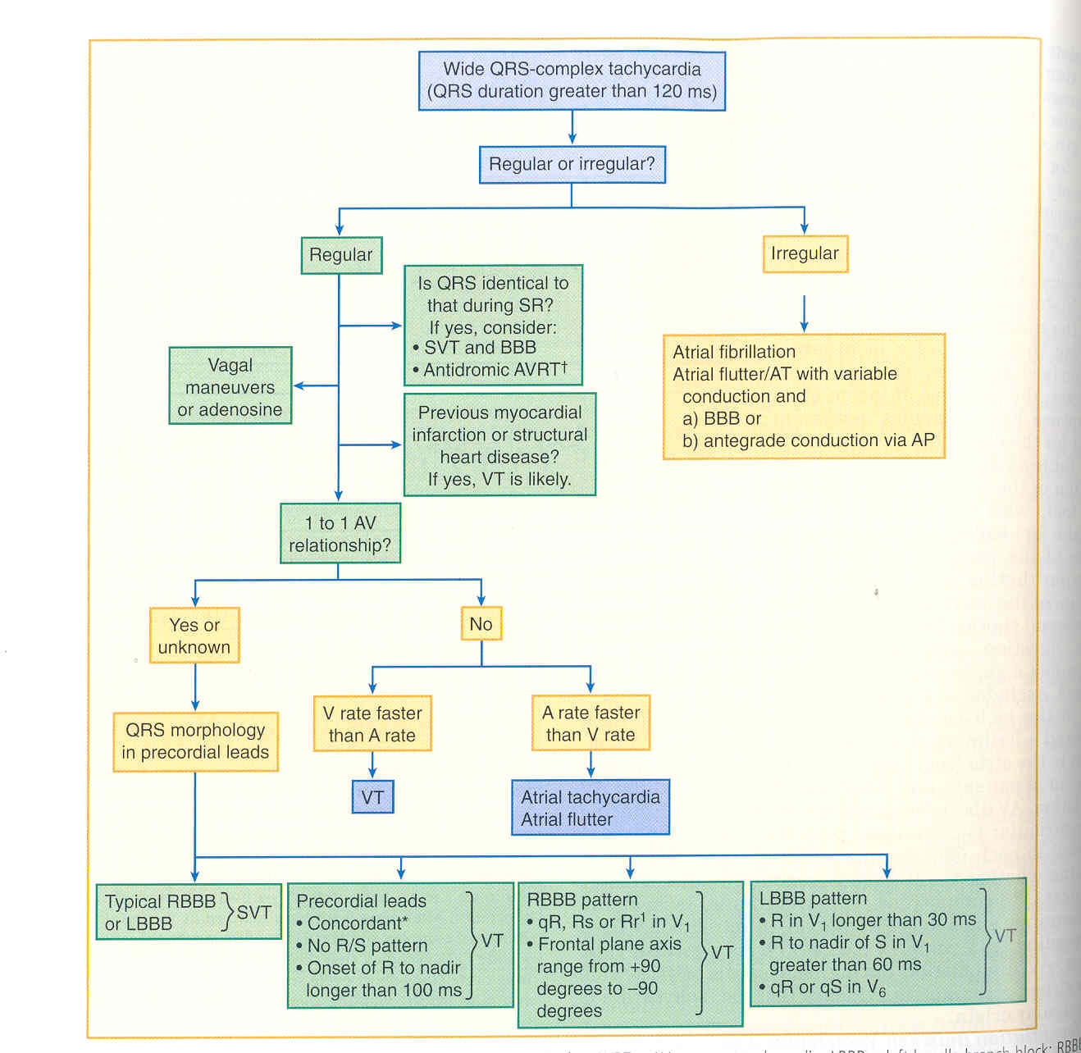

Slide 41
Most specific criteria in sequence: When one criterion is met diagnosis is made-
Step 1: AV relationship (if dissociated VT; if not proceed to next step)
Step 2: Rightward superior axis (if present VT; if not proceed to next step)
Step 3: Vi/Vt ratio (if greater than 1 SVT-A is diagnosed; if not proceed to next step)

Slide 42
Step 4: Precordial RS pattern (if absent VT; if not proceed to next step)
Step 5: Precordial RS interval (if RS present and interval greater than 100 ms VT; if not proceed to next step)
Step 6: In LBBB type WCT, R wave less than 30 ms or R onset to S nadir less than 60 ms in V1 (if present SVT-A is diagnosed)

Slide 43
Finally artefact that mimics VT particularly when observed on a rhythm strip can lead to misdiagnosis.
Knight et al surveyed 221 cardiologists and 490 electrophysiologists with case simulation that included two-lead ECG monitor tracing of artefact
Found that the rhythm strip was misdiagnosed as VT by 58% of cardiologists and 38% of electrophysiologists.

Slide 44
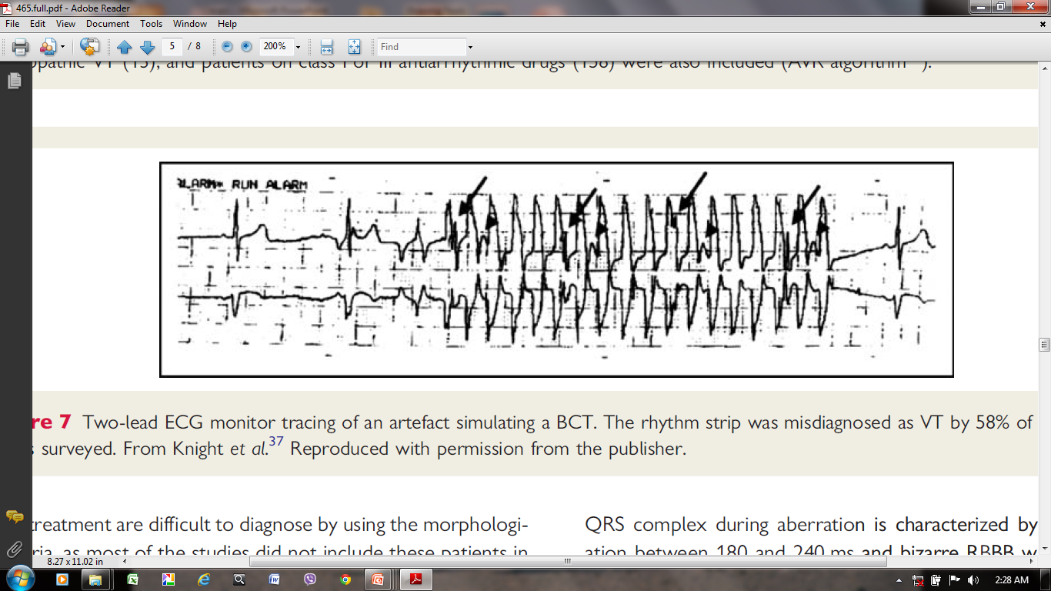

Slide 45
EP testing
Baseline Observations During NSR
Presence of preexcitation during NSR or atrial pacing suggests SVT
Induction of Tachycardia
Mode of induction cannot distinguish between SVT and VT

Slide 46
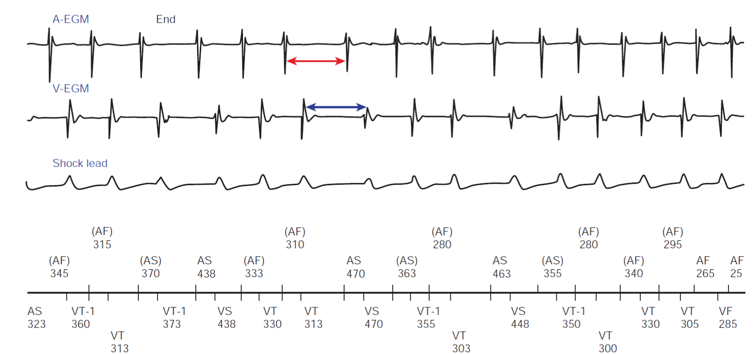
Oscillation in the Tachycardia Cycle Length

Slide 47
Tachycardia Features
Atrioventricular Relationship
Usually 1:1
Atrial Activation Sequence
Eccentric atrial activation sequence practically excludes VT.
His Bundle–Ventricular Interval
When the HV interval is positive , an HV interval during the WCT shorter than that during NSR (HV WCT < HV NSR) indicates VT or preexcited SVT.

Slide 48
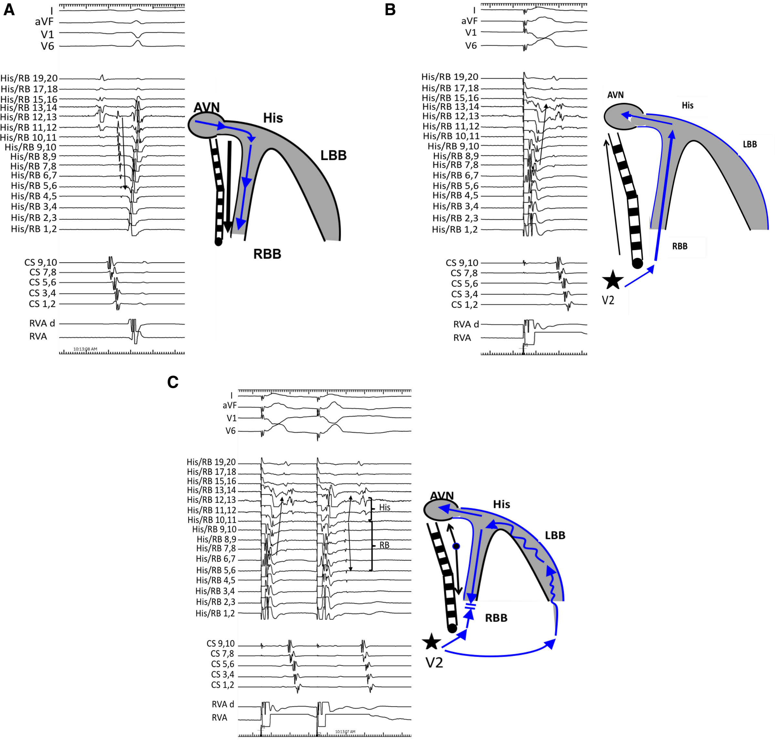

Slide 49
Ventricular tachycardia

Slide 50
Introduction
Premature ventricular complexes
Definition of VT
Classification
Mechanism
Clinical symptoms
Investigations
Treatment

Slide 51
Introduction
Major cause of SCD
CAD is the most frequent cause of clinically documented VT and VF (80% of patients)
Sustained VT and VF→6% of patients in the very early phase of acute MI→ mortality in first 30 days post MI
GUSTO-1 trial→41000pts with STEMI ;3.5% developed VT.
Sustained ventricular arrhythmias are most frequent within 24 to 48 hours after the onset of ischemia

Slide 52
Premature Ventricular Complexes (PVCs)
Premature impulses that originate in the ventricles.
80% in healthy young adults
Etiologies of PVCs
Anxiety/Stress
Drugs
  Alcohol
  Amphetamines
  Caffeine
  Cocaine
  Tobacco
Cardiac Disease
  Infarction/ischemia
  Cardiomyopathy
  Congenital Abnormalities
  Hypertensive Heart Disease

Slide 53
Electrolyte Abnormalities
  Hypercalcemia
  Hypokalemia
  Hypomagnesemia
Drugs
  Aminophylline
  Digoxin
  Sympathomimetics
  Tricyclic Antidepressants
Respiratory Abnormalities
  Hypercapnia
  Hypoxia
Hormonal
  Hyperthyroidism
  Pheochromocytoma

Slide 54
Mechanisms:
Extrasystoles:
    More frequent
    Most commonly due to reentry; less often induced by triggered activity.
    Fixed or nearly fixed coupling interval.
Parasystoles:
    Less frequent; independent of baseline rhythm.
    Due to presence of unidirectional entrance block in the parasystolic focus.
    Varying coupling intervals, interectopic intervals are multiples of each other and presence of fusion complexes.

Slide 55
Extrasystole- Trigeminy
Parasystole

Slide 56
Clinical features
  Palpitations,missed beat
  Long runs→angina, hypotension, or heart failure
  Sleep→ decrease the frequency of ventricular arrhythmias
Physical examination
  Premature beat followed by a long pause
  Decrease in intensity of the heart sounds in PVC
  Second heart sound can be split abnormally
Features predicting the development of PVC-induce cardiomyopathy
  PVC burden greater than 10% to 24% (HOLTER MONITORING)
  Very wide-QRS PVCs
  PVCs of epicardial origin.

Slide 57
Electrocardiographic presentations
Usually shows a compensatory pause(BC=2xAB)
  PVC usually fails to discharge SA node.
PVC resets the sinus node , non complete compensatory pause(BC<2xAB).
At slow sinus rates, it enters AV junction leaving it in refractory period but does not prevent the next sinus impulse from being conducted towards the ventricles ( with a longer PR interval)→ interpolated PVC.

Slide 58
Lown Classification 1971
According to prognostic significance (Holter ECG)
Grade 0: No PVC
Grade 1: < 30/hr
Grade 2: > 30/hr
Grade 3: Polymorphic PVC
Grade 4a: In pairs
Grade 4b: Salvos of VPCs
Grade 5: R on T phenomenon

Slide 59
Morphologies of PVCs
In individuals with no evidence of heart disease:
  High voltage, unnotched QRS complexes.
  ST segment depression when QRS positive and vice versa.
  T wave has asymmetrical branches.
In individuals with heart disease:
  QRS complexes present notches and slurrings and are of low voltage.
  Symmetrical T waves.

Slide 60
Site of origin
RV ectopics: LBBB pattern
LV ectopics: RBBB pattern
  Leftward axis: location in or near posterior division of left BB.
  Rightward axis: location in or near anterior division of left BB.
QRS duration depends on:
  Site of origin
  Characteristics of tissues activated by the premature impulse
  Coupling time (QRS wider with short coupling interval)

Slide 61
Management
Absence of Structural Heart Disease
Most patients→ no treatment
Reassurance
Correct the underlying cause
Avoidance of provoking drugs
Beta blockers are often the first line of therapy
CCBs
Presence of heart disease
CAD→BB
Cardiac arrhythmia suppression trial (CAST)→class I antiarrhythmics in post MI patients→ suppressed pvcs/ total mortality was increased
Canadian amiodarone myocardial infarction arrhythmia trial (CAMIAT)
No significant change in overall mortality
Ablation

Slide 62
3 key pieces of information
Information regarding symptoms
PVC burden (PVC %)
Presence or absence of structural heart disease.

Slide 63
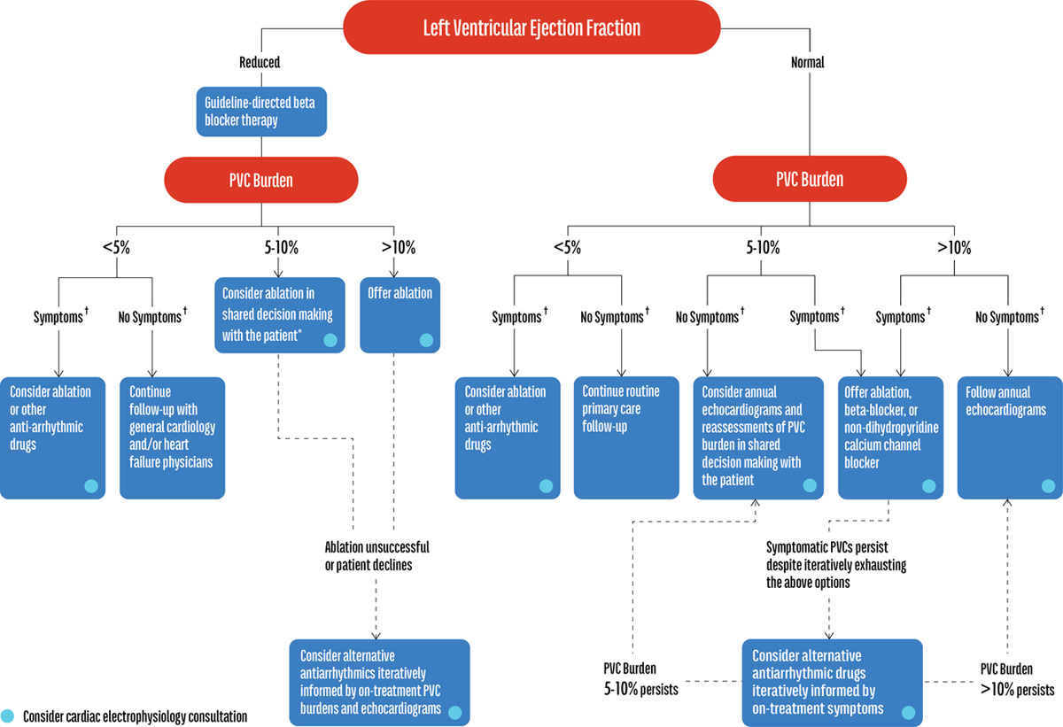

Slide 64
VENTRICULAR TACHYCARDIA

Slide 65
DEFINITION
Ventricular tachycardia (VT) is defined as a three or more consecutive beats at rate greater than 100 /min that originates below the bifurcation of the His bundle, in the specialized conduction system, the ventricular muscle, or in a combination of both tissues, independent of atrial and atrioventricular node conduction.

Slide 66
CLASSIFICATION OF VENTRICULAR
TACHYARRHYTHMIAS

Slide 67
VA Classification by Clinical Presentation
ACC/AHA/ESC 2006 Guidelines for Management of Patients With Ventricular Arrhythmias and the Prevention of Sudden Cardiac Death
Hemodynamically stable
  Asymptomatic
  Minimal symptoms, e.g., palpitations
Hemodynamically unstable
  Shock
  Presyncope
  Syncope
  Sudden cardiac death
  Sudden cardiac arrest

Slide 68
Classification According to Tachycardia Morphology
Monomorphic
Polymorphic VT
Torsades de pointes
Pleomorphic VT
Bidirectional VT
Ventricular flutter
Ventricular fibrillation

Slide 69
Classification According to Tachycardia Duration
Sustained VT lasts for more than 30 seconds or requires termination
in less than 30 seconds because of hemodynamic compromise
Non-sustained VT
Incessant VT Incessant VT is defined as continuous sustained VT during several hours, which recurs promptly despite repeated intervention for termination.
VT storm
Classification According to QRS Morphology in Lead V1
Right bundle branch block (RBBB)–like pattern
Left bundle branch block (LBBB)–like pattern

Slide 70
VT classification by Disease Entity
Structurally normal hearts
Coronary artery disease
Heart failure
Congenital heart disease
Cardiomyopathies:
  Dilated cardiomyopathy
  Hypertrophic cardiomyopathy
  Arrhythmogenic right ventricular cardiomyopathy

Slide 71
VT in Absence of Structural Heart Disease
Non life threatening (typically monomorphic)
  Outflow tract:
    Right and Left ventricle outflow
    Aortic sinus of Valsalva
    Peri‐His bundle
  Idiopathic left ventricular tachycardia
    Left posterior and left anterior fascicle
    High septal fascicle
  Other
    Mitral and Tricuspid annulus
    Papillary muscle
    Perivascular epicardial

Slide 72
VT in Absence of Structural Heart Disease
Life threatening (typically polymorphic)
  Genetic Syndromes
    Long QT
    Brugada
    Catecholaminergic polymorphic ventricular tachycardia
    Short QT
  Idiopathic ventricular fibrillation

Slide 73
Mechanism
1.Disorder of impulse formation
2.Disorder of impulse conduction
3.Combination of Both
Impulse formation
  Abnormal automaticity
  Triggered activity
Impulse propagation
  Re-entry (circus movement )

Slide 74
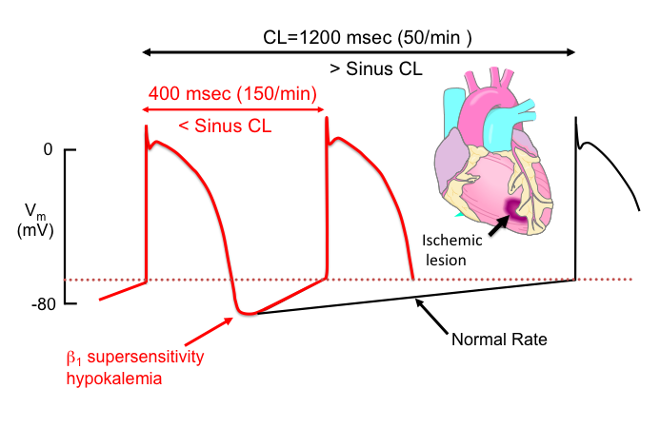
Abnormal automaticity

Slide 75
Triggered Activity
Triggered activity is initiated by afterdepolarizations
Depolarizing oscillations in membrane voltage induced by one or more preceding action potentials
EAD occur in phases 2 (type 1) and 3 (type 2) of the cardiac action potential
Late afterdepolarizations occur after completion of repolarization (phase 4)

Slide 76
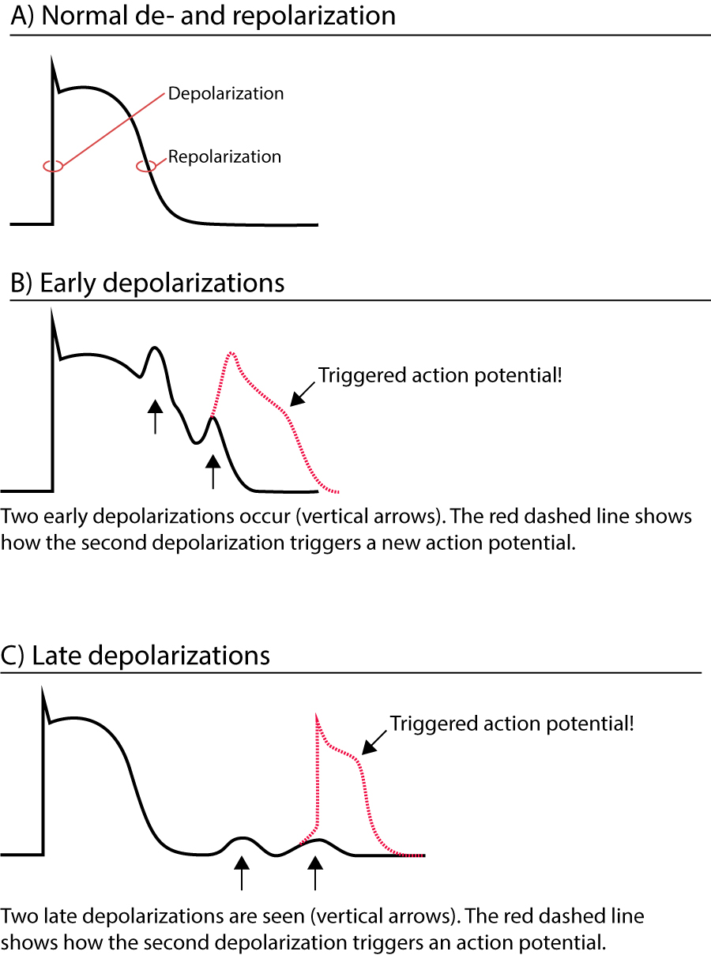

Slide 77
Early after-depolarizations (EADs), arise from a reduced level of membrane potential during phases 2 (type 1 – augmented opening of Ca channels) and 3 (type 2 – augmented opening of Na channels) of the cardiac action potential
Late or delayed after-depolarizations (DADs), occur after completion of repolarization (phase 4 – secondary to increase cytosolic Ca++ levels), generally at a more negative membrane potential than that from which EADs arise

Slide 78
Causes of EAD include:
Low potassium blood level
Slow heart rate
Drug toxicity (i.e. quinidine causing torsades de pointes)
DAD may cause triggered activity due to:
Premature beats
Increased serum Ca++ level
Increased adrenaline levels
Digitalis toxicity

Slide 79
Mechanisms of VT
Disorders of impulse conduction
Re-entry (circus movements)
Electrical Impulse
Cardiac Conduction Tissue
Fast Conduction Path Slow Recovery
Slow Conduction Path Fast Recovery
Two distinct pathways that come together at beginning and end to form a loop
A unidirectional block in one of those pathways
Slow conduction in the unblocked pathway

Slide 80
Disorders of impulse conduction
Premature Beat Impulse
Cardiac Conduction Tissue
Repolarizing Tissue (long refractory period)
Fast Conduction Path Slow Recovery
Slow Conduction Path Fast Recovery
An arrhythmia is triggered by a premature beat
The fast conducting pathway is blocked because of its long refractory period so the beat can only go down the slow conducting pathway

Slide 81
Disorders of impulse conduction
Re-entry (circus movements)
Cardiac
Conduction Tissue
Fast Conduction Path Slow Recovery
Slow Conduction Path Fast Recovery
The wave of excitation from the premature beat arrives at the distal end of the fast conducting pathway, which has now recovered and therefore travels retrogradely (backwards) up the fast pathway

Slide 82
Disorders of impulse conduction
Re-entry (circus movements)
Cardiac Conduction Tissue
Fast Conduction Path Slow Recovery
Slow Conduction Path Fast Recovery
On arriving at the top of the fast pathway it finds the slow pathway has recovered and therefore the wave of excitation ‘re-enters’ the pathway and continues in a
‘circular’ movement. This creates the re-entry circuit

Slide 83
Mechanisms of VT in CAD
All arrhythmia mechanisms involved
Automaticity: VT arising from ischemic border during acute ischemia
Reentry: VT associated with MI scar.
Trigerred activity : VT arising during ischemia due to delayed or early after depolarization.

Slide 84
During acute ischemia
Acute ischemia →tissue hypoxia→ depletion of ATP/anaerobic glycolysis
Na-K ATPase pump dysfunction→extracellular K increases
Abnormal automaticity
Intracellular acidification→ Na+- H+exchanger →Na+-Ca2+ exchanger→DADs and triggered arrhythmias
Injury current flows between ischemic and non ischemic cells at border zone promoting focal activity in normal tissue.
Polymorphic VT due to microentry.
  Single reentrant wavefront splits into multiple wavelets when it enters surrounding nonischemic tissue (shorter effective refractory period).

Slide 85
Acute Ischemia
Phase 1
Acute phase
1A
reentry
1B
Abnormal automaticity
Phase 2
Subacute
Healed infarction
VFib

Slide 86
Healing phases of MI
95% of these VTs due to reentry
Two conditions essential for reentry:
  Unidirectional block of conduction.
  Circuit cycle with longer refractory periods
Unidirectional block:
  Anatomical : discontinuities in ventricular muscle, branching strands of slow conduction or tissue discontinuation due to gap junction abnormalities present in the areas of MI scar.
  Functional : due to dispersion of refractoriness.

Slide 87
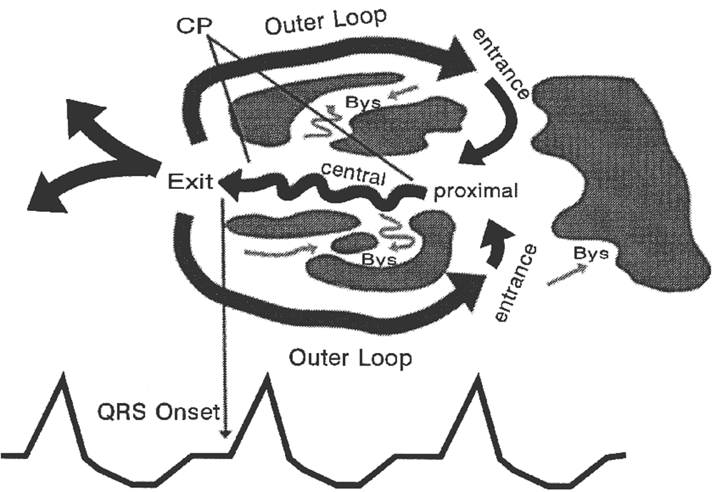
MI Scar-Related Sustained Monomorphic VT Circuit

Slide 88
Clinical Features
Symptoms depend on the
  Ventricular rate
  Duration of the tachycardia
  Presence and extent of the underlying heart disease
  Peripheral vascular disease
Asymptomatic
Palpitations
Features of hypoperfusion (Syncope/blackouts,sweating,etc.)
Exacerbations of angina &heart failure
SCD/SCA

Slide 89
Physical examination
Tachycardia
Shock
Findings depend in part on the P-to-QRS relationship
  AV dissociation features
  Irregularly occurring cannon a waves
  Variable pulse volume
  Varying S1 intensity

Slide 90
Risk Stratification
Ventricular Arrhythmias
Left Ventricular Ejection Fraction
Invasive Electrophysiological Testing
Measures of Cardiac Repolarization(TWA)
Syncope
Measures of Autonomic Imbalance
Measures of Myocardial Conduction Disorders
Genetic Testing
Cardiac Magnetic Resonance Imaging

Slide 91
ECG features suggesting VT related to old MI
Presence of Q waves (qR, QR or Qr) in related leads.
Notched or wide QRS complexes.
Low QRS voltage.

Slide 92
Identifying the site of origin of VT in CAD
ECG tends to locate reentry circuit exit rather than site of VT origin.
Helpful tool to guide mapping and ablation during EP.
Localisation must be done in 3 axis:
  Septal vs lateral walls
  Superior vs inferior
  Apical vs basal regions

Slide 93
Identifying the site of origin of VT in CAD
Lateral vs Septal
Lateral wall VTs:
  RBBB pattern
  Wider QRS
    Sequential activation of 2 ventricles.
Septal VTs:
  LBBB pattern
  Narrower QRS
    Parallel activation of both ventricles.
    Early engagement of HPS.

Slide 94
Identifying the site of origin of VT in CAD
Superior vs Inferior
Look for QRS axis in inferior leads.
Superior axis: QRS negative in inferior leads.
Inferior axis: QRS positive in inferior leads.
IWMI: 80% have superior axis.
AWMI: 55% have superior axis.
45% have inferior axis.

Slide 95
Identifying the site of origin of VT in CAD
Basal vs Apical regions
QRS polarity in precordial leads.
VTs from base: positive concordant pattern.
VTs from apex: negative concordant pattern.

Slide 96
PRINCIPLES OF MANAGEMENT
Pharmacological Therapy
Acute Therapy
  VAs precipitated by acute ischemia→ immediate reperfusion
  Initiation of BB
  Correction of electrolyte disturbances
  Heart failure management optimised
For sustained VTs
Management depends upon hemodynamic tolerance

Slide 97
Hemodynamically stable VT
IV amiodarone is the drug of choice
IV procainamide and sotalol
Lidocaine
  Less effective in the absence of acute ischemia
  Can be considered in combination
Drug-refractory electrical storm
  Neuraxial modulation (thoracic epidural anesthesia, left or bilateral cardiac sympathetic denervation)
  Catheter ablation should be considered early

Slide 98
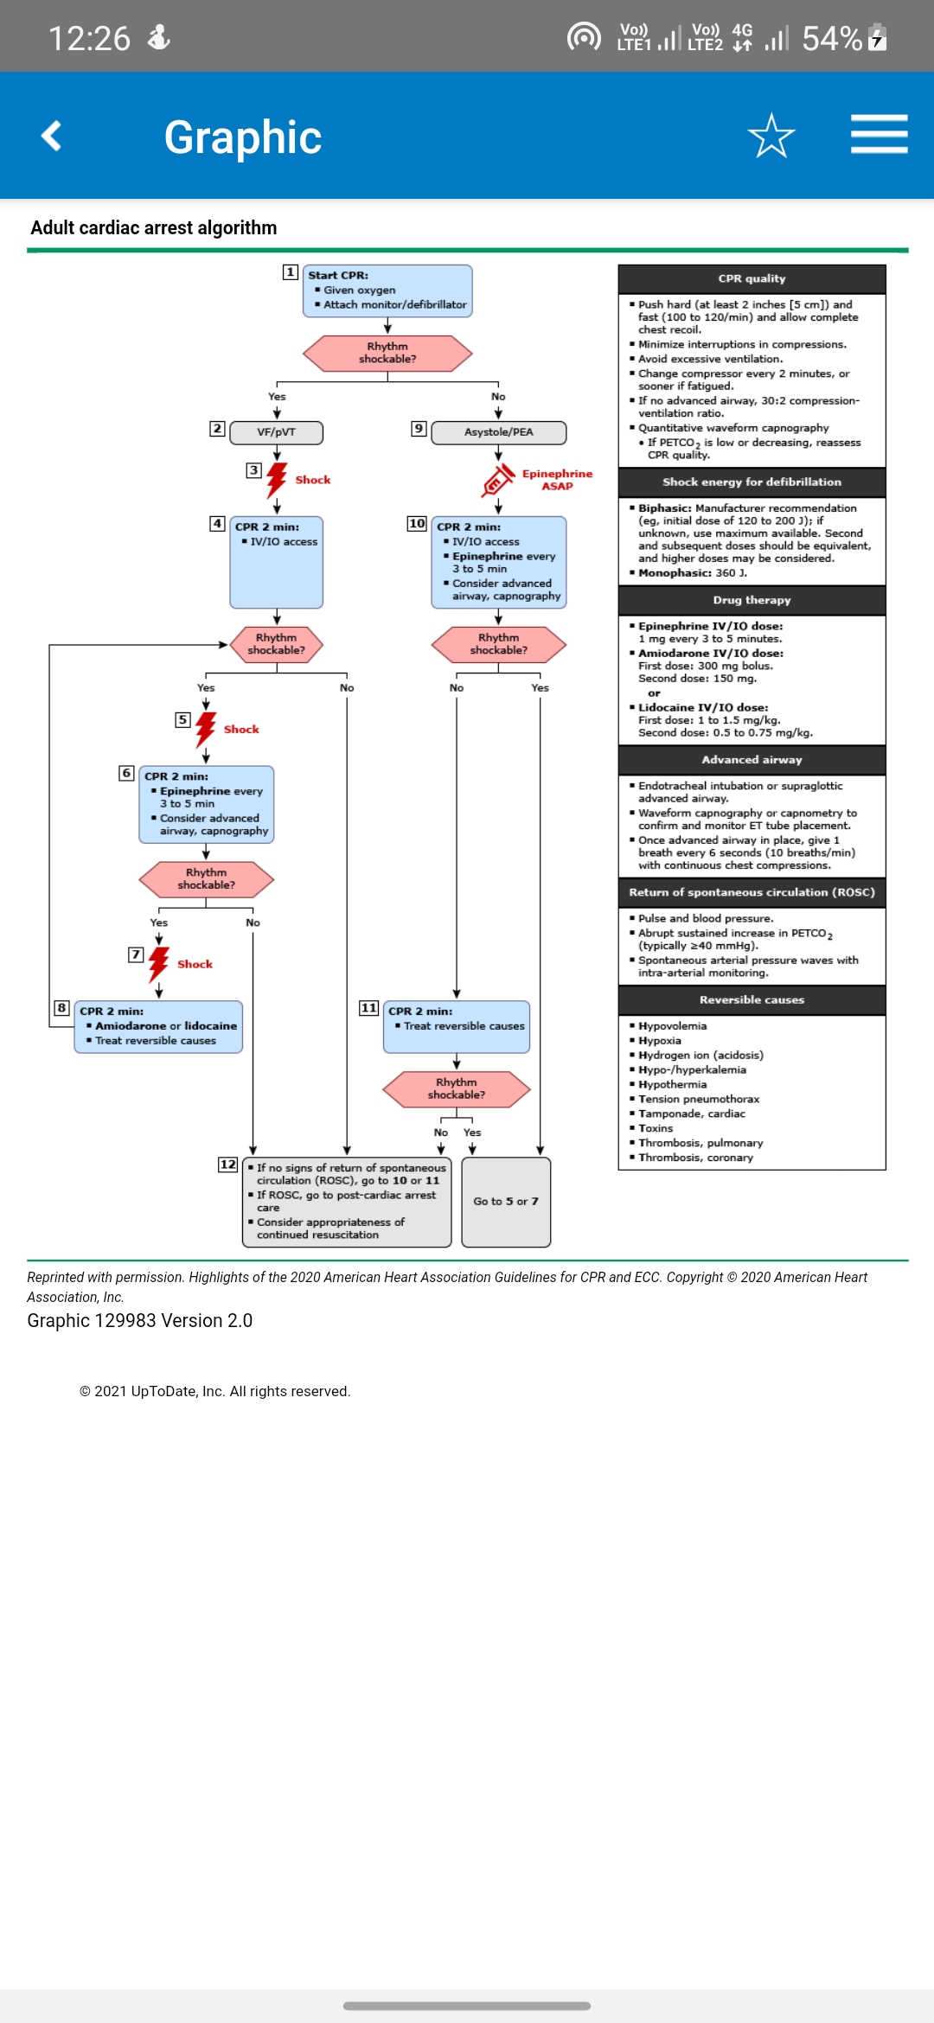
VF and pulseless VT

Slide 99
Chronic Therapy
With the exception of beta-blocker therapy, no antiarrhythmic medication has been demonstrated to reduce the mortality of patients with SMVT
Goal of antiarrhythmic drugs in VT patients is to improve quality of life
Three main indications for antiarrhythmic drug therapy along with an ICD:
  1) to reduce the frequency of ventricular arrhythmias in patients with unacceptably frequent ICD therapies
  2) to reduce the rate of VT so that it is better tolerated hemodynamically and more amenable to termination or low-energy cardioversion
  3) to suppress other arrhythmias

Slide 100
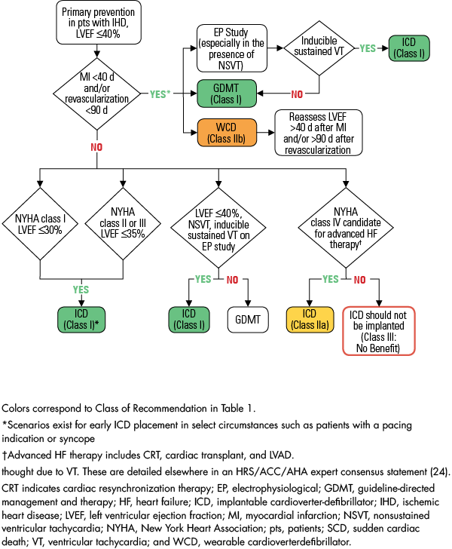
ICD for primary prevention

Slide 101
ICD for secondary prevention
Proven mortality benefit among patients with structural heart disease and a history of VT or VF
7% absolute reduction and a 25% relative reduction in all-cause mortality
“Early” and “late” → not clear→ 24/48hrs

Slide 102
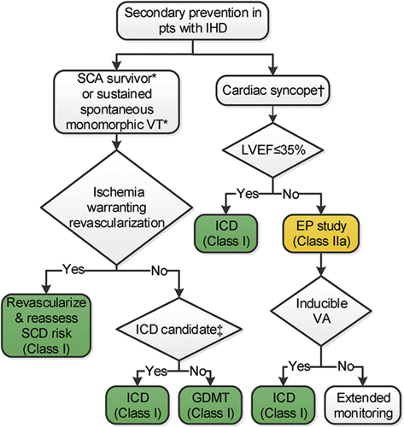
Secondary prevention

Slide 103
Catheter Ablation
Indicated as a palliative and adjunctive therapy in post-mi patients
ICD shocks reduces the risk of SCD by approximately 60%
ICD shocks are associated with progressive heart failure
A significant decline in psychosocial quality of life
Two- to fivefold increase in non-arrhythmic mortality
        OPTOMIZATION OF THE DEVICE/DRUG UPTITRATION
                SYMPTOMATIC
        Catheter ablation recommended

Slide 104
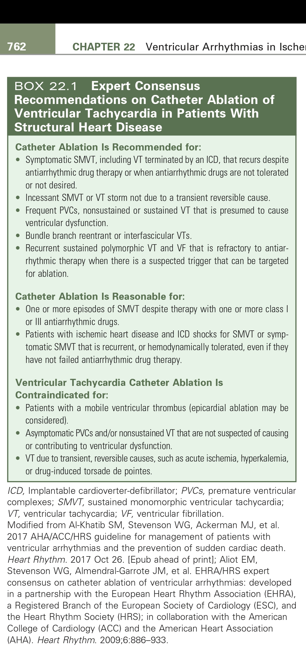
Expert Consensus
Recommendations on Catheter Ablation

Slide 105
Contraindications for catheter ablation
Patients with a mobile ventricular thrombus
Asymptomatic PVCs and/or nonsustained VT that are not suspected of causingor contributing to ventricular dysfunction
VT due to transient, reversible causes, such as acute ischemia, hyperkalemia, or drug-induced torsade de pointes

Slide 106
R on T is grade ______ according to lowne classification
Grade 2
Grade 3
Grade 4
Grade 5

Slide 107
Fixed coupling interval is seen in
Parasystole
Extrasystole
Atrial ectopic
Junctional ectopic

Slide 108
Mechanism of VT in long QT tachycardia
Re-entry
Abnormal automaticity
Triggered activity

Slide 109
Ventricular Tachycardia in the absence of structural heart disease.
Constitutes for 10% of patients presenting with ventricular tachycardia.
NORMAL
ECG
CAG
ECHO

Slide 110
Classification
Non Life threatening- typically monomorphic
A. Outflow tract
- Right ventricular outflow
- Left ventricular outflow
- Aortic sinus of valsalva
B. Idiopathic left ventricular tachycardia
- Left posterior fascicle
- Left anterior fascicle
- High septal fascicle
C. Others
- Mitral annulus
- Tricuspid annulus
- Papillary muscle

Slide 111
2. Life threatening
A. Genetic syndromes.
-Long QT syndrome
-Brugada Syndrome
-Catecholaminergic polymorphic ventricular tachycardia
-Short QT
B. Idiopathic Ventricular fibrillation.

Slide 112
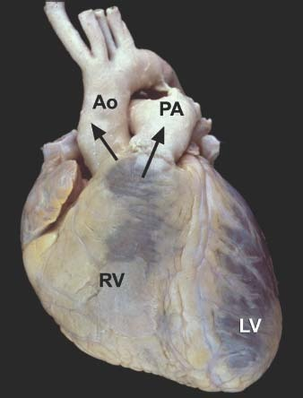
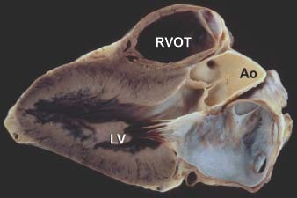
Outflow tract VT(60%-80%)
Most common type of idiopathic ventricular tachycardias.
- 70% originate from RVOT .
- 20% from the aortic cusps.
- 10% from the LVOT, pulmonary artery or the LV epicardium .
Common age at presentations 30-50 yrs
Females>males ; LVOT→men commonly affected

Slide 113
Anatomic correlates
RVOT:-
- Is a muscular infundibulum circumferentially
- Bounded cranially by pulmonary valve and caudally by the RV inflow/top of tricuspid valve
- Lateral aspect of the RVOT region is the RV free wall
- Medial part is the septal part
- Main body courses anterior to LVOT and in its superior aspect extents leftward of the LVOT.
LVOT:-
- Region of LV between anterior cusp of mitral valve and ventricular septum
- Partly muscular and partly fibrous.

Slide 114
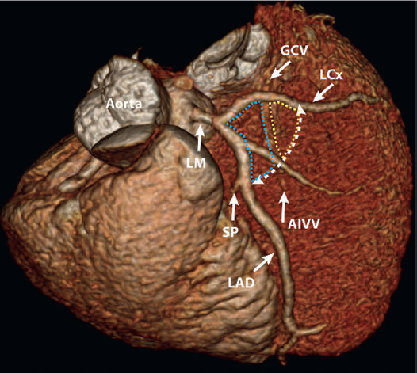
LV ventricular arrythmias
70% from aortic root
  R/L SoV or the commissure between them
LV summit 12%
LV ostium 5-10%

Slide 115
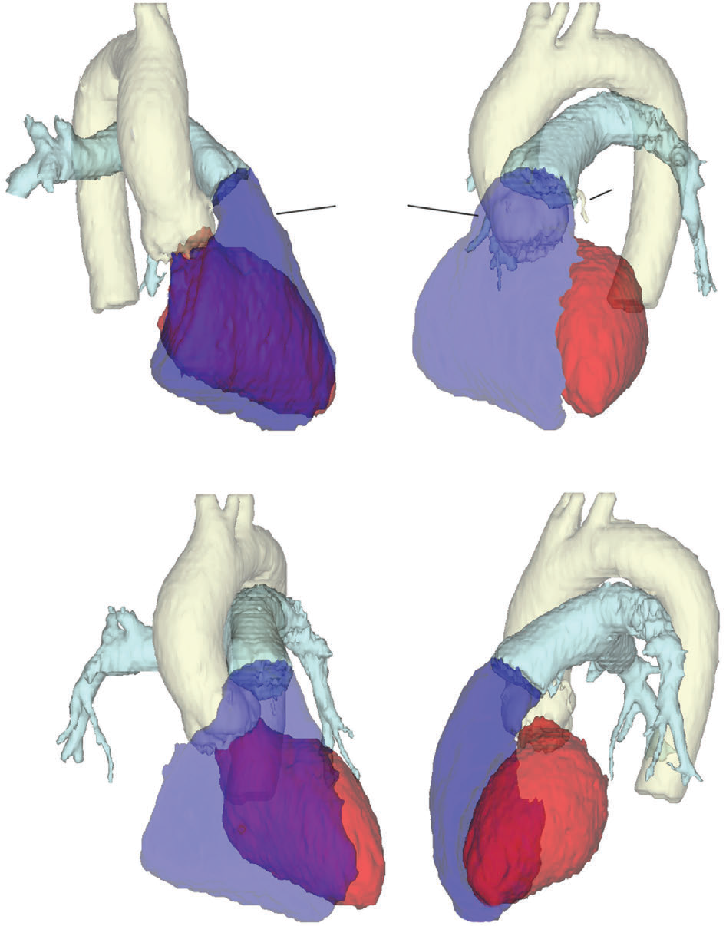
LAO
RAO
Anteroposterior
Left lateral

Slide 116
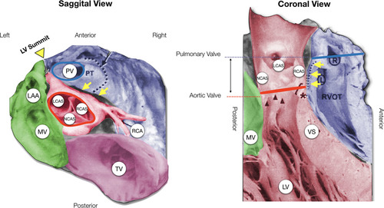

Slide 117
Phenotypes
Exhibits three type of phenotypes:-
- Repititive monomorphic PVCs(60% to 90%).
- Non-sustained repititive monomorphic VT.
- Paroxysmal exercise induced sustained VT.
Considerable overlap may occur among the three phenotypes.
Ablating one phenotype at a discrete site eliminates the other two phenotypes suggesting all three are representative of the same focal cellular process.

Slide 118
Mechanism
Triggered activity mediated by catecholamine induced delayed after depolarizations(DAD).
Increase in intracellular cyclic adenosine monophosphate (cAMP) and ICa,L
Spontaneous oscillatory release of Ca 2+ from the sarcoplasmic reticulum
Activates a transient inward current (Iti), giving rise to a DAD.

Slide 119
Initial evaluation
Diagnosis of exclusion
Diagnostic features→ structurally normal heart& QRS morphology consistent from typical origin sites
ECG
  Normal during NSR
  10% have RBBB
  Freq monomorphic PVC,couplets,salvos of NSVT
  Cycle length <300ms
  Localization
  70% from RVOT
  20-50% from LV(Aortic root MC site )

Slide 120
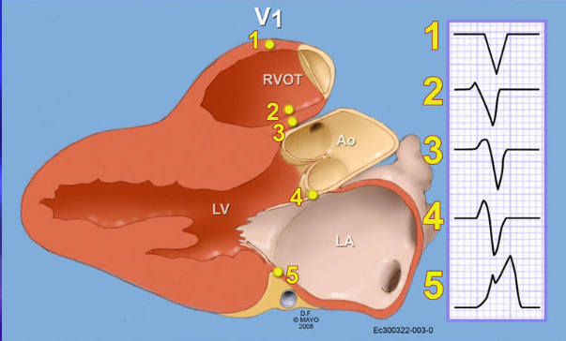
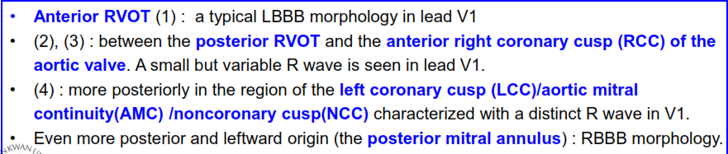
Precordial Transition

Slide 121
Frontal plane vertical axis
  Inferior leads (II, III, and aVF) reflect the vertical axis.
  All OT VAs exhibit positive deflections in the inferior leads.
  Magnitude of the inferiorly directed vector diminishes (subpulmonic region to the para-Hisian region).

Slide 122
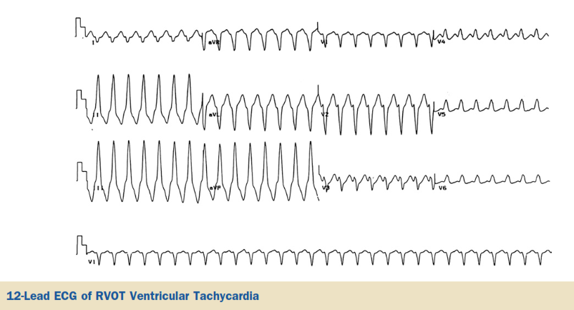
RVOT VT

Slide 123
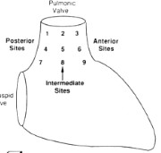
ECG in localizing RVOT VT
RVOT is divided into nine distinct sites.
Sites 1 to 3 are the most superior sites below the pulmonary valve in a posterior to anterior orientation .
Vast majority of RVOT arrythmias arise from its most superior aspect.
Jadonath : Am Heart J 1995; 130: 1107

Slide 124
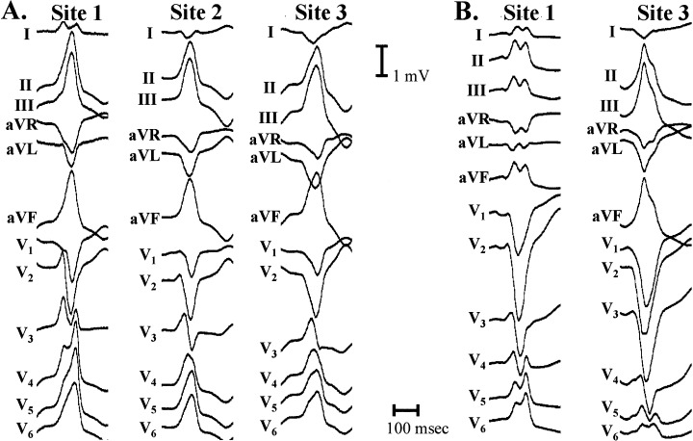
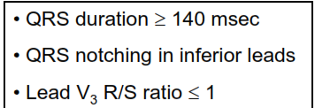
Septal Free wall
Dixit et al, JCE 2003

Slide 125
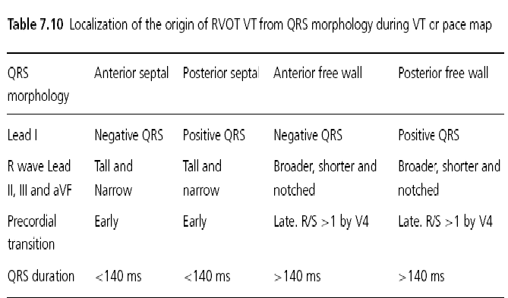

Slide 126
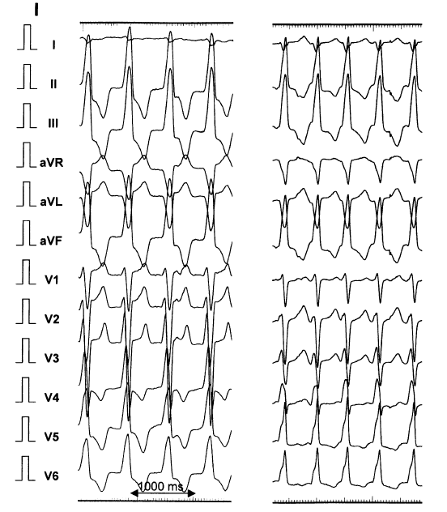
Pulmonary Artery VT
In 4-6% of RVOT VT, site of origin may be above the plane of pulmonary valve.
LBBB morphology
Greater R wave in inferior leads ( location superior to RVOT)
Taller R wave in lead III compared with lead II( due to leftward orientation).

Slide 127
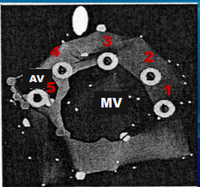
LVOT VT
Can originate from several sites.
Basal LV
-Aorto mitral continuity(majority)
-Lateral, superolateral and superior mitral annulus
-Septal parahisian region
Aortic cusp
- Left aortic sinus
- Right aortic sinus
- Non coronary sinus
LV summit tachycardias
Others

Slide 128
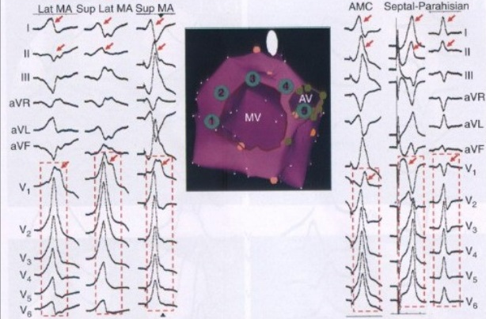
Basal LV VT
LBBB PATTERN
EARLY PRECORDIAL TRANSITION
SIGNATURE qR pattern&
BROAD MONOPHASIC R WAVE
RBBB

Slide 129
Treatment
Acute management
Chronic management
Carotid sinus massage, Valsalva maneuvers
Intravenous adenosine or verapamil
Long-term oral therapy with either BB or CCB
Nonresponders (33%)- class I or III antiarrhythmic agentsAA
Reassurance & counselling
Annual follow up with holter &echo when PVC >10,000/24hrs
Pharmacology therapy
1st line→BB,Verapamil,ditiazem
Only modest efficacy
Catheter ablataion (Rx of choice)
RFA Cure rate of > 90%
Reccurence in 15%

Slide 130
Fascicular VT
Accounts for 10% to 15% of all idiopathic VTs
15-40yrs with male preponderance (60%-80%)
Diagnostic triad:-
-VT sensitive to verapamil
- RBBB and left axis configuration
- Absence of structural heart disease.
Re entrant tachycardia involving the left fascicular Purkinje system
Benign course & SCD rare
Verapamil sensitive VT

Slide 131
Initial evaluation
Surface electrocardiogram
Invasive electrophysiology testing→ confirms
Echocardiographic examination (that may show one or more prominent false tendons),
Stress testing,
CAG

Slide 132
ECG
VT rate is approximately 150 to 200 beats/min
relatively narrow QRS duration (127± 11 milliseconds)
short RS interval in the precordial leads
RBBB pattern
According to the fascicular territory involved
  Left posterior fascicular VT -RBBB and LAD (90%)
  Left anterior fascicular VT -RBBB and RAD
  High septal fascicular VT -relatively narrow QRS and normal axis

Slide 133
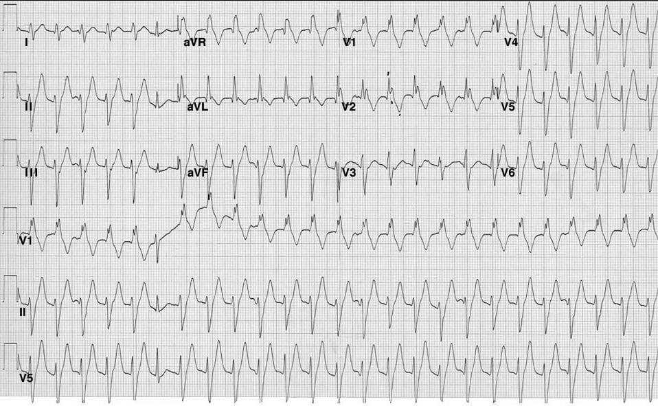

Slide 134
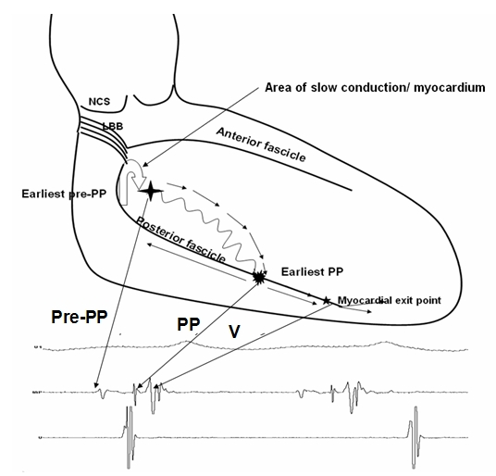
Electrophysiologic mechanism
Mechanism – Reentry
Anterograde limb- Specialised verapamil sensitive zone from basal to apical site of left of ventricular septum.
Retrograde limb- posterior fascicle from apical to basal septum.
Zone of slow conduction- completes the circuit.

Slide 135
MANAGEMENT
Acute management
Intravenous verapamil/diltiazem is the first line treatment
Vagal maneuvers→ ineffective
Chronic management
Oral verapamil or diltiazem
Catheter ablation(success rate of 85% to 90%)

Slide 136
Epicardial Ventricular Tachycardia
Importance of epicardial VT circuits was first highlighted in Chagas disease
Substrate has also been described in
  Nonischemic dilated cardiomyopathy (DCM)
  Arrhythmogenic right ventricular cardiomyopathy (ARVC)
  Post–myocardial infarction VT
  Idiopathic VT

Slide 137
Around 10% of patients with idiopathic VT
Perivascular origin, catecholamine enhancement and adenosine sensitivity.
Mechanism- triggered activity.
Most common site- LV summit.
LV summit- triangle formed anteriorly by the proximal LAD, laterally by the proximal LCx and superiorly by the GCV and AIV.

Slide 138
ECG Features Suggesting an Epicardial Origin of VT
LV VT in Nonischemic Dilated Cardiomyopathy
  Pseudo-delta wave >34 msec
  • Long R-wave peak time (≥85 msec) in lead V2
  • Shortest precordial RS complex duration >120 msec
  • QRS duration >200 msec
  • The presence of a Q wave in lead I (for basal superior and apical
  superior VTs)
  • The absence of a Q wave in any of the inferior leads (for basal
  superior VTs)
  • The presence of a Q wave in the inferior leads (for basal inferior and
  apical inferior VTs)
  • Maximum deflection index ≥0.59 (for basal-superior/lateral VTs)
Site-specific criteria

Slide 139
LV Summit Idiopathic VT
  Pseudo-delta wave >34 msec
  • Long R-wave peak time (≥85 msec) in lead V2
  • Shortest precordial RS complex duration >120 msec
  • Delayed shortest precordial maximal deflection index (≥0.55)
  • Peak deflection index >0.6
  • R wave amplitude ratio in leads III/II ratio of >1.25
  • R wave amplitude ratio in leads aVL/aVR >1.75

Slide 140
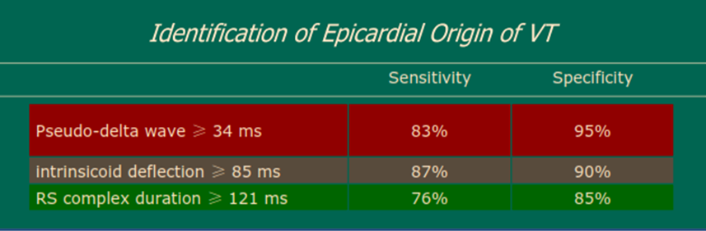

Slide 141
Precordial maximum deflection index
Beginning of QRS to earliest maximal deflection in any precordial leads / QRS duration. (> 0.55) (sensitivity of 100%, specificity of 98%)
Shortest precordial complex:
Interval from earliest ventricular activation to the 1st S wave in any precordial lead. (> 121 ms)
Ablation is the main stay of treatment

Slide 142
Genetic syndromes
Long QT
Brugada Syndrome
CPVT
Short QT

Slide 143
Long QT syndrome
LQTS is characterized by abnormally prolonged QT interval.
Thirteen different genes described
LQT1, LQT2, and LQT3 account for 75%
LQT1 and LQT2 -mutations of KCNQ1 and KCNH2 genes that encode subunits of IKs and Ikr potassium channels.
LQT3 -mutations of SCN5A gene that encode subunits of INa sodium channels
Approximately 25% don’t have identifiable gene mutations

Slide 144
CHANNELOPATHY | GENE | PROTEIN
LQT 1 | KCNQ1 | α-subunit of Iks
LQT 2 | KCNH2 | α-subunit of Ikr
LQT 3 | SCN5A | Sodium channel, α-subunit
LQT 4 | ANK2 | Cellular structural protein
LQT 5 | KCNE1 | β-subunit of Iks
LQT 6 | KCNE2 | β-subunit of Ikr
LQT 7 | KCNJ2 | α-subunit of Ik1

Slide 145
CHANNELOPATHY | GENE | PROTEIN
LQT 8 | CACNA1C | l-type Ca + channel, α-subunit
LQT 9 | CAV3 | Plasma membrane structural protein
LQT 10 | SCN4B | Sodium channel, β-subunit
LQT 11 | AKAP9 | Kinase anchoring protein (Yotaio)
LQT 12 | SNTA1 | Syntrophin α1 (affects sodium current)
LQT 13 | KCNJ5 | Inwardly rectifying potassium channel, α-subunit

Slide 146

Triggers of arrhythmia
Swimming and exertion-induced cardiac events are strongly associated with LQT1.
Auditory triggers and events
during postpartum period
occur in pts with LQT2.
Events occurring during periods of sleep or rest are most common in LQT3.

Slide 147

ECG in LQTS
QTc values exceeding 450 ms (in males) and 460 ms (in females) are considered abnormal .
LQT1 is associated with a broad-based T wave.
LQT2 with low-amplitude notched or
biphasic T wave.
LQT3 with long isoelectric segment followed by a narrow-based T wave.

Slide 148

LQTS : Diagnostic Criteria
Score
≤1 point: low probability
1.5–3 points: intermediate probability
≥3.5 points: high probability.
Schwartz et al
Circ Arrhythm Electrophysiol. 2012;

Slide 149
Jervell and Lange-Nielsen syndrome
Autosomal recessive variant of long QT syndrome.
Due to homozygous or compound heterozygous mutations on either the KCNQ1 or KCNE1 genes.
Pts also suffer from congenital deafness.
Most severe of major variants of LQTS.
90% have cardiac events, 50% become symptomatic by age of 3 yrs and their average QTc is markedly prolonged (557± 65 ms)

Slide 150
Management
- Avoid trigger events and medications prolong QT interval
- Risk stratification schemes based on degree of QT prolongation, genotype, and sex
- Corrected QT interval exceeding 500 ms poses a high risk for cardiac events
- Patients who have LQT2 and LQT3 may be at higher risk for SCD compared with patients who have LQT1

Slide 151

Risk stratification
Risk of a 1st cardiac event in pts younger than 40 years of age in the absence of any LQTS active treatment

Slide 152
Beta blockers
BB are indicated for all patients with syncope and for asymptomatic patients with significant QT prolongation
Role of BB in asymptomatic patients with normal or mildly prolonged QT intervals remains uncertain.
BB are highly effective in LQT1, but less effective in other LQTS
Role of BBs in LQT3 is not established.
Because LQT3 is a minority of all LQTS, symptomatic patients who have not undergone genotyping should receive BBs

Slide 153
ICD are indicated for secondary prevention of cardiac arrest and for patients with recurrent syncope despite BB therapy
Less defined therapies
- Gene-specific therapy with mexiletine , flecainide , or ranolazine for some LQT3 patients
- PPI for bradycardia-dependent torsade de pointes
- Surgical left cardiac sympathetic denervation for recurrent arrhythmias resistant to BB therapy

Slide 154

DRUGS AND ELECTROLYTES
BETA BLOCKERS
SYMP DENERVATION
ICD

Slide 155

Catecholaminergic PMVT.
Disorder of myocardial calcium homeostasis
Clinically manifested as exertional syncope and SCD due to exercise induced VT
Often polymorphic or bidirectional

Slide 156
Genetic basis
Mutations in 2 genes are identified : ryanodine receptor gene (RyR2) and calsequestrin 2 gene (CASQ2).
RyR2 mediates release of Ca+ from SR which is is required for myocardial contraction.
RyR2 mutation result in Autosomal Dominant form of CPVT
Calsequestrin 2 is a protein in sarcoplasmic reticulum which binds large amounts of calcium.
CASQ2 mutation result in Autosomal Recessive form of CPVT.

Slide 157
Mechanism for Arrhythmogenesis
DAD dependent triggered activity.
Mutant ryanodine receptor is leaky and it releases excess of calcium during diastole.
This activates NCX that extrudes calcium ions out from the cell.
This generates a net inward current results in DAD.
When large enough, DADs trigger extrasystolic AP.

Slide 158

Mechanism for Arrhythmogenesis

Slide 159

Management

Slide 160
Short QT Syndrome
Rare condition with short-QT interval (<320 ms).
Presents symptomatically with recurrent syncope, sudden cardiac death and atrial fibrillation.
Mutations in 6 different genes (3 gain of function and 3 loss of function) are identified .

Slide 161
Genes in SQTS
CHANNELOPATHY | GENE | CHANNEL /PROTEIN
SQT 1 | KCNH2 | I_{Kr}
SQT 2 | KCNQ1 | I_{Ks}
SQT3 | KCNJ2 | I_{K1}
SQT4 | CACNA1C | l-type ca+ channel, α-subunit
SQT5 | CACNB2 | l-type ca+ channel, β-subunit
SQT 6 | CACNA2D1 | l-type calcium channel subunit

Slide 162

Proposed Diagnostic Criteria: SQTS
Michael H. Gollob, MD, Calum J. Redpath et al JACC Vol. 57, No. 7, 2011

Slide 163

Management

Slide 164
Idiopathic VF
Presents as syncope or sudden cardiac death in young people with structurally normal heart.
Defined as a resusucitated cardiac arrest victim, preferably with documentation of VF in whom known cardiac, respiratory, metabolic and toxicological etiologies have been excluded.
No identifiable genetic syndromes.
Unrelated to stress or activity.
May occur in clusters characterised by frequent ventricular ectopy and short episodes of VF.
Triggered by PVCs, generally with a short coupling interval.

Slide 165
Idiopathic VF
Early repolarisation pattern in the inferior or lateral ECG leads occurs more frequently in patients with IVF than in normal subjects.
Isoproterenol- useful in suppressing VF in acute setting.
Quinidine – useful in chronic cases.
ICD- recommended for patients with IVF.

Slide 166
BRUGADA SYNDROME
Pathogenesis
Loss of function mutation in SCN5A(3p21-24) coding for alpha subunit of cardiac sodium channel
The defective subunit reduces the sodium inflow current → reducing the duration of normal action potential .
In addition, a prominent transient outward current I(to) ,in the right ventricular epicardium further shortens the AP

Slide 167

Ventricular arrhythmias & phase 2 rentry
Due to heterogeneity of myocardial refractory periods in RV
This heterogeneity arises from the presence of both normal & abnormal sodium channels in the same tissue.

Slide 168
Brugada syndrome comprises of typical ECG features with clinical features of ventricular arrhythmias
SCD may be an initial presentation in one third of the patients
Syncope → tachyarrythmia associated
Noctural agonal respiration may also occur

Slide 169
ECG pattern
Pseudo RBBB with ST elevation in v1-v3
Classical Brugada Type 1
  Elevated ST segment (>2mm) with upward convexity to inverted T wave (coved type)
Type 2
  ST segment elevated (>2mm) saddle back configuration
Type 3
  Morphology either type 1 or type 2; ST elevation (<2mm)

Slide 170


Slide 171
Provoking factors
ECG can be unmasked by
  Sodium channel blockers.e.g: Flecainade, procainamide, ajmaline
  Beta blockers, TCA,lithium,alcohol & cocaine
  Fever, hyperkalemia/hypokalemia, hypercalcemia,

Slide 172
Sudden cardiac arrest and syncope
Most important clinical manifestation (ventricular arrhythmias)
Age group 22-56yrs
More common at night
More during sleep than awake (SUNDS)
Frequent VPC are seen prior to onset of arrythmias

Slide 173
More prone to atrial tachyarrythmias escpecially →A fib
Patient with A fib indicate greater severity and higher chance for V fib
Nocturnal agonal respiration
Equivalent to syncope/ ventricular arrythmias
Asymptomatic patients →Risk of cardiac death is very less

Slide 174


Slide 175
Drug challenge
Drugs for drug challenge
  Flecanide-2mg/kg over 10 mins iv or 400mg po
  Procainamide -10mg/kg over 10 mins iv
  Ajmaline-1mg/kg over 5min iv
Termination of drug challenge
  Development of type 1 pattern
  Development of VCP/arrhythmias
  Widening of QRS >/=30% above baseline

Slide 176


Slide 177

2017 AHA guidelines for management for Brugada Syndrome

Slide 178
Drugs to be avoided by Brugada syndrome patients
Anesthetics / analgesics
Bupivacaine
Procaine
Propofol
Other substances
Acetylcholine
Alcohol(overdose)
Cannabis
Cocaine
Ergonovine
Antiarrhythmic drugs
Ajmaline
Propafenone
Procainamide
Flecainide
Allapinin
Ethacizin
Pilsicainide
Psychotropic drugs
Amitriptyline
Clomipramine
Desipramine
Lithium
Loxapine
Nortriptyline
Oxcarbazepine
Trifluoperazine

Slide 179
Drug-Induced Ventricular Arrhythmias
Monomorphic VT can occasionally be precipitated by medications
Mechanisms vary depending upon drug classes
  Myocardial sodium channel activation or inhibition
  Intracellular calcium overload
  Stimulation of myocardial β₂-receptors
  Induction of coronary ischemia
Prevention
  Avoidance of the offending agents
  Careful patient selection
  Dose adjustment.

Slide 180


Slide 182
Treatment of drug-induced monomorphic VT
Hemodynamically unstable patients → synchronized cardioversion
Stable patients
  Intravenous amiodarone, lidocaine, or procainamide
  Synchronized cardioversion if necessary
Flecainide-induced incessant VT→ IV lidocaine and amiodarone

Slide 183
Torsades de Pointes
TdP is a polymorphic VT associated with QT prolongation
TdP may be inherited/acquired
>200 drugs potential to cause TdP
Incidence of TdP
Range from 2.5 and 4.0 per 1 million person-years in men and women

Slide 184
Drug-induced TdP is rare in patients without risk factors
  Heart rate–corrected QT interval (QTc) >500 milliseconds
  QTc lengthening ≥60 milliseconds from pretreatment value
  Female sex; age >65 years
  Bradycardia
  Acute myocardial infarction
  Hypokalemia; hypomagnesemia; hypocalcemia
  Heart failure with reduced ejection fraction
  Concomitant administration of ≥2 QT-prolonging drugs
  History of drug-induced TdP

Slide 185
Mechanism of Drug Induced QT Prolongation and TdP
At the cellular level, the repolarisation phase →driven predominantly by IK out
Two important K+ currents participating in ventricular repolarisation are
  Subtypes of the delayed rectifier current – IKr ("rapid") and IKs ("slow")
Blockade of either of these outward potassium currents prolong the action potential
IKr is the most susceptible to pharmacological influence.
Mainly the blockade of IKr current by these drugs is at least in part responsible for their pro-arrhythmic effect
QT prolongation

Slide 186
QT prolongation when accompanied by dispersion of repolarization results in TdP which is further sustained by Re-entry
This phenomenon readily induced in the his-purkinje system & M cells
M cells show much more pronounced action potential prolongationin response to IKr blockade

Slide 187


Slide 188
Characteristic Sequence before the Onset of TdP
Ventricular ectopic beat or the last beat of a salvo of ventricular premature beats
Compensatory pause terminated by a sinus beat
Sinus beat frequently has a very prolonged QT interval and an exaggerated U wave
Ventricular extrasystole then falls on the exaggerated U wave of the sinus beat
Precipitates TdP

Slide 189


Slide 190
Management of drug-induced TdP
QT-prolonging drugs should be discontinued, and hypokalemia, hypomagnesemia, and hypocalcemia should be corrected.
hemodynamically unstable TdP→defibrillation
Intravenous magnesium 1 to 2 g; can be repeated
TdP associated with bradycardia→overdrive pacing or isoproterenol

Slide 191
Bradycardia and TdP
Bradycardia is known to be one of the major factors predisposing to TdP
Inverse relationship
Bradycardia increases the torsadogenicity of drugs that block I_{Kr} because these drugs block K⁺ channels in a reverse-use-dependent manner
Described in many conditions with bradycardia
  atrioventricular (AV) block, drugs, vagotonia, hypothyroidism

Slide 192
MECHANISM
Prolongation of APD→ depression of electrogenic Na⁺ pumping and more complete inactivation of I_{K}
Early after-depolarisations
Brady is associated with submaximal activation of I_{TO}, which shifts plateau of the action potential to a voltage levels in which the Ca²⁺ current availability is increased
Fast heart rates tend to oppose these actions, preventing early after-depolarisations and TdP.

Slide 193
Ventricular Tachycardia in Non-ischemic
Dilated Cardiomyopathy
The diagnosis of non-ischemic DCM is established by the absence of significant coronary artery disease and prior myocardial infarction (MI)
Various etiologies →Valvular heart disease, Hypertension,Chagas disease, sarcoidosis, amyloidosis, infections, hypothyroidism, thiamine deficiency, pregnancy,vasculitides, and toxins
50% are considered idiopathic
Patients with DCM can develop any variety of VAs
5-year mortality for DCM→SCD accounting for approximately one-third of deaths

Slide 194
Initial Evaluation
ECG
Echocardiography
CAG
Holter
CMR
  Determine the underlying etiology of cardiomyopathy
  Accurate assessment of ventricular chamber size
  Wall thickness
  Systolic function
  Characterize the scar tissue
  Prognostic implication
Genetic testing

Slide 195
MANAGEMENT
Pharmacological Therapy
GDMT → reduces the risk of SCD
Symptomatic ventricular arrhythmia
  Amiodarone can be considered
  But inferior to ICD in reducing the mortality & incidence of SCD

Slide 196


Slide 197
CARDIAC SARCOIDOSIS
Multisystem infiltrative, granulomatous disease of unknown etiology
The disease progresses though three successive histopathological stages
(1) Inflammation and edema with the infiltration of leukocytes
(2) Noncaseating (nonnecrotizing) epithelioid cell granuloma formation
(3) Fibrosis leading to post-inflammatory scarring

Slide 198


Slide 199
Management of Ventricular Arrhythmias
Pharmacological therapy→Trial of immunosuppression therapy with corticosteroids, alone or in combination with antiarrhythmic drug therapy
Amiodarone and sotalol most widely utilized
Catheter ablation →Electrical storm, or frequent ICD discharges refractory to immunosuppressive and antiarrhythmic therapy
ICD implantation

Slide 200


Slide 201
Thank you

