Slide 1
CARDIAC AMYLOIDOSIS
DR SREEDEV ARAVIND

Slide 2
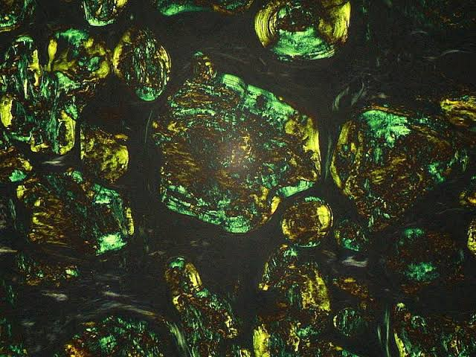
Amyloid
Rudolph Virchow in 1854 adopted the term “amyloid” to refer to tissue deposits of material that stained in a similar manner to cellulose when exposed to iodine
Amyloid has blue staining with iodine . (Virchow 1854)
Cellulose (amylum) has the same staining.

Slide 3
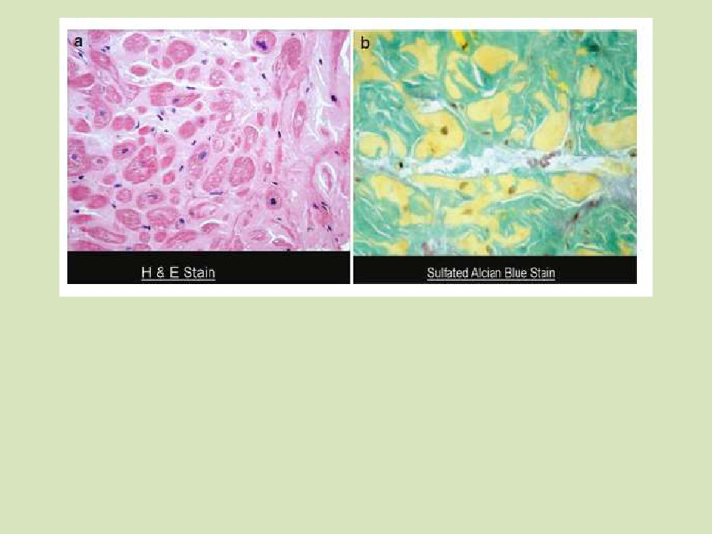
(a) H and E stain showing extensive amyloid
(b) Staining with Sulfated
Alcian Blue (another patient) shows typical amyloid
infiltration of the myocardium (light
staining with turquoise
pink) which distorts and separates the myocytes (darker pink).
staining of the amyloid
and yellow myocyte staining.

Slide 4
AMYLOIDOSIS
Definition-Extracellular infiltration of amyloid fibrils originating from different precursor proteins that self-assemble with highly ordered but abnormal cross-beta sheet confirmation
The hallmark of these diseases are the aggregation and deposition of misfolded protein as insoluble amyloid fibrils.

Slide 5
Amyloidogenic protein can be
-abnormal(AL amyloidosis)
-normal( reactive AA systemic amyloidosis, WT TTR amyloidosis)
-normal but abundantly produced for prolongrd times(beta 2 microglobulin dialysis related amyloidosis)

Slide 6
Pathogenetic steps in the development of amyloid diseases.
The two most common forms of cardiac amyloidosis are the AL and ATTR types.

Slide 7
Pathogenetic steps in the development of amyloid diseases.
Inherited mutations in transthyretin cardiac amyloidosis (ATTR) or the
aging process in wild-type disease (ATTRwt) cause destabilization of
the transthyretin (TTR) protein into monomers or oligomers, which
aggregate into amyloid fibrils. These insoluble fibrils accumulate in the myocardium and result in diastolic dysfunction, restrictive
cardiomyopathy, and eventual congestive heart failure

Slide 8
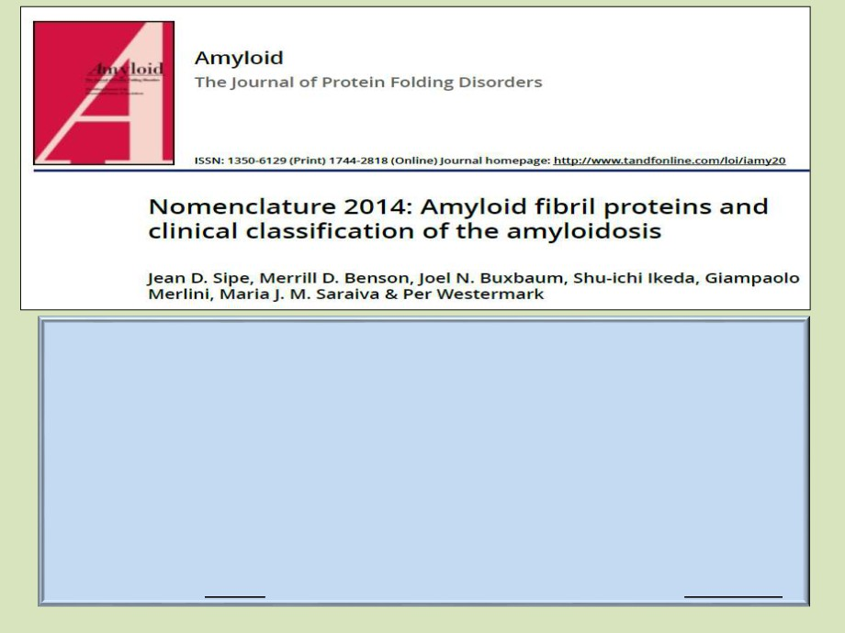
AL amyloidosis
A : Amyloid fibril protein >>> derived from immunoglobulin light (L) chains
ATTR amyloidosis
A : Amyloid fibril protein >>> derived from the plasma protein transthyretin ( TTR )
ATTRwt amyloidosis
Wild-type ATTR
ATTR V30M amyloidosis
Where the normal valine residue at position 30 has been substituted with methionine.

Slide 9
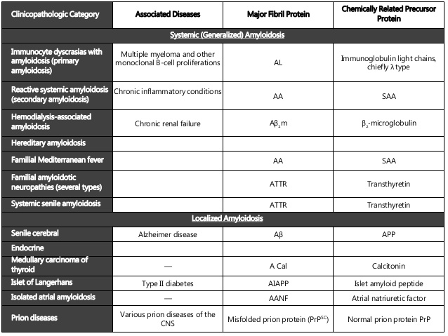

Slide 10
The commonly diagnosed types of cardiac amyloidosis
Some types of amyloid have a greater predilection
for the heart than others.
The two most common forms of cardiac amyloidosis are the AL and ATTR types.
AL amyloidosis may involve almost any other organ in the body, whereas inherited ATTR amyloidosis variably involves the heart and autonomic and peripheral nerves.
Nonhereditary ATTR amyloidosis has almost exclusively a cardiac phenotype.

Slide 11
The commonly diagnosed types of cardiac amyloidosis
Primary (AL)
ATTRwt
ATTR V122I
ATTR T60A
ATTR V30M
(Senile CA)
Precursor/
Monoclonal
Wild-type
Variant
Variant
Variant
amyloidogenic
Immuno-
transthyretin
transthyretin
transthyretin
transthyretin
protein
globulin
light chain
Average age at
60-70 years
70-80 years
≥60 years
≥60 years
30-40 or 50-
presentation
60
years
Common
Any
Caucasian
African/
Caucasian
Any
ethnicity
Caribbean
(Irish
(Portuguese,
Swedish,
Japanese

Slide 12
The commonly diagnosed types of cardiac amyloidosis
Primary (AL)
ATTRwt
ATTR V122I
ATTR T60A
ATTR V30M
(Senile CA)
Frequency of
40-50%
Almost 100%
Almost 100%
Detectable in
Uncommon
cardiac
at least 90%
involvement
Other
Kidney, liver,
Carpal
Carpal
Nerves
Nerves
systemic
soft
tunnel
tunnel
involvement
tissue,
(bladder,
nerves,
spine)
spleen
AL, monoclonal immunoglobulin light chain amyloidosis; ATTR, transthyretin amyloidosis;
ATTRwt; transthyretin amyloidosis associated with wild-type transthyretin; SCA, senile cardiac amyloidosis

Slide 13
DIAGNOSIS OF AMYLOIDOSIS
High index of suspicion
Variable signs and symptoms-fatigue,weightloss,HF,nephrotic syndrome,non diabetic peripheral neuropathy,autonomic neuropathy,hepatomegaly,macroglossia, purpura,carpal tunnel syndrome and jaw claudicatio

Slide 14
Factors leading to misdiagnosis
Physician-related factors
➢ Common misconceptions about diagnosing and typing amyloid
• Low voltage is not sensitive nor specific finding in isolation to exclude the presence of CA
• Serum protein electrophoresis is not a sufficient
screening test to exclude the presence of a plasma
cell disorder that can cause AL amyloid
• A fat pad biopsy has a sensitivity for AL amyloid of
70 % at best and is positive in<50 % of subjects with
ATTR CA

Slide 15
Factors leading to misdiagnosis
Disease-related factors
▪ Rarity
▪ Intrinsic phenotypic heterogeneity ▪ Genotypic heterogeneity in ATTR
▪ Necessity of target organ tissue histological diagnosis in the vast majority of cases

Slide 16
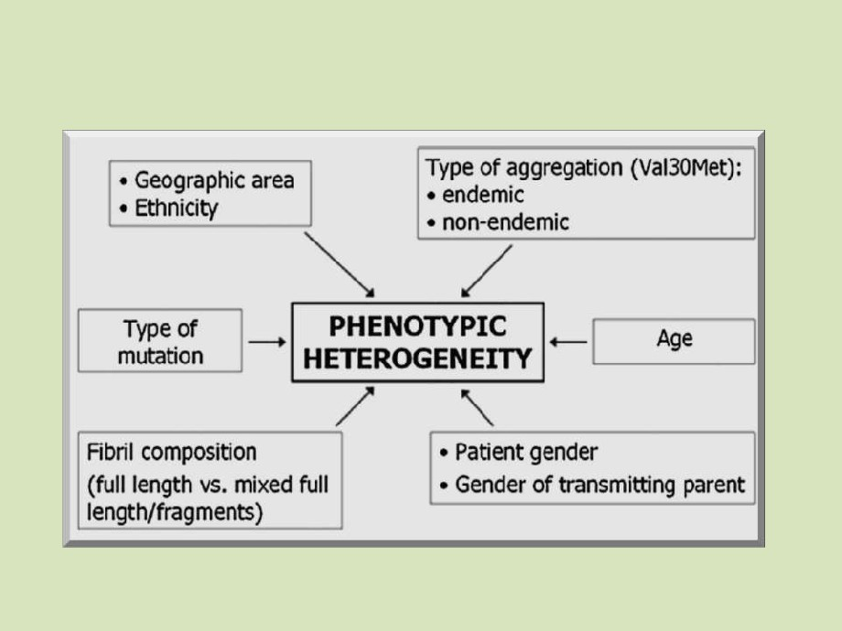
Main known determinants of
phenotypic heterogeneity in ATTR.

Slide 17
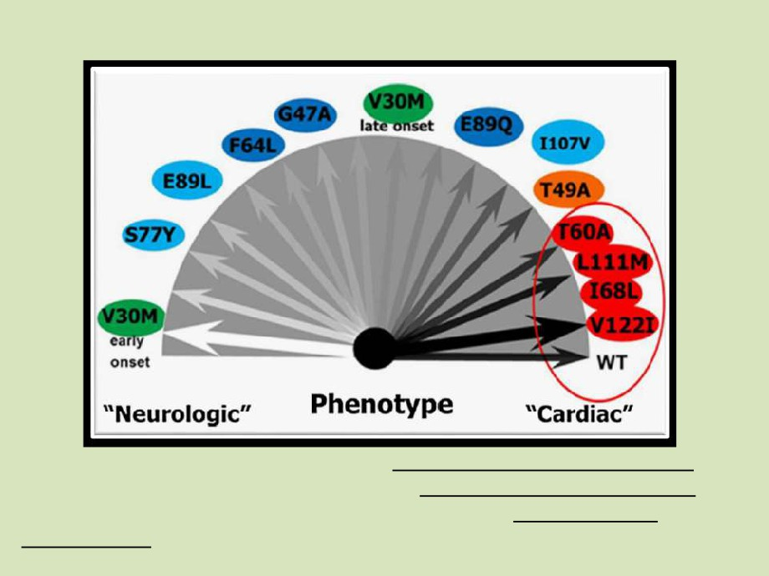
Genotype-phenotype correlation in ATTR.
Some mutations are associated with both neurological and cardiac
manifestations, whereas others lead to an exclusively neurological
disease and a small number are associated with an exclusively cardiological phenotype.

Slide 18
CARDIOLOGY EVALUATION
PHYSICAL EXAMINATION
ECG
ECHO
BIOCHEMICAL TESTING
CMR
SCINTIGRAPHY
CT
TISSUE BIOPSY

Slide 19
SYMPTOMS & SIGNS
Non specific symptoms
Paroxysms of AF
Non cardiac traits asso with AL amyloidosis-skin dyschromia,macroglossia,purpura of eyelids jaw claudication,gastroparesis,polyarthralgia, xerostomia, alopecia
Peripheral neuropathy can occur in both AL and ATTR
Carpal tunnel sx- early in ATTR

Slide 20
BIOCHEMICAL TESTING
Evaluation of monoclonal protein production
Serum immunofixation and electrophoresis
Serum free light chain assay
Proteinuria,serum creatinine and ALP
Negative test for monoclonal protein exclude AL amyloidosis

Slide 21
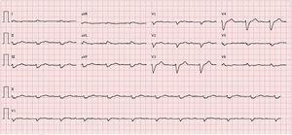
ECG
Decreased QRS voltage in > 50% of cardiac amyloidosis
Low voltages can be absent in ATTR WT
AV block –can occur in HCM and cardiac amyloidosis

Slide 22
2D Echo
Symmetric LV hypertrophy
Biventricular wall thickening
Atrial septum thickening
Slightly depressed LV systolic function
Pericardial effusion
AV valve thickening
Typical granular sparking echo reflectance

Slide 24
Current diagnostic imaging criteria for cardiac involvement includes a mean LV wall thickness(septum + PW thickness/2) greater than 12mm in the absence of alternative explanation

Slide 25
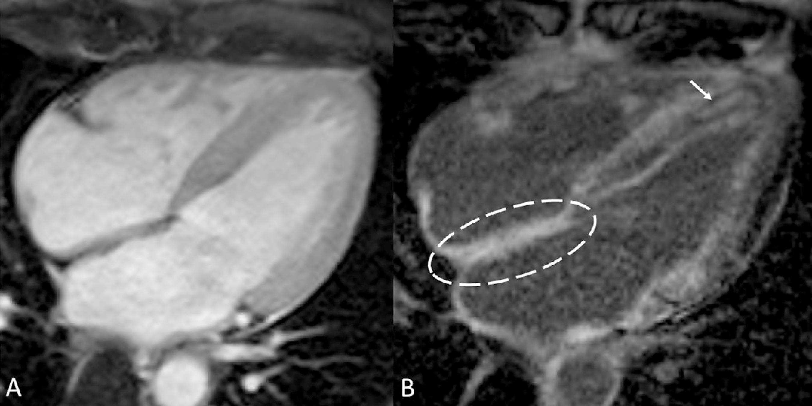
CMR
Infiltrated myocardium has different gadolinium kinetics from that of normal myocardium

Slide 26
Cardiac CT
Diagnosis and quantification of cardiac amyloidosis by measuring myocardial extracellular volume.

Slide 27
Scintigraphy
Tc99 in ATTR amyloidosis used for diagnosis in asymptomatic carriers of ATTR mutations or in elderly patients with HF of unknown etiology

Slide 28
EMB
Demonstrate amyloid deposition and allowing for immune characterisation of amyloidogenic protein
Performed in suspected cases with a low scintigraphy score or in the presence of monoclonal proteins

Slide 29
Genetic testing
In all pts with non-AL amyloidosis to confirm results of tissue typing and to descriminate between hereditary and wild type ATTR

Slide 30
CARDIAC AMYLOIDOSIS: A PAN HEART DISEASE
Affects myocardium,valves and vessels
Endocardium and pericardium can be focally involved without significant functional consequence
Damage exerted by amyloid deposition in cardiac structures is a result of infiltration of amyloid deposits that surround single myocytes or expand in interstitium at the endocardial and pericardial levels and in cardiac valves

Slide 31
Amyloid deposition leads to loss of patency of lumen.
AL amyloidosis has additional direct cardiotoxic effect

Slide 32
AL AMYLOIDOSIS
Incidence 3-5 per million
Fibrils are constituted of Ig light chains produced by a clonal population of plasma cells
In unrecognized AL amyloidosis, AF or HF or other cardiac symptoms can be the presenting phenotype

Slide 33
Cardiac dysfunction in AL amyloid results from both amyloid infiltration with disruption of myocardial architecture and from direct cytotoxic effect of amyloidogenic light chains
Internalisation into lysosomal compartments of amyloidogenic light chains has been proposed as a possible myocyte toxic mechanism

Slide 34
Late diagnosis leads to about 30% mortality in 1 st year after diagnosis
Cardiac biomarkers (troponin,NT pro BNP, BNP) should be tested in all patients for their role as marker for cardiac involvement,prognostic contributors,and indicator of cardiac response to therapy
High conc of NT pro BNP has 100% sensitivity in diagnosing amyloidosis at presymptomatic stage

Slide 35
Echo—granular sparkling feature in thickened myocardial wall
Cardiac dysfn is primarily diastolic
Late Gd enhancement has prognostic value :transmural extension is associated with advanced cardiac involvement and poorer survival.

Slide 36
PROGNOSIS OF AL AMYLOIDOSIS
Median survival –8 months
(24 to 66 months in TTR)
Mayo staging system (prognostic scoring system)
Troponin T≥0.035ng/ml
NT pro BNP ≥332ng/L
Stage III with biomarkers above cut off have a median survival from 3-6 months

Slide 37
Evaluation of cardiac response to treatment is based on decrease of NT pro BNP by> 30% or by 300pg/ml when baseline NT pro BNP >650pg/ml or improvement of NYHA scale

Slide 38
MANAGEMENT
Treatment option depends on eligibility for autologous stem cell transplantation as well as tolerability of chematherapeutic agents
Elevated cardiac biomarkers are considered exclusion criteria for stem cell transplantation
Therapeutic agents include proteasome inhibitors (bortezomib), immunomodulators ( thalidomide,lenalidomide and pomalidomide)

Slide 39
Loop diuretics and aldosterone antagonists are the mainstay of rx
ACE inhibitors/ARBs---limited use due to hypotension

Slide 40
ATTR AMYLOIDOSIS
Mutation in TTR gene
AD
Predominant cardiac involvement in patients who carry p(Val1221le) and p(Leu111met)mutation

Slide 41
Bone scintigraphy enables the diagnosis of cardiac ATTR amyloidosis without a biopsy
Combined findings of grade 2 or 3 myocardial radiotracer uptake on bone scintigraphy and absence of a monoclonal protein in serum or urine result in a specificity and positive predictive value for cardiac ATTR amyloidsis of 100%

Slide 42
Echo shows a greater wall thickness and lower mortality in ATTR than in AL

Slide 43
TREATMENT
Diuretics in pt with HF
Digoxin,ACEI,ARBs,betablockers must be avoided
ICDs and PPIs must be considered

Slide 44
Liver transplantation can be considered bcoz 95% of TTR protein is produced by the liver.
Combined heart and liver transplation is occasionally indicated for advanced disease

Slide 45
Emerging Therapies for Transthyretin Cardiac Amyloidosis

Slide 46
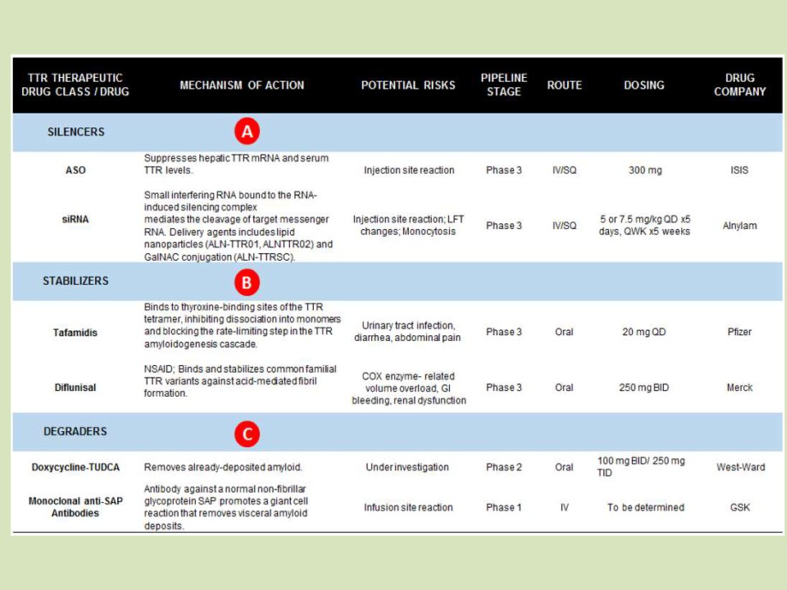
Emerging Therapies for Transthyretin Cardiac Amyloidosis

Slide 47
Amyloidosis and cardiac transplantation
Although cardiac transplantation has been performed for patients with end-stage cardiac amyloidosis for decades, only in recent years has it garnered widespread acceptance
Cardiac transplantation for amyloidosis was once considered contraindicated owing to unacceptably high morbidity/mortality rates.

Slide 48
Evolution of Transplant Outcomes
In the 1980s and 1990s, cardiac transplant outcomes in amyloidosis were poor, with survival consistently worse than in the nonamyloidosis transplant population
Factors —>
Most transplantations were for light chain (AL) amyloidosis, which has a higher risk of recurrent amyloid deposition in the transplanted heart.
Patients were often transplanted with significant extracardiac organ involvement, and would often die from complications of multiorgan disease.
Chemotherapy options were very limited, typically to alkylator/steroid combinations. Most patients were unable to achieve good long-term pathologic light chain control, and progressive amyloidosis in the transplanted heart (or in other vital organs) was common.

Slide 49
The landscape evolved considerably in the late 2000s, with 2007-2008 often regarded as a cutoff between an older “era 1” and a newer “era 2” based on 2 factors:
•Availability of new chemotherapy options for light chain control in AL amyloidosis, including bortezomib and lenalidomide.
•Publication of a protocol emphasizing both extensive pre-transplantation screening for extracardiac organ involvement and aggressive post-transplantation plasma cell–directed therapy, typically including autologous stem cell transplantation (ASCT)

Slide 50
By the 2010s, 2 factors led to further improvements in outcomes:
•Increased diagnosis of transthyretin (ATTR) amyloidosis, driven by the ability to make a noninvasive diagnosis with the use of bone scintigraphy and by newly approved therapeutic options (tafamidis, patisiran, inotersen).
•Rapidly expanding options for plasma cell–directed therapies in AL amyloidosis (eg, daratumumab).

Slide 51
Special considerations in amyloidosis
largely depending on the amyloidosis subtype.
For wild-type ATTR amyloidosis (ATTR-wt), there are no additional considerations for most patients, given the lack of other vital organ involvement typical of the disease, although cardiac transplantation is not a realistic option for most patients due to advanced patient age.

Slide 52
In variant/hereditary ATTR amyloidosis (ATTR-v), the situation is more complex and varies markedly by genotype.
For genotypes that cause a predominantly “mixed” phenotype of cardiomyopathy and neuropathy (eg, V30M, T60A), cardiac transplantation alone will not prevent a progressive disabling polyneuropathy.
For those patients, concomitant liver transplantation can be considered, with the goal being the removal of the source of the variant transthyretin protein.
However, in the present era of effective pharmacologic therapies (eg, patisiran, inotersen), it is unclear if liver transplantation is still needed—versus an alternative approach of cardiac transplantation plus pharmacologic therapy.
Before cardiac transplantation is performed in patients with mutations associated with mixed-phenotype disease, it is important to perform a thorough neurologic evaluation to exclude clinically significant neuropathy.
Further evaluations may be needed for patients with mutations characterized by other organ involvement, such as gastrointestinal evaluation in patients with the T60A mutation

Slide 53
AL AMYLOIDOSIS
Because multiorgan amyloid infiltration is a common characteristic of AL amyloidosis, it is crucial to screen for the presence of significant extracardiac organ involvement. While thresholds of “too much” involvement vary among institutions, the principle of extensive screening is widely accepted, with several protocols published by large amyloid centers
Because progressive amyloid deposition is one of the most common causes of death after transplantation, it is important to show an adequate hematologic response to light chain suppressive therapy before transplantation whenever possible.

Slide 54
Post-transplantation Chemotherapy/Immunotherapy
An extra consideration for patients transplanted for AL amyloidosis is the interaction of plasma cell–directed therapy with post-transplantation immunosuppression and rejection risks.
Although there is no clear signal in published case series , concomitant therapy with chemotherapy would be expected to raise the risk of infection.
At centers that routinely use ASCT after cardiac transplantation, complications (including infection) have contributed to mortality in some series

Slide 55
Treatment with light chain–directed therapies may serve to decrease the risk of rejection owing to their effects on immunoglobulin production
On the other hand, treatment with the anti–plasma cell immunomodulatory agent lenalidomide (and others in the “imid” class) has been temporally associated with rejection episodes in multiple case reports and should be avoided after transplantation if possible

Slide 56
Although the importance of effective light chain control after cardiac transplantation in AL amyloidosis is widely acknowledged, the best means of achieving control is unclear
when chemotherapy/immunotherapy options were limited, ASCT was typically the standard
With increased options available for light chain control (eg, daratumumab) and the nontrivial ASCT-related mortality rates reported, other centers have moved away from ASCT as a standard, reserving it for patients who have inadequate light chain control with other approaches

Slide 57
Mechanical Circulatory Support
Patients with cardiac-amyloidosis have multiple challenges for successful durable MCS. Factors include:
•Small ventricular cavities leading to difficult inflow cannula placement and high risks for suction events.
•Biventricular dysfunction leading to a high risk for right ventricular failure if left ventricular support devices are used alone.
•Higher risk for infection for AL amyloidosis patients on active chemotherapy/immunotherapy.
Despite these limitations, MCS can be an option for selected patients.

Slide 58
Conclusion
Though cardiac transplantation poses unique challenges in systemic amyloidosis, tremendous improvements have been made over the past decade.
With careful patient selection, and with a focus on effective plasma cell–directed therapies before and after transplantation, outcomes in multiple institutional case series and national transplant databases have improved, approaching parity with outcomes for patients transplanted for other indications.
With the growing numbers of patients diagnosed with ATTR amyloidosis, and with continued improvement in pharmacologic therapy options for both AL and ATTR amyloidosis, cardiac transplantation for amyloidosis is likely to become increasingly common in the coming years.

Slide 59
MCQs
1.Pick the wrong statement: a) Light chain cardiac amyloidosis has a better survival than transthyretin cardiac amyloid amyloidosis b) Light chain cardiac amyloidosis responds to chemotherapy c) Transthyretin cardiac amyloidosis is associated with sensorimotor polyneuropathy d) Transthyretin cardiac amyloidosis can be detected by bone scintigraphy

Slide 60
ANS)
A)Light chain cardiac amyloidosis has a better survival than transthyretin cardiac amyloid amyloidosis

Slide 61
2)All involve heart in amyloidosis predominantly except
a)Light chains produced by plasma cell dyscrasia
(AL Amyloidosis)
b)Amyloid derived from wild type transthyretin
c)Localised Atrial amyloid
d)Secondary (AA) amyloidosis

Slide 62
ANS) D

Slide 63
3)All can be seen on examination in AL amyloidosis except
a)JVP may be markedly elevated and kussmauls sign is frequently present
b)S4 is present and S3 may indicate RV dysfunction
c)Apex beat is often impalpabe and heart sounds are generally normal
d)A pleural effusion often deteted on physical examination and may be larger

Slide 64
ANS B)

Slide 65
4)All are frequently seen ECG findings in AL amyloidosis except
A)low voltage limb leads, rightward axis
B) first degree AV Block
C)LBBB
D) Q waves are seen in lead V1-V3

Slide 66
ANS C)

Slide 67
5) All are the echo findings in amyloidosis except
A)speckle tracking shows a classic appearance of regional longitudinal dysfunction characterised by relative septal sparing and prolonged diastolic relaxation
B)doppler tissue imaging frequently shows elevated LV filling pressure
C)severely impaired longitudinal LV systolic function even with a near normal LV ejection fraction
D)assymetrical septal thickening with a LVOT gradient may be present and mimic HCM

Slide 68
ANS A)

Slide 69
THANK YOU

