Slide 1
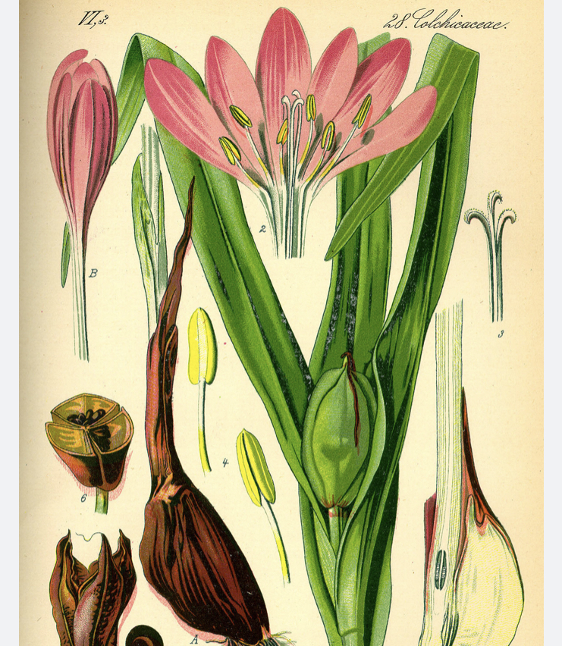
RECENT COLCHICINE BASED TRIALS
Dr. Sanchna Dev S

Slide 2
INTRODUCTION:
History:
Colchicine is a lipophilic tricyclic alkaloid derived from Colchicum autumnale / autumn crocus
Native to temperate areas of Europe, Asia, and America
Described as early as 1550 BC – Ebers Papyrus
Poisonous plant, high concentrations in the corm or bulb
After the ancient district of Colchis on the Eastern shore of the Black Sea
This Photo by Unknown Author is licensed under CC BY-SA-NC

Slide 3
Mechanism of Action
Binds to tubulin -Inhibits microtubule polymerization- inhibit mitosis
Preferentially accumulates in meutrophils because of lack of p – glycoprotein efflux pump
Inhibits activation and migration of neutrophils to sites of inflammation
Interferes with the inflammasome complex found in neutrophils and monocytes that mediate interleukin-1β activation, a component of inflammation
Inhibits superoxide anion production in response to urate crystals
Interrupts mast cell and lysosome degranulation
Inhibits release of glycoproteins that promote chemotaxis from synovial cells and neutrophils

Slide 5
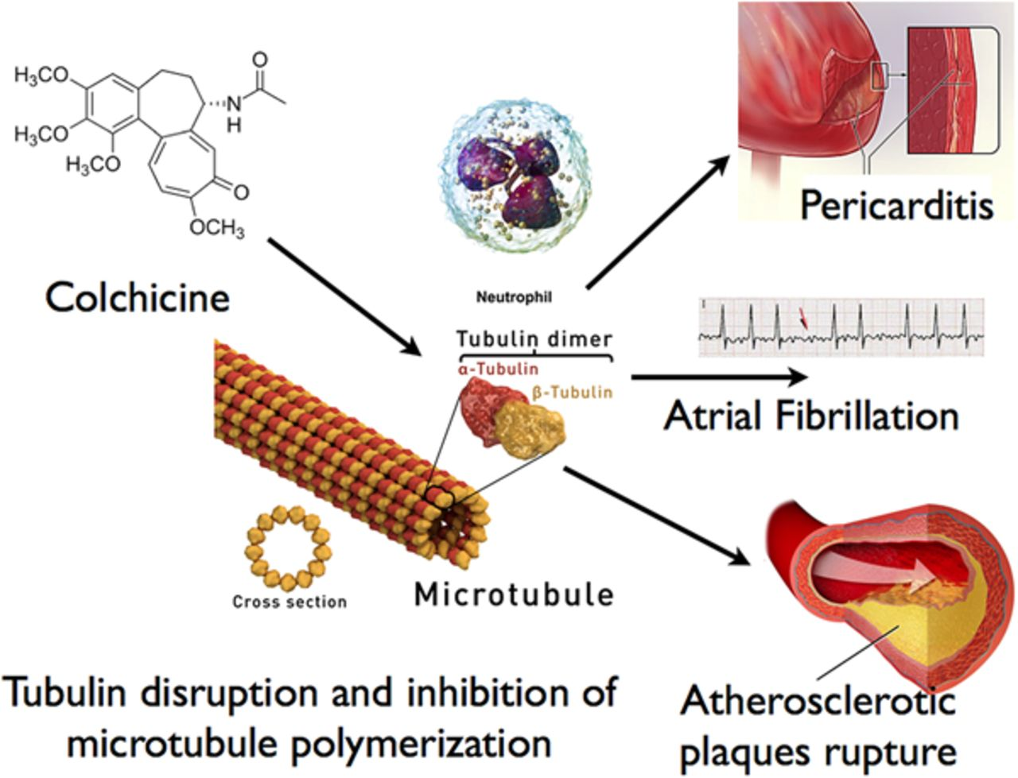

Slide 6
Pharmacokinetic data
Bioavailability | 45%
Protein binding | 35-44%
Metabolism | Mainly hepatic, partly by CYP3A4 cleared by p-glycoprotein efflux
Elimination half-life | 26.6-31.2 hours
Excretion | Faeces (65%), bile and urine.

Slide 8
Indications:
Gouty arthritis
Familial Mediterranean fever
Scleroderma, amyloidosis, Behcet’s disease, Paget’s disease
Dermatitis herpetiformis, Acute neutrophilic dermatosis
Erythema nodosum leprosum, Condyloma acuminata
Resistant idiopathic thrombocytopenic purpura
Pericarditis, pulmonary fibrosis, biliary cirrhosis, various vasculitides, pseudogout.

Slide 10
Contraindications:
Advanced kidney failure .(10-20 excreted unchanged by the kidneys)
Severe neuromyopathy
Statins are generally well tolerated with colchicine despite their own risk of musculoskeletal effects, although rhabdomyolysis has been reported with combination therapy
Colchicine toxicity can be potentiated by the concomitant use of STATINS
Adverse effects:
gastrointestinal upset, diarrhea, and neutropenia.
High doses - bone marrow suppression ,anemia, hair loss.
Neuromuscular toxicity and rhabdomyolysis.
A comprehensive safety analysis of colchicine in 35 double-blind randomized trials including 8659 participants with various inflammatory conditions confirmed known gastrointestinal adverse events (relative risk [RR], 1.74 ) —> did not demonstrate an increase in mortality or rate of adverse events related to the liver, neuropathy, muscle, infection, or hematologic disturbances

Slide 11
Colchicine in CAD

Slide 12
RECENT STUDIES ON COLCHICINE AND ITS USES IN CVS
:
COLCOT TRIAL 2019
COPS TRIAL 2019
LODOCO 2 TRIAL 2020
COLCHICINEPCI TRIAL2020

Slide 13
LODOCO 2 TRIAL
Dutch trial

Slide 14
LODOCO 2 TRIAL

Slide 15
Inclusion criteria
Age >35 and <80
Proven coronary artery disease; as evidenced by coronary angiography, CT coronary angiography or a Coronary Artery Calcium Score (Agatston score >400).
Clinically stable for at least six months

Slide 16
Exclusion criteria
1.Renal impairment (serum creatinine >150 µmol/l or estimated glomerular filtration rate (eGFR) < 50 )
2. Peripheral neuritis, myositis or marked myo-sensitivity to statins
3 Severe heart failure – systolic or diastolic New York Heart Association Functional classification 3 or 4
4. Moderate or severe valvular heart disease considered likely to require intervention

Slide 17
Important Baseline characteristics
mean age of the patients - 66±8.6 years
15.3% were female
11.7% of the patients- current smokers
18.2% - diabetes
84.4%- had a history of acute coronary syndrome(68% had ACS >24 months)
99.7% - antiplatelet agent or an anticoagulant
96.6% -a lipid-lowering agent,
62.1% -a beta-blocker
71.7% an inhibitor of the renin–angiotensin system.

Slide 20
LODOCO2 Trial conclusion
Among patients with chronic coronary disease, most of whom were already receiving proven secondary prevention therapies, the occurrence of cardiovascular events was significantly lower with low-dose colchicine than with placebo.

Slide 21
COPS trial
Australian trial
Study Design
Patients were randomized in a 1:1 fashion to either colchicine 0.5 mg BID for 1 month, followed by 0.5 mg daily for 11 months, or matching placebo.
795 patients(396 assigned to the colchicine group and 399 to the placebo
December 2015 and September 2018

Slide 22
Inclusion criteria:
Age ≥18 years
ACS managed with percutaneous coronary intervention (PCI) or medically within 30 days
Angiographic evidence of coronary artery disease

Slide 23
Salient baseline characteristics
mean age, 59.8±10.3 years
21% female
(STEMI): 50%, NSTEMI: 46%
PCI: 87%

Slide 24
Principal Findings:
Primary outcome,(death from any cause, acute coronary syndrome (STEMI/NSTEMI/unstable angina), ischemia-driven urgent revascularization and non-cardioembolic ischemic stroke) at 365 days for colchicine vs. placebo, was 6.1% vs. 9.5% (p = 0.09).
Secondary outcomes:
All-cause mortality: 8 vs. 1 (p = 0.055)
Non-CV death: 5 vs. 0 (p = 0.023)
Primary endpoint at 400 days: 24 vs. 41 events (p = 0.055)

Slide 25
Conclusion of COPS
The addition of colchicine to standard medical therapy did not significantly affect cardiovascular outcomes at 12 months in patients with ACS.

Slide 26
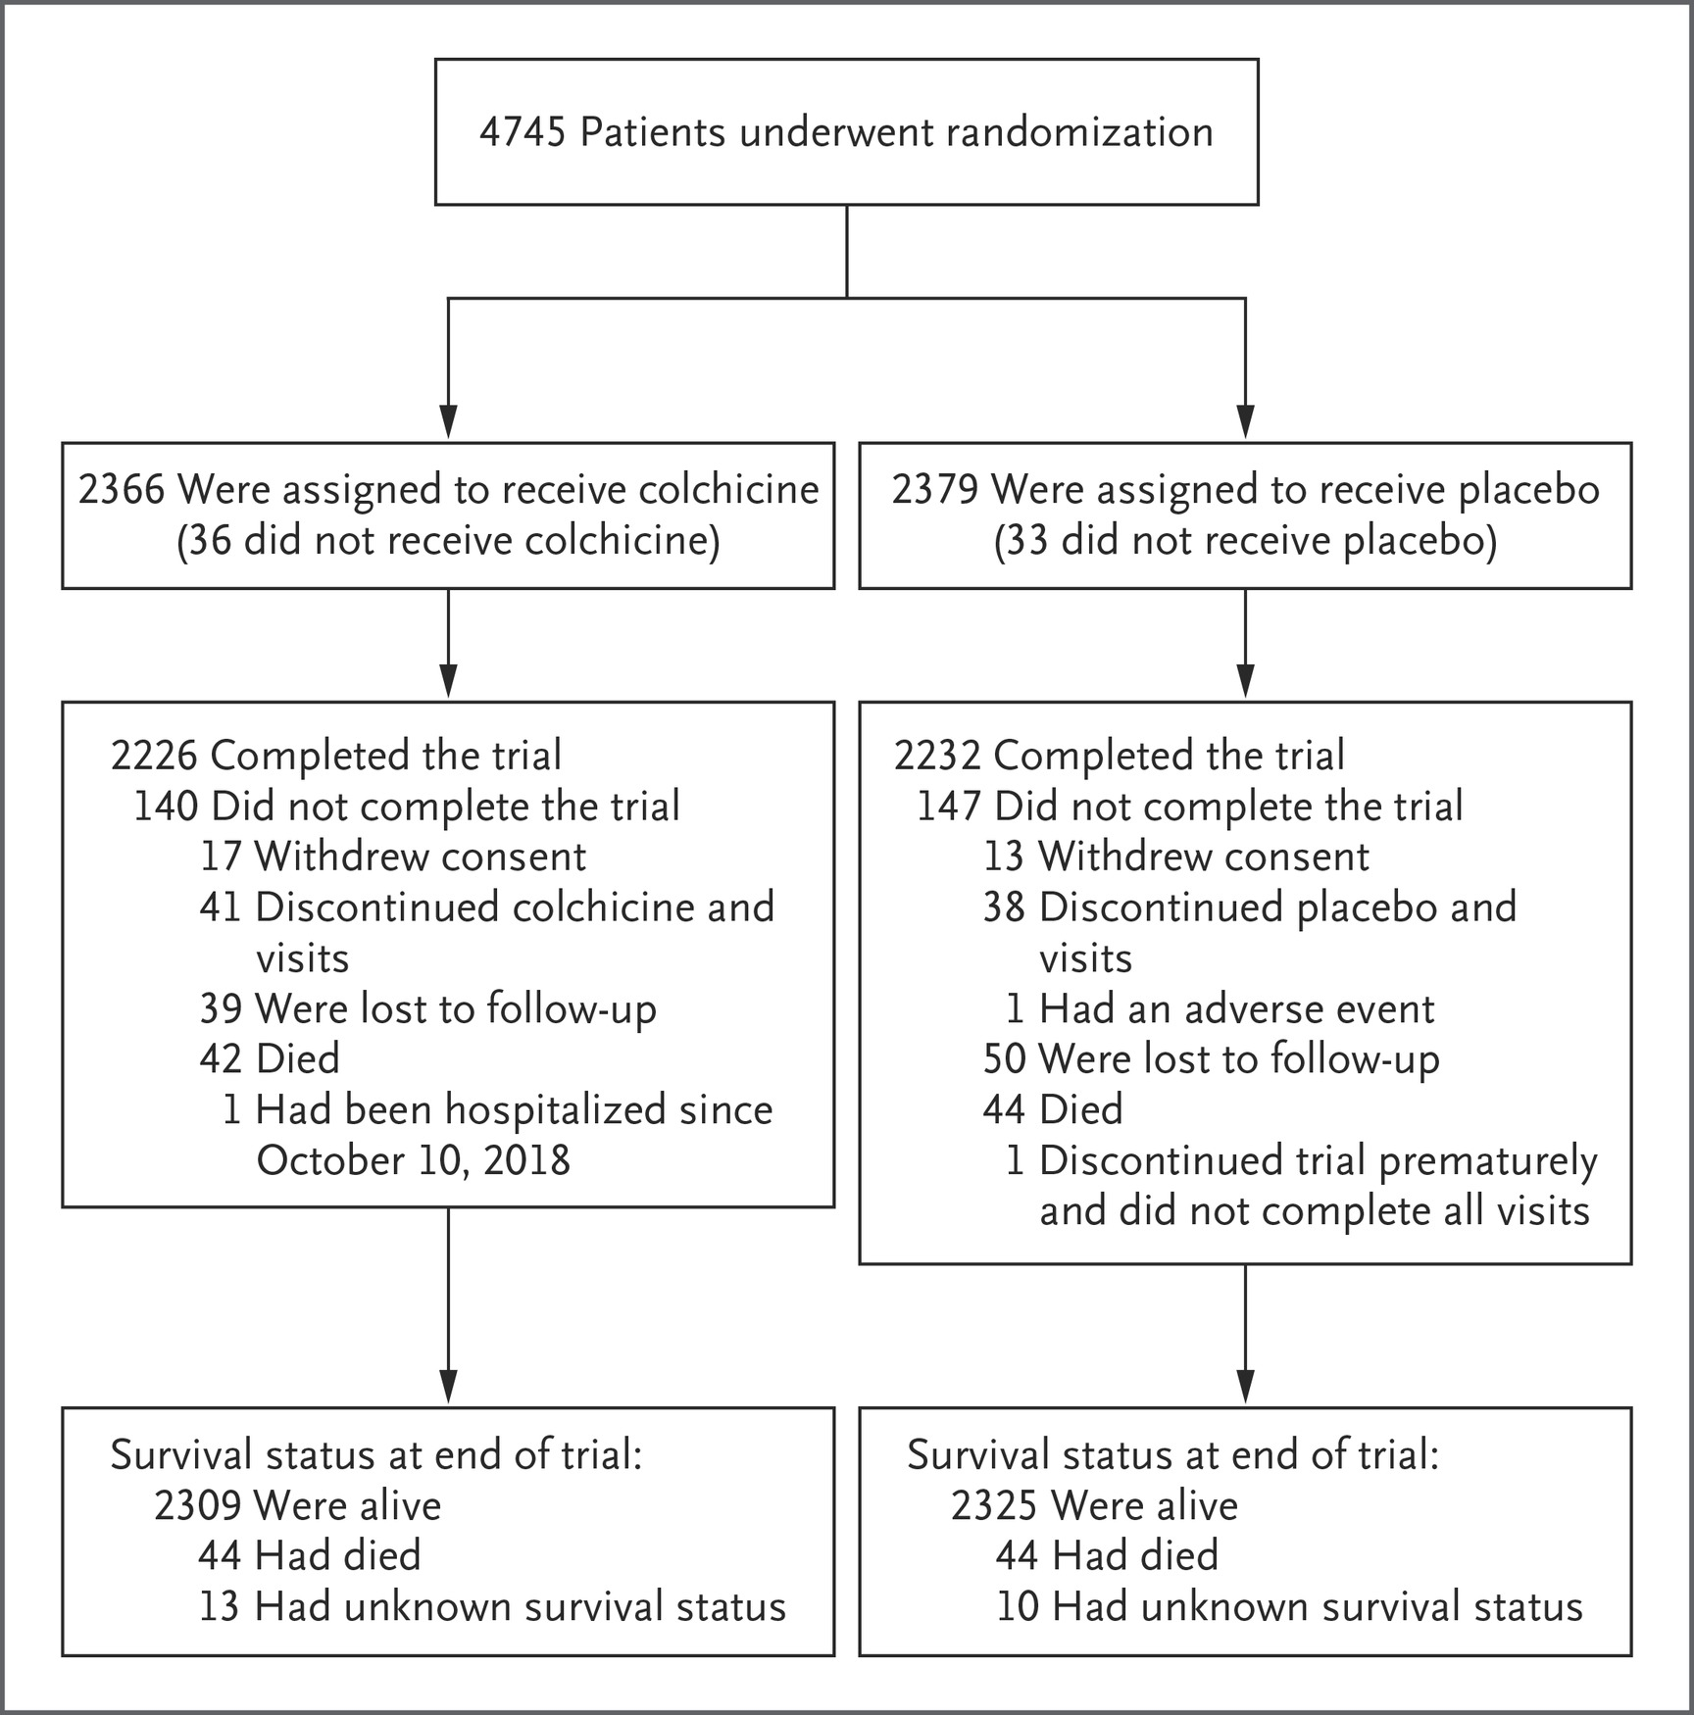
COLCOT TRIAL
Canadian Trial
Duration of folowup-23 months

Slide 27
COLCOT TRIAL
INCLUSION CRITERIA
EXCLUSION CRITERIA
had a myocardial infarction within 30 days before enrollment
had completed any planned percutaneous revascularization procedures, and
were treated according to national guidelines that included the intensive use of statins
Severe heart failure, a left ventricular ejection fraction of less than 35%,
stroke within the previous 3 months
coronary-bypass surgery either within the previous 3 years or planned,
a history of noncutaneous cancer within the previous 3 years,
inflammatory bowel disease or
chronic diarrhea,

Slide 28
Baseline characteristics
mean age - 60.6 years,
19.2% - women
20.2% had diabetes.
93.0%underwent percutaneous coronary intervention for their index myocardial infarction.
Aspirin, a different antiplatelet agent, and a statin were taken by 98.8%, 97.9% and 99.0% of the patients,

Slide 29
RESULT-COLCOT TRIAL

Slide 30
COLCOT trial conclusion
Among patients with a recent myocardial infarction, colchicine at a dose of 0.5 mg daily led to a significantly lower percentage of patients with ischemic cardiovascular events than placebo.

Slide 31
COLCHICINE PCI TRIAL
Background:
Vascular injury and inflammation during PCI are associated with increased risk of post-PCI adverse outcomes. Colchicine decreases neutrophil recruitment to sites of vascular injury. The anti-inflammatory effects of acute colchicine administration before PCI on subsequent myocardial injury are unknown.
Methods:
A prospective, single-site trial, subjects referred for possible PCI (n=714) were randomized to acute preprocedural oral administration of colchicine 1.8 mg or placebo.

Slide 32
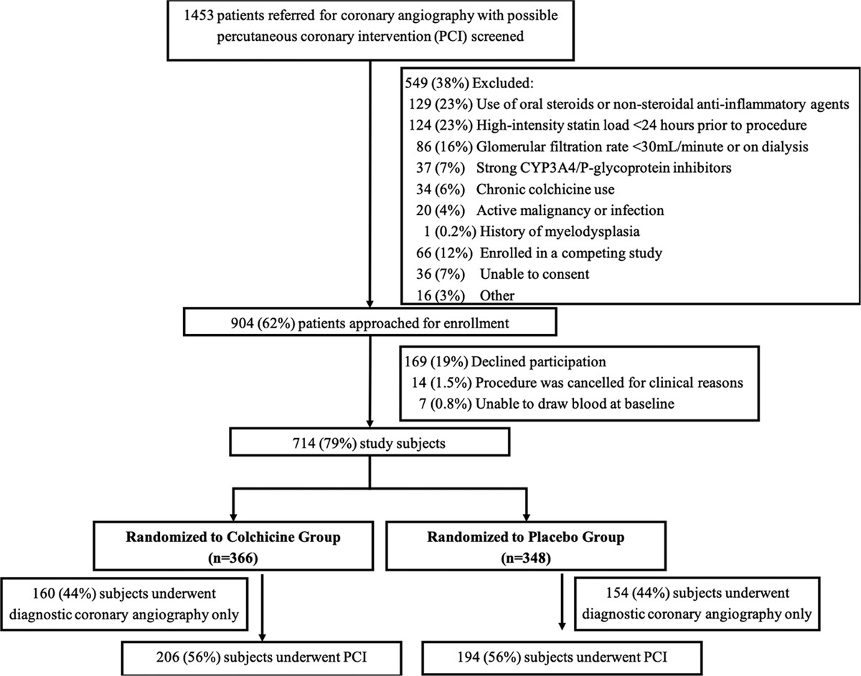

Slide 33
Results
Colchicine (n=206) | Placebo (n=194) | Placebo (n=194) | P Value
Primary outcome
PCI-related myocardial injury | 118 (57.3) | 122 (64.2) | 0.19
Secondary outcomes
30-day major adverse cardiovascular events | 24 (11.7) | 25 (12.9) | 0.82
Type 4a myocardial infarction (universal definition) | 23 (11.2) | 23 (12.1) | 0.89
Type 1 myocardial infarction (universal definition) | 0 | 1 (0.5) | 0.49
Target vessel revascularization | 0 | 0 | …
All-cause mortality | 1 (0.5) | 1 (0.5) | 0.99
PCI-related myocardial infarction (SCAI definition) | 6 (2.9) | 9 (4.7) | 0.49

Slide 34
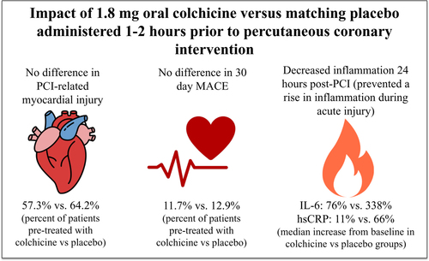

Slide 35
Conclusions:
Acute preprocedural administration of colchicine attenuated the increase in interleukin-6 and high-sensitivity C-reactive protein concentrations after PCI when compared with placebo but did not lower the risk of PCI-related myocardial injury.

Slide 36
Recommendation -CAD
2021 ESC guidelines
colchicine can be considered for the secondary prevention of cardiovascular disease, in particular for those with uncontrolled risk factors and recurrent cardiac events despite optimal medical therapy (class IIb recommendation, level of evidence A)

Slide 37
Colchicine in pericardial disease

Slide 38
Colchicine in pericardial disease – evidence revew

Slide 40
European Society of Cardiology (ESC) guidelines (class I recommendation, level of evidence A) as a first-line treatment for both acute and recurrent pericarditis and may be administered with conventional anti-inflammatory regimens (aspirin or nonsteroidal anti-inflammatory drugs).
The American College of Cardiology/American Heart Association guidelines -only recommend colchicine for pericarditis after myocardial infarction (MI; class IIb recommendation, level of evidence C).

Slide 41
Post Operative AF (POAF)

Slide 42
Postoperative AF
0.8% of patients undergoing noncardiac surgery
16% after cardiac surgery,
associated with significant morbidity - risk of embolic stroke, increased length of stay, and higher health care costs
Higher postoperative levels of inflammatory markers such as IL-6 and CRP are associated with POAF
colchicine may suppress POAF through a variety of pathways, including the NLRP3 inflammasome cascade

Slide 43
American College of Cardiology/American Heart Association guidelines suggest that colchicine can be considered for postoperative AF prevention (class IIb recommendation, level of evidence B), whereas ESC guidelines do not include colchicine treatment postoperatively

Slide 44
Evidence thus far is scarce, and there are currently no recommendations from scientific society guidelines that address AF after RFA PVI

Slide 45
Clinical Implications
although not Food and Drug Administration–approved per se, the use of colchicine for pericarditis has strong evidence and is currently recommended by the practice guidelines
colchicine can effectively decrease AF and PPS after cardiac surgery; however, additional RCTs are warranted to determine colchicine’s effect after RFA PVI
recent large, well designed RCTs and meta-analyses have illustrated substantial benefit of colchicine in CAD
larger RCTs should further examine the use and timing of colchicine in relation to PCI

Slide 46
Thank you

Slide 47
Which among the following can cause colchicine toxicity the most?
Atorvastatin
Clarithromycin
Erythromycin
Ciprofloxacin

Slide 48
Colchicine is obtained from a member of
Solanacaea
Lilacaea
Fabaceae
Brassicaceae

Slide 49
Odd one out
COLCOT
COPS
LODOCO
COPE

