Slide 1
Culprit versus Complete Revascularisation - in STEMI patients with Multivessel CAD

Slide 2
What would you do ?
Culprit vessel only PPCI
Multivessel PPCI
Staged PCI during index hospitalisation
Staged PCI after hospital discharge

Slide 3
Background
Approximately 50% of patients presenting with ST-segment elevation myocardial infarction (STEMI) have at least 1 other obstructive lesion (>50% stenosis) in a nonculprit vessel at index presentation besides the culprit lesion undergoing primary percutaneous coronary intervention (PCI)
Silent ischaemia after AMI associated with cardiac death, MACE in untreated patients (SWISS II JAMA 2007)
Multiple unstable plaques in STEMI patients - PROSPECT NEJM 2011 (ACS) , Goldstein NEJM 2000 (STEMI)

Slide 4
In the Primary PCI era, should additional non infract lesions be revascularised (with PCI ) ?
Even with primary PCI , STEMI has high early morbidity and mortality
Complete > partial revascularisation improves outcome in MV coronary disease
Questions to be answered :
Impact of STEMI pathophysiology on non culprit vessel plaque
How treatment of non –culprit lesions alter natural history of coronary disease after STEMI and results in clinical benefit

Slide 5
Arguments for Culprit only PCI
Ischaemia and complications in non –IRA are poorly tolerated – potential for hemodynamic , electrophysiologic instability
Increased contrast —> CIN ( renal status not known)
Better to delay 2nd procedure – STEMI milieu :
Systemic vasoconstriction , endothelial dysfunction
Overestimation of non –IRA lesion severity , undersizing of stents
Suboptimal reperfusion results of infarct artery, heavy thrombotic burden
Platelet activation, prothrombotic state , increased risk of stent thrombosis

Slide 6
Arguments for Multivessel PCI
AMI represents a more generalised pathophysiological derangements of endothelial dysfunction , coagulation, and inflammation (instigates weakening of fibrous cap, catecholamine- mediated intraluminal mechanical forces, heightened sympathetic tone)
—> has potential to impair coronary perfusion beyond culprit lesion distribution and destabilise plaques throughout the coronary vasculature

Slide 7
“ No time like the present”
Patient factors : captive audience , already on antithrombotics, avoiding “ lost to follow up”
Clinical effects : potential for improved hemodynamics, reduced ischaemia, prevention of reinfarction , vessel passivation, etc
System of care : Fewer procedures, decreased total cost of care

Slide 8
EVIDENCE REVIEW

Slide 9
Initial studies – very early

Slide 13
Methods
Search strategy
Study selection- studies that met the following eligibility criteria
1) RCTs
2) evaluated the efficacy and safety of multivessel PCI versus culprit vessel only PCI
3) patients with multivessel CAD presenting with STEMI
* Studies that enrolled patients with cardiogenic shock or comparing alternative revascularization techniques were excluded.

Slide 14
Clinical outcome –from individual trials
all-cause mortality
reinfarction
Cardiovascular mortality
Repeat revascularization
Stroke
contrast- induced nephropathy (CIN)
major bleeding
The definitions of reinfarction varied across the studies, and trial-specific definitions were used

Slide 16
Clinical outcomes
The primary efficacy outcomes were all-cause mortality and reinfarction.
Secondary efficacy outcomes were cardiovascular mortality and repeat revascularization.
The primary safety outcome was major bleeding. The secondary safety outcomes were stroke and CIN.

Slide 17
Results

Slide 18
Study characteristics
This meta-analysis included 10 RCTs with 7,030 patients, of whom 3,426 were randomized to multivessel revascularization and 3,604 to culprit vessel only revascularization.
Fractional flow reserve (FFR) was used to guide multivessel PCI in 4 RCTs. The cutoff value for FFR was 0.80 in 3 trials and 0.75 in 1 trial.
The mean age of the study patients ranged from 52.2 to 66.5 years, and 80.8% were men .
The prevalence of hypertension and diabetes mellitus was 42.2% and 19%, respectively.
The proportions of patients with 3-vessel CAD and prior MI were 28.9% and 6.8%, respectively

Slide 20
Revascularization of the nonculprit vessel was performed only during the index procedure in 2 RCTs , while 3 RCTs included intention-to-treat index nonculprit vessel revascularization, although early staged procedures were performed in a minority of the trial population.
Staged revascularization was performed in 4 RCTs (10,13,14,19). One RCT included both index and staged revascularization (50% each) .
The timing of staged revascularization ranged from 2 days to 57 days after index PCI of the culprit vessel. The follow-up period was 25 months (interquartile range: 12 to 36 months)

Slide 23
Primary efficacy outcome
There was no statistically significant difference in the risk for all- cause mortality between the 2 groups (RR: 0.85; 95% CI: 0.68 to 1.05)
Multivessel PCI was associated with a significantly lower risk for reinfarction compared with culprit vessel–only PCI (RR: 0.69; 95% CI: 0.50 to 0.95)

Slide 26
Secondary efficacy outcomes
Compared with culprit vessel–only PCI, multivessel PCI was associ- ated with a lower risk for cardiovascular mortality (RR: 0.71; 95% CI: 0.50 to 1.00) and repeat revascularization (RR: 0.34; 95% CI: 0.25 to 0.44)

Slide 28
Safety outcome
Primary safety outcome-There was no difference in major bleeding between the 2 groups (RR: 0.92; 95% CI: 0.50 to 1.67)
Secondary safety outcomes -There was no statistically significant difference in the risk for stroke (RR: 1.15; 95% CI: 0.65 to 2.01) or CIN between the 2 groups (RR: 1.25; 95% CI: 0.80 to 1.95)

Slide 31
Results….
Pooling of RCTs that compared index multivessel PCI with culprit vessel– only PCI showed lower risk for all-cause mortality, reinfarction, cardiovascular mortality, and repeat revascularization with index multivessel PCI
Pooling of RCTs that compared staged multivessel PCI with culprit vessel–only PCI showed lower risk for repeat revascularization with a staged procedure, while no statistically significant difference was observed for all-cause mortality, reinfarction, and cardiovascular mortality.

Slide 32
A strategy of multivessel PCI was associated with 31% lower risk for reinfarction, with no significant difference in all-cause mortality.
Furthermore, there was 29% lower risk for cardiovascular mortality and 66% lower risk for repeat revascularization with multivessel PCI, without any difference in major adverse events of bleeding, stroke, or CIN.

Slide 33
Discussion
The magnitude of benefit of multivessel PCI in patients with STEMI is strikingly similar to that observed previously with multivessel revascularization in patients with stable CAD, suggesting that multivessel revascularization may be beneficial irrespective of the clinical syndrome at presentation in certain high-risk group of patients.
Furthermore, the techniques of PCI have undergone significant advancement, with more operators able to perform primary multivessel PCI with door-to-balloon times <90 min, which also significantly contributed to overall improved clinical outcomes.

Slide 34
However, it is noteworthy that a small number of patients may experience periprocedural MI from repeat revascularization, which may be masked when PCI is performed in the setting of STEMI, somewhat overestimating the benefit of multivessel PCI with regard to the primary clinical outcome of reinfarction

Slide 35
Reduced repeat revascularisation
Secondary plaque rupture in a nonculprit coronary artery is more common after acute MI than after stable angina
Stone et al. reported that nearly 50% of future major adverse cardiovascular events during 3-year follow- up occurred in nonculprit bystander lesions.
This maybe angiographically mild at baseline. So other noninvasive techniques (computed tomographic calcium scoring, coronary computed tomographic angiography, magnetic resonance) or intravascular ultrasound markers such as thin cap fibroatheroma and minimal luminal area, which are known to identify unstable plaques and also predict future major adverse cardiovascular events, may be considered in future studies evaluating the 2 revascularization techniques

Slide 36
Limitations
The sample size of included studies, except for the COMPLETE trial, was small. Therefore, the results of meta-analysis could have been skewed toward biases within the COMPLETE trial
A potential favorable effect of multivessel PCI compared with culprit-only PCI with regard to cardiovascular mortality must be interpreted in the light of disparities in the available data, such as missing cardiovascular mortality data in 3 clinical trials that reported only all-cause mortality and wide CIs in the point estimates of the rest of the trials (other than COMPLETE)

Slide 37
3. There was variation in follow-up duration, and the included trials were conducted in different time periods. There was also variation in the timing of non–culprit vessel PCI between the studies.
4. 4 trials used FFR-guided multivessel PCI, which is associated with high sensitivity and speci- ficity for identifying ischemic lesions . There was variation in the FFR cutoff criteria for stenting the nonculprit vessel
5. Trial participants are highly selected patients, so generalizing such results to sicker patients in daily clinical practice should be undertaken with caution

Slide 38
6. The results do not apply for late STEMI presentations, as there is no consensus regarding optimal timing and PCI strategy in those patients
7. Publication bias

Slide 39
Current recommendations

Slide 40
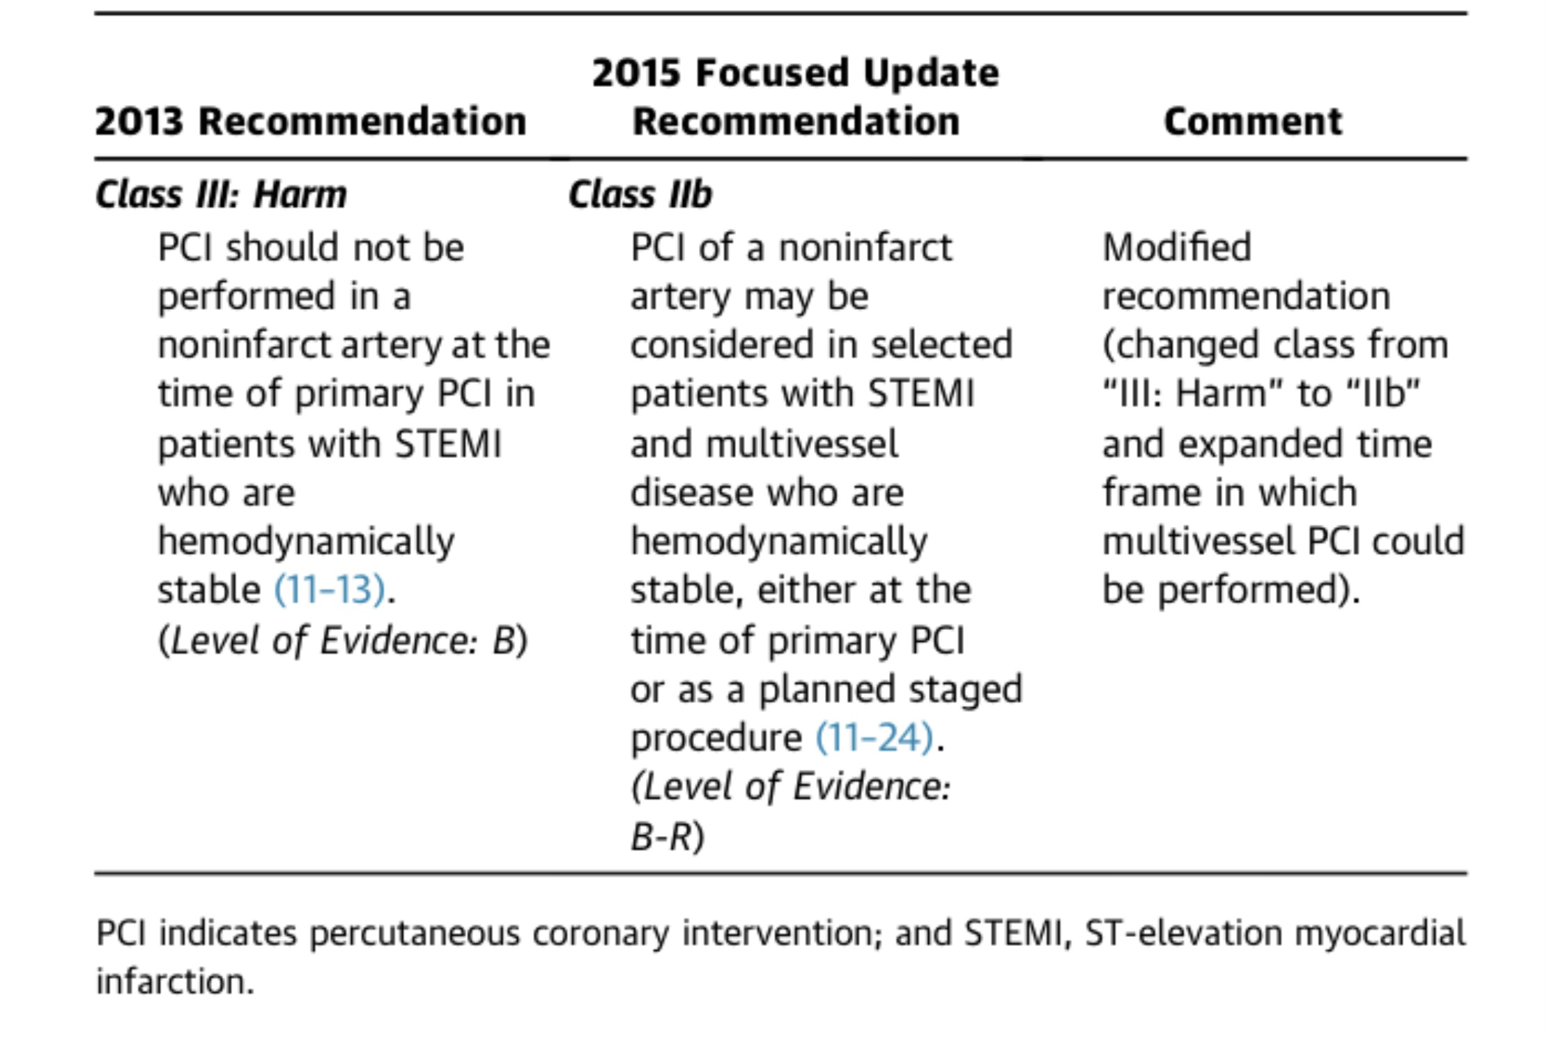

Slide 41
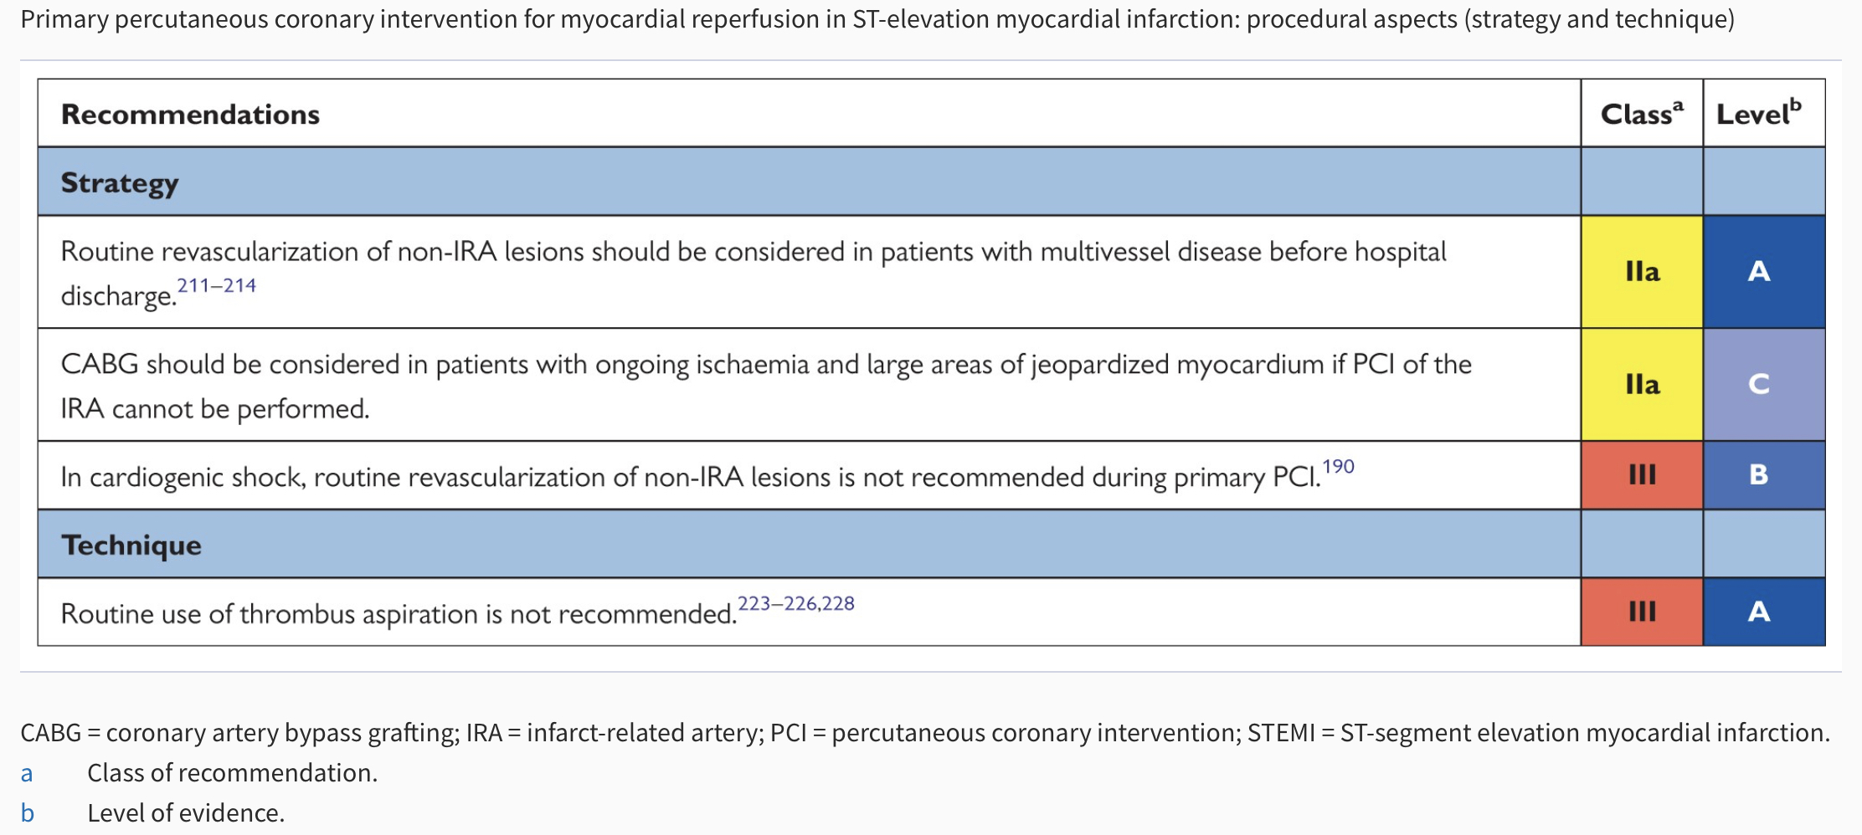

Slide 44
CULPRIT SHOCK TRIAL -
In patients with acute myocardial infarction and cardiogenic shock culprit-lesion-only PCI with possible staged revascularization compared with immediate multivessel PCI is associated with a reduction in all-cause death or renal replacement therapy at 30 days.
This effect in the composite endpoint is persistently observed at 12 months follow-up.
The 30-day difference in all-cause mortality is attenuated over time. However, there is no increase in mortality after 30-days until 1-year follow-up.
Culprit-lesion-only PCI is possibly associated with a higher incidence of heart failure hospitalizations and more frequent repeat revascularization at 1-year.

Slide 46
Quick Takes
Complete revascularization is recommended in patients presenting with an acute ST-segment elevation myocardial infarction (STEMI) without shock.
In individuals who present in cardiogenic shock during an acute STEMI, revascularization of the culprit vessel only is recommended.
Fractional flow reserve (FFR) or optical coherence tomography (OCT) evaluation of non-culprit vessels can guide the revascularization strategy.

Slide 47
THANK YOU

