Slide 1
PERIPHERAL ARTERIAL DOPPLER
DR KANNAN

Slide 2
Each normal major vessel-characteristic flow pattern that is representable in spectral waveforms obtained with doppler ultrasonography
Doppler spectrum-time-velocity waveform that represents variation in intravascular blood flow velocities

Slide 3
Time is represented along the horizontal axis and frequency shift (velocity) is depicted along the vertical axis
The intensity/brightness of the spectral line-number of RBCs that are reflecting the US beam at each velocity
Width of the spectral-represents the range of velocities within a vessel

Slide 4
Laminar and disturbed flow
Laminar flow-the movement of blood is in parallel lines
Blood in the center of the vessel moving faster than the blood at the periphery
In laminar flow-majority of blood cells at a given point are moving at a uniform speed
Doppler spectrum shows a thin line that outlines a clear space called the spectral window

Slide 5
Spectral window-clear black zone between the spectral line and the baseline
Spectral broadening-widening of the spectral line and filling of the spectral window-normal seen in the presence of high flow velocity, at the branching of a vessel or small diameter vessels

Slide 7
Disturbed flow
The movement of blood cells is less uniform and orderly than in laminar flow
Manifested as spectral broadening or filling in of the spectral window
The degree of spectral broadening (or fill-in of the spectral window) is proportionate to the severity of the flow disturbance

Slide 8
Disturbed flow illustration
(B) Minor flow disturbance is indicated by spectral broadening
at peak systole and through diastole.
(C) Moderate flow disturbance causes fill-in of the spectral window.
(D) Severe flow disturbance is characterized by spectral
fill-in, poor definition of spectral borders, and simultaneous
forward and reversed flow.
The audible Doppler
signal has a loud, gruff character when flow is severely
disturbed.

Slide 9
Although disturbed blood flow often indicates vascular disease- can occur in normal vessels
Kinks, curves, and arterial branching may produce flow disturbances

Slide 10
Pulsatility
Waveform refers to the shape of each of these waves, and this shape, in turn, defines a very important flow property called pulsatility.

Slide 11
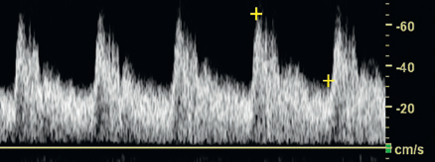
Low-pulsatility Doppler waveforms
have broad systolic peaks and forward flow throughout diastole

Slide 12
Carotid
Vertebral
Renal
Celiac
These vessels feed circulatory systems with low resistance to flow (low peripheral resistance).
Low-pulsatility
waveforms are also monophasic, meaning that flow is always forward
Low-pulsatility waveforms do not demonstrate reversal of flow.

Slide 13
High-pulsatility Doppler waveforms
Tall, narrow, sharp systolic peaks and reversed or absent diastolic flow

Slide 14
Classic example of high pulsatility-triphasic flow pattern seen in an extremity artery of a resting individual
High-pulsatility waveforms-feature of circulatory systems with high resistance to blood flow-high peripheral resistance
First phase-A sharp systolic peak
Second phase-brief flow reversal
Third phase-brief forward flow

Slide 15
Doppler Spectrum of Normal Lower Extremity Arteries
The Doppler waveform of the lower extremity arteries at rest is classified as a high pulsatility waveform and is characterized by a triphasic flow pattern
Over the course of each heartbeat, a tall, narrow, and sharp systolic peak in the first phase is followed by early diastolic flow reversal in the second phase, and then by late diastolic forward flow in the third phase

Slide 17
TRIPHASIC FLOW
High forward flow-during systole d/t LV contraction
Diastolic flow reversal results from the high peripheral resistance of normal extremity arteries
Diastolic forward flow-reflection from closed aortic valve during late diastole

Slide 19
Acceleration
Important flow feature evident in Doppler spectral waveforms
Red cells accelerate very rapidly during systole, and the peak velocity is reached within a few hundredths of a second after ventricular contraction begins
Rapid acceleration produces a vertical deflection of the Doppler waveform at the start of systole-rapid systolic upstroke

Slide 21
Prolonged acceleration time -severe arterial obstruction proximal (upstream) to the point of Doppler examination

Slide 22
Prolonged acceleration time

Slide 23
Diagnosis of Arterial Obstruction
5 main categories of information are used in this process
Increased stenotic zone velocity
Disturbed flow in the post stenotic zone
Proximal pulsatility changes
Distal pulsatility changes
Indirect effects of obstruction, such as collateralization

Slide 24
Increased stenotic zone velocity
Stenotic zone-narrowed portion of the arterial lumen
Increased velocity in the stenotic zone- the single most valuable Doppler finding- for determining the severity of arterial stenosis

Slide 25
Flow velocity is increased in the stenosis because blood must move more quickly if the same volume is to flow through the narrowed lumen as through the larger normal lumen
The increase in stenotic zone velocity is directly proportional to the severity of luminal narrowing.

Slide 26
1) peak systolic velocity – highest systolic velocity within the stenosis
(2) end-diastolic velocity - highest end-diastolic velocity
(3) systolic velocity ratio- which compares peak systole in the stenosis with peak systole proximal to the stenosis

Slide 27
Peak systolic velocity
First Doppler parameter to become abnormal
The region of maximum velocity within the stenotic zone may be quite small-the sonographer must search the stenotic lumen with the sample volume to locate the highest flow

Slide 28
Peak systolic velocity rises steadily with progressive narrowing, but ultimately the flow resistance becomes so high (at greater than 80% diameter reduction) that peak systolic velocity falls to normal or even subnormal levels

Slide 29
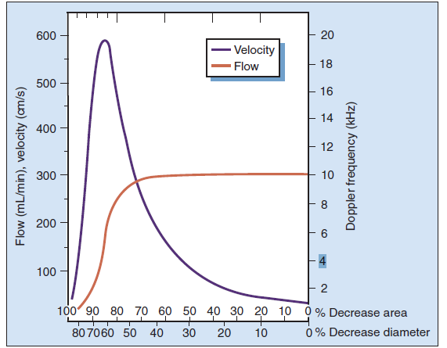
This drop in velocity can cause an underestimation of the severity of a high-grade stenosis
Peak systolic velocity in the stenotic lumen increases exponentially as the lumen diameter decreases (from right to left).
The highest velocities correspond to approximately 70% diameter reduction.
With greater stenosis severity, peak systolic velocity falls off rapidly to zero

Slide 31
End diastolic velocity
In the stenotic zone generally remains within the normal range with less than 50% (diameter) narrowing, as there is no pressure gradient across the stenosis in diastole
In moderate stenosis (50% to 69% diameter reduction)- a pressure gradient exists throughout diastole, and end-diastolic velocity is elevated in proportion to stenosis severity

Slide 32
Severe stenosis (≥70% reduction in diameter)- a substantial pressure gradient exists throughout diastole-diastolic velocities are high

Slide 35
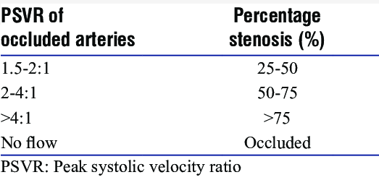
Systolic velocity ratio
Peak systole in the stenotic zone is compared with peak systole in a normal arterial segment (typically the common carotid artery)

Slide 36
Poststenotic flow disturbance
Poststenotic zone is the region immediately beyond an arterial stenosis in which disorganized or disturbed flow occurs

Slide 38
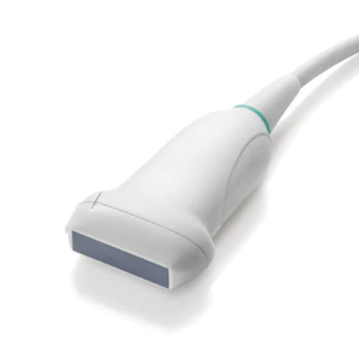
ULTRASOUND ASSESSMENT OF LOWER EXTREMITY ARTERIES
Transducer
Low-frequency (2 or 3 MHz) transducers are best for evaluating the aorta and iliac arteries
Higher frequency (5 or 7.5 MHz) transducer is adequate in most patients for the infrainguinal vessels

Slide 39
The transducer is placed over an artery for transverse scanning, and then is rotated 90° for longitudinal scanning
The artery should be scanned on a longitudinal plane as long as possible
Pulsed-wave Doppler US is performed in the longitudinal plane.

Slide 40
Parameters and Optimization of Doppler US
The operator should be aware of both color and pulsed-wave Doppler parameters and how to adjust these parameters to obtain an optimal Doppler images
color box, color gain, color velocity scale, and inversion are frequently used during color Doppler US scanning

Slide 41
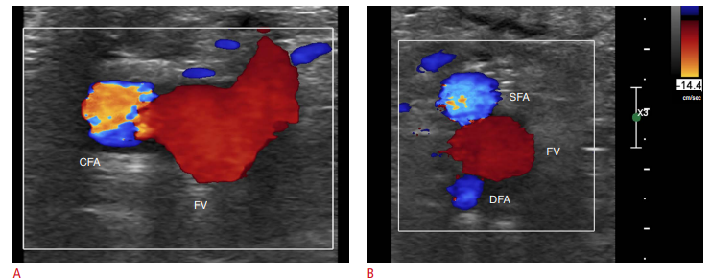
Color box
Color box is a square area within the grayscale sonogram in which all color Doppler information is displayed

Slide 42
The size and location of the box are adjustable, and the image resolution and quality are affected by the box size and depth
The box should be made as small and placed as superficially as possible, thereby maximizing the frame rate
The color box should be tilted using the steer button according to the arterial axis during longitudinal scanning

Slide 44
Color gain
Color gain -amplification of flow data to improve the depiction of flow
should be set as high as possible without displaying background color noise
Color flow artifacts outside an artery should be removed by decreasing the gain

Slide 45
Color velocity
The color velocity is the range of flow velocities that are depicted in color Doppler US
If the velocity scale setting is lower than the flow velocity of the artery, aliasing artifacts will be present
A homogeneous color of arterial flow can be obtained by increasing the scale

Slide 46
Wall filter (WF)
Eliminates the low frequency noise that may arise from vessel wall motion below an operator-defined frequency threshold
usually preset by manufacturer

Slide 47
Sample volume
The sample volume cursor is composed of parallel lines on both sides of the arterial axis line
should be placed within an arterial lumen
Range of the sample volume size is generally from one-third to one-half of the luminal diameter

Slide 48
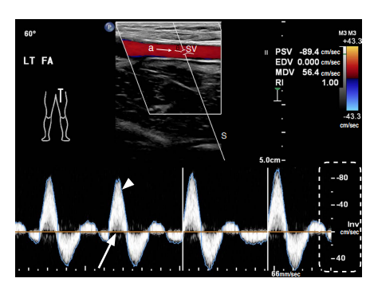
Doppler angle
Formed by the Doppler line and the axis of arterial flow
45° and 60° for optimal accuracy

Slide 49
The Doppler spectrum is a graph showing the mixture of frequencies over a short period of time
The key elements of the Doppler spectrum are the time and velocity scales
On the Doppler spectrum, time (seconds) is represented on the x-axis, and the velocity scale (cm/sec) is shown on the y-axis
Flow direction relative to the transducer is shown in relation to the spectrum baseline

Slide 50
PSV is the highest systolic velocity
EDV is the highest end-diastolic velocity.

Slide 56
US Anatomy of the Lower Extremity Arteries
Arteries are round in transverse images, while veins are somewhat oval
Arteries are smaller than veins
Arteries have visible walls and sometimes have calcified plaques on the walls
When the vessels are compressed by the transducer, arteries are partially compressed, while veins are completely collapsed

Slide 61
LOWER EXTREMITY
Doppler US of the lower extremity begins at the inguinal crease by putting a transducer on the common femoral artery in the transverse plane with the patient in the supine position

Slide 62
The ultrasound probe should be sequentially moved along the artery at closely spaced intervals in order to evaluate blood flow patterns in an overlapping fashion
This is necessary because the flow disturbances produced by arterial lesions are propagated along the vessel for a relatively short distance.

Slide 63
The examination is usually performed- supine position
Hip -abducted and externally rotated
Knee-flexed like frog legs in order to easily approach the popliteal artery in the popliteal fossa and the posterior tibial artery in the medial calf

Slide 64
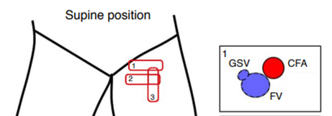
The common femoral artery is seen lateral to the femoral vein, which is drained from the greater saphenous vein anteromedially at the inguinal area
The superficial femoral artery and the deep femoral artery are present alongside the femoral vein

Slide 66
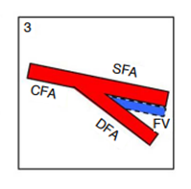
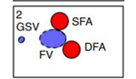
The common femoral artery, the bifurcated superficial femoral artery and deep femoral artery are seen in a fallen-Y configuration in a longitudinal scan

Slide 68
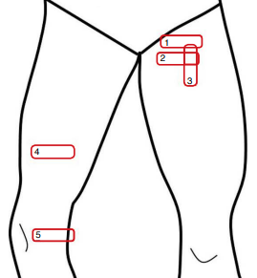
From the proximal to distal thigh, scanning is performed by moving a transducer distally along the superficial femoral artery deep to the sartorius muscle.
The superficial femoral artery goes together with the femoral vein

Slide 70
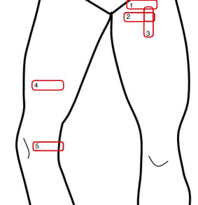
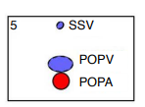
The popliteal artery is evaluated from the knee crease level in the transverse plane and then traced proximally up to the adductor

Slide 73
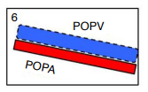

Slide 75
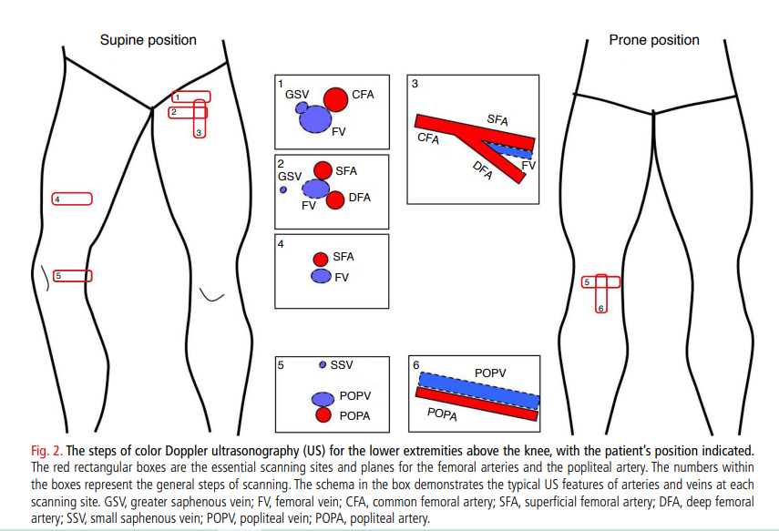

Slide 76
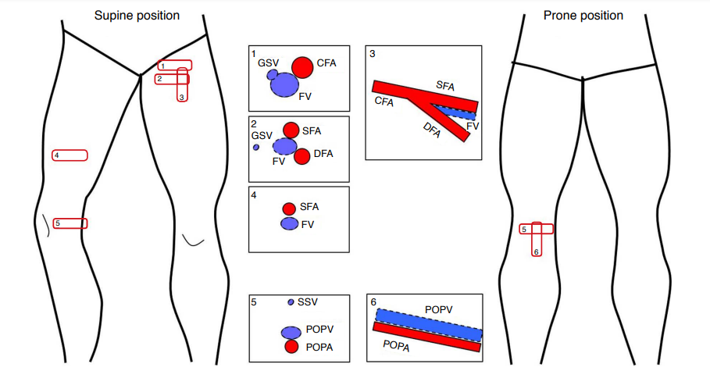

Slide 77
Left lateral decubitus position or the prone position - alternatives for evaluating the popliteal artery, the posterior tibial artery, and the peroneal artery
The anterior tibial artery and dorsalis pedis artery are scanned in the supine position

Slide 79
PTA

Slide 80
Peroneal artery

Slide 98
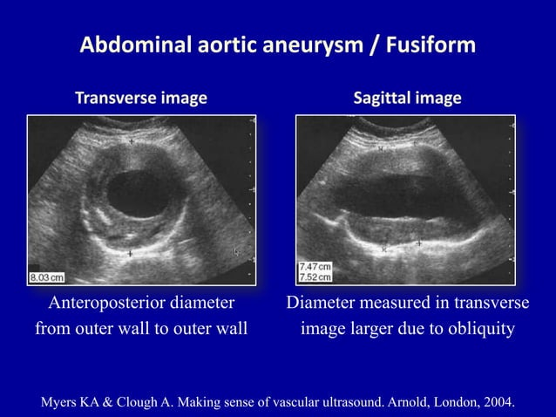

Slide 108
MCQs
The single most valuable Doppler finding for determining the severity of arterial stenosis
A) Increased velocity in the stenotic zone
B) Icreased acceleration time
C) presence of collaterals
D) distal pulsatility changes

Slide 109
The single most valuable Doppler finding for determining the severity of arterial stenosis
A) Increased velocity in the stenotic zone
B) Icreased acceleration time
C) presence of collaterals
D) distal pulsatility changes

Slide 110
False statement among the following?
A)Low-frequency (2 or 3 MHz) transducers are best for evaluating the aorta and iliac arteries
B)Higher frequency (5 or 7.5 MHz) transducer is adequate for infrainguinal vessels
C)Pulsed-wave Doppler US is performed in the longitudinal plane
D)None of the above

Slide 111
A)Low-frequency (2 or 3 MHz) transducers are best for evaluating the aorta and iliac arteries
B)Higher frequency (5 or 7.5 MHz) transducer is adequate for infrainguinal vessels
C)Pulsed-wave Doppler US is performed in the longitudinal plane
D)None of the above

Slide 112
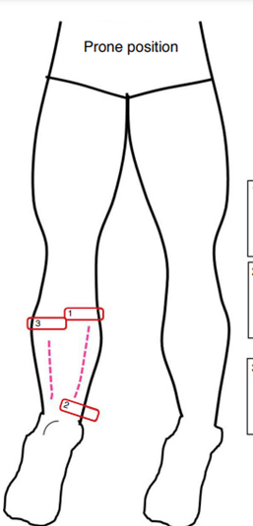

Slide 113
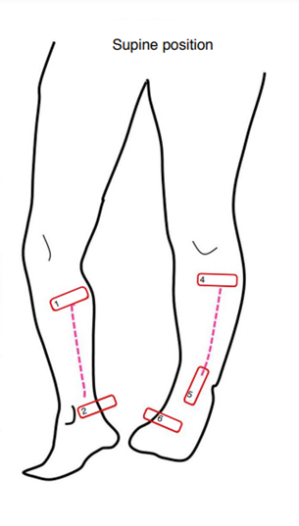
1-2-> PTA 3-4 -> ATA

Slide 114
THANK YOU

