Slide 1
IVUS
DR KANNAN

Slide 2
Rationale for Intravascular Imaging
Angiography is the gold standard in coronary imaging for more than 4 decades
Visual interpretation of coronary angiography exhibits intraobserver and interobserver variability (≤50%)
The complex atherosclerotic disease process is frequently not reflected in the luminal silhouette
Glagov phenomenon (Vascular remodeling)

Slide 3
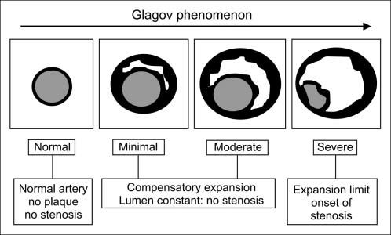

Slide 4
Vessel foreshortening and overlapping side branches, particularly in disease involving bifurcations, are important practical limitations of angiography
Presence of contrast filled dissection and intra-plaque channels hamper determination of proper stent apposition during balloon angioplasty

Slide 5
These limitations of angiography can be minimized by the intravascular tomographic visualization of lumen and vessel wall architecture
Intravascular ultrasound (IVUS), optical coherent tomography (OCT), near-infrared(NIR) spectroscopy, angioscopy, intravascular MRI

Slide 6
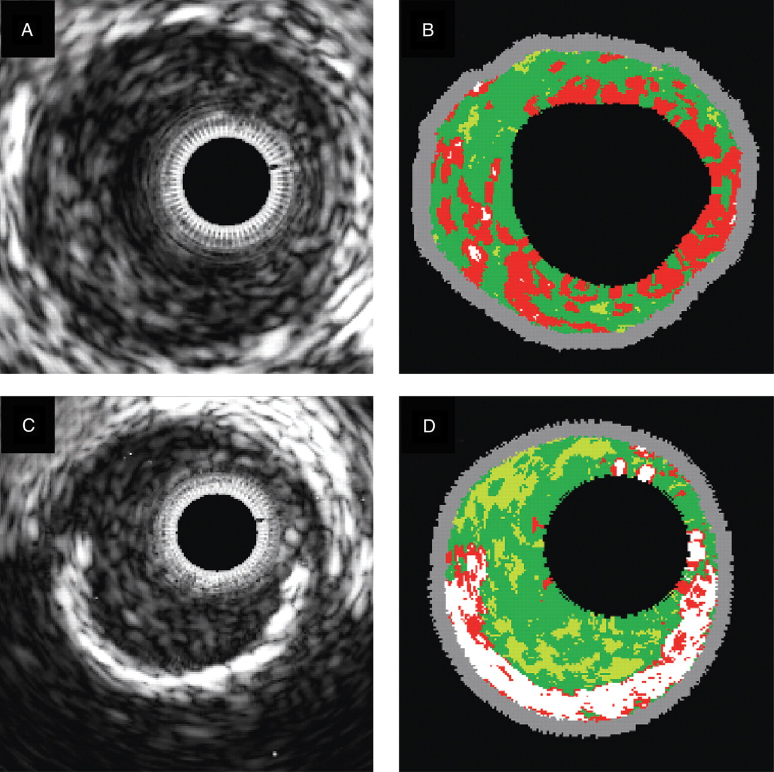
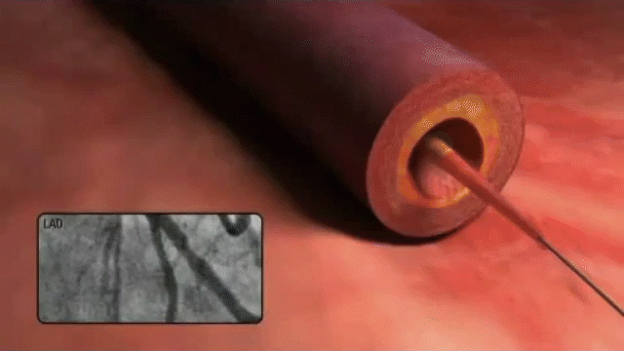
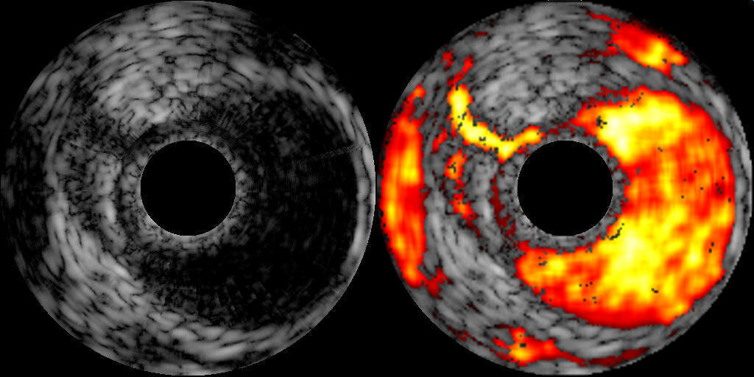
IVUS

Slide 7
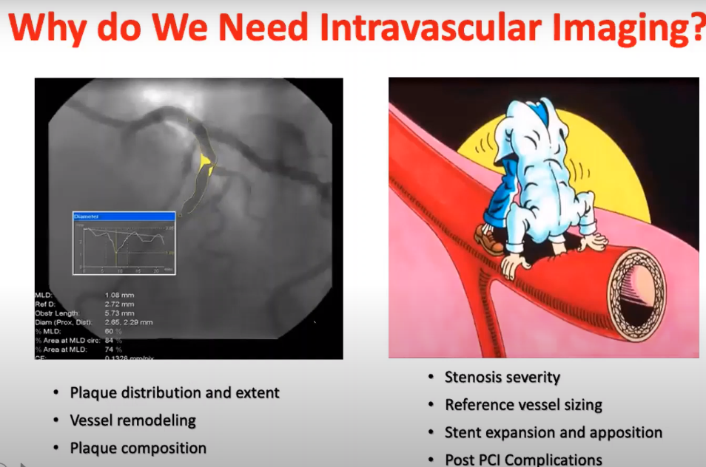

Slide 8
IVUS Technology
A catheter incorporating a miniaturized transducer and a console containing the electronics necessary to reconstruct the image
IVUS catheters use reflected sound waves to visualize the arterial wall in a two-dimensional, tomographic format
Use higher frequencies than noninvasive echo (20 to 40 MHz) providing high resolution (150 µm)

Slide 9
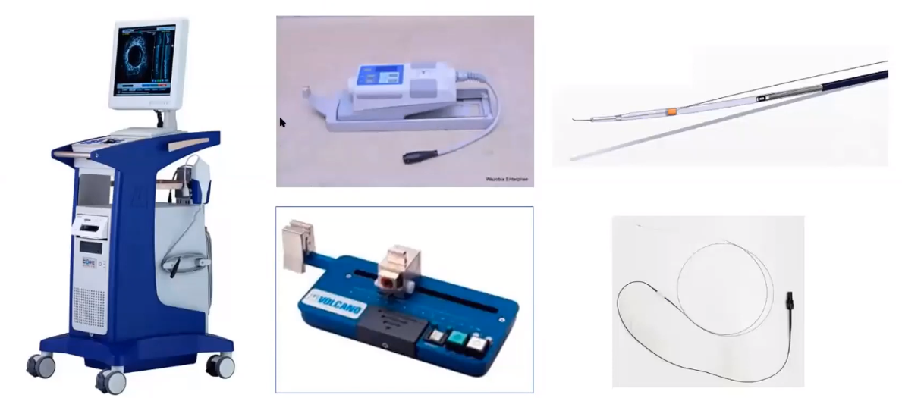

Slide 10
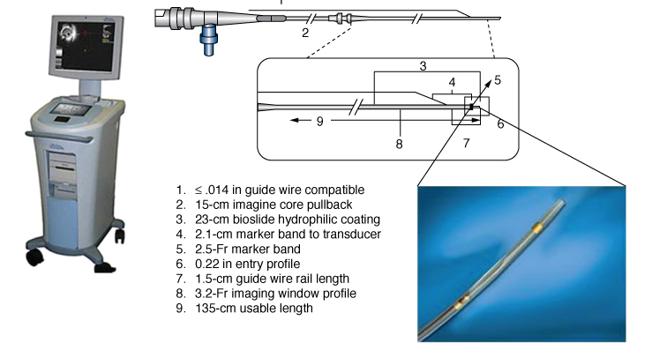

Slide 11
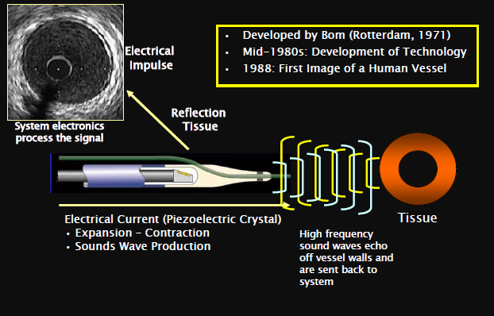

Slide 12
Imaging Systems
There are two IVUS transducer system
  Mechanical scanning
    A mechanical system that contains a flexible imaging cable which rotates a single transducer at its tip inside an echo-lucent distal sheath
  Solid state dynamic aperture
    An electronic solid state catheter system with multiple imaging elements at its distal tip, providing cross sectional imaging by sequentially activating the imaging elements in a circular way
Multi element designs - Catheters that are easier to set up & use
Mechanical probes - Superior image quality

Slide 13
Transducer Technology
Current catheters range from 2.6 and 3.5 French (0.87 to 1.17 mm) and can be placed through a 6-French guiding catheter

Slide 14
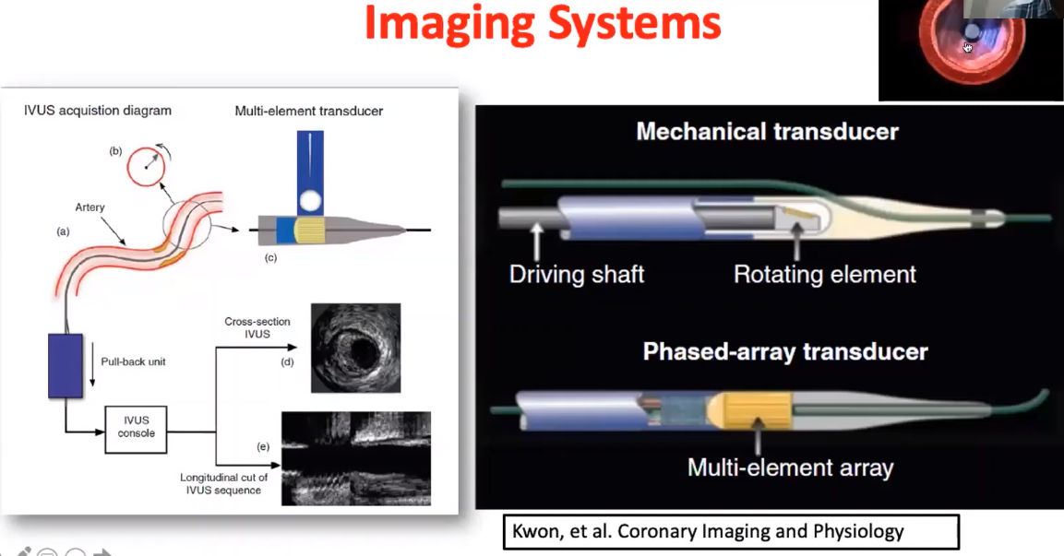

Slide 15
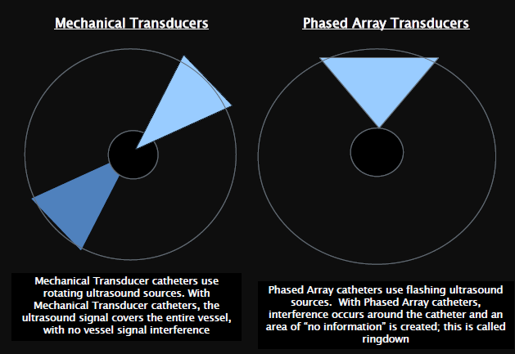
Transducer Technology

Slide 16
Ultrasound Principles
Basic principles
  The beam remains fairly parallel for a distance (near field) and then begins to diverge (far field)
  The quality of ultrasound images is better in the near field because the beam is more parallel and the resolution greater
  Therefore, larger transducers with lower frequencies are used for examination of large vessels because they create a deeper near field

Slide 17
Image Quality
Image quality can be described by two important factors
    Spatial resolution
      Ability to discriminate small adjacent objects within the image
      For a 30-40MHz IVUS transducer the typical resolution is 80-100 microns axially and 200-250 microns laterally
    Contrast resolution or dynamic range = the distribution of the grayscale of the reflected signal
      Low dynamic range images appear as “black and white “with a few levels of gray
      High dynamic range images have more shades of gray, are often “softer”

Slide 18
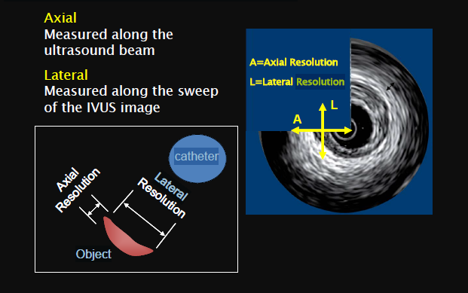

Slide 19
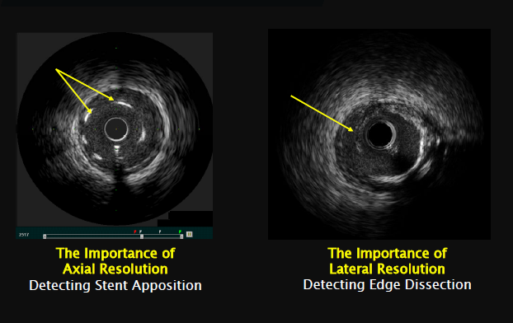
Clinical Importance of Axial and Lateral Resolution

Slide 20
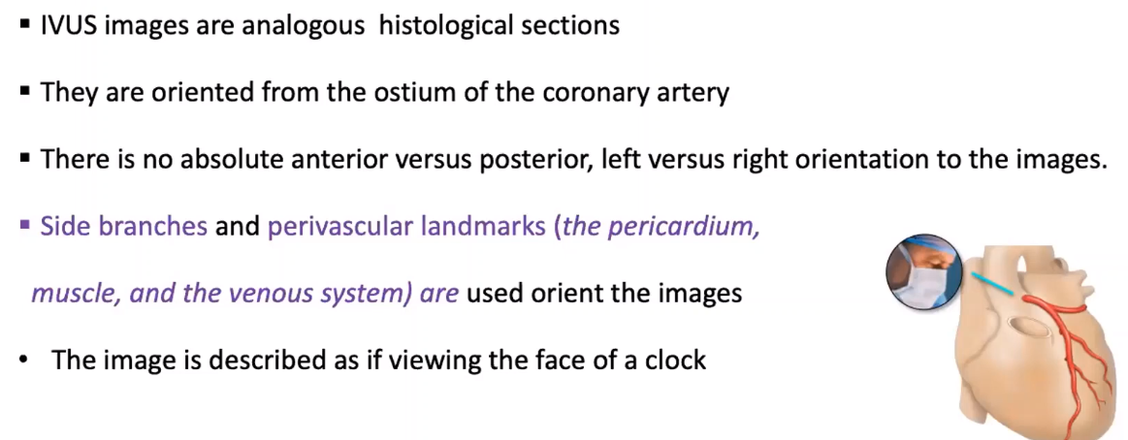
IVUS IMAGES

Slide 21
Examination Technique
Heparin and intracoronary NTG routinely administered
A 0.014-inch guide wire is first advanced
IVUS imaging is then performed with 2.5F to 3.5F catheters
Catheter should be advanced 10 mm distal to the area of interest
With the solid state catheter, the catheter tip is first positioned in the aorta or large proximal coronary vessel so that the ring-down artifact can be electronically subtracted from the image before entering the coronary artery
Perform a systematic examination during pullback

Slide 22
Motorized Transducer Pullback (0.5 or 1.0 mm/second)
  Intended Advantages
    Steady catheter withdrawal
    Creates length and volumetric measurements
    Uniform & Reproducible images
  Disadvantages
    May provide inadequate examination in regions of interest due to preset speed
Manual Transducer Pullback
  Intended Advantages
    Ability to concentrate on a specific region of interest
  Disadvantages
    Possibility of skipping over significant pathology by irregular pullback
    Potential inaccuracies in length and volume measurements

Slide 23
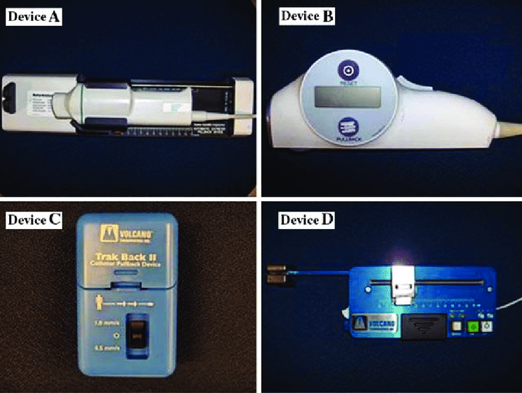
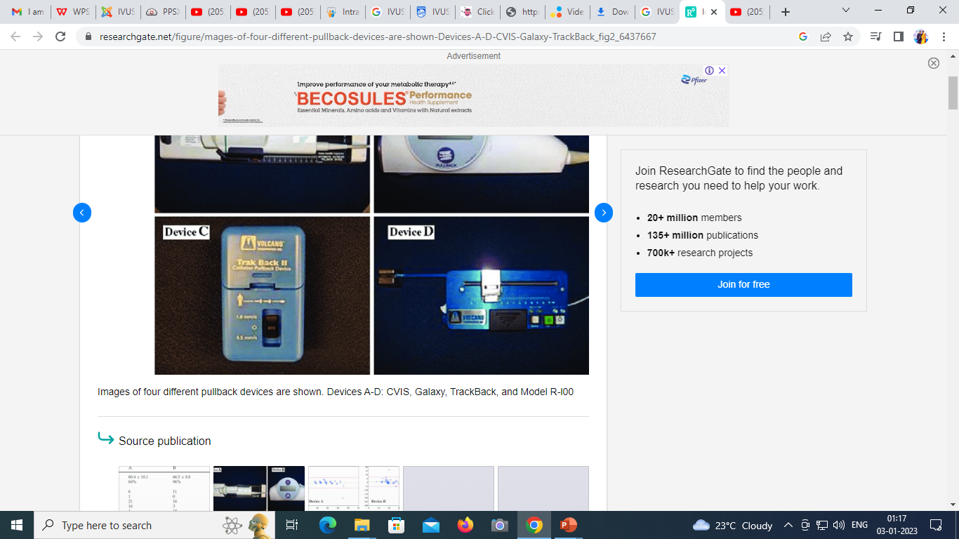

Slide 24
Image Interpretation
Interpretation of the images begins with the identification of two key landmarks: the blood/intima (luminal) border and the media/adventitia interface
Normal value for intimal thickness-0.15 ± 0.07 mm
0.25 to 0.50 mm- the upper limit of normal

Slide 25
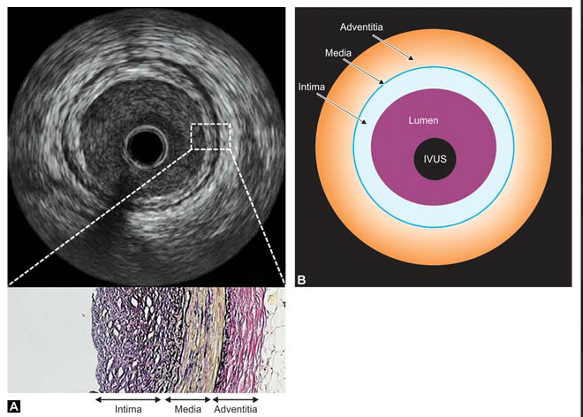

Slide 26
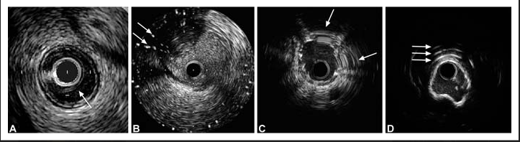
Image artifact
Halo around the mechanical IVUS due to air bubbles
Interference caused by other electrical equipments
Non-uniform rotational distortion-bending of the drive cable inter-feres with uniform transducer rotation, causing a wedge-shaped, smeared image to appear in one or more segments of the image
Calcification causing reverberation artifacts

Slide 27
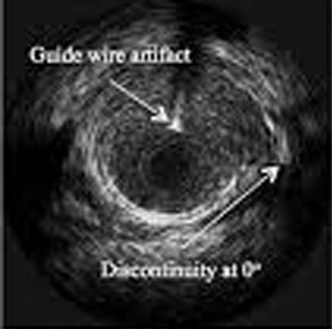
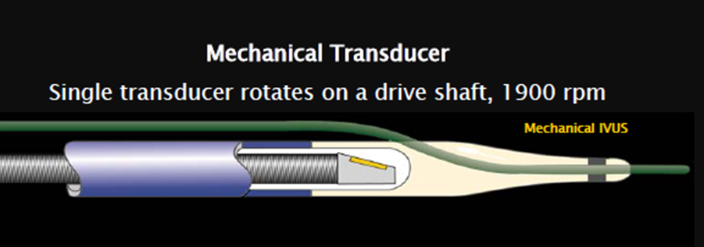
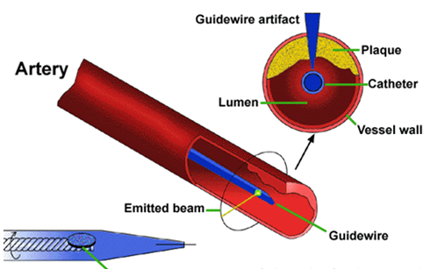
Guidewire artifact
Guidewire runs outside the catheter parallel to the imaging segment results in a shadow artifact in the image

Slide 28
Perivascular Landmarks
In most cases, the IVUS beam penetrates beyond the arterial wall, providing images of perivascular structures
Perivascular markings are important reference for axial position and tomographic orientation within the artery
Important for reproducibility of examination within same segment

Slide 29
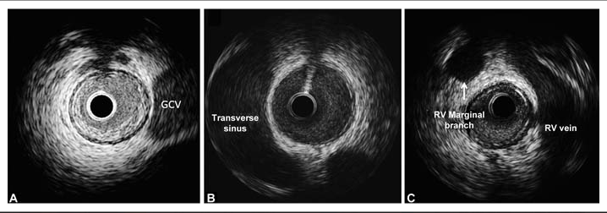
Perivascular Landmarks
Great cardiac vein running superior to left circumflex
Echo free space adjacent to prox. LMCA- transverse sinus
At the middle of RCA the RV vein arc over the artery

Slide 30
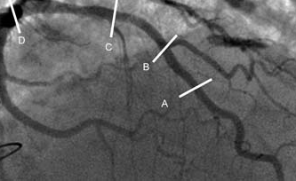
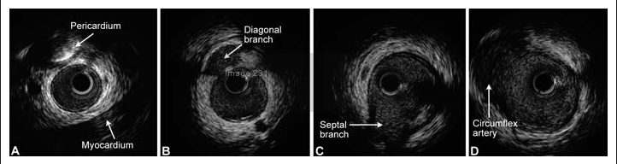
Perivascular Landmarks
Pullback imaging sequence from mid to proximal LAD

Slide 31
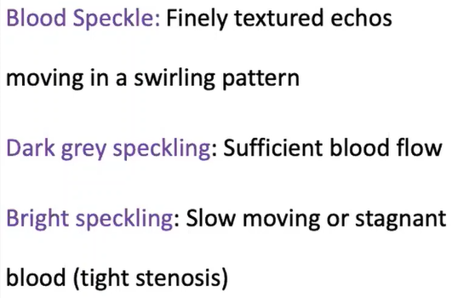
TERMINOLOGIES

Slide 32
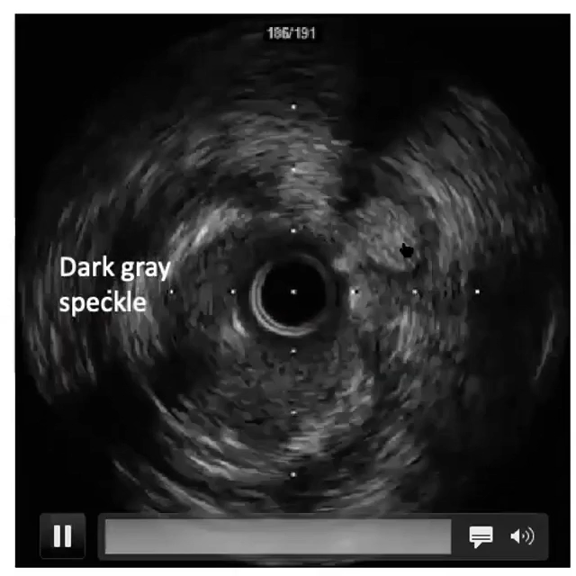

Slide 33
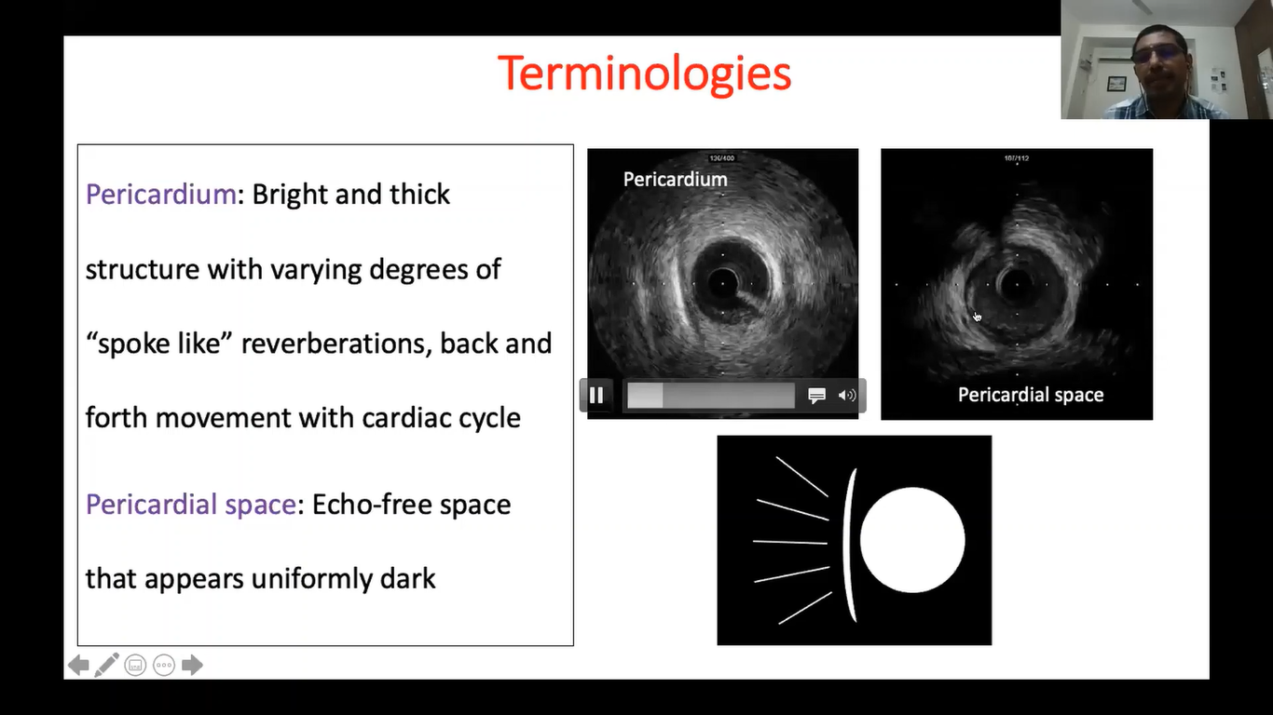

Slide 34
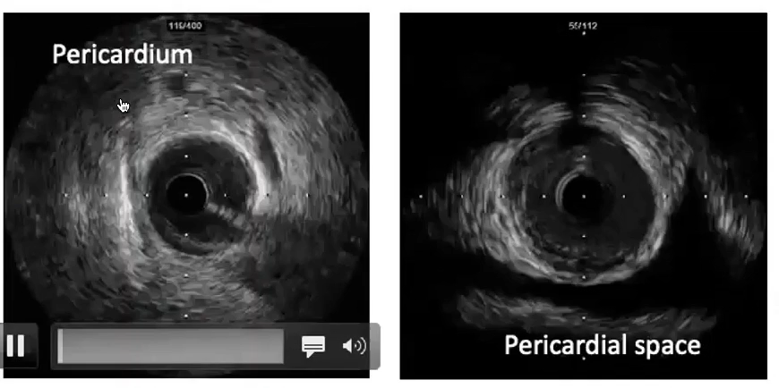

Slide 35
Image Interpretation
Spillover effect, known as blooming-Result in slight over- estimation of the intima & underestimation of the media
This three-layered appearance may be undetectable in truly normal coronary arteries of which the intimal thickness is below the effective resolution of IVUS
Most studies measures plaque –plus-media area as a surrogate measure of plaque area alone

Slide 36
IVUS Measurements
Intrinsic distance calibration, which is usually displayed as a grid on the image
Measurements are performed at tightest cross section and at reference segments located proximal and distal to the lesion
Reference segment -the most normal-looking (largest lumen with smallest plaque burden) cross section within 10 mm from the lesion with no intervening major side branches
Area measurements are performed with computer planimetry

Slide 37
IVUS Measurements
lumen area is determined by tracing the leading edge of the blood/intima border
Total vessel (or external elastic membrane, EEM) area is defined as the area enclosed by the outermost interface between media and adventitia
Plaque area (or more accurately, the plaque plus media area) is calculated as the difference between vessel and lumen areas
The ratio of plaque to total vessel area is termed the percent plaque area, plaque burden, or percent cross-sectional narrowing

Slide 38
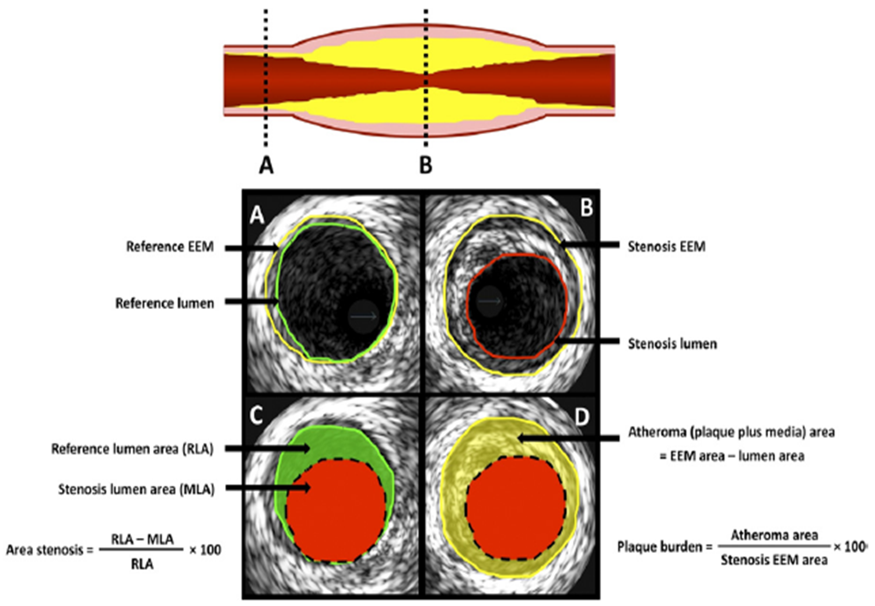
IVUS Measurements

Slide 39
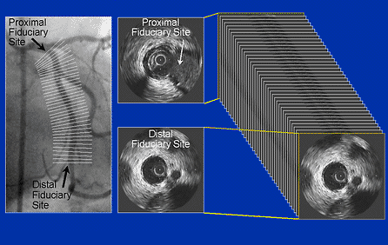
IVUS Measurements
Area measurements can be added to calculate volumes using Simpson’s rule with the use of motorized pullback

Slide 40
Tissue Characterization
IVUS can provide detailed information about plaque composition
Regions of calcification are brightly echo reflective& create a dense shadow more peripherally from catheter – acoustic shadowing
Shadowing prevents determination of true thickness of calcific deposits & precludes visualization deep vessel structures
In patients undergoing intervention IVUS detects calcium in 70% to 80% of target lesion while fluoroscopy detects calcium in 10% to 35%

Slide 41
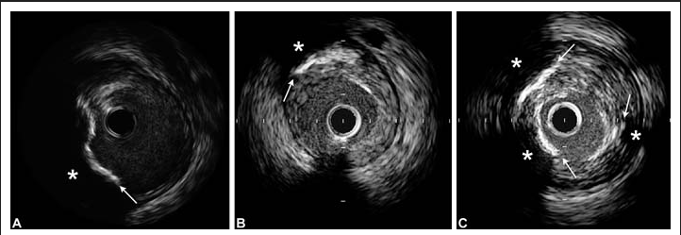

Slide 42
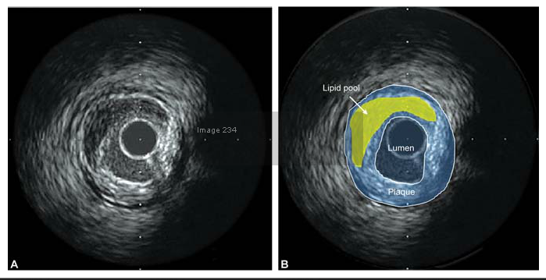
Tissue Characterization
Fatty plaque is less echogenic than fibrous plaque

Slide 43
Tissue Characterization
Major limitations - difficulty in discriminating thrombus from soft plaque because both have similar signals or brightness
IVUS clues to the presence of thrombus
  a nodular appearance or clefts in the tissue
  small channels within the mass
  scintillating appearance
  tissue that moves in response to motion of the vessel wall

Slide 44
Visual interpretation of conventional grayscale images is limited in the detection & quantification of specific plaque components
Computer assisted analysis of raw radiofrequency signals in the reflected ultrasound beam is developed
  Virtual Histology (VH) IVUS ( Volcano corporation , California)
  Integrated Backscatter (IB) IVUS ( YD Corporation, Japan)
  iMap ( Boston scientific Inc, Massachusetts)
Color mapped images of the vessel wall with distinct color for each category

Slide 45
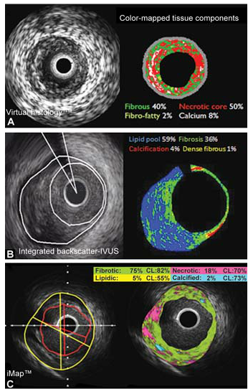
Tissue Characterization
Newer techniques
Virtual Histology (VH) IVUS ( Volcano corporation , California)

Slide 46
Tissue Characterization
Newer techniques
Integrated Backscatter (IB) IVUS ( YD Corporation, Japan)

Slide 47
Tissue Characterization
Newer techniques
iMap ( Boston scientific Inc)- compatible with 40Hz mechanical IVUS

Slide 48
Plaque distribution and remodeling
IVUS studies have shown that reference segment for an intervention by angiography has 35 to 51% plaque burden
Arterial remodeling - changes in vascular dimensions during the development of atherosclerosis – “Glagov phenomenon”
First described in human coronary specimen by Seymour Glagov
Positive remodeling - localized expansion of the vessel wall
Negative remodeling or arterial shrinkage - at diseased sites the vessel shrink in size, contributing to luminal stenosis

Slide 49
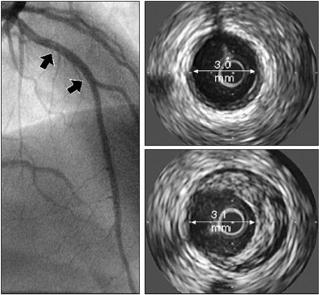
Plaque distribution and remodeling
Positive remodeling
CAG completely normal
2 sites in LAD (arrows) show a varying extent Of atherosclerosis by IVUS
More distal site (top right) has little disease
More proximal site (bottom right) has a large crescentic atheroma
The lumen size at both sites is similar because of remodeling resulting in a false-negative angiogram

Slide 50
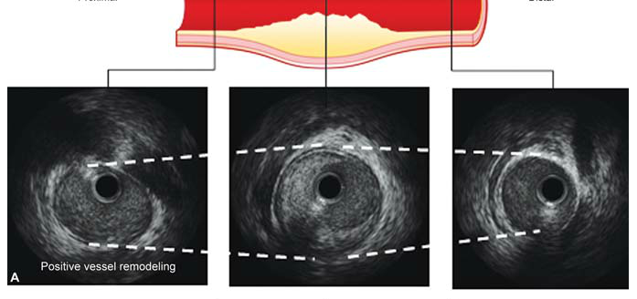
Plaque distribution and remodeling
Positive remodeling

Slide 51
Plaque distribution and remodeling
Clinical importance
  Optimal therapeutic device sizing
  Risk stratification regarding plaque rupture
    Culprit lesions in ACS usually undergone extensive positive remodeling
  Evaluating procedural or long term outcomes of intervention
    Association between preinterventional positive remodeling and CK-Mb elevation after intervention – a marker of distal embolization and future adverse cardiac events

Slide 52
Clinical Indications for IVUS
Diagnostic IVUS Assessment
Assessment of lesion significance
Assessment of angiographically indeterminate lesion
Guidance for plaque modification, stenting
Assessment of complex lesions, thrombosis and restenosis
Assessment for complications
Guidance in peripheral interventions
Additional clinical applications with IVUS
  IVUS assessment in disease progression/regression
  IVUS assessment in SVG’s
  IVUS assessment in cardiac transplants
  IVUS use in clinical studies/research

Slide 53
Diagnostic IVUS Assessment
Evaluate Lesion Characteristics
  Calcification, fibrous, lipid/necrotic zone, mixed plaque, concentric, eccentric, size, length
Assessment may impact treatment choices
  Pre-dilatation
  Plaque modification
  Stent selection, size and length
  Medical management
  No treatment

Slide 54
Assessment of lesion significance
Limitation of a single IVUS MLA cutoff :
  Hemodynamic effects of a lesion are not only dependent on MLA, but also on numerous other factors , including lesion length, eccentricity, entrance and exit angles and forces, reference vessel dimensions, and the amount of myocardium subtended by the lesion
MLA<4.0mm² can accurately identify nonischemic lesions for which PCI can be safely deferred. By contrast, an MLA 4.0 mm² does not accurately predict a hemodynamically significant lesion and should not be used to justify revascularization

Slide 55
IVUS Assessment -Lesion Significance and anatomical Assessments
Measurement | FFR | IVUS
Lesion Significance | x | x
MLA |  | x
MLD |  | x
%Stenosis |  | x
Plaque Burden |  | x
Plaque Tissue Type |  | x
Stent Expansion |  | x
Stent Apposition |  | x
Lesion Length |  | x
Stent Placement |  | x
Dissections |  | x

Slide 56
Assessment of Angiographically
Indeterminate Lesions
What is an angiographically indeterminate lesion?
  Angiographically indeterminate lesions occur when there are overlapping branches, bifurcations, contrast streaming, or ostiallesions. Example: left main disease
  Or, any ambiguous angiographic lesion, tortuous vessels, sites with focal spasm, sites with plaque rupture, filling defects, or angiographically hazy lesions
  Or, anytime the angiographic presentation does not match up with the clinical presentation

Slide 57
Assessment of Angiographically
Indeterminate Lesions
Angiographic challenges of the left main:
  Aortic cusp opacification or streaming of contrast obscures the ostium
  Short length of the vessel leaves little normal vessel for comparison
  Distal left main artery may be concealed by the branching of the left anterior descending and the left circumflex
  Significant inter-and intra-observer variability in the angiographic assessment of left main

Slide 58
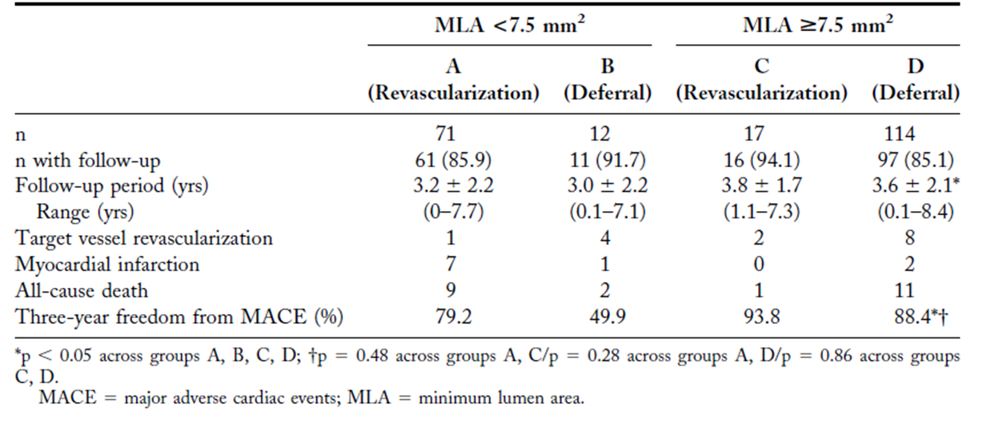
Assessment of Angiographically
Indeterminate Lesions
IVUS is an accurate method to assess angiographically indeterminate lesions of the LMCA. Deferring revasculariza-tion for patients with a MLA >7.5 mm² appears to be safe
Amir-Ali Fassa,et al. JACC 2005;45:204 –11
Notes:
Intravascular ultrasound was performed on 121 patients with angiographically normal
LMCAs to determine the lower range of normal minimum lumen area (MLA), defined as the
mean 2 SD. We conducted IVUS studies on 214 patients with angiographically
indeterminate LMCA lesions, and deferral of revascularization was recommended when the
MLA was larger than this predetermined value.
RESULTS The lower range of normal LMCA MLA was 7.5 mm2. Of the patients with angiographically
indeterminate LMCAs, 83 (38.8%) had an MLA 7.5 mm2, and 131 (61.2%) an MLA 7.5
mm2. Left main coronary artery revascularization was performed in 85.5% (71 of 83) of
patients with an MLA 7.5 mm2 and deferred in 86.9% (114 of 131) of patients with an
MLA 7.5 mm2. Long-term follow-up (mean 3.3 2.0 years) showed no significant
difference in major adverse cardiac events (target vessel revascularization, acute myocardial
infarction, and death) between patients with an MLA 7.5 mm2 who underwent revascularization
and those with an MLA 7.5 mm2 deferred for revascularization (p 0.28). Based
on outcome, the best cut-off MLA by receiver operating characteristic was 9.6 mm2.
Multivariate predictors of cardiac events were age, smoking, and number of non-LMCA
vessels diseased.

Slide 59
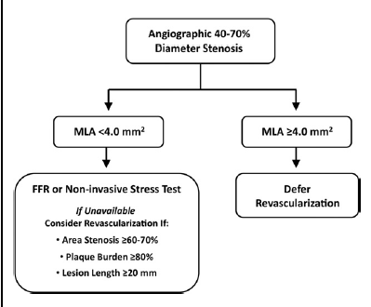
Assessment of Angiographically
Indeterminate Lesions
FFR is the gold standard for intermediate lesion assessment ; If IVUS is used, then the proposed algorithm for non-left main lesions is
Michael C,e t al. JACC int.4 ,20 11: 1155 – 67

Slide 60
Assessment of Angiographically
Indeterminate Lesions
In a study of 55 patients with moderate LMCA stenosis, an MLA≤ 5.9 mm2 (sensitivity 93% ,specificity 95%) and a minimal lumen diameter of 2.8 mm (sensitivity 93% , specificity 98%) best correlated with FFR<0.75¹
In 354 patients with intermediate LMCA stenosis, an MLA value >6.0 mm² identified patients at low risk for adverse events with deferred revascularization²
1. Jasti V,et al. Circulation 2004;110:2831– 6.
2. de la Torre Hernandez JM,et al. J ACC 2011;58:351– 8

Slide 61
Guidance for Plaque Modification
Assess Lesion Characteristics-
  Calcification, fibrocalcific, fibrotic,
mixed plaque, lesion resistance
  Concentric, eccentric, size, length
              Assessment may impact treatment choices
                Pre-dilatation with cutting balloon
                Rotablator
Cutting Balloon
Rotablator

Slide 62
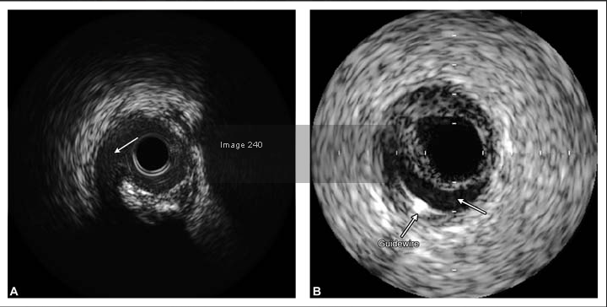
Guidance for Balloon angioplasty
Demonstrate plaque disruption or dissection more often than angiography does ( 40 -70% vs 20 - 40%)
Possible to predict where tear will occur – eccentric plaque tear usually occurs at junction between normal vessel & plaque
Localized calcification – epicenter for the start of tear ( cutting balloon may be preferable due to controlled tearing)

Slide 63
IVUS-guided PCI
Several IVUS characteristics have been associated with increased adverse events after PCI
  Smaller minimal stent area (MSA)
  Stent underexpansion
  Persistent edge dissections ( 10 -15%)
  Incomplete stent apposition (ISA) ( 3 -15%)
  Incomplete lesion coverage
Assess thrombus burden - operators may alter anticoagulant therapies or consider mechanical thrombectomy

Slide 64
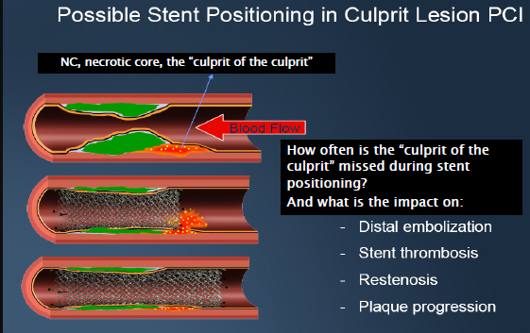
IVUS-guided PCI

Slide 65
IVUS-guided PCI with BMS
Smaller MSA is most commonly associated with target vessel failure at follow-up - 2 major mechanisms
  Smaller stents, compared with larger diameter stents, have greater restenosis rates, as similar amounts of neointimal hyperplasia leads to smaller lumen areas
  Smaller MSA can represent stent underexpansion
In a registry of 1,706 patients, the risk of restenosis with BMS decreased 19% for every 1-mm² increase in MSA
The best cutoff value for MSA ranging from 6.5 to 9.0

Slide 66
IVUS-guided PCI with BMS
Multi center Ultrasound-guided Stent Implantation in Coronaries (MUSIC) trial- Landmark trial
Three main IVUS variables were considered for assessing optimal stent deployment
  Complete stent apposition over entire stent length
  MSA ≥ 90% of the average of reference area or equal to 100% of smallest reference area
  Symmetrical stent expansion with minimum/maximum lumen diameter ratio ≥ 0.7
Sub acute thrombosis rate < 2%
With current dual antiplatelet regimens similar results can be achieved by high pressure post dilatation without IVUS confirmation

Slide 67
Stent Under expansion
Stent under expansion in the mid stent at an area of calcified plaque (B). The proximal stent illustrates symmetrical stent expansion (A)

Slide 68
IVUS-guided PCI
High grade edge dissection : lumen area narrowing <4 mm² or dissection angle >60°, have been associated with higher rates of early stent thrombosis & so should be stented
There is no consensus on optimal management of low grade edge dissection
In PCI with DES - limited number of studies
  Stent underexpansion and smaller MSAs (<5.0 mm2) are associated with early and late stent thrombosis
  Until larger studies are performed, it seems reasonable to target optimal DES expansion defined similarly to BMS criteria (90% average reference cross-sectional area)

Slide 69
Incomplete stent apposition (ISA)
Acute ISA not associated with increased cardiac events at 1 year¹
Late ISA (4 times more common with DES vs BMS) is associated with increased rates of stent thrombosis
Study by Cook et al, the rate of late ISA was significantly higher in patients with DES thrombosis than in control patients without stent thrombosis (77% vs. 12%, p<0.001)²
However, segments with thrombosis were also associated with longer lesions, longer stents, more stents per lesion, lower stent expansion index, and more stent overlapping making definitive conclusions about the importance of late ISA in this setting difficult
A Recent meta analysis - the results are inconclusive as to the relationship between ISA and long-term adverse outcomes in DES
Steinberg et al. jacc intv 2010
Cook et al. circulation 2007

Slide 70
Incomplete stent apposition
Acute ISA found immediately post stent implantation by IVUS (B) in the LAD
Post-dilation angiography (C) and IVUS (D) of the same location

Slide 71
IVUS in unprotected LMCA PCI
Adverse consequences related to suboptimal stent deployment are more dramatic - IVUS guidance may be important
MAIN-COMPARE trial (largest study to date of unprotected LMCA PCI) 210 patients
  There was a trend toward lower 3-year mortality with an IVUS-guided strategy vs angiography alone (6.0% vs. 13.6%, p =0.063)
  In the 145 matched-patient subgroup receiving DES, the 3-year incidence of mortality was significantly lower in the IVUS-guided group (4.7% vs. 16.0%, p 0.048) - related to reduced rates of sudden cardiac death related to late stent thrombosis

Slide 72
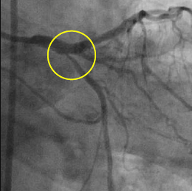
IVUS-guided PCI for bifurcation lesions
Ostial lesions are often fibrotic/elastic & can cause complications because of recoil & spasm
Angiographically assessment of ostial lesion severity is hampered by vessel overlap with the aorta and angulation
IVUS - pre-intervention assessment of plaque morphology and distribution at the side branch ostium
In a recent propensity-matched analysis of patients undergoing PCI of non–left main bifurcations with DES an IVUS guided PCI strategy (n=487) vs angio guided (n=487)was associated with larger post-stent lumen diameters in both the main vessel and side branch and lower rates of death or MI (3.8% vs. 7.8%, p =0.03)

Slide 73
IVUS-guided PCI for bifurcation lesions
Pre-intervention IVUS of the side branch ostium may also be useful to predict the likelihood of side branch compromise due to plaque and/or carina shift after single-stent deployment in the main branch
At present, IVUS guidance is advocated in bifurcation lesion PCI with DES. If the pre-intervention side branch MLA is > 2.4 mm², provisional side branch PCI can usually be deferred. However, if the side branch MLA is <2.4mm², clinical judgment and/or side branch FFR should be considered to guide provisional side branch intervention

Slide 74
IVUS-guided PCI for ISR
IVUS can assist in the differentiation of restenosis related predominantly to intimal hyperplasia versus mechanical complications, such as stent fracture or stent underexpansion
An IVUS-guided high-pressure angioplasty with a noncompliant balloon is often performed when stent underexpansion is the major mechanism for restenosis to avoid deployment of a second stent, especially with DES restenosis
POBA may also be appropriate in the presence of very focal lesions due to neointimal hyperplasia in both BMS and DES
In diffuse/proliferative ISR of either BMS or DES, a second DES is often warranted

Slide 75
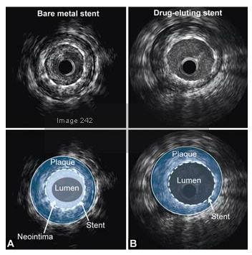
In-stent restenosis
IVUS images of 8 month after stent deployment
BMS show a considerable amount of neointimal inside the stent (A)
Significant suppression of instent neointimal proliferation is observed when a DES was used (B)

Slide 76
IVUS-guided PCI for CTO
Subintimal guide wire tracking - IVUS imaging from the false lumen can guide re-entry of the wire into the true lumen
two basic techniques
  IVUS identification and differentiation of true vessel lumen from false lumen, thereby assisting re-entry into the true lumen with a guide wire
  Facilitating true lumen entry of a CTO when a side branch arises just proximal to the CTO
In a small series of 31 CTO lesions (of which 22 were previous failed attempts), successful recanalization was achieved in 100% of cases using a modified retrograde IVUS-guided approach Rathore S et al.Jacc intrv 2010

Slide 77
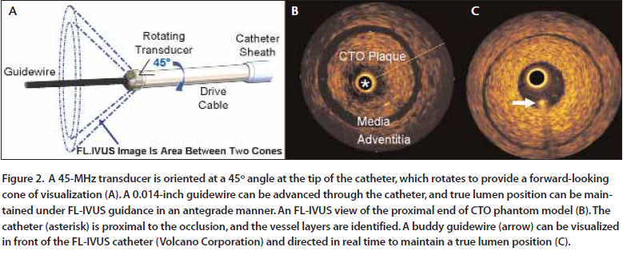
IVUS-guided PCI for CTO
Forward-looking intravascular ultrasound (FL-IVUS)

Slide 78
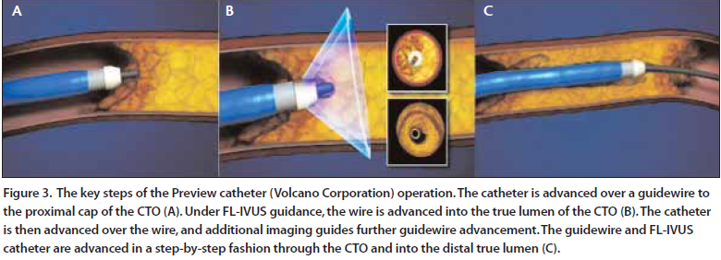
IVUS-guided PCI for CTO
The Preview catheter: currently undergoing preclinical and early clinical evaluation. It is a single-use, over the wire imaging catheter

Slide 79
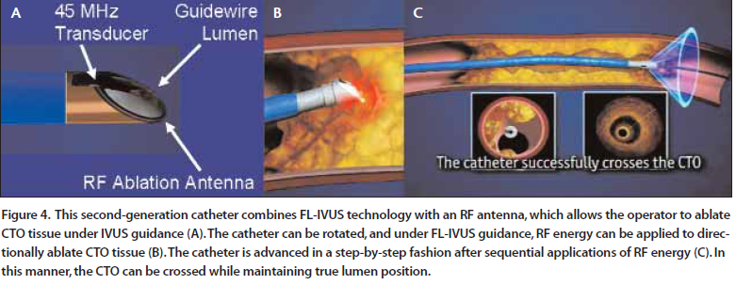
IVUS-guided PCI for CTO
FL-IVUS with Radiofrequency (RF) :A second-generation FL-IVUS catheter - built on the Preview catheter platform, also integrates a RF ablation element at the catheter tip

Slide 80
IVUS-guided PCI for SVG lesions
Saphenous vein graft lesions (SVGs) are often larger making angiographic size assessment more difficult
Oversized stents (stent to reference ratio 1.0) result in greater rates of periprocedural myocardial necrosis & distal embolization without reducing 9-month revascularization rates
In SVG’s stent oversizing may result in graft perforation
it is reasonable to use IVUS to select appropriately sized stents for SVG PCI

Slide 81
Guidance in Peripheral Interventions
IVC Filter Placement
Visualization of AV Shunts
Renal Artery Imaging
Aortic and Arterial Dissections
Venous Imaging
EVAR/ TEVAR
Peripheral Angioplasty (eg. Iliac, Thrombus)
Iliac Vein Compression Syndrome

Slide 82
Conclusion
IVUS provides cross-sectional images of both the arterial wall and lumen with excellent resolution
IVUS Reveals the diffuse nature of atherosclerosis & involvement of reference segments & takes into account vessel wall remodeling
Clinical indications of IVUS imaging include assessment of
  Left main coronary artery disease
  Ambiguous lesions on angiography
  Discordance between symptoms and angiographic findings,
  Unsatisfactory results of coronary intervention

Slide 83
THANK YOU

