Slide 1
LONG QT SYNDROME Dr Aswin Narendran

Slide 2
Long QT syndrome is a part of heterozygous group of disorders called cardiac channelopathies.
Cardiac channelopathies refers to genetic disorders characterized by altered cardiac excitability, in the absence of structural cardiac involvement.
Also known as inherited arrhythmogenic diseases (IADs).
Disorders due to genetic mutation affecting the genes that control the excitability of myocardial cells.

Slide 3
Major cardiac channelopathies include
Long QT Syndrome
Brugada syndrome
CPVT
Short QT syndrome

Slide 4
Webster and Berul circulation 2013;127:126-140

Slide 5
Long QT Syndrome
LQTS is an IAD characterized by abnormally prolonged QT interval.
13 genes are found to be linked to LQTS till now.
Mutations in 3 genes KCNQ1 (LQT1), KCNH2 (LQT2) and SCN5A (LQT3) accounts for approximately 75% of cases with a strong clinical phenotype.

Slide 6
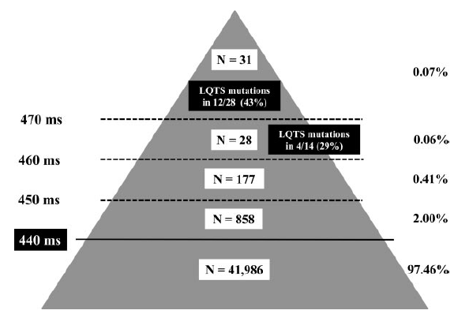
Prevalence
Assumed to be 1/2500 live births .
In an Italian study ,where ECG was performed in 44,596 infants , 0.07% had a QTc >470 ms and 0.47% had QTc between 451 and 470 ms
Molecular screening showed
disease-causing mutation in
43% of neonates with
QTc >470 ms & 29% of
those with QTc b/w
461 and 470 ms
Schwartz etal
Circulation. 2009;120:1761-1767

Slide 7
CHANNELOPATHY | GENE | PROTEIN
LQT 1 | KCNQ1 | α-subunit of Iks
LQT 2 | KCNH2 | α-subunit of Ikr
LQT 3 | SCN5A | Sodium channel, α-subunit
LQT 4 | ANK2 | Cellular structural protein
LQT 5 | KCNE1 | β-subunit of Iks
LQT 6 | KCNE2 | β-subunit of Ikr
LQT 7 | KCNJ2 | α-subunit of Ik1

Slide 8
CHANNELOPATHY | GENE | PROTEIN
LQT 8 | CACNA1C | l-type Ca + channel, α-subunit
LQT 9 | CAV3 | Plasma membrane structural protein
LQT 10 | SCN4B | Sodium channel, β-subunit
LQT 11 | AKAP9 | Kinase anchoring protein (Yotaio)
LQT 12 | SNTA1 | Syntrophin α1 (affects sodium current)
LQT 13 | KCNJ5 | Inwardly rectifying potassium channel, α-subunit

Slide 9
CARDIAC ACTION POTENTIAL
Depolarization (phase 0) of the cardiac action potential results from rapid sodium influx (I_{Na}), whereas repolarization (phases 2 and 3) is driven by potassium efflux via the slow (I_{ks}) and rapid (I_{kr}) components of the delayed rectifier current

Slide 10
Potassium Channel LQTS
Potassium channel derangements account for majority of LQTS cases : Long QT 1, 2, 5, 6, 7 and 13.
IKs : slowly activating delayed rectifier cardiac potassium channel
α subunit is encoded by KCNQ1
β subunit is encoded by KCNE1
Loss of function mutation result in LQT 1 and LQT 5
Ikr : rapid delayed rectifier potassium channel
α subunit encoded by KCNH2
β subunit encoded by KCNE2
Loss of function mutation result in LQT 2 and LQT 6.

Slide 11
I_{KI} : another inwardly rectifying K+ channel
encoded by gene KCNJ2
Loss of function mutation result in LQT 7 (Tawil-Anderson syn)
KCNJ5 mutation which is a loss-of-function mutation in an inwardly rectifying potassium channel result in LQT 13

Slide 12
Sodium channel LQTS
α subunit of sodium channel is encoded by SCN5A and β subunit encoded by SCN4B.
Gain of function mutations in SCN5A produce LQT3.
Mutations in SCN4B produce LQT10.

Slide 13
Molecular basis for long QT syndrome
Topol EJ, Califf RM et al

Slide 14
Pathophysiology of LQTS
Prolonged repolarization results fm net reduction in outward current, due to ↑ in inward Na + or Ca + current, ↓ in outward K+ current or both resulting in long QT interval.
Fast heart rate preceding TdP in LQT1 postulate delayed afterdepolarizations (DADs) as its arrthymogenic mechanism.
Increased Ca+ loading in parallel with QT prolongation, facilitate DADs and DAD-dependent TdP.
Pause-dependent TdP is triggered by early afterdepolarizations (EADs).
Pause leads to enhanced Ca+ release from intracellular stores and activate Ca+ dependent transmembrane currents.

Slide 16
Initiation of arrhythmia in LQTS
Non-pause dependent
torsade de pointes
Mainly in LQT1
Pause dependent
torsade de pointes
Mainly in LQT2

Slide 17
Clinical features
May be asymptomatic
Symptomatic pts present with palpitations, presyncope, syncope or cardiac arrest.
Neuronal deafness is associated with Jervell and Lange-Nielsen syndrome
In a study on 287 pts , 61% were symptomatic : 9% presented with a cardiac arrest, 26% with syncope ,10% with seizures , 6% had presyncore or palpitation
67% had symptoms related to exercise, 18% had symptoms during exercise and with emotion, 7% with emotion alone, 3% with loud noise and exercise and 2% with anesthesia.
A Garson, M Dick et al Circulation. 1993;87:1866-1872

Slide 18
Concealed LQTS may be unmasked by either standing, exercise testing, or epinephrine challenge, which may lead to QT prolongation and T-wave morphological abnormalities in a type-specific manner.

Slide 19
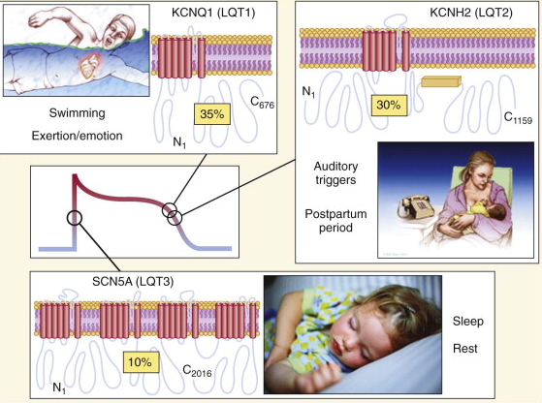
Triggers of arrhythmia
Triggers include exercise, noise, emotion, sudden wakening from sleep by noise , swimming or diving.
Swimming and exertion-induced cardiac events are strongly associated with LQT1.
Auditory triggers and events
during postpartum period
occur in pts with LQT2.
Events occurring during periods of
sleep or rest are most common in
LQT3.

Slide 20
Triggers of LQTS
Schwartz et al

Slide 21
Jervell and Lange-Nielsen syndrome
Autosomal recessive variant of long QT syndrome.
Due to homozygous or compound heterozygous mutations on either the KCNQ1 or KCNE1 genes.
Pts also suffer from congenital deafness.
Most severe of major variants of LQTS.
90% have cardiac events, 50% become symptomatic by
age of 3 yrs and their average QTc is markedly prolonged (557± 65 ms)

Slide 22
Event-free survival comparing Jervell and Lange-Nielsen syndrome pts with other long-QTS

Slide 23
Timothy syndrome / LQT8
Mutations in CACNA1C, encoding voltage-gated calcium channel results in Timothy syndrome or LQT8.
Rare and extremely malignant variant.
Pts had marked QT prolongation and associated syndactyly .
Presents with 2:1 atrioventricular block and macroscopic T-wave alternans.
Among 17 children reported by Splawski et al, 10 (59%) died at a mean age of 2.5 yrs.

Slide 24
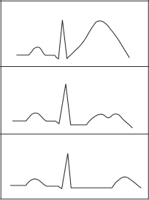
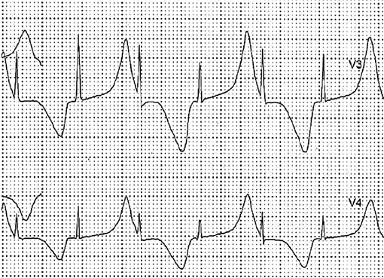
ECG in LQTS
QTc values exceeding 440 ms (in males) and 460 ms (in females) are considered abnormal .
LQT1 is associated with a broad-based T wave.
LQT2 with low-amplitude notched or
biphasic T wave.
LQT3 with long isoelectric segment followed
by a narrow-based T wave.

Slide 25
T-wave alternans in polarity or amplitude when observed, is diagnostic.
T-wave alternans is a marker of major electric instability and identifies patients at particularly high risk
Its presence in a patient already undergoing treatment should alert the physician to persistent high risk and warrants an immediate reassessment of therapy.
Sinus pauses, unrelated to sinus arrhythmia, are an additional warning signal especially in patients with SCN5A mutations.

Slide 27
RISK FACTORS IN LQTS
QT interval - Longer QT intervals represent enhanced electric instability within the myocardium and hence greater arrhythmic risk
Age - Symptomatic infants represent an extreme end of the disease spectrum, typically with severe QT prolongation, and a significantly higher cumulative event rate in later life. Younger age of presentation of first cardiac event the indicated bad prognosis.
Sex - Males are typically at higher risk during childhood and females from teenage life onward.⁹ The QTc shortens by ≈20 ms in males but not females postpuberty, due to hormonal effects.

Slide 28
LQT genotype - LQT1 is associated with a shorter QT interval (466±44 ms), lower cumulative cardiac event rate (30%), and lower incidence of cardiac arrest or sudden death (0.3%/yr) by 40 years of age compared with either LQT2 (490±49 ms; 46% and 0.6%/yr) or LQT3 (496±49 ms; 42% and 0.56%/yr).³
A more complex genotype typically confers greater QT prolongation and higher risk of cardiac events, as seen in the autosomal recessive Jervell-Lange Nielsen syndrome
Time-dependent syncope - recurrent syncope, particularly in the recent past, is associated with a significantly increased risk of subsequent cardiac arrest independent from other risk factors.

Slide 29
LQTS : Diagnostic Criteria
Score
≤1 point: low probability
1.5–3 points: intermediate probability
≥3.5 points: high probability.
Schwartz et al
Circ Arrhythm Electrophysiol. 2012;

Slide 30
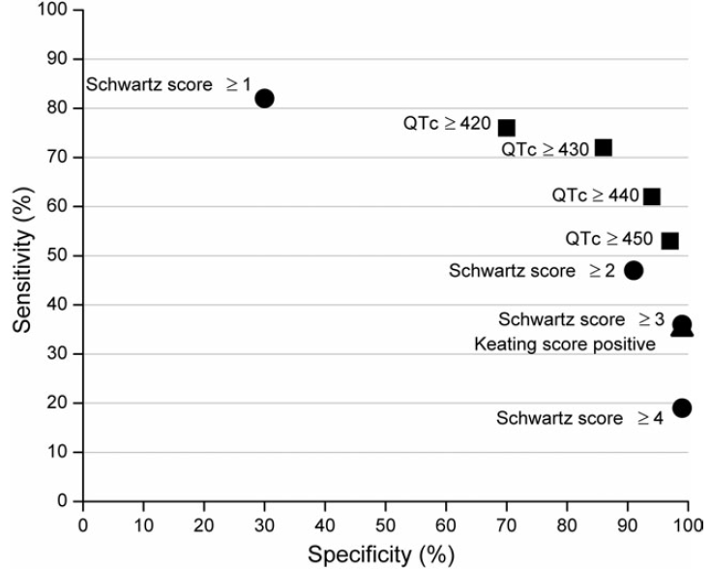
Keating Criteria
Asymptomatic with QTc > 470 ms or
Typical symptoms with QTc ≥ 450 ms
Sensitivity and specificity of
QTc duration alone ,
Schwartz score and
Keating criteria
Nynke Hofman, Arthur A.M. Wilde et al
EHJ

Slide 31
Risk stratification
Risk of a 1st cardiac event in pts younger than 40 years of age in the absence of any LQTS active treatment

Slide 32
Treatment
All LQTS pts with h/o syncope and asymptomatic individuals with definite QT prolongation should be treated withβ-blockers
Drugs used are Propranolol ( 2-4 mg/kg/d),
Nadolol (1-2.5 mg/kg/d)
Metoprolol (2-4 mg/kg/d)
Dose titration done with a target of 25% to 35% reduction of maximal heart rate attained on therapy.
Left Cardiac Sympathetic Denervation may be considered in symptomatic patients even after betablocker therapy.

Slide 33
LEFT CARDIAC SYMPATHETIC DENERVATION
Interruption of the upper thoracic sympathetic chain by left cardiac sympathetic denervation (LCSD) to reduce adrenergic stimulation of the heart has been used in LQTS,
1. As a mechanism to reduce arrhythmia burden in highly symptomatic individuals receiving repeated ICD therapies as an alternative strategy when β-blockers are contraindicated
2. For high risk infants with severe QT prolongation.
3. LCSD may be an intermediate step between medical therapy and defibrillator implantation in select patients.

Slide 34
ICD implantation along with β -blockers is recommended for LQTS patients with previous cardiac arrest or who are experiencing syncope and/or VT while receiving beta blockers.
Permanent pacing is indicated for sustained pause-dependent VT, with or without QT prolongation.
Avoid competitive sports, QT-prolonging drugs and lowered K+ levels .

Slide 35
JLN and TS patients who appear incompletely protected by antiadrenergic therapies, the possibility of triple therapy, namely β-blockers plus LCSD plus ICD should be considered

Slide 36
β-blocker therapy in LQTS
β-blocker therapy results in 42% to 78% reduction of aborted cardiac arrest or sudden cardiac death.
Pts on β-blockers still have risk of sudden death.
In a study , no. of cardiac events before initiation of β-blocker therapy was 0.97 events /pt/yr which decreased to 0.31 after initiation of therapy .
β-blocker is most efficacious in LQT1 and less effective in LQT3.
In LQT3, combination of mexiletine at a dose of 8mg/kg/day with a noncardioselective β-blocker (propranolol ) is used .

Slide 37
The 2 most effective are propranolol and nadolol. Propranolol is still the most widely used drug, at 2 to 3 mg/kg per day; sometimes, the dosage is increased to 4 mg/kg
Nadolol is also used, usually at 1 to 1.5 mg/kg per day.
Metoprolol is less effective

Slide 38
ICD IMPLANTATION IN LQTS
Given the potential for sudden cardiac death, ICDs are frequently used in the management of LQTS
Based on the findings of a recent European ICD registry, the following indications were proposed for ICD implantation:
(1) cardiac arrest on therapy,
(2) cardiac arrest off therapy (although for LQT1 patients β-blockade may be sufficient)
(3) syncope on β-blockade where LCSD is unavailable or declined by the patient

Slide 39
(4) compound heterozygous/homozygous patients with syncope on β-blockade
(5) asymptomatic patients with a QTc >550 ms, who also manifest signs of high electric instability (eg, T-wave alternans) or other evidence of being at high risk (eg, long sinus pauses followed by abnormal T-wave morphologies), despite β-blockade and LCSD.

Slide 40
Asymptomatic LQTS Patients and Patients With Normal QTc
β-Blocker treatment should be initiated in all patients including those still asymptomatic because in 10% to 12% of LQTS cases the first clinical manifestation is sudden death.
Among these, reasonable exceptions appear to be LQT1 men aged >40 years because they seldom have a first event after this age and possibly individuals aged >50 years with a QTc <480 ms.

Slide 41
MCQS

Slide 42
Phase 0 of action potential –predominant current
Na into cytoplasm
Na out of cytoplasm
K into cell
K out of cell

Slide 43
A

Slide 44
Mainstay of pharmacological treatment of congenital LQTS
Calcium channel blocker
Amiodarone
Beta blocker
Procainamide

Slide 45
C

Slide 46
Mexilitine is used in which among the following LQTS
LQTS 1
LQTS 2
LQTS 3
JLN

Slide 47
C

Slide 48
Which of the following electrolyte abnormality predispose to arrhythmias in LQTS
Hypokalemia
Hypocalcemia
Hyponatemia
Hypermagnesemia

Slide 49
A

Slide 50
KCNH2 GENE is associated with which of the following LQTS
LQTS 1
LQTS 2
LQTS 3
LQTS 5

Slide 51
B

Slide 52
THANK YOU

