Slide 1
Prosthetic valves
Dr Aswin Narendran

Slide 3
TYPES OF PROSTHETIC HEART VALVES
MEHANIAL VALVES
There are three basic types of mechanical prosthetic valves:1. bileaflet, 2.tilting disc 3.ball-cage.
The St. Jude bileaflet valve is the most frequently implanted mechanical prosthesis worldwide.
It consists of two pyrolytic semi-circular “leaflets” or discs with a slit-like central orifice between the two leaflets and two larger semi-circular orifices laterally. The opening angle of the leaflets relative to the annulus plane ranges from 75 to 90 degrees.
The Carbomedics valve is a variation of the St. Jude prosthesis.
For a given valve annulus size, the effective orifice areas (EOAs) are larger and transprosthetic pressure gradients are lower for the bileaflet mechanical valves compared with the tilting disc valves.

Slide 4
Tilting disc or monoleaflet valves use a single circular disc that rotates within a rigid annulus to occlude or open the valve orifice.
The disc is secured by lateral or central metal struts. The opening angle of the disc relative to the valve annulus ranges from 60 to 80 degrees, resulting in two orifices of different size.
Tilting disc valves also have a small amount of regurgitation, arising from small gaps at the perimeter of the valve.

Slide 5
The bulky Starr-Edwards ball-cage valve, the oldest commercially available prosthetic heart valve first used in 1965, is no longer implanted.
The ball-cage valve is more thrombogenic and has less favorable hemodynamic performance characteristics than either bileaflet or tilting disc valves.
Currently available mechanical valves have excellent long-term durability, with up to 45 years for the Starr-Edwards valve and more than 35 years for the St. Jude valve.

Slide 6
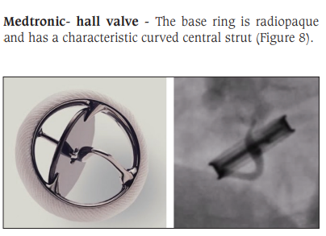
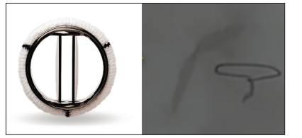

Slide 7
Tissue Valves
Tissue or biological valves include stented and stentless bioprostheses (porcine, bovine), homografts (or allografts) from human cadaveric sources, and autografts of pericardial or pulmonic valve origin.
They provide an alternative, less thrombogenic heart valve substitute for which long-term anticoagulation in the absence of additional risk factors for thromboembolism is not required.

Slide 8
Stented Bioprosthetic Valves
A heterograft valve consists of three biologic leaflets made from the porcine aortic valve or bovine pericardium treated with glutaraldehyde to reduce its antigenicity mounted on a metal or polymeric stented ring; they open to a circular orifice in systole, resembling the anatomy of the native aortic valve.
The vast majority of bioprosthetic valves are treated with anti-calcifying agents or processes.
Eg- The Inspiris Resilia Aortic Valve (Edwards LifeSciences, Irvine, CA)
The Perceval valve (LivaNova, London, UK) is a sutureless bioprosthetic valve
The current generation of bovine pericardial valves offers improved hemodynamic performance compared with earlier generations.

Slide 9
Small degree of regurgitation can be detected by color Doppler flow imaging in 10% of normally functioning bioprostheses.
Limitation of bioprosthetic valves ---limited durability due to SVD, typically beginning within 5 to 7 years after implantation but varying by position and age at implant, with tissue changes characterized by calcification, fibrosis, tears, and perforations.
SVD occurs earlier for mitral than for aortic bioprosthetic valves, due to exposure of the mitral prosthesis to relatively higher left ventricular (LV) closing pressures.
The process of SVD is accelerated in younger patients, in those with disordered calcium metabolism (end-stage renal disease), and, possibly, in pregnant women independent of younger age.
With current generation bioprosthetic pericardial valves, durability is excellent, with SVD rates of 2% to 10% at 10 years, 10% to 20% at 15 years, and 40% at 20 years.

Slide 10
Stentless Bioprosthetic Valves
The rigid sewing ring and stent-based construction of certain bioprostheses allow for easier implantation and maintenance of the three-dimensional relationships of the leaflets. However, these features also contribute to impaired hemodynamic performance.
Homograft
Aortic valve homografts are harvested from human cadavers within 24 hours of death and are treated with antibiotics and cryopreserved at −196°C.
They are most commonly implanted in the form of a total root replacement with reimplantation of the coronary arteries.
Neither immune suppression nor routine anticoagulation is required.
long-term durability beyond 10 years is not superior to that for current generation pericardial valves

Slide 11
Autografts
In the Ross procedure, the patient’s own pulmonic valve (or autograft) is harvested as a small tissue block containing the pulmonic valve, annulus, and proximal pulmonary artery and inserted in the aortic position usually as a complete root replacement with reimplantation of the coronary arteries.
The pulmonic valve and right ventricular outflow tract are replaced with either an aortic or a pulmonic homograft.
Thus, the procedure requires two separate valve operations, a longer time on cardiopulmonary bypass, and a steep learning curve.
The procedure is reserved for children and young adults but should be avoided in patients with dilated aortic roots due to high incidence of accelerated degeneration, pulmonary autograft dilation, and significant regurgitation.

Slide 12
Transcatheter Bioprosthetic Valves
TAVR is a valuable alternative to surgical AVR in patients across the surgical risk spectrum. Two main types of transcatheter aortic valves are currently used: balloon-expandable valves (BEV) and self-expanding valves (SEV) .
The Edwards LifeSciences (Irvine, CA) SAPIEN 3 and SAPIEN 3 Ultra BEVs consist of a three-leaflet pericardial bovine valve mounted in a cobalt chromium frame.
The Medtronic (Minneapolis, MN) EVOLUT-R and EVOLUT-Pro+ SEVs consist of three leaflets of porcine pericardium seated relatively higher in a nitinol frame to provide supra-annular placement.
The vast majority of TAVR procedures are performed via a transfemoral approach

Slide 13
The choice of SEV versus BEV is highly operator dependent, though there are anatomic and echocardiographic considerations to be taken into account.
Intermediate term durability appears similar, though the risk of permanent pacemaker implantation is higher with SEVs due to risk of development of high-grade AV block.
Leaflet thrombosis can be recognized by the appearance of hypoattenuated leaflet thickening (HALT) on ECG-gated computed tomography (CT) and occurs in 10% to 20% of patients 30 days after TAVR, compared with approximately 5% to 15% after surgical AVR (SAVR).
Subclinical leaflet thrombosis, that is HALT in the absence of thromboembolic complications or a progressive increase in the transvalvular gradient, appears to be a dynamic phenomenon for which indications for treatment are uncertain.

Slide 14
For a given aortic annulus size, TAVR valves often have larger EOAs, lower gradients, and lower incidence of severe prosthesis-patient mismatch compared with SAVR valves.
Paravalvular leak (PVL) is more frequent following TAVR and may result in adverse long-term consequences depending on its severity.
Some studies have suggested that SEVs have slightly larger EOAs and lower gradients but somewhat higher rates of PVL than BEVs.

Slide 15
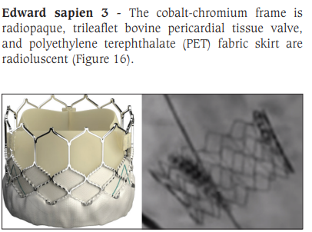

Slide 16
COMPARISON OF MECHANICAL AND TISSUE VALVES
Durability- theoretically indefinite for mechanical versus limited for tissue valves)
need for anticoagulation (i.e., obligatory use for mechanical versus none for tissue valves absent other risk factors for thromboembolism).
Short-to intermediate-term hemodynamic performance characteristics with low-profile mechanical prostheses (e.g., St. Jude) are comparable to those with stented tissue valves of similar size.
Endocarditis -no important differences in rates of prosthetic valve endocarditis (PVE), though some series have suggested a higher incidence of early (<1 year) infection with mechanical valves versus bioprostheses.
SVD- Bioprosthesis have a higher rate of SVD
Bleeding – higher risk with mechanical valve replacement
Thromboembolism or PVE. No major differences

Slide 17
In an analysis of over 39,000 AVR patients aged 65 to 80 years reported to the STS Adult Cardiac Surgery Database and linked to Medicare, patients receiving a bioprosthesis had a similar adjusted risk for death, higher risks for reoperation and endocarditis, and lower risks for stroke and bleeding, compared with patients receiving a mechanical valve

Slide 18
CHOICE OF VALVE REPLACEMENT PROCEDURE AND PROSTHESIS
The 2020 AHA/ACC guidelines for the management of patients with valvular heart disease advocate shared decision making regarding the choice of intervention (repair or replacement, transcatheter or surgical) as well as the type of prosthetic valve (mechanical valve or bioprosthesis).
This choice is based on consideration of several factors including patient age, expected longevity and comorbidities, valve durability, expected hemodynamics for a specific valve type and size, surgical or interventional risk, the potential need for and safety of long-termanticoagulation, and patient preferences.

Slide 19
CHOICE OF PROCEDURE
For patients meeting an indication for AVR, the choice of TAVR versus SAVR begins with assessment of surgical risk considering patient age and life expectancy.
The ultimate choice also hinges on technical factors related to access (transfemoral versus alternative route), aortic valve and root anatomy, the extent and severity of calcification, the height of the coronary arteries, and the need for additional cardiac surgery (e.g., root or ascending aortic replacement, coronary artery bypass grafting).
TAVR is preferred for prohibitive or high surgical risk patients provided life expectancy with reasonable quality exceeds 1 year.
SAVR is preferred for low or intermediate surgical risk patients younger than 65 due to the paucity of data regarding TAVR valve durability beyond 5 years.
For patients 65 to 80 years of age, the choice between TAVR and SAVR is largely driven by patient preference and the need for concomitant surgery.
TAVR is generally preferred for patients over age 80.
Recommendations regarding TAVR apply primarily to patients with trileaflet aortic stenosis, although the use of TAVR for selected patients with bicuspid aortic valve stenosis has increased rapidly.

Slide 20
In patients with chronic severe primary mitral regurgitation (MR) who meet an indication for mitral valve surgery, mitral valve repair is recommended in preference to MVR when a successful and durable repair can be accomplished.
Transcatheter mitral valve repair using an edge-to- edge clip device is reserved for prohibitive surgical risk patients with primary MR.
In patients with severe chronic secondary MR in the setting of ischemic cardiomyopathy referred for coronary artery bypass graft, concomitant MVR may be superior to mitral valve repair because it is associated with lower rates of recurrent moderate to severe regurgitation.
Transcatheter edge-to-edge repair (TEER) is reasonable for selected patients with heart failure, reduced ejection fraction and moderately severe to severe MR

Slide 21
Tricuspid valve annuloplasty repair is frequently performed at the time of left-sided valve surgery when secondary tricuspid regurgitation (TR) is severe or when there is significant tricuspid annular dilation (>40 mm) despite only mild or moderate degrees of TR or a history of right-sidedheart failure).
Tricuspid valve replacement is undertaken for severe primary tricuspid valve disease that cannot be repaired, such as with advanced rheumatic disease, carcinoid, or destructive endocarditis

Slide 22
CHOICE OF PROSTHETIC VALVE
A bioprosthesis is recommended in patients of any age for whom anticoagulant therapy is contraindicated, cannot be managed appropriately,or is not desired.
SAVR- A mechanical prosthesis is reasonable for SAVR in patients <50 years old who do not have a contraindication to anticoagulation, whereas a bioprosthesis is reasonable in SAVR patients >65 years old.
Either a bioprosthetic or mechanical valve is reasonable in SAVR patients between 50 and 65 years old.
MVR -A mechanical prosthesis is reasonable for patients <65 years old and a bioprosthesis is reasonable for patients ≥65 years old.
For women contemplating pregnancy, a bioprosthesis is preferred to avoid the hazards of anticoagulation

Slide 23
MEDICAL MANAGEMENT AND SURVEILLANCE AFTER VALVE REPLACEMENT
Antithrombotic Therapy
General Principles
All patients with mechanical heart valves require lifelong anticoagulation with a VKA
Anticoagulant therapy with non-vitamin K oral anticoagulants (NOACs) should not be used in patients with mechanical prostheses, although they can be used in patients with bioprosthetic valves or annuloplasty rings at a distance from surgery.
The addition of low-dose aspirin to VKA therapy can be considered in patients with mechanical valves when dictated by another indication.
A VKA may be used even in the absence of risk factors for thromboembolism for the first 3 to 6 months after bioprosthetic AVR or MVR.
Longer-term treatment of low thromboembolic risk bioprosthetic AVR and MVR patients consists of low-dose Aspirin
In the absence of an indication for anticoagulation, single-agent antiplatelet therapy with low-dose aspirin is reasonable after TAVR.
For patients with an indication for anticoagulation, monotherapy with either a VKA or NOAC is reasonable after TAVR.

Slide 25
Low-risk patients with low-profile bileaflet or tilting disc valves in the aortic position can usually stop VKA therapy 3 to 5 days before noncardiac surgery and then resume it postoperatively as soon as it is considered safe, without the need for a heparin “bridge.”
In all other patients, either low-molecular-weight heparin (LMWH) or intravenous unfractionated heparin(UFH) should be given on an individualized basis both before and after surgery
For patients with a bioprosthetic valve or annuloplasty ring receiving an anticoagulant,it is reasonable to consider the need for bridging on the basis of the CHA2DS2-VASc score and the risk of bleeding.

Slide 26
Pregnancy
In pregnant patients with mechanical valves, warfarin is reasonable in the first trimester if the dose is ≤5 mg/day and is recommended to achieve a therapeutic international normalized ratio (INR) target in the second and third trimesters.
Discontinuation of warfarin with initiation of intravenous UFH is recommended before planned vaginal delivery in pregnant patients with a mechanical valve.

Slide 27
Infective Endocarditis Prophylaxis
Patients with prosthetic valves are at increased risk for infective endocarditis because of the foreign valve surface and sewing ring
Antibiotic prophylaxis is indicated for patients with prosthetic valves who undergo dental procedures that involve manipulation of gingival tissue, the periapical region of teeth, or perforation of the oral mucosa,
It is not recommended for non-dental procedures such as transesophageal echocardiography, esophagogastroduodenoscopy, colonoscopy, or cystoscopy

Slide 28
CLINICAL ASSESSMENT OF PROSTHETIC VALVE FUNCTION
The clinical assessment can be classified into:
Symptom assessment
Clinical Examination

Slide 29
SYMPTOM ASSESSMENT
Patients of significant valve disease improve in functional class following valve replacement except in patients with significant left ventricular dysfunction.
After the initial post operative period, failure of improvement in symptoms of patients of valve replacement points towards prosthetic valve malfunction or surgical complication.
Again after an initial improvement in cardiac function, any deterioration in the functional status indicates the possibility of valve malfunction or a complication like atrial fibrillation which resulted in clinical deterioration.
Other associated complications like systemic and pulmonary embolism, atrial fibrillation, haemolysis, anaemia, infective endocarditis or infections especially chest infections should be specifically sought for in a prosthetic valve patient.

Slide 30
CLINICAL EXAMINATION
Caged – ball valve (eg.Starr-Edwards) Caged- ball valves are characterized by metallic closing and opening noises.
These correspond to the closing movement of the ball which seats on to the ring of the valve and opening process when the ball falls on to the metallic cage.
Both the noises are high pitched, metallic, loud noises which can be easily distinguished from normal heart sounds.
The opening noise is louder than the closing noise because in the opening motion the ball comes to strike the metallic cage while in closing motion the ball seats onto the cloth covered metallic ring.

Slide 31
The metallic opening sound (OS) is louder than the closing sound (CS) of the valve.
The OS, which corresponds to the opening snap of the mitral stenosis, is audible 0.07 to 0.11second after A2 and is best audible at the apex.
Narrowing of A2 –OS interval to less than 0.05 second indicate prosthetic valve obstruction or severe regurgitation.
Delay in A2 –OS interval is suggestive of interference with the opening motion of the poppet.
Sometimes multiple opening sounds could be audible. It is due to the multiple excursions of the poppet related to the blood flow and indicates well functioning caged ball prosthesis.
The CS of the caged ball prosthetic valve produces a metallic noise which corresponds to first heart sound. It occurs 0.06 to 0.08 second after the onset of QRS complex.
A mid systolic murmur is very often audible in the left sternal border which is caused by the projecting rigid cage of the caged ball onto the left ventricular (LV) outflow.
Presence of diastolic murmur in caged ball prosthetic valve indicates valve malfunction.

Slide 32
Aortic caged ball valve
The opening of the caged ball aortic prosthetic valve produces a metallic sound.
The interval between S1 and aortic OS is approximately 0.07 second.
Multiple opening sounds may be audible due to the movement of the poppet.
The aortic OS may be heard all over the precordium.
It may be best audible at the apex or the left parasternal region.
The CS of the aortic prosthetic valve is also heard as a loud metallic noise. However CS is less loud than OS.
Reduction in intensity of OS compared to CS of the aortic prosthetic valve indicates valve dysfunction.

Slide 33
Ejection systolic murmur can be heard at the aortic area with radiation to carotids.
Sometimes carotid shudder may be palpated.
Presence of a diastolic murmur indicates valve dysfunction.

Slide 34
Single Tilting Disc Valve
The tilting disc valve does not produce a loud OS because as the disc swings open it does not strike against any metallic/ resonant part.
However a metallic CS will be audible.
Absence of metallic CS indicates valve malfunction.
In general tilting disc valve sounds are less loud than caged-ball valve sounds

Slide 35
Mitral single tilting disc valve
The OS is not clinically audible.
The CS is metallic and loud and corresponds to S1.
The CS can decrease in intensity if the disc movement is interfered with due to thrombosis or pannus.
In addition to grade 2/6 Ejection systolic murmur in the parasternal region, normally functioning tilting disc prosthetic valve, may produce a mid-diastolic murmur at apex.
The tilting disc valves are inherently stenotic and the opening size of the valve may be half of the size of the normal valve
This results in turbulent flow across the valve which can be the reason for the mid-diastolic murmur

Slide 36
Aortic single tilting disc valve
Similar to mitral single tilting disc valve, the aortic tilting disc valve also does not produce clinically detectable OS while metallic CS is audible.
Reduction in intensity/metallic nature of CS of aortic prosthetic valve indicates associated prosthetic valve malfunction.
An ejection systolic murmur is heard in the aortic area.
Occasionally soft diastolic murmur may be audible in the normally functioning tilting disc prosthetic valve.

Slide 37
Bileaflet Tilting Disc Valve
Auscultatory findings of bileaflet tilting disc valve are similar to single tilting disc valve except that diastolic murmur is not normally audible in bileaflet tilting disc valve at aortic position.
Tissue Valves or Bioprosthetic Valves -Tissue valve can produce a CS similar to normal valves both in aortic and mitral positions.
The aortic bioprosthetic valve will have a systolic ejection murmur at the base of the heart which can radiate to the carotids.

Slide 38
The mitral bioprosthetic valve will have OS best audible at the apex in one half of the patients.
This is a high pitched event.
Apical diastolic murmur can be heard in majority of the patients with mitral bioprosthetic
There can be a mid systolic murmur in one half to two thirds of patients with mitral bioprosthetic valve.
The murmur production may be due to the resonating properties of the valve cusps or due to the flexible resonating stents.
Any alteration in the murmur character indicates prosthetic valve dysfunction.
In aortic bioprosthetic valve, OS is not audible.
A grade 2/6 mid systolic murmur can be audible in the left sternal border while no diastolic murmur is audible.
Presence of diastolic murmur indicates valve malfunction in aortic bioprosthesis

Slide 39
Homograft
The homograft prosthetic valve sounds are similar to normal heart sounds.
Homografts are not associated with murmurs. Presence of diastolic murmur indicates valve dysfunction

Slide 41
ECHO ASSESSMENT OF PROSTHETIC VALVE
An initial TTE examination performed 6 weeks to 3 months after prosthetic valve implantation is recommended to assess the results of surgery and serve as a baseline for comparison should complications or deterioration occur
Repeat TTE (as well as transesophageal echocardiography (TEE), fluoroscopy, or gated cardiac CT) is recommended if there is a change in clinical symptoms or signs suggesting valve dysfunction.
Bioprosthetic surgical valve,- routine TTE follow-up is recommended at 5 and 10 years and then annually thereafter.
TAVR patients-- annual TTE studies are recommended
Mechanical valves, routine annual echocardiography is not indicated in the absence of a change in clinical status.

Slide 42
A complete echocardiogram includes two-dimensional imaging of the prosthetic valve;
evaluation of the valve leaflet/occluder morphology and mobility;
measurement of the transprosthetic velocity and gradients,
valve EOA, and Doppler velocity index;
estimation of the degree of regurgitation;
evaluation of LV size and systolic function;
calculation of systolic pulmonary arterial pressure

Slide 45
Fluoroscopy of Prosthetic Heart Valves

Slide 46
Identification of prosthetic valve in chest X-ray
In chest X-ray PA view, the aortic valve should lie above, and the mitral valve below an imaginary line passing from the right cardio-phrenic angle to the inferior aspect of the left hilum .
On the lateral view the aortic valve lies above, and the mitral valve below an imaginary line passing from the carina to the cardiac apex

Slide 48
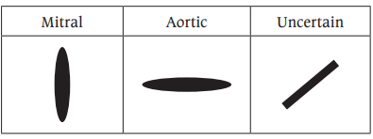
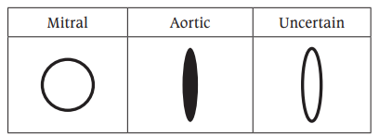
Valve orientation method- Mitral valve appears more vertical and aortic valve appears more horizontal and uncertain if it lies in between
Valve orifice shape method - If the valve orifice appears en face then it is mitral, if in profile it is aortic and uncertain if in projects in between

Slide 49
Direction of blood flow –
Perceived direction of blood flow across valve method- If the perceived direction of blood flow appears to be across the valve toward the cardiac apex then it is mitral, if it is towards the ascending aorta then it is aortic, otherwise the position is uncertain
Identification of type of implanted device in fluoroscopy - Each model of prosthetic valve has unique radiological properties and it may help to identify the valve when no previous records are available

Slide 50
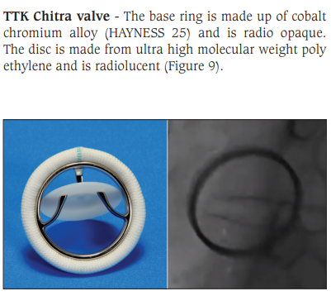
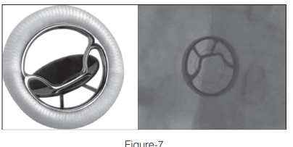
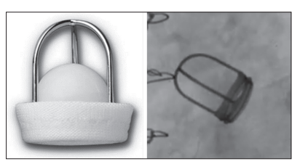
Tilting disc valves
Caged ball heart valves - Starr Edwards valve
Bjork-Shiley Prosthesis

Slide 51
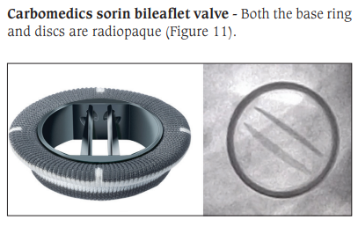

Slide 52
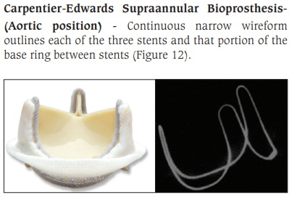
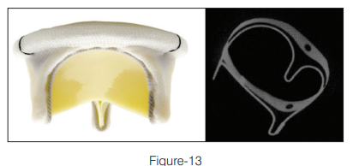
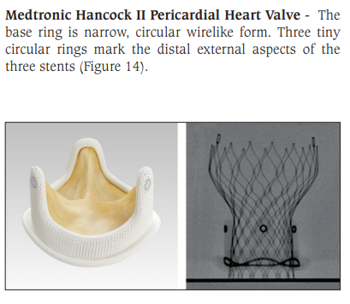

Slide 53
EVALUATION OF PROSTHETIC VALVE FUNCTION
Using cinefluoroscopy prosthetic valve dysfunction can be easily detected , especially in patients with bileaflet prosthetic valves where the disks can be directly visualized, and opening and closing angles measured.
Persistent restriction of leaflet motion with calculated opening angle greater than the mean value suggest prosthetic valve obstruction.
Increased mobility of the valve ring suggest dehiscence although a higher degree of dehiscence is required to be detected by cine fluoroscopy.

Slide 54
Calculation of Opening and Closing Angle
Patient in supine position
Aortic prosthesis may be visualized better in RAO caudal and LAO cranial angles, whereas RAO cranial position is more appropriate for visualization of mitral prosthesis.
European Association of Cardiovascular Imaging Recommendations for the imaging assessment of prosthetic heart valves suggest three views for optimal evaluation of prosthetic valve function.
1. Posteroanterior view - 0 and lateral 90 view to assess the in-situ orientation of valve

Slide 55
2. ‘In profile’ projection - with the radiographic beam parallel to both the valve ring plane and the tilting axis of disc , allowing calculation of opening and closing angles
3. The ‘en face’ projection - with the radiographic beam parallel to the valve outflow tract which is utilized only for mitral prostheses.
Cinefluoroscopy provides a better evaluation of the motion of discs in the aortic position than echocardiography

Slide 56
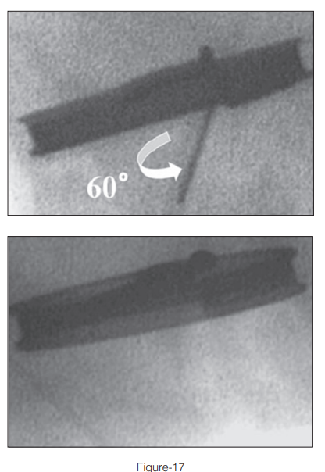
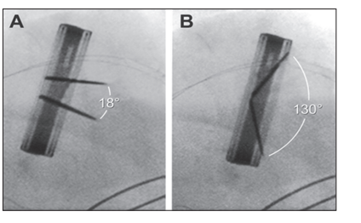
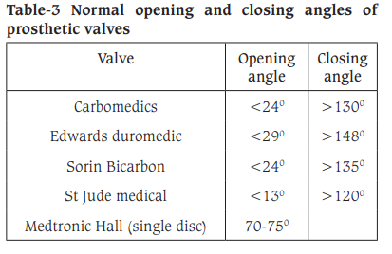
Opening and closing angles Single disc valves - the opening angle is defined as the angle between the housing and the disc at its fully open position
Bileaflet disc valves - the angle between the leaflets in the fully open and closed position
The utility of cinefluoroscopy is limited in patients with bioprosthetic valves.

Slide 57
Evaluation of valve ring motion
The dehiscence of prosthetic aortic valve is an uncommon complication, which may result from endocarditis, aortic aneurysm, and severe calcification or defective collagen. This results in paravalvular regurgitation.
Fluoroscopy will demonstrate rocking and tilting of the base ring of the prosthesis.
Tilting or rocking of more than 10° in the case of the mitral valve and more than 6° in the case of aortic valve is highly suggestive of dehiscence.
Interruption must be continuous for at least 40% of the circumference of the base ring before abnormal rocking will be appreciated in cinefluoroscopy.
Doppler echocardiography can identify earlier stages of valve dehiscence than fluoroscopy.

Slide 58
EVALUATION OF STRUCTURAL INTEGRITY OF VALVE
Cinefluoroscopy helps in identification of structural failure of the prosthetic valve like ball variance, poppet embolization, strut fracture and embolization of discs
MONITORING THE EFFECT OF THROMBOLYSIS IN PROSTHETIC VALVE THROMBOSIS
Fluoroscopy can identify early stages of prosthetic valve thrombosis before increase in Doppler gradient.
Improvement in valve leaflet mobility and normalization of opening angle helps to assess the effectiveness of thrombolysis.
So a pretreatment and post treatment fluoroscopy will help to assess the therapeutic benefit of thrombolysis in patients with prosthetic valve thrombosis

Slide 60
EVALUATION AND TREATMENT OF PROSTHETIC VALVE DYSFUNCTION AND COMPLICATIONS
The suspicion of prosthetic valve dysfunction may be heightened by the appreciation of a new murmur or symptom in a patient with a prosthetic valve or the incidental finding of abnormally high flow velocities and gradients detected during routine echocardiography.
Doppler-echocardiography is the method of choice to evaluate prosthetic valve function, identify and quantitate prosthetic valve stenosis or regurgitation, and identify prosthesis-patient mismatch (PPM)
Prosthetic valve stenosis may be caused by thrombus formation, pannus ingrowth (or a combination of both), leaflet calcification in the case of bioprosthetic valves, and vegetations.
Prosthetic valve regurgitation may be related to thrombus formation (mechanical valves), leaflet tear (bioprostheses),vegetations, or PVL.

Slide 61
Prosthesis-Patient Mismatch
PPM occurs when the size of a normally functioning prosthetic valve is too small in relation to the patient’s body size and thus to the patient’s cardiac output requirements, resulting in abnormally high postoperative gradients.
PPM is defined as an indexed EOA <0.85 cm2 (severe:<0.65 cm2) for aortic prosthetic valves and EOA <1.2 cm2 (severe: <0.9 cm2) for mitral prosthetic valves.
The prevalence of moderate PPM ranges from 20% to 70% and that of severe PPM from 2% to 10% following AVR or MVR, respectively

Slide 62
Patients with aortic PPM have higher functional class and worse exercise capacity, reduced regression of LV hypertrophy, more adverse cardiac events, and increased risk of both perioperative and late mortality after SAVR
Patients with mitral PPM have persisting pulmonary hypertension and increased incidence of congestive heart failure and death.
PPM is less frequent with TAVR compared with SAVR, particularly in the subset of patients with a small aortic annulus.
To reduce the incidence of postoperative PPM, aortic root enlargement is often performed to allow for implantation of a larger prosthesis.

Slide 63
Structural Valve Deterioration
Mechanical prostheses have an excellent durability, and SVD is extremely rare with contemporary valves.
On the other hand, SVD due to leaflet calcification and/or collagen fiber disruption is the major cause of bioprosthetic valve failure.
SVD may lead to leaflet stiffening and progressive stenosis or leaflet tear with transvalvular regurgitation
SVD ia an active and potentially modifiable process involving lipid infiltration,inflammation, immune rejection, and active mineralization.

Slide 64
Paravalvular Leak
PVL occurs external to the prosthetic valve at the interface between the valve ring and the native valve annulus.
It can occur as a result of inadequate technique, suture dehiscence, compromised native tissue integrity (dense calcification, extensive myxomatous degeneration), infection, or chronic abrasion of the sewing ring against a calcified or rigid annulus.
The magnitude of the regurgitant volume will depend on the size of the orifice.
A small and hemodynamically inconsequential PVL is usually discovered incidentally during routine TTE . No change in management would be indicated.
Small PVLs may, however, be associated with significant intravascular hemolysis and anemia as red blood cells are forced through a narrow orifice at high velocities.
TEE may be necessary to differentiate paravalvular versus transvalvular regurgitation and to visualize the defect appropriately, especially with mitral prostheses.
Larger PVLs may result in significant volume overload and heart failure, to an extent that reoperation or catheter closure with an occluder device might be indicated.
Significant PVL may develop during the late postoperative period is often the result of endocarditis.
Management can prove quite challenging and a conservative approach with medical therapy may be chosen.

Slide 65
Thromboembolism and Bleeding
Thromboembolisms are a major source of morbidity in patients with prosthetic heart valves.
The incidence of clinically recognizable events ranges from 0.6% to 2.3% per patient-year
Risk factors for thromboembolism include the inherent thrombogenicity of the prosthesis, valve position (mitral > aortic), valve number, time spent out of the therapeutic range of VKA anticoagulation, a history of thromboembolism, hypercoagulable state, atrial fibrillation, left atrial enlargement, and LV systolic dysfunction.
The risk of bleeding, estimated at 1% per patient-year, increases with age and the intensity of anticoagulation.
In patients with uncontrollable bleeding who require reversal of anticoagulation, administration of prothrombin complex concentrate is reasonable.

Slide 66
Management of a thromboembolic event in patients with mechanical valves generally proceeds along one or more of the following lines:
(1) For patients whose INR is subtherapeutic, the dose of the VKA is advanced to achieve the intended INR range;
(2) for patients whose INR is in the therapeutic range, the dose of the VKA is advanced to achieve a higher INR range and/or low-dose aspirin is added if not already used;
(3) the patient and family are informed about the increased risks of bleeding;
(4) the potential for drug interactions is reviewed.

Slide 67
Prosthetic Valve Thrombosis
The incidence of mechanical valve thrombosis is estimated at 0.3% to
1.3% per patient-year in high-income countries, but as high as 6%per patient-year in low-to middle-income countries.
The CT substudy of the EVOLUT Low Risk trial reported similar incidence of HALT in TAVR versus SAVR at 30 days (17.3% versus 16.5%) and 1 year (31% versus 27%).
Oral anticoagulation is reasonable for patients with bioprosthetic valve thrombosis and clinical symptoms (thromboembolism) or progressive prosthetic valve gradients with evidence of leaflet dysfunction; a VKA may be preferred

Slide 68
Clinical suspicion of mechanical prosthetic valve thrombosis should be raised by symptoms of heart failure, thromboembolism, and/or low cardiac output, coupled with a decrease in the intensity of the valve closure sounds new and pathologic murmurs and/or documentation of inadequate anticoagulation.
Thrombosis is more common in the mitral and tricuspid positions than in the aortic position.
Although differentiation from pannus formation can be difficult, the clinical context usually allows accurate diagnosis.
Evaluation with TTE/TEE can help guide management decisions.

Slide 69
Emergency surgery is reasonable for patients with left-sided mechanical valve thrombosis and shock or New York Heart Association (NYHA) functional class III to IV symptoms and for patients with a large thrombus burden (≥0.8 cm2 on TEE).
Slow infusion, low-dose fibrinolytic therapy is reasonable for patients with recent onset (<2 weeks) NYHA class I to II symptoms and small thrombus burden (<0.8 cm2) or for sicker patients with larger thrombi when surgery is either not available or inadvisable.
Fibrinolytic therapy is generally recommended for patients with right-sided prosthetic valve thrombosis.6
Some patients with no or minimal symptoms and small thrombi can often be managed with intravenous UFH alone and then converted to fibrinolytic therapy if unsuccessful.
Any course of fibrinolytic therapy is followed at the appropriate interval by a continuous infusion of UFH during the transition to VKA therapy targeted to a higher INR with or without low-dose aspirin.
Serial TTE studies are useful to assess the response to treatment.

Slide 70
Infective Endocarditis
PVE is an extremely serious condition with high in-hospital mortality rates (20% to 50%).
The diagnosis based on the Modified Duke Criteria relies predominantly on the combination of positive blood cultures and echocardiographic evidence of prosthetic valve infection, including vegetations, paravalvular abscess, or a new paravalvular regurgitation.
TEE is essential in patients with prosthetic valves because of its greater sensitivity in detecting these abnormalities
Despite prompt and appropriate antibiotic treatment, many patients with PVE will eventually require surgery.
Medical treatment alone is more likely to succeed in late PVE (occurring >6 months after surgery) and in nonstaphylococcal infections.

Slide 71
Surgery should be considered in the following situations:
heart failure;
failure of antibiotic treatment;
hemodynamically significant prosthetic valve regurgitation, especially if associated with deterioration of LV function;
large vegetations (>10 mm in size);
persistently positive blood cultures
on therapy; recurrent emboli with persistent vegetations;
intracardiac fistula formation.6

Slide 72
Hemolytic Anemia
The development of a non-immune hemolytic anemia after valve replacement or repair is usually attributable to PVL with intravascular red blood cell destruction.
Diagnosis is based on a high index of suspicion, coupled with laboratory evidence of hemolysis, including the characteristic changes in red blood cells morphology (schistocytes),
elevated indirect bilirubin and LDH, a high reticulocyte count, and depressed serum haptoglobin.
Reoperative surgery or catheter closure of the defect is indicated when heart failure, a persistent transfusion requirement, or poor quality of life intervenes

Slide 73
MCQS
ST JUDE VALVE IS A TYPE OF
TILTING DISC
BILEAFLET
CAGED BALL
BIOPROSTHETIC

Slide 74
FOLLOWING ALL ARE SUGGESTIVE OF SEVERE MITRAL PROSTHETIC VALVE STENOSIS EXCEPT
DVI > 2.5
MEAN PRESSURE GRADIENT > 10
VMAX > 2.5
EOA – 1-1.9CM2

Slide 75
All are true about Aortic caged ball valve except
The opening of the caged ball aortic prosthetic valve produces a metallic sound.
The interval between S1 and aortic OS is approximately 0.07 second.
Multiple opening sounds may be audible due to the movement of the poppet.
The CS of the aortic prosthetic valve is also heard as a loud metallic noise. However OS is less loud than CS

Slide 76
A non-immune hemolytic anemia after valve replacement or repair is usually attributable to PVL with intravascular red blood cell destruction. Laboratory findings are all except
elevated indirect bilirubin
elevated LDH,
a high reticulocyte count,
elevated serum haptoglobin

Slide 77
All are true statements regarding anti thrombotic therapy after prosthetic valve replacement except
Anticoagulant therapy with non-vitamin K oral anticoagulants (NOACs) should not be used in patients with mechanical prostheses
The addition of low-dose aspirin to VKA therapy can be considered in patients with mechanical valves when dictated by another indication.
A VKA may be used even in the absence of risk factors for thromboembolism for the first 3 to 6 months after bioprosthetic AVR or MVR.
Treatment following TAVR with low-dose rivaroxaban (10 mg daily) plus aspirin (75 to 100 mg daily for the first 3 months) is indicated

Slide 78
THANKYOU

