Slide 1
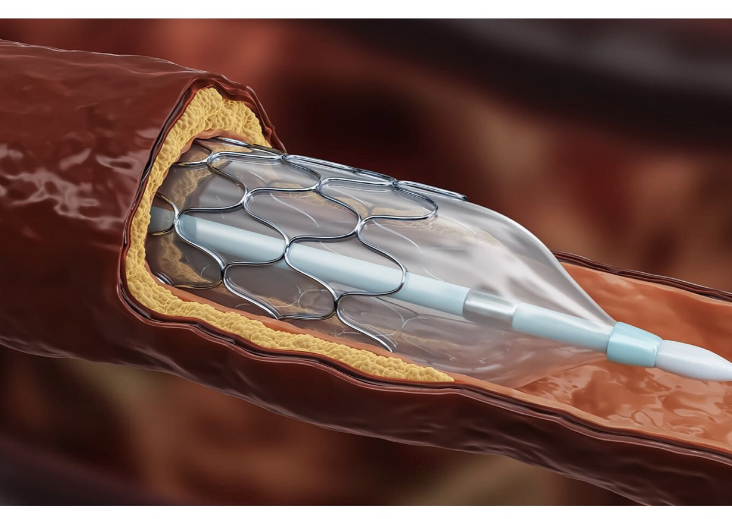
Revascularisation vs optimal medical therapy in CHRONIC CORONARY SYNDROME
DR SANCHNA DEV S
DEPT OF CARDIOLOGY
TDMC

Slide 2
DEFINITION
Stable chest pain - When chest pain symptoms are chronic (≥2 mo) and associated with consistent precipitants such as exertion or emotional stress
Chronic coronary syndrome refers to the spectrum of CAD that is chronic, often progressive, and can be modified by lifestyle adjustments, pharmacological therapies, and invasive interventions designed to achieve disease stabilization or regression.
Chronic coronary syndrome is a replacement term for “stable ischemic heart disease.”(SIHD)
Knuuti J, Wijns W, Saraste A, et al. 2019 ESC guidelines for the diagnosis and management of chronic coronary syndromes. Eur Heart J. 2020;41:407-477

Slide 3
ETIOLOGY
mismatch between myocardial oxygen supply and demand
long-standing atherosclerotic obstruction within the epicardial coronary arteries
microcirculatory dysfunctions
coronary artery vasospasm
congenital anomalies

Slide 4
J Am Coll Cardiol. 2023 Feb, 81 (5) 505–514

Slide 5
BACKGROUND
In patients with stable ischemic heart disease (SIHD), treatment options
revascularization by either percutaneous coronary intervention (PCI) or coronary artery bypass graft surgery (CABG) plus guideline-directed medical therapy
initial management with guideline-directed medical therapy alone
The fundamental goal of such therapies
make the patients live longer
feel better (relieve angina)
a reduction of nonfatal cardiovascular events that ultimately result in improved survival and quality of life

Slide 6
Many randomized clinical trials have attempted to determine whether routine revascularization in SIHD improves prognosis, with varying results.
Clinical trials have shown a mortality benefit of routine revascularization compared with an initial conservative approach in ischemic cardiomyopathy and in acute coronary syndromes.
However, the data to support routine revascularization in patients with SIHD with preserved ejection fraction have been the subject of intense debate.

Slide 8
COURAGE: Clinical Outcomes Utilizing Revascularization and Aggressive Guideline-Driven Drug Evaluation

Slide 9
COURAGE
Hypothesis : PCI + Optimal Medical Therapy will be Superior to Optimal Medical Therapy Alone
Multicentre, open-label , parallel-group, randomized controlled trial
Study period : 1999 to 2004
Setting : 50 centres in US and Canada
Follow-up : 2.5 to 7.0 yrs (median- 4.6)
Primary Outcome : composite of death from any cause and non fatal MI

Slide 10
COURAGE
Inclusion Criteria :
1, 2 or 3 vessel disease ( >70% visual stenosis of proximal coronary segment) , Anatomy suitable for PCI , CCS Class I-III angina , Objective evidence of ischemia at baseline.
Exclusion criteria :
Persistent CCS class IV angina
Markedly positive stress test ( Stage 1 Bruce protocol +ve )
LMCA disease > 50%
Refractory heart failure or cardiogenic shock
EF less than 30%
Revascularization within previous 6 months
Coronary anatomy not suitable for PCI.

Slide 11
Enrollment

Slide 12
Enrollment and Outcomes

Slide 13
BASELINE CLINICAL AND ANGIOGRAPHIC CHAR.
Characteristic | PCI + OMT (N=1149) | OMT (N=1138) | P Value
CLINICAL
Stress test |  |  | 0.84
Total patients - % | 85 % | 86 %
Treadmill test | 57 % | 57 % | 0.84
Pharmacologic stress | 43 % | 43 %
Nuclear imaging - % | 70 % | 72 % | 0.59
Single reversible defect | 22 % | 23 % | 0.09
Multiple reversible defects | 65 % | 68 % | 0.09
ANGIOGRAPHIC
Vessels with disease – % |  |  | 0.72
1, 2, 3 | 31, 39, 30 % | 30, 39, 31 %
Disease in graft | 62 % | 69 % | 0.36
Proximal LAD disease | 31 % | 37 % | 0.01
Ejection fraction | 60.8 ± 11.2 | 60.9 ± 10.3 | 0.86

Slide 14
BASELINE CLINICAL AND ANGIOGRAPHIC CHAR.
Characteristic | PCI + OMT (N=1149) | OMT (N=1138) | P Value
CLINICAL
History – %
Diabetes | 32 % | 35 % | 0.12
Hypertension | 66 % | 67 % | 0.53
CHF | 5 % | 4 % | 0.59
Cerebrovascular disease | 9 % | 9 % | 0.83
Myocardial infarction | 38 % | 39 % | 0.80
Previous PCI | 15 % | 16 % | 0.49
CABG | 11 % | 11 % | 0.94

Slide 15
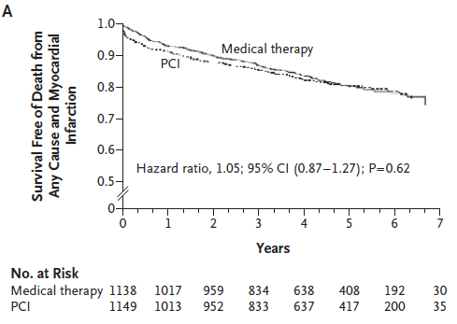
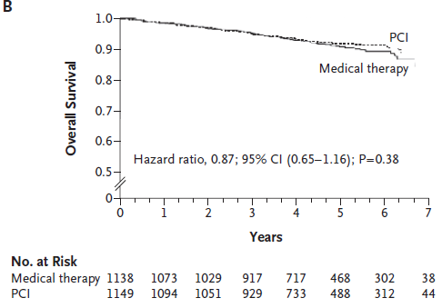
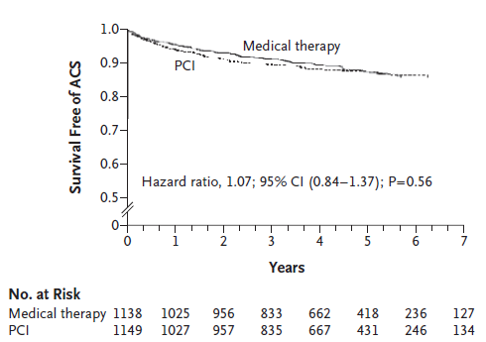
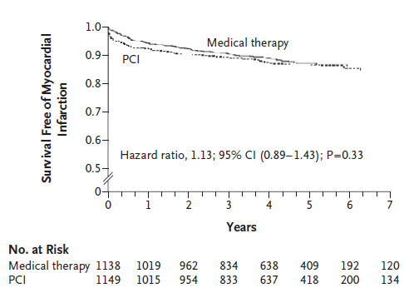
OUTCOME

Slide 16
the estimated 4.6 ­year rate of the composite primary outcome of death from any cause and nonfatal myocardial infarction was 19.0% in the PCI group and 18.5% in the medical­ therapy group.
the estimated 4.6­year rate of death from any cause was 7.6% in the PCI group and 8.3% in the medical ­therapy group.
the estimated 4.6 ­year rate of hospitalization for acute coronary syndrome (ACS) was 12.4% in the PCI group and 11.8% in the medical­ therapy group.
the estimated 4.6­year rate of acute myocardial infarction was 13.2% in the PCI group and 12.3% in the medical therapy group.

Slide 17
Need for Subsequent Revascularisation
At a median 4.6 yr follow-up, 21.1% of the PCI patients required an additional revascularization, compared to 32.6% of OMT group who required a 1st revascularization (P<0.001)
77 pts in the PCI group and 81 pts in OMT group required subsequent CABG surgery
Median time to subsequent revascularization was 10.0 mo in the PCI group and 10.8 mo in the OMT group
Notes:
Revascularization was performed for an- gina that was unresponsive to maximal medical therapy or when there was objective evidence of worsening ischemia on noninvasive testing, at thediscretion of the patient’s physician

Slide 18
Freedom from Angina During Long-Term Follow-up
Characteristic | PCI + OMT | OMT
CLINICAL
Angina free (%)
Baseline | 12% | 13%
1 Yr | 66% | 58%
3 Yr | 72% | 67%
5 Yr | 74% | 72%
The comparison between the PCI group and the medical-therapy group was significant at 1 year ( P<0.001) and 3 years (P=0.02) but not at baseline or 5 years.

Slide 19
CONCLUSION
As an initial management strategy in pts with stable CAD , PCI did not reduce the risk of death, MI or other major CV events when added to OMT
PCI resulted in better angina relief during most of the follow-up period, but medical therapy was also remarkably effective, with no difference in angina-free status at 5 yrs.
Notes:
Vulnerable plaques (precursors of acute coronary syndromes) tend to have thin fibrous caps, large lipid cores, fewer smooth- muscle cells, more macrophages, and less colla- gen, as compared with stable plaques, and are associated with outward (expansive) remodeling of the coronary-artery wall, causing less stenosis of the coronary lumen. As a result, vulnerable plaques do not usually cause significant stenosis before rupture and the precipitation of an acute coronary syndrome.36 By contrast, stable plaques tend to have thick fibrous caps, small lipid cores,ischemia and anginal symptoms and are easily detected by coronary angiography but are less like- ly to result in an acute coronary

Slide 20
LIMITATIONS
The preponderance of male patients (85%) and lack of ethnic diversity (14% patients were non white)
Only 6.3 % of screened pts were randomized.
Among 70% of pts assigned to PCI who had 2-vessel disease, only 36% received > 1 stent.
Only 2.7% were treated with a DES.
32% of OMT patients crossed over to PCI.
Excluded high risk patients.
Post angiography selection bias.

Slide 21
BARI 2D TRIAL

Slide 23
BARI 2D
Randomized, parallel, factorial, stratified
Study period : January 2001, to March 2005
Mean follow up : 5.3 yrs
Primary Endpoint: All- cause mortality at 5 years
Secondary Endpoint: Composite of Death, MI, or Stroke at 5 yrs
2 x 2 factorial randomization to:
Revascularization plus medical therapy (n = 953) versus medical therapy (n = 991)
Insulin-sensitizing treatment of diabetes (n = 977) versus insulin-providing treatment (n = 967; both achieving a similar goal of glycemic control)

Slide 24
BARI 2D
Inclusion criteria:
Diagnosis of both type 2 diabetes & CAD.
CAD diagnosis documented by angiography ( ≥50% stenosis of a major epicardial coronary artery associated with a positive stress test or ≥70% stenosis of a major epicardial coronary artery and classic angina)
All patients had to be candidates for either PCI or CABG
Exclusion criteria :
Pts requiring immediate revascularization or had left main coronary disease
Creatinine level > 2.0 mg/dL
Glycated Hb > 13.0%
Class III or IV heart failure or hepatic dysfunction
Undergone PCI or CABG within the previous 12 months.

Slide 27
BARI 2D - CONCLUSION
Among patients with diabetes and stable coronary artery disease, a strategy of revascularization by PCI or CABG failed to demonstrate superiority to medical therapy over a mean of 5.3 years.
There was also no notable benefit from insulin-sensitizing therapy versus insulin-providing therapy.
There was no association of exposure to rosiglitazone and adverse events.

Slide 29
MASS –II TRIAL

Slide 30
MASS –II TRIAL
MASS –II TRIAL
single-center RCT designed to compare the long-term effects of MT, angioplasty, or surgical strategies among patients with stable angina symptoms of multivessel CAD and preserved ventricular function who are appropriate candidates for all 3 therapies.
Study period : May 1995 and May 2000
Inclusion criteria: Pts with angiographically documented proximal multivessel coronary stenosis of more than 70% by visual assessment and documented ischemia.
Exclusion criteria: Unstable angina or acute MI , ventricular aneurysm requiring surgical repair, LVEF < 40% , history of PCI or CABG and single-vessel disease.
Primary end point : cardiac mortality, Q-wave myocardial infarction (MI) or refractory angina requiring revascularization.

Slide 31
MASS –II TRIAL
Database :20,769 coronary angiographies
Eligible: 2,076 patients (suitable to PCI-CABG)
Randomised 611 patients
Angioplasty
(n=205)
Surgery
(n=203)
Medical Treatment
(n=203)
Hueb W, et al. J Am Coll CardioI 2004; 43:1743-51

Slide 32
Baseline characteristics of MASS II

Slide 33
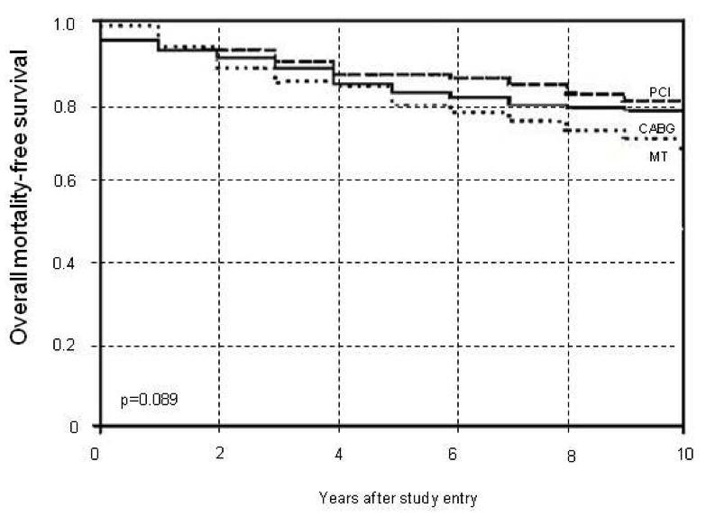
Overall Mortality-Free Survival

Slide 34
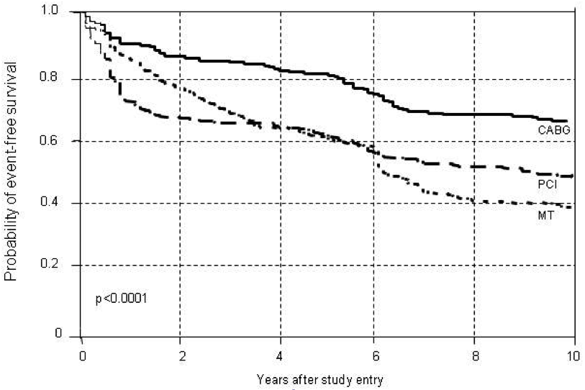
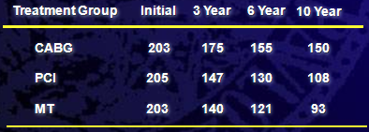
Ten-Year Follow-up Event-free Survival

Slide 35
CONCLUSION
All three groups had similar rates of overall mortality.
Compared with CABG, angioplasty was associated with elevated rate of myocardial infarction and need for revascularization.
Medical therapy showed significant incidence of myocardial infarction and high rate of additional revascularization.

Slide 36
Limitations of MASS-II Trial
Single center study
Small number of subjects
No DES usage
Post-angiography selection bias

Slide 37
STICH TRIAL– SURGICAL TREATMENT OF ISCHAEMIC HEART FAILURE

Slide 38
STICH TRIAL
Randomized controlled trial, non-blinded
Study period : July 2002 and May 2007
A total of 1212 pts were randomly assigned to medical therapy alone (602 patients) or medical therapy plus CABG (610 pts).
Primary Endpoint
All-cause mortality
Major Secondary Endpoints
Cardiovascular mortality
Death (all-cause) + cardiovascular hospitalization

Slide 39
STICH TRIAL
Inclusion criteria
Pts with coronary artery disease that was amenable to CABG and EF of 35% or less
Medical therapy eligible
Absence of left main CAD as defined by an intraluminal stenosis of ≥ 50%
Absence of CCS III angina or greater (angina markedly limiting ordinary activity)
Exclusion criteria
Recent acute MI (within 30 dys) ,Cardiogenic shock (within 72 hrs of randomization) , Plan for percutaneous intervention , Aortic valve disease requiring repair or replacement , Life expectancy of < 3 yrs .

Slide 43
CONCLUSION
No significant difference between the two study groups with respect to the primary end point of the rate of death from any cause.
The rates of death from cardiovascular causes and of death from any cause or hospitalization for cardiac causes were lower among patients assigned to CABG than among those assigned to medical therapy

Slide 44
FAME 2
Trial design: Patients with stable angina who were appropriate candidates for PCI and had a fractional flow reserve (FFR) value ≤0.80 were randomized to either PCI + optimal medical therapy (OMT) or OMT alone.
Patients were followed for a mean of 7 months.
RESULTS-
Trial was terminated early. Primary endpoint (death/ MI/ urgent revascularization) for PCI + OMT vs. OMT: 4.3% vs. 12.7%, HR 0.32, 95% CI 0.19-0.53, p < 0.001
Mortality: 0.2% vs. 0.7%, p = 0.31; MI: 3.4% vs. 3.2%, p = 0.89; urgent revascularization: 1.6% vs. 11.1%, p < 0.001
Highest benefit if lesion FFR <0.65

Slide 45
Conclusions
FFR-guided PCI + OMT was superior to OMT in patients with stable angina, mainly due to a reduction in need for urgent revascularization
These results suggest that a positive FFR may be a good method to risk stratify these patients

Slide 46
ISCHAEMIA- International Study of Comparative Health Effectiveness with Medical and Invasive Approaches

Slide 50
Conclusion
Over a median of 3.2 years of follow-up, among patients with stable coronary disease who had moderate or severe ischemia on stress testing, an initial invasive strategy, as compared with an initial conservative strategy, did not reduce the rates of the primary composite outcomes.
Patients in the invasive-strategy group had more procedural infarctions, and they had fewer nonprocedural infarctions during follow-up.
The incidence of death from any cause was low and similar in the two groups
the initial invasive strategy did not reduce the risk of ischemic cardiovascular events or death from any cause

Slide 51
14 RCTs - randomized a total of 14877 patients followed for a weighted mean of 4.5 years
Most trials enrolled patients with preserved left ventricular systolic function (ejection fraction 35% or greater) and less symptomatic patients (Canadian Cardiovascular Society Class I/II) and excluded patients with left main disease

Slide 52
In the revascularization arm, any revascularization was performed in 87.5% of patients -PCI was the first procedure in 71.3% of patients, and CABG was the first procedure in 16.2%
In 8 trials (BARI 2D, COURAGE, MASS-2, TIME, ISCHEMIA, ISCHEMIA-CKD, FAME 2, JSAP) stents were used in at least 50% of patients undergoing PCI.
Drug-eluting stents were mainly used in 3 trials (FAME 2, ISCHEMIA, and ISCHEMIA- CKD).
Revascularization was performed in 31.9% of patients in the medical therapy alone group during 4.5 years of mean follow up

Slide 53
CONCLUSION
NO MORTALITY BENEFIT FROM ROUTINE REVASCULARISATION
In patients with SIHD, routine revascularization was not associated with improved survival but was associated with a lower risk of nonprocedural MI and unstable angina with greater freedom from angina at the expense of higher rates of procedural MI.
Longer-term follow-up of trials is needed to assess whether reduction in these nonfatal spontaneous events improves long- term survival

Slide 54
Guideline recommendations- ACC/AHA 2021

Slide 55
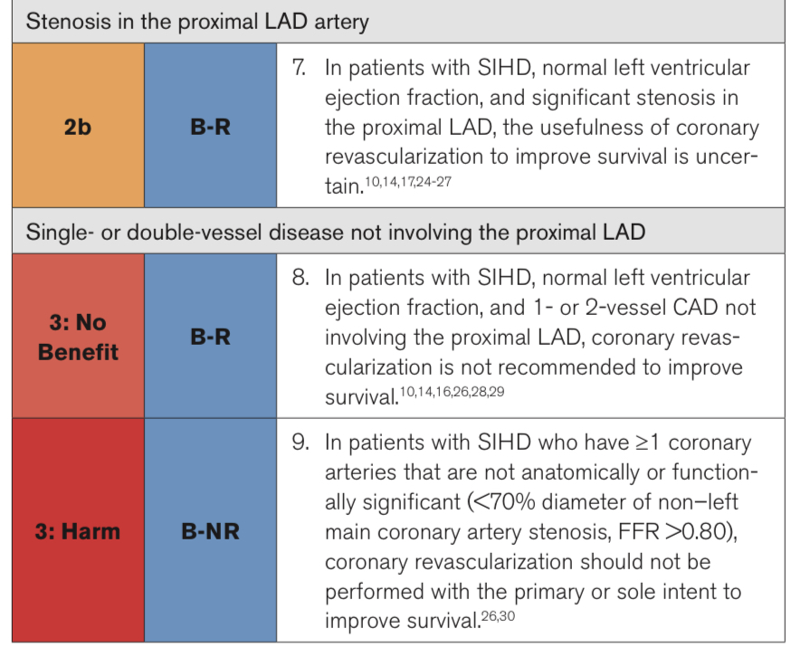
ACC/AHA 2021

Slide 56
ESC 2018

Slide 57
ESC 2018

Slide 58
Q. Odd one out
COURAGE TRIAL
ISCHAEMIA TRIAL
COMPLETE TRIAL
MASS-II TRIAL

Slide 59
Q. Systolic dysfunction was an exclusion criteria in all except:
COURAGE TRIAL
ISCHAEMIA TRIAL
STICH TRIAL
MASS-II TRIAL

Slide 60
FFR was used in guiding revascularisation in
COURAGE TRIAL
ISCHAEMIA TRIAL
FAME-2 TRIAL
MASS-II TRIAL

Slide 61
Not a limitation of COURAGE TRIAL
Only 2.7% were treated with a DES
The preponderance of female patients
lack of ethnic diversity
Excluded high risk patients

Slide 62
ROSIGLITAZONE effect on cardiovascular outcome was studied in :
COURAGE TRIAL
ISCHAEMIA TRIAL
FAME-2 TRIAL
BARI -2D TRIAL

