Slide 1
Study of Dietary Intervention Under 100 MMOL in Heart Failure
Dr Shreyas Samaga
Dept of Cardiology
Govt TD Medical College

Slide 2
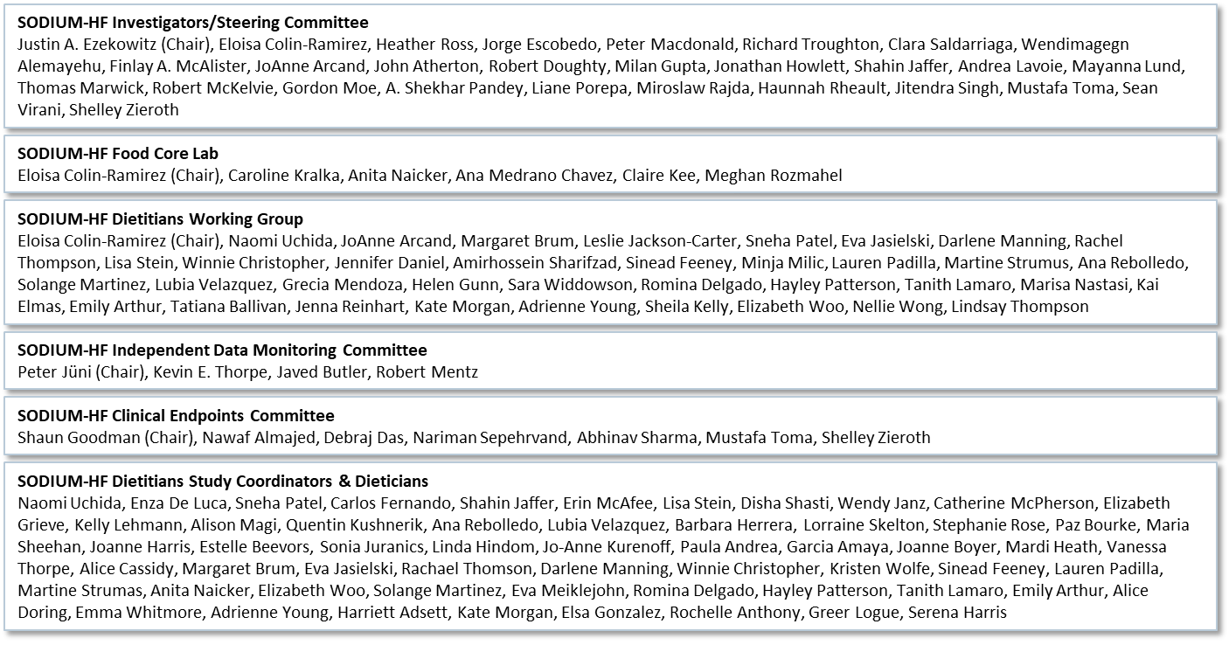
SODIUM-HF team

Slide 3
Heart Failure and Dietary Sodium
HF is associated with:
neurohormonal activation
abnormalities in autonomic control
sodium and water retention
Clinicians have focused on dietary sodium and water restriction to minimize the risk of volume overload for > 100 years
Little evidence supports this practice

Slide 4
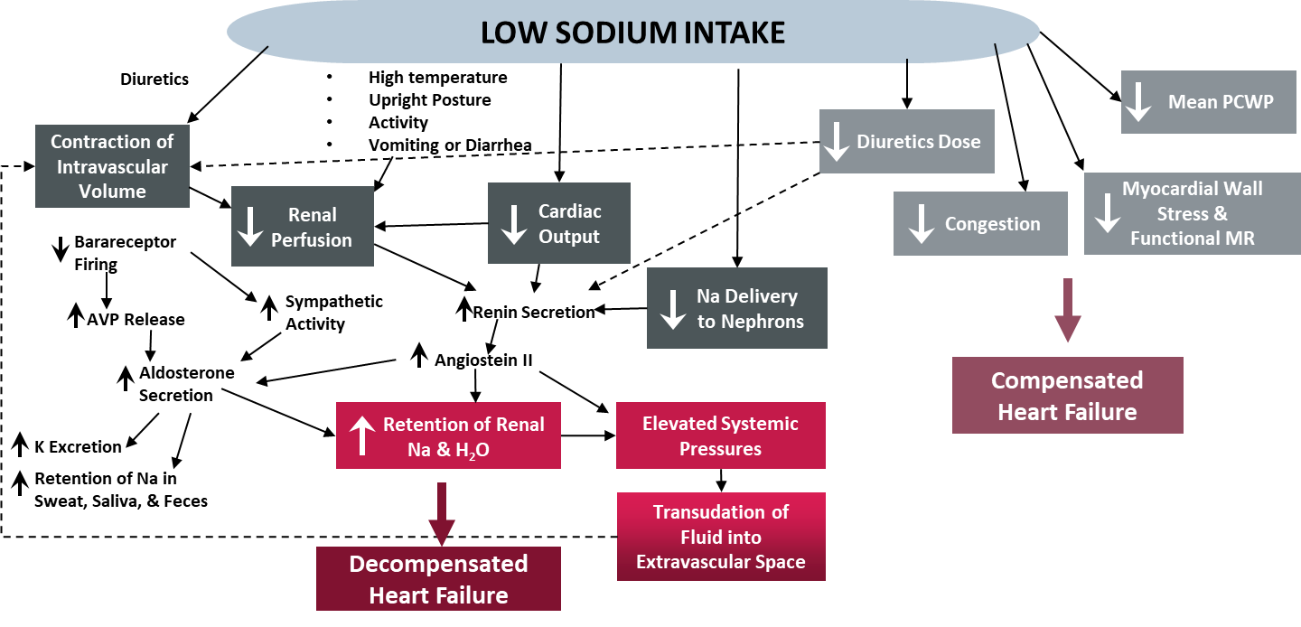
Dietary Sodium Intake
Gupta et al. Circulation 2012

Slide 5
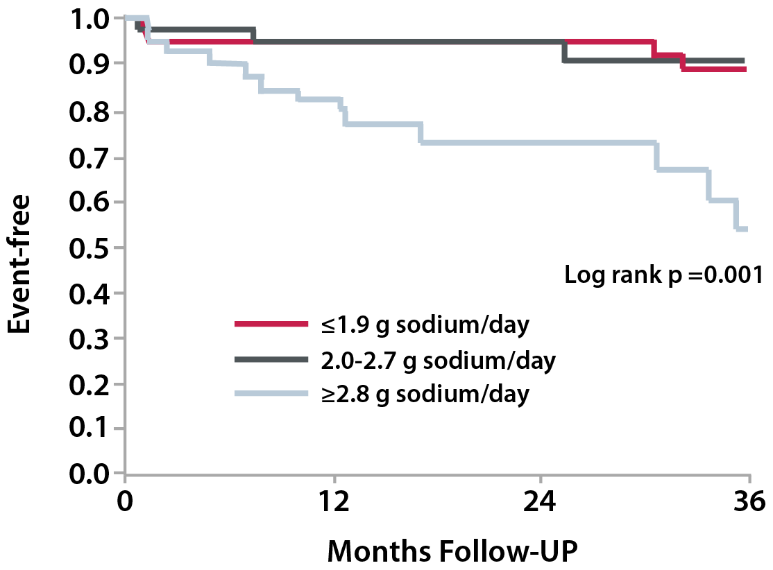
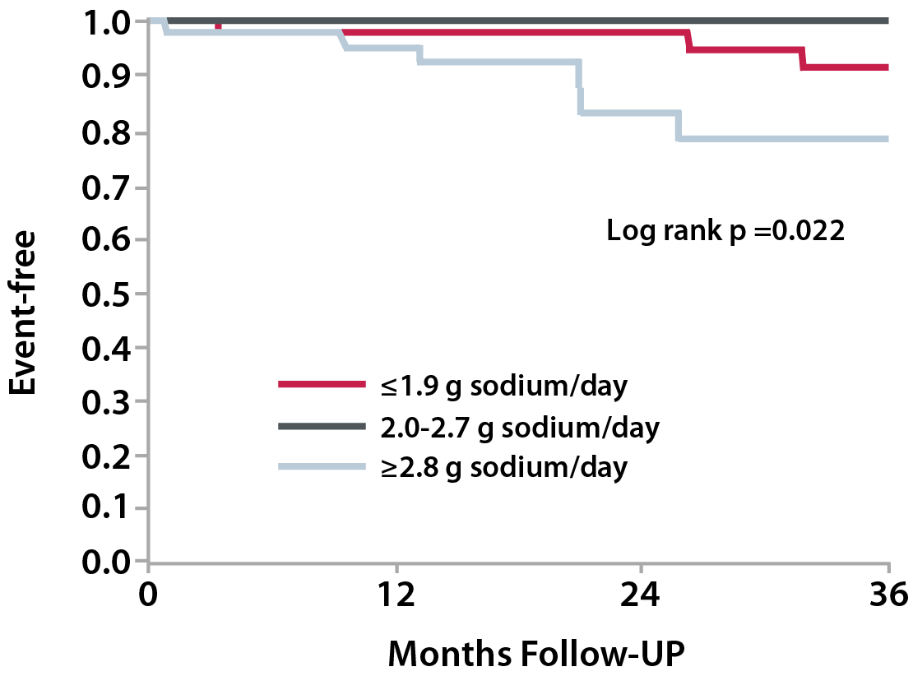
Dietary sodium: Observational studies
HF Hospitalization
Mortality
n= 123 patients with HF
Arcand et al. Am J Clin Nutr. 2011.

Slide 6
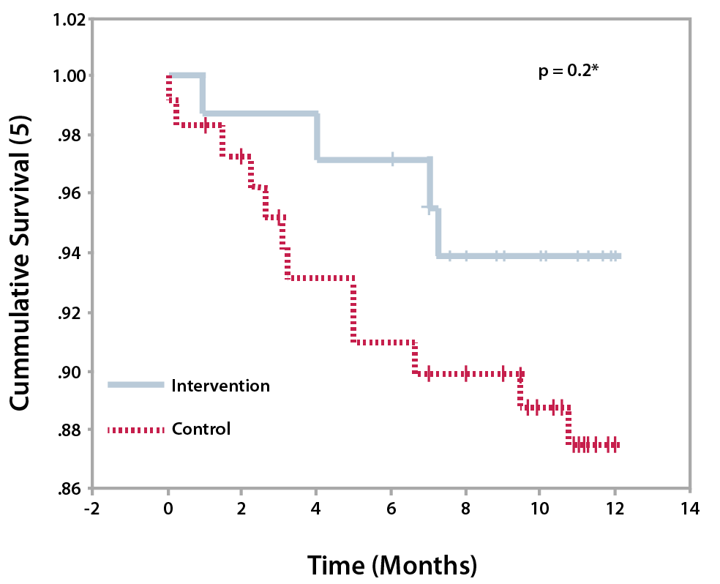
Dietary sodium reduction: RCT
n= 195 patients with HF, Outpatient, Mexico city
Systematic review:
9 studies
All < 100 patients Mixed interventions
No consistent results on any outcome
Intervention group: Dietary recommendations for sodium restriction to <2400 mg/day provided by a dietitian.
Control Group: Usual dietary recommendations for dietary sodium reduction.
Colin et al. Rev Chil Nutr, 2010.
Mahtani JAMA: Internal Medicine 2018

Slide 7
SODIUM-HF Objectives
Evaluate the effects of a low-sodium diet, compared to usual care, in patients with HF, on a 12 month outcome of:
Primary Endpoint: Composite clinical outcome of All-cause mortality, CV hospitalizations, CV ED visits
Secondary Endpoints:
Quality of life (by KCCQ)
Exercise capacity (by 6MWT)
NYHA class
Colin-Ramirez, AHJ, 2018

Slide 8
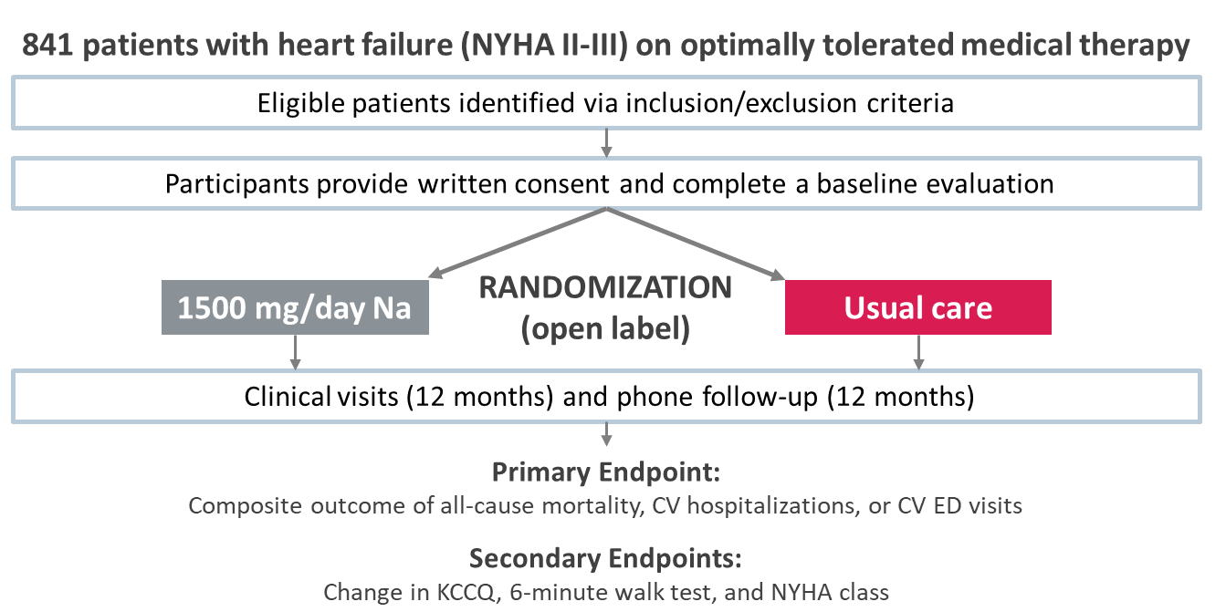
SODIUM-HF: Trial Design
Colin-Ramirez, AHJ, 2018

Slide 9
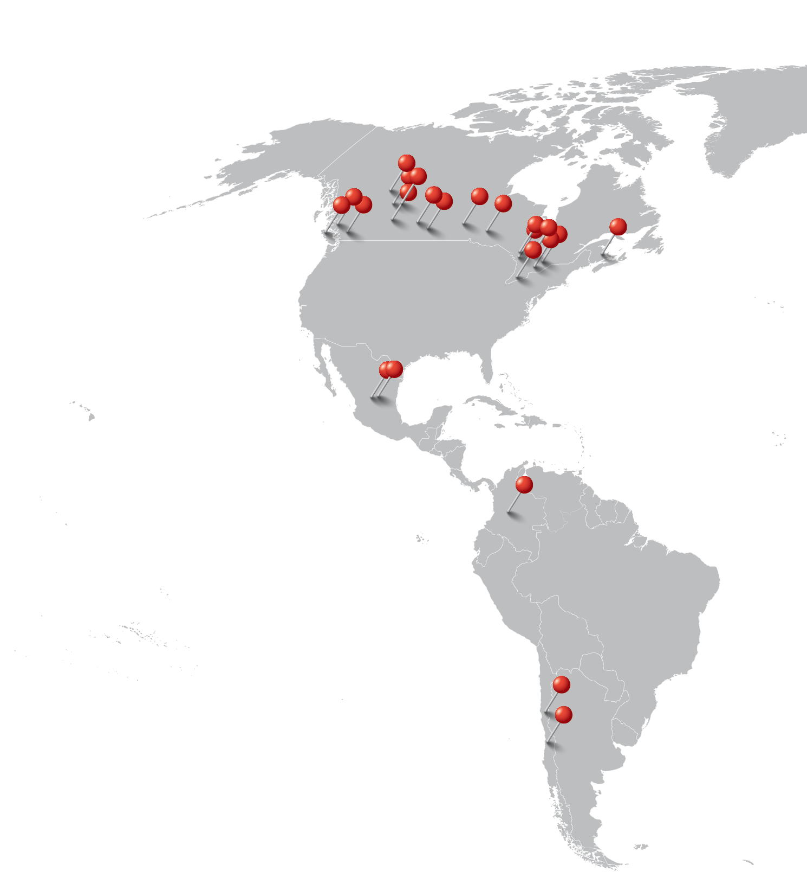
SODIUM-HF: Sites
26 sites
Canada, Mexico, Chile, Colombia, Australia, New Zealand

Slide 10
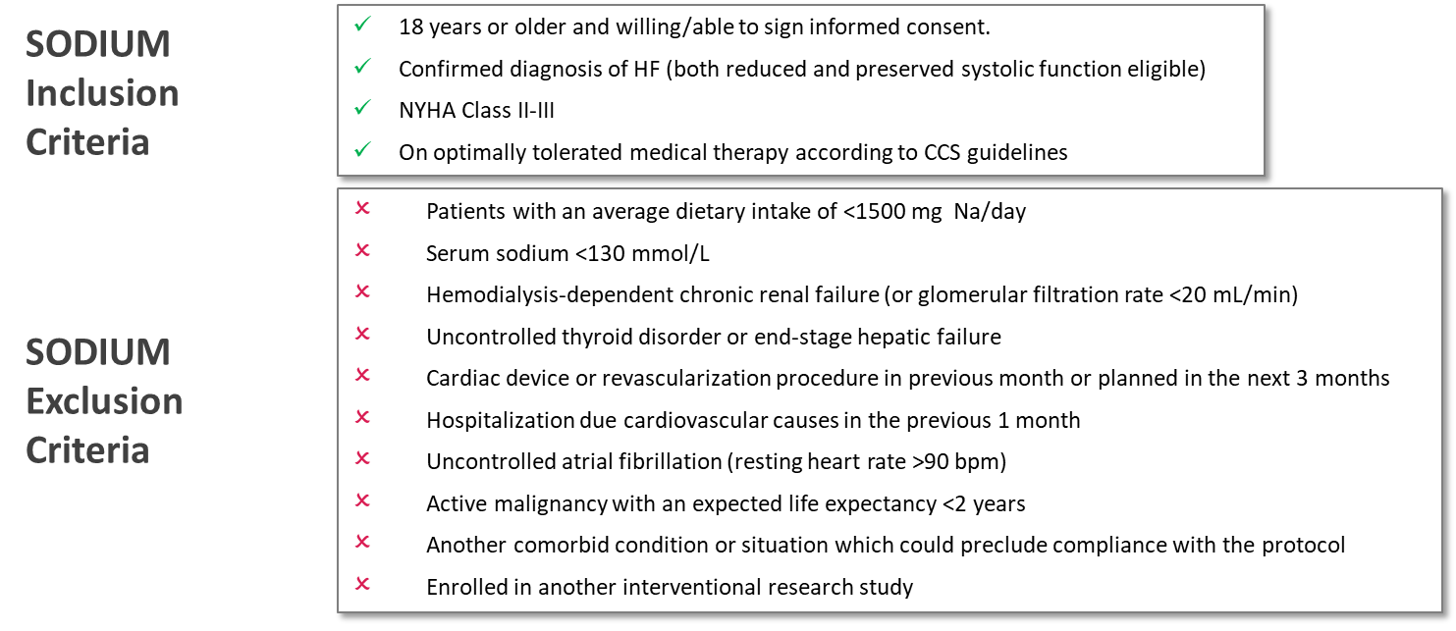
SODIUM-HF: In/Exclusion criteria
Colin-Ramirez, AHJ, 2018

Slide 11
SODIUM-HF: Intervention
Patients randomized to one of two study arms:
Low-sodium containing diet
<1500 mg daily (<65 mmol/daily)
Usual care
general advice to limit dietary sodium as provided in routine clinical practice
Colin-Ramirez, AHJ, 2018

Slide 12
SODIUM-HF: Intervention
Samples of menus at different levels of energy requirement (1400-2200 kcal)
Patient might interchange any of the food items included in the menus by another one included in the recommended foods lists of the same food group that the original one included in the menu.
Food individualized to local region/country
If energy requirements were adjusted during a follow-up visit, new sample menus were provided.
3 day food records for each visit
Colin-Ramirez, AHJ, 2018 Colin-Ramirez, CJC Open, 2019

Slide 13
SODIUM-HF: Baseline Characteristics
 | Low sodium diet group n=397 | Usual care group n=409
Age, years | 66 (57–73) | 67 (58–75)
Female Sex | 127 (32%) | 141 (34%)
Geographical region
Canada | 230 (58%) | 241 (59%)
Australia and New Zealand | 79 (20%) | 78 (19%)
Mexico, Chile, and Colombia | 88 (22%) | 90 (22%)
Diagnosed with HF for ≥1 year | 269 (68%) | 282 (69%)
Hospitalised for HF in past 12 months | 129 (32%) | 141 (34%)
Ejection fraction | 36 (28–48) | 35 (27–50)

Slide 14
SODIUM-HF: Baseline Characteristics
 | Low sodium diet group n=397 | Usual care group n=409
Medical history
Coronary artery disease | 187 (47%) | 186 (45%)
Atrial fibrillation or flutter | 156 (39%) | 173 (42%)
Diabetes (type 1 or 2) | 132 (33%) | 156 (38%)
Vital signs and physical findings
BMI, kg/m² | 30 (26–35) | 31 (27–36)
Heart rate, beats per min | 69 (61–76) | 69 (61–77)
Systolic blood pressure, mm Hg | 118 (105–129) | 118 (104–130)
Laboratory values
eGFR, mL/min per 1·73m² | 61 (46–75) | 58 (42–71)

Slide 15
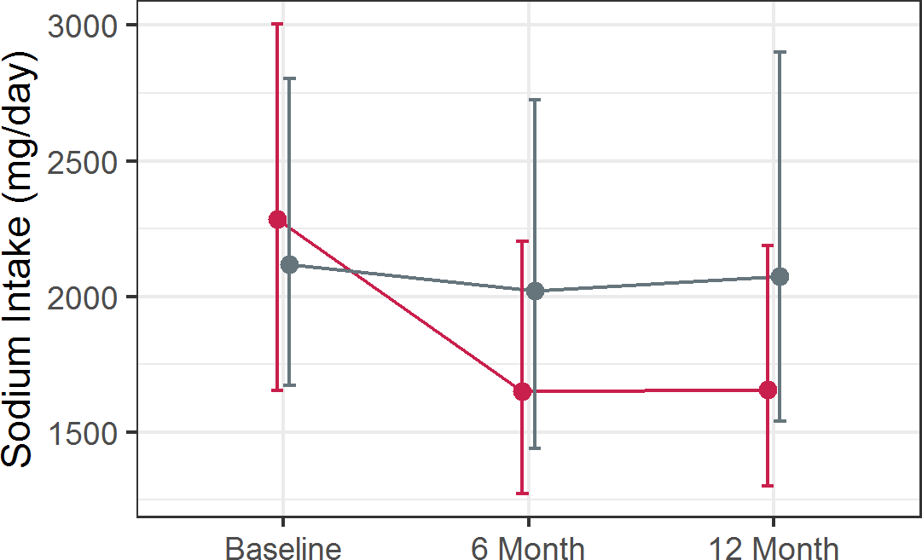
Dietary sodium intake
P=0.45
P<0.0001
P<0.0001
usual care low sodium
2073
415 mg/d
1658

Slide 16
Outcomes

Slide 17
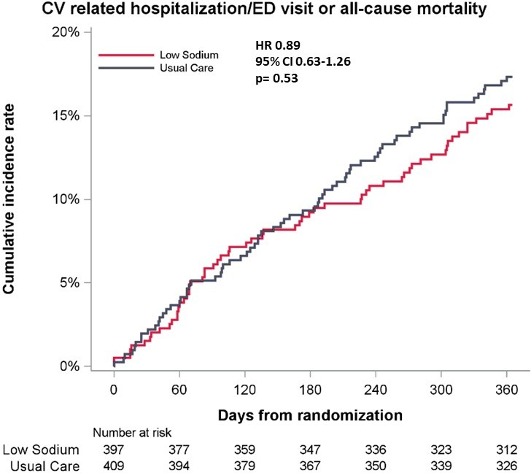
Primary Outcome

Slide 18
The primary outcome, all-cause mortality, or cardiovascular emergency department visit/hospitalization at 12 months, occurred in 15% of the low-sodium group vs. 17% of the usual care group (hazard ratio [HR] 0.89, p = 0.53).

Slide 19
Secondary Outcomes

Slide 20
All-cause mortality at 12 months: 6% of the low-sodium group vs. 4% of the usual care group (HR 1.38, p = 0.32)

Slide 21
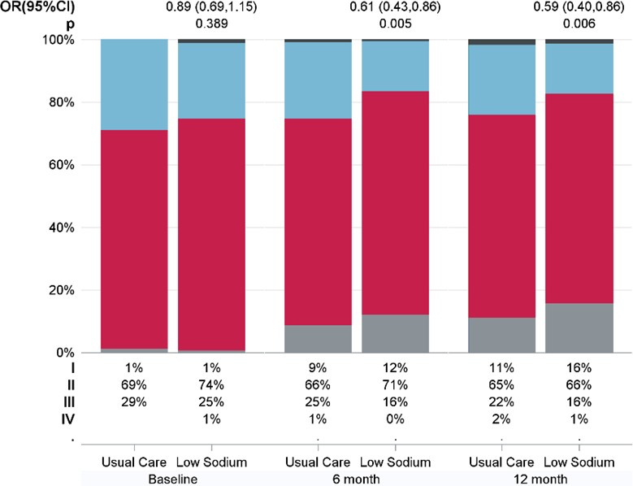
Change in NYHA class
IV III
NYHA class: I
II III IV
II
I

Slide 22
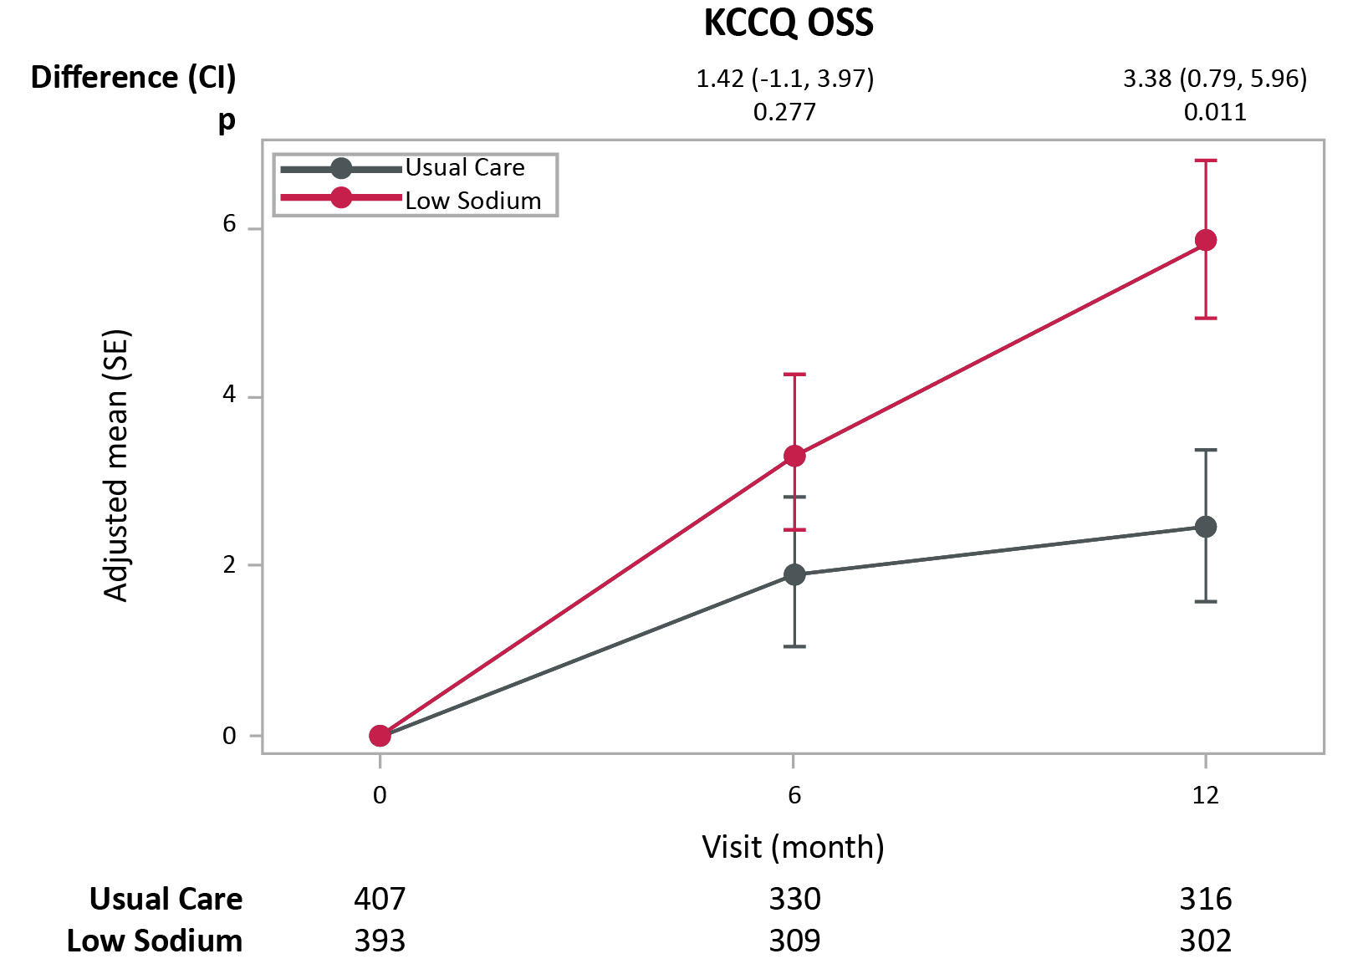
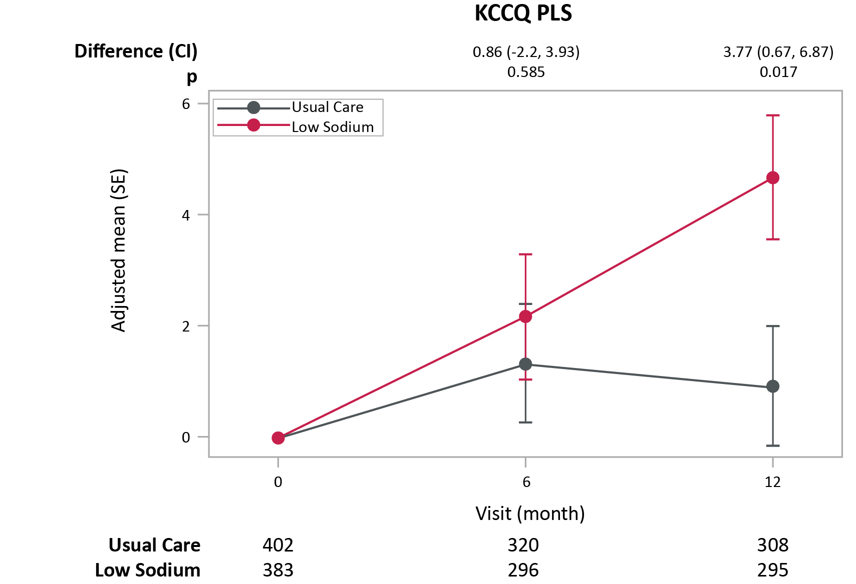
Change in KCCQ score

Slide 23
The difference in the adjusted mean Kansas City Cardiomyopathy Questionnaire (KCCQ) overall summary score at 12 months was 3.38 points greater in the low-sodium group vs. usual care group (p = 0.011).

Slide 24
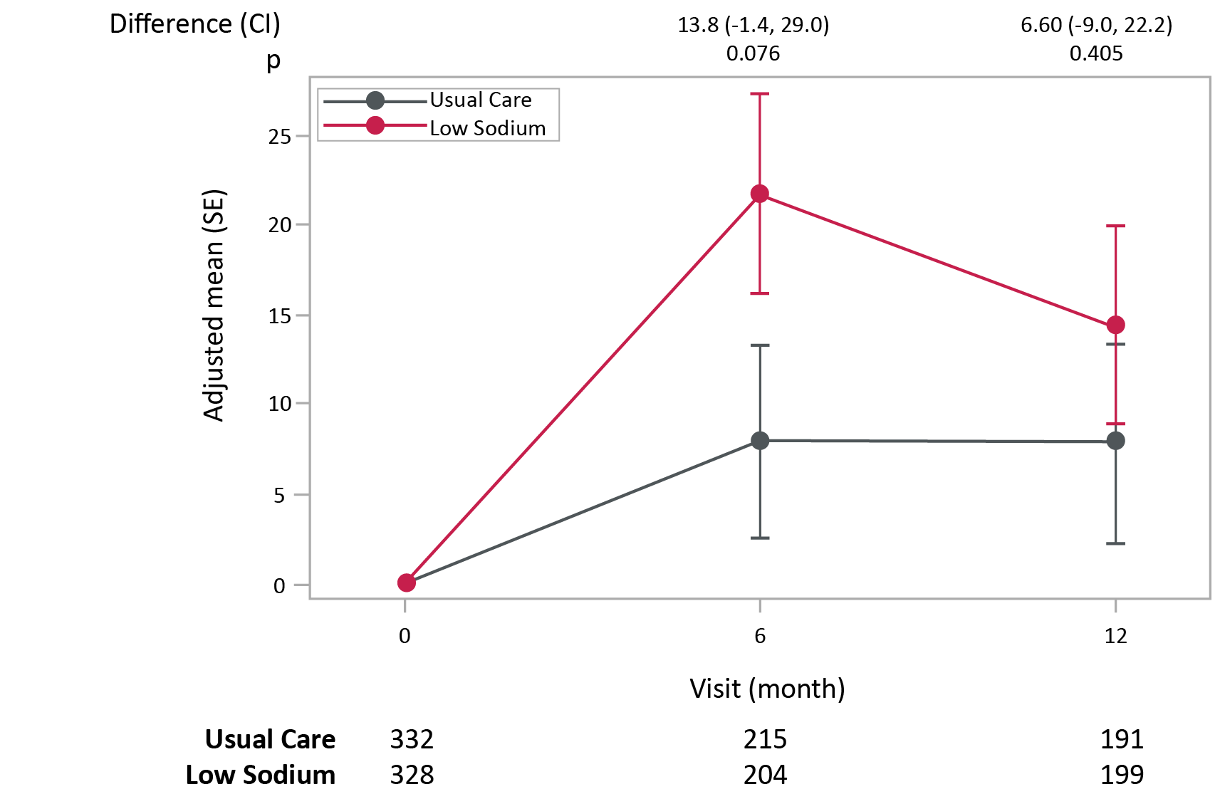
Change in 6 min walk test distance

Slide 25
The difference in the adjusted mean 6-minute walk test at 12 months was 6.6 minutes greater in the low-sodium group vs. usual care group (p = 0.41).

Slide 26
Limitations
There was a sodium reduction of 415 mg / day by 12 months, and greater reductions in daily sodium or alternatively, enrolling patients with markedly higher dietary sodium may or may not produce different results.
The trial was stopped early
Lower than anticipated event rate
Inclusion criteria were pragmatic and no NT-proBNP required

Slide 27
Conclusions
In ambulatory patients with HF, a dietary intervention to reduce sodium intake did not reduce clinical events.
There was a modest benefit on quality of life as measured by the KCCQ, and in NYHA class.
The 6-minute walk test was not statistically different between groups.

Slide 28
Implications
A low-sodium diet as done in SODIUM-HF:
Clinicians: as a therapy to improve QOL
Patients: as part of an overall health strategy
Guidelines: informs with best evidence

Slide 30
THANKYOU……..

