Slide 1
A Randomized Trial of Intensive versus Standard Blood-Pressure Control
Dr Aswin Narendran

Slide 3
Hypertension affects approximately 1 billion adults worldwide.
Among persons 50 years of age or older, isolated systolic hypertension is the most common form of hypertension
Systolic blood pressure becomes more important than diastolic blood pressure as an independent risk predictor for coronary events, stroke, heart failure, and end-stage renal disease (ESRD).

Slide 4
Treatment of hypertension reduces the risk of cardiovascular disease outcomes, including incident stroke (by 35 to 40%), myocardial infarction (by 15 to 25%), and heart failure (by up to 64%).
However, the target for systolic blood-pressure lowering is uncertain.

Slide 5
Study Design
SPRINT was a randomized, controlled, open-label trial that was conducted at 102 clinical sites (organized into 5 clinical center networks) in the United States

Slide 6
SPRINT Research Question
Examine effect of more intensive high blood pressure treatment than is currently recommended
Randomized Controlled Trial
Target Systolic BP Intensive Treatment Goal SBP < 120 mm Hg
Standard Treatment Goal SBP < 140 mm Hg

Slide 7
Major Inclusion Criteria
≥50 years old
Systolic blood pressure : 130 – 180 mm Hg (treated or untreated)
Additional cardiovascular disease (CVD) risk
Clinical or subclinical CVD (excluding stroke)
Chronic kidney disease (CKD), defined as eGFR 20 – <60 ml/min/1.73m2
Framingham Risk Score for 10-year CVD risk ≥ 15%
Age ≥ 75 years (At least one)

Slide 8
Major Exclusion Criteria
Stroke
Diabetes mellitus
Polycystic kidney disease
Congestive heart failure (symptoms or EF < 35%)
Proteinuria >1g/d
CKD with eGFR < 20 mL/min/1.73m2 (MDRD)
Adherence concerns

Slide 10
Demographic and Baseline Characteristics

Slide 14
Primary Outcome and Primary Hypothesis
Primary outcome
CVD composite: first occurrence of
Myocardial infarction (MI)
Acute coronary syndrome (non-MI ACS)
Stroke
Acute decompensated heart failure (HF)
Cardiovascular disease death
Primary hypothesis
CVD composite event rate lower in intensive compared to standard treatment

Slide 15
Additional Outcomes
All-cause mortality
Primary outcome + all-cause mortality
Renal
Main secondary outcome:
Participants with CKD at baseline: incidence of decline in eGFR ≥50% or ESRD
Additional secondary outcomes:
Participants without CKD at baseline: incidence of decline in eGFR ≥30% (to <60 mL/min/1.73m²)
Participants with or without CKD at baseline: Incidence of albuminuria

Slide 16
Follow-up Assessment of Selected Measures
CVD outcomes
Pre-specified diagnostic criteria
Ascertainment method identical in both treatment arms
Structured interview every 3 months
Possible events adjudicated by a panel of experts, blinded to treatment assignment
Fatal events
Structured approach to collection of information
Cause of death adjudicated by the panel of experts, blinded to treatment assignment
Safety events
Could be reported at any SPRINT visit
Observers aware of treatment assignment
Labs: blood chemistries and urine albumin/creatinine

Slide 17
BP Intervention
BP monitored monthly for 3 months and every 3 months thereafter (additional visits could be scheduled)
Antihypertensive medication titration decisions based on mean BP
(3 readings at each visit), using a structured stepped-care approach
Agents from all major antihypertensive drug classes available free of charge
Periodic assessment for orthostatic hypotension and related symptoms

Slide 18
Intensive Treatment

Slide 19
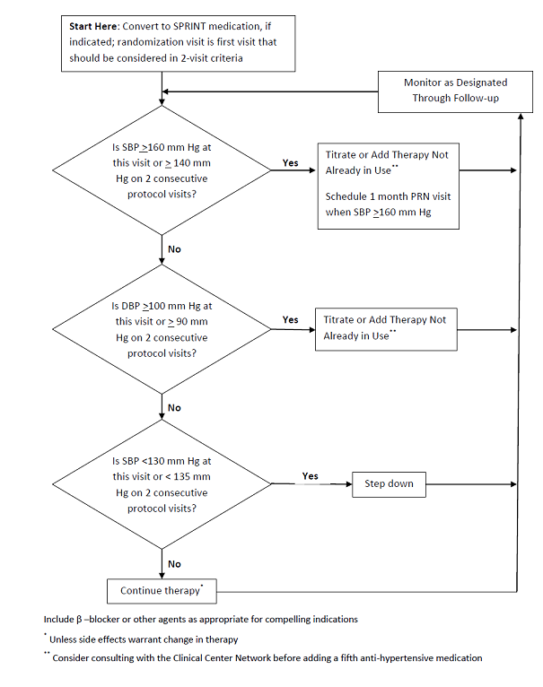
Standard Treatment

Slide 21
Systolic BP During Follow-up

Slide 23
The trial was terminated early due to overwhelming evidence of benefit.
The primary outcome, myocardial infarction (MI), acute coronary syndrome (ACS), stroke, congestive heart failure (CHF), or cardiovascular (CV) death, was significantly lowered in the intensive BP management arm compared with the routine management arm (5.2% vs. 6.8%, hazard ratio [HR] 0.75, 95% confidence interval [CI] 0.64–0.89; p < 0.0001).

Slide 24
Individual components (event rates for intensive vs. routine management, absolute event rates):
MI: 2.1% vs. 2.5%, p = 0.19
ACS: 0.9% vs. 0.9%, p = 0.99
Stroke: 1.3% vs. 1.5%, p = 0.5
CHF: 1.3% vs. 2.1%, p = 0.002
CV death: 0.8% vs. 1.4%, p = 0.0005

Slide 25
Important secondary endpoints for intensive vs. routine BP control, absolute event rates:
Mortality: 3.3% vs. 4.5%, p = 0.0003
Among patients with chronic kidney disease: composite renal endpoint (decrease in GFR ≥50%, need for HD, renal transplant); 1.1% vs. 1.1%, p = 0.76
Among patients without CKD: ≥30% decline in GFR to <60 ml/min: 3.8% vs. 1.1%, p < 0.001
Hypotension: 2.4% vs. 1.4%, p = 0.001
Syncope: 2.3% vs. 1.7%, p = 0.05
Hyponatremia: 3.8% vs. 2.1%, p < 0.001

Slide 26
SPRINT Primary Outcome Cumulative Hazard
Hazard Ratio = 0.75 (95% CI: 0.64 to 0.89)
Standard
(319 events)
Intensive
(243 events)
During Trial (median follow-up = 3.26 years)
Number Needed to Treat (NNT)
to prevent a primary outcome = 61
Number of
Participants

Slide 27
All-cause Mortality Cumulative Hazard
Hazard Ratio = 0.73 (95% CI: 0.60 to 0.90)
Standard
(210 deaths)
Adapt from Figure 2B in the N Engl J Med manuscript
Intensive
(155 deaths)
During Trial (median follow-up = 3.26 years)
Number Needed to Treat (NNT)
to Prevent a death = 90
Include NNT
Number of
Participants
Intensive

Slide 29
SPRINT Primary Outcome and its Components Event Rates and Hazard Ratios
 | Intensive |  | Standard
 | No. of Events | Rate, %/year | No. of Events | Rate, %/year | HR (95% CI) | P value
Primary Outcome | 243 | 1.65 | 319 | 2.19 | 0.75 (0.64, 0.89) | <0.001
All MI | 97 | 0.65 | 116 | 0.78 | 0.83 (0.64, 1.09) | 0.19
Non-MI ACS | 40 | 0.27 | 40 | 0.27 | 1.00 (0.64, 1.55) | 0.99
All Stroke | 62 | 0.41 | 70 | 0.47 | 0.89 (0.63, 1.25) | 0.50
All HF | 62 | 0.41 | 100 | 0.67 | 0.62 (0.45, 0.84) | 0.002
CVD Death | 37 | 0.25 | 65 | 0.43 | 0.57 (0.38, 0.85) | 0.005

Slide 30
Primary Outcome Experience in the Six Pre-specified Subgroups of Interest

Slide 32
Renal Disease Outcomes
 |  | Intensive |  | Standard
 |  | Events | %/yr | Events | %/yr | HR (95% CI) | P
Participants with CKD at Baseline
 | Primary CKD outcome | 14 | 0.33 | 15 | 0.36 | 0.89 (0.42, 1.87) | 0.76
 | ≥50% reduction in eGFR* | 10 | 0.23 | 11 | 0.26 | 0.87 (0.36, 2.07) | 0.75
 | Dialysis | 6 | 0.14 | 10 | 0.24 | 0.57 (0.19, 1.54) | 0.27
 | Kidney transplant | 0 | - | 0 | - | - | .
 | Secondary CKD Outcome
 | Incident albuminuria** | 49 | 3.02 | 59 | 3.90 | 0.72 (0.48, 1.07) | 0.11
Participants without CKD at Baseline
 | Secondary CKD outcomes
 | ≥30% reduction in eGFR* | 127 | 1.21 | 37 | 0.35 | 3.48 (2.44, 5.10) | <.0001
 | Incident albuminuria** | 110 | 2.00 | 135 | 2.41 | 0.81 (0.63, 1.04) | 0.10
*Confirmed on a second occasion ≥90 days apart **Doubling of urinary albumin/creatinine ratio from <10 to >10 mg/g

Slide 33
Serious Adverse Events(SAE) During Follow-up

Slide 35
Interpretation
Among adults with hypertension but without diabetes, lowering systolic blood pressure to a target goal of less than 120 mm Hg, as compared with the standard goal of less than 140 mm Hg, resulted in significantly lower rates of fatal and nonfatal cardiovascular events and death from any cause.
25% lower relative risk of the primary outcome;
heart failure (38% lower relative risk), death from cardiovascular causes (43% lower relative risk), and death from any cause (27% lower relative risk).

Slide 36
Limitations
The lack of generalizability to populations not included in the study — such as persons with diabetes, those with prior stroke, and those younger than 50 years of age
No enrollment of older adults residing in nursing homes or assisted-living facilities.
In addition, the effects of the lower blood pressure on the central nervous system and kidney could not be reasonably interpreted

Slide 37
Summary and Conclusions
SPRINT examined effects of more intensive antihypertensive therapy than currently recommended
Participants were US adults ≥50 years with hypertension and additional risk for CVD
Rapid and sustained difference in SBP achieved between the two treatment arms
Trial stopped early, due to benefit, after median follow-up of 3.26 years

Slide 38
Incidence of primary outcome (composite of CVD events) 25% lower in Intensive compared to Standard Group and all-cause mortality reduced by 27%.
In participants with CKD at baseline, no differences in renal outcomes
In participants without CKD at baseline, incidence of eGFR reduction ≥ 30% more common in Intensive Group

Slide 39
No overall difference in serious adverse events (SAEs) between treatment groups
SAEs associated with hypotension, syncope, electrolyte abnormalities, and hospital discharge reports of acute kidney injury or acute renal failure more common in Intensive Group
Overall, benefits of more intensive BP lowering exceeded the potential for harm

Slide 44
THANK YOU

