Slide 1
ACCESORY PATHWAY LOCALISATION
DR KANNAN

Slide 2
The cardiac skeleton consists of four rings of dense connective tissue that surround the AV canals (mitral and tricuspid) and extend to the origins of the aorta and the pulmonary trunk,
providing structure and support for the heart &
electrical isolation between the atria and the ventricles.

Slide 3
aberrant muscle bundles that connect the atria to the ventricles outside of the normal AV conduction system.
found most often in the parietal AV junctional areas, including the paraseptal areas.
They breach the insulation

Slide 4
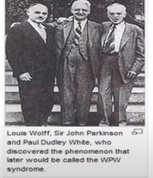
WPW
1930-Wolff,Parkinson and White described
Holz Mann and Schraf → first to describe our understanding of WPW syndrome and its reentry mechanism
1967—Cob et al succesfully ablated accesory pathwya during open heart surgery
1984→ first succesful catheter ablation of accesory pathway → Morady and Scheimann

Slide 5
PR interval less than 120ms during sinus rhythm
QRS> 120ms with delta wave
Secondary ST-T changes directed in opposite direction to major delta and QRS vectors

Slide 6
DELTA WAVE
The delta wave is the most important finding in the WPW pattern
depicts slow conduction through the bypass tract and ventricular myocardium between the site of bypass tract insertion and the site at which ventricular activation proceeds via the rapidly conducting Purkinje system

Slide 7
Clinical Significance
WPW pattern is present in 0.15 to 0.20 percent of the general population
M>F
Two thirds with the WPW pattern have no associated organic heart disease
In the presence of coronary, hypertensive, or rheumatic heart disease, the WPW pattern is usually an unrelated finding
Patients with hyperthyroidism are said to have a high incidence of the WPW pattern
WPW syndrome -apparent during pregnancy -sensitivity of women with preexcitation to supraventricular arrhythmias in this condition

Slide 8
Among CHD, the WPW pattern is seen most commonly in patients with Ebstein’s anomaly
5 to 10 percent of patients with Ebstein’s anomaly--WPW pattern, nearly always with a right-sided AP
ASD, tricuspid atresia, C TGA, VSD,TOF, and CoA

Slide 9
Tachyarrhythmias
Paroxysmal tachycardias -most important clinical manifestation
In many cases the tachyarrhythmia is the first clue to the diagnosis of preexcitation syndrome
Paroxysmal SVT -75 to 80 percent of all paroxysmal tachycardias in patients with WPW syndrome

Slide 10
Accesory pathway
Anomalous tracts that connects atria and ventricle bypassing the AV node
The AV myocardial bundles commonly exist during fetal life but then disappear by the time of birth
Caused by incomplete regression of embryonic muscular continuity between atrium and ventricle
This abnormal connection may have the ability to conduct retrogradely as well as anterogradely

Slide 11
Sites-pathways that skirt the ant,lat or post aspects of the AV valves-FREE WALL PATHWAYS
Accesory pathways that insert near the septal aspect of AV valves –SEPTAL PATHWAYS
Left free wll pathways (60%) are more prevalent thsn septal pathways (25%) > right free wall pathways (15%)

Slide 12
four pre-excitation pathways:
atrioventricular (Kent bundle)
3 types of Mahaim fibers-atriofascicular (Brechenmacher tract), nodoventricular, fasciculoventricular.
The atrioventricular (AV) bypass is the most common type

Slide 16
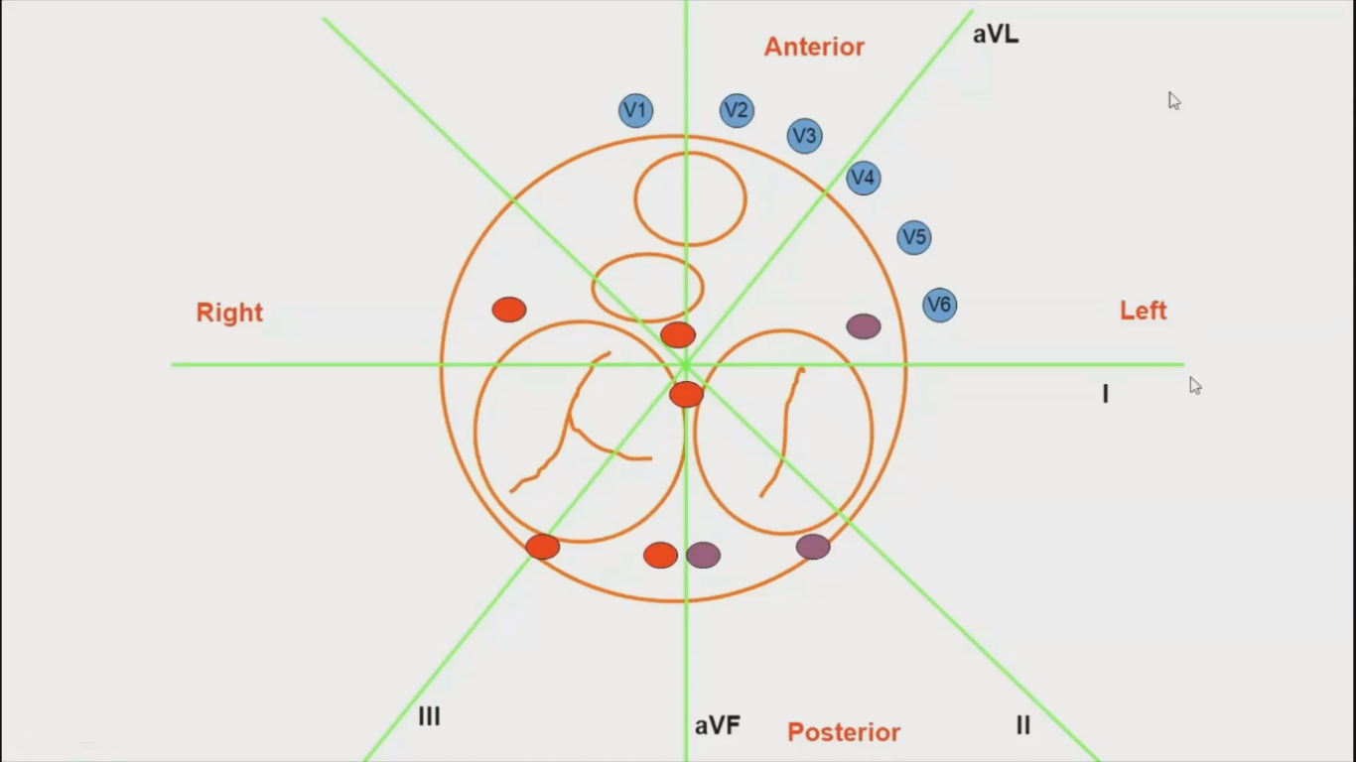

Slide 17
Localization of the accessory pathway is of value only when considering catheter ablation .
Various algorithms (Chern – En Chiang’s, Ftizpatrick’s and Xie’s algorithms) have been used for predicting accessory pathway location using different electrographic criteria.
Algorithm developed by Arruda et.al utilizing the surface ECG has an overall sensitivity of 90% and specificity of 99 %
AP Fitzpatrick described eight anatomical locations of pathways using fluoroscopic landmarks

Slide 18
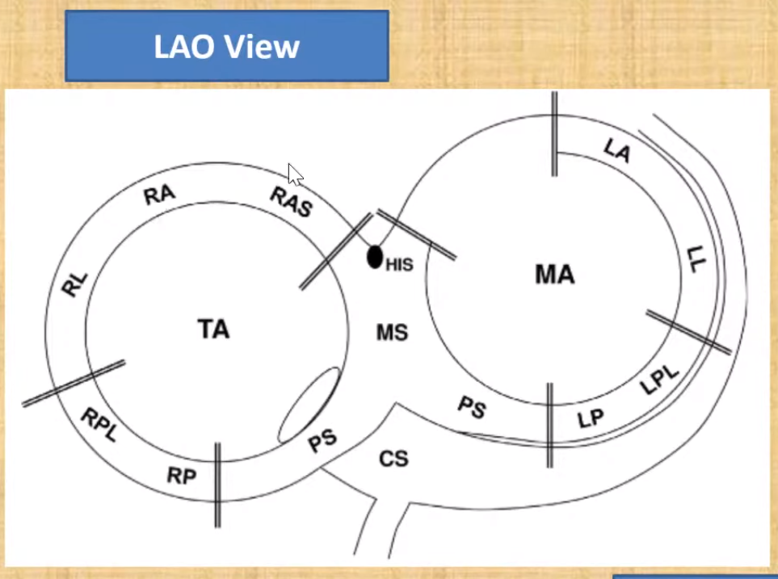

Slide 19
Right anteroseptal (RAS)
Right midseptal (RMS)
Right posteroseptal (RPS)
Right anterolateral (RAL)
Right posterolateral (RPL)
Left anterolateral (LAL)
Left posterolateral (LPL)
Left posteroseptal (LPS)
46 to 60 percent of accessory pathways are found within the left free wall space
25 percent are within the posteroseptal space
13 to 21 percent of pathways are within the right free wall space
2 percent are within the anteroseptal space

Slide 21
Most important factors in localising an AP .
Transition zone
R in lead I
Polarity of delta wave in II, III, aV_{F}

Slide 22
QRS TRANSITION

Slide 24
The height or the polarity of the delta wave is measured on the surface ECG in the first 20-60 msec of QRS complex from the end of P wave.
On the basis of this it is ISOELECTRIC, if it is on the baseline or deflected above or below the baseline but comes back before the onset of QRS complex.
POSITIVE, if it is above the baseline and NEGATIVE, if it is below the baseline

Slide 25
ALGORITHMS
Algorithms facilitate prediction of the location of a AP
Algorithms should be regarded as an orientation rather than a precise localization tool.
Algorithms appear most accurate in predicting left free-wall AP locations and least accurate in predicting midseptal or right anteroseptal AP locations

Slide 26
Limitations of algorithm
biological variability in anatomy (e.g., rotation of the heart within the thorax),
variable degree of preexcitation and QRS fusion,
the presence of more than one manifest AP,
intrinsic ECG abnormalities (such as prior MI and ventricular hypertrophy),
patient body habitus
technical variability in ECG acquisition and electrode positioning.

Slide 27
Therefore these algorithms should be regarded as an orientation rather than a precise localization tool.
No single published algorithm offers extremely high sensitivity and specificity for all BT locations.
The algorithms appear most accurate in predicting left free-wall AP locations and
least accurate in predicting midseptal or right anteroseptal AP locations.
Posteroseptal and right-sided BTs tend to be associated with a prominent degree of preexcitation because of the proximity to the sinus node, whereas left lateral BTs are often associated with subtle preexcitation

Slide 31
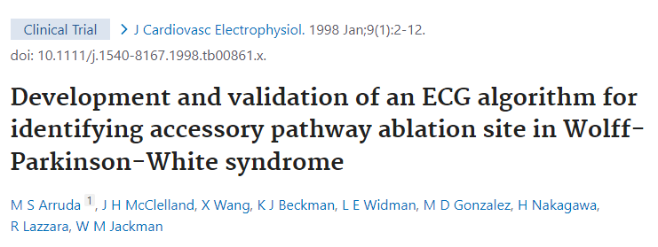
ARRUDA ALGORITHM

Slide 32
Algorithm developed by correlating a resting 12-lead ECG with the successful RF ablation site in 135 consecutive patients with a single, anterogradely conducting accessory pathway
This algorithm was subsequently tested prospectively in 121 consecutive patients
When tested prospectively, the ECG algorithm accurately localized the accessory pathway to 1 of 10 sites around the tricuspid and mitral annuli or at subepicardial locations within the venous system of the heart.
Overall sensitivity was 90% and specificity was 99%.
The algorithm was particularly useful in correctly localizing anteroseptal (sensitivity 75%, specificity 99%), and mid-septal (sensitivity 100%, specificity 98%) accessory pathways as well as pathways requiring ablation from within ventricular venous branches or anomalies of the coronary sinus (sensitivity 100%, specificity 100%).

Slide 33
The polarity of the delta wave was measured during the initial 20 ms of the preexcitation and was classified as positive (+), negative (-), or isoelectric (+/-).
Step 1-- If the delta wave in lead I is (-) or (+/-) or the R/S in lead V1 is >1, a left free-wall AP is present
If this criterion is fulfilled → lead aVF is examined
delta wave in lead aVF is (+), an LL/LAL AP
If a delta wave in lead aVF is (-) or (+/-), the AP is located at the LP/LPL region
If the criteria in leads I and V1 are not fulfilled, a septal or right-free wall AP pathway is identified →Proceed to step 2.

Slide 34
Step 2: Lead II is examined
A (-) delta wave in lead II identifies the subepicardial posteroseptal AP.
If the delta wave in lead II is (+) or (+/-)→ proceed to step 3

Slide 35
Step 3: Lead V1 is examined. A (-) or (+/-) delta wave identifies a septal AP. If this criterion is fulfilled, lead aVF is examined
If the delta wave in lead aVF is (-), an AP is identified that is located at the CSOs.
If the delta wave is (+/-) in lead aVF, the AP may be located close to either PSTA or the PSMA
A (+) delta wave in aVF identifies the AS/RAPS or MS regions
These two regions are differentiated by examining the R/S ratio in lead III: R >S identifies AS/RAPS AP, and R <S identifies an AP located along MSTA

Slide 37
If the delta wave in lead V1 is (+) (after having excluded patients with a left free-wall APs, in step 1), a right free-wall AP is identified.
Proceed to step 4

Slide 38
In patients with right free-wall APs, examine lead aVF.
A (+) delta wave in lead aVF identifies RA/RAL.
If the delta wave in aVF is (+/-) or (-), examine lead II.
A (-) delta wave in lead II identifies RP/RPL.

Slide 40
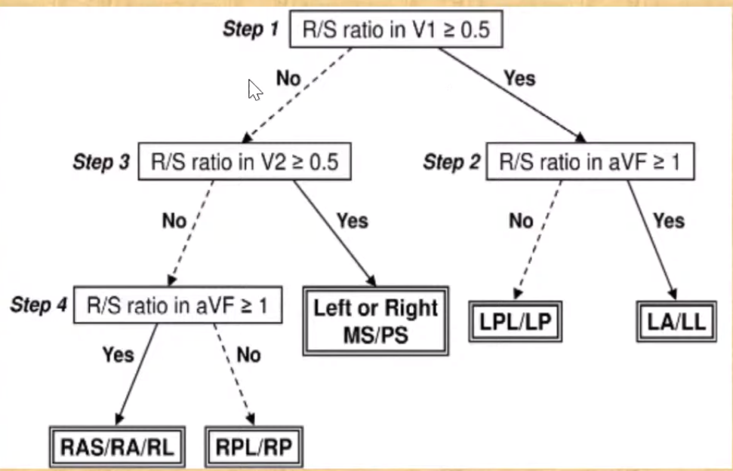
TAGUCHI’S ALGORITHM

Slide 41
Rosenbaum and colleagues divided patients into two groups on the basis of the direction of the “main deflection of the QRS complex” in transverse plane leads V1 and V2

Slide 44
MCQ & IMAGE BASED QNS

Slide 45
The anatomical substrate of the Wolff–Parkinson–White syndrome is .
a Mahaim (atriofascicular) fiber
b.Kent bundle
c. His bundle
d. James fiber
b. Kent bundle

Slide 46
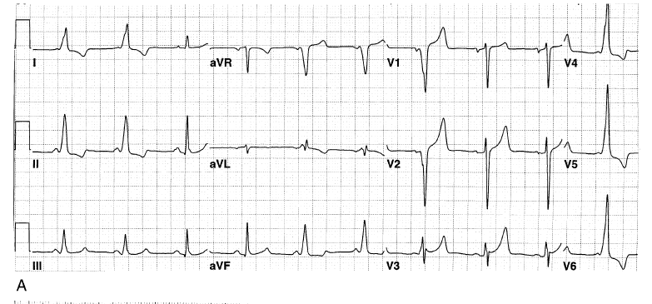
AS/RAPS

Slide 47
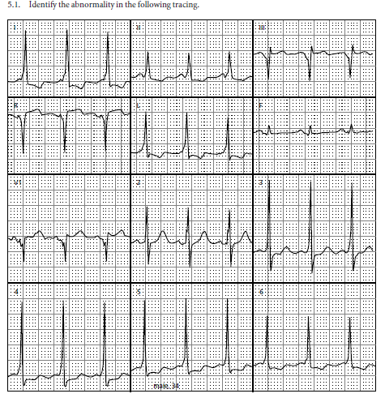
MSTA

Slide 48
POSTERO SEPTAL ACCESORY PATHWAY

Slide 49
LEFT LATERAL ACCESORY PATHWAY

Slide 50
RAL/RA AP

Slide 51
RP/RPL AP

Slide 52
PS AP

Slide 53
THANK YOU

