Slide 1
FFR Basics & FAME Trial
Dr. Aiswarya Ravikrishnan

Slide 2
Structure & Function of the Coronary circulation
Epicardial arteries (>400 μm in diameter): Serve a conduit artery function
Coronary resistance: Resistance arteries (100 to 400 μm), Arterioles (<100 μm)
Capillary density: Average intercapillary distance of 17 μ m

Slide 3
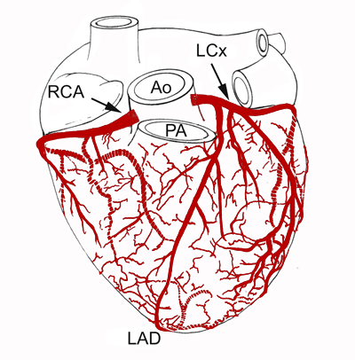

Slide 4
The Coronary blood flow
Oxygen extraction at rest is around 70 %
Increase in oxygen demand is met by:
Increase in coronary blood flow
Dilation of microcirculation
Coronary blood flow
At rest is 250ml/min
Stress upto 5 times

Slide 5
Myocardial ischemia results from…
Microcirculation dysfunction
Epicardial stenosis >50%

Slide 6
Limitations of coronary angiography
Interpretation is highly subjective
Intermediately severe luminal narrowing (40% -70%) cannot be accurately determined
Identification of normal and diseased vessel segments is complicated by diffuse disease
Artifacts of contrast streaming
Image foreshortening
Overlapping vessels

Slide 7
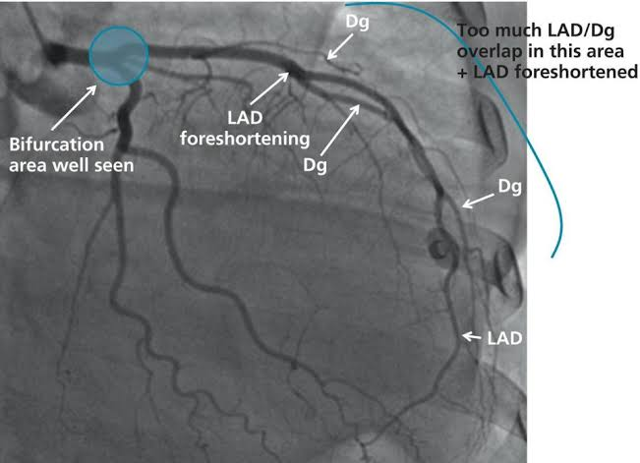

Slide 8
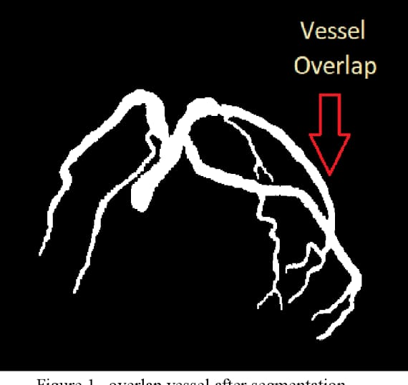

Slide 9
Flow Velocity
The flow velocity of RBCs moving past the ultrasound emitter/receiver on the end of a guidewire
c.s.a of a 0.014-inch sensor guidewire is 0.099 mm2
1.4% of a 3-mm–diameter vessel and
12% of a vessel with a diameter of 1 mm.
The error favors overestimating severity in the marginal cases over missing hemodynamically significant lesions.

Slide 10
Coronary flow reserve
Ratio
maximal flow in a coronary artery with stenosis (QS) to
maximal flow in a normal coronary artery without a stenosis
Normal range 0.8 to 1.0
Limited role in MVD
Assumes that the microvascular circulatory response is uniformly distributed among the myocardial beds
Is of no value in with myocardial infarction left ventricular regional dysfunction, Asymmetric hypertrophy

Slide 11
Coronary Pressure
The resistance to flow through a stenosis caused by viscous friction, flow separation, turbulence, and eddies at the site of the stenosis results in energy loss.
Energy loss produces pressure loss distal to the stenosis and thus a pressure gradient across the narrowed segment

Slide 13
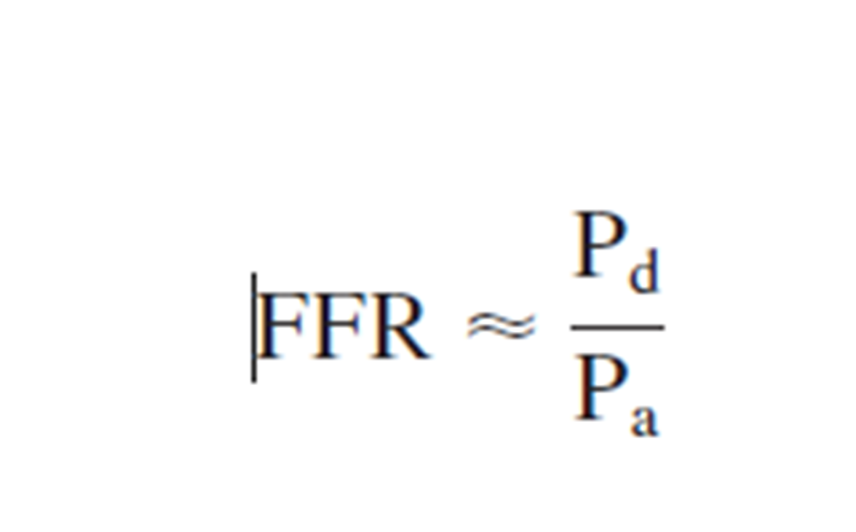
Fractional Flow Reserve

Slide 14
Normal value 1
An FFR value of 0.6 means the maximum myocardial flow across the stenosis is only 60% of what it should be without the stenosis
An FFR <0.75 is associated with inducible ischemia (specificity, 100%),
An FFR a value >0.80 indicates absence of inducible ischemia in the majority of patients (sensitivity, 90%).

Slide 15
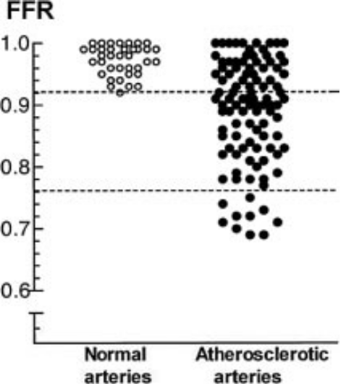

Slide 16
FFR - advantages
Human studies did not show significant changes in FFR with changes in
heart rate,
blood pressure,
contractility.
FFR has a high reproducibility
Low intra-individual variability
FFR, unlike CFR, is independent of gender and CAD risk factors
It varies less with common doses of adenosine than does CFR

Slide 17
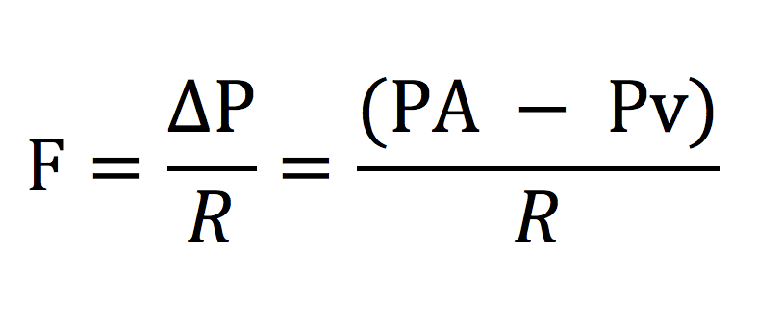

Slide 18
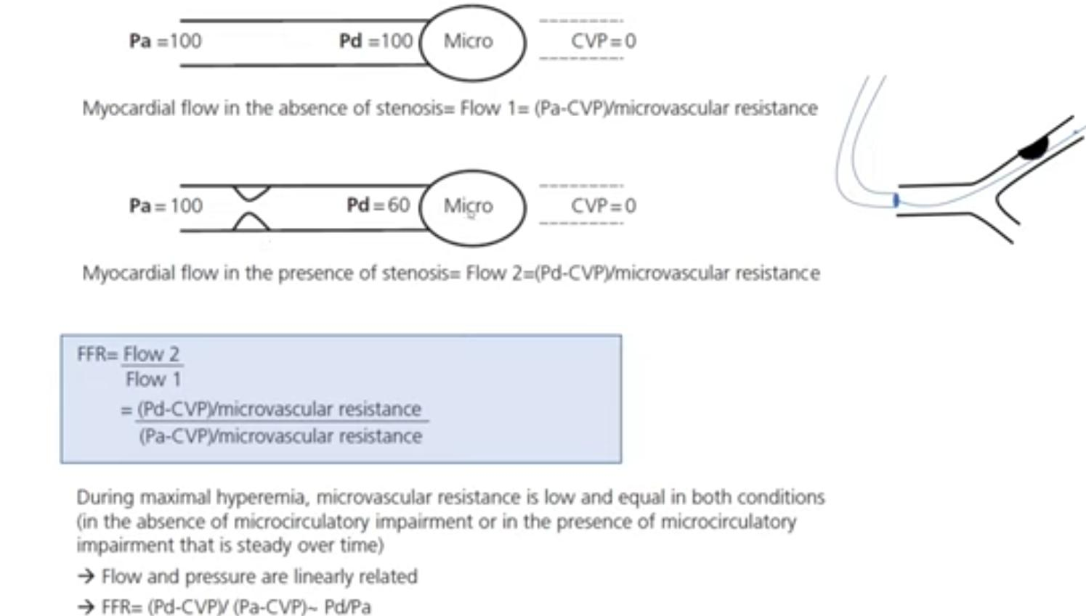

Slide 23
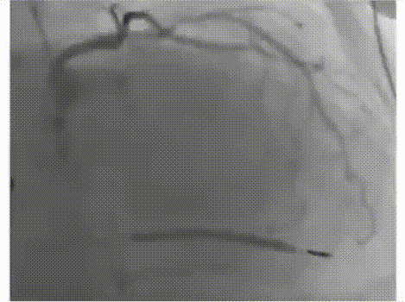

Slide 25
iFR may underestimate lesions in:
Large vessels
Supplying bigger territories
Because more gradient is generated by inducing hyperemia in such vessels while doing FFR.

Slide 30
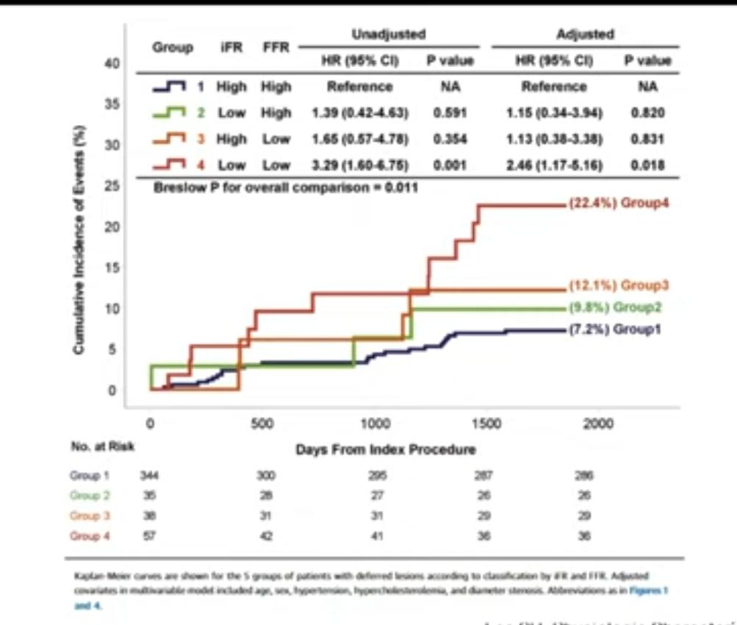

Slide 34
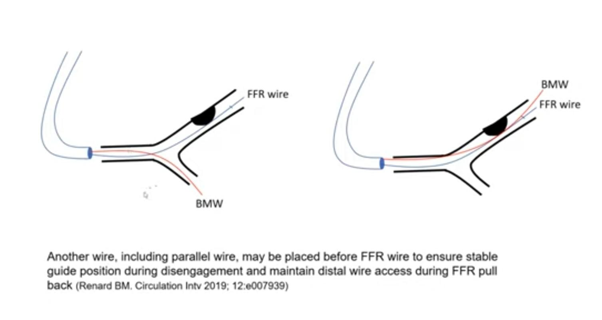

Slide 35
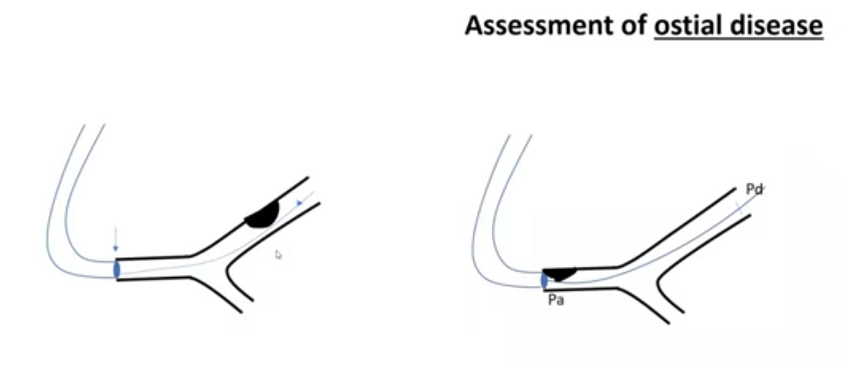

Slide 36
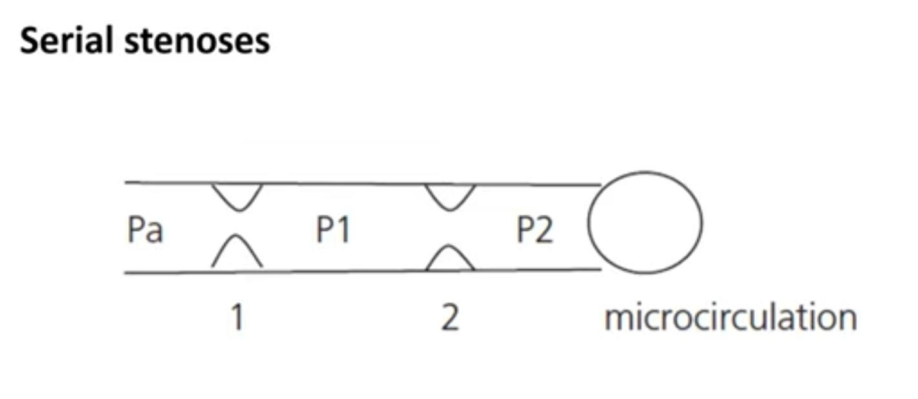

Slide 37
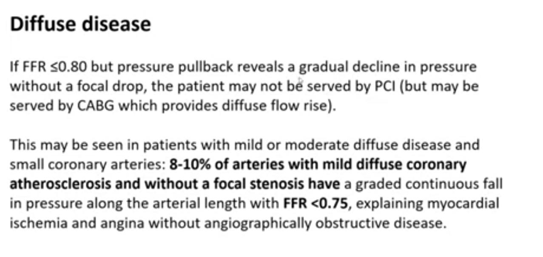

Slide 39
Fractional Flow Reserve Versus Angiography for Multivessel Evaluation - FAME
Although PCI of ischemia-causing lesions is has better outcomes, it is often hard to determine the exact lesion causing ischemia in patients with multiple stenoses.
The FAME trial sought to determine if FFR guidance of PCI would be associated with better outcomes in patients with multivessel disease.

Slide 43
Study Design
Patients Screened: 1,905 Patients
Enrolled: 1,005
Mean Follow Up: 1 year, 5 years
Mean Patient Age: 64.5 years
Female: 26%
Mean Ejection Fraction: 57%
Patient Populations: Patients with stenoses of >50% in at least two of the three major coronary arteries, Lesions amenable for stenting

Slide 44
Exclusions:
Left main disease or previous bypass surgery
ST-elevation MI with creatine kinase >1000 U/L within the last 5 days
Cardiogenic shock
Life expectancy <2 years
Contraindication to drug-eluting stents
Pregnant patients
Extremely tortuous or calcified coronary arteries

Slide 45
Multivessel disease FAME study:
Study Population
Inclusion criteria:
ALL patients with multivessel disease
At least 2 stenoses ≥ 50% in 2 or 3 major epicardial coronary artery disease, amenable for stenting
Exclusion criteria:
Left main disease or previous bypass surgery
ST-elevation MI with CK > 1000 U/l within last 5 days
extremely tortuous or calcified coronary arteries
Note: patients with previous PCI were not excluded

Slide 46
Primary Endpoints
Incidence of MACE, defined as
death,
MI, or
need for repeat revascularization at 1 year

Slide 47
Secondary Endpoints
Death at 1 year
MI at 1 year
MACE at 30 days and 6 months
Revascularization at 1 year
Functional class at 1 year
Number of antianginal medications used
Health-related quality of life, as measured by EuroQOL-5D
Procedure time
Amount of contrast used during the procedure
Cost of the procedure

Slide 48
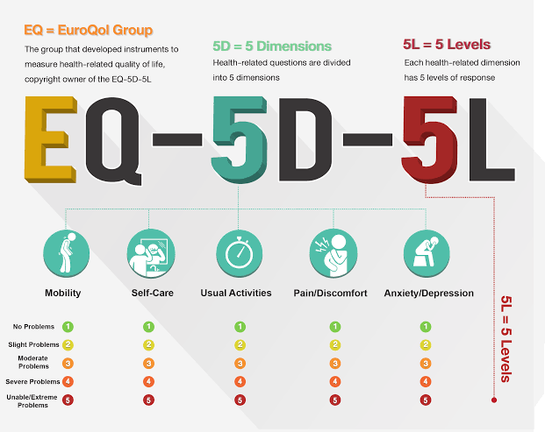

Slide 49
Procedure
Patients with multivessel disease, in whom a decision was made to stent all stenoses >50%, were randomized to either routine angiography-guided PCI, or FFR-guided PCI, in which FFR was measured in all significant stenoses, with stenting only of those lesions with an FFR ≤0.8.
FFR was measured using a Pressure Wire

Slide 50
Concomitant Medications
All patients in the FFR-PCI group, and 97% of the patients in the PCI group, received drug-eluting stents (either everolimus, sirolimus, or paclitaxel-eluting).
Hyperemia was induced by intravenous adenosine 140 mcg/kg/min in the femoral vein.
All patients received aspirin and clopidogrel for 1 year. Beta-blockers (77%), statins (81%).

Slide 51
Principal Findings
A total of 1,005 patients were randomized,
509 to FFR-guided PCI, and
496 to angiography-guided PCI.
Baseline characteristics were fairly similar
33%: unstable angina,
27%: prior PCI,
27%: ejection fraction of 50% or less.
The mean number of indicated lesions was 2.8 per patient, with a mean reference vessel diameter of 2.5 mm, and a mean stenosis severity of 61%.
Only about 3-4% of the lesions were total occlusions.

Slide 53
Principal Findings
FFR was successfully measured in 94% of the lesions, and of the indicated lesions, only about two-thirds (67%) had an FFR ≤0.8.
As a result, the mean number of stents was significantly lower in the FFR arm compared with the routine management arm (1.9 vs. 2.7, p < 0.001).
Also, as expected, FFR of ischemic lesions was lower than FFR of non-ischemic lesions (0.60 vs. 0.88).

Slide 54
The mean procedure time was similar between the two arms (71 vs. 70 minutes),
but the amount of contrast used was significantly lower in the FFR arm (272 vs. 302 ml, p < 0.001).
The cost of materials for the procedure was also significantly lower in the FFR arm ($5,332 vs. $6,007, p < 0.001),
and the length of hospital stay tended to be shorter as well (3.4 vs. 3.7 days, p = 0.05).

Slide 55
Principal Findings
The incidence of major adverse cardiac events (MACE) at 1 year was significantly lower in the FFR arm compared with the routine management arm (13.2% vs. 18.3%, p = 0.02).
The incidence of death (1.8% vs. 3.0%, p = 0.19), myocardial infarction (MI) (5.7% vs. 8.7%, p = 0.07), and coronary artery bypass grafting or rePCI (6.5% vs. 9.5%, p = 0.08) at 1 year was similar between the two arms.

Slide 56
Principal Findings
The number of patients who were angina free at 1 year was also similar between the two arms (81% vs. 78%, p = 0.2).
The quality of life, as measured by the EuroQOL5D, was similar between the two arms as well (p = 0.65).

Slide 57
Five-year results:
MACE for FFR vs. routine management: 28% vs. 31%, relative risk 0.91, 95% confidence interval 0.75-1.10; p = 0.31,
mortality: 9% vs. 10%, p = 0.5;
MI: 9% vs. 12%, p = 0.24;
repeat revascularization: 15% vs. 17%, p = 0.49.
There was a significant interaction with gender (p = 0.03); MACE was superior for FFR in males.

Slide 58
FFR immediately post-PCI (residual FFR burden) was measured in approximately two-thirds of the patients (median 0.9).
At 2 years, the risk of vessel-related death, MI, or revascularization was lowest in patients with a post-PCI FFR of 0.92 or higher, primarily driven by a reduction in the need for revascularization.

Slide 59
Interpretation:
FFR-guided PCI is associated with a significantly lower incidence of MACE compared with routine angiography-guided PCI in patients with multivessel disease, without a significant increase in the procedure time and with lower costs and resource utilization.
Routine use of FFR may deem more than a third of “significant” angiographic stenoses as non-significant (FFR ≥0.8), thus minimizing PCI due to the oculo-stenotic reflex.

Slide 60
Results appear durable up to 5 years of follow-up in these patients, with no overall excess in MI, mortality, or revascularization in FFR-guided patients, suggesting that an FFR-guided strategy is likely safe and cost-effective.

Slide 61
Further trials are necessary to validate these findings before FFR can be considered for routine use in patients undergoing multivessel PCI.
Moreover, most operators have limited experience with FFR, in contrast to the FAME investigators, who have extensive experience with FFR technology and its applications.
Therefore, the benefits and applicability of FFR in routine practice may be diminished as a result of errors and higher complication rates.

Slide 62
CONCLUSIONS
Routine measurement of FFR in patients with multivessel disease (MVD) who are undergoing PCI with drug-eluting stents (DES) significantly improves outcomes at 1 year by reducing MACE (composite rate of death, nonfatal myocardial infarction, and repeat revascularization)

Slide 63
The results of this trial: similar to the nuclear substudy of the COURAGE trial, where PCI: better outcomes compared with medical management in stable angina only if there was demonstrable ischemia on a nuclear stress test.
FFR is a functional test for ischemia, with good relation to nuclear imaging, and thus the combination of these studies would suggest that PCI is beneficial only in stenoses that are associated with ischemia.

Slide 64
DEFER Study
Revascularization of coronary stenoses angiographic criteria vs non-invasive or invasive evidence of reversible myocardial ischaemia.
Stenting an angiographically significant but functionally non-significant stenosis: controversial.
Is deferral based on FFR safe? especially over the long term.
Concerns about future plaque rupture
The DEFER study was the first randomized controlled trial investigating the suitability of FFR to guide coronary interventions.

Slide 65
Aims
Stenting an angiographically intermediate but functionally non-significant stenosis is controversial.
Is it safe to defer a functionally non-significant lesion on the basis of fractional flow reserve (FFR) measurement on the long term?
Five-year follow-up of the DEFER trial showed that outcome after deferral of PCI of an intermediate coronary stenosis based on FFR ≥ 0.75 is excellent and was not improved by stenting.
Aim: to investigate the validity of this position on the very long term

Slide 66
Method
In 325 patients scheduled for PCI of an intermediate stenosis, FFR was measured just before the planned intervention.
If FFR was ≥0.75, patients were randomly assigned to deferral (Defer group; n = 91) or performance (Perform group; n = 90) of PCI.
If FFR was <0.75, PCI was performed as planned (Reference group; n = 144). Clinical follow-up was 15 years.

Slide 67
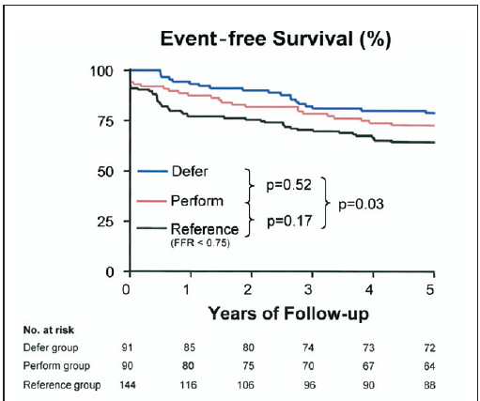

Slide 68
Results
No differences in baseline clinical characteristics between the randomized groups. Complete 15-year follow-up was obtained in 92% of patients.
The rate of death was not different between the three groups:
33.0% in the Defer group,
31.1% in the Perform group, and
36.1% in the Reference group (Defer vs. Perform, RR 1.06, 95% CI: 0.69–1.62, P = 0.79).

Slide 69
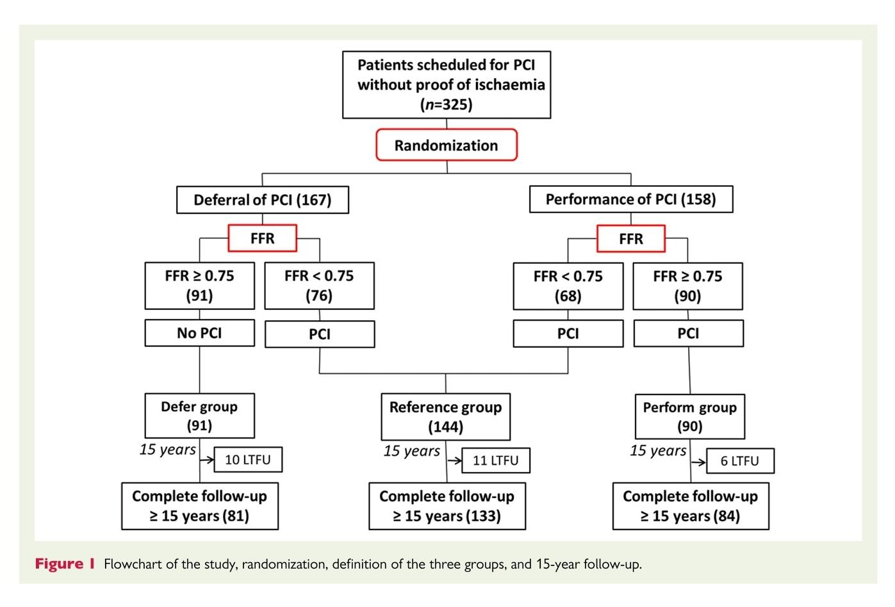

Slide 70
The rate of myocardial infarction was significantly lower in the Defer group (2.2%) compared with the Perform group (10.0%), RR 0.22, 95% CI: 0.05–0.99, P =0.03.

Slide 71
Conclusion
Deferral of PCI of a functionally non-significant stenosis is associated with a favourable very long-term follow-up without signs of late ‘catch-up’ phenomenon.

