Slide 1
Clinical Assessment & Biomarkers in Heart Failure
Dr. Aiswarya Ravikrishnan

Slide 2
Initial evaluation of Acute HF
(1) establish rapid definitive diagnosis
(2) treat potentially life-threatening conditions (e.g., shock, respiratory failure);
(3) identify clinical triggers (e.g., ACS, acute pulmonary embolism);

Slide 3
Initial evaluation of Acute HF
(4) risk stratification & triage (e.g., intensive care unit, telemetry unit, observation unit); and
(5) defining the clinical profile (based on BP, volume status, and renal function) to implement therapy.

Slide 4
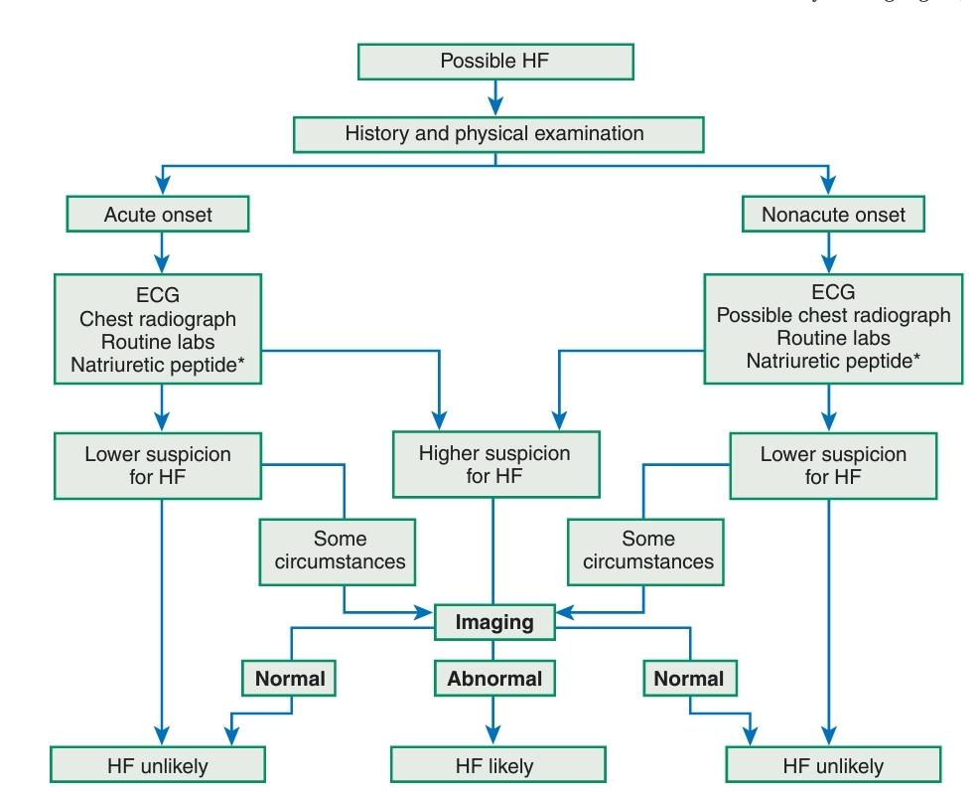

Slide 5
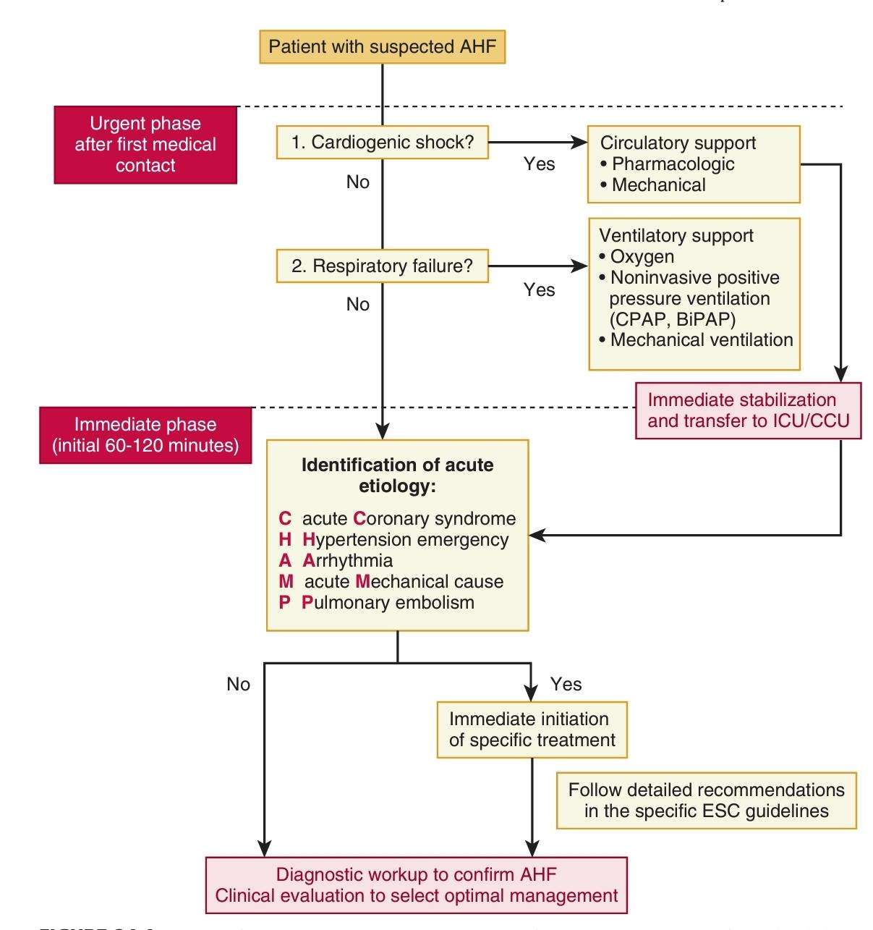

Slide 6
Classification
presence or absence of a prior history of HF.
New-onset or de novo HF: 20% of hospitalizations for AHF.
no prior h/o CV d/s or risk factors (e.g., acute myocarditis),
a background of risk factors for HF (stage A heart failure) or
preexisting structural heart disease (stage B heart failure)
Many in the setting of acute coronary syndrome (ACS).

Slide 7
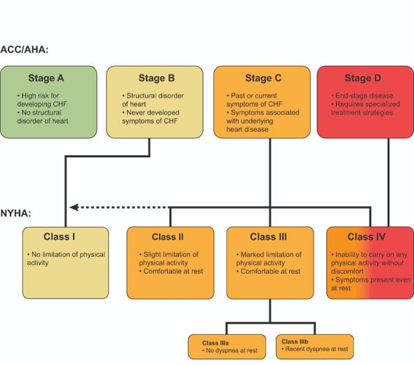

Slide 8
Classification
Majority: h/o preexisting chronic HF.
Less dramatic clinical presentation:
Compensatory mechanisms and remodeling (e.g., increased pulmonary lymphatic capacity).
Already treated with neurohormonal antagonists and loop diuretics,
neurohormonal activation may be less, diuretic resistance more common.

Slide 9
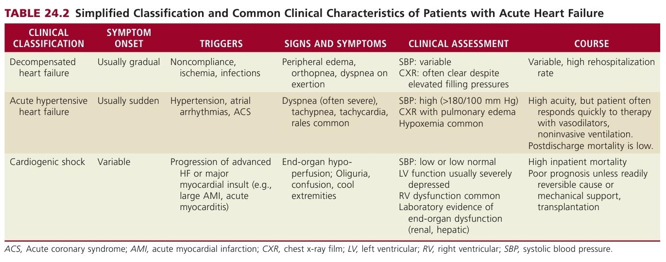

Slide 10
Decompensated heart failure.
patients with worsening signs and symptoms of congestion on a background of chronic HF.
Acute, subacute, or indolent, with gradually worsening symptoms over days to weeks.
Either preserved or reduced EF
Cardiac output is generally preserved and blood pressure is within the normal range.
Largest portion of patients hospitalized for AHF.

Slide 11
Acute hypertensive heart failure.
Hypertension: common feature of the AHF presentation
50% SBP > 140 mm Hg 25% > 160 mm Hg.
HTN: triggered by a high sympathetic tone related to dyspnea and accompanying anxiety (reactive hypertension),
or acute hypertension with changes in afterload may be a trigger for decompensation.
Both mechanisms operative: cause-and-effect relationships may be difficult to discern.

Slide 12
Epidemiologically, acute hypertensive HF:
preserved systolic function,
women,
sudden onset of symptoms. Frank pulmonary edema, evident rales, florid congestion on chest x-ray film
likely related to difference in LV compliance,
acuity of pressure changes & pulmonary lymphatic capacity.
Although often strikingly ill initially with hypoxemia and the possible need for NIV or intubation,
They respond well to therapy and have lower in-hospital mortality.

Slide 13
Cardiogenic shock
C/f of organ hypoperfusion despite adequate preload.
SBP is often decreased, and e/o frank or impending end-organ dysfunction (renal, hepatic, CNS).
Relatively uncommon (4% of AHFS presentations in EHFS II) in broad community registries but more common in tertiary care settings.
Does not fully capture some less common clinical scenarios (e.g., isolated right HF or high output HF),
But covers vast majority of AHF patients likely to be seen in routine clinical practice.

Slide 14
Symptoms
The most common: symptoms related to congestion
Dyspnea(MC): >90%
The duration & time course of symptom onset vary,
from very acute onset over minutes to slow worsening of chronic symptoms

Slide 15
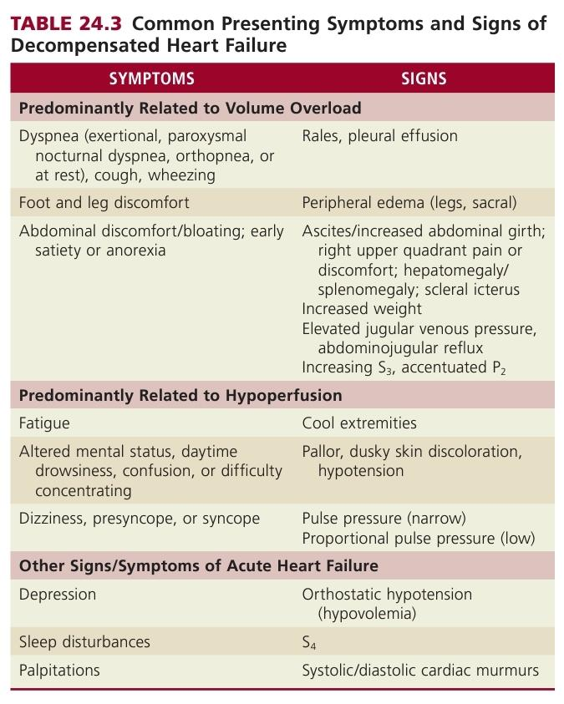

Slide 17
Symptoms
Dyspnea: at rest or with minimal exertion
Symptoms of systemic venous congestion: peripheral edema, weight gain, early satiety, and increasing abdominal girth.
Atypical symptoms can predominate, (elderly patients),
fatigue, depression, altered mental status, & sleep disruptions

Slide 18
Physical Examination
HF remains a clinical diagnosis
A useful framework in the bedside evaluation: developed by Stevenson and colleagues,
focuses on the adequacy of perfusion (“cold” versus “warm”) and congestion at rest (“wet” versus “dry”)

Slide 19
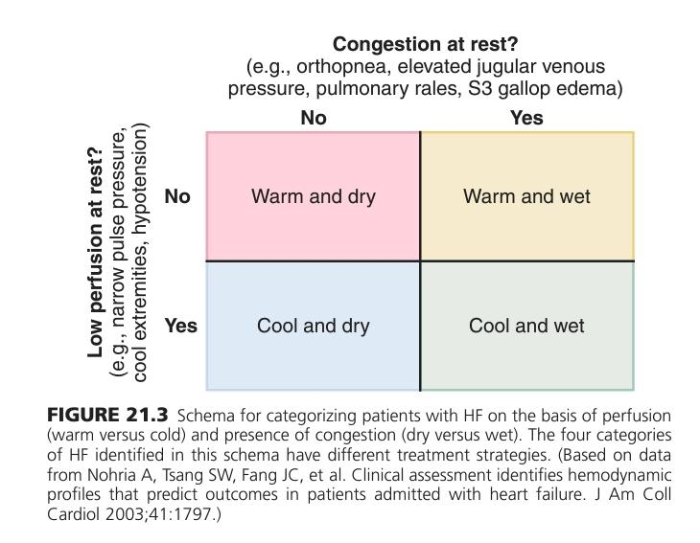

Slide 20
Hypotension: one of the strongest predictors of poor outcomes, define the clinical profile
SBP: typically normal or elevated in patients with AHF,
(50%: SBP >140 mm Hg).
Underlying HTN + increase in sympathetic stimulation : increase SBP
(12% SBP >180 mm Hg)

Slide 21
Very low SBP are uncommon, (2% in ADHERE SBP < 90 mm Hg).
Hypotension and hypoperfusion are not synonymous.
Pulse pressure: indirect marker of cardiac output.
JVP is a barometer of systemic venous hypertension and is the single most useful physical examination finding

Slide 22
The JVP reflects the RAP an indirect measure of LV filling pressures.
JVP may not reflect LV filling pressures in isolated right ventricular (RV) failure (e.g., from pulmonary hypertension or RV infarct), and significant TR

Slide 23
Rales or inspiratory crackles MC (66% to 87%)
Not heard: background of chronic HF and pulmonary venous hypertension, (increased lymphatic drainage)
Cool extremities with palpable peripheral pulses: decreased peripheral perfusion: marginal cardiac index, marked vasoconstriction, or both.

Slide 24
Temperature should be assessed at the lower leg as opposed to the foot,
Relative to the temperature of the examiner’s hands.
Peripheral edema: 65%, less common: predominantly low-output HF or cardiogenic shock. Good PPV & a low sensitivity,
Edema dependent, symmetric, and pitting.
Minimum of 4 L of ECF is accumulated to produce clinically detectable edema.

Slide 25
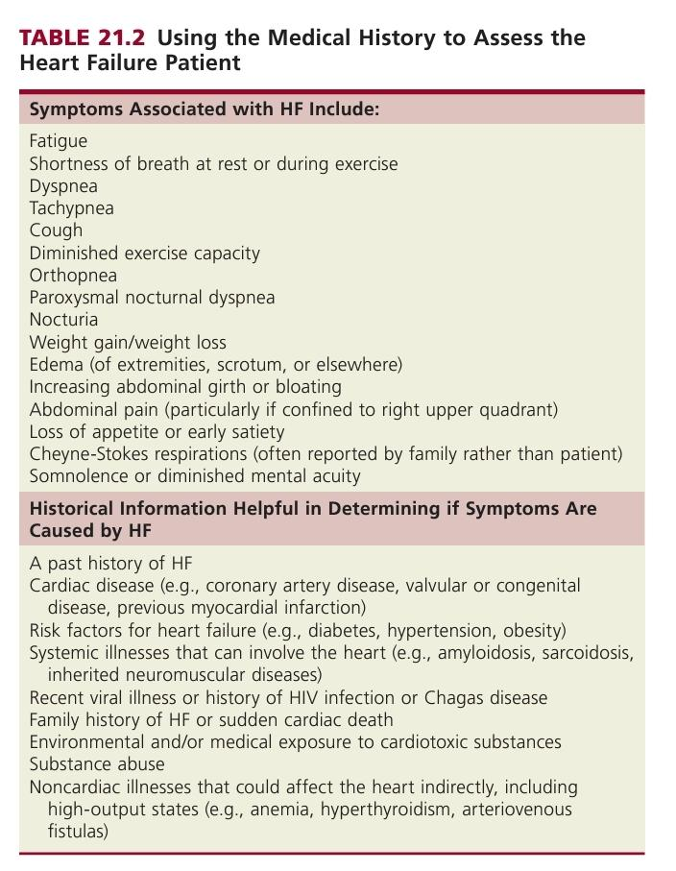

Slide 27
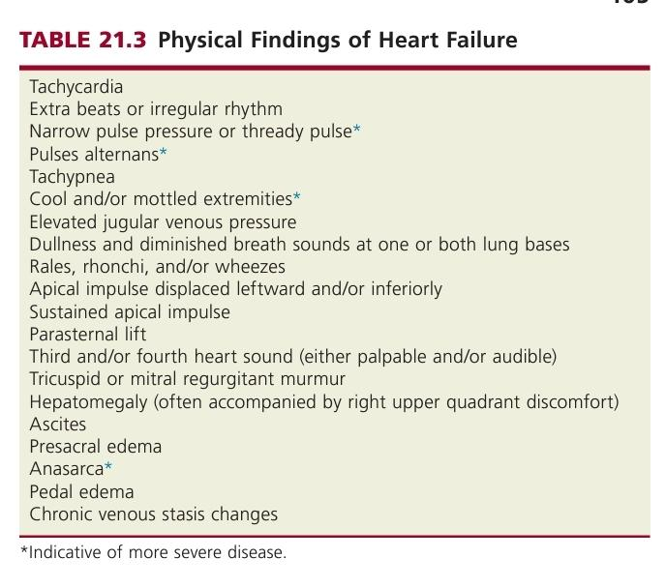

Slide 29
Biomarkers
Emerged over the past decade as an important adjunct evaluation of HF.
Biomarkers are now routinely used to
Distinguish HF from other conditions,
Establish severity of the diagnosis, &
Prognosticate HF patients.
There is also considerable interest in determining the ability of biomarkers to guide therapy, in both acute and chronic settings.

Slide 30
Six distinct categories, with an additional category reserved for biomarkers not yet classified.
Clinically useful biomarkers of HF should be
easily measured with high analytic precision,
should reflect important processes involved in HF presence and progression,
should not recapitulate clinical information already available at the bedside,
and must provide clinically useful information for caregivers to establish or reject a diagnosis more swiftly and reliably,
to estimate prognosis more accurately, or
to inform more successful therapeutic strategies.
Only the natriuretic peptides have met these requirements, although other promising biomarkers exist for use in HF assessment.

Slide 31
Biomarkers
The natriuretic peptides: a family of important counterregulatory hormones in HF with vasodilatory and other effects.
In the context of AHF, both brain (B-type) natriuretic peptide (BNP) and N-terminal pro-BNP (NT-proBNP): important role in the differential diagnosis
NPV > PPV

Slide 32
Natriuretic Peptides
Useful biomarkers for HF diagnosis, estimation of HF severity and prognosis, and possibly for management of HF as well.
Most frequently measured: B-type natriuretic peptide (BNP) and its amino-terminal (N-terminal) cleavage propeptide equivalent, NT-proBNP.
Released from cardiomyocytes in response to stretch, and highly precise assays exist for their detection in blood
Given the preponderance of myocardium in the ventricles, BNP and NT-proBNP are held to reflect ventricular stretch and synthesized in response to wall stress.

Slide 33
Atrial natriuretic peptide (ANP) is another member of this class
Synthesized and secreted from atrial tissue.
A midregional (MR) pro-ANP assay: now available, deliver comparable results to BNP and NT-proBNP in HF (data limited).
Differences in their clearance, BNP and NT-proBNP have different half-lives
(BNP: 20 minutes; NT-proBNP: 90 minutes)
they circulate with very different concentrations.

Slide 34
Both are important part of the HF assessment;
Remember the broad array of structural and functional reasons for BNP or NT-proBNP release to interpret these values correctly.
Increase progressively with worsening NYHA functional class and
Higher in HFrEF than HFpEF,
despite independent contributions of diastolic function to their concentrations.
Acute HF more often have higher values for BNP and NT-proBNP than stable patients with chronic HF, (not a universal finding).
Knowledge of an individual’s natriuretic peptide value when stable: useful to better interpret a change in symptoms when it occurs.

Slide 35
concentrations of both peptides are higher in patients with
valvular heart disease,
pulmonary hypertension,
ischemic heart disease,
atrial arrhythmias,
pericardial processes such as constriction.
Age

Slide 36
Both natriuretic peptides are higher in patients with
Renal failure, slower clearance, also identify heart disease with prevalent cardiovascular risk factors.
Hyperdynamic states, including sepsis.
Right ventricular dysfunction: pulmonary embolus
Angiotensin receptor neprilysin inhibitors (ARNIs): elevated levels of BNP but not NT-proBNP.

Slide 37
Obesity is strongly linked to lower-than-expected BNP or NT-proBNP values, despite comparable or higher wall stress in heavier patients.
Given the common effect on BNP, NT-proBNP, and MR-proANP, this is not likely to be a clearance effect (because each is cleared differently),
but rather more likely to represent suppression of natriuretic peptide gene expression or post-translational modification.

Slide 38
Results of BNP or NT-proBNP should always be interpreted in the context of sound clinical judgment and integrated with results of history, physical examination, and other testing.
Strongly supplement clinical judgment but should not replace it.
Identify and exclude ADHF in the emergency department, as well as more indolent HF in the outpatient setting.

Slide 39
Pivotal data for BNP and NT-proBNP testing to diagnose acute HF
Breathing Not Properly study and
ProBNP Investigation of Dyspnea in the Emergency Department (PRIDE) study, respectively.
In the Breathing Not Properly, a BNP concentration of 100 pg/mL was highly accurate for the diagnosis of acutely decompensated HF; in PRIDE an NT-proBNP cutoff value of 900 pg/mL provided comparable performance to a BNP of 100 pg/mL.

Slide 40
The International Collaborative of NT-proBNP (ICON) investigators subsequently showed that age stratification improved PPV of NT-proBNP in acutely dyspneic patients.
An NT-proBNP concentration less than 300 pg/mL was also useful to exclude acutely decompensated HF.
Knowledge of natriuretic peptide levels in the emergency department (ED) is associated with more rapid diagnosis, lower admission rate, shorter length of hospital stay and reduced cost

Slide 41
As clinical uncertainty in acute dyspnea is associated with worse prognosis,
natriuretic peptide testing is particularly useful
For patients with less acute presentations of dyspnea in settings other than the ED, values of BNP or NT-proBNP are most often considerably lower.
When used for evaluation of the dyspneic ambulatory patient, the optimized cutoff values from ED studies should not be used; lower values are mandatory
Optimized for their NPV to exclude (rather than identify) HF
Age stratification again improves diagnostic accuracy: older patients have higher concentrations of BNP or NT-proBNP in the absence of clinical HF.
High values: further diagnostic testing (e.g. echocardiography) is needed.

Slide 42
One natriuretic peptide measurement is prognostically meaningful, but serial follow-up measurements add incrementally important prognostic information.
In patients with acute HF, those who do not show a robust reduction in BNP or NT-proBNP by the time of hospital discharge tend to have considerably higher rates of morbidity and mortality.
It has thus been suggested that a BNP or NT-proBNP decrease of 30% or more by hospital discharge is desirable.
In ambulatory HF patients, chronically elevated or rising natriuretic peptide values identify a particularly high-risk population.
HF therapies may lower BNP and NT-proBNP concentrations, and when this finding occurs, prognosis is improved

Slide 46
False positives (e.g., due to MI or pulmonary embolism) and
False negatives (primarily due to obesity, which results in lower NP levels for a given degree of HF)
Cannot reliably distinguish HFpEF from systolic HF.
Cardiac troponin is frequently elevated in AHF, with worse in-hospital and postdischarge outcomes.

Slide 47
More sensitive troponin assays has increased the proportion of patients presenting with AHF with elevations of circulating troponin.
Assessment of cardiac troponin in patients with AHF: now recommended for prognosis, know the likelihood of concurrent ACS.

Slide 48
ST2
Newer biomarkers: supplement natriuretic peptides for prognostication.
Most have not yet achieved prerequisite data to justify their widespread use
Soluble concentrations of ST2 (Suppression of Tumerogenicity 2), a member of the interleukin receptor family, strongly linked to progressive HF and death across the four ACC/AHA stages
Originally identified in a basic science model of mechanotransduction
ST2 plays a pivotal role in the formation of fibrosis in the heart

Slide 49
ST2
High ST2: progressive cardiovascular dysfunction, remodeling, and risk of death.
Soluble ST2 concentrations are additive to natriuretic peptides for prognostication,
Useful in both HFrEF and HFpEF,
and are similarly dynamic to natriuretic peptides in their changes after HF therapies.
Both ADHF and c/c HF, a chronically elevated or rising ST2 value strongly predicts adverse outcome.

Slide 50
ST2
Among apparently normal patients in a population-based analysis, ST2 values predicted future HF, beyond other biomarkers such as BNP as well as echocardiographic parameters.
This implies that the biochemical changes of ventricular remodeling may be detectable well before conventional biomarkers or imaging are abnormal. Recently ST2 concentrations: indicate vascular remodeling: predict future arterial hypertension.
Whether this mediates risk for future HF is uncertain.

Slide 51
Galectin 3
Novel biomarker of tissue fibrosis.
Produced by activated macrophages involved in response to tissue injury
Strongly associated with increased myocardial collagen formation.
Predict adverse outcomes in both HFrEF and HFpEF,
Predict onset of HF in apparently normal patients, similar to ST2.

Slide 52
Troponin
The myofibrillar proteins troponin T and I are indicators of cardiomyocyte injury
May be elevated in HF in the absence of an ACS or significant CAD.
Emergence of highly sensitive troponin assays, even more patients may be found to have elevated concentrations.
Elevated troponin value does not specifically identify myocardial necrosis caused by CAD per se,
AMI may trigge acute HF: measure troponin, but interpret with caution.

Slide 53
Troponin
Elevated troponin concentrations in community-based normal individuals are prognostic for onset of HF (particularly if rising in serial measurement).
Troponin is independently predictive of increased mortality risk across the HF spectrum.

Slide 54
Many novel markers reflect systemic stress or disarray of organs outside the heart.
The midregional fragment of proadrenomedullin is a biomarker reflective of vascular and systemic stress
Powerfully prognostic for short-term adverse outcome
Growth differentiation factor-15, another marker of cardiovascular stress
Strongly predicts outcomes in established HF
also may be prognostic for new-onset HF in apparently normal persons.

Slide 55
The C-terminal fragment of provasopressin (aka copeptin): indirect means to measure biologically unstable parent hormone from which it is derived
Values of copeptin are prognostic in HF but are not directly associated with serum sodium values in this setting.

Slide 56
Novel biomarkers of renal dysfunction:
Emerging as strong predictors of cardiovascular risk beyond the standard measures of BUN and serum creatinine.
Cystatin C, a ubiquitous protein found in all nucleated cells
Clearance is directly related to glomerular filtration,
Beta trace protein are two renal function markers whose values are tightly related to outcomes in HF.
Neutrophil gelatinase-associated lipocalin,
N-acetyl-β-D-glucosaminidase, and
kidney injury molecule-1 promising biomarkers of AKI: values rise well before renal function worsens & gives prognostic information in HF patients

