Slide 1
CARDIAC AXIS

Slide 2
Introduction
The electrical activity of the heart starts at SA node and then spreads to the AV node.
It then spreads down the Bundle of his and then to the purkinje fibres to cause ventricular contraction.
These electrical signals can be picked up from the body surface by means of electrodes.
Whenever the direction of the electrical activity is towards a lead, we get a positive deflection in that lead
When the direction of the electrical activity is away from a lead, we get a negative deflection in that lead.

Slide 3
THE CARDIAC AXIS
The average direction of the electrical potential during depolarization of the ventricles.
Since the left ventricle makes up most of the heart muscle under normal circumstances,normal cardiac axis is directed downwards and slightly to the left.

Slide 4
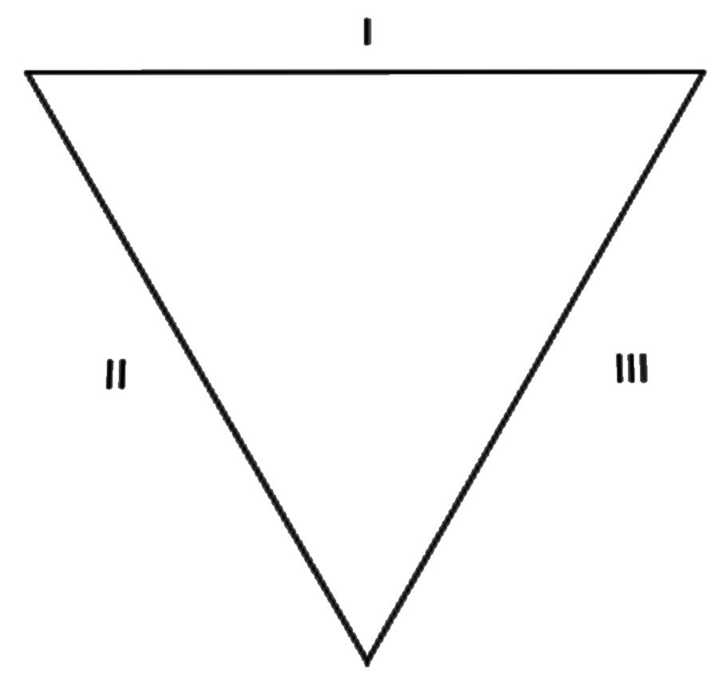
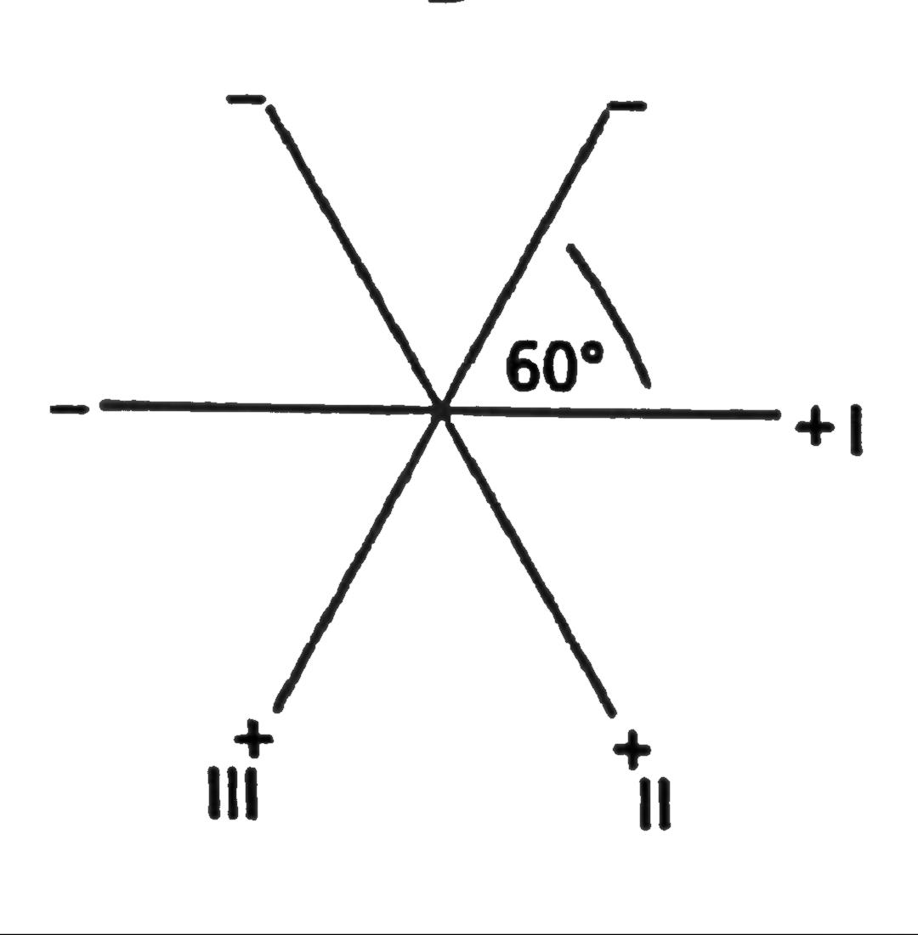
THE HEXAXIAL SYSTEM
It is a diagram based on the first 6 leads of the 12 lead ECG.
The 3 standard limb leads, LI, LII, LIII form an equilateral triangle with the heart at the centre(Einthoven triangle)
Einthoven trianlge can be redrawn in such a way that the 3 leads pass through a common central point.
This constitutes a triaxial reference system with each axis seperated from each other by 60°.

Slide 5
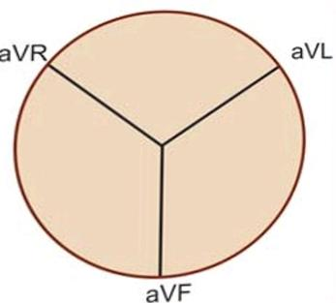
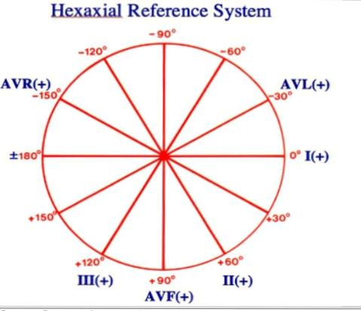
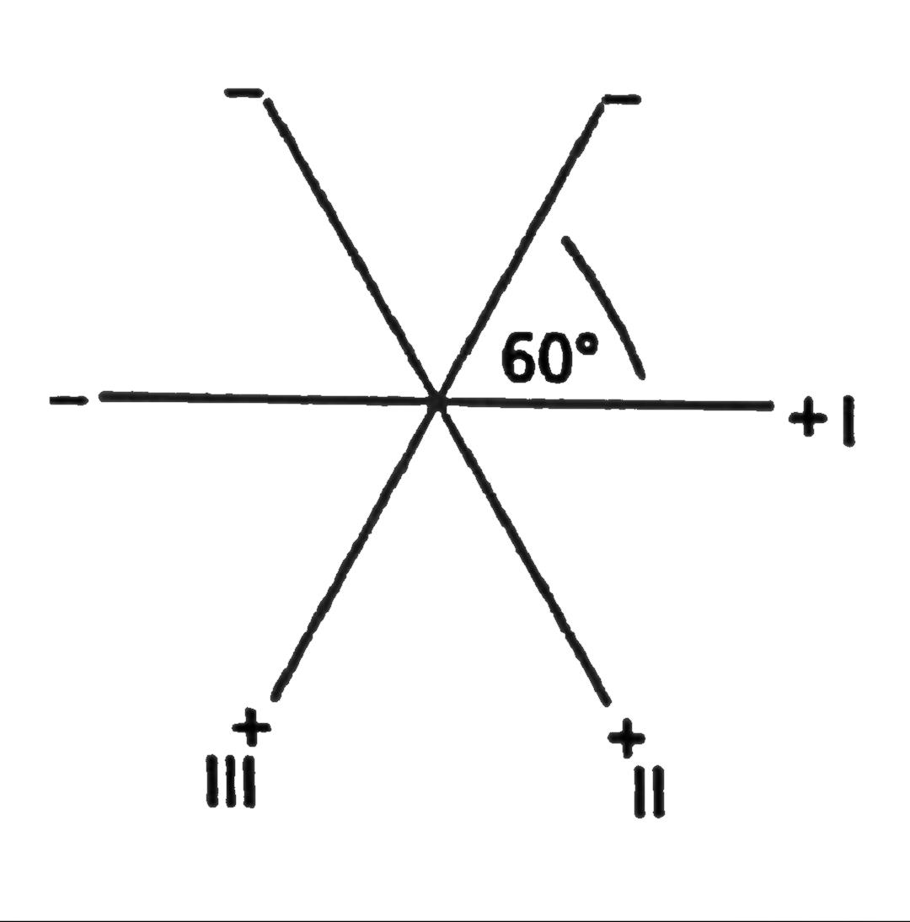
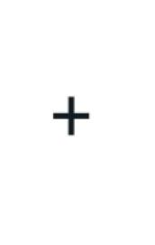
THE HEXAXIAL SYSTEM
Similarly 3 augmented limb leads ( aVR, aVF and aVL) can constitute another triaxial reference system.
When these 2 triaxial reference systems are superimposed on each other we can derive a hexaxial reference system in a 360° circle with each axis seperated from each other by 30°

Slide 6
THE QRS AXIS
QRS complex is the major deflection on the ECG.
The QRS axis is expressed as a degree on the hexaxial system.
Represents the direction of electrical forces in the frontal plane.
The net deflection in any lead is the algebraic sum of the positive and negative deflections.
Eg: if in any lead the positive deflection (R) is +6 and the negative
deflection is -2,then the net drflection will be +4.

Slide 7
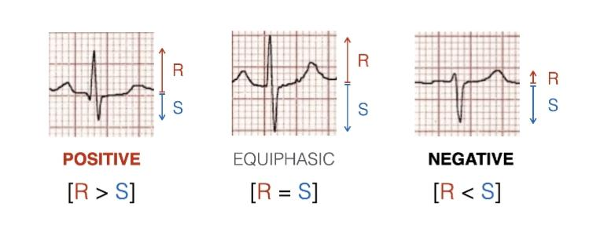

Slide 8
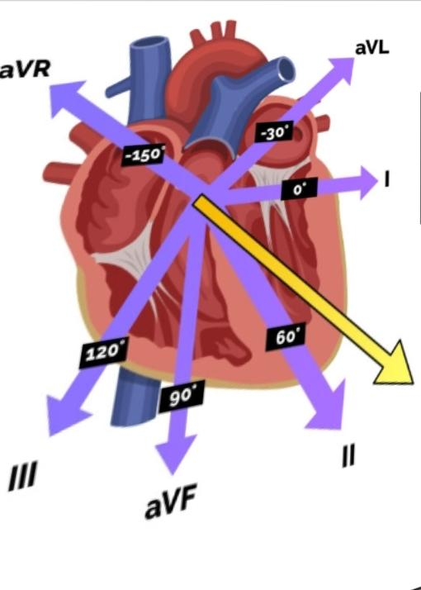
NORMAL CARDIAC AXIS
In healthy individuals, the axis lies between -30° and +90°
The overall direction of the electrical activity is towards the leads I, II and III
As a result a positive deflection is seen in all these leads
Lead II shows the most positive deflection – most closely aligned to the overall direction of electrical activity.
aVR shows the most negative deflection because
aVR is looking at the heart in the opposite direction.

Slide 9
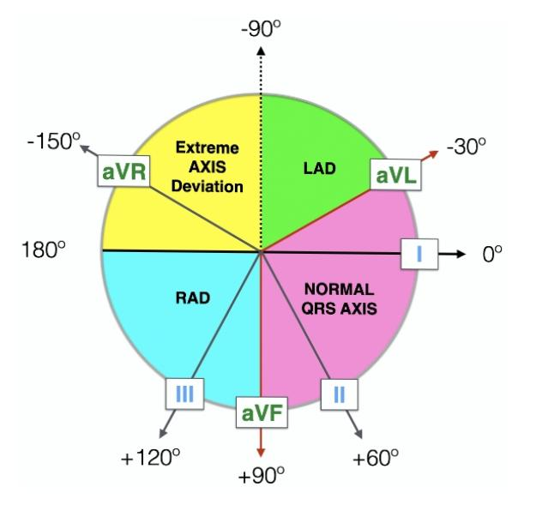
Normal axis -> -30° to 90°
Left axis deviation -> -30° to -90°
Right axis deviation -> 90° to 180°
Extreme axis deviation -> -90° to 180°
( Northwest )

Slide 10
DETERMINATION OF CARDIAC AXIS
Methods:
Quadrant method (LI and aVF)
3 lead analysis ( LI, LII and aVF)
Isoelectric lead analysis

Slide 11
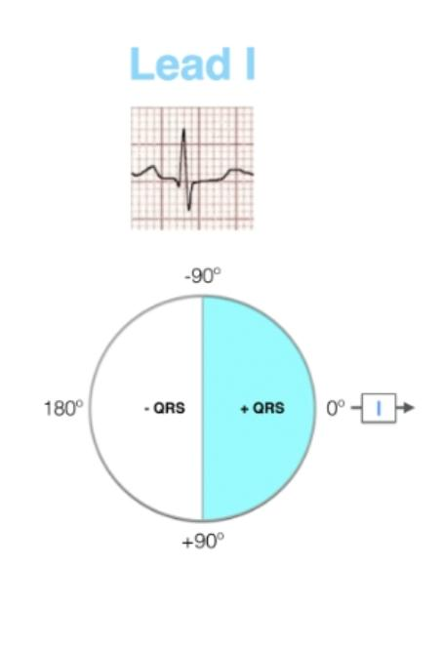
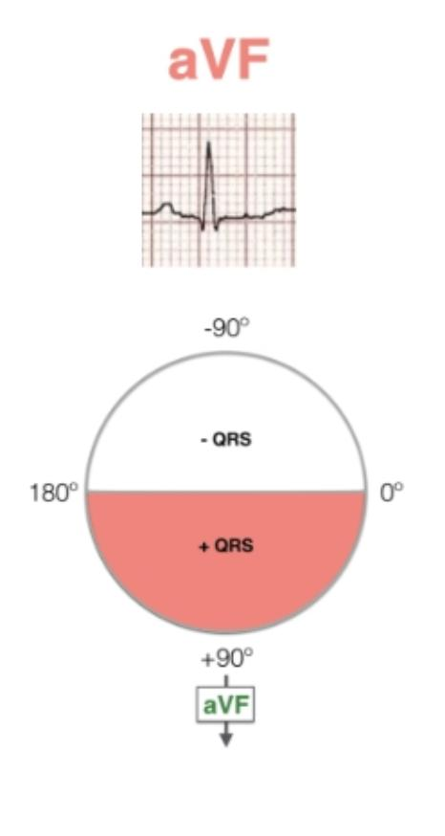
1.The quadrant method
• Consider the 4 possible quadrants.
Step 1) • Look at lead I
• If LI is positive (depolarizing towards LI),
axis must be in the right two quadrants.
Step 2) • Look at aVF
• If aVF is positive ( depolarizing towards aVF),
axis must be in the bottom two quadrants.

Slide 12
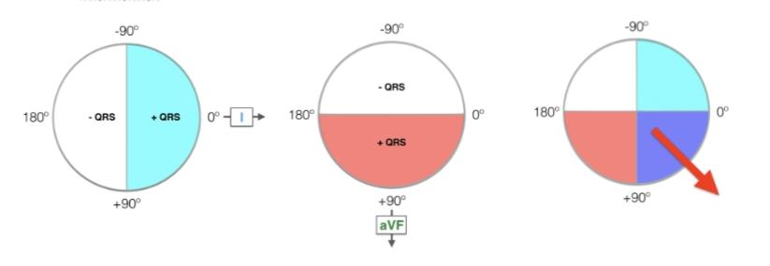
•By combining these two coloured areas , the quadrant of overlap determines the axis.
• Here the axis is between 0° and 90° ie, normal axis

Slide 13
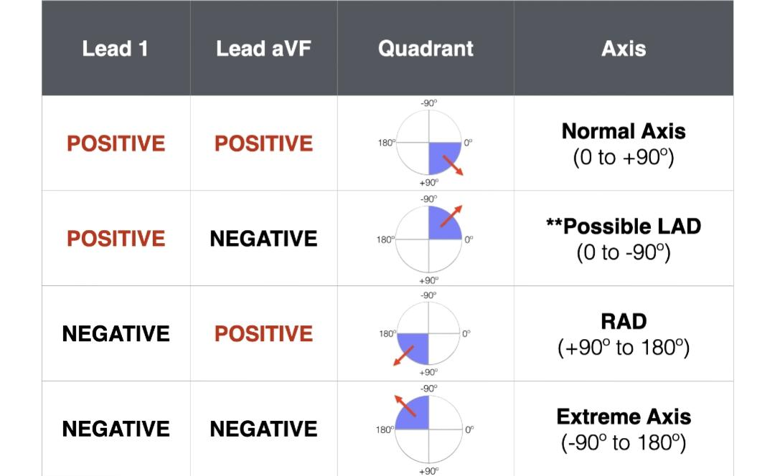

Slide 14
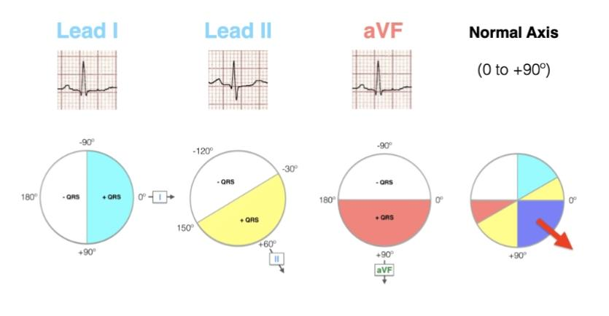
2. Three lead analysis
Here we add LII to the analysis of LI and aVF
Addition of LII can help determine pathological LAD from normal axis or physiologycal LAD.
( LIII an also be used instead of aVF)

Slide 16
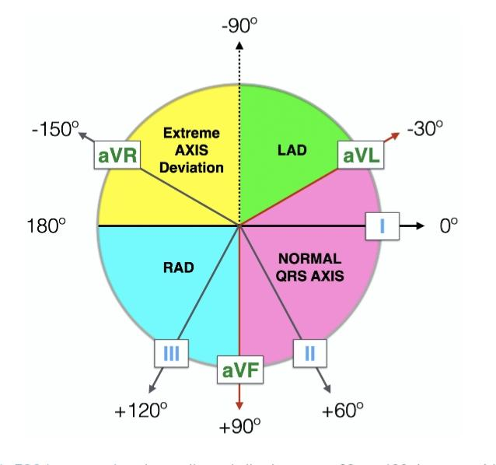
3. Isoelectric lead analysis
Step 1 : find the isoelectric lead
Step 2 : find the lead perpendicular to the isoelectric lead
Step 3 : Find the direction of the perpendicular lead
Lead I is perpendicular to aVF
Lead II is perpendicular to aVL
Lead III is perpendicular to aVR

Slide 17
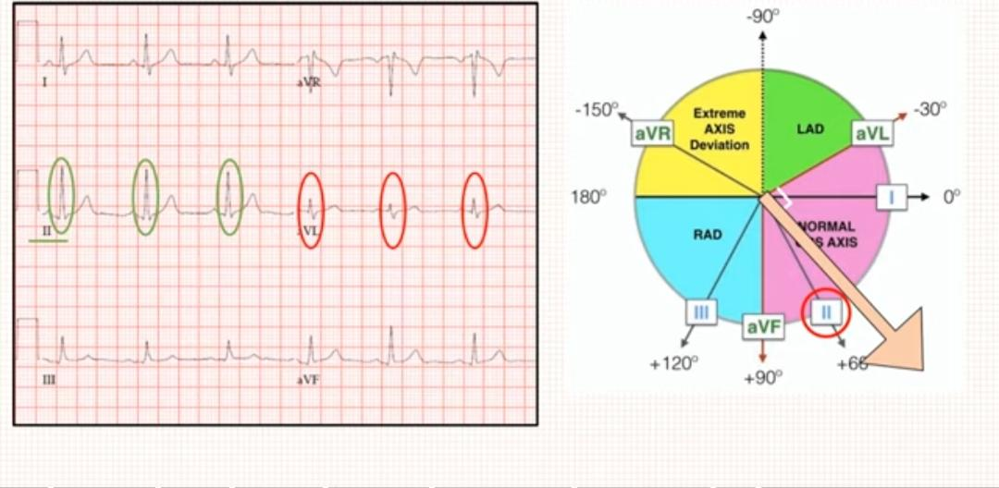

Slide 18
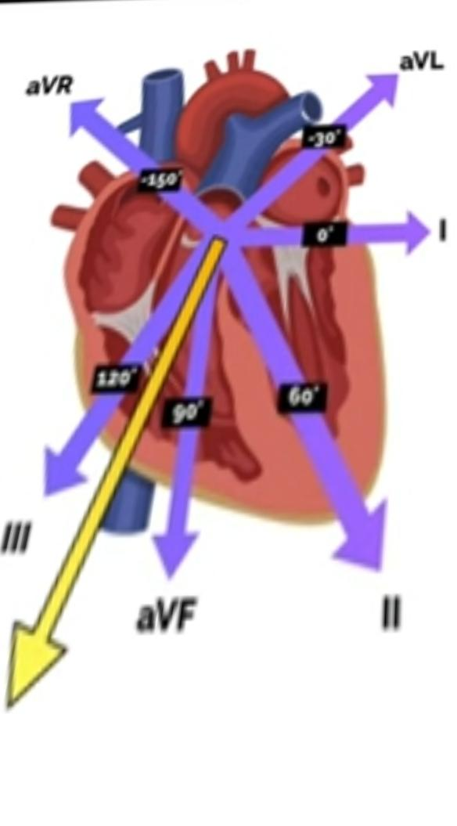
ABNORMALITIES OF CARDIAC AXIS
Right Axis Deviation
Causes: • Right ventricular hypertrophy
• Pulmonary embolism
• Lateral wall MI
•Dextrocardia
• Ostium secundum ASD
• Left posterior hemiblock
• Chronic lung disease
• Tall thin individuals

Slide 19
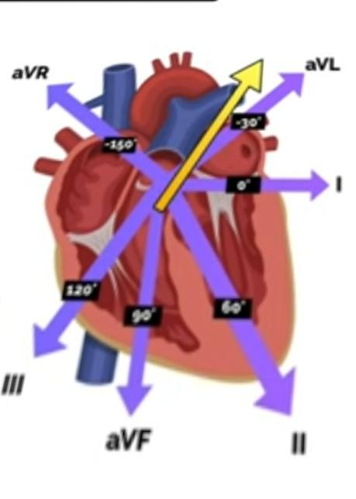
ABNORMALITIES OF CARDIAC AXIS
2.Left Axis Deviation
Causes : • Left ventricular hypertrophy
• Inferior wall MI
• Ostium primum ASD
• Left anterior hemiblock
• Wolf parkinson white syndrome
• Short squat individuals

Slide 20
ABNORMALITIES OF CARDIAC AXIS
3. Extreme axis deviation
Causes : • Ventricular tachycardia
• Severe RVH

Slide 21
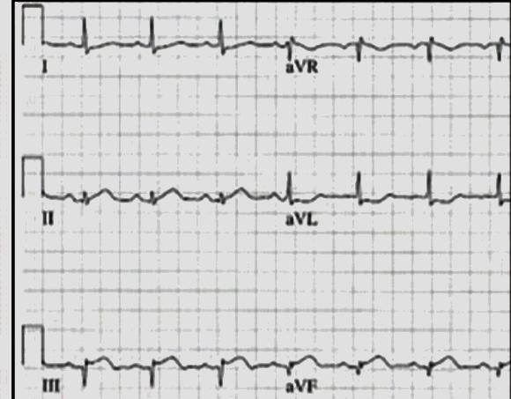
MCQs
Identity the axis
a ) normal axis
b) RAD
c ) LAD

Slide 22
Ans. c) LAD

Slide 23
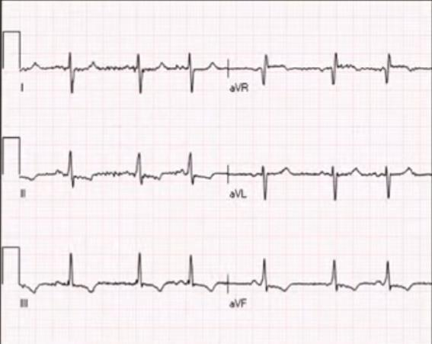
2.
a) RAD
b) LAD
c) Extreme axis deviation

Slide 24
Ans :a) RAD

Slide 25
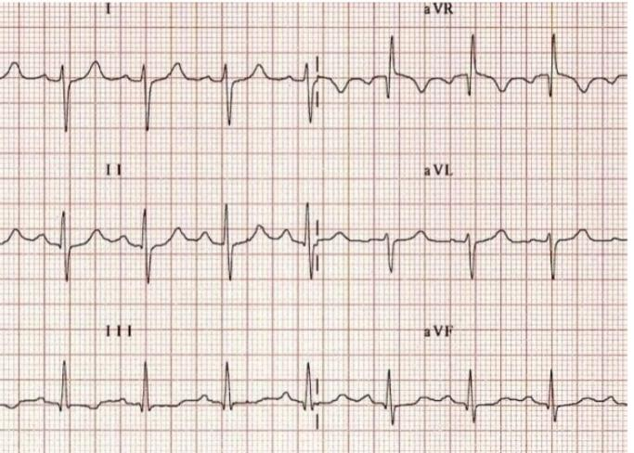
3.
a)Normal axis b) RAD c) LAD d) Extreme axis

Slide 26
Ans: b) RAD

