Slide 1
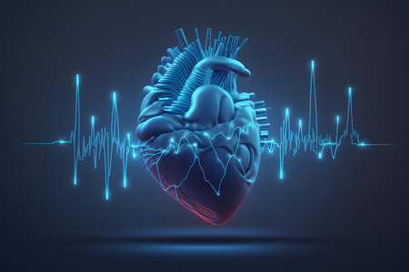
CONDUCTION SYSTEM OF THE HEART
Sana Muhammed P P

Slide 2
Introduction
The parts of the heart normally beats in an orderly sequence.
Atrial systole followed by ventricular systole &
during diastole all chambers are relaxed.
The cardiac electric activity that triggers heartbeat
originates in a specialized cardiac conduction system
and spreads to all parts of the myocardium.

Slide 3
Conducting system has following parts :
• Sinoatrial node (SA node)
• Atrioventricular node (AV node)
• AV bundle ( Bundle of His) and its branches
• Purkinje fibres

Slide 5
Origin and spread of cardiac excitation
Anatomic considerations
• SA node
- ‘Pacemaker of the heart’
- located at the Junction of SVC with the RA
- About 1.5cm long and 0.5 cm wide
- Action potential generated are of slow response type
- Conduction velocity – 0.05 m/s

Slide 6
There are 3 bundles of atrial fibres that connect SA node
to AV node :
1. Anterior tract of Bachmann
2. Middle tract of Wenckebach
3. Posterior tract of Thorel
• Conduction velocity of impulse – 1m/s
• Bachman's bundle / interatrial tract
From SA node, a conducting tract arises and directly enters into
LA.

Slide 7
AV node
- Situated in the lower part of RA close to IAS and just above
the AV ring
- 22m in length ,10mm wide and 3mm in thickness
- Fibre diameter is small and there are multiple sub-branches.
Therefore, rate of impulse conduction – 0.05m/s
- AV nodal delay
Delay of about 0.1s occurs for the impulse to be
transmitted through AV node
- When SA node stops producing impulses, AV node becomes the pacemaker of
the heart.

Slide 8
Bundle of His
- Small bundle of fibres that arises from AV node &
terminates in the Purkinje system
- Situated below the AV node and passes towards the IVS
- Length – 1cm
- On entering the IVS divides into RBB & LBB
- LBB divides into
▪︎ Anterior fascicles ▪︎ Posterior fascicles
- When SA node and AV node are defunct , the bundle of His
generates impulses

Slide 9
• Purkinje fibres
- form a sub endocardial plexus
- cells of Purkinje system are the largest cells in heart
- Possess double nuclei
- generates impulses - 20 to 35 bpm
- numerous gap junctions are present b/w cells
- rate of conduction is highest ( because of larger
diameter of fibre and presence of gap junctions)
- conduction rate – 4m/s

Slide 10
BLOOD SUPPLY
SA node – SA nodal artery
AV node – AV nodal artey
Bundle of His – Dually supplied by AV node
artery & the first septal branch of LAD
Purkinje fibres – Circumflex branch of LMCA

Slide 14
Cardiac muscle action potential
RMP of
- cardiac muscle fibres- -90mV
- Purkinje fibres - - 95mV
- Pacemaker tissue - -60mV
• Normally, 2 types of AP are seen in heart
1. Slow response AP
2. Fast response AP

Slide 15
Fast response AP occurs in
Atrial & ventricular muscle
Purkinje fibres
• Slow response AP occurs in
SA node and AV node
☆ AP vary from slow to fast type in different tissue of the heart

Slide 17
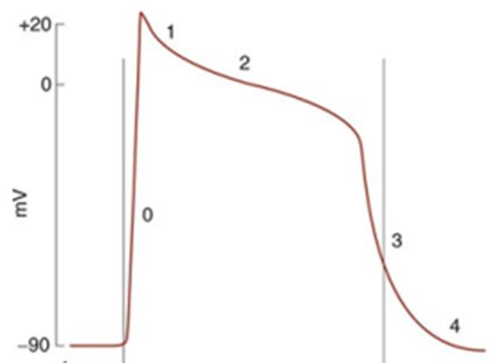
FAST RESPONSE ACTION POTENTIAL
Phases and ionic basis
Typically 5 phases are observed (recorded from ventricular muscle fibres)
• Phase 0: Depolarization
• Phase 1: Initial rapid repolarization
• Phase 2: Plateau Phase
• Phase 3: Late rapid repolarization
• Phase 4: Baseline

Slide 18
IONIC FLUX RESPONSIBLE FOR EACH PHASE OF CARDIAC MUSCLE AP
• Phase 0 : Initial rapid depolarization
& overshoot – opening of voltage-gated Na+ channels
• Phase 1 : Initial rapid repolarization -closure of Na+ channels
& opening of one type of K+ channels
( KCND2, CCND3, KCNA4)

Slide 19
Phase 2 : Plateau Phase- slower but prolonged
opening of voltage-gated Ca2+ channels
(L type channels)
• Phase 3 : Final repolarization – closure of Ca2+
channels & a slow, delayed increase of K+ efflux
• Phase 4 : RMP

Slide 21
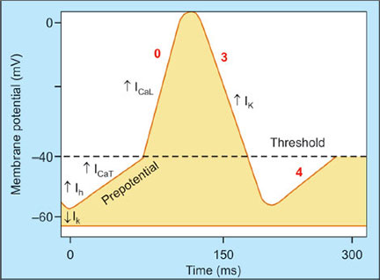
SLOW RESPONSE ACTION POTENTIAL
Consists mainly of 3 components
• Phase 0 : depolarization or slow rising upstroke
• Phase 3 : Phase of repolarization
• Phase 4 : Phase of slow depolarization

Slide 22
Phase 0 : opening of Ca2+ channels
Phase 3 : closure of Ca2+ channels and opening of K+ channels
Phase 4 : Early part due to closure of K+ channels
Later part due to transient Ca2+ channels

Slide 24
PACEMAKER POTENTIAL
SA node discharges rhythmically and automatically.
RMP that depolarizes is called the prepotential as it brings the membrane potential to the threshold, which then triggers the AP
Prepotential is known as pacemaker potential

Slide 25
Ionic basis of electrical activity in pacemaker
• RMP is not stable in SA node
• Initial part of pacemaker potential
Sloe influx of sodium channels
• Later part of pacemaker potential
Slow influx of calcium ions

Slide 26
Depolarization
When the negativity is decreased to -40mV ( threshold level) –
AP starts with rapid depolarization
• occurs because of influx of more calcium ions
• unlike other tissues,
Depolarization in SA node is mainly due to
influx of Ca2+ ions , rather than sodium ions.

Slide 27
Repolarization
Starts after rapid depolarization
Due to efflux of potassium ions from pacemaker fibres.
K+ channels remain open for longer time
⬇️
Efflux of more potassium ions
⬇️
Development of more negativity,
beyond the level RMP
⬇️
Slow depolarization starts once again
⬇️
Development of pacemaker potential,
which triggers the next action potential

Slide 29
Spread of cardiac excitation

