Slide 1
Device therapy in Heart Failure
Dr. Aiswarya Ravikrishnan

Slide 2
The U.S. FDA approved CRT device in 2001: a new era
ICDs and combined CRT-ICD devices also FDA approved for the management of HF.
ICDs: primary prevention of all-cause mortality through a reduction in SCD in HFrEF.
Combined CRT-ICD devices: reduce morbidity and mortality in HF patients with ventricular dyssynchrony, additive benefit over a CRT device alone.

Slide 3
In 2005 ACC/AHA heart failure guideline strongly supported, with class I indications, the use of ICD and CRT devices in the management of eligible HF patients
indications were updated in 2013
Implantable devices that monitor physiologic parameters:
patient activity level,
heart rate variability,
intrathoracic impedance, and
hemodynamics have been developed.

Slide 4
VENTRICULAR DYSSYNCHRONY: THE TARGET OF CRT
Several conduction abnormalities seen in chronic heart failure.
Abnormalities of ventricular conduction: bundle branch blocks,
alter timing and pattern of ventricular contraction: place the already failing heart at a further mechanical disadvantage.
Suboptimal ventricular filling,
a reduction in LV contractility,
prolonged duration of MR, and
paradoxical septal wall motion.
Mechanical manifestations of altered ventricular conduction have been termed ventricular dyssynchrony.

Slide 5
Ventricular dyssynchrony: prolonged QRS duration, (> 120 ms) on ECG.
1/3 pt with systolic HF have ventricular dyssynchrony.
increased mortality in HF patients.
Addressed with pacing therapy, through the implantation of pacing leads to both right and left ventricles.
This form of pacing therapy is now known as cardiac resynchronization therapy.

Slide 6
Several uncontrolled or unblinded studies: evaluate further the acute and longer-term effects of CRT on clinical status in HF patients
The results: encouraging:
patients demonstrating consistent, sustained improvement in exercise tolerance, quality of life, and NYHA functional class.
Large-scale RCTs confirmed the beneficial effects of CRT

Slide 7
RCTs of CRT in NYHA Class III and IV Patients
>4000 patients have been evaluated in RCTs of CRT in NYHA FC III and IV heart failure.
Landmark studies:
the Multisite Stimulation in Cardiomyopathy (MUSTIC) studies,
Multicenter InSync Randomized Clinical Evaluation (MIRACLE) trial,
MIRACLE ICD trial,
CONTAK CD trial,
Cardiac Resynchronization in Heart Failure (CARE HF) trial,
Comparison of Medical Therapy, Pacing and Defibrillation in Heart Failure (COMPANION) trial.

Slide 8
Multisite Stimulation in Cardiomyopathy Trials
The MUSTIC trials: designed to evaluate the safety and efficacy of CRT in patients with advanced HF, ventricular dyssynchrony, and either NSR or AF.
The first randomized single-blinded trials of CRT for HF.
The first study: 58 randomized patients with NYHA Class III HF, NSR, and a QRS duration of at least 150 ms
All patients implanted with a CRT device, and after a run-in period, randomized to either active pacing or no pacing. After 12 weeks, patients were crossed-over and remained in the alternate study assignment for 12 weeks.

Slide 9
The second MUSTIC study: fewer patients (only 37 completers) with AF and a slow ventricular rate (either spontaneously or from radiofrequency ablation).
A VVIR biventricular pacemaker and leads for each ventricle were implanted, the same randomization procedure;
however, biventricular VVIR pacing versus single-site right ventricular VVIR pacing (rather than no pacing) were compared in this group of patients with AF.

Slide 10
The primary endpoints for MUSTIC were
exercise tolerance assessed by measurement of peak oxygen consumption (V . O2) or the 6-minute hall walk distance (6MHWD) test and
quality of life determined using the Minnesota Living with Heart Failure (MLWHF) questionnaire.
Secondary endpoints included rehospitalizations and/or drug therapy modifications for worsening HF.

Slide 11
Results from the normal sinus rhythm arm of MUSTIC provided strong evidence of benefit.
The mean 6MHWD was 23% greater with CRT than without CRT (P < 0.001).
Significant improvement: quality of life and NYHA functional class ranking.
Fewer hospitalizations during active resynchronization therapy.
The AF cohort evaluated in MUSTIC demonstrated similar improvements, although the magnitude of benefit was slightly less.

Slide 12
Multicenter InSync Randomized Clinical Evaluation
MIRACLE was the first prospective, randomized, double-blind, parallel controlled clinical trial designed to evaluate the benefits of CRT.
Primary endpoints were NYHA class, quality of life score (using the MLWHF questionnaire), and 6MHWD.
Secondary endpoints included assessments of
a composite clinical response,
cardiopulmonary exercise performance,
cardiac structure and function,
a variety of measures of worsening HF, and
combined morbidity and mortality.

Slide 13
The MIRACLE trial
Conducted between 1998 and 2000.
It included 453 patients with moderate to severe symptoms of HF associated with a left ventricular ejection fraction (LVEF) of 35% or less and a QRS duration of at least 130 ms. Randomized (double blind) to CRT (n = 228) or to a control group (n = 225) for 6 months, while conventional therapy for HF was maintained.
Significant improvement in quality of life score, 6MHWD, NYHA functional class ranking, treadmill exercise time, peak V . O2, and LVEF.

Slide 14
CRT group: highly significant improvement in a composite clinical HF response endpoint.
fewer hospitalization (8% vs. 15%) or intravenous medications (7% and 15%) for the treatment of worsening HF (both P < 0.05).
reduction in length of stay, resulting in a 77% decrease in total days hospitalized over 6 months compared to the control group.
The major limitation of the therapy resulted from unsuccessful implantation of the device in 8% of patients.
The results of this trial led to FDA approval of the InSync system in August 2001, the first approved CRT system in America, allowing the introduction of CRT into clinical practice.

Slide 15
Evidence supporting the occurrence of reverse LV remodeling with chronic CRT.
Serial Doppler echocardiograms were obtained at baseline, 3 months, and 6 months in a subset of 323 patients.
CRT for 6 months was associated with
reduced end-diastolic and end-systolic volumes (both P < 0.001),
reduced LV mass (P < 0.01),
increased LVEF (P < 0.001),
reduced mitral regurgitant blood flow (P < 0.001), and
improved myocardial performance index (P < 0.001), compared with controls.
These effects are similar to those seen with beta-adrenergic blockade in HF but were seen in MIRACLE in patients already receiving beta-blocker therapy.

Slide 16
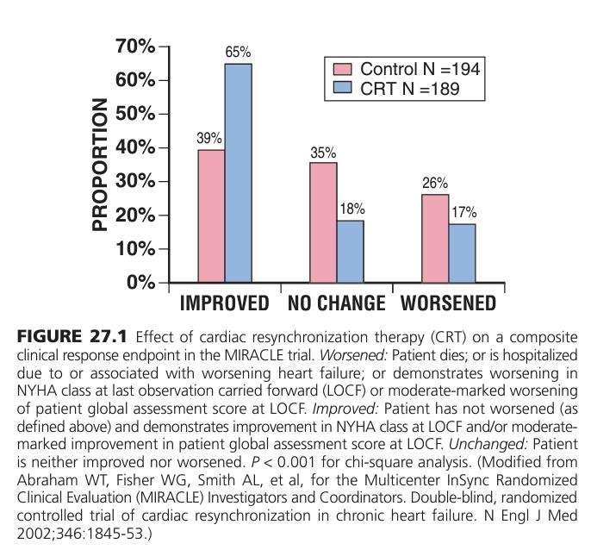

Slide 17
Multicenter InSync–Implantable Cardioverter-Defibrillator Randomized Clinical Evaluation
The MIRACLE ICD study: almost identical to the MIRACLE trial.
MIRACLE ICD was a prospective, multicenter, randomized, double-blind, parallel-controlled clinical trial intended to assess the safety and efficacy of a combined CRT-ICD system in patients with
dilated cardiomyopathy (LVEF ≤35%; LVEDD ≥55 mm),
NYHA Class III or IV HF,
ventricular dyssynchrony (QRS ≥130 msec),
and an indication for an ICD.

Slide 18
Primary and secondary efficacy measures were essentially the same as those evaluated in the MIRACLE trial, but also included measures of ICD function.
Of 369 patients receiving devices and randomized,
182 were controls (ICD activate, CRT inactive), and
187 were in the resynchronization group (ICD activate, CRT active)
At 6 months, active CRT had a greater improvement in median quality-of-life score and functional class than controls,
but were no different than controls in the change in 6MWD
Peak V . O2 increased by 1.1 mL/kg/min in the resynchronization group, versus 0.1 mL/kg/min in controls (P = 0.04),
while treadmill exercise duration increased by 56 seconds in the CRT group and decreased by 11 seconds in controls (P = 0.0006).

Slide 19
The magnitude of improvement was comparable to that seen in the MIRACLE trial, suggesting that
HF patients with an ICD indication benefit as much from CRT as those without an indication for an ICD.
The combined CRT-ICD device used in this study was approved by the FDA in June 2002 for use in NYHA Class III and IV systolic HF patients with ventricular dyssynchrony and an ICD indication.

Slide 20
CONTAK CD
581 symptomatic HF patients with ventricular dyssynchrony and malignant ventricular tachyarrhythmias, who were all candidates for an ICD.
Following unsuccessful implant attempts and withdrawals, 490 patients were available for analysis.
The study did not meet its primary endpoint of a reduction in disease progression, defined by a composite endpoint of HF hospitalization, all-cause mortality, and ventricular arrhythmia requiring defibrillator therapies, although the trends were in a direction favoring improved outcomes with CRT.

Slide 21
However, statistically significant improvements in peak V . O2 and quality of life, although quality of life was improved only in NYHA Class III and IV patients without right bundle branch block.
LV dimensions were also reduced, and
LVEF increased.
Improvements in NYHA functional class were not observed in this study.
The CONTAK CD device was approved by the FDA for use in NYHA Class III and IV systolic HF patients with ventricular dyssynchrony and an ICD indication in May 2002

Slide 22
Cardiac Resynchronization in Heart Failure Trial
The CARE HF trial: evaluate the effects of CRT without an ICD on morbidity and mortality in patients with NYHA Class III or IV HF and ventricular dyssynchrony.
819 patients with an LVEF of 35% or less and ventricular dyssynchrony (defined as QRS ≥150 msec or 120-150 msec, with echocardiographic e/o dyssynchrony)
followed for an average of 29.4 months;
404 patients were assigned to receive optimal medical therapy alone, and
409 were randomized to optimal medical therapy plus CRT.

Slide 23
The primary endpoint, risk of death from any cause or unplanned hospitalization for a major cardiac event, significantly reduced by 37%
In the CRT group, 82 (20%) died, in the medical group 120 (30%): significant 36% reduction in all-cause mortality with CRT.
CRT also significantly reduced
the risk of unplanned hospitalization for a major cardiac event by 39%,
all-cause mortality plus HF hospitalization by 46%, and
HF hospitalization by 52%.

Slide 24
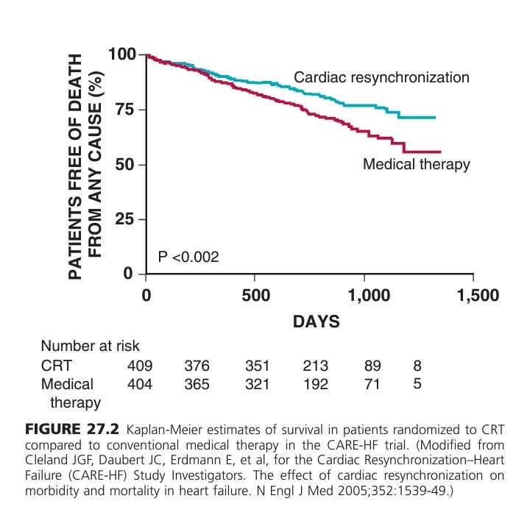

Slide 25
Comparison of Medical Therapy, Pacing, and Defibrillation in Heart Failure
Early 2000, COMPANION was a multicenter, prospective RCT designed
to compare drug therapy alone to drug therapy combined with CRT in patients with
dilated cardiomyopathy,
an intraventricular conduction defect (IVCD),
NYHA Class III or IV HF, and
no indication for a device.

Slide 26
Randomized 1520 patients into one of three treatment groups in a 1 : 2:2 allocation:
group I (308 patients) received optimal medical care only,
group II (617 patients) received optimal medical care and the Guidant CONTAK TR (biventricular pulse generator), and
group III (595 patients) received optimal medical care and the CONTAK CD (combined HF/bradycardia-tachycardia device).
The primary endpoint: composite of all-cause mortality and all-cause hospitalization, measured as time to first event, beginning from time of randomization.
Secondary endpoints included all-cause mortality and a variety of measures of CV morbidity.

Slide 27
The combined endpoint of mortality or HF hospitalization was reduced by 35% in CRT and 40% in CRT-ICD (both P < 0.001).
For the mortality endpoint alone, CRT had a 24% risk reduction (P = 0.060), and CRT-ICD had of 36% reduction (P < 0.003),
COMPANION confirmed the results of earlier CRT trials
In addition, COMPANION showed for the first time the impact of CRT-ICD in reducing all-cause mortality and suggested incremental benefit from combined device therapies.

Slide 28
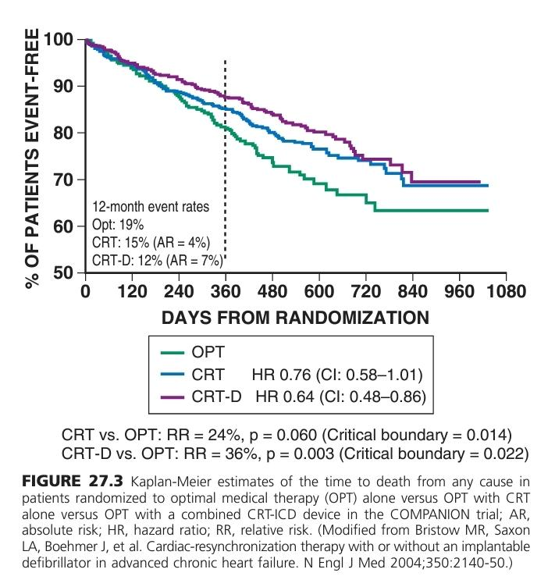

Slide 29
Guideline Recommendation
Trials in NYHA Class III and IV HF patients established the initial guideline recommendation for CRT:
“Patients with LVEF </=35%, sinus rhythm, and NYHA FC III or ambulatory Class IV symptoms despite recommended optimal medical therapy and who have cardiac dyssynchrony, which is currently defined as a QRS >/= 0.120s, should receive CRT, with or without an ICD, unless contraindicated(Level of Evidence:A).”
These guidelines have been updated.
Recent clinical trials in CRT have focused on delaying progression of HF in asymptomatic or less symptomatic patients.
The MIRACLE-ICD II trial: a small cohort of NYHA Class II patients benefited: subsequent large-scale trials in this population.

Slide 30
RCTs of CRT in NYHA Class I and II Patients
>4500 patients evaluated.
Landmark studies:
the Resynchronization Reverses Remodeling in Systolic Left Ventricular Dysfunction (REVERSE) trial,
Multicenter Automatic Defibrillator Implantation Trial with Cardiac Resynchronization Therapy (MADITCRT), and
Resynchronization/defibrillation for Ambulatory Heart Failure Trial (RAFT).

Slide 31
Resynchronization Reverses Remodeling in Systolic Left Ventricular Dysfunction Trial
The REVERSE trial: double-blinded RCT: address the benefit of CRT on heart failure morbidity in patients with mild HF compared to optimal medical therapy alone
610 patients with NYHA Class I and II HF (QRS ≥120 msec, LVEF ≤40%, LVEDD ≥55 mm) were randomized.
All patients received a CRT device with or without an ICD, and 191 were assigned to the control of optimal medical therapy alone (CRT off) and 419 to the CRT group combined with optimal medical therapy.
The primary endpoint was a clinical composite HF score.
The study goal: preventing disease progression, so a “worsened” status was considered a negative outcome.

Slide 32
While the percent worsened in the clinical composite response endpoint was not significantly reduced in the CRT compared to control group,
a significant benefit of CRT was seen in improvement in ventricular structure and function and in HF morbidity, which was also significantly improved with a 53% relative risk reduction (RRR) in the time to first HF hospitalization.
Thus, REVERSE was the first large, randomized, multicenter trial to demonstrate the potential for CRT to slow progression of disease through reverse remodeling in NYHA Class I and II HF patients with ventricular dyssynchrony.

Slide 33
Multicenter Automatic Defibrillator Implantation Trial with Cardiac Resynchronization Therapy
The MADIT-CRT trial: a multicenter RCT designed to address the potential survival and morbidity benefit of CRT in NYHA Class I and II HF patients by assessing the reduction in risk of death and nonfatal HF events in this population.
Prophylactic CRT combined with an ICD was compared to ICD only in 1820 patients (LVEF ≤30%, QRS ≥130 msec) with either an ischemic (Class I patients) or any (Class II patients) cause.

Slide 34
Not blinded;
Average follow-up of 2.4 years, the primary endpoint of death from any cause or nonfatal HF event occurred in 17.2% of the CRT-ICD group versus 25.2% of the ICD-only group, (P = 0.001).
41% reduction in HF events
both ischemic and nonischemic: benefit with CRT;
women > men and
in patients with QRS of 150 milliseconds or longer
QRS morphology; LBBB benefit more

Slide 35
The MADIT-CRT trial led the FDA to expand the indication for CRT to NYHA Class II or ischemic Class I patients, with
LVEF less than 30%,
QRS duration longer than 130 ms, and
LBBB,
for the devices evaluated in this study.

Slide 36
Resynchronization/Defibrillation for Ambulatory Heart Failure Trial
The RAFT trial differs in that, initially, patients in NYHA Class II and III were included.
After data from the CARE HF trial showed a clear reduction in mortality for patients in NYHA Class III, protocol revised to include only patients in Class II.
The RAFT trial was first to show a mortality benefit of combined CRT-ICD over an ICD alone, and a mortality reduction with the addition of CRT in patients in NYHA Class II HF

Slide 37
The primary outcome of all-cause mortality or hospitalization for HF
ICD: 40% and CRT-ICD: 33%
significant delay to time of occurrence of the primary outcome in the CRT-ICD group.
5-year actuarial death rate was lower
time to death longer

Slide 38
These benefits were at the expense of an increased rate of procedure-related adverse events.
The results from RAFT and REVERSE resulted in the FDA expanding the indication for certain CRT devices to include patients with mildly symptomatic HF (NYHA Class II, with LVEF ≤30%, LBBB, and QRS ≥130 msec).

Slide 39
CRT in Patients with Narrow QRS Complex
Mechanical dyssynchrony occurs in patients with a narrow QRS complex, suggesting the potential usefulness of CRT in HF patients with narrow QRS and imaging-identified (usually echocardiographic) ventricular dyssynchrony.
Preliminary studies suggested the benefits of CRT in such patients;
Definitive trial, Echocardiography Guided Cardiac Resynchronization Therapy (EchoCRT), did not confirm these benefits.

Slide 40
The EchoCRT trial
Evaluated the effect of CRT in patients with
NYHA Class III or IV HF,
LVEF of 35% or less,
QRS duration less than 130 milliseconds, and
echocardiographic evidence of LV dyssynchrony.
All patients underwent device implantation and were randomly assigned to have CRT turned on or off.
The primary efficacy outcome was the composite of death from any cause or first hospitalization for worsening HF.
The study was stopped for futility on the recommendation of the Data and Safety Monitoring Board.

Slide 41
809 randomized patients
followed for a mean of 19.4 months,
the primary outcome: 116 of 404: CRT group, versus 102 of 405: control group
Deaths: CRT group: 45, control group: 26, demonstrating the potential for harm in using CRT in narrow-QRS patients.
Thus, CRT is considered contraindicated in these patients.

Slide 44
Indications for CRT in Patients with Heart Failure
Since the original 2005 guideline recommendation for CRT, the indications for CRT have been expanded to less symptomatic patients, but also limited on the basis of QRS morphology and QRS duration.
Current guideline recommendations define ventricular dyssynchrony by QRS duration, rather than by imaging (echocardiography)–assessed ventricular dyssynchrony.

Slide 45
Subgroup analyses from REVERSE, MADITCRT, and RAFT: patients with QRS duration of >/=150 ms and/or with LBBB morphology benefit most from CRT.
Recommendations for the use of CRT were revised in 2012
According to these revised CRT guidelines, indications for CRT include:
patients who have an LVEF of 35% or less,
sinus rhythm,
LBBB with QRS of 120 ms or longer, and
NYHA Class II, III, or ambulatory IV symptoms while receiving optimal medical treatment.

Slide 46
Although the level of indication is somewhat stronger for patients fulfilling these criteria,
CRT should generally be offered to all HF patients with a reduced EF and LBBB.
In patients with more advanced HF (i.e., NYHA Class III or ambulatory Class IV patients), those fulfilling the aforementioned criteria with a QRS duration of at least 150 ms and non-LBBB morphology should also be considered for CRT

Slide 47
Limitations of CRT
The success rate for placement of a transvenous cardiac resynchronization system: 88% to 92% in clinical trials, 97% to 98% in contemporary clinical experience (e.g., Ohio State University experience).
Some patients will not receive a functioning system using this approach.
Implant-related complications are similar to those seen with standard pacemakers and defibrillators
Additional risk of dissection or perforation of the coronary sinus.
Rare event with substantial morbidity and even mortality in HF patients

Slide 48
Some patients do not respond to this therapy.
The nonresponder rate for CRT ~ 25%,
Similar to the nonresponder rate for HF drug therapies.
Factors:
suboptimal LV lead placement,
suboptimal AV and VV timing,
ventricular scar, and
HF disease progression.

Slide 49
SUDDEN CARDIAC DEATH IN HEART FAILURE
HF & LV Systolic Dysfunction patients are at increased risk for sudden cardiac death
Occurs at a rate six to nine times that seen in the general population.
Given this high incidence of SCD in HF patients, it was easy to hypothesize that an ICD used as prophylactic therapy would reduce total mortality by reducing the incidence of SCD.
A series of studies have tested this hypothesis.

Slide 50
Randomized Controlled Trials of Implantable-Cardioverter Defibrillators for Heart Failure
Landmark trials establishing a role for ICDs as primary prevention of mortality in HF patients are
the Multicenter Automatic Defibrillator Implantation II (MADIT II),
Prophylactic Defibrillator Implantation in Patients with Nonischemic Dilated Cardiomyopathy (DEFINITE), and
the National Institutes of Health (NIH)–sponsored Sudden Cardiac Death–Heart Failure Trial (SCD-HeFT).
A more recent study, the Danish Study to Assess the Efficacy of ICDs in Patients with Non-ischemic Systolic Heart Failure on Mortality (DANISH) trial, questions efficacy of prophylactic ICD use in nonischemic HF patients

Slide 51
Multicenter Automatic Defibrillator Implantation II Trial
MADIT II was prospectively designed to assess the survival benefit of ICDs in a population of post–MI patients with reduced EF (<30%).
Included no arrhythmic markers, such as nonsustained or inducible ventricular tachycardia, for inclusion.
1232 patients: randomly assigned in a 3 : 2 ratio to receive an ICD (742) or conventional medical therapy (490).

Slide 52
During an average follow-up of 20 months,
the all-cause mortality rates were 19.8% in the conventional therapy arm and 14.2% in the ICD group.
The effect of ICD therapy on survival was similar in subgroup analyses stratified according to age, gender, EF, NYHA class, and QRS duration.
Betablocker use was 72% and was well balanced

Slide 53
Majority of patients enrolled in MADIT II were NYHA Class II or III.
Class IV patients excluded, and the Class I cohort was relatively small.
The average LVEF was 23%.
These findings suggest that HF patients with mild to moderate symptoms and moderate to severe reductions in LVEF may benefit the most from a prophylactic ICD.
Survival benefit observed in MADIT II began approximately 9 months after the device was implanted.
Important when considering the timing of device placement in eligible patients.

Slide 54
Prophylactic Defibrillator Implantation in Patients with Nonischemic Dilated Cardiomyopathy Trial
MADIT II: exclusively post-MI patients
the DEFINITE trial was the first RCT of primary prevention therapy with an ICD in nonischemic cardiomyopathy patients.
Such patients also exhibit high rates of SCD;
But no invasive or noninvasive testing procedure has been shown to determine accurately which nonischemic HF patient is likely to die suddenly.
Older observations that the prophylactic administration of an antiarrhythmic agent, amiodarone, might prolong survival in nonischemic cardiomyopathy patients.

Slide 55
The DEFINITE trial was a prospective evaluation of 458 patients with nonischemic dilated cardiomyopathy.
Entry criteria included
EF of 35% or less,
history of symptomatic HF, and
presence of ambient arrhythmias, defined as an episode of nonsustained ventricular tachycardia (VT) or at least 10 premature ventricular complexes (PVCs) per 24-hour period on continuous ambulatory electrocardiographic monitoring.

Slide 56
The 229 patients randomized to each study arm to receive
either an ICD and standard medical therapy or
standard medical therapy alone.
Compliance with medical therapy was excellent and included
an angiotensin-converting enzyme inhibitor (ACEI) in 86% of the cohort and
a beta blocker in 85%.
A mean of 29.0 ±14.4 months,
primary endpoint of all-cause mortality.

Slide 57
68 deaths: , 28 in the ICD group and 40 in the standard therapy group.
The implantation of an ICD yielded
a nonsignificant 35% reduction in death from any cause and
significantly reduced the risk of SCD by a remarkable 80%
In the subgroup of NYHA Class III patients, all-cause mortality was significantly decreased in the ICD arm
This study was underpowered and did not reach statistical significance
The results demonstrated a strong trend toward a survival advantage for patients receiving an ICD.

Slide 58
Sudden Cardiac Death–Heart Failure Trial
Published in 2005
2521 patients between 1997 and 2001.
Patients with NYHA Class II (70%) or III (30%) HF and reduced LVEF (≤35%; mean ≈ 25%) of either ischemic or nonischemic etiology were eligible for the study.
SCD-HeFT was a three-arm trial, comparing treatment with an ICD to amiodarone and placebo.

Slide 59
Thus, SCD-HeFT addressed at least two important issues in HF management:
(1) whether or not empiric amiodarone therapy saved lives in well-treated NYHA Class II and III HF patients with no arrhythmic indication for the drug, and
(2) whether or not a prophylactic ICD saved lives in such patients with HF from either an ischemic or a nonischemic cause.
In SCD-HeFT, patients received standard HF therapy, if tolerated, which included an ACEI or angiotensin receptor blocker (ARB) in 85%, beta blocker in 69%, and aldosterone antagonists in 19%, compatible with then-current guideline recommendations.

Slide 60
The median follow-up was 45.5 months.
The cohort was equally divided between ischemic and nonischemic causes of HF
Mortality rates in
ICD, amiodarone, and placebo groups were, respectively,
17.1%, 24%, and 22.3% at 3 years and
28.9%, 34.1%, and 35.9% at 5 years
The ICD was associated with a statistically significant 23% reduction in all-cause mortality compared to placebo

Slide 61
Mortality in the amiodarone arm was not significantly different from placebo across all subgroups
Similar degrees of benefit with the ICD were noted in patients with ischemic (21% mortality reduction) and nonischemic (27% mortality reduction) HF,
thus confirming the findings of MADIT II and DEFINITE, respectively.
The SCD-HeFT trial provides the most robust evidence to date supporting the prophylactic use of an ICD in patients with NYHA Class II and III systolic HF.

Slide 62
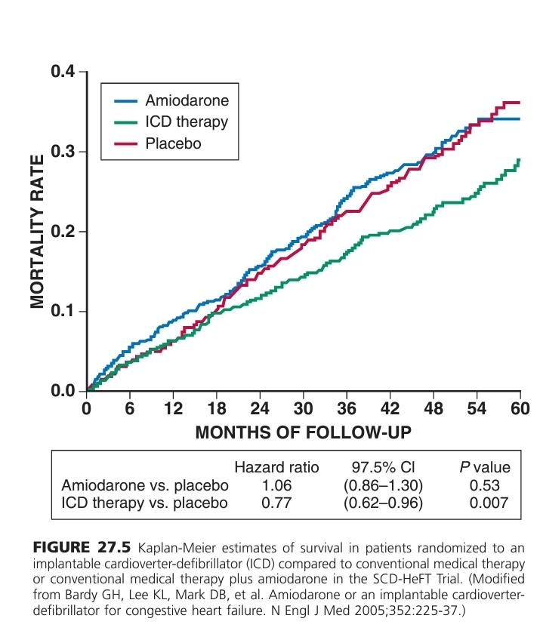

Slide 63
Danish Study to Assess the Efficacy of ICDs in Patients with Non-Ischemic Systolic Heart Failure on Mortality (DANISH)
The DANISH trial randomly assigned 1116 patients with systolic HF not caused by coronary artery disease (CAD; i.e., nonischemic cardiomyopathy) to receive an ICD (556 patients) versus usual care (560 patients).
In both groups, 58% of patients received CRT.
Results showed that at after 5.6 years, the primary outcome of death from any cause occurred in 120 patients in the ICD group compared to 131 patients in the usual-care group

Slide 64
The secondary endpoint of SCD occurred in
24 patients in the ICD group versus
46 patients in the usual-care group (P = 0.005).
The authors concluded “prophylactic ICD implantation in patients with symptomatic systolic heart failure not caused by coronary artery disease was not associated with a significantly lower long-term rate of death from any cause than was usual clinical care

Slide 65
However, an updated meta-analysis supports the efficacy of ICD use for nonischemic cardiomyopathy, despite the results of the DANISH trial.
six RCTs enrolling 2970 patients with nonischemic cardiomyopathy to study the efficacy of ICDs for primary prevention.
Pooled analysis demonstrated a statistically significant 23% risk reduction (RR) in all-cause mortality in favor of ICD therapy
Thus it is unlikely that current guideline recommendations for ICDs will change, despite the negative result of the DANISH trial.

Slide 69
Indications for Prophylactic ICD Implantation in Heart Failure Patients
The 2013 ACC/AHA heart failure guidelines provided strong (level I) recommendations for prophylactic ICDs in patients with HF and reduced EF.
primary prevention of SCD in
nonischemic dilated cardiomyopathy or
ischemic heart disease at least 40 days after MI and with LVEF of 35% or less and
NYHA Class II or III symptoms receiving chronic GDMT, who have reasonable expectation of meaningful survival for more than 1 year (level of evidence A).

Slide 70
NYHA Class I patients with ischemic heart disease at least 40 days post-MI with LVEF of 35% or less, who have reasonable expectation of meaningful survival for more than 1 year (level of evidence B).

Slide 71
Implantable Hemodynamic Monitors
Under investigation.
These devices allow continuous or intermittent assessment of hemodynamics, generally focused on the assessment of intracardiac or pulmonary artery pressures.
The CardioMEMS Heart Sensor Allows Monitoring of Pressure to Improve Outcomes in NYHA Class III Heart Failure Patients (CHAMPION) trial
randomized 550 patients, regardless of LVEF, to two groups;
clinicians used a novel wireless monitoring system for daily measurement of pulmonary artery pressure (PAP) in addition to standard of care (treatment group; n = 270) versus standard of care alone (control group; n = 280).43

Slide 72
The CHAMPION trial differed from prior studies of IHMs in that specific pressure targets and treatment algorithms were mandated by protocol to ensure adequate testing of the hypothesis.
The primary endpoint of the trial was the rate of HF hospitalization over 6 months, and long-term outcomes were also prospectively evaluated.
Significantly fewer HF hospitalizations occurred in the treatment group (83) than in the control group (120).
The majority of pressure-based medication changes (≈75%) involved diuretics and long-acting nitrates.

Slide 73
All four secondary endpoints were met favoring the treatment group,
including PAP reduction,
proportion of patients hospitalized for HF,
days alive and out of the hospital for HF, and
quality-of-life score.
Freedom from device- or system-related complications was 98.6%, and
overall freedom from pressure-sensor failures was 100%.
The results of the CHAMPION trial led to the FDA approval of the first implantable hemodynamic monitoring system in May 2014, for use in HF patients with NYHA Class III symptoms and a history of HF hospitalization within the past 12 months.
Other IHMs are currently in development.

Slide 74
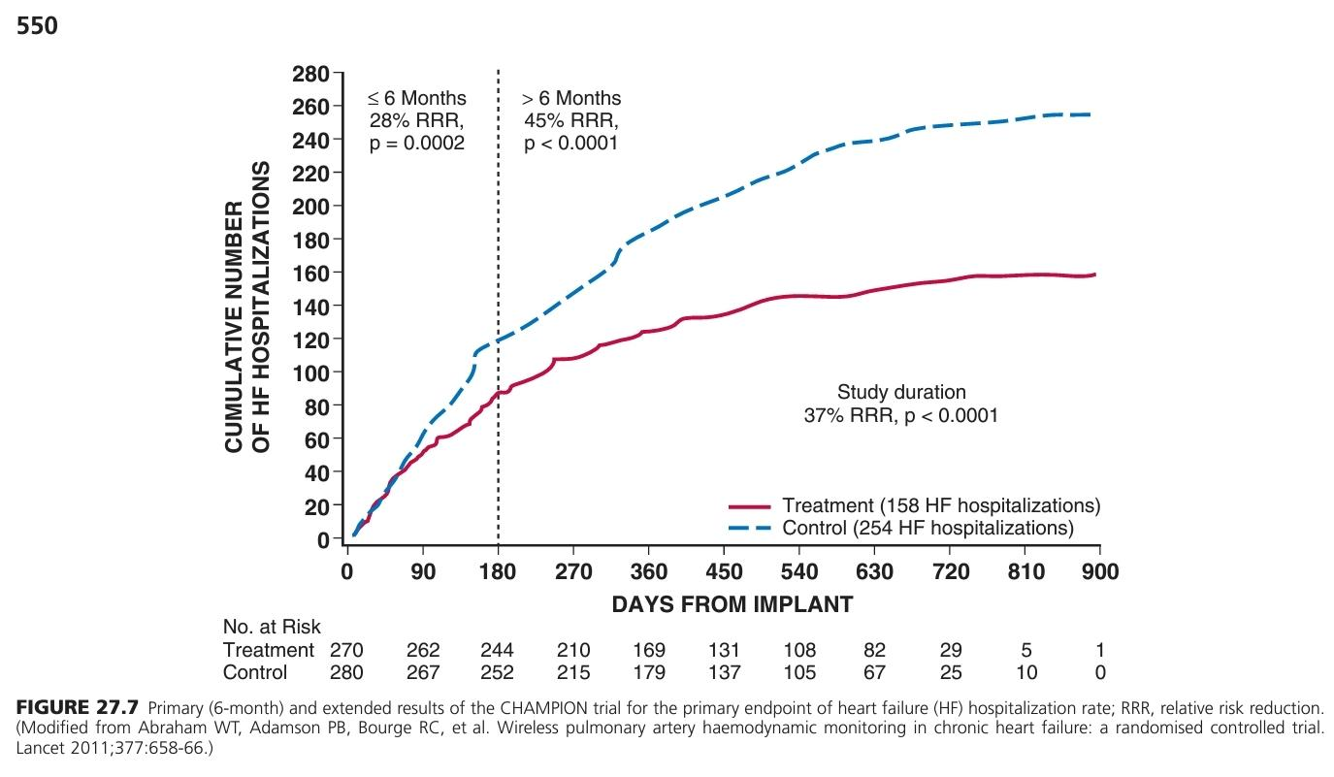

Slide 75
CONCLUSION
CRT offers a therapeutic approach for treating patients with ventricular dyssynchrony and heart failure.
CRT is safe and effective,
significant improvement in both clinical symptoms and multiple measures of functional status, exercise capacity, and outcomes.
Recommendations for CRT are now based not only on QRS duration but also on morphology.
Prophylactic implantation of an ICD is also of proven benefit in HF patients.
Implantable hemodynamic monitoring technologies improve the clinician’s ability to avoid episodes of HF decompensation and may improve the natural history of the disease.

Slide 76
Guidelines: CRT and ICD in HFrEF
In 2012, the American College of Cardiology, American Heart Association, and Heart Rhythm Society (ACC/AHA/HRS) updated the 2008 guidelines for device-based therapy of cardiac rhythm abnormalities.
These revised guidelines were incorporated into the 2013 ACCF/AHA heart failure guidelines.
Comprehensive revision of CRT indications, based on all available studies through 2013.
The guidelines expand the indications for CRT to some NYHA Class II and very selected Class I patients,
limit CRT indications by QRS morphology and QRS duration,

Slide 77
The most certain indications are for those patients who have
a left ventricular ejection fraction (LVEF) of 35% or less,
sinus rhythm,
left bundle branch block with a QRS duration of 150 ms or longer, and
NYHA Class II, III, or ambulatory IV symptoms and who are receiving optimal medical treatment.

Slide 78
Patients who have had
sustained ventricular tachycardia,
ventricular fibrillation,
unexplained syncope, or
cardiac arrest
are at highest risk for recurrence.
Indications for implantable cardioverter-defibrillator (ICD) therapy as secondary prevention of SCD is also discussed in the 2013 ACCF/AHA guidelines for heart failure as well as the ACCF/AHA/HRS device-based therapy guidelines

Slide 80
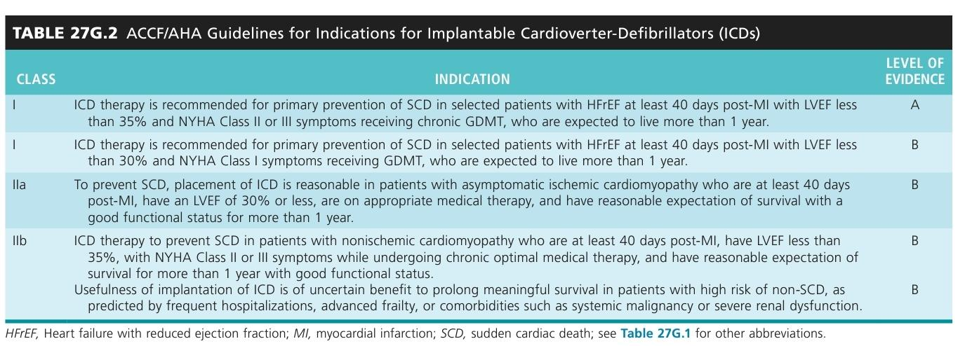

Slide 81
Palliative surgery in Heart Failure

Slide 85
The STICH trial
a prospective, randomized, intention-to-treat study of 2800 patients from 100 centers.
Patients on an optimal medical regimen with LV dysfunction and CAD amenable to CABG were randomly assigned to one of three different treatment strategies:
CABG,
CABG plus surgical ventricular reconstruction (SVR), or
medical therapy alone (MED)
Address two primary hypotheses:
(1) CABG combined with medical therapy improves long-term survival over that achieved with MED, and
(2) SVR provides additional long-term survival benefit when combined with CABG and medical therapy.

Slide 86
A 10-year follow-up to the original STICH trial demonstrated a significantly lower mortality in patients who underwent CABG (58.9%) compared to medical therapy (66.1%)
The updated 10-year follow-up of the STICH cohorts (STICHES) has further confirmed these findings, with a clear improvement in the primary outcome of all-cause mortality, with improved median survival in the CABG group compared to medical therapy (7.73 versus 6.29 years).

Slide 87
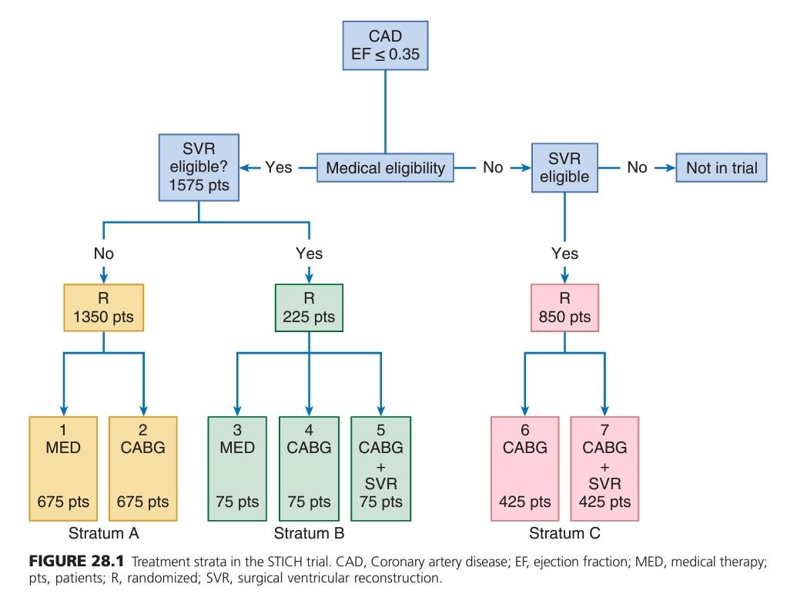

Slide 88
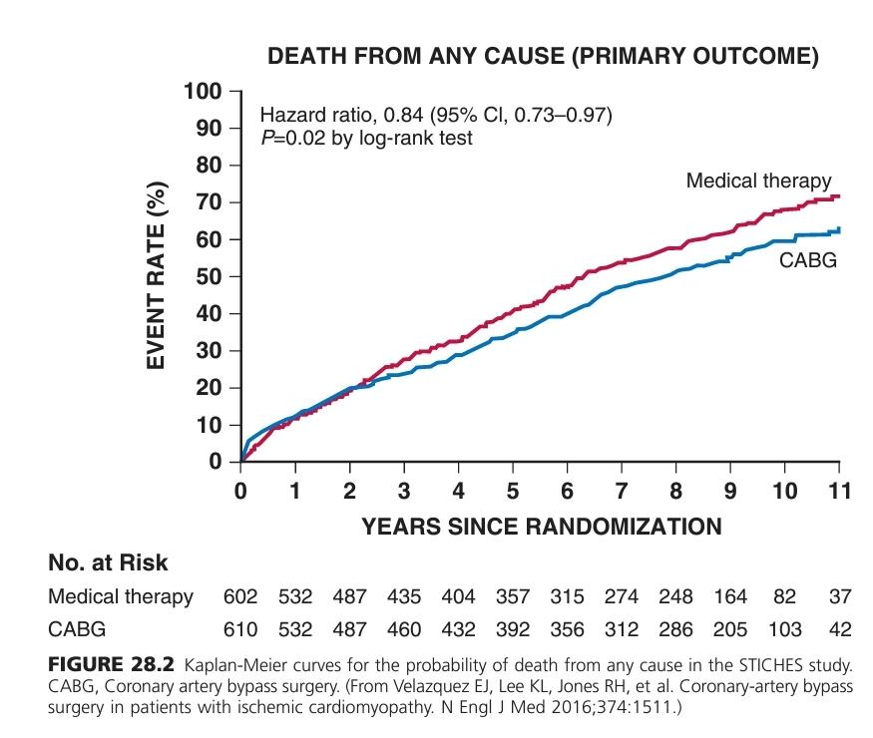

Slide 89
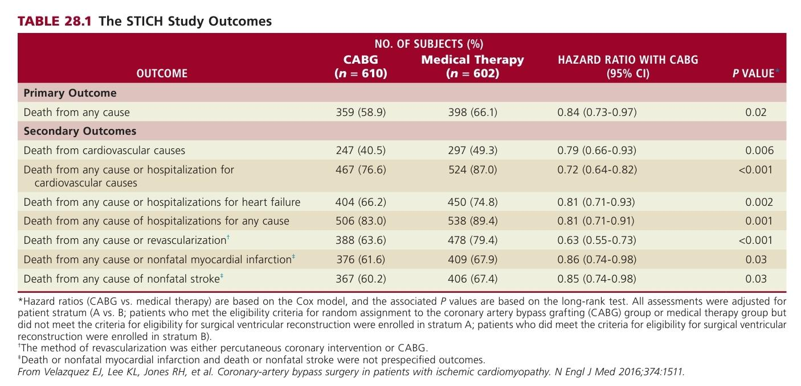

Slide 90
LEFT VENTRICULAR RECONSTRUCTION
Revascularization and valve operations lead to clinical improvement in many patients,
but in others, ventricular dilation and dysfunction are so severe that direct ventricular surgery has been proposed to optimize cardiac function.
Patients who have a transmural myocardial infarction (MI) may develop ventricular dilation and remodeling
that lead to changes in increased LV wall stress and LV dysfunction.
increased myocardial oxygen consumption secondary to increased wall stress, increased neurohormone and cytokine levels, afterload mismatch, and subendocardial hypoperfusion.

Slide 91
The stated goals of ventricular reconstruction
remove or to exclude the infarcted segment to restore an elliptical ventricular chamber,
to diminish remote wall stress,
to promote helical fiber orientation and
increase thickening of the akinetic or dyskinetic portion of the chamber,
to reduce end-systolic volume,
to diminish mitral insufficiency, and
to eliminate residual ischemia.

Slide 92
Concomitant CABG often is necessary, and if more than moderate MR is present, this should be corrected separately.
This type of operation is variously named surgical ventricular reconstruction (SVR) or the Dor procedure (after Vincent Dor),
in which the aneurysm or akinetic segment is reconstructed, typically with a patch (endoventricular patch plasty).
The operation is performed through the area of scar. A pursestring suture is placed between the infarcted and normal myocardium.

Slide 93
An endoventricular Dacron patch usually is used to exclude the infarcted segment, with closure of the aneurysm sac over the patch.
This operation typically is reserved for patients who have had a large anterior-apical infarct that involves the apex, anterior wall, and septum with resulting LV remodeling.
Ideally, the operation was designed to reduce end-systolic volumes by at least 30% while ensuring adequate size of the ventricle.

Slide 94
The RESTORE (Reconstructive Endoventricular Surgery Returning Torsion Original Radius Elliptical Shape to the Left Ventricle)
one arm of the STICH trial further explored the usefulness of this operative procedure for patients with ischemic cardiomyopathy.

Slide 95
