Slide 1
Ecg - Basics
Aysha Jamal

Slide 2
ELECTROCARDIOGRAM (ECG)
• It is a representation of the electrical events of cardiac cycle.
• Each event has a distinctive waveforms, the study of which can lead to greater insight
into a patient’s cardiac pathophysiology.
• Useful in the diagnosis of,
- Cardiac arrhythmias
- Myocardial ischemia and infarction
- Pericarditis
- Chamber hypertrophy
- Electrolyte disturbances
- Drug effects and toxicity
• Recorded in Electrocardiograph / ECG Machine

Slide 3
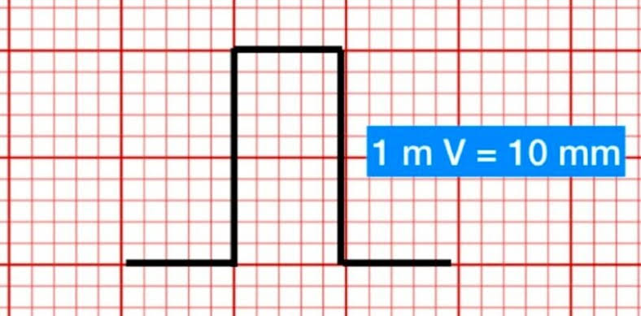
• STANDARDIZATION:
The ECG is conventionally standardized so that 1mV will result in
10mm vertical deflection.
• ECG GRAPH:
- 1mm small squares
- 5mm large squares
- Vertically, Deflection amplitude
1 small square = 0.1mV
1 large square = 0.5mV
- Horizontally, Time parameter
1 small square = 40ms
1 large square = 200ms

Slide 4
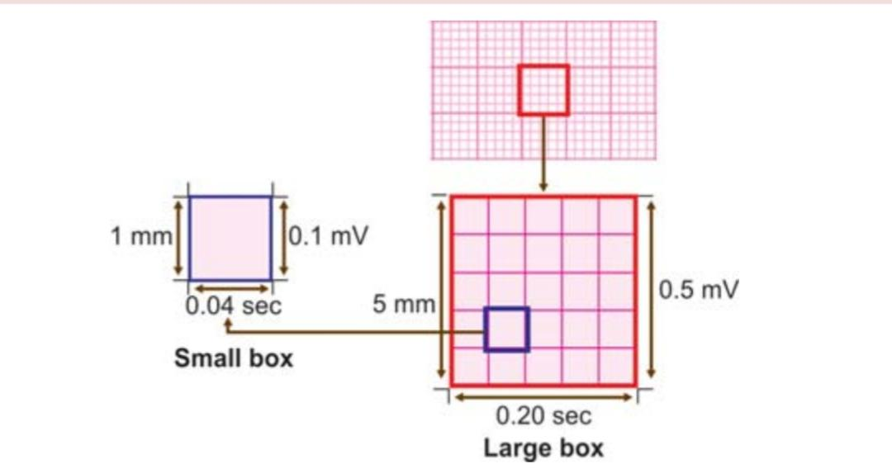
• PAPER SPEED:
- 25mm/sec
• VOLTAGE CALIBRATION:
- 10mm/mV

Slide 5
ECG LEADS
• Leads are electrodes which measure the difference in electrical potential b/w either;
1. Two different points on the body (BIPOLAR LEADS)
2. One point on the body and a virtual reference point with zero electrical potential,
located in the centre of the heart (UNIPOLAR LEADS)
• There are 12 conventional ECG lead placements that constitute the routine
12 lead ECG.
They are,
- 6 Limb leads / Extremity leads
- 6 Chest leads / Precordial leads

Slide 6
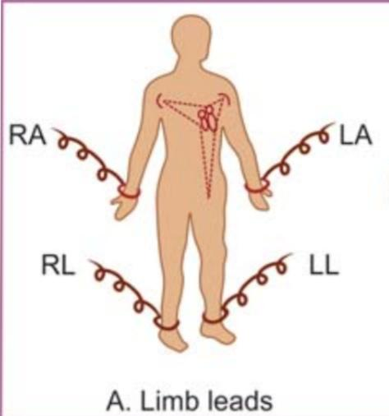
LIMB LEADS
• Derived from electrodes placed on the limbs.
- 3 Standard limb leads
- 3 Augmented limb leads
• An electrode is placed on each of the 3 limbs,
- Right arm
- Left arm
- Left leg
• Right leg electrode acts as the grounding electrode

Slide 7
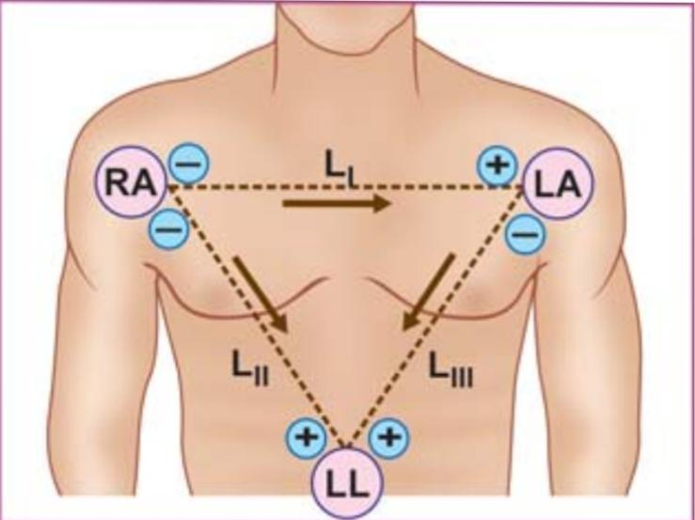
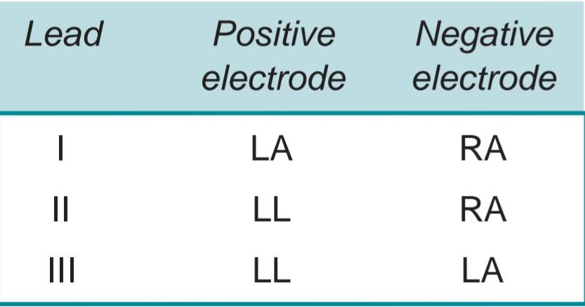
☆ STANDARD LIMB LEADS
• Obtain a graph of the electrical forces as recorded b/w 2 limbs at a time.
• Also called Bipolar leads.
• One limb carries a +ve electrode & the other limb carries a –ve electrode.
• 3 types,
- Limb lead I
- Limb lead II
- Limb lead III

Slide 8
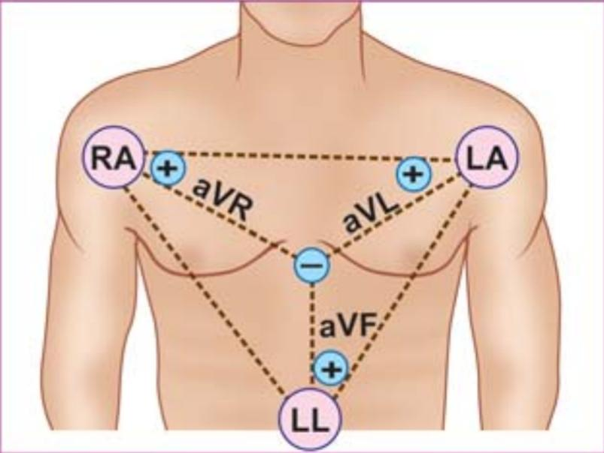
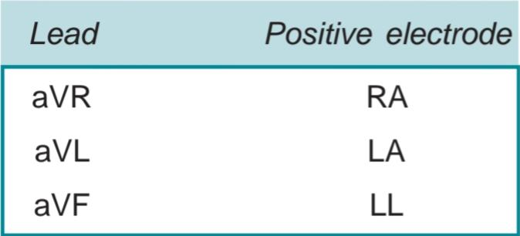
☆ AUGMENTED LIMB LEADS
• Obtain a graph of the electrical forces as recorded from one limb at a time.
• Also called Unipolar leads.
• One limb carries a +ve electrode, while a central terminal represents the –ve pole
which is actually at zero potential.
• 3 types,
i. aVR lead
ii. aVL lead
iii.aVF lead

Slide 9
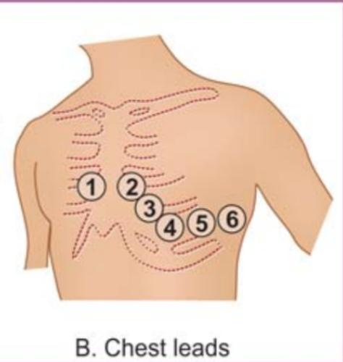
CHEST LEADS
• Obtained from electrodes placed on the precordium in designated areas.
• An electrode can be placed on 6 different positions on the left side of the chest
each position representing one lead.
• There are 6 chest leads namely,
- V1: Over the 4th intercostal space immediately to the
right of the sternum.
- V2: Over the 4th intercostal space immediately to the
left of the sternum.
- V3: Midway b/w V2 & V4.
- V4: Over the 5th intercostal space in the midclavicular line.
- V5: At the same horizontal level as V4 but on the anterior axillary line.
- V6: At the same horizontal level as V4 & V5 but on the midaxillary line.

Slide 10
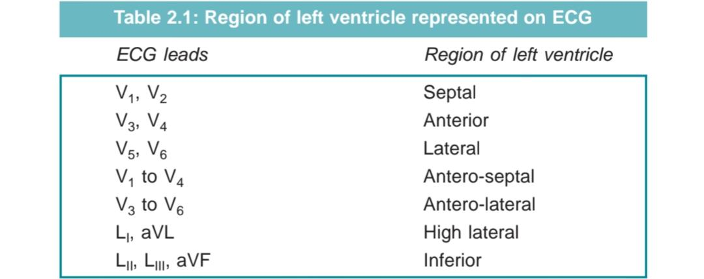
LEAD ORIENTATION
• The 12 lead ECG consists of the following 12 leads recorded in succession:
LI LII LIII aVR aVL aVF V1 V2 V3 V4 V5 V6
•The LV can be viewed from different angles, each with a specific set of leads,

Slide 11
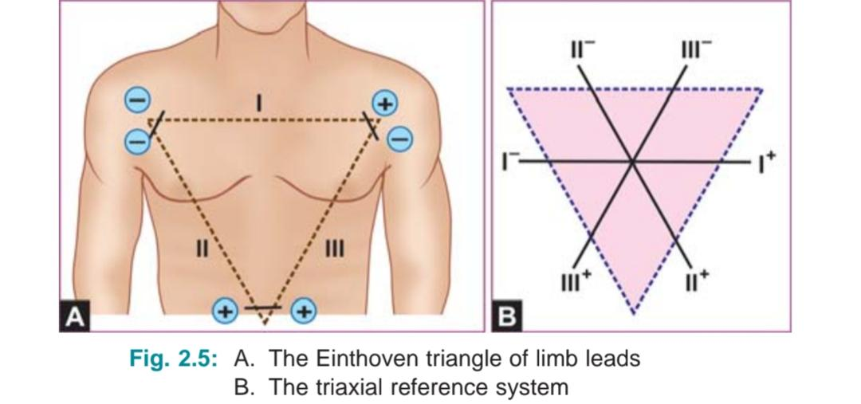
EINTHOVEN’S TRIANGLE
• The 3 standard limb leads (LI, LII, LIII) form an equilateral triangle with the heart
at the centre.
Einthoven’s law : I + III = II
• The 3 limbs of Einthoven triangle can be redrawn in such a way that the 3 leads
they represent bisect each other & pass through a common central point.
• This produces a triaxial reference system with each axis separated by 60° from the other,
lead polarity & direction remaining the same.

Slide 12
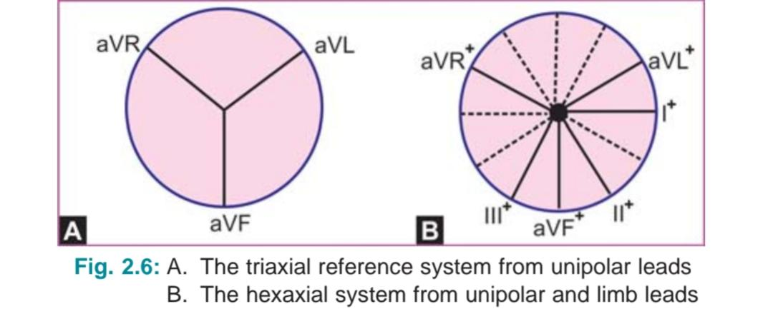
• The 3 Augmented limb leads (aVR, aVL, aVF) can be seen to form another triaxial
reference system with each axis being separated 60° from the other.
• When the triaxial system of unipolar leads is superimposed on the triaxial system
of limb leads, Hexaxial reference system can be derived with each axis being
separated by 30° from the other.
- Important in determining the major direction of heart’s electrical forces.

Slide 13
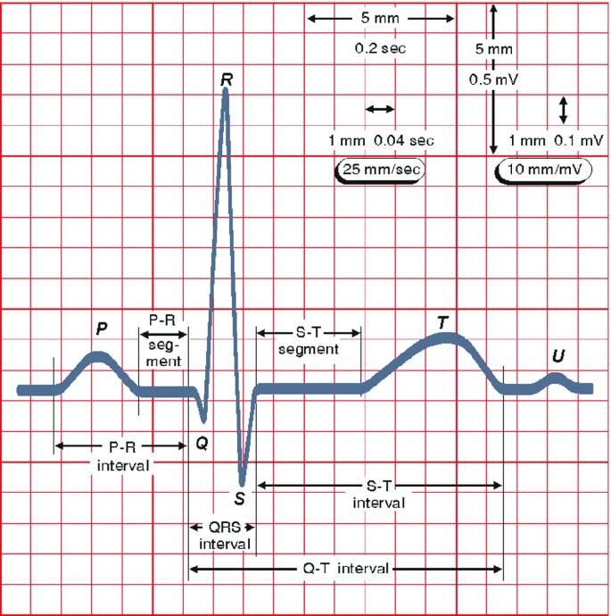
• ECG mainly consists of,
- P wave
- QRS complex
- T wave
- U wave
- P-R interval
- Q-T interval
- R-R interval
- PR segment
- ST segment

Slide 14
NORMAL ECG VALUES
☆ NORMAL P WAVE
• Produced by Atrial depolarization.
• Small rounded wave.
• Reflects the sum of right & left atrial activation, the right preceeding the left
since the pacemaker is located in the RA.
• Normally upright in most of the ECG with 2 exceptions;
- In lead aVR, it is inverted along with the inversion of QRS complex & T wave,
since the direction of atrial activation is away from this lead.
- In lead V1, it is generally biphasic that is, upright but with a small terminal
-ve deflection, representing left atrial activation in reverse direction.

Slide 15
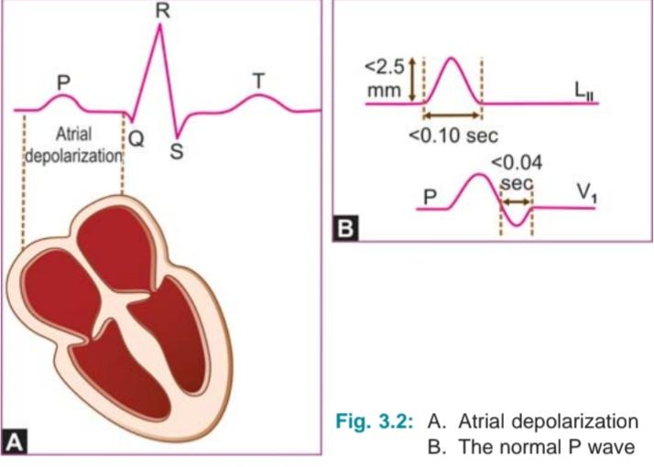
• Normally, P wave has a single peak without a gap or notch b/w the right & left atrial
components.
• It meets the following criteria:
- < 2.5mV in amplitude
- < 100ms in duration

Slide 16
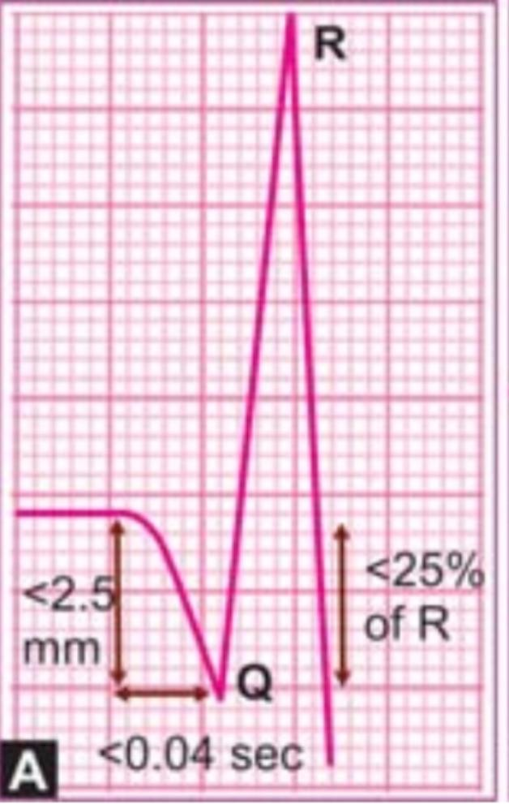
☆ NORMAL QRS COMPLEX
• Produced by Ventricular depolarization.
• Major positive deflection.
• It represents the timing & sequence of synchronized depolarization of the RV & LV.
Q wave:
• Not visible in all ECG leads.
• Physiological Q waves may be observed in leads I, aVL, V5 & V6 were
they represent initial activation of Interventricular septum in
a direction opposite to the direction of activation of the main LV mass.
• It meets the following criteria;
- < 40ms in duration
- < 25% of R wave

Slide 17
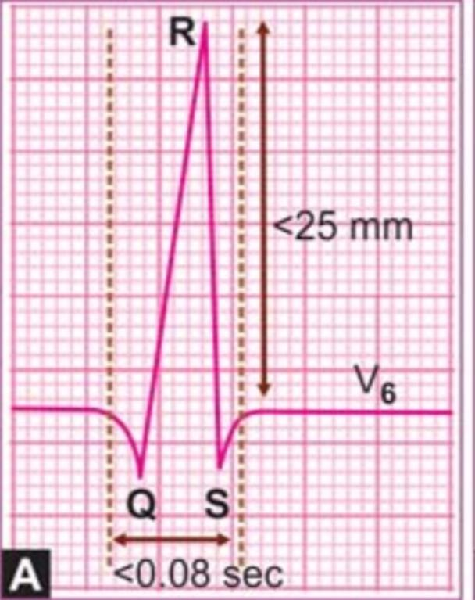
R wave:
• Major positive deflection.
• Mostly upright, except in lead aVR.
• In the limb leads, R wave voltage is normally atleast 5mm
while in the precordial leads, R wave voltage exceeds 10mm.
• Under normal circumstances, the R wave voltage gradually increases as we
move from lead V1 to V6 – R wave progression in Precordial leads.
• R wave is smaller than S wave in lead V1 & the R wave is
taller than S wave in lead V6.

Slide 18
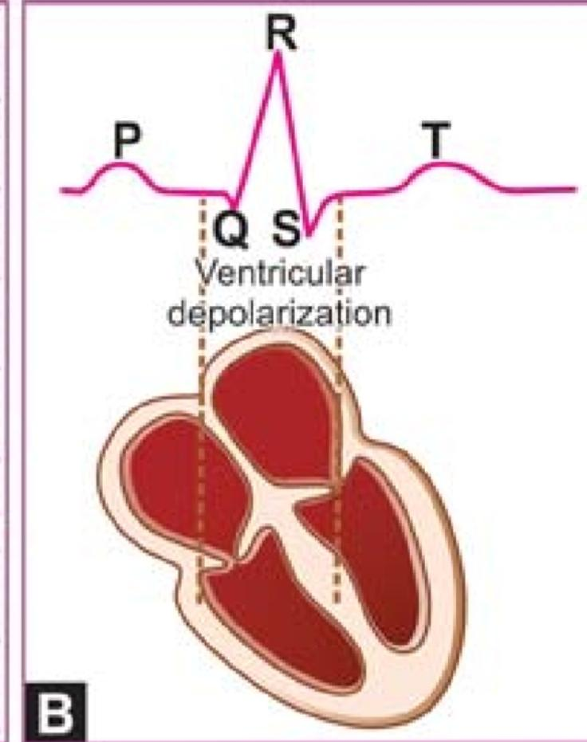
S wave:
• Negative deflection representing the small terminal portion of
ventricular depolarization
• In lead V1 - deflects Left ventricular activation
In lead V6 - deflects Right ventricular activation
• The normal S wave voltage doesn’t exceed 0.7mV
• Since the Right & Left ventricles are depolarized in a
synchronous fashion, the normal QRS complex is narrow,
has a sharp peak & measures less than
80ms on the horizontal axis

Slide 19
☆ NORMAL T WAVE
• Produced by the rapid phase of Ventricular repolarization.
• Large rounded wave.
• Normally upright in most leads with certain exceptions.
• It is invariably inverted in lead aVR along with inversion of P wave & QRS complex.
• It is often inverted in lead V1, occasionally in V2, V3 & sometimes in lead III.
• Normal T wave is taller in V6 than in V1.
• Amplitude doesn’t generally exceed 5mm in Limb leads &
10mm in Precordial leads.

Slide 20
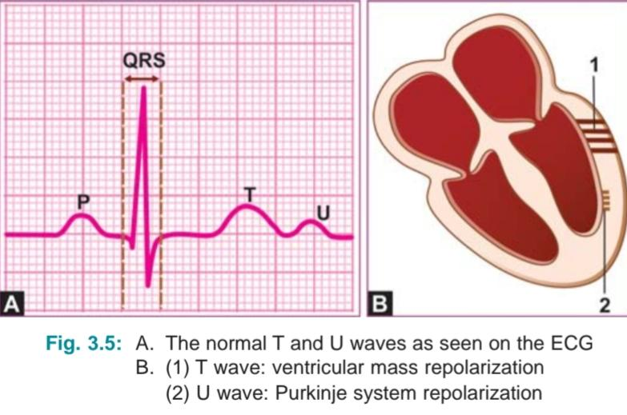
☆ NORMAL U WAVE
• Produced by slow & late repolarization of the Interventricular Purkinje system,
after the main ventricular mass has been repolarized.
• Small rounded wave.
• It is best appreciated in Precordial leads V2 to V4.
• More easy to recognize when the QT interval is short or the heart rate is slow.
• Normal U wave is upright & it is normally
much smaller than T wave which it follows.

Slide 21
☆ NORMAL P-R INTERVAL:
• Measured on the horizontal axis from the onset of P wave to the beginning of
the QRS complex, irrespective of whether it begins with a Q wave or a R wave.
• P-R interval is a measure of the AV conduction time (Since, P wave represents
Atrial depolarization & QRS complex represents Ventricular depolarization).
• AV conduction time includes:
- Time for Atrial depolarization
- Conduction delay in the AV node
- Time required for impulse to traverse the conduction system before
ventricular depolarization begins

Slide 22
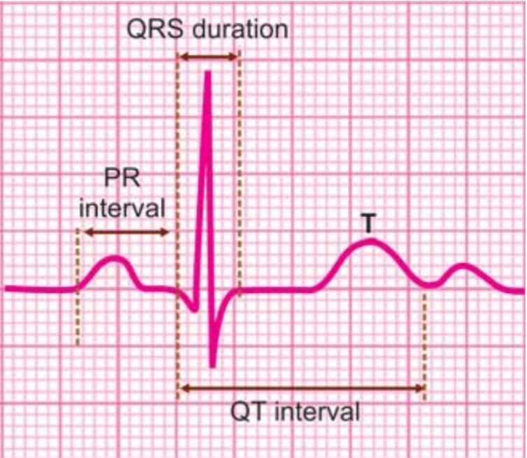
• Range: 120ms to 200ms
• Prolonged at slow heart rates & shortened at fast heart rates.
• The P-R interval tends to be slightly shorter in children (Upper limit – 180ms) &
slightly longer in elderly persons (Upper limit – 220ms).

Slide 23
☆ NORMAL Q-T INTERVAL:
• Measured on the horizontal axis from the onset of the Q wave to the end of the T wave.
• Q-T interval denotes the total duration of ventricular systole
(Since, QRS complex represents ventricular depolarization & T wave represents
ventricular repolarization).
• Includes:
- Duration of QRS complex
- Length of ST segment
- Width of the T wave
• Range: 350ms to 430ms
• Q-T interval depends upon 3 variables namely age, sex & heart rate.

Slide 24
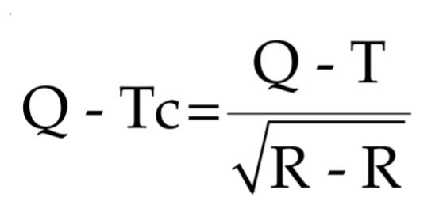
• It tends to be shorter in young individuals & longer in elderly.
• Slightly shorter in females(Upper limit – 420ms).
• Q-T interval shortens at fast heart rates and lengthens at slow heart rates.
• Corrected Q-T interval, ( Bazett’s formula )
☆ NORMAL R-R INTERVAL:
• Time interval b/w 2 consecutive R waves.
• Signifies the duration of one cardiac cycle ( 800ms )
• Helps to calculate:
- Heart rate
- Heart rate variability

Slide 25
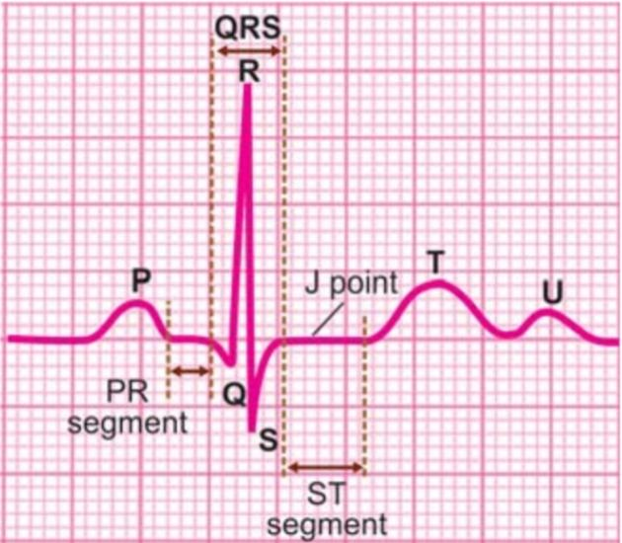
☆ NORMAL P-R SEGMENT
• Portion b/w the termination of P wave & the onset of the QRS complex.
• It represents conduction delay in the AV node.

Slide 26
☆ NORMAL S-T SEGMENT
• Portion b/w the termination of S wave & the onset of T wave.
• It represents the plateau phase of ventricular repolarization.
• The beginning of S-T segment is the Junction point ( J point )
• Normally, the S-T segment & the J point are in level with the main segment of
the isoelectric line.

Slide 27
THANK YOU!

