Slide 1
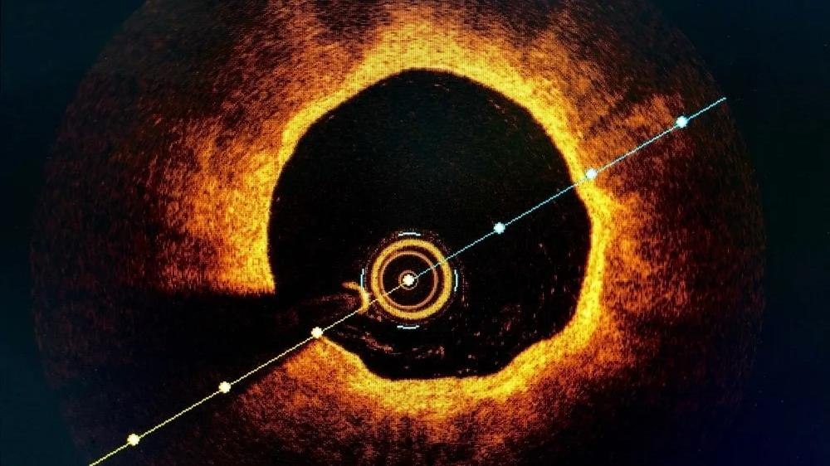
OCT
DR SANCHNA DEV S
SENIOR RESIDENT
DEPT OF CARDIOLOGY
TDMC

Slide 2
CONTENTS
PHYSICAL PRINCIPLES OF OCT IMAGE ACQUISITION
IMAGE INTERPRETATION – QUALITATIIVE ANALYSIS
QUANTITATIVE ANALYSIS
ARTIFACTS
CLINICAL USE IN PCI

Slide 3
INTRODUCTION
Optical analog of IVUS
OCT delivers near-infrared light to the wall of the coronary artery through small-diameter optical fibers
The light that illuminates the vessel —> absorbed and reflected (backscattered) by the structures in the tissue to different degrees.
Different tissues - different optical characteristics and the wave length was selected so that lipid-rich tissue can be differentiated from fibrous and calcified tissue
Originally described in the early 1990s—> ophthalmology

Slide 4
PHYSICAL PRINCIPLES OF OCT
based on optical interference of near-infrared light
Light is emitted and collected back from the tip of a small diameter optical fiber that rotates rapidly inside a transparent sheath of the catheter
For longitudinal scanning of the vessel —> a drive motor unit on the table pulls back the fiber as it rotates within the sheath
Ultrasound —>depth —> measuring the time taken for acoustic reflections

Slide 5
light is too fast – direct quantification cannot be achieved on such a time scale
To overcome this property —> interferometry technique —> collected light is combined with a reference light beam to generate lower-frequency optical interference signals
modulated interference signals can be measured and digitally decoded to generate an optical profile of the tissue (A-scan)
Multiple optical profiles are collected as the catheter core rapidly rotates within the vessel
These profiles are then represented in a 2D image (B scan )

Slide 7
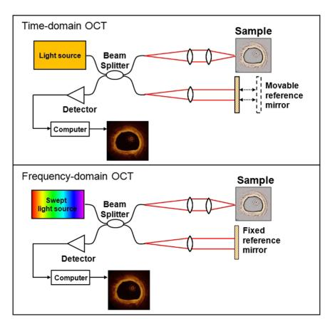
Types
TD OCT
FD OCT

Slide 8
1. TD OCT
first generation of OCT platforms used a time domain (TD) detection system
light from a broadband source with wavelengths centered on 1300 nm was directed at the tissue of interest
Determination of imaged tissue depth required a reference mirror to be moved back and forth, significantly limiting the speed of image acquisition

Slide 9
2. FD OCT
Fourier or frequency domain (FD) detection —> monochromatic source emits light sweeping across a range of wavelengths between 1250 and 1350 nm
Reflected light from various tissue depths —> detected simultaneously —> facilitating significantly faster image acquisition
Interference signals generated by an interferometer at various wavelengths are mathematically processed by Fourier transformation to determine the amplitudes of reflections returning from different depths.
As in MRI , the frequency of the recorded signal encodes position in the image

Slide 10
Important consideration….
blood must be cleared or flushed from the vessel lumen (backscatter of light by RBCs)
Initially, blood clearance was accomplished using the occlusion technique —> occlusive balloon was inflated proximally to stop coronary blood flow —>saline or Ringer lactate was infused downstream to clear the vessel of blood during pullback imaging
Limitations — ischemia during balloon occlusion, potential damage to the vessel at the site of balloon occlusion, need for multiple catheter exchanges, inability to image ostial lesions; vessel dimensions may be small (reduced intracoronary pressure downstream from the occlusion balloon)
Now—> pullback imaging is performed with contrast flush (3 to 4.5 mL/s depending on vessel size)

Slide 11
The current generation of commercial OCT systems have
high image acquisition rate (158 to 180 frames/s)
Ranging depth of 4.6 to 5 mm in tissue
pullback length of 75 up to 150 mm is obtained in 2 to 3.5 seconds at maximum pullback speed of 40 mm/s
Imaging catheters are designed for rapid exchange over a 0.014-inch guidewire delivery — with a crossing profile of 2.4 to 2.8 Fr —> compatible with 6-Fr or larger guiding catheters

Slide 12
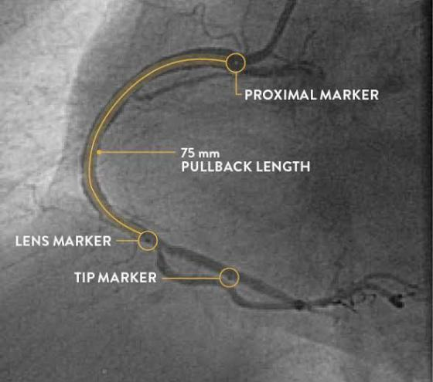
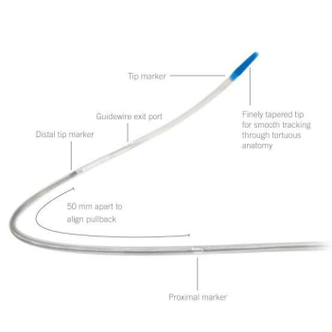

Slide 19
IMAGE INTERPRETATION - QUALITATIVE ANALYSIS

Slide 20
PLAQUE CHARACTERISATION
atherosclerotic plaque —> 3-layered structure of the normal coronary arterial wall is lost + lumen may appear narrowed
Plaques can be categorized by their tissue composition and the OCT appearance of fibrous, lipid-rich, and calcific plaques
Fibrous tissue —homogeneous area of high reflectivity with low signal attenuation
Lipid — homogeneous area of low reflectivity with high signal attenuation that may limit the visualization of deeper structures
Calcium — heterogeneous area of either high or low reflectivity with low signal attenuation and most notably a sharp demarcating border

Slide 22
THROMBUS -protruding mass attached to the arterial wall
(for image analysis— a measured dimension threshold of greater than or equal to 250 mm has been used to minimize inclusion of small thrombi caused by the guidewire)
Red thrombus — composed primarily of RBCs —> signal-rich mass with high signal attenuation
white thrombus— consists primarily of white blood cells and platelets —> signal-rich mass with low signal attenuation

Slide 24
Plaque characterisation in ACS
Most ACS —>attributable to coronary thrombosis caused by one of three distinct underlying pathologic mechanisms: plaque rupture, plaque erosion, or calcified nodules
Plaque rupture — identified as a lipid plaque with fibrous cap discontinuity and cavity formation inside the plaque
Plaque erosion –
Definite OCT erosion —requires the presence of attached thrombus over- lying an intact and visualized plaque
Probable OCT erosion —defined in absence of attached thrombus by luminal surface irregularity at the culprit site or in the presence of attached thrombus without underlying plaque by a lack of superficial lipid or calcification in sites adjacent to the culprit lesion

Slide 25
calcified nodules — describes sites of fibrous cap disruption with underlying calcified plaque characterized by protruding calcification,superficial calcium, or the presence of significant calcium adjacent to the lesion

Slide 27
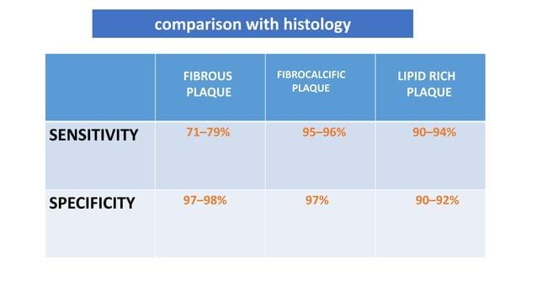

Slide 29
OCT features of vulnerable plaque
thin fibrous caps
Large lipid cores
Microchannels
Macrophage infiltration
Superficial spotty calcification
cholesterol crystals.

Slide 31
OCT features of vulnerable plaque
TCFA -Thin cap fibroatheromas -lipid-rich plaque with an overlying fibrous cap measuring less than 65 microns
Large extracellular lipid pools - lipid occupying greater than or equal to 2 quadrants of the cross-sectional image
Microchannels -small black (signal absent) holes within a plaque that measure 50 to 300 microns in diameter and span at least 3 consecutive frames on pullback OCT imaging (resistance to statin therapy)

Slide 32
OCT features of vulnerable plaque
4. Macrophages - identified as linear series of signal- rich spots with high signal attenuation (challenging identification )
5. Spotty calcium - deposits occupying only 1 quadrant of the CS image
6. Cholesterol crystals - thin, linear, signal-rich structures with low signal attenuation

Slide 34
IMAGE INTERPRETATION - QUANTITATIVE ANALYSIS

Slide 35
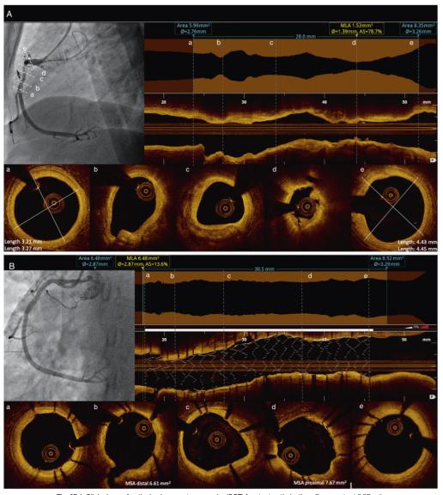

Slide 36
ARTIFACTS
An important component of OCT image analysis is the recognition of OCT artifacts that may either mimic or limit identification of true tissue structures
Can be related to imaging technique, processing, catheter or guide wire or stent struts or eccentric wire position

Slide 37
ARTIFACTS –related to imaging technique
Obliquity artifact — occurs when the imaging catheter is not parallel to the longitudinal axis of the vessel wall —> creating an elliptically distorted off- axis image
this artifact can occur because of vessel curvature or tortuosity and can make measurements less accurate
Residual blood —signal-rich swirling pattern within the lumen and can sometimes be falsely identified as red thrombus

Slide 39
ARTIFACTS –related to image processing
Sew up( motion) artifact — appears as a single radius of misalignment in the circumferential image and results from the rapid movement of the artery or imaging wire
Nonuniform rotation distortion ( NURD) -appears as smearing within an arc of the circumferential OCT image; it most commonly occurs in the setting of vessel tortuosity, tight stenosis, heavy calcification, or equipment imperfections that perturb the smooth rotation of the optical components, resulting in variation in the rotational speed of the imaging catheter
Fold over artifact - when reflected signals from structures beyond the system’s field of view produce aliasing along the Fourier transformation, causing a portion of the vessel to appear to fold over in the image; this artifact occurs most commonly at side branches or with large vessels

Slide 40
ARTIFACTS –related to imaging catheter or guide wire
Shadow artifact — reduction in signal intensity beyond a structure such as a guidewire or metallic stent strut, or small bubbles in the imaging catheter
Multiple reflections—appear as 1 or more circles centered on the imaging catheter and result from reflections from multiple facets of the catheter

Slide 41
ARTIFACTS –related to stent struts
Reverberation artifact — similar to the multiple reflections artifact ; describes reflections produced by stent struts that are centered on the imaging cathete
Saturation artifact - when stent struts or other highly reflective structures produce a high-amplitude backscattered signal that is beyond the range that can be accurately detected by the data acquisition system ; appears as spokes of high and low intensity signal emanating from the center of the imaging catheter
Blooming artifact -when stent struts or other highly reflective structures appear slightly smeared or thickened in the axial direction.

Slide 43
ARTIFACTS –related to eccentric wire position
Proximity artifact- when the imaging catheter is near or touching the artery wall, causing the adjacent tissue to appear brighter or more signal rich
Tangential signal dropout - occurs when the imaging catheter is near or touching the artery wall and appears as attenuated signal tangential to the luminal surface
Merry-go-round effect — reduced lateral resolution at increased distances or depths from the imaging catheter. Stent struts that are farther from the imaging catheter - appearing wider than struts closer to the imaging catheter
Sunflower effect — the artificial alignment of reflections from stent struts toward the imaging catheter, mimicking the way sunflowers align toward the sun ( can appear even perpendicular )

Slide 45
OCT AND PCI

Slide 47
Stent sizing

Slide 48
POST INTERVENTION

Slide 52
ILUMIEN III trial —demonstrated noninferiority of OCT versus IVUS with respect to post stenting MLD
OPINION (optical frequency domain imaging vs.intravascular ultrasound in percutaneous coronary intervention)trial -showed noninferiority with respect to the primary clinical end point of target-vessel failure in patients undergoing PCI with a second-generation DES

Slide 53
AHA ACC 2021

Slide 54
At least three major clinical settings that hold the highest risk of PCI failure and negative outcome might reap large benefits from the immediate use of OCT:
complex interventions such as bifurcation (including distal LM disease) requiring advanced operative techniques
ACSs
stent failure

Slide 55
MCQs

Slide 56
1.True statement : IVUS vs OCT
Tissue penetration is more for IVUS
Frame rate is higher for IVUS
Axial and lateral resolution is better in IVUS
Maximum scan diameter is less in IVUS

Slide 57
2. Match the following
A
Plaque erosion
Calcified nodule
Plaque rupture
A-3
B-1
C-2

Slide 58
3. Identify lipid rich plaque

Slide 59
4. Inadequate flushing of OCT catheter can result in which artefact ?

Slide 60
Thank you !

