Slide 1
Vascular access
Karthik ks

Slide 2
→ Percutaneous cardiac catheterization uses needle puncture for vascular access.
→ Clinical outcomes of the procedure depends on obtaining safe and adequate
vascular access.

Slide 3
Vascular access
ArTerial
Venous
• FEMORAL
• RADIAL
• ULNAR
• BRACHIAL
• AXILLARY
• LUMBAR
• FEMORAL
• INTERNAL JUGULAR VEIN
• SUBCLAVIAN
• ANTICUBITAL

Slide 4
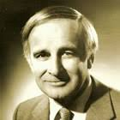
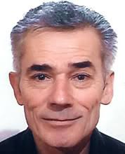
Radial access
History
› Lucien Campeau – Canadian cardiologist who performed first transradial
coronary angiogram in 1989.
› Ferdinand Kiemeneij – Father of transradial intervention.

Slide 5
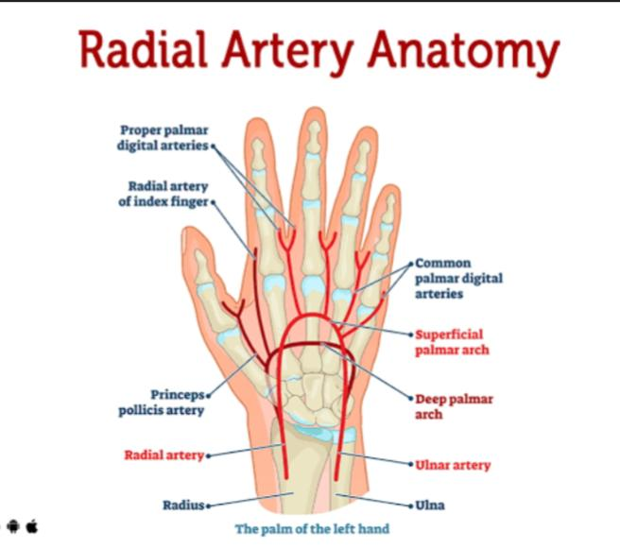

Slide 6
Radial Access Indication
* Absent femoral pulse
* Femoral artery graft surgery.
* Extensively tortious iliac system.
* Abdominal aortic aneurysm
* Patient request

Slide 7
Contraindication
Radial artery being considered for CABG/AV fistula.
Upper limb atherosclerosis, extreme tortiousity.
Need for 7F or larger sheath.

Slide 8
Advantages of radial approach
* Easily accessible artery in most patients.
* Not located near significant veins or nerves.
* Superficial location enables easy control of bleeding.
* No significant clinical sequelae in patients with normal Allen's test due to collateral flow through
ulnar artery.
* Patient comfort as they can situp and walk after the procedure.

Slide 9
Disadvantages of Radial Access
> more tendency to develop spasm, pain, difficulty in catheter manipulation.
> Anatomical variations, severe tortuosity or loops.
> Doesn’t allow catheters above 7F.
> Decrease backup support for complex procedures.

Slide 10
Patient Selection
→ Allen’s/Barbeau test access the overall blood supply to the hand.
→ Contralateral radial (or femoral) artery should be assessed in cases where radial
arterty might ultimately used as a bypass conduit.
→ Patients with ACS / STEMI have increase bleeding risks and are excellent candidates
for the radial approach.

Slide 11
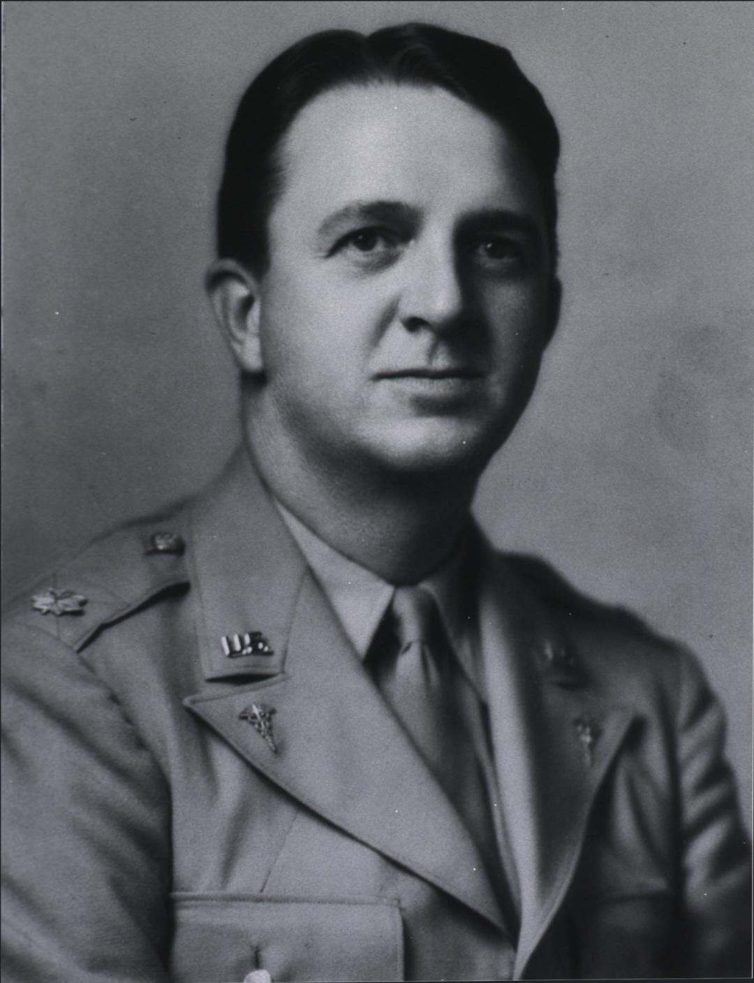
Allen‘s Test
• Named after Edgar Van Nuys Allen.
• In 1952, Irving S Wright described modified Allen’s test.
• Done to assess the overall blood flow to hand,
to confirm the hand will get adequate blood supply via
ulnar artery and collaterals in case of radial artery occlusion.

Slide 13
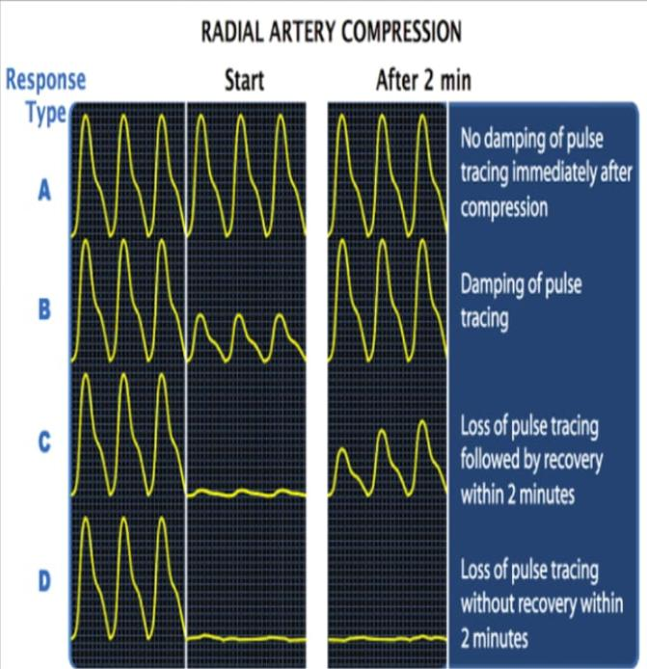
Barbeau Test
› The pulse wave monitored with both arteries open using pulse oximeter.
› Radial artery occluded and pulse wave of ulnar artery is observed.
› Radial artery cannulation can be proceed with A, B & C ; not recommended in D.
› A reverse Allen’s or Barbeau test can also be done to check the patency of radial artery by occluding ulnar artery.
› Recommended for patients with h/o previously assessed radial arteries for catheterization/ABG.

Slide 14
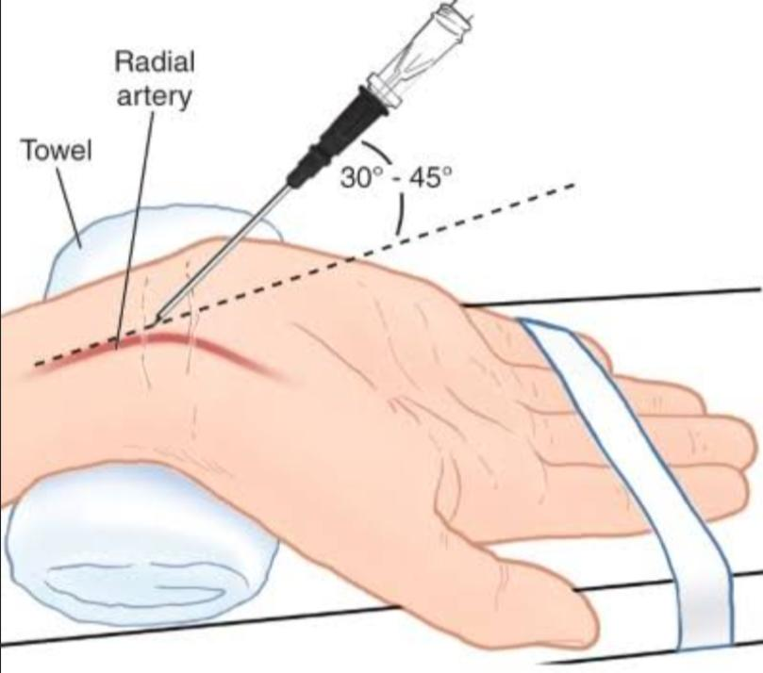
Patient Preparation
> Patient should be sedated, well hydrated and comfortably positioned.
> Wrist should be placed next to the femoral access site.
> A roll of sterile towel/wrist splinter is used to support and flex the wrist to
hyperextended position.
> After draping radial pulse is palpated.

Slide 15
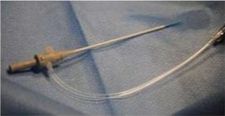
Radial Artery Puncture & Sheath Insertion
* Administrate local anaesthesia with 0.5 ml of 1% lidocaine.
* Puncture site should be 2cm proximal to the styloid process.
* Use seldinger technique with back wall puncture.
* Use 21 G needle for puncture.
* After puncturing, remove the needle from cannula and withdraw the cannula gently until blood
pulsates out of the needle.
* Advance 0.018”×45 cm hydrophilic guide wire through cannula and keeping the guide wire in,
withdraw the cannula from the artery.

Slide 16
* Make a small nick on skin around GW.
* Thread the sheath on GW & push the sheath in and remove GW and dilator from the sheath.
Radial Cocktail
* After sheath insertion, infuse “radial cocktail” to prevent arterial spasm.
* Combination of verapamil(2.5-5 mg) & NTG (100-200microgram) in 10 ml saline.
* Heparin(5000-10000u) is given to prevent thrombus formation.

Slide 17
Right vs Left Radial Approach
Operators choice is mostly right radial approach.
Left radial artery shows shorter learning curve and reduced radiation exposure.
Left radial artery is advisable for short and elderly patients due to increased tortiousity in innominate artery.
Left radial artery is preferred in patients with LIMA graft.

Slide 18
Radial Artery Access Site Care
* Radial sheath is removed just after the procedure on full anticoagulation.
* Post procedure-check wrist every 15 minutes for bleeding, hematoma, colour, pulse
Oxymetry, etc.
* Several compression devices are commercially available to facilitate patent hemostasis
after procedure.

Slide 19
Radial Access Site Complications
Radial artery occlusion
Forearm hematoma
Radial artery pseudoaneurysm
Artery perforation
Local access bleeding
Access failure

Slide 20
MCQs
Who is known as the father of radial access?
i) Ferdinand Kiemeneij
ii Lucien Campeau
iii) Edgar Van Nuys Allen
iv) Irving S Wright

Slide 21
2) In which type radial artery cannulation cannot be proceeded in barbeau test?
i) Type A
ii) Type B
iii) Type C
iv) Type D

Slide 23
Femoral access
Indications ;
* IABP
* Rotablator
* Bifurcation strategies
* LMCA interventions
* Acute MI
* Structural HD interventions
Femoral access is contraindicated if INR ≥ 2.5
Normal range of INR ≤ 1.1

Slide 24
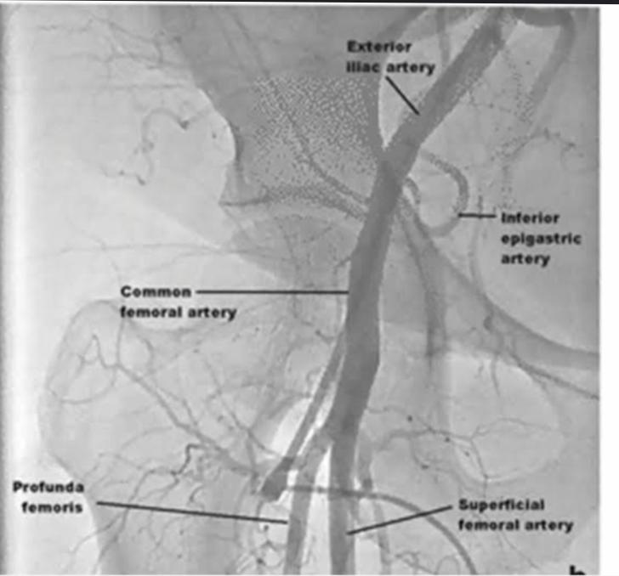
• Femoral Access Anatomy
> CFA – Continuation external iliac artery below inguinal ligament which bifurcate into profunda femoral artery(PFA) and superficial femoral artery(SFA).
• Landmarkers Used To Guide Femoral Artery Puncture
> Skin area 2cm below inguinal ligament by surface marking
( no longer advocated due to variability in obese patients)
> Radiological marker – Center of the femoral head
> US guided puncture.

Slide 25
Femoral Arterial Puncture
• Locate the puncture site and feel the pulse.
• Administrate LA with 10 ml of 1% lidocaine.
• Single anterior arterial wall puncture ( Seldinger )technique is preferred.
• Micropuncture kit / 18 G MP needle is used.

Slide 26
Seldinger Technique
> Introduced by Dr Sven Iver Seldinger in 1953.
> The vessel is punctured using access needle.
> Introduce the needle through skin 30-45° angle to horizontal plane.
> GW is inserted through needle.
> Remove the needle by holding the GW in place.
> Insert the sheath with dilator along GW.
> Remove GW & dilator together.

Slide 27
Femoral complications
Vascular | Non-vascular
* Dissection | * Infection
* Pseudoaneurysm | * Nerve damage
* Hematoma
* Thrombosis
* Retroperitoneal hemorrhage

Slide 28
Femoral Venous Access
Indications;
• Right heart study
• TPI
• IVC filteration
• ASD device closure

Slide 29
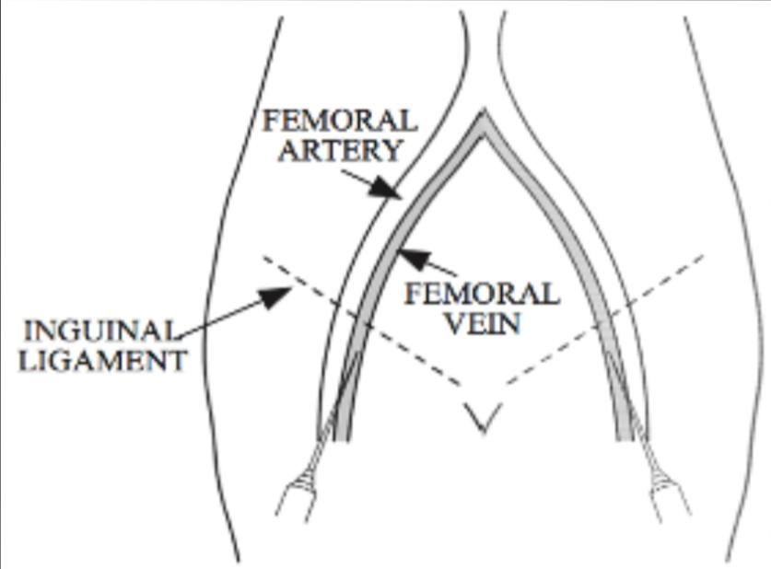
Puncture Site
* 1cm medial to femoral artery
* Needle held at 45° angle
* Skin insertion 2cm below inguinal ligament
Complications
* Puncture site infection
* Femoral vein thrombosis
* Femoral nerve injury

Slide 30
Advantages
> Easy to find vein
> Preferred site for emergencies & CPR
> Low risk for complications
Disadvantages
> Highest risk of infection
> Risk of DVT
> Not good for ambulatory patients.

Slide 31
Subclavian venous access
Indications
* PPI leads
* TPI
* IVC filter
* Central venous access

Slide 32
Contraindications
* Coagulopathy
* Thrombolysis
* Chest wall deformity
Patient positioning
* Right side supine position is preferred with head neutral
* Arms should be abducted
* Trendelenburg position(10-15 degrees )
* Shoulder neutral with mild retraction

Slide 33
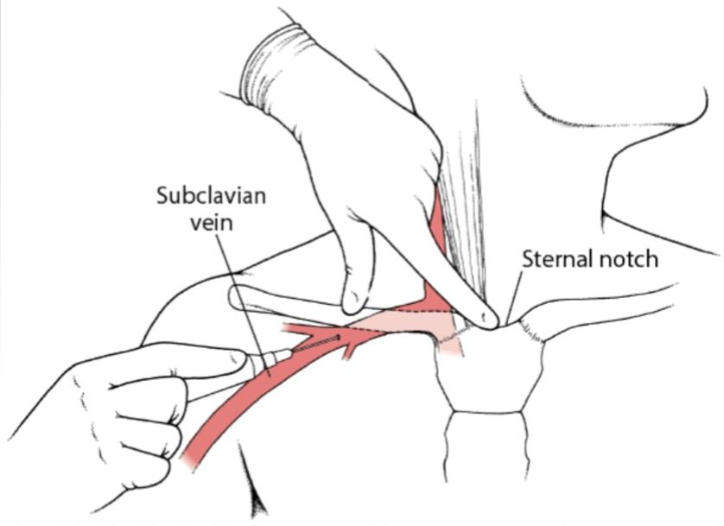
Puncture site
• Junction of middle and medial thirds of clavicle.
• Needle should be parallel to skin.
• Arm towards the finger in supraclavicular notch and just under
the clavicle.
Complications
* Infection
* Thrombus
* Bleeding
* Air embolization

Slide 34
Advantage
> Most comfortable for consious patients.
Disadvantage
> Highest risk of pneumothorax
> Vein is non-compressible

Slide 35
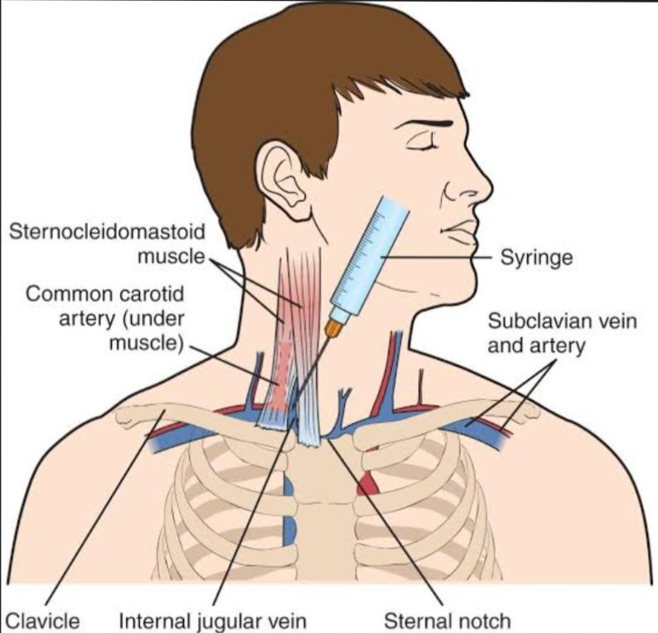
Ijv access
Indications
. TPI
. Central venous line
Avoided in ;
. Trendelenburg tilt is not possible
. Pulm edema
. Children < 1 yr age who can’t be sedated.

Slide 37
Advantage
• Less risk of pneumothorax
• Malposition is rare
• Straight access to SVC
Disadvantage
• Risk of carotid artery puncture

Slide 38
Hemostasis
i) Manual compression
ii) Mechanical compression
iii) Topical hemostatic aids
iv) Vascular closure devices ; - Active
- Passive

Slide 39
i) Manual compression
• Remains the “gold standard”
• Timing of sheath removal - Diagnostic procedure immediately
- Interventions after 4-6 hours (ACT < 170 ms)
• Site – 3-4 minute compression/french size
. 15-30 min average – 5F sheath
. Larger sheath – longer time
Disadvantage
• Patient discomfort : 6-8 hours of bed rest
• Ineffective compression in case of fatigue/impatience

Slide 40
ii) Mechanical compression
• Using special equipment for hemostasis
Advantage
• more effective compression
Disadvantage
• Increased time to hemostasis
• Patient discomfort

Slide 41
iii) Topical hemostatic Aids
* Variety of topical patches, pads, bandages and powders which assist in hemostasis with manual/machanical compression.
* Accelerate natural clotting process.
* Still require compression
iv) Vascular closure devices
* Introduced in 1995
* Decreased vascular complications
* Reduced time for hemostasis & ambulation
> Active
> Passive

Slide 42
Active
• Enhance hemostasis with prothrombotic material/mechanical compression.
• Shorter time to hemostasis
Passive
• Suture(perclose), collagen plugs(angioseal), clips(starclose)
• Achieve prompt hemostasis
• Shorter time to ambulation

Slide 43
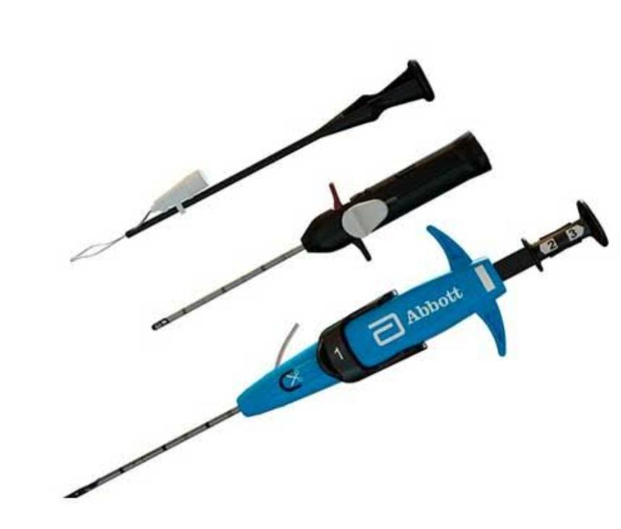
Suture (perclose)
• Success rate 91-94%
•Advantage – i)Closure with only suture in the wall of vessel.
ii)Provide end to end anastamosis.
iii)No thrombogenic material in the lumen.
•Disadvantage – Difficult to use in calcified vessels.

Slide 44
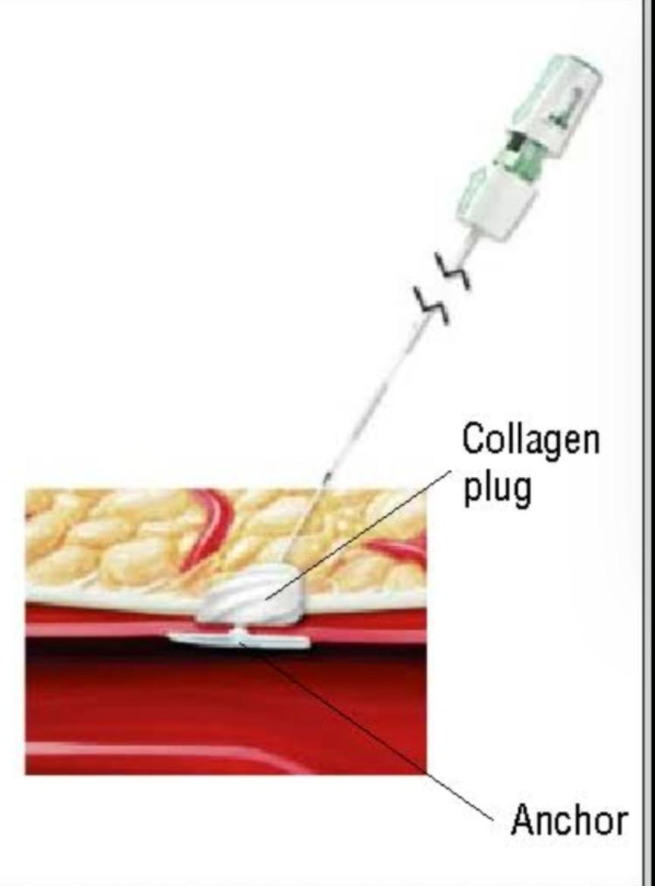
Angioseal(Collagen plug)
•Components – i)Biodegradable anchor (intra material)
ii)Collagen plug (extra material)
iii)3-0 vycril suture.
•Success rate – 90 to 97%
•Advantage –i)One of the easiest device to learn & use.
ii)Has very high success rate.
iii)Retained components are completely resorbed.
iv) Collagen plug in the tract also acts to reduce oozing from the site.

Slide 45
•Disadvantage –i) Infection
ii) Can cause obstruction of heavily diseased vessel.
iii) Embolization of intravascular anchor.

Slide 46
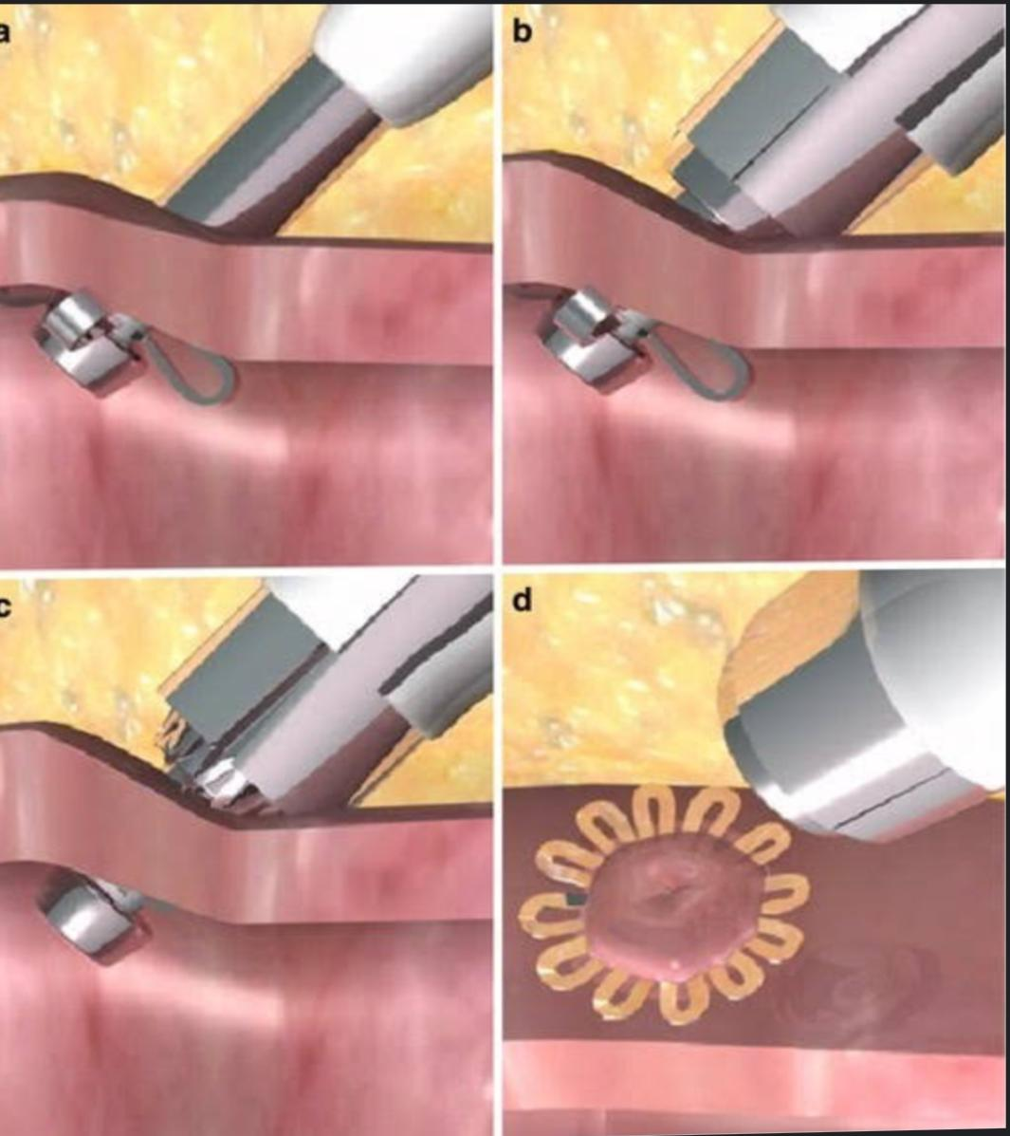
Star close
•Extravascular closure device
•Nitinol clip deployed over arteriotomy site.
•Clip is designed to close adventitia and media.
•Advantage- No intra arterial components
•Disadvantage – Adequate skin tract needed to prevent device failure.

Slide 47
VASCULAR CLOSURE DEVICE RECOMMENDATIONS ACCF/AHA/SCAI GUIDELINES
FOR PCI
→Class 1
Patient should undergo femoral angiogram to ensure anatomic stability for deployment.
→Class IIa
Should be reasonable for the purposes of achieving faster hemostasis and earlier ambulation.
→Class III;No benefit
Routine use of vascular closure device is not recommended for the purpose of decreasing vascular complications.

Slide 48
MCQs
1) Normal range of INR
a) >1.1
b) ≥ 1.1
c) ≤ 1.1
d) ≥ 2.5

Slide 49
Ans : C

Slide 50
2) Which method is called ‘ gold standard ‘ in hemostasis ?
a) Machanical compression
b) Manual compression
c) Topical hemostatic aids
d) Vascular closure device

Slide 51
Ans : B

Slide 52
3) Which one is extravascular closure device ?
a) Perclose
b) Starclose
c) Angioseal

Slide 53
Ans : B

