Slide 1
ALLHAT Trial
Dr. Aiswarya Ravikrishnan

Slide 2
The Antihypertensive and Lipid-Lowering Treatment to Prevent Heart Attack Trial (ALLHAT), sponsored by the National Heart, Lung, and Blood Institute (NHLBI):
the largest outcome trial of antihypertensive treatment ever carried out and
the only large blood pressure (BP) trial to be carried out in a US population in the past decade.
designed in the early 1990s

Slide 3
ALLHAT
Compared four antihypertensive agents in patients 55 years and older:
chlorthalidone,
doxazosin,
amlodipine, and
lisinopril.
The doxazosin arm was terminated early because of an excess of congestive heart failure.
Chlorthalidone was at least equivalent to amlodipine and lisinopril in all of the outcomes measured, and was better in some, notably heart failure.

Slide 4
Rationale
The urgent need to determine which of the several classes of antihypertensive drugs that had been developed and released for clinical use was most effective in preventing coronary heart disease (CHD), defined as fatal CHD and nonfatal myocardial infarction.

Slide 5
The only randomized trials that had previously compared representatives of the antihypertensive drug classes,
the Department of Veterans Affairs Cooperative Study Group on Antihypertensive Agents and
the Treatment of Mild Hypertension Study (TOMHS),
showed BP reductions with all classes but were not powered to evaluate CHD outcomes.
Further, prior outcome trials had shown that the reduction in CHD event rates with antihypertensive treatment was less than expected based on epidemiologic data.

Slide 6
Adverse effects of study drugs, particularly diuretics, including
hypokalemia,
hypomagnesemia,
hyperuricemia,
hyperlipidemia,
insulin resistance, and
ventricular ectopic activity:
disappointing outcomes of earlier trials by offsetting the beneficial effects of BP reduction.

Slide 7
Benefits beyond BP reduction had been attributed to some antihypertensive drug classes,
improved survival and reduced morbidity in persons with heart failure or LV dysfunction treated with angiotensin-converting enzyme (ACE) inhibitors and
improved insulin sensitivity and lipid profiles with α-blocker treatment.
In contrast, the dihydropyridine calcium channel blockers (CCBs), had been associated with unfavorable outcomes in patients with acute MI or unstable angina.

Slide 8
No data comparing the effectiveness of different classes of antihypertensive drugs in preventing cardiovascular disease (CVD) outcomes and
No outcome data on the effectiveness of antihypertensive treatment in high-risk populations, including blacks and persons with type 2 diabetes.
Rapidly rising cost of treating hypertension in the US, increased acquisition prices of the newer classes of drugs compared with the older diuretics, the only class that had been shown to reduce CVD outcomes.

Slide 9
Design and Baseline Data
ALLHAT was designed to test the primary hypothesis that
the combined incidence of fatal CHD and nonfatal myocardial infarction would be lower in hypertensive persons randomized to representatives of the newer antihypertensive drug classes—the CCB amlodipine, the ACE inhibitor lisinopril, or the α-blocker doxazosin—than in those randomized to the thiazide-like diuretic chlorthalidone as first-line therapy.

Slide 10
Secondary hypotheses
participants randomized to the newer drugs would have a reduced incidence of all-cause mortality and of other CVD endpoints, including
combined CHD (CHD, coronary revascularization procedures, or hospitalized angina),
stroke, combined CVD (CHD, stroke, coronary revascularization procedures, angina, heart failure, or peripheral arterial disease),
left ventricular hypertrophy (LVH) by electrocardiogram (ECG),
renal disease,
improved health-related quality of life, and
reduced major costs of medical care.

Slide 11
Hypertensives at high risk of CVD events because of
age (≥55 years) and
the coexistence of other risk factors (HDL cholesterol <35 mg/dL, current cigarette smoking),
preexisting CVD, or
type 2 diabetes were eligible for the trial.
ALLHAT was planned to include 55% blacks and 45% women because of the paucity of outcomes data for these subgroups of hypertensive persons.

Slide 12
The study included 33,357 patients (42,418 counting the discontinued doxazosin arm),
all of whom were at least 55 years old (mean age 67) and
had stage 1 or stage 2 hypertension (mean baseline blood pressure 146/84 mm Hg)
plus at least one other risk factor,
Ninety percent were already taking antihypertensive drugs at baseline.

Slide 13
Risk factors
• Cigarette smoking: 22%
• Atherosclerotic cardiovascular disease: 52%
• Type 2 diabetes: 36%
• HDL cholesterol levels lower than 35 mg/dL: 12%
• LVH detected by electrocardiography: 16%
• LVH detected by echocardiography: 5% (echocardiography was not a required screening procedure).

Slide 14
Because of the large number of statistical comparisons needed to test the primary hypothesis, a large sample size was needed, and 42 418 participants were recruited into the trial at 623 clinical practice sites in the US, Canada, Puerto Rico, and the US Virgin Islands.
Many of these sites had no prior research experience.
The mean age of participants at the time of enrollment was 67 years;
35% were black, 19% Hispanic;
36% had type 2 diabetes;
47% had existing CVD;
47% were women;
90% were receiving medications for treatment of their hypertension.
Thus, ALLHAT participants mirrored the high risk US hypertensive population, a profile not seen in previous outcome trials.

Slide 15
ALLHAT, launched by the National Heart, Lung, and Blood Institute in 1994, compared four antihypertensive agents in a randomized, double-blind protocol
• Chlorthalidone (a thiazide-type diuretic sold as Hygroton, Thalitone, and generic preparations, 12.5 to 25 mg/day)
• Doxazosin (Cardura, an alpha-blocker, 2 to 8 mg/day). The doxazosin arm of the trial was stopped in 2000 owing to an excess in the 4-year rate of heart failure, 8.13% in the doxazosin group vs 4.45% in the chlorthalidone group.
• Amlodipine (Norvasc, a long-acting dihydropyridine calcium channel blocker, 2.5 to 10 mg/day).
• Lisinopril (Prinivil, Zestril, an ACE inhibitor, 10 to 40 mg/day).

Slide 16
ALLHAT did not include a beta-blocker arm, as this would have added another 10,000 patients to an already large and costly trial.
Beta-blockers, like diuretics, are considered “traditional” antihypertensive agents and are of proven benefit.

Slide 17
If the study medication did not reduce the blood pressure to below the goal of 140/90 mm Hg, the dose was titrated upward;
if this did not achieve the goal then a second-step drug (atenolol, clonidine, or reserpine) was added.
A third-step agent, hydralazine, was also available.
About one fourth of the patients also participated in a trial of pravastatin (Pravachol) compared with usual care for elevated lowdensity lipoprotein (LDL) levels.

Slide 18
Preliminary Findings
The α-blocker arm of ALLHAT was terminated early (January 2000) because of an increased incidence of major CVD events, particularly heart failure, and for futility (a very low likelihood of observing a significant treatment-related difference for the primary outcome by the scheduled end of the trial).
The primary CHD outcome did not differ between the α-blocker and diuretic treatment arms, however.

Slide 19
Blood Pressure Control
Follow-up of participants in the remaining 3 arms of ALLHAT was completed in March 2002, after a mean of 4.9 years.
Overall, BP control (goal BP ≤140/90 mm Hg) was greatly improved from only 27% at enrollment to 66% at the conclusion of the study.
Systolic BP was <140 mm Hg in 67% of participants; diastolic BP was <90 mm Hg in 92%, confirming that systolic BP is more difficult to control than diastolic BP in older populations.

Slide 20
Almost two thirds of participants were on 2 or more antihypertensive drugs by the end of the trial, and
among those who were controlled, only 40% were on a single drug;
35% required 2 drugs, and 23% 3+ drugs.
These observations indicate that BP control in usual practice settings can be greatly improved with careful follow-up and monitoring and with aggressive use of currently available antihypertensive medications.

Slide 21
BP was less well controlled in
women
older participants,
diabetic,
obese,
had LVH or
higher baseline systolic BP, and
blacks.

Slide 22
Blacks were 31% less likely to be controlled than nonblacks and were less likely to be treated with multiple drugs.
Available data do not explain the poorer BP control in black ALLHAT participants—whether this relates to
physiological or
lifestyle differences,
differences in practice patterns of the ALLHAT investigators, or
poorer medication adherence by the black participants is not yet clear.
Cost of medications was not an issue, as all of the antihypertensive medications prescribed by the ALLHAT protocol were provided to the participants without cost.

Slide 23
Final Results
In the analysis of ALLHAT final results, all treatments were compared with the diuretic.
BP control by treatment assignment showed interesting differences:
systolic BPs were significantly higher in the CCB (0.8 mm Hg, P=0.03) and ACE inhibitor (2 mm Hg, P<0.001) groups than in the diuretic group, and
the ACE inhibitor-diuretic disparity was even greater (4 mm Hg) in blacks.
Diastolic BP was lower in the CCB (0.8 mm Hg, P<0.001) than in the diuretic group.

Slide 24
There was no difference between treatments in the primary outcome (nonfatal myocardial infarction and fatal CHD) or in all-cause mortality.
Secondary outcomes did show interesting differences, however.
For the CCB-diuretic comparison, all secondary outcomes were similar except for
a 38% excess risk of developing heart failure and
a 35% higher risk of being hospitalized for heart failure.

Slide 25
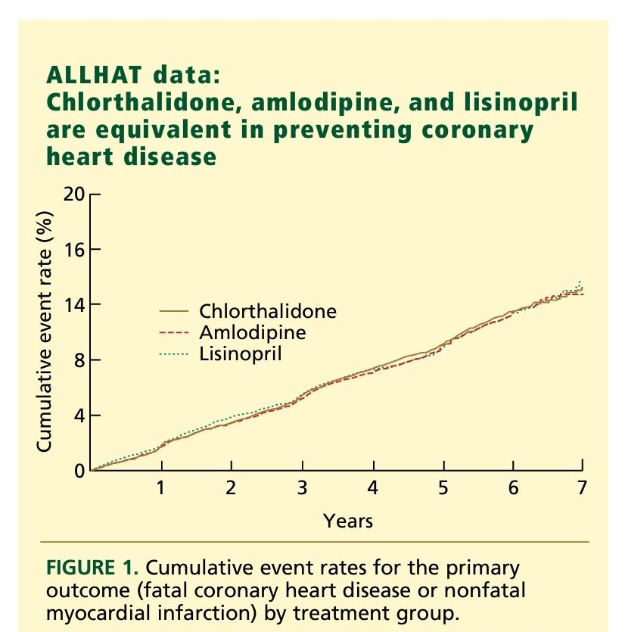

Slide 26
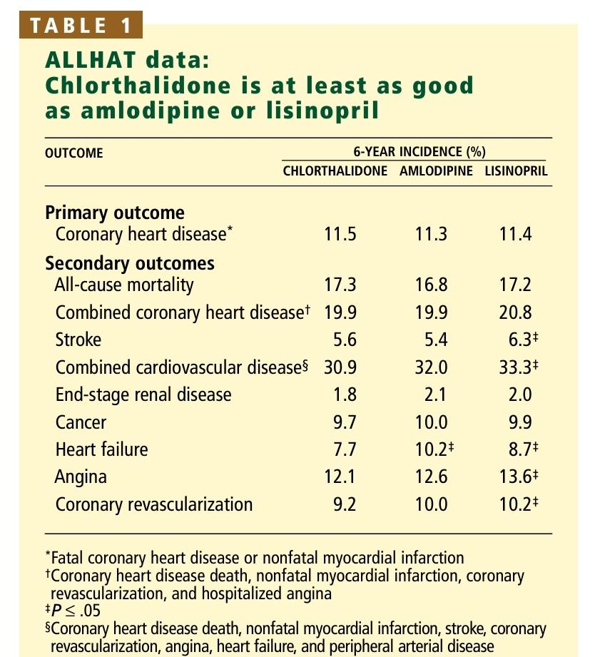

Slide 27
The ACE inhibitor-diuretic comparison showed many more differences:
participants assigned to the ACE inhibitor experienced 10% more combined CVD events (19% more in blacks),
including 15% more strokes (40% more in blacks),
19% more heart failure (32% more in blacks),
11% more angina (hospitalized or treated), and
10% more coronary revascularizations than those assigned to the diuretic.

Slide 28
Treatment effects were consistent across 3 of the 4 predefined subgroups (age, sex, diabetic status) for both treatment comparisons.
In the black subgroup, the relative risks of stroke, heart failure, combined CVD, and combined CHD among those randomized to the ACE inhibitor compared with the diuretic were significantly higher than in nonblacks.
These differences could not be attributed to differences in BP control
Primary safety outcomes included
hospitalization for gastrointestinal bleeding, (did not differ) and
angioedema, which was significantly more common in the ACE inhibitor group, especially among blacks.

Slide 29
All three drugs lowered blood pressure well
although systolic pressures were 1 to 2 mm Hg lower in the chlorthalidone group than in the other groups for most of the study.
At 5 years, the mean blood pressure was
134/75 mm Hg in the chlorthalidone group,
135/75 in the amlodipine group, and
136/75 in the lisinopril group.
Also at 5 years, the percentage of patients who had achieved the goal blood pressure of less than 140/90 mm Hg was
68.2% in the chlorthalidone group,
66.3% in the amlodipine group, and
61.2% in the lisinopril group.

Slide 30
Comments
ALLHAT fulfilled its promise in that it clearly refuted its own primary hypothesis, that the newer classes of antihypertensive drugs would be superior to a thiazide-type diuretic in preventing fatal and nonfatal CHD when given as a first-line therapy.
There was no difference between treatment groups (even the discontinued α-blocker group) with respect to this primary endpoint.
There were, however, major differences among treatment groups with respect to major secondary endpoints.

Slide 31
The excess risk of heart failure with the CCB and the α-blocker was predictable from previous studies.
However, the absence of excess CHD, cancer, gastrointestinal bleeding, and all-cause mortality with the CCB does not support previous reports based on observational data and clinical trials of short-acting CCBs.
No significant difference in the incidence of end stage renal disease between the CCB and diuretic groups, and
comparison of the reciprocal creatinine slopes actually suggested a slower decline in renal function in the CCB group, although interpretation of the latter finding is open to question.

Slide 32
Preservation of renal function with CCB treatment is consistent with findings of the Intervention as a Goal in Hypertension Treatment (INSIGHT) trial,
which was carried out in a European population without baseline renal disease,
but contrasts with findings of studies carried out in persons with baseline diabetic or nondiabetic renal insufficiency and associated proteinuria.
In the latter trials, amlodipine treatment appeared to accelerate the development of renal insufficiency.

Slide 33
Importantly, ALLHAT enrolled a low renal risk population (mean baseline serum creatinine =1.0 mg/dL; serum creatinine >2 mg/dL was an exclusion criterion), and
end stage renal disease was not a primary endpoint of the trial.
Taken together, the ALLHAT results give assurance that long-acting CCBs are safe and effective alternatives to diuretics as first-line antihypertensive treatment.

Slide 34
Another surprising result of ALLHAT was the superiority of diuretic-based treatment to ACE inhibitor-based treatment in preventing stroke, heart failure, angina, and coronary revascularization.
These findings are counterintuitive, considering the proven efficacy of ACE inhibitors in delaying the transition from left ventricular dysfunction to heart failure & in the treatment of established heart failure.

Slide 35
Differences present in all 4 prespecified subgroups, even diabetics, in whom ACE inhibitor treatment would be expected to be superior, and were even greater in blacks.
The latter observation is consistent with reports of poorer BP responses to ACE inhibitors and lesser effects of ACE inhibitors in secondary prevention of heart failure in blacks.

Slide 36
Importantly, although the differential responses for disease outcomes and BP responses were in parallel, the differences in outcomes were not substantially reduced by statistically adjusting for systolic BP.
Further, ACE inhibitor-based therapy was no better than diuretic-based treatment in preserving renal function, contrary to published findings in high renal-risk populations

Slide 37
Adverse metabolic effects of diuretic treatment were common in ALLHAT.
Hypokalemia occurred in nearly 13% at year 2 of the trial, and 8% were receiving K+ supplements at 5 years;
fasting glucose was elevated (>126 mg/dL) in nearly 12% of previously nondiabetic participants at 2 years, and
total cholesterol was significantly higher in the other treatment groups.
Despite these abnormalities in surrogate endpoints, no excess of CVD events or mortality was associated with diuretic treatment.

Slide 38
Limitations of ALLHAT
(1) the failure to achieve identical BPs in all treatment groups, a particular problem in the black subgroup;
(2) a trial design that resulted in a somewhat artificial regimen of step-up drugs (no diuretics or CCBs allowed) in the ACE inhibitor group;
(3) uncertainty about whether the results can be extrapolated from the specific drugs tested to other drugs of the same class; and
(4) omission of newer agents, released since ALLHAT was designed, such as angiotensin receptor blockers and selective aldosterone receptor antagonists, and of β-blockers, which are often used to treat hypertension in high risk persons.
(5) No formal cost-benefit analysis

Slide 39
Despite these limitations, some of which are inherent in any randomized, controlled trial, the results of ALLHAT provide convincing evidence that thiazide-type diuretics are the best initial therapy for hypertension in a high risk US population.

Slide 40
MCQs
Drug NOT included in ALLHAT:
chlorthalidone
doxazosin
amlodipine
ramipril

Slide 41
MCQs
Drug NOT included in ALLHAT:
chlorthalidone
doxazosin
amlodipine
ramipril

Slide 42
NOT a risk factor included in ALLHAT
Cigarette smoking
Atherosclerotic cardiovascular diseases
Renal Diseases
Type 2 diabetes

Slide 43
NOT a risk factor included in ALLHAT
Cigarette smoking
Atherosclerotic cardiovascular diseases
Renal Diseases
Type 2 diabetes

