Slide 1
ECG in Left atrial and Right atrial Abnormality
Sana Muhammed PP

Slide 2
INTRODUCTION
• Cardiac chamber enlargement refers to :
- Dilatation of the heart chamber
(heart muscle is stretched & chamber become enlarged)
- Hypertrophy
(heart muscle fibres actually get increased in size
with resultant enlargement of chamber)

Slide 3
• Both dilatation & hypertrophy usually result from
some type of chronic pressure or volume
load on the heart muscle.
- Left atrial abnormality - Right atrial abnormality - RVH - LVH - Biatrial abnormalities - Biventricular hypertrophy

Slide 4
RIGHT ATRIAL ENLARGEMENT

Slide 5
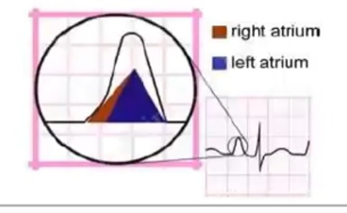
Right Atrial enlargement – lead ll
In RAE ,right atrial depolarization lasts
longer than normal and it’s waveform extends
to the end of left atrial depolarization.
• Although the amplitude of the right atrial depolarization current remains unchanged , it’s peak now falls on top of that of the left atrial
depolarization wave
• The combination of these 2 waveforms produces a P waves that is taller than normal (>2.5mm) ,although the width remain unchanged (<120ms)

Slide 6
ECG criteria of RAE
• produces a peaked P wave (P pulmonale)
with amplitude:
– >2.5 mm in the inferior leads
– > 1.5 mm in V1 & V2

Slide 7
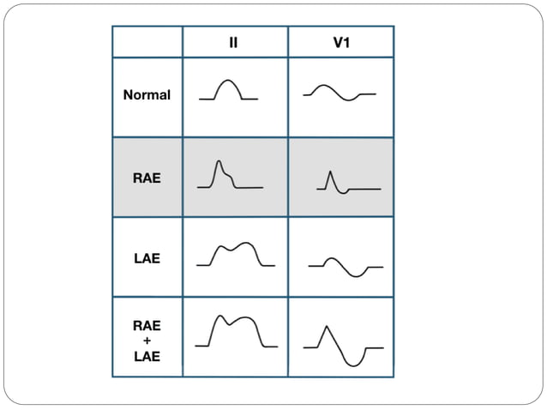

Slide 8
CAUSES OF RAE
Principle cause of pulmonary hypertension
due to
- chronic lung disease (cor pulmonale)
- Tricuspid stenosis
- CHD ( pulmonary stenosis ,TOF)
- primary pulmonary hypertension

Slide 9
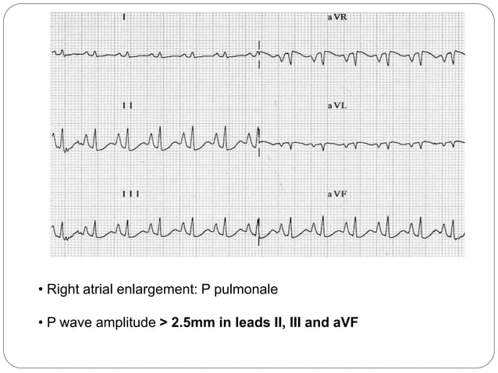

Slide 10
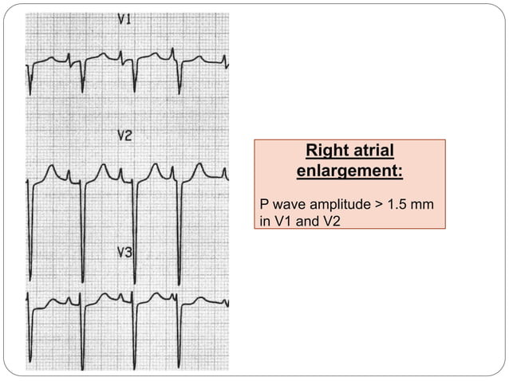

Slide 11
LEFT ATRIAL ENLARGEMENT

Slide 12
LAE is due to pressure or volume overload
of the LA
Often a precursor to atrial fibrillation

Slide 13
LAE – Lead ll
Left atrial depolarization lasts longer than normal but it’s amplitude remains unchanged
Therefore, the ht. of the resultant P wave remains within normal limits but it’s duration is longer than 120 ms
A notch ( broken line) near it’s peak may or may not be present (P mitrale)

Slide 14
P wave changes with LAE

Slide 15
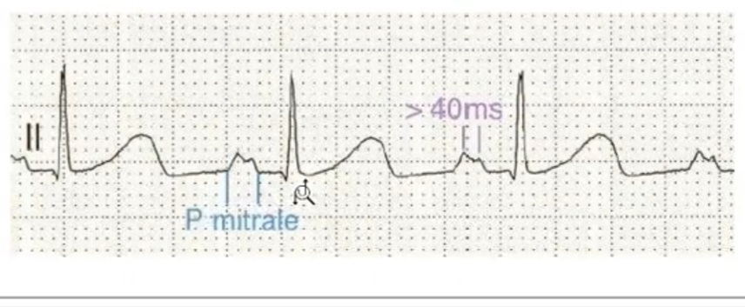
ECG criteria for LAE
Produces a broad ,bifid P wave in lead ll ( P mitrale) & enlarges the terminal –ve portion of P wave in V1
In lead ll
- Bifid P wave with > 40ms b/w the 2 peaks
- Total P wave duration >110 ms

Slide 16
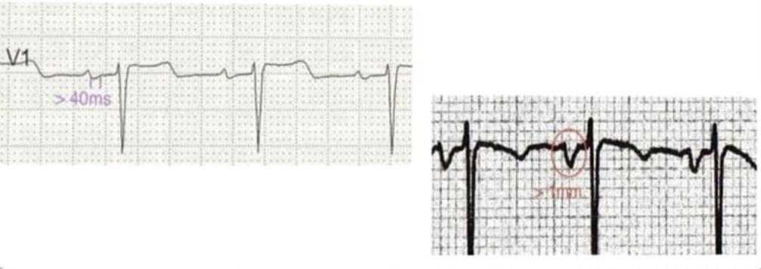
In V1
- Biphasic P wave with terminal –ve portion > 40 ms duration
- Biphasic P wave with terminal –ve portion > 1mm deep

Slide 17
Causes of Left atrial hypertrophy
In isolation
classically seen with MS
• In association with LVH
- Systemic hypertension
- AS
- MR
- Hypertrophic cardiomyopathy

Slide 18
BIATRIAL ENLARGEMENT

Slide 19
Biatrial enlargement
Diagnosed when criteria for both RAE & LAE are present
on the same ECG
The diagnosis requires criteria for LAE & RAE to be
met in either in lead ll , lead V1 or a combination of leads.

Slide 20
ECG criteria for Biatrial Enlargement

Slide 21
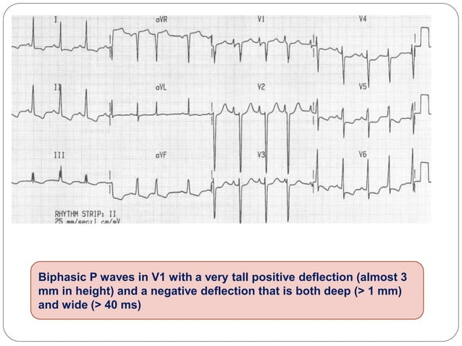

Slide 22
MCQs
Which of the following is not an ECG criteria for RAE
a. >2.5 mm in the inferior leads
b. > 1.5 mm in V1 & V2
c. <2.5 mm in the inferior leads

Slide 23
c. <2.5 mm in the inferior leads

Slide 24
Figure shows :
a. Right atrial enlargement
b. Left atrial enlargement
c. Biatrial enlargement

Slide 25
a. Right atrial enlargement

Slide 26
Which of the following is the P wave changes with biatrial enlargement :
a.
b.
c.

Slide 27
b.

Slide 28
P pulmonale corresponds to :
RAE
LAE
Biatrial enlargement

Slide 29
a. RAE

Slide 30
THANK YOU!

