Slide 1
ANGIOGRAPHIC VIEWS
Karthik K S

Slide 2
INTRODUCTION
→Term ‘Angiography’ is derived from
•Angeion – vessel
•Graphy – record
→Angiography or arteriography is the technique for diagnosing or healing of atherosclerosis.
→2 important procedures •Catheter angiogram
•Angioplasty
→Coronary angiography was first performed by American physician Mason Sones in 1959.

Slide 3
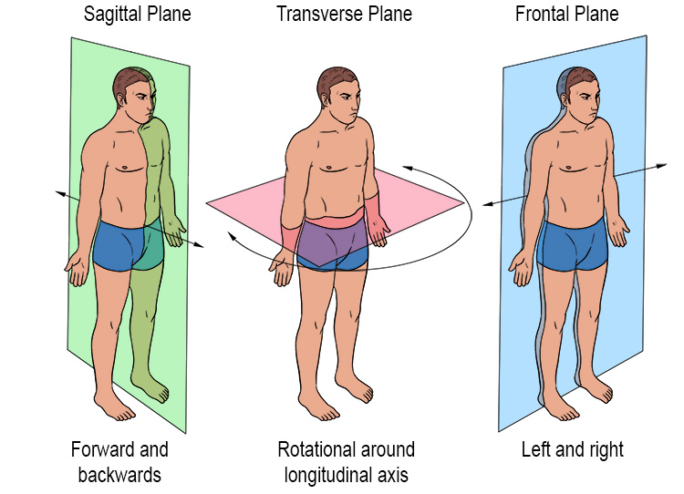
RADIOGRAPHIC PROJECTIONS
a) Transverse plane – Referred to as degrees left or right anterior oblique.
b) Sagittal plane – Degrees cranial or caudal, by the position of imaging detector(II), not
the x-ray tube.
c) Coronal plane - Any vertical plane which divides the body into ventral and dorsal.

Slide 4
ANGIOGRAPHIC VIEWS
→Angulations are of 2 types:1) Rotation
2) Skew
→Rotation – RAO &LAO
→Skew – Cranial & caudal
→In oblique projections, shadow of spine will be opposite of the used position.
→ In cranial projection, diaphragm dome is prominent.

Slide 5
Indications/Used in;
→ Femoral puncture, coronaries – profiling lesions
→ Grafts
→ LV, RV, aorta, pulmonary artery angio
→ ASD, VSD, PDA closures
→ Prosthetic valve

Slide 6
Coronaries – Cannulations and profiling lesions
*LMCA cannulation – AP or LAO
*RCA cannulation – LAO or Lateral
*Anomalous – Customized view

Slide 7
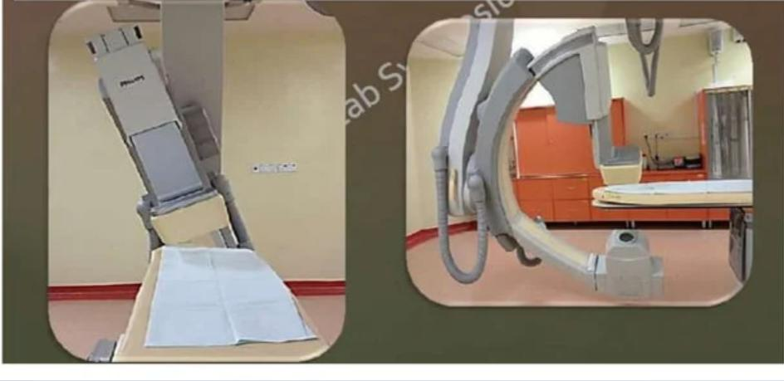
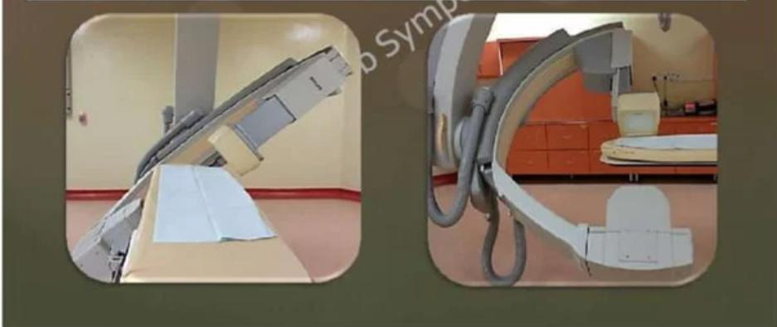
TERMINOLOGY
Right Anterior Oblique (RAO)
Image intensifier(II) is angled above the right side of the
patient’s chest, visualising the heart from the right side.
Left Anterior Oblique (LAO)
II is angled above the left side of the patient’s chest,
visualising the heart from the left side.

Slide 8
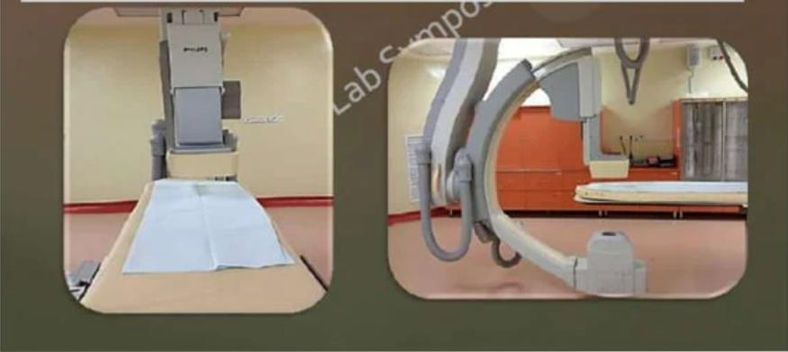
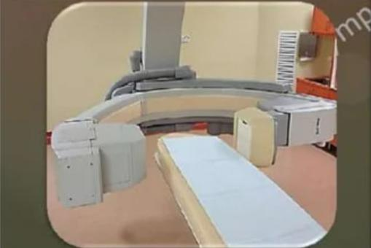
Posterior Anterior (PA)
II is angled directly above patient’s mid chest,
visualising heart from front to back.
Lateral
II is angled 90° from patient’s mid line,
visualising heart from far left side.

Slide 9
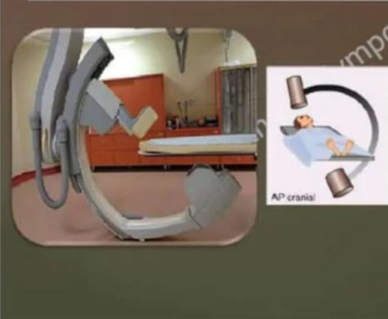
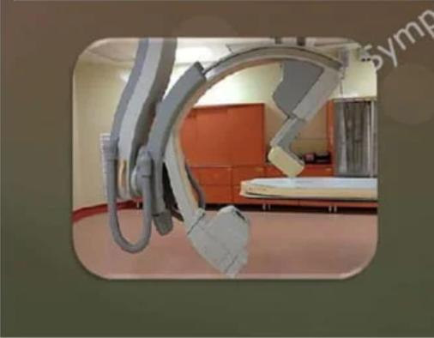
Cranial
II is angled towards the patient’s head,
visualizing the heart from above.
Caudal
• II is angled towards the patient’s feet,
visualising heart from below.
• Optimise visualization of LCX and OM ;
tend to foreshorten LAD and elongate LCX.

Slide 10
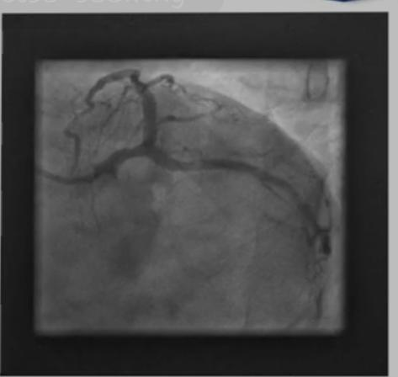
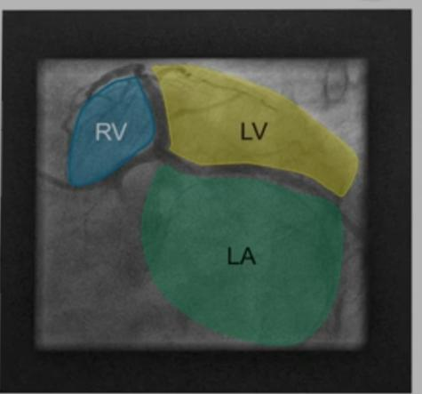
Profiling Left Coronary
Common views used :
LAO Caudal, RAO Caudal, PA Cranial, PA Caudal,RAO Cranial, LAO Cranial, Left Lateral
Left Anterior Oblique Caudal (LAO Caudal) { LAO – 30°to 50° }
• Also known as spider view { Caudal - 30°to 40° }
• Visualise left main trunk, bifurcation /trifurcation in
to LAD, LCX and Ramus intermidus.
• LAD is foreshortened
• Poor image quality may be caused by overlap of the
diaphragm and spine.
• More angulation is needed in patients with vertically
displaced heart.
• RV, LV and LA chambers are seen.

Slide 11
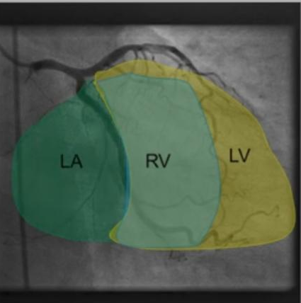
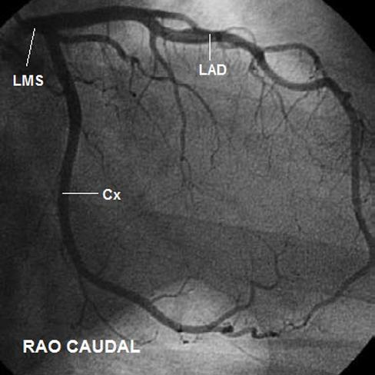
Right Anterior Oblique Caudal(RAO Caudal )
{ RAO – 10° to 20° }
• Better visualisation of LCX { Caudal – 15° to 20° }
• Visualise left main bifurcation /trifurcation, proximal LAD, proximal-mid LCX and OM.
• LA, RV, LV chambers are seen.

Slide 12
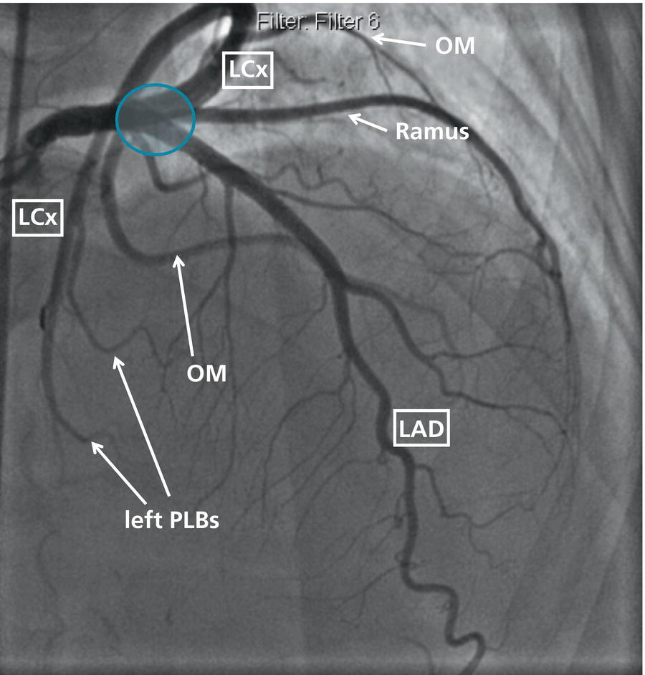
Shallow RAO Cranial
{ RAO - 0°to 10° }
• Visualise ; { Cranial – 25°to 40°}
* Mid and distal LAD with origin of septals and diagonals.
* Mid and distal LCX and OM

Slide 13
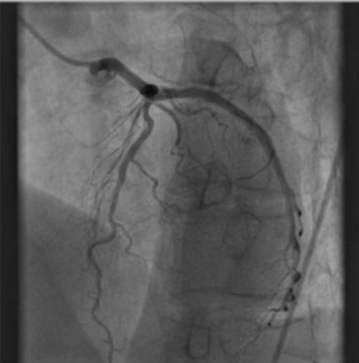
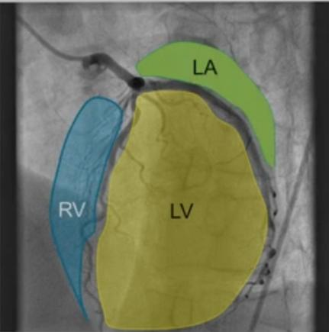
LAO Cranial
{ LAO - 30°to 60° }
• Visualise ; { Cranial – 15° to 30°}
* LPDA(left dominant )
* Ostium of LM, LAD with diagonal and septal
separation.
* Left to right collaterals
• RV, LV & LA chambers are seen.

Slide 14
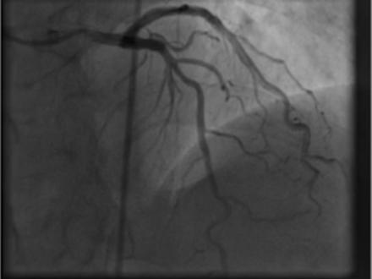
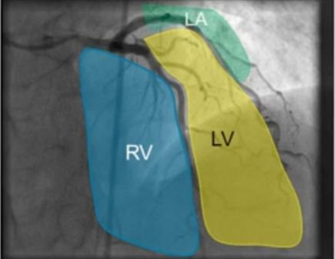
Posterior Anterior (PA)
• Best for visualising ostium of the left main.
PA Cranial
{ Cranial – 30°}
• Visualise LAD with septals towards right and
diagonals towards left, helping in wire placement.
• RV, LV & LA chambers are seen.

Slide 15
PA Caudal
{ Caudal – 20° to 30° }
• Visualise ;
* LMCA in entire length
* Proximal LAD
* Proximal to Mid LCX
• LA, RV & LV chambers are seen.

Slide 16
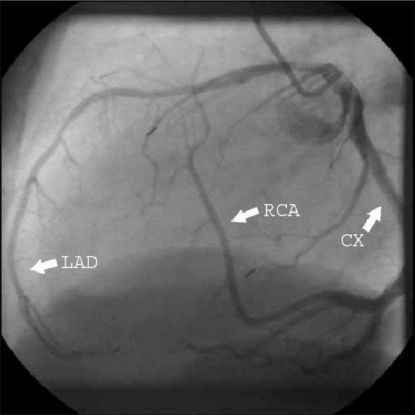
Left Lateral
• Visualise ;
* Mid and distal LAD
* LCX

Slide 17
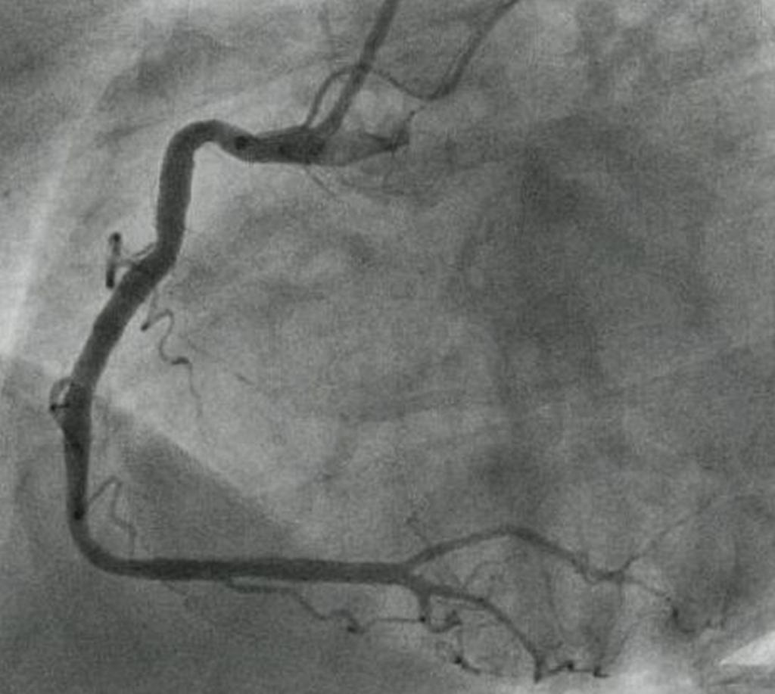
Profiling Right Coronary
• Common views used ;
* LAO (30°)
* RAO (30°)
* PA Cranial (cranial - 30°)
* LAO Cranial
Left Anterior Oblique (30°)
• Visualise ostio-proximal and distal RCA well.

Slide 18
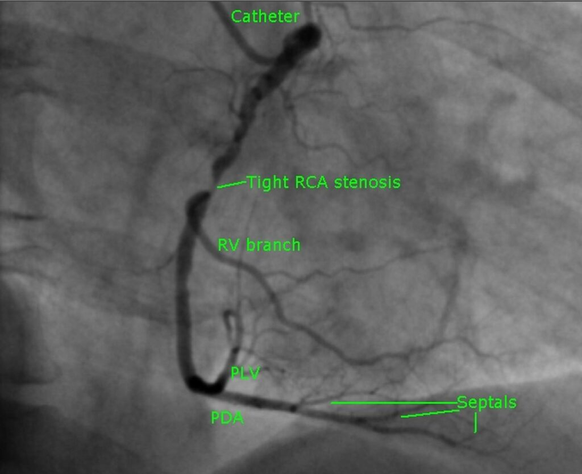
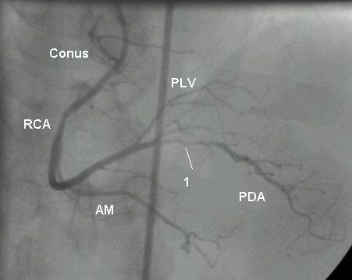
Right Anterior Oblique (30°)
•Visualise Mid RCA and RPDA.
Posterior Anterior Cranial(PA Cranial)
• Visualise ;
* Distal RCA bifurcation, PDA & PLB.

Slide 19
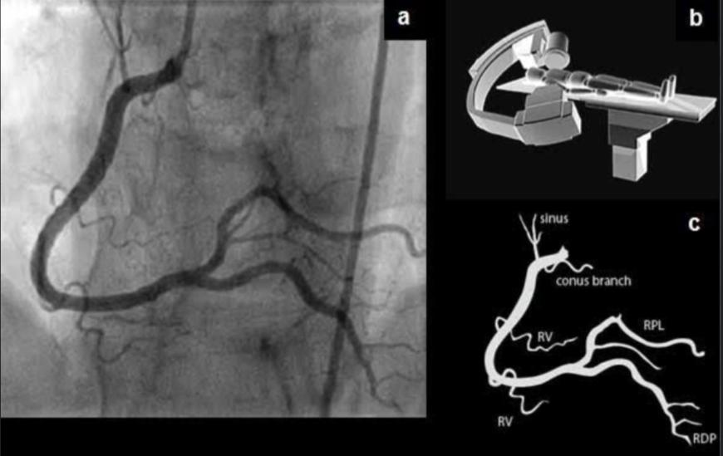
LAO Cranial
•Visualise ;
*mid and distal RCA
*PDA & PLB
*Collateral filling

Slide 20
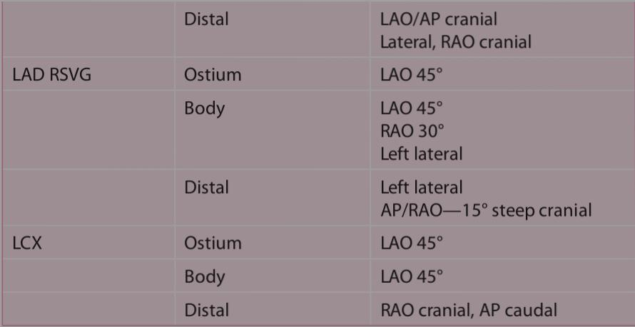

Slide 21
MCQS
1) Who performed first coronary angiography?
a) Werner Forssmann b) Mason Sones
c) Edward Jenner c) Inge Edler

Slide 22
2) In which among the following II will be 90° from the patient’s midline?
a) RAO b) PA
c) Lateral d) Cranial

Slide 23
3) __________ is also known as spider view?
a) LAO Cranial b) LAO Caudal
c) RAO Caudal d) LAO

Slide 24
THANK YOU

