Slide 1
Ecg & VENTRICULAR Hypertrophy
Aysha Jamal

Slide 2
• Cardiac enlargement refers to either dilatation of a heart chamber or Hypertrophy of
the heart muscle:
In dilatation of a chamber, the heart muscle is stretched & the chamber becomes
enlarged
In cardiac hypertrophy, the heart muscle fibers actually increase in size, with
resultant enlargement of the chamber.
• Both dilatation & hypertrophy usually result from some type of chronic Pressure or Volume
load on the heart muscle.
Right atrial abnormality
Left atrial abnormality
Left ventricular hypertrophy
Right ventricular hypertrophy
Biatrial abnormalities
Biventricular hypertrophy

Slide 3
LEFT VENTRICULAR HYPERTROPHY
•Normally, LV is electrically predominant over the RV (because of its relatively larger mass).
•As a result prominent –ve S waves are produced in the right chest leads,
and tall +ve R waves are seen in the left chest leads.
•When LVH is present, the balance of electrical forces is tripped even further to the left.
Thus with LVH, abnormally tall, +ve R waves are usually seen in the left chest leads, &
abnormally deep –ve S waves are present in the right chest leads.

Slide 4
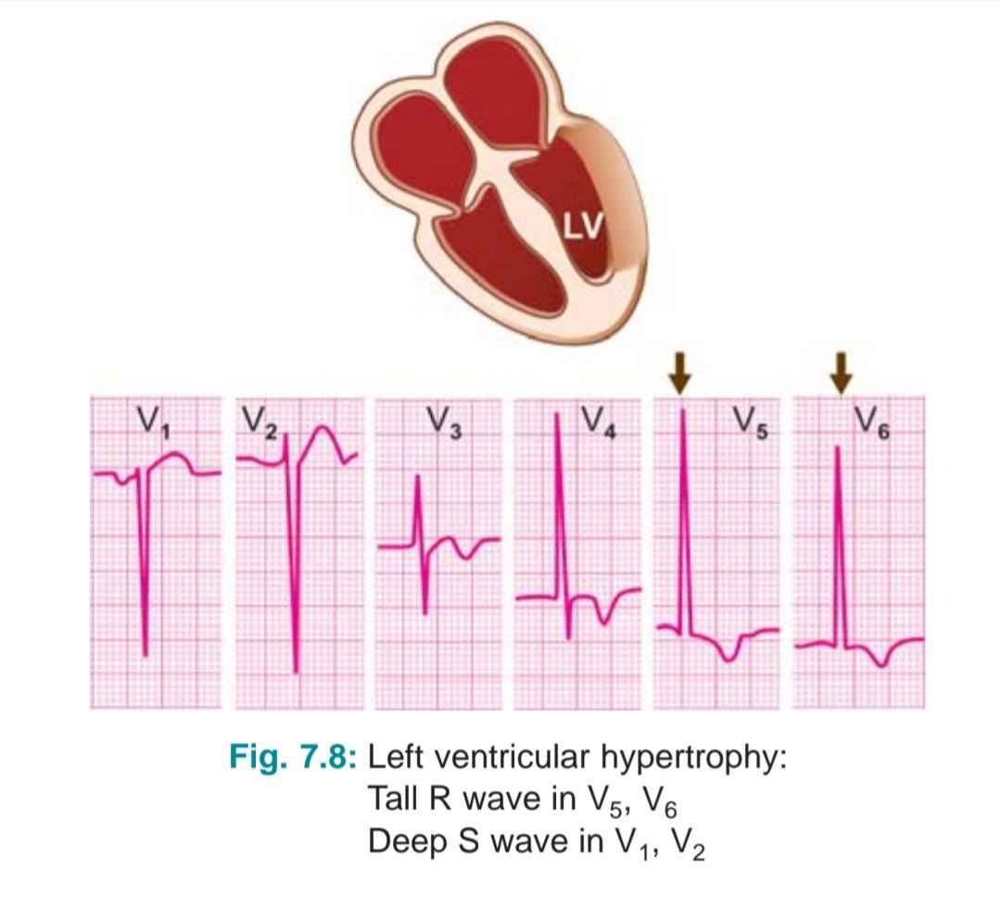

Slide 5
ECG CRITERIA
1. Sokolow Lyon index
S in V1 + R in V5 or V6 > 3.5mV (35mm)
2. Romhilt & Estes point score system
A score of 5 points or more indicates LVH
3. Cornell voltage product
S in V3 + R in aVL > 2mV (20mm) in Women
> 2.8mV (28mm) in Men
Increased QRS magnitude - 3 points
ST - T abnormalities - 3 points
A P wave of left atrial abnormality - 3 points
Left axis deviation - 2 points
Increased ventricular activation time - 1 point

Slide 6
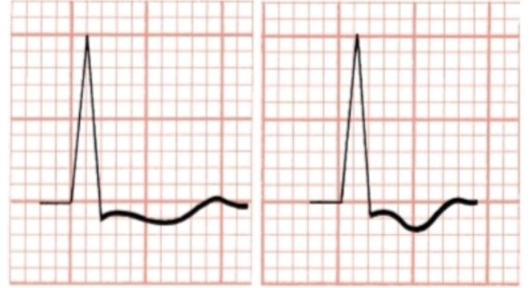
4. R wave of 11 to 13mm or more in lead aVL
5. ECG shows slight ST depression followed by a broadly inverted T wave.
In some cases these T wave inversions are very deep.
This LV overload related repolarization abnormality
(formerly called LV “strain”) is usually best seen in
leads with tall R wave.
6. Patients with LVH eventually develop an incomplete or complete LBBB pattern.
7. Signs of LAA, (Broad P waves in the extremity leads / biphasic P waves in V1)
are often seen in patients with LVH.

Slide 7
• LVH may occur due to Systolic overload / Diastolic overload
☆ SYSTOLIC OVERLOAD
- Due to resistance of LV systolic outflow & hence, LV contraction.
- Also known as Pressure overload
- Occurs with AS, SHTN, HOCM, CoA
☆ DIASTOLIC OVERLOAD
- Due to overfilling of LV, so that compromise occurs during diastole
- Also known as Volume overload
- Occurs with MR, AR, VSD, PDA

Slide 8
ECG CHANGES
☆ In Pressure overload,
• Changes in QRS complex, ST segment & T wave
• Characteristic finding is increased amplitude of QRS complex
• R waves in leads facing LV (I, aVL, V5, V6) are taller than normal, & S waves in the leads
overlying the opposite side of the heart (V1 & V2) are deeper than normal.
• Other changes include,
- Widening of QRS complex beyond 110ms
- Delay in ventricular activation time
- Notching of QRS complex
• Prolongation of QT interval & evidence of LAA

Slide 9
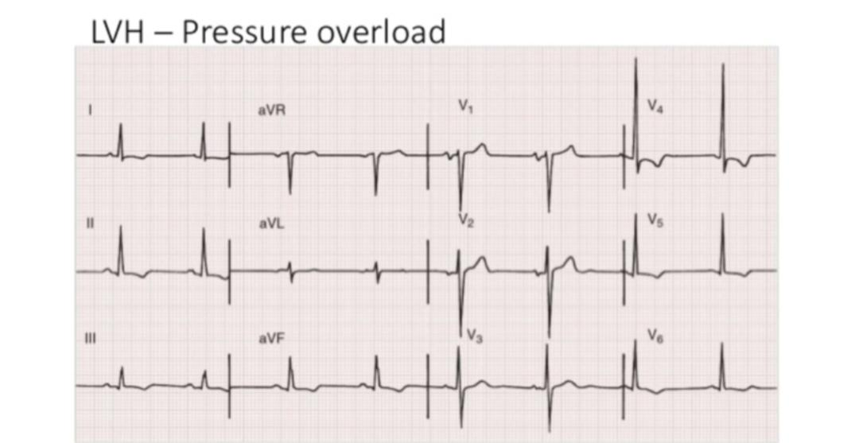
• ST-T waves vary widely. It can be normal / somewhat elevated
• In many patients ST segment is depressed with T inversion.

Slide 10
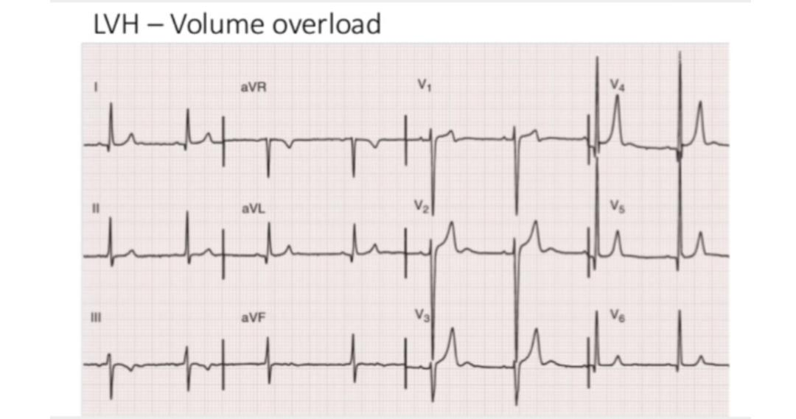
☆ In Volume overload,
• Tall upright T waves & sometimes narrow but deep Q waves in leads facing
left side of the septum or LV free wall.

Slide 11
RIGHT VENTRICULAR HYPERTROPHY
• RVH is an abnormal enlargement or pathologic increase in muscle mass of the RV
in response to pressure overload, most commonly due to severe lung disease.
• Involve one/more of 3 major regions,
- Right paraseptal region
- Free wall of RV
- The basal regions of RV, especially RVOT
• Normally, the LV & RV depolarize simultaneously, & the LV is electrically predominant.
As a result, leads placed over the right side of the chest (eg: V1) record rS - type complexes.
• In these rS - type complexes, the deep –ve S wave indicates the spread of
depolarization voltages away from the right and toward the left side.

Slide 12
• Conversely, leads placed over the left side of the chest (eg: V5,V6) record qR - type complex.
• In this complex, the tall +ve R wave indicates the predominant depolarization voltages
that point to the left & generated by the LV.
• Instead of the rS complex normally seen in lead V1, a tall +ve R wave indicates
marked RVH.
• Along with tall right chest R waves, RVH often produces 2 additional ECG signs:
- Right axis deviation (RAD)
- T wave inversions in right to mid-precordial leads.
• RVH affects both depolarization (QRS complex) & repolarization (ST-T complex).
• With RVH, the characteristic repolarization change is the appearance of
inverted T waves in the right and middle chest leads. These right chest T wave inversions
were formerly referred to as a Right ventricular "strain" pattern.

Slide 13
• Sometimes, the middle and left chest leads show poor R wave progression,
with rS or RS complexes all the way to lead V6.
• In other cases, normal R wave progression is preserved and
the left chest leads also show R waves.
• Signs of RVH are accompanied by tall P waves.
• In summary, with RVH the ECG may show,
- Tall R waves in right chest leads & the R wave may be taller than the S wave in lead V1.
•In addition, RAD and right precordial T wave inversions are often present.

Slide 14
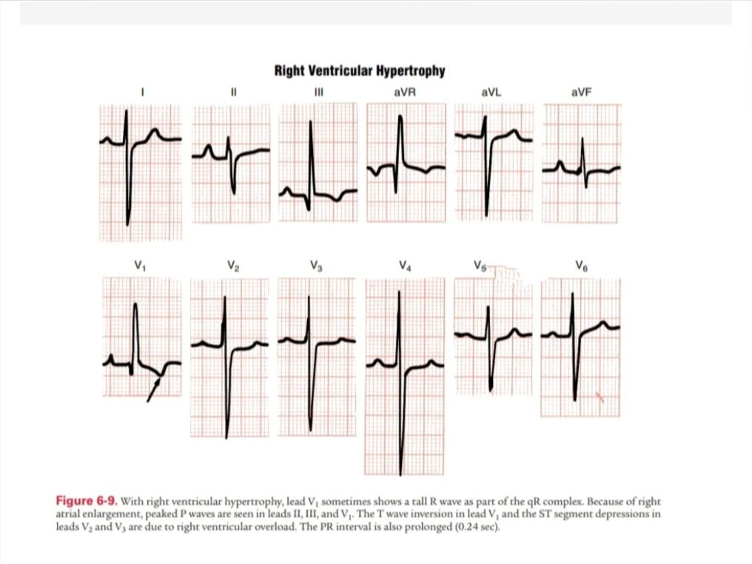

Slide 15
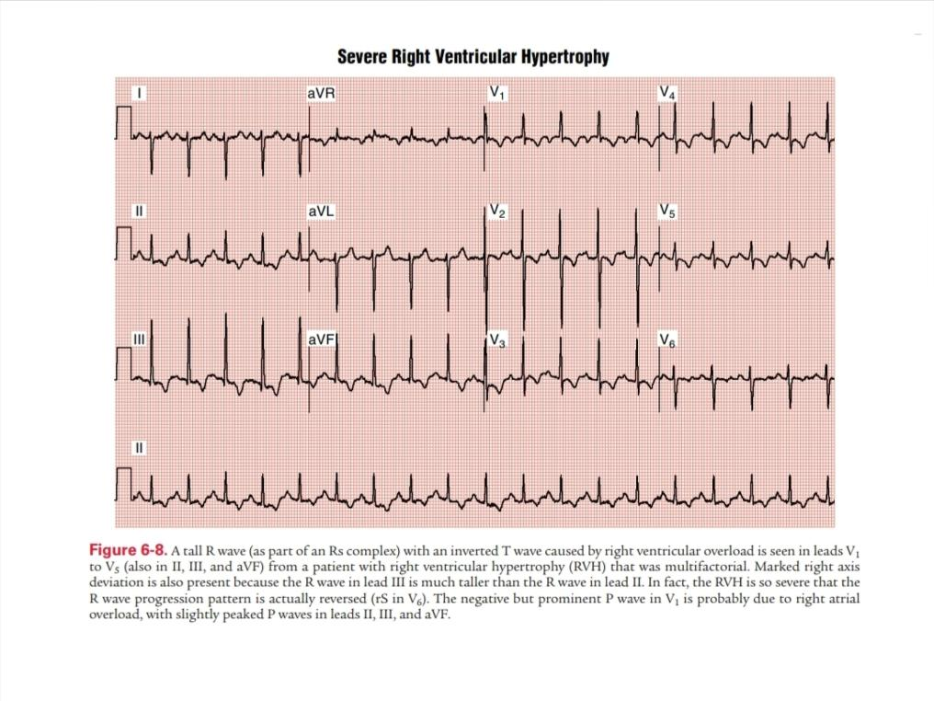

Slide 16
BIVENTRICULAR HYPERTROPHY
• Hypertrophy of both the LV & RV.
• ECG has a low sensitivity for the diagnosis, as the opposing
left and right ventricular forces tend to cancel each other out.
☆ ECG CHANGES:
- Tall R waves in right and left precordial leads.
- Right axis deviation.
- Deep S waves in left precordial leads.

Slide 17
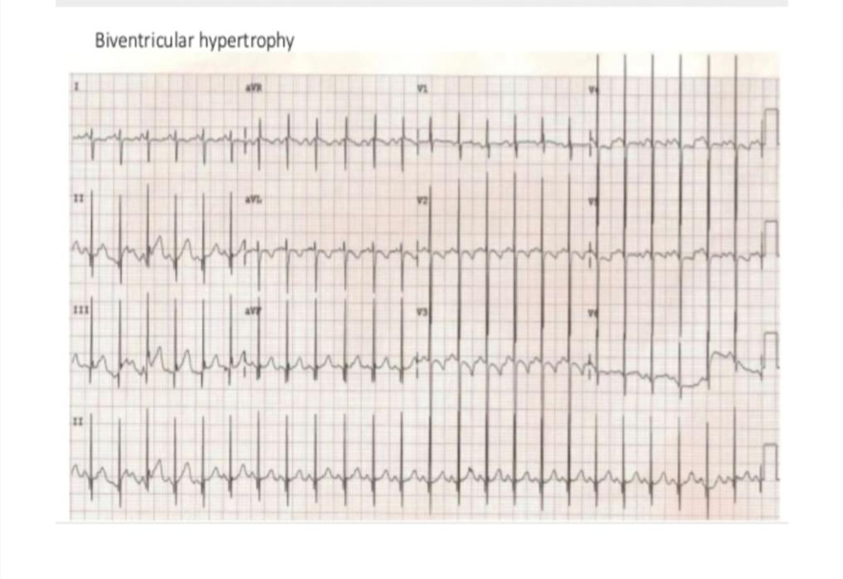

Slide 18
MCQs
In Romhilt & Estes point score system,
A score of _______ or more indicates LVH.
a) 6 points
b) 5 points
c) 8 points

Slide 19
Ans: b) 5 points

Slide 20
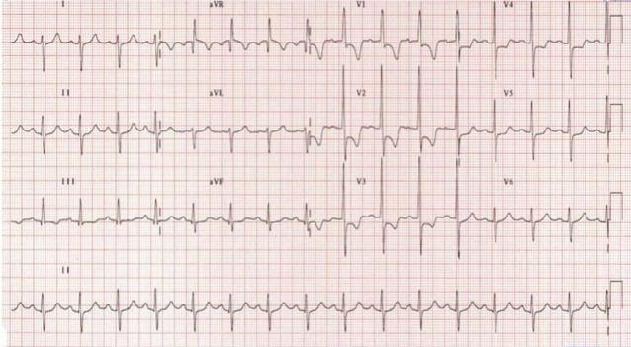
ECG shows,
a) Right ventricular hypertrophy
b) Left ventricular hypertrophy
c) Biventricular hypertrophy

Slide 21
Ans: a) Right ventricular hypertrophy

Slide 22
3. Diastolic overload do not occur with
a) MR
b) VSD
c) HOCM

Slide 23
Ans: c) HOCM

Slide 24
THANK YOU

