Slide 1
Echocardiographic Assessment of LV systolic function
Dr. Aiswarya Ravikrishnan

Slide 2
Ventricular systolic dysfunction is a strong predictor of clinical outcomes in various cardiovascular diseases:
Ischemic cardiac disease
Cardiomyopathies
Valvular heart disease
Congenital heart disease

Slide 3
Echocardiographic estimates are valuable tools in clinical settings for assessing:
Global and regional function
Quantitative ventricular volumes
Ejection fractions
Doppler echocardiographic ejection phase indices

Slide 4
Evaluation of ventricular systolic function is a key component in every clinical echocardiographic study, even if not the primary focus.
In research applications, echocardiographic measures of left ventricular (LV) systolic function:
Provide important baseline data on disease severity
Serve as clinical endpoints for intervention trials in patients with ventricular dysfunction.

Slide 5
Cardiac Cycle
Systole Definition:
Segment of the cardiac cycle from mitral valve closure to aortic valve closure.
Begins with ventricular depolarization (QRS complex) and ends after repolarization (end of T wave).
Ventricular Pressure Curves: Systole starts when left ventricular (LV) pressure exceeds left atrial (LA) pressure, closing the mitral valve.
Followed by isovolumic contraction:
Cardiac muscle depolarizes.
Calcium influx and myosin-actin shortening occur.
Ventricular pressure rises rapidly at a constant volume.

Slide 6
Aortic Valve Dynamics:
Opens when LV pressure exceeds aortic pressure.
LV volume falls rapidly as blood flows to the aorta during ejection.
LV pressure initially exceeds aortic pressure (rapid acceleration of blood flow).
In mid-systole, aortic pressure exceeds LV pressure (deceleration phase).
End of Systole:
Aortic valve closure occurs at the dicrotic notch on the aortic pressure tracing.
Includes isovolumic contraction and ventricular ejection phases (acceleration and deceleration).
Ventricular Volume Changes: Ranges from maximum at end-diastole (onset of systole) to minimum at end-systole.

Slide 7
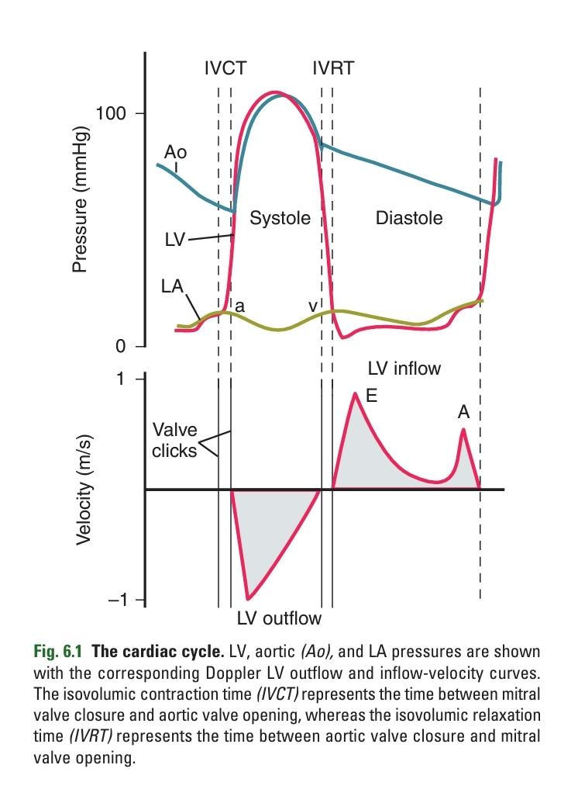

Slide 8
Physiology of Systolic Function
Myocardial Contraction:
Ventricular myocardial fibers contract circumferentially and longitudinally.
Results in myocardial wall thickening and inward motion of the endocardium.
Ventricular Changes During Systole:
Decrease in ventricular size.
Increase in ventricular pressure.
Outcome:
Ejection of blood (stroke volume) from the ventricle.

Slide 9
Stroke volume reflects the pump performance of the heart.
The decrease in chamber volume relative to end-diastolic volume, or ejection fraction, reflects overall ventricular function.
Ventricular function and pump performance depend on:
■ Contractility (the basic ability of the myocardium to contract)
■ Preload (initial ventricular volume or pressure)
■ Afterload (aortic resistance or end-systolic wall stress)
■ Ventricular geometry

Slide 10
Contractility:
Intrinsic ability of the myocardium to contract, independent of loading conditions or geometry.
Requires measurement of ventricular ejection performance under different loading conditions.
Experimental Measurement:
Described by the slope of the end-systolic pressure-volume relationship (Emax).
LV pressure on the vertical axis, volume on the horizontal axis in a pressure-volume "loop".
Each loop represents a cardiac cycle under different loading conditions (e.g., varying end-diastolic volume or afterload).

Slide 11
Emax:
Slope of the line intersecting the end-systolic pressure-volume points for each curve.
Decrease in contractility results in decreased stroke volume and larger LV volumes.
Factors Affecting Contractility:
Heart rate
Coupling interval
Metabolic factors
Disease processes
Pharmacologic agents

Slide 12
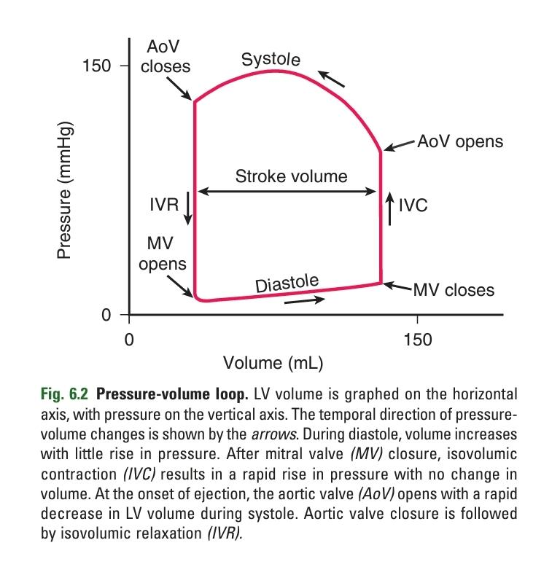

Slide 13
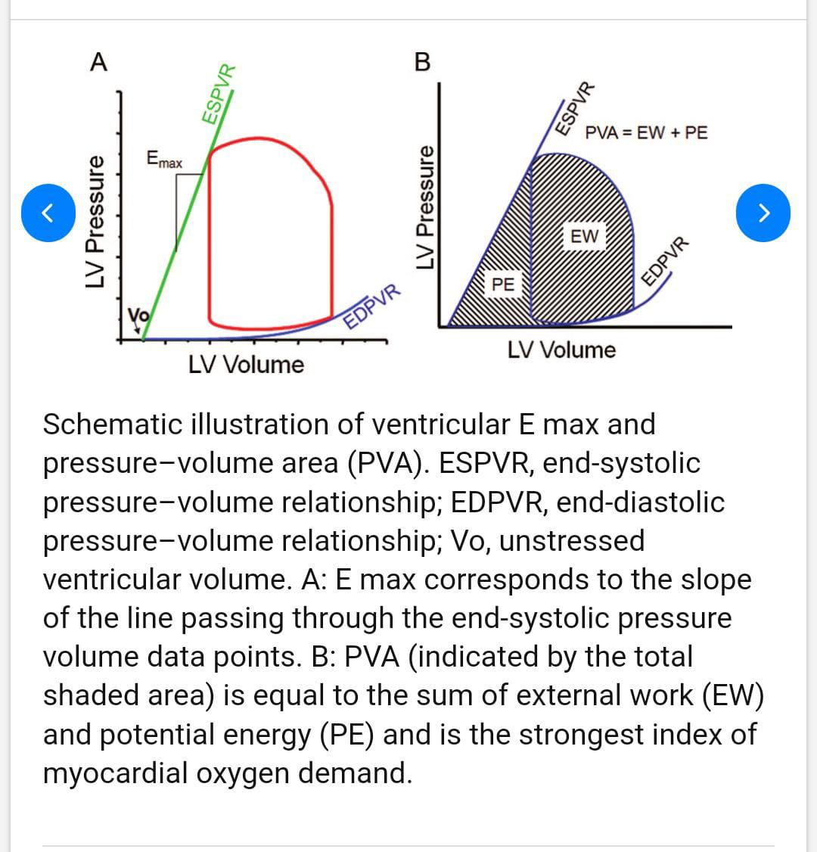

Slide 14
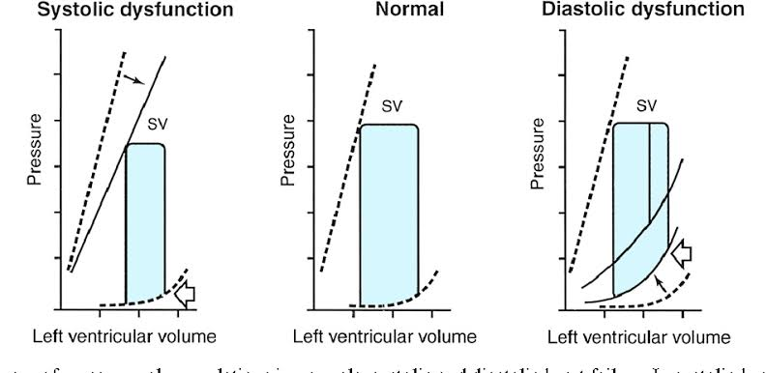

Slide 15
Frank-Starling Curve:
Shows the relationship between ventricular end-diastolic volume (or pressure) and stroke volume.
End-diastolic volume on the horizontal axis.
Stroke volume on the vertical axis.
Relationship:
Curvilinear relationship: increasing end-diastolic volume results in greater stroke volume.
For a given degree of contractility, stroke volume increases as end-diastolic volume increases.
Effect of Contractility:
Increased contractility results in a greater increase in stroke volume for a given increase in preload.
Decreased contractility results in a lesser increase in stroke volume for the same preload increase.

Slide 16
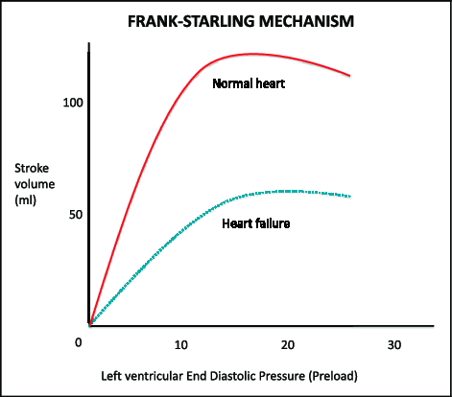

Slide 18
Afterload:
Defined by resistance or impedance.
Has an inverse relationship with myocardial fiber shortening.
Impact on Stroke Volume:
Increasing vascular resistance results in decreased stroke volume.
Increased contractility helps maintain normal stroke volume despite higher afterload.
Decreased contractility leads to further reductions in myocardial fiber shortening and stroke volume with even slight increases in afterload.

Slide 19
Challenges in Measuring LV Systolic Function:
Difficult to measure independently of loading conditions using echocardiographic or clinical methods.
Pressure-volume loops under different conditions are hard to construct due to:
Difficulty in measuring instantaneous LV volumes.
Risk of altering loading conditions in ill patients.
Common Clinical Measurements:
Cardiac output
Ejection fraction
End-systolic dimension or volume
Limitations:
These measures are load-dependent.
Alternative Approach:
Strain and strain rate measurements are becoming more widely used for evaluating ventricular function.

Slide 20
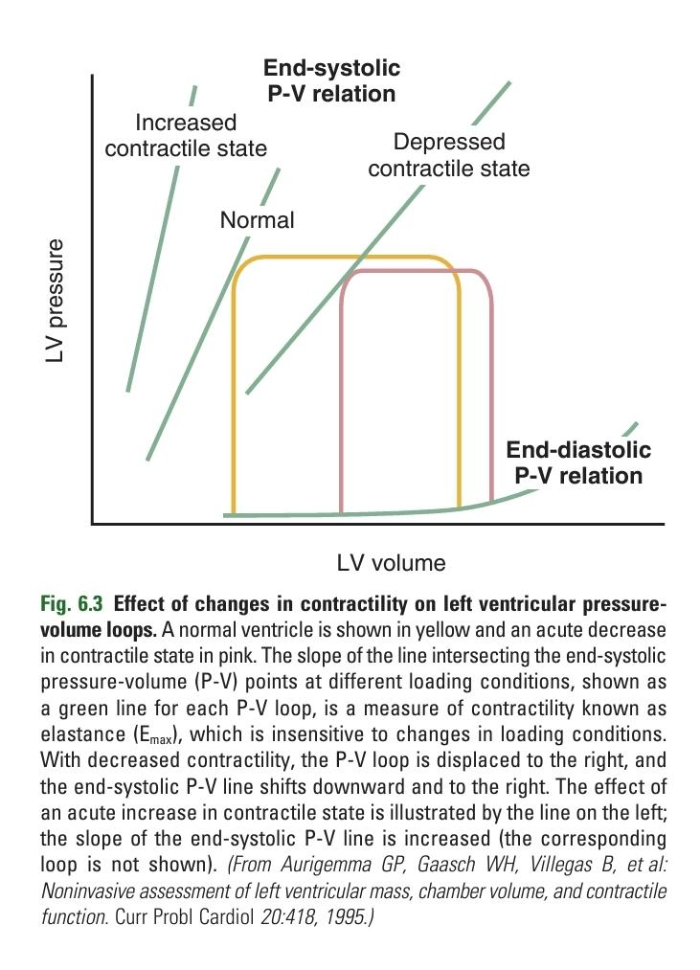

Slide 21
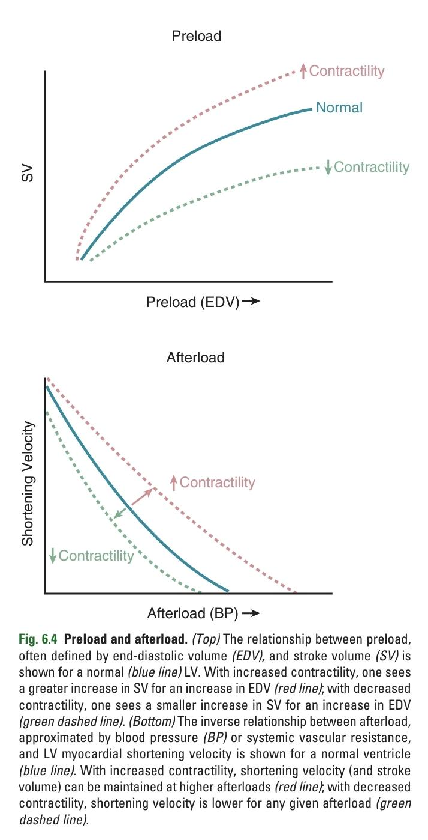

Slide 22
Ventricular Volumes and Geometry
Normal LV Shape:
Symmetric with two relatively equal short axes.
Long axis runs from the base (mitral annulus) to the apex.
Apex is slightly rounded, resembling a hemiellipse in long-axis views.
Basal half is cylindrical, appearing circular in short-axis views.
Volume Calculation Methods:
Derived from:
Linear dimensions (M-mode)
Cross-sectional areas (2D echo)
Assumptions about LV shape simplify these formulas.

Slide 23
Variability:
Variability exists among patients in ventricular shape.
3D Imaging:
Calculation of LV size from 3D images avoids inaccuracies related to geometric assumptions.

Slide 24
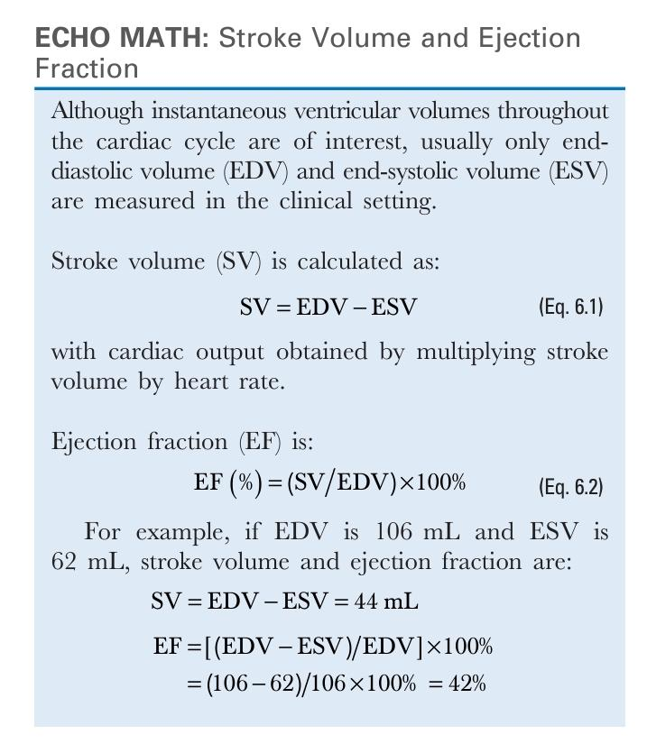

Slide 25
Cardiac Output
Heart Function:
Primary function is as a pump.
Cardiac output measures the volume of blood pumped per minute.
Stroke volume is the amount pumped per beat.
Measurement Methods:
Derived from ventricular volumes.
Right heart catheterization with indicator dilution methods (Fick, thermodilution).
Inert gas rebreathing approaches.
Angiographic, radionuclide, or cardiac magnetic resonance (CMR) for ventricular volumes.
CMR or Doppler flow-velocity methods.

Slide 27
Dynamic Nature:
Ventricular systolic function and cardiac output respond rapidly to metabolic demands.
Cardiac output increases from 6 L/min at rest to 18 L/min with exercise in young, healthy adults.
Mechanisms of Increase:
Primarily mediated by an increase in heart rate.
Minimal increase in stroke volume with supine exercise (~10%).
Greater increase in stroke volume with upright exercise (20% to 35%).
Exercise Effects:
End-diastolic volume remains unchanged or slightly decreases.
Ejection fraction increases.
End-systolic volume decreases.
Endocardial motion and myocardial wall thickening are augmented.
Appearance of “hypercontractility” during and immediately after exercise.

Slide 28
IMAGING THE LEFT VENTRICLE
Qualitative Evaluation of Systolic Function
Both global and regional ventricular function can be evaluated with 2D echocardiography on a semiquantitative scale by an experienced observer.
On transthoracic (TTE) imaging, overall LV systolic function is evaluated best from multiple tomographic planes, typically:
■ Parasternal long-axis view
■ Parasternal short-axis view
■ Apical four-chamber view
■ Apical two-chamber view
■ Apical long-axis view

Slide 29
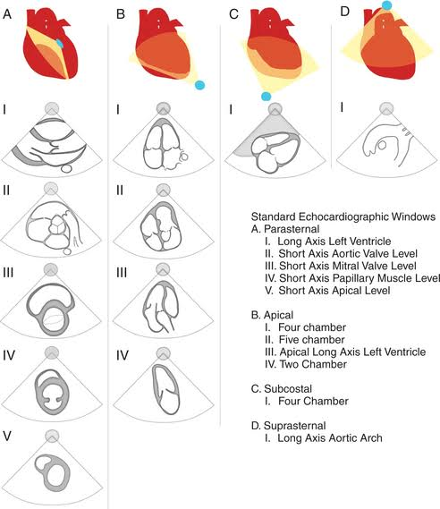

Slide 30
TEE Imaging:
Equivalent views from high TEE and transgastric positions are used.
Adequate attention to image acquisition is necessary for sufficient endocardial definition.
3D Image Acquisition:
Allows simultaneous display of two or more tomographic planes.
Likely to be more widely used as 3D image quality and endocardial definition improve.
Assessment of Systolic Function:
Echocardiographer integrates:
Degree of endocardial motion
Wall thickening from various views
Classifies systolic function as normal, mildly reduced, moderately reduced, or severely reduced.
Visual Estimation of Ejection Fraction:
Experienced observers can estimate ejection fraction visually from 2D images.
Reasonable correlation with ejection fractions measured quantitatively.
Typically estimated in intervals of 5% to 10% or reported as a range (e.g., 20% to 30%)

Slide 31
Several other imaging parameters provide a qualitative measure of LV systolic function.
M-mode signs include:
■ The separation between the maximum anterior motion of the anterior mitral leaflet and maximum posterior motion of the ventricular septum (E-point septal separation)
■ The degree of anteroposterior motion of the aortic root

Slide 32
Normal Systolic Function:
Anterior mitral leaflet opens to nearly fill the ventricular chamber.
Result: little (0 to 5 mm) E-point septal separation.
Systolic Dysfunction:
Increased E-point septal separation due to:
LV dilation
Reduced motion of the mitral valve from low transmitral volume flow.
Effects on LA Filling and Emptying:
LV systolic dysfunction leads to reduced LA filling and emptying (low cardiac output).
Seen on M-mode as reduced anteroposterior motion of the aortic root.

Slide 33
Mitral Annulus Motion:
Moves toward the ventricular apex during systole.
Magnitude of motion is proportional to the extent of shortening in ventricular length.
Useful measure of overall LV systolic function.
Normal Range:
Motion of the mitral annulus toward the apex is ≥8 mm.
Mean value is 12 ± 2 mm in both four- and two-chamber views.
Diagnostic Value:
Sensitivity of mitral annulus motion <8 mm is 98%.
Specificity is 82% for identifying an ejection fraction <50%.

Slide 34
Qualitative Evaluation:
Simple and highly predictive.
Valuable in clinical practice.
Limitations:
Accuracy dependent on observer experience.
Inadequate endocardial definition can lead to incorrect estimates.
Difficulty integrating data from multiple images with asynchronous or asymmetric contraction patterns.
Minimized by experienced observers, optimal endocardial definition, contrast use, and integration of data from multiple views.
Preference for Quantitative Measurements:
Preferable when possible to avoid limitations of qualitative estimates.

Slide 35
Regional Ventricular Function Evaluation:
Assessed by imaging in multiple tomographic planes using TTE or TEE.
Ventricular segments correspond to coronary artery anatomy.
Wall motion is graded on a 1 to 4+ scale:
Normal (score = 1)
Hypokinetic (score = 2)
Akinetic (score = 3)
Dyskinetic (score = 4)
Additional Scoring:
Hyperkinesis may also be scored, indicating:
Compensatory increase in wall motion in regions remote from an acute myocardial infarction.
Normal increase seen with exercise.

Slide 36
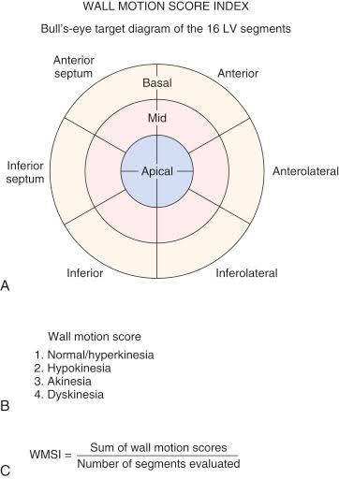

Slide 37
Quantitative Evaluation of Systolic Function: Linear Dimensions
LV Internal Dimensions and Wall Thickness:
Routinely measured using 2D echocardiography.
Measurements are most accurate when the ultrasound beam is perpendicular to the blood-endocardium interface.
Precision is higher with axial resolution compared to lateral resolution.
Specific Situations:
2D guided M-mode measurements are recommended for serial evaluation of patients with chronic aortic or mitral regurgitation.
Particularly useful when identification of the endocardium is suboptimal on 2D images.

Slide 40
Ventricular Size Measurement:
Measured in the parasternal long-axis view at the level of the - (mitral chordal level).
Measurement is perpendicular to the long axis of the ventricle.
Biplane imaging or scanning between long- and short-axis views ensures centered measurements in the short-axis plane.
TEE Measurements:
LV internal dimensions measured in the transgastric two-chamber view at the junction between the basal third and apical portion of the ventricle.
Wall thickness measured in the transgastric short-axis view.

Slide 41
Measurement Technique:
On 2D images, LV internal dimensions measured at end-diastole and end-systole from the tissue-blood interface (white-black transition).
End-diastole:
Defined as the onset of the QRS complex.
The first frame after mitral valve closure.
Maximum ventricular volume.
End-systole:
Defined as the smallest ventricular volume.
The frame just after aortic valve closure.

Slide 42
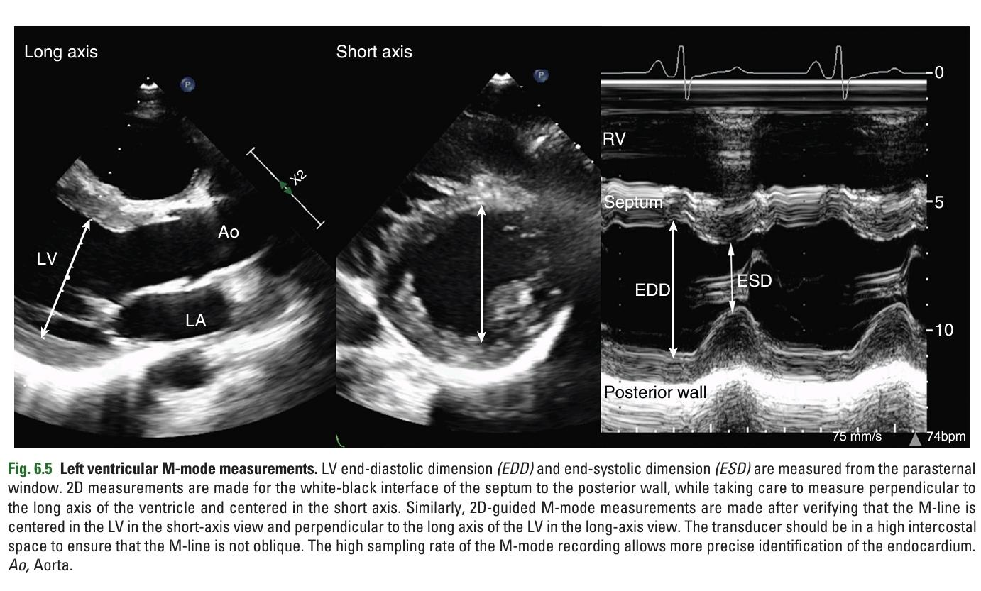

Slide 43
2D Guided M-Mode Measurements:
Transducer may need to be moved cephalad for a perpendicular angle between the M-line and the ventricle's long axis.
If only an oblique orientation is possible, use 2D images for correct alignment.
Advantages of M-Mode Echocardiography:
High time resolution.
Facilitates recognition of endocardial motion.
Provides more accurate measurement of ventricular internal dimensions.

Slide 44
Identifying Structures on M-Mode:
LV posterior wall endocardium: most continuous line with the steepest systolic motion.
Posterior wall epicardium: echo reflection immediately anterior to the pericardium.
Septal endocardium: continuous reflection through the cycle with the steepest slope in systole.
Important to exclude reflections from RV trabeculations.
Avoid confusing a dark “mid-septal” stripe with endocardial borders.

Slide 45
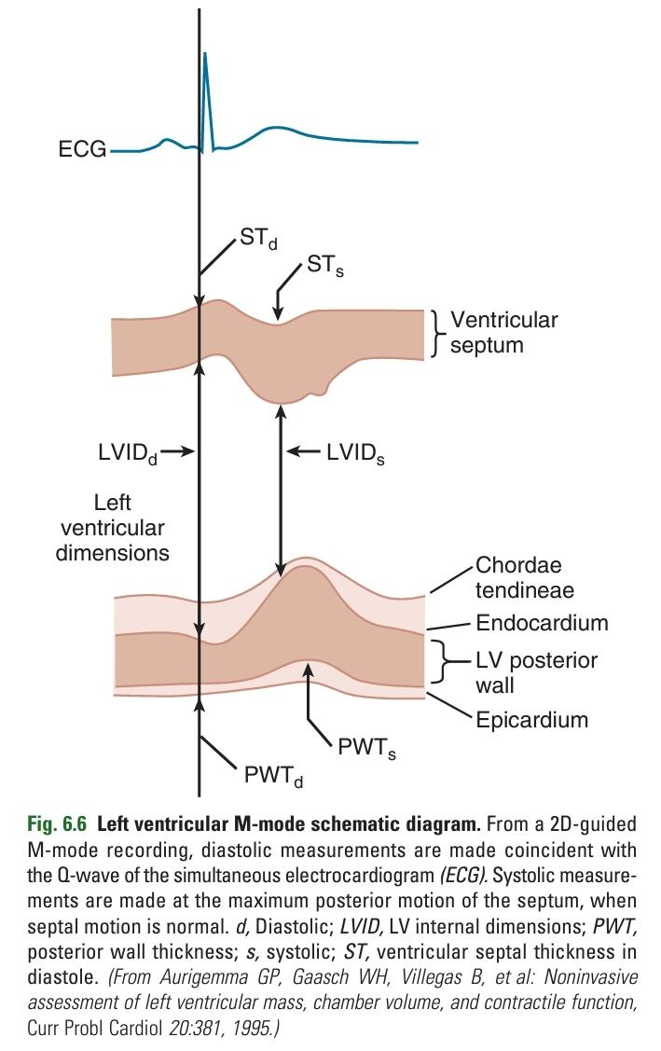

Slide 46
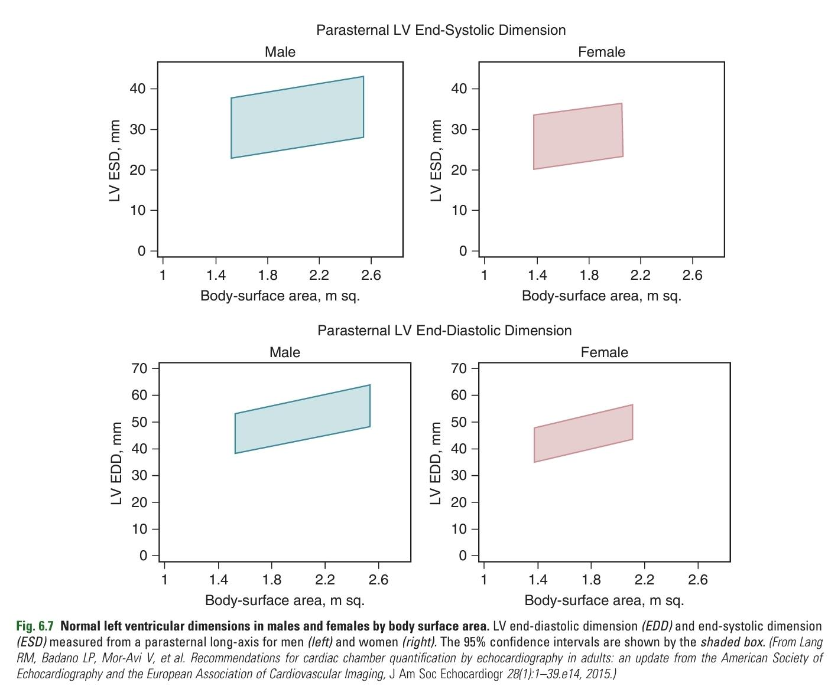

Slide 47
In addition to LV wall thickness and internal dimensions (LVID) at end-diastole (d) and end-systole (s), endocardial fractional shortening (FS) can be calculated as:

Slide 48
Fractional Shortening:
Rough measurement of LV systolic function.
Normal range: 25% to 45% (95% confidence limits).
Mid-Wall Fractional Shortening:
Better reflector of contractility than endocardial fractional shortening.
Reflects both inward motion of the endocardium and degree of wall thickening.
Rarely used in clinical practice.
Preference in Clinical Practice:
2D measures of ventricular systolic function are more robust and preferred.

Slide 50
The 2D echocardiographic calculation of ventricular volumes is based on endocardial border tracing at end-diastole and end-systole in one or more tomographic planes on TTE or TEE images
Prerequisites for quantitative evaluation by 2D echocardiography are:
■ Nonoblique standard image planes or image planes of known orientation relative to the long and short axis of the LV
■ Inclusion of the apex of the ventricle
■ Adequate endocardial definition
■ Accurate identification of the endocardial borders

Slide 51
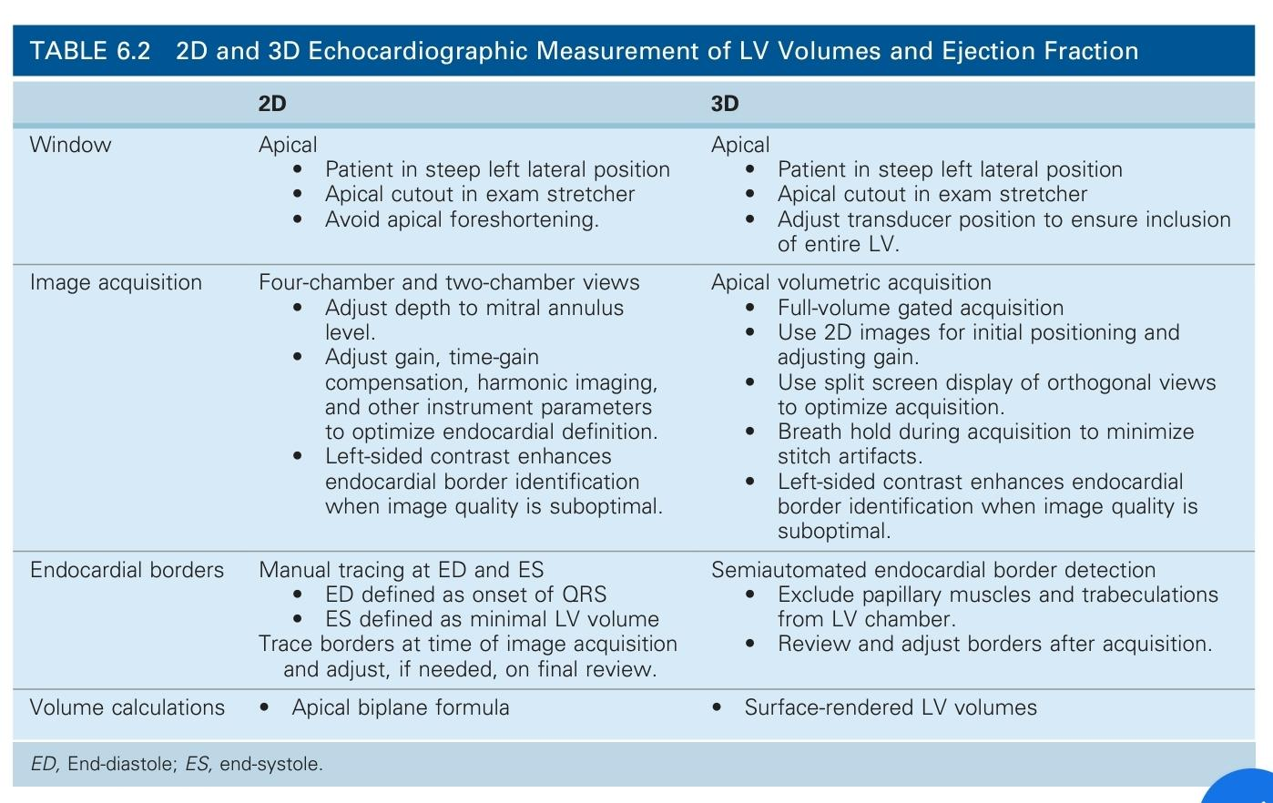

Slide 52
Improving Image Quality:
Use of left-sided echo contrast improves endocardial definition when image quality is suboptimal.
Manual Tracing:
2D or contrast-enhanced endocardial borders must be traced manually by an experienced physician or sonographer for accurate quantitation of LV systolic function.
Geometric Assumptions:
2D echocardiography is a tomographic technique.
LV volume calculations are based on geometric assumptions about the shape of the LV.

Slide 53
Papillary Muscles:
Included in the ventricular chamber by convention.
Endocardial borders are extrapolated along the base of the papillary muscle, following the expected curvature of the ventricular wall.
Accuracy:
Highest in individual patients with methods that have the fewest geometric assumptions.
Using data from multiple tomographic images enhances accuracy.

Slide 54
LV Volume Calculation Approaches:
Based on various geometric assumptions:
Simple ellipsoid shape
Complex hemicylindrical or hemiellipsoid shapes
Preferred Method:
Simpson’s Rule (Method of Disks):
Most robust and practical for clinical use.
Calculates ventricular volume as the sum of a series of parallel “slices” from apex to base.

Slide 56
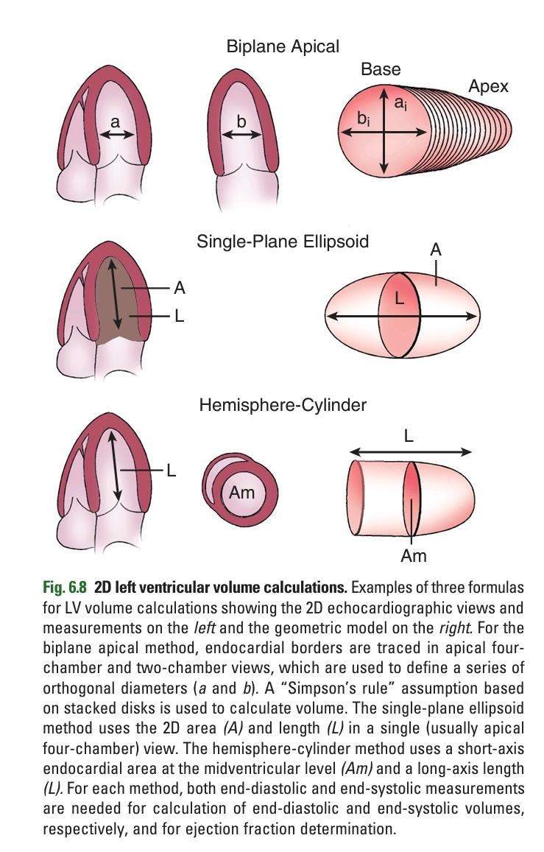

Slide 58
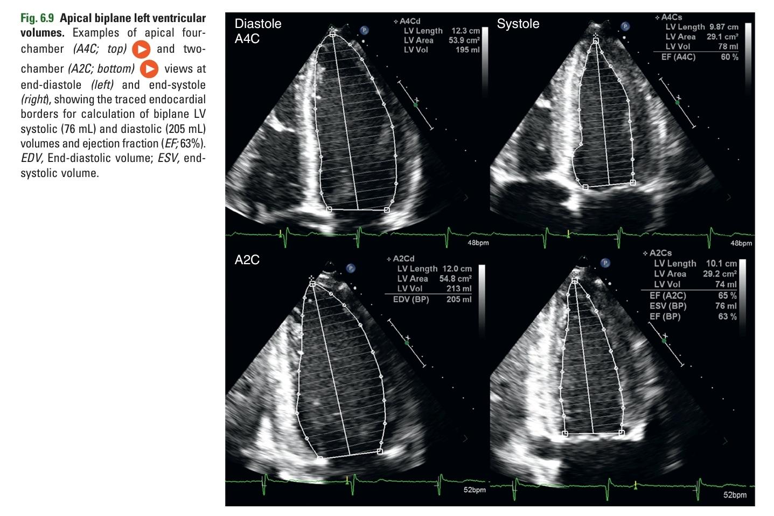

Slide 59
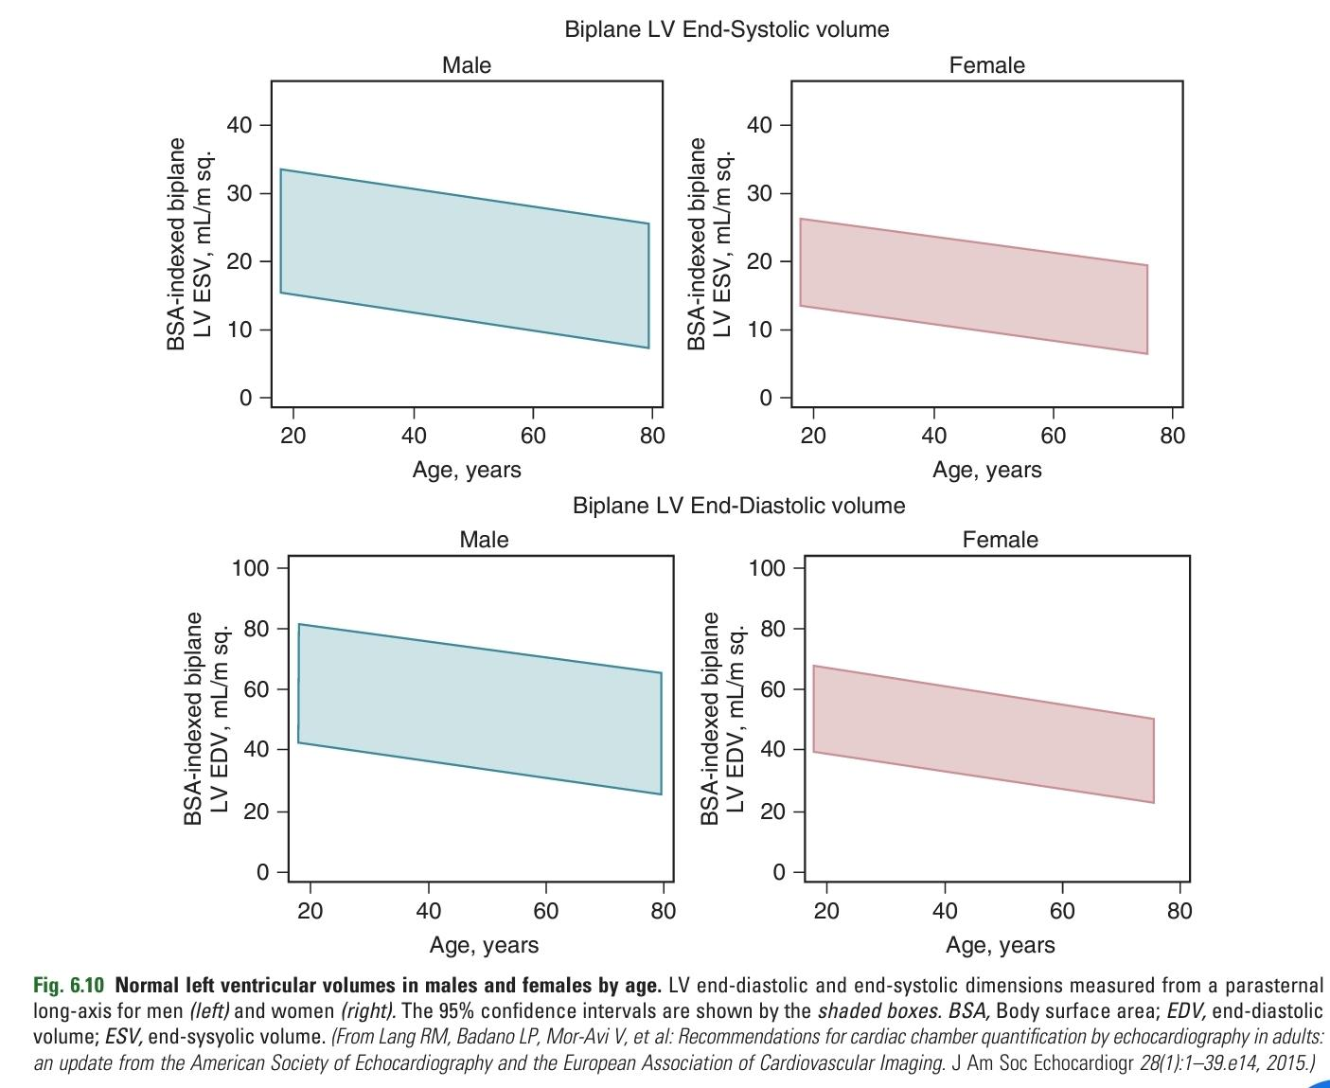

Slide 60
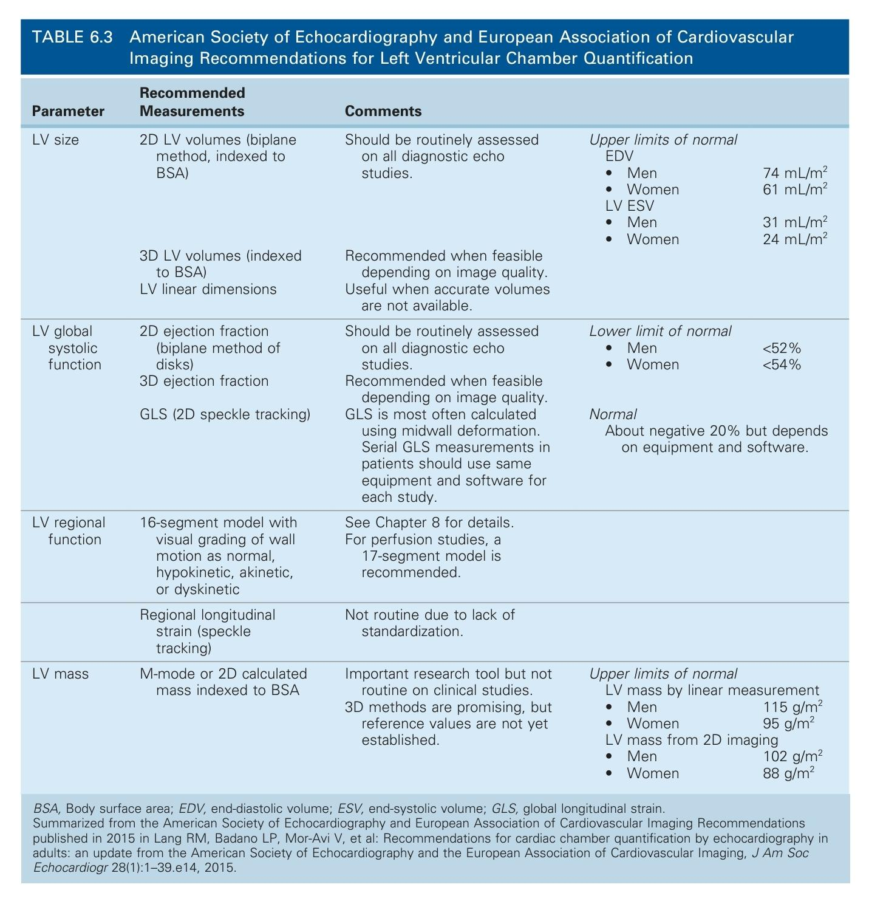

Slide 62
Simpson’s Rule (Method of Disks):
Recommended in consensus guidelines.
Accurate even when ventricular geometry is distorted.
Apical Biplane Approach:
Tracing of endocardial borders at end-diastole and end-systole in four-chamber and two-chamber views.
Can be performed with TTE or TEE images.
Borders used to calculate cross-sectional areas of elliptical disks.
Volume Calculations:
End-diastolic volume (EDV) from end-diastolic images.
End-systolic volume (ESV) from end-systolic images.
Normal LV volumes are smaller in women compared with men.
LV volumes decrease with age in both sexes.
Stroke Volume and Ejection Fraction:
Stroke volume = EDV - ESV.
Ejection fraction (EF) calculated as:

Slide 63
Alternative method: area-length method
Assumes base of ventricle as a cylinder
Apex approximated by an ellipsoid (referred to as the "bullet" formula)
Long-axis length (L) and cross-sectional area (Am) of an orthogonal short-axis view at mid-papillary level used

Slide 64
In the presence of a distorted ventricular shape or regional wall motion abnormalities, these alternate methods are less accurate because, if the region of abnormal wall motion is included in the dimension or area measurements, volumes will be overestimated and vice versa.
- 3D echocardiography for accurate measurements of LV volumes and ejection fraction
Independent of geometric assumptions
Semiautomated border detection from 3D volumetric data set
- Calculation of:
- End-diastolic volumes
- End-systolic volumes
- Ejection fraction

Slide 65
From an apical window, the key steps in 3D data acquisition for evaluation of the LV are as follows:
■ Start with 2D apical views to optimize gain settings, typically higher than for 2D imaging.
■ Guide the 3D acquisition by use of a split screen display of orthogonal views of the LV.
■ Acquire the 3D volume data set during a breath hold to minimize stitch artifacts.
■ Consider use of contrast to opacify the LV to improve endocardial border identification.

Slide 66
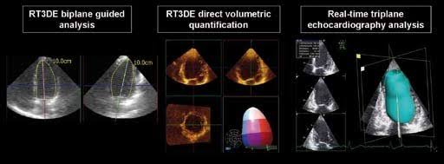

Slide 67
Display of data in clinical practice:
Cine loop 3D-rendered LV volume
Graph of LV volume over the cardiac cycle
Images depicting regional wall motion or regional ejection fraction
Limitations of 3D evaluation of the LV:
Lower temporal and spatial resolution compared to 2D imaging
Difficulty in including the entire LV chamber within the 3D volume data set
Despite limitations, 3D volumes and ejection fraction offer:
Greater accuracy than 2D measurements
Recommendation:
Quantitative evaluation of LV systolic function using 3D echocardiography whenever possible

Slide 68
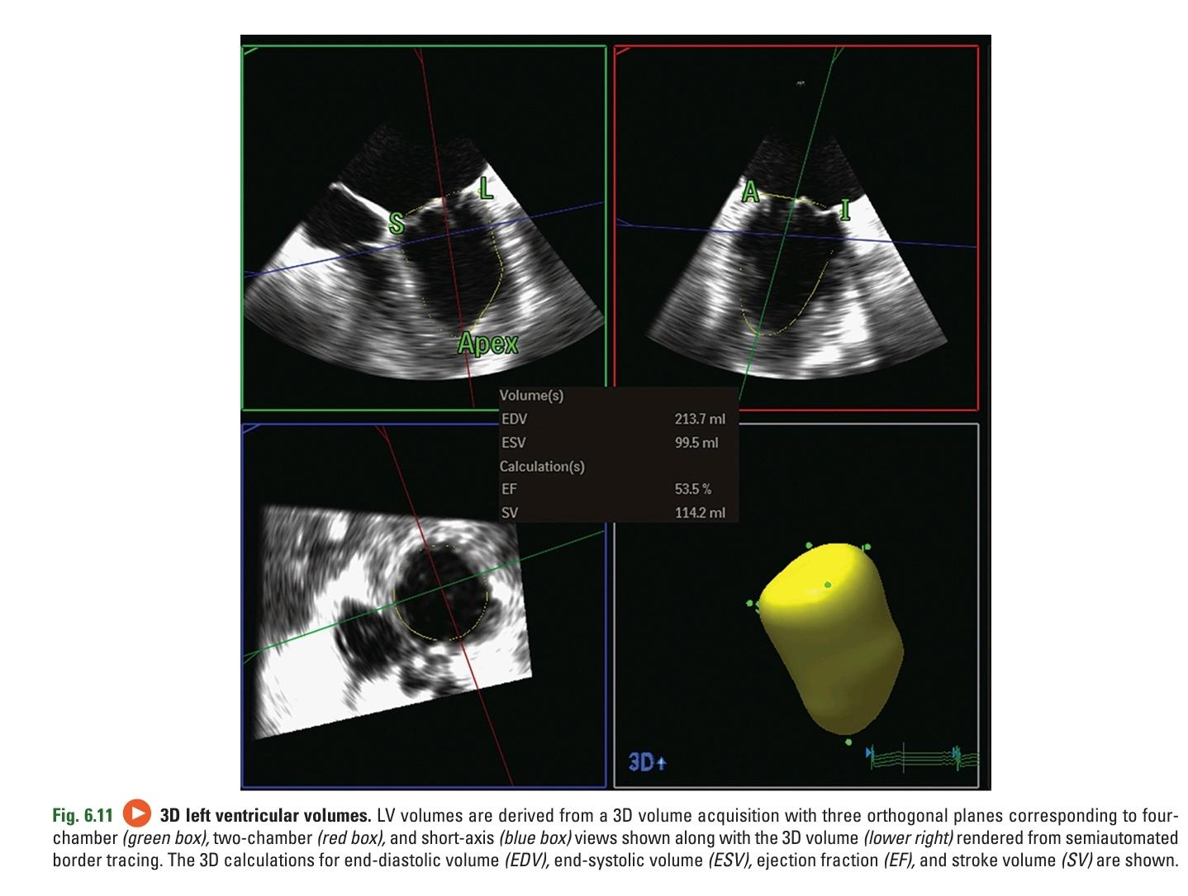

Slide 69
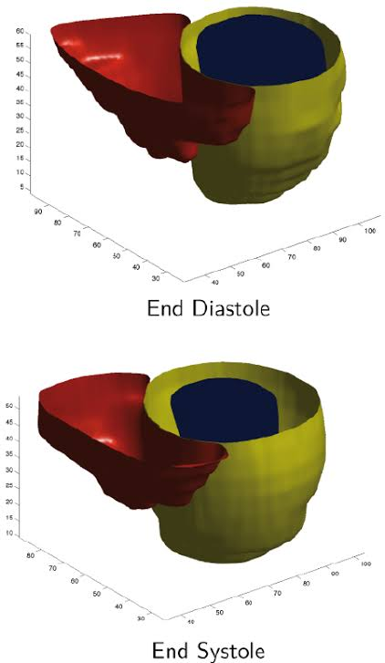

Slide 70
Left Ventricular Wall Stress, Strain, and Strain Rate Imaging
Wall stress is the force per unit area exerted on the myocardium. Wall stress is dependent on:
■ Cavity radius (R)
■ Pressure (P), and
■ Wall thickness (Th)
The basic equation for wall stress (σ) is:

Slide 71
Wall stress described in three dimensions: circumferential, meridional (longitudinal), and radial
End-systolic calculations of circumferential and meridional wall stress reflect ventricular afterload
End-diastolic wall stress reflects preload

Slide 72
Calculation of meridional and circumferential wall stress possible from 2D echocardiographic measures of chamber size and wall thickness
Importance of wall stress in understanding ventricular function, particularly in ventricular pressure or volume overload states (e.g., hypertension, aortic stenosis, aortic or mitral regurgitation)
Limited utilization of wall stress calculations in clinical practice currently

Slide 73
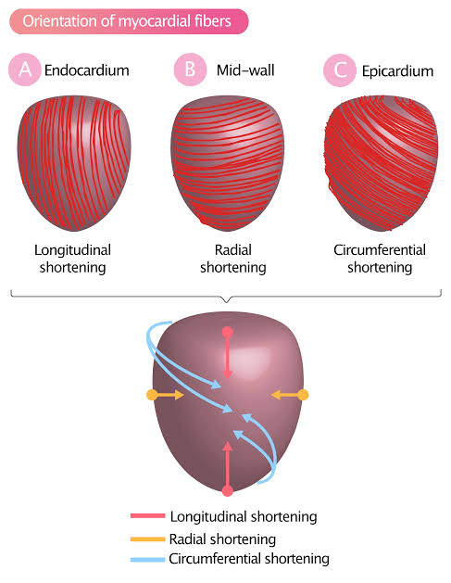

Slide 74
Left Ventricular Speckle Tracking Strain Imaging
- Speckle tracking strain:
- Less load-dependent than other echocardiographic parameters
- Detects early LV systolic dysfunction before ejection fraction decreases
- Measurement of Global Longitudinal Strain (GLS):
- Acquired from apical four-chamber, two-chamber, and long-axis views
- Longitudinal strain is a negative number
- Normal value varies by ultrasound system, typically around 20%
- Global Longitudinal Strain:
- Includes data from all three apical views
- Results presented as:
- Target-type color-coded chart
- Graph of strain over the cardiac cycle for each myocardial wall
- Single number representing global longitudinal systolic LV function

Slide 77
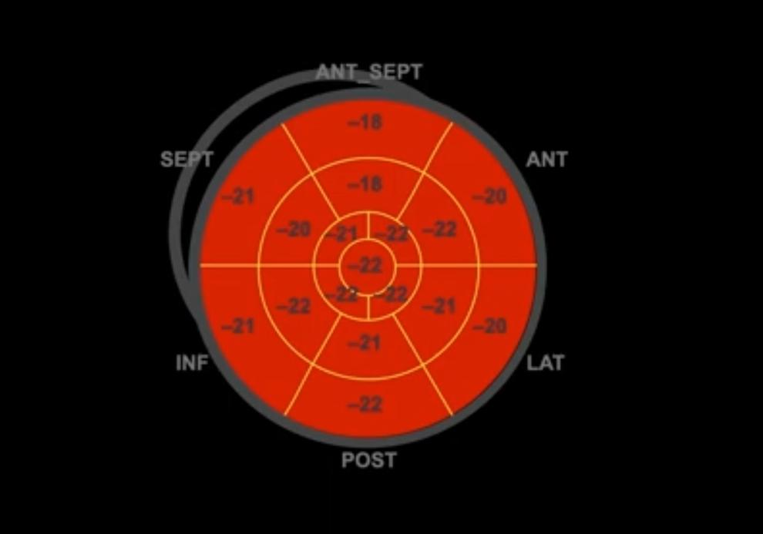

Slide 78
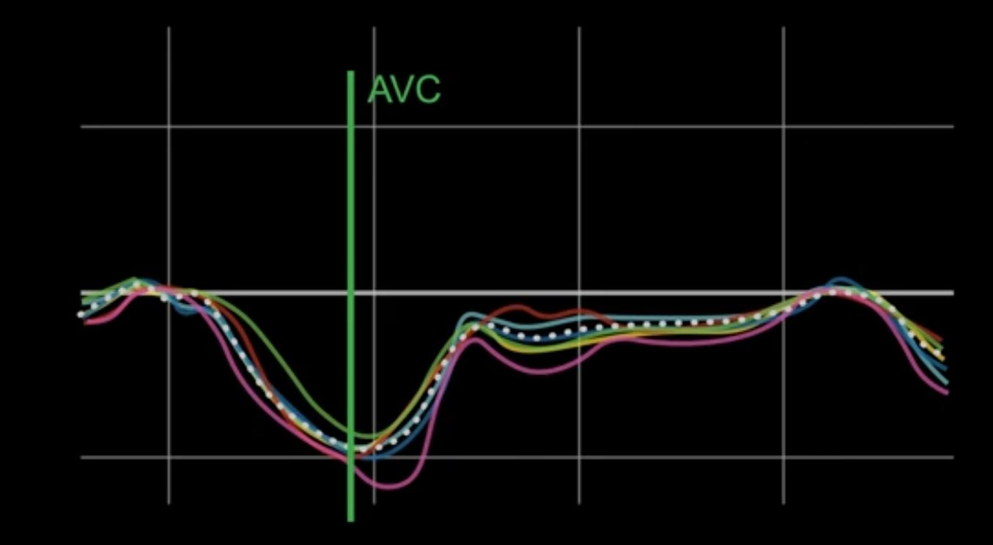

Slide 79
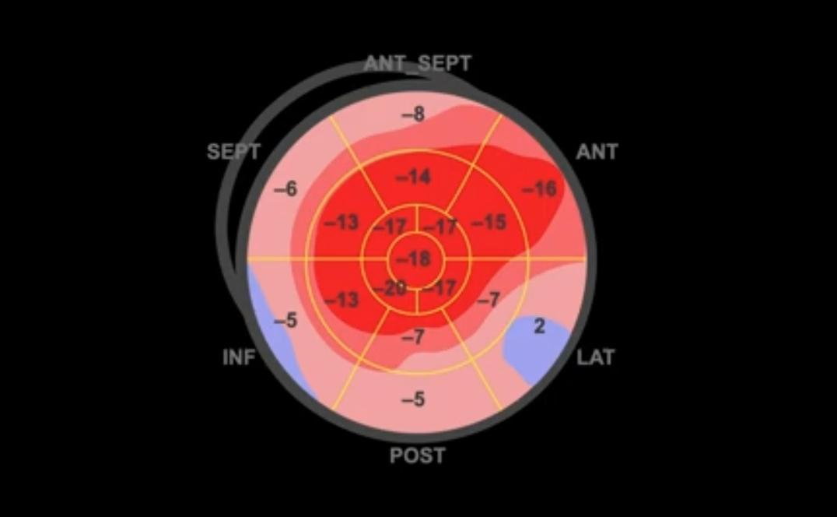

Slide 80
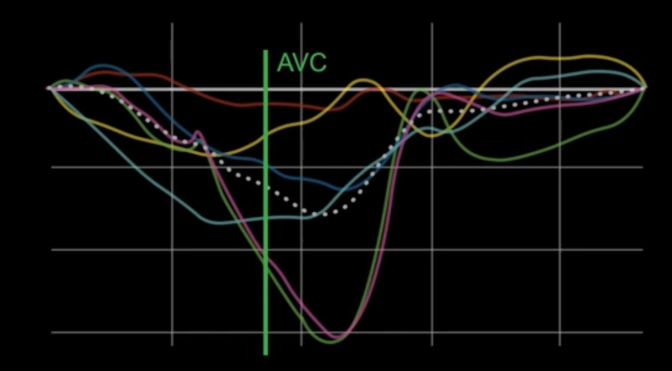

Slide 81
Left Ventricular Geometry and Mass
LV mass is the total weight of the myocardium, derived by multiplying the volume of myocardium by the specific density of cardiac muscle. LV mass can be estimated from M-mode dimensions of septal thickness (ST), posterior wall thickness (PWT), and LV internal dimensions (LVID) at end-diastole as:

Slide 82
On 2D or 3D echocardiography, LV mass theoretically can be determined by tracing epicardial borders to calculate the total ventricular volume (walls plus chamber), subtracting the volumes determined from endocardial border tracing, and then multiplying by the specific density of myocardium:

Slide 83
Epicardial definition alone is rarely sufficient for this approach.
Mean wall thickness is calculated from:
Epicardial (A1) cross-sectional area
Endocardial (A2) cross-sectional area
These areas are measured in a short-axis view at the papillary muscle level.
Left ventricular (LV) mass measurements are often indexed for body size.
This indexing is done using either body surface area or height.
Gender-specific normal values are used for this indexing.

Slide 84
Relative wall thickness is a simpler measure of ventricular geometry in patients with hypertrophy that reflects the relative thickness of the walls compared with chamber size.
Relative wall thickness (RWT) is calculated from posterior wall thickness (PWT) and LV internal dimension (LVID), both at end-diastole, as:

Slide 85
Ventricular geometry can be classified based on relative wall thickness (normal <0.42) and LV mass as:
■ Normal geometry—Normal LV mass and normal relative wall thickness
■ Concentric hypertrophy—Increased LV mass and increased relative wall thickness
■ Eccentric hypertrophy—Increased LV mass with normal relative wall thickness
■ Concentric remodeling—Normal LV mass with increased relative wall thickness

Slide 86
Concentric hypertrophy:
Caused by ventricular pressure overload, such as aortic stenosis.
Characterized by a small chamber and thick walls.
Eccentric hypertrophy:
Caused by chronic volume overload, such as aortic regurgitation.
Characterized by a dilated chamber with normal wall thickness but increased total ventricular weight.
Hypertensive heart disease:
Most often results in concentric remodeling.
Features normal total ventricular weight but relatively thick walls compared to the chamber size.

Slide 87
Limitations and Alternate Approaches
Endocardial Definition
Accurate identification of the ventricular endocardium is crucial for evaluating LV systolic function in M-mode, 2D, or 3D echocardiography.
Speckle tracking strain is most accurate with high-quality myocardial images.
Endocardial definition is influenced by:
Ultrasound instrumentation physics
Anatomic factors
Technical factors, including sonographer skill
The endocardial-ventricular cavity interface appears differently based on the angle of the ultrasound beam:
As a thin, bright line when perpendicular to the beam (axial resolution)
As a broad, blurred line when parallel to the beam (lateral resolution)
Lateral resolution is depth-dependent.

Slide 88
Signal dropout may occur due to:
Attenuation
Parallel intercept angle
Acoustic shadowing
Reverberations
The endocardium has numerous trabeculations, especially prominent at the LV apex.
Ultrasound reflects from the inner edge of trabeculations, so the "endocardium" seen in echocardiography differs from that seen in contrast ventriculography or cardiac MRI, which outline the outer edges of trabeculations.

Slide 89
Several technical factors affect endocardial definition during image acquisition, and meticulous examination technique is needed for optimal image quality.
First, acoustic access can be optimizing by:
■ Patient positioning
■ Use of an echo-stretcher with an apical cutout
■ Having the patient suspend respiration
■ Careful adjustment of transducer position

Slide 90
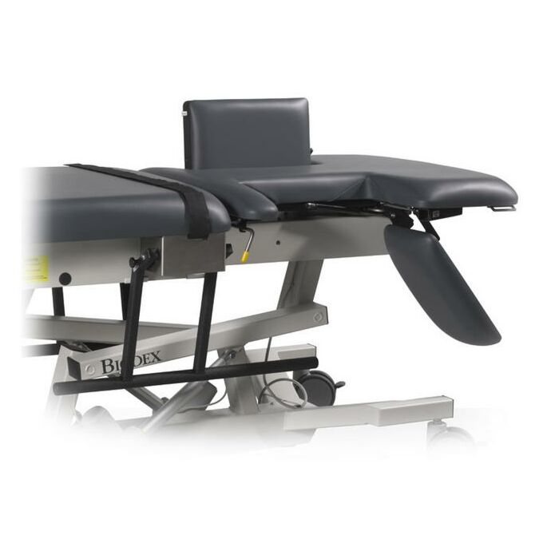

Slide 91
Instrument settings can dramatically affect image quality, including:
■ Transducer frequency
■ Gain
■ Gray-scale settings
■ Focal depth
■ Tissue harmonic imaging

Slide 92
2D Endocardial Borders:
Traced from digitally acquired images using real-time motion for accurate identification.
End-diastolic and end-systolic images traced within the same cardiac cycle:
End-diastole: onset of the QRS complex.
End-systole: minimal ventricular volume.
Manual tracing by a trained human observer remains the most accurate method.
Manual tracing is tedious and time-consuming, limiting the application of quantitative methods.

Slide 93
3D Imaging:
Uses semiautomated border detection.
Relies on manual identification of key anatomic landmarks.
Automated borders often require manual adjustments for accurate volume measurements.
Speckle Tracking Strain:
Images are visually inspected and adjusted to ensure correct tracking of the myocardium.

Slide 94
Patient Positioning:
Steep left lateral position on a stretcher with an apical cutout to avoid foreshortening the LV length.
Transducer Use:
Higher-frequency transducer for optimal image quality.
Focal depth adjusted to the depth of interest.
Image Optimization:
Adjust sector depth and width to maximize LV size on the screen and optimize frame rate.
Use tissue harmonic imaging to improve 2D endocardial definition.

Slide 95
Respiration Management:
Patient suspends respiration at the phase where image quality is optimal, avoiding a Valsalva maneuver.
Contrast Agent Use:
Intravenous contrast agent to opacify the LV if endocardial definition remains poor.

Slide 96
Geometric Assumptions
Quantitation of LV volumes relies on accurate visualization of the endocardium along the entire chamber length.
Foreshortened 3D data sets or 2D views can underestimate LV length, affecting both TTE and TEE approaches.
Adequate apical views in TTE imaging require:
Steep left lateral decubitus position.
Apical cutout in the echo-stretcher mattress to visualize the true long axis of the chamber.
In TEE imaging:
Even with adjustments in transducer position and image plane angulation, it's not always possible to include the apex in 3D data sets or in the 2D four-chamber and two-chamber views.

Slide 97
Respiratory and Cardiac Motion:
Geometric assumptions of LV volume calculations are confounded by respiratory and cardiac motion within the chest during the cardiac cycle.
Respiratory Motion:
Avoided by measuring beats at the same phase of respiration or by having the patient briefly suspend respiration during data acquisition.
Optimal images may be obtained when the patient suspends respiration after taking in a small breath, rather than at end-expiration.

Slide 98
Cardiac Motion:
More difficult to correct for during tomographic imaging procedures.
Involves cardiac translation, rotation, and torsion:
Translation: movement of the heart in the chest.
Rotation: movement around the long axis of the heart.
Torsion: unequal rotational motion of the heart.
Can result in images of different LV segments during systole and diastole, even with a fixed image plane.

Slide 99
Effect on LV Volume Calculations:
Limited effect on accuracy.
Effect on Regional Ventricular Function Evaluation:
Can have a pronounced effect on quantitative evaluation of regional ventricular function.

Slide 100
Accuracy and Reproducibility
Qualitative Comparison of LV Systolic Function:
Facilitated by the standard digital cine-loop side-by-side format.
Loading conditions' influence on LV systolic function must be considered when comparing studies conducted at different time points in a patient’s clinical course.
-Variability in LV Volume Measurements:
Intraobserver variability for 2D LV volumes: 5% to 10%.
Interobserver variability for 2D ventricular volumes: 7% to 25%.
Reproducibility of ejection fraction (EF) is better, with variability of about 10%.
Comparison with Other Methods:
Variability in ventricular volumes and EF determined by contrast or radionuclide ventriculography is similar to those reported for 2D measurements.

Slide 101
Variability between studies in an individual patient includes:
■ Physiologic variability (loading condition, heart rate, volume states)
■ Image acquisition or test-retest variability (endocardial definition, image orientation)
■ Measurement variability in tracing the endothelial borders

Slide 102
Significant Changes Between Studies:
Ejection fraction >2%
End-diastolic volume >2%
End-systolic volume >5%
Comparison with Cardiac Magnetic Resonance Imaging (MRI):
LV volumes are underestimated by 3D echocardiography compared to cardiac MRI.
However, 3D echocardiography measurements are more accurate and reproducible than 2D-derived data.

Slide 103
Alternate Approaches
Cardiac Magnetic Resonance Imaging (MRI):
- Provides precise and accurate measures of:
LV volumes
Mass
Ejection fraction
Cardiac output
Other Approaches:
Contrast angiography in the cardiac catheterization laboratory
Radionuclide ventriculography
Factors Influencing Choice of Imaging Technique:
Other clinical questions present
Availability
Cost

Slide 104
Interobserver Differences:
- Mean difference between observers for 3D echocardiographic LV end-diastolic volume: -3 ± 10 mL
- Mean difference between observers for 2D LV volumes: 13 ± 17 mL
- Interobserver mean difference of LV ejection fraction:
0 ± 3% for 3D imaging
2 ± 8% for 2D imaging

Slide 105
DOPPLER EVALUATION OF LEFT VENTRICULAR SYSTOLIC FUNCTION
Stroke Volume Calculation
Doppler echocardiographic evaluation of LV systolic function usually is based on calculation of stroke volume and cardiac output

Slide 106
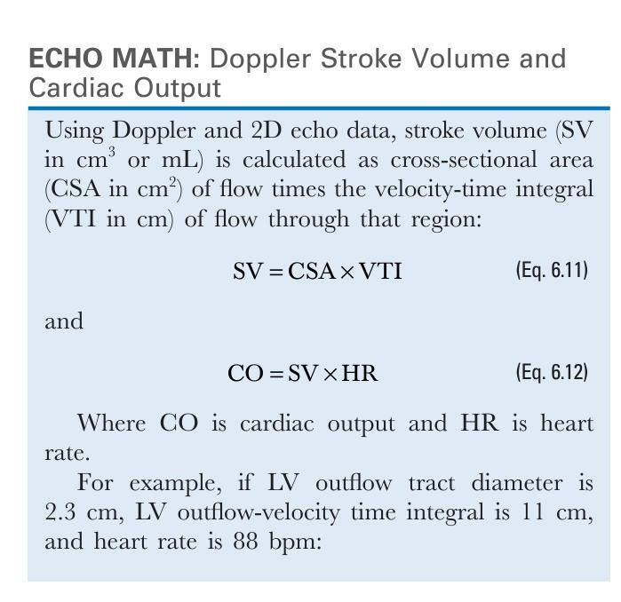

Slide 107
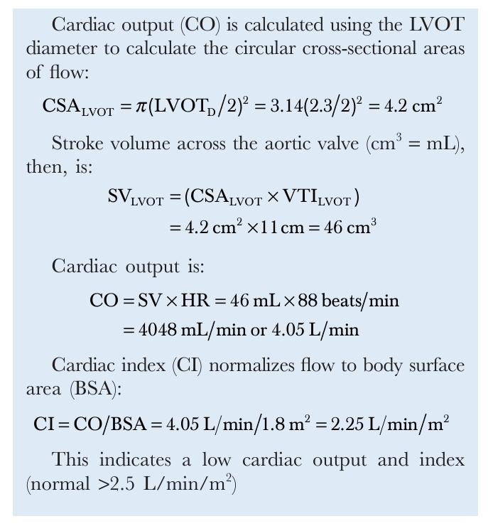

Slide 108
Conceptual Model:
The LV ejects a volume of blood into the cylindrical aorta on each beat.
The base of this cylinder is the systolic cross-sectional area of the outflow tract.
The height is the distance the average blood cell traveled during ejection for that beat.
Measurement of Height:
The distance is expressed as the integral of the Doppler systolic velocity-time curve because velocity is the first derivative of distance.
Alternatively, it can be calculated as mean velocity (cm/s) multiplied by ejection duration (seconds).
Stroke Volume Calculation:
Stroke volume is calculated as cross-sectional area multiplied by the velocity-time integral.
This is derived from the concept that the volume of a cylinder is base times height.

Slide 109
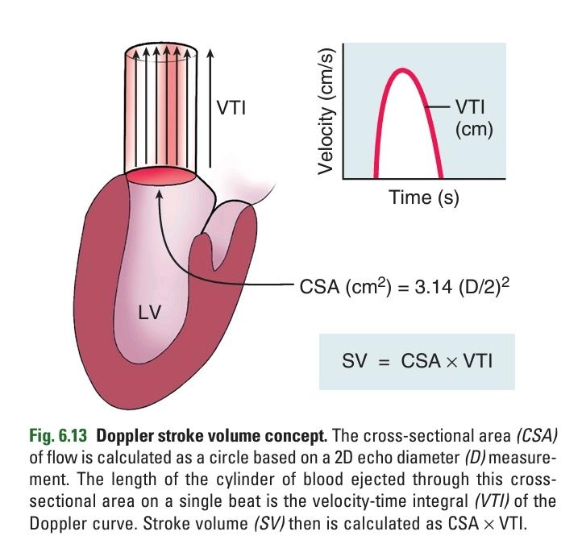

Slide 110
This approach to stroke volume calculation depends on several basic assumptions:
■ Accurate cross-sectional flow area measurement
■ Laminar flow with spatially “flat” flow-velocity profile
■ Parallel intercept angle between Doppler beam and direction of blood flow
■ Velocity and diameter measurements are made at the same anatomic site

Slide 111
Measurement of Cross-Sectional Area:
Typically, diameter is measured, and 2D area is calculated as π(D/2)² based on the assumption of a circular geometry.
Deviations from a circular geometry or changes in cross-sectional area during the flow period can lead to inaccuracies unless appropriate corrections are applied.
Error Minimization Strategies:
Use transducer orientation and instrument settings that maximize image quality.
Perform measurements based on axial (rather than lateral) resolution.
Measure diameter in two orthogonal planes when possible.
Average measurements from several beats to reduce error accumulation.
Error Amplification:
Small errors in 2D diameter measurements can result in large errors in cross-sectional area calculations because the radius (half the diameter) is squared in the calculations.

Slide 112
Sites for Stroke Volume Measurement
Stroke volume can be measured by this approach at any intracardiac site where both cross-sectional area and the flow-velocity integral can be recorded, given the assumptions of laminar flow and a flat flow profile.

Slide 113
Left Ventricular Outflow
- Standard site for stroke volume measurement: LV outflow tract at the level of the aortic annulus just proximal to the valve leaflets.
- Advantages of LV outflow tract measurement:
Relatively flat spatial flow profile due to tapering geometry and flow acceleration.
Data can be recorded in nearly all patients.
Flow remains laminar proximal to a stenosis, allowing transaortic stroke volume calculations in patients with aortic valve disease.
- Measurement procedure:
LV outflow tract diameter measured in parasternal long-axis view parallel and immediately adjacent to the aortic valve, in mid-systole.
Diameter measured from the white-black edge of the septal endocardium to the black-white edge of the anterior mitral leaflet.

Slide 114
- On TEE imaging, outflow tract diameter is measured in a long-axis view, offering improved accuracy due to higher-resolution images.
- LV outflow velocity may be recorded:
From a transgastric apical view, or
Starting from a transgastric short-axis view, rotating the image plane 90° to the two-chamber view, and then turning the transducer slightly medially to visualize the LV outflow tract.
- Difficulty in ensuring a parallel intercept angle between the ultrasound beam and LV outflow.
- Underestimation of stroke volume is likely due to this difficulty.

Slide 115
- LV stroke volume can also be measured in the ascending aorta.
- Diameter is measured from a parasternal long-axis view.
- Flow-velocity curve is recorded from either an apical or a suprasternal notch window.
- Continuous-wave (CW) Doppler ultrasound is used to record the highest velocities along the path of the beam.
Diameter measurement is taken at the narrowest segment of the aorta (the sinotubular junction).
- Note: Stroke volume measurement in the ascending aorta will be inaccurate if aortic valve disease is present due to nonlaminar flow distal to the valve.

Slide 116
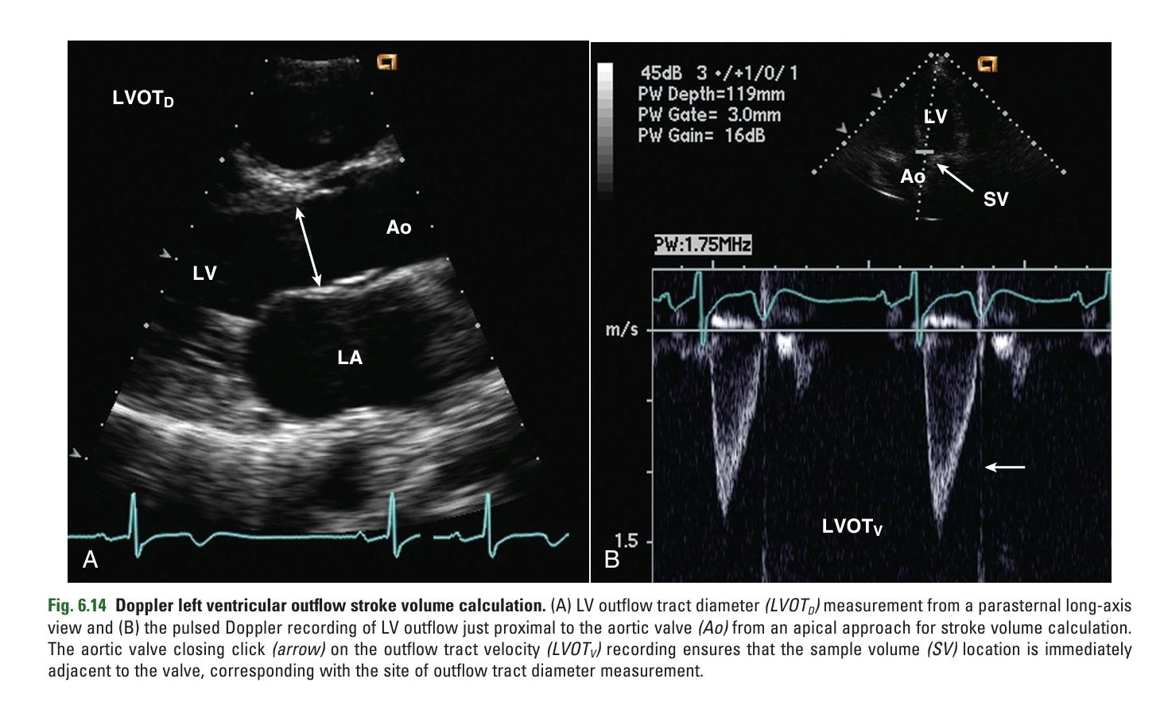

Slide 117
Mitral Valve
- Transmitral stroke volume calculations assume the mitral annulus as the limiting cross-sectional flow area, with leaflets moving passively in response to the flowstream.
- Transmitral stroke volume is the product of cross-sectional annulus area and the velocity-time integral of flow recorded at the mitral annulus level.
- On TEE imaging:
Transmitral flow rate is measured in the four-chamber view.
Pulsed Doppler sample volume placed at the annulus level.
Diameter measured from the 2D image.
- Mitral annulus is typically assumed to be circular for most clinical applications.

Slide 118
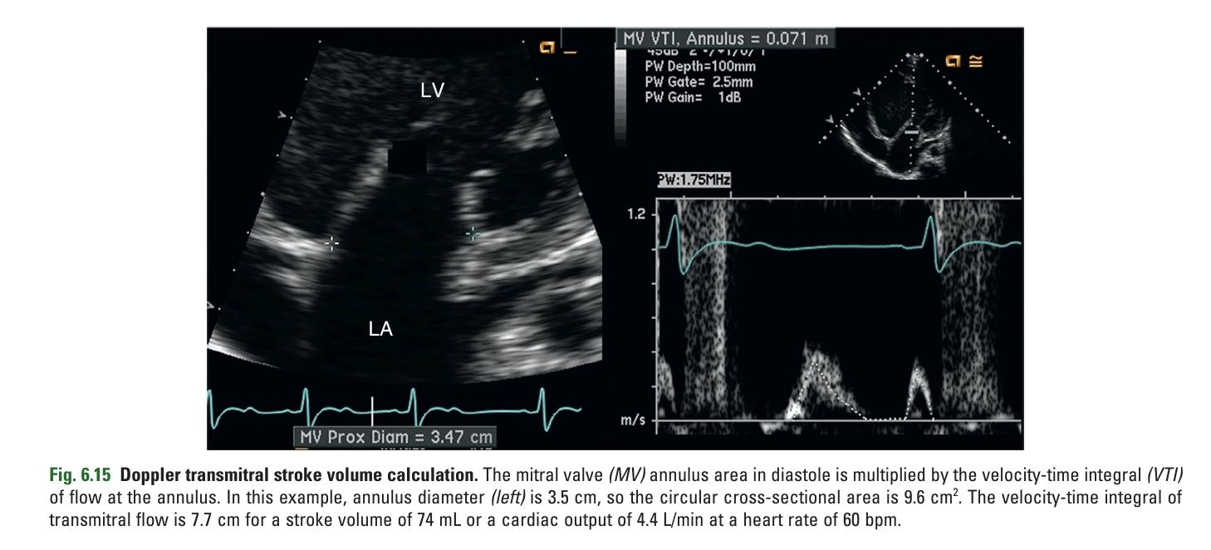

Slide 119
Right Heart
- Stroke volume can be calculated similarly in the pulmonary artery or across the tricuspid valve.
- In adult patients, using the pulmonary artery site on TTE imaging is often limited by poor image quality, leading to unobtainable or inaccurate pulmonary artery diameter measurements.
- However, from a TEE approach:
Pulmonary artery flow and diameter can often be measured using a very high transducer position, looking from the pulmonary artery bifurcation toward the pulmonic valve.

Slide 120
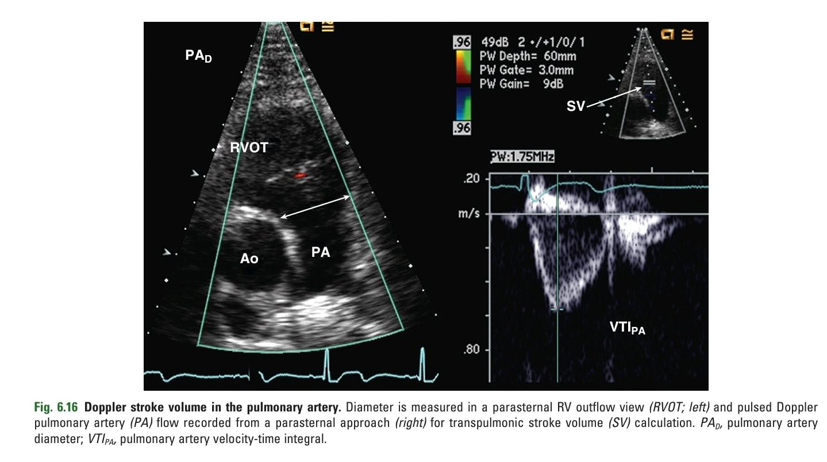

Slide 121
- In a normal heart, stroke volume across each of the four valves is equal, and measurement at more than one site serves as an internal accuracy check.
- However, in the presence of valvular regurgitation or an intracardiac shunt:
Calculation of stroke volume at two intracardiac sites allows quantitation of the degree of regurgitation or pulmonic-to-systemic shunt ratio.

Slide 122
Other Doppler Measures of Systolic Function Ejection Acceleration Times
The shape of the Doppler ejection curve provides information about ventricular function.
Normal systolic function:
- Short isovolumic contraction period.
- Rapid rate of pressure rise in early systole.
- Doppler velocity curve reflects:
Short isovolumic contraction time.
Rapid acceleration of blood in early systole.
Short time interval from onset of flow to maximum velocity.

Slide 123
- Impaired LV systolic function:
Isovolumic contraction time (pre-ejection period) becomes longer.
Rate of acceleration diminishes.
Time to maximum velocity increases.
Doppler velocity curve reflects these changes.
- Some centers evaluate aortic ejection curves with exercise to detect LV systolic dysfunction.

Slide 124
Limitations and Alternate Approaches
- The major limitation of Doppler evaluation of LV systolic function in adults is accurate diameter measurement for cross-sectional area calculations.
- Major source of variability for Doppler velocity data is data recording, requiring a parallel intercept angle between the ultrasound beam and the flow of interest.
- For 2D diameters, major source of variability is measuring the 2D images, especially when image quality is suboptimal or when lateral resolution limits accurate border recognition

Slide 126
Dobutamine administration

Slide 127
The basic equation for wall stress (σ) is:
Th/2PR
PR/2Th
Th x P / 2R
2P/ Th x R

Slide 128
The basic equation for wall stress (σ) is:
Th/2PR
PR/2Th
Th x P / 2R
2P/ Th x R

Slide 129
The bullet formula is
RV volume = 2/6 Am x R
LV volume = € AT
LV volume = ⅚ Am x L
RV volume = € AT

Slide 130
The bullet formula is
RV volume = 2/6 Am x R
LV volume = € AT
LV volume = ⅚ Am x L
RV volume = € AT

Slide 131
Which of the following is not a Site for Stroke Volume Measurement
Left Ventricular Outflow
Cavo isthmic junction
Mitral valve
Pulmonary artery

Slide 132
Which of the following is not a Site for Stroke Volume Measurement
Left Ventricular Outflow
Cavo isthmic junction
Mitral valve
Pulmonary artery

Slide 134
Flow Pattern Assumptions:
Flow pattern is assumed to be laminar.
Spatial flow profile across the flowstream is assumed to be relatively flat.
Rationale for Assumptions:
Ensure that the velocity curve represents the spatial (and temporal) average flow in that region.
Validation of Assumptions:
- Validity of laminar flow assumption is demonstrated by:
Narrow band of velocities
Smooth spectral signal seen on pulsed Doppler echo recordings in the great vessels and across normal cardiac valves.

Slide 135
Reasonable Assumptions:
Flat flow profile is also assumed at the inlet to the great vessels and across the valve planes due to:
Effects of geometric convergence and acceleration.
Confirmation of Flat Flow-Velocity Profile:
Moving the sample volume across the flowstream in two orthogonal views to demonstrate uniform velocities at the center and the edges of the flowstream.

Slide 136
Assumption of Parallel Intercept Angle:
Doppler signal is assumed to have been recorded at a parallel intercept angle to flow, ensuring accurate velocity measurement (cos θ = 1 in the Doppler equation).
Practical Implementation:
Sonographer aligns the Doppler beam in the presumed direction of flow.
Carefully moves the ultrasound beam across the image plane and in the elevational plane to obtain the highest-velocity signal, indicating the most parallel alignment with flow.
Optimal Window for Doppler Interrogation:
Ultrasound beam and flowstream are parallel.
Optimal Window for Diameter Measurement:
Ultrasound beam and tissue-blood interfaces are perpendicular.

Slide 137
Importance of Consistency in Measurements:
Diameter and velocity measurements must be made at the same anatomic site.
Cross-sectional area and flow-velocity curves must be temporally and spatially congruent for accurate volume flow rate calculations.
Effects of Changes in Cross-Sectional Area on Flow Velocity:
As the cross-sectional area of flow narrows or expands, flow velocity increases or decreases correspondingly.
Conjoining information from two different anatomic sites will result in erroneous stroke volume data.
Dynamic Changes in Stroke Volume:
Occur with changes in heart rate, loading conditions, exercise, etc.
Measurements made at disparate times cannot be combined.
Clinical Practice:
Diameter and velocity recordings are made in close sequence.
Measurements are repeated if any question of an interval physiologic change exists.

Slide 138
Lvot measurement
- Pulsed Doppler used from an apical approach to record the velocity curve.
- Closing click of the aortic valve used to ensure sample volume is located at the annulus (same site as diameter measurement).
- Small region of flow convergence proximal to the narrowed aortic valve avoided by moving the sample volume slightly apically until a narrow spectral width is seen at the velocity peak.

Slide 139
Rate of Ventricular Pressure Rise (dP/dt)
In the presence of mitral regurgitation, the continuous-wave (CW) Doppler velocity curve indicates the instantaneous pressure difference between the LV and the LA in systole.
This assumes a constant intercept angle between the mitral regurgitant jet and the ultrasound beam.
With normal systolic function, there is a rapid rate of rise of LV pressure (and low LA pressure), resulting in a rapid rise to maximum velocity of the mitral regurgitant jet according to the Bernoulli equation.

Slide 140
If the rate of rise in ventricular pressure is reduced due to LV systolic dysfunction, the rate of increase in velocity of the mitral regurgitant jet is also reduced.
For example, in patients with premature ventricular beats, the altered contractility of the premature beat is evidenced by a marked difference in the rate of velocity increase of the mitral regurgitant jet.

Slide 141
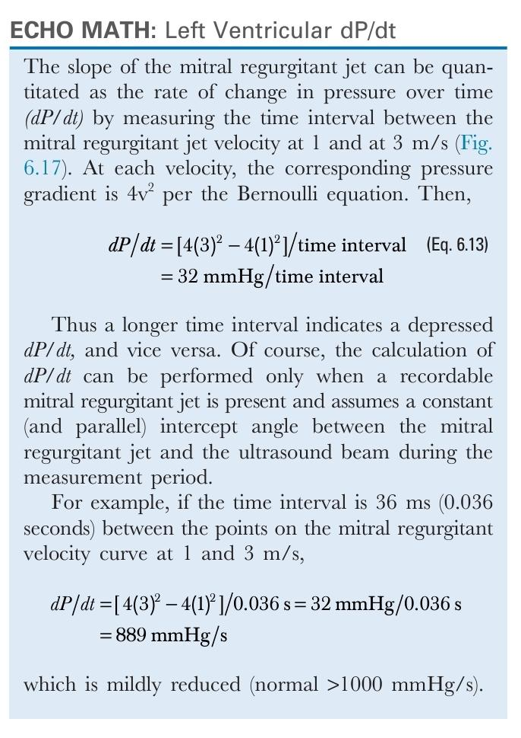

Slide 144
Mitral annulus diameter measurement:
Parasternal long-axis view:
- Advantage: Uses axial resolution, improving accuracy.
- Disadvantage: Ambiguity in correct measurement location; Doppler recording site must be estimated.
Apical four-chamber view:
- Advantage: Diameter measurement and sample volume display on the same image, ensuring correct measurement site.
- Disadvantage: Lateral resolution limitation, affecting measurement accuracy.

Slide 145
- Despite potential limitations, Doppler measurement of stroke volume has been well validated in various clinical and research settings.
- Measurement of dP/dt is limited by the need for enough mitral regurgitation to generate a Doppler signal with a well-defined velocity curve.
- Changes during ejection in the intercept angle between the ultrasound beam and the regurgitant jet can result in erroneous measurement, as the assumption that cos θ = 1 in the Doppler equation may not be valid.
- When more precise or repeated measures of flow are needed, cardiac output can be measured by the thermodilution or Fick techniques.
- These techniques are performed through a right-sided heart catheter.
- They can be conducted both in the catheterization laboratory and in the coronary care unit.

