Slide 1
CORONARY GUIDEWIRES
SRUTHI S PAL

Slide 2
GUIDEWIRES
Guide wires are essential tools , to track through the vessels, allowing access and the ability to cross the lesions with interventional devices.
Simple spring type.
PTFE coated.

Slide 3
Purpose
To track through the vessel
To access the lesion
To cross the lesion atraumatically
To provide support for interventional devices

Slide 4
GUIDE WIRE MAIN CHARACTERISTICS
Torque control
Trackability
Steerability
Flexibility
Prolapse tendency
Radiopacity/visibility
Tactile feedback
Support

Slide 5
GUIDE WIRE COMPONENTS
Covers
Coatings
Coils

Slide 6
CORE
Inner part of guidewire.
Extends to proximal – distal part,where it begins to taper.

Slide 7
Core Material

Slide 9
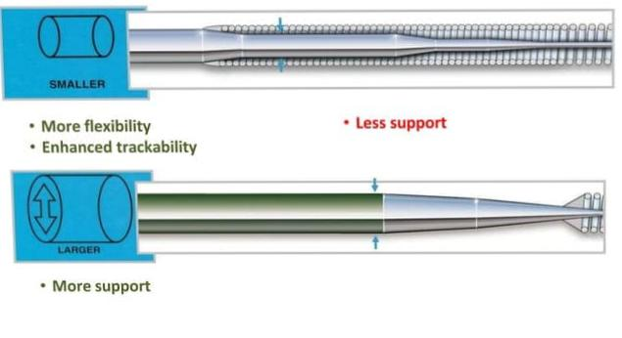
CORE DIAMETER

Slide 10
Core Taper

Slide 12
TIP
Distal end of GW.
Tip style affect steering and tip softness.
Tip could be covered ;
a.Coils(spring tipGw)
b.Polymer(polymer tip Gw.

Slide 13
TIP STYLE
Tapers distally to a variable extend .
Core to tip design(1 piece core ):Tapered core reaches the distal tip.
Shaping ribbon(2 piece core) : The core stops just before the distal end.
2 piece : easy shaping and durable shape memory.
1 piece : Better force transmission to tip and greater “tactile response” for operator.

Slide 16
COILS

Slide 17
Covers
Polymer or plastic
Provide lubricity
Smooth tracking through tortuosity

Slide 18
COATINGS

Slide 19
HYDROPHOBIC

Slide 20
TIP LOAD
Force needed to bend a wire when exerted on a straight guide wire tip, at 1 cm from the tip
Floppy <0.5 g
Balanced 0.5-0.9g
Extra support >0.9g

Slide 21
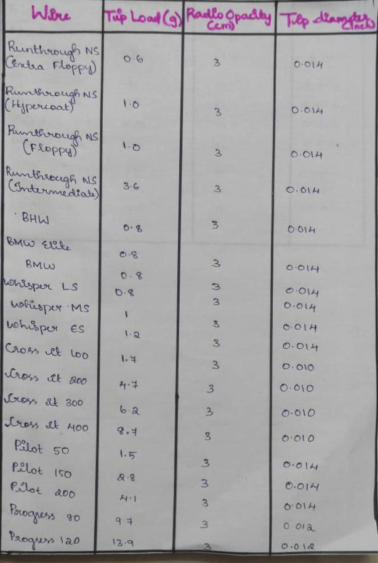

Slide 22
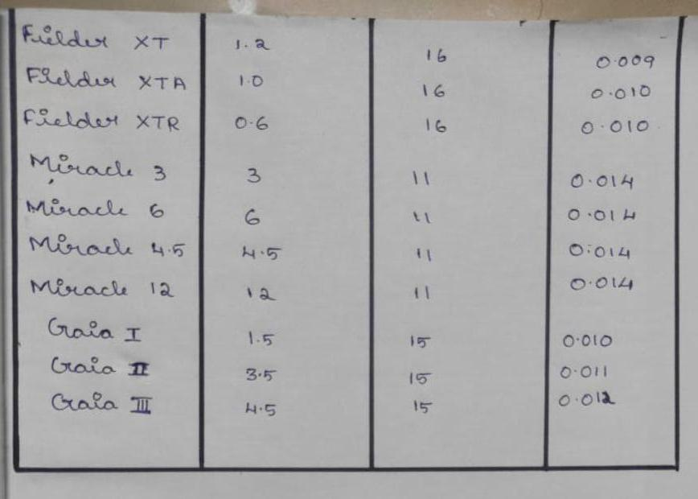

Slide 23
What is penetration power
Penetration Power = Tip Load/Tip Area
Penetration Power = Tip Load/ (∏ (D/2)²)

Slide 24
Shapeability and shaping memory
Shapeability- allows to modify it's distal tip conformation
Shaping memory - ability of tip to return back to it's basal conformation after having been exposed to deformation and stress
Both do not necessarily go in parallel
Ss core wires-easier to shape

Slide 25
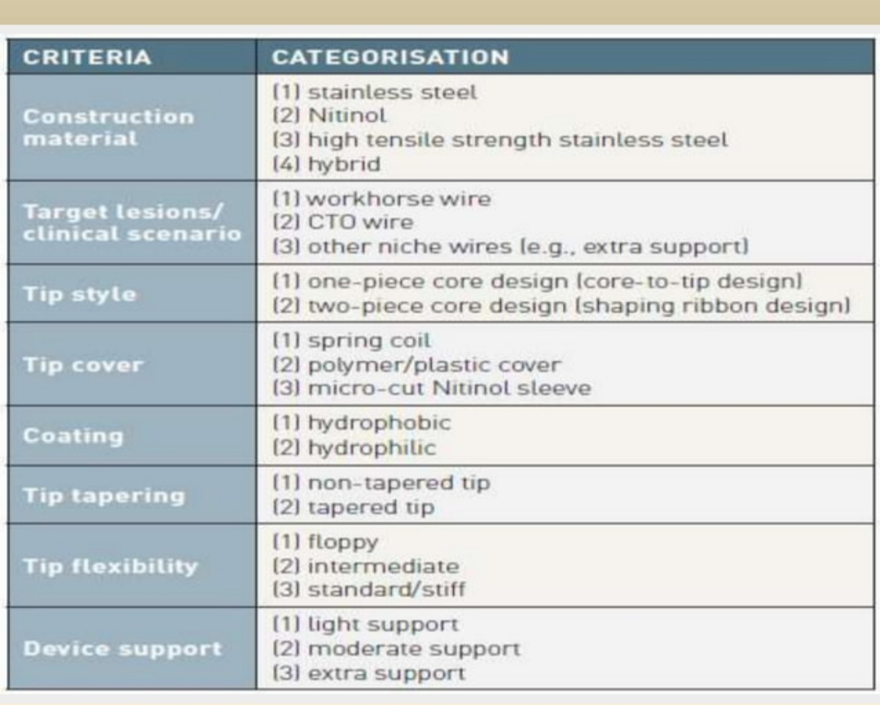

Slide 26
COMPLICATION OF GW
Plaque embolization.
Arterial dissection and perforation.
Acute closure due to vasospasm.
Subintimal wire placement.
Wire fracture.

Slide 27
Tip load of floppy wire
<0.5mg
>0.5mg
0.5mg
0.5-1 mg

Slide 28
Wire for negotiating tortuous lesions
Hydrophobic
Hydrophilic
Floppy
Stainless steel

Slide 29
Penetration power=
Tipload/Tip area
Tip load ×Tip area
Tip load + Tip area
Tip load – Tip area

Slide 30
THANKYOU

