Slide 1
Embryology of Conotruncal Anomalies
Dr. Aiswarya Ravikrishnan

Slide 2
Heart develops from splanchnopleuric mesoderm cranial to prochordal plate: Cardiogenic area.
Cells of this area migrate b/w mesoderm & endoderm and arrange as two longitudinal cellular strands called cardiogenic cords.
The cords become canalised to form two thin walled endothelial tubes: called endocardial heart tubes.

Slide 3
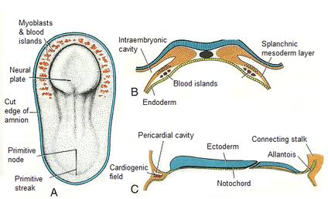

Slide 4
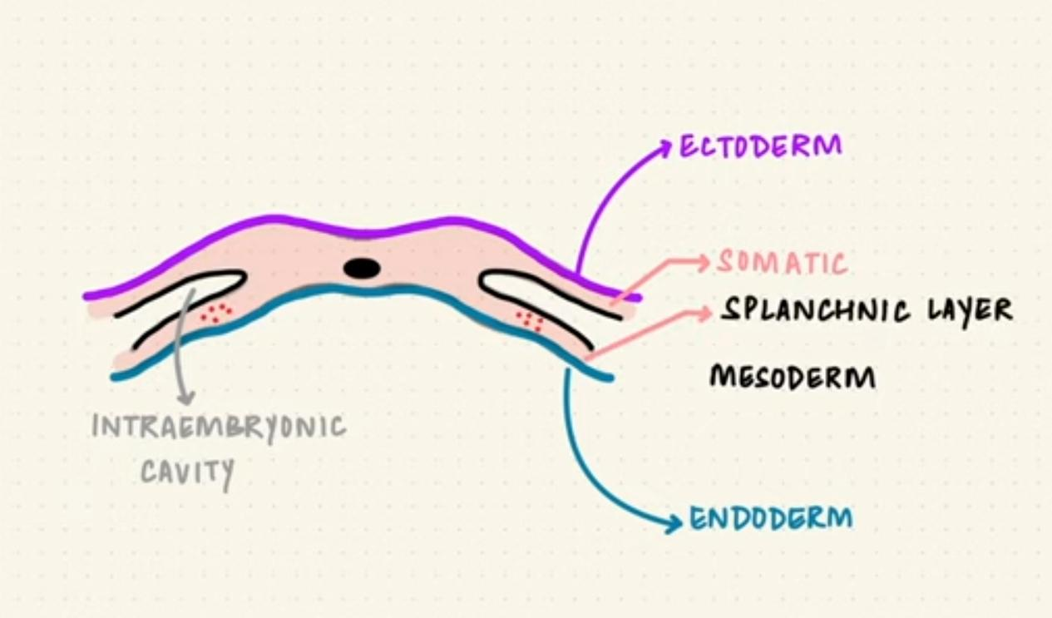

Slide 5
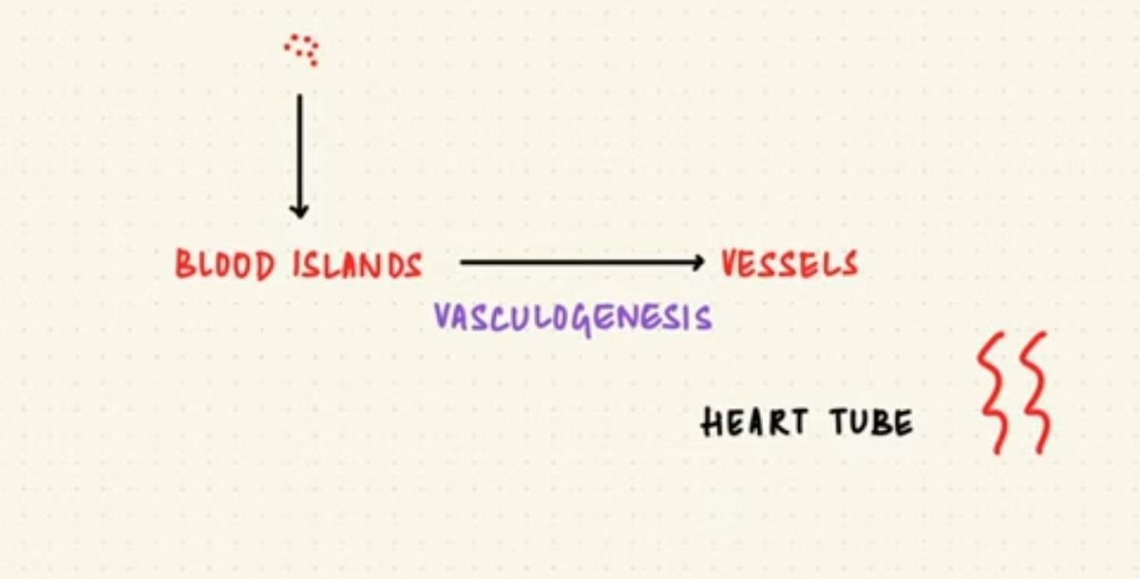

Slide 6
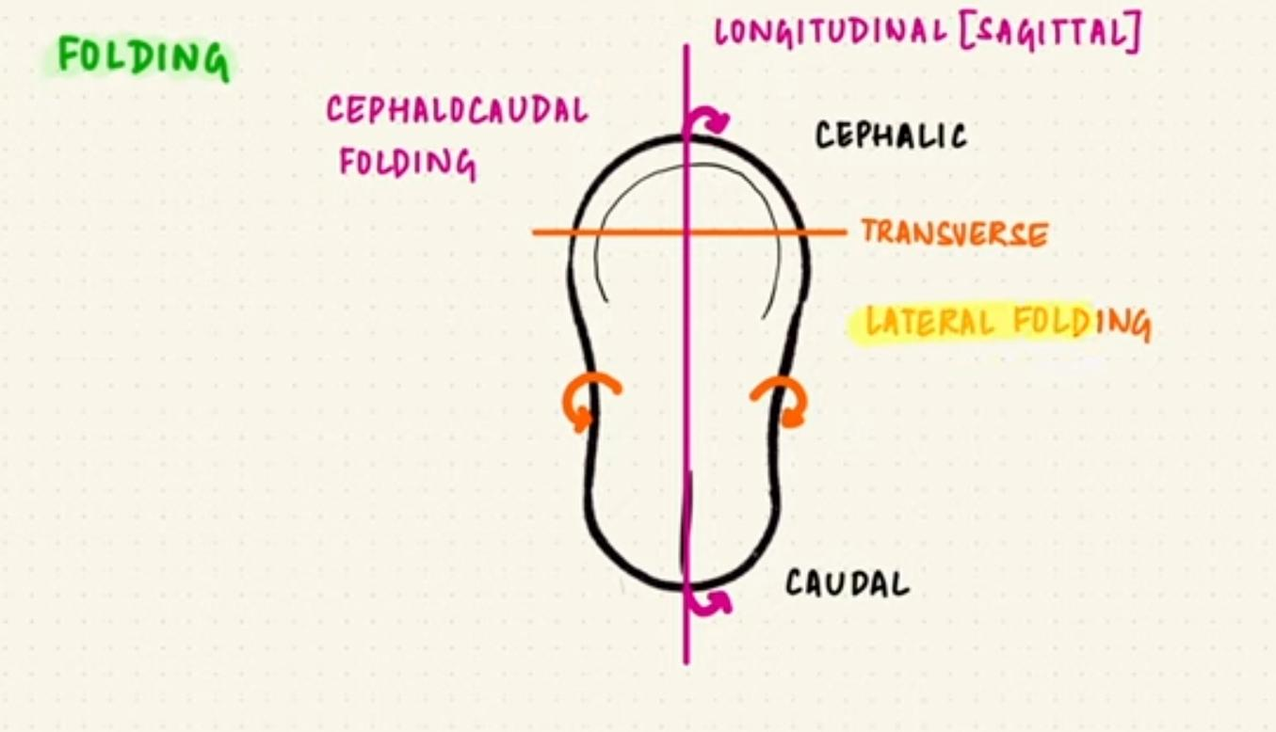

Slide 7
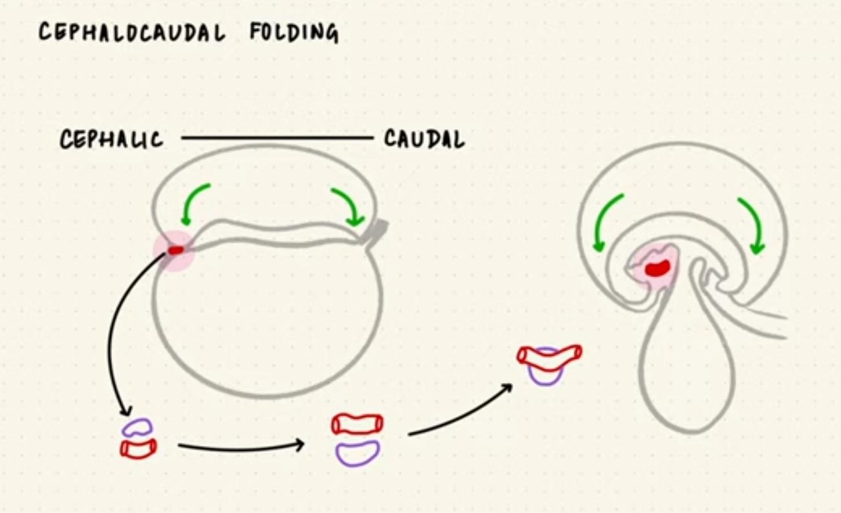

Slide 8
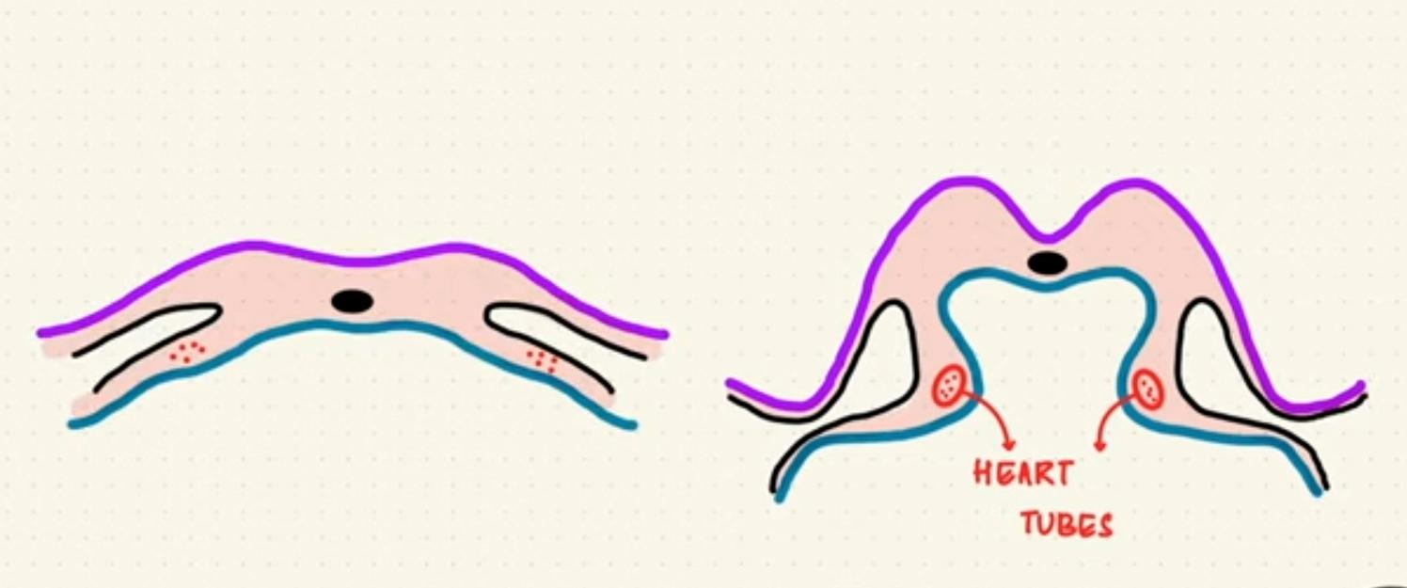

Slide 10
the sinus venosus,
the common atrium,
the common ventricle, and
the bulbus cordis,
serially arranged in that order from the venous to the arterial end.

Slide 11
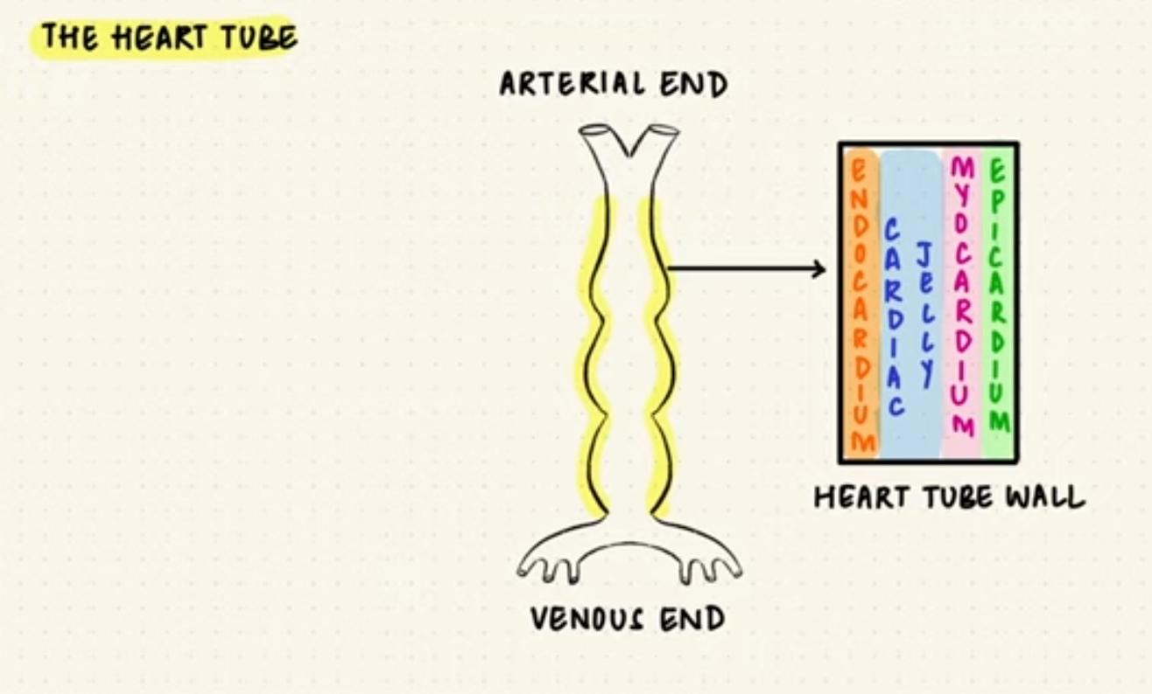

Slide 12
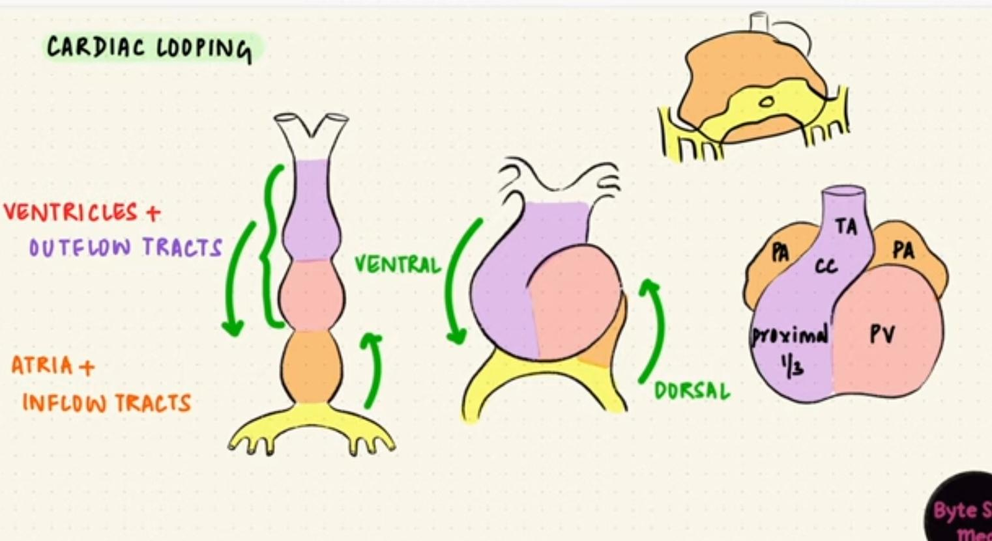

Slide 14
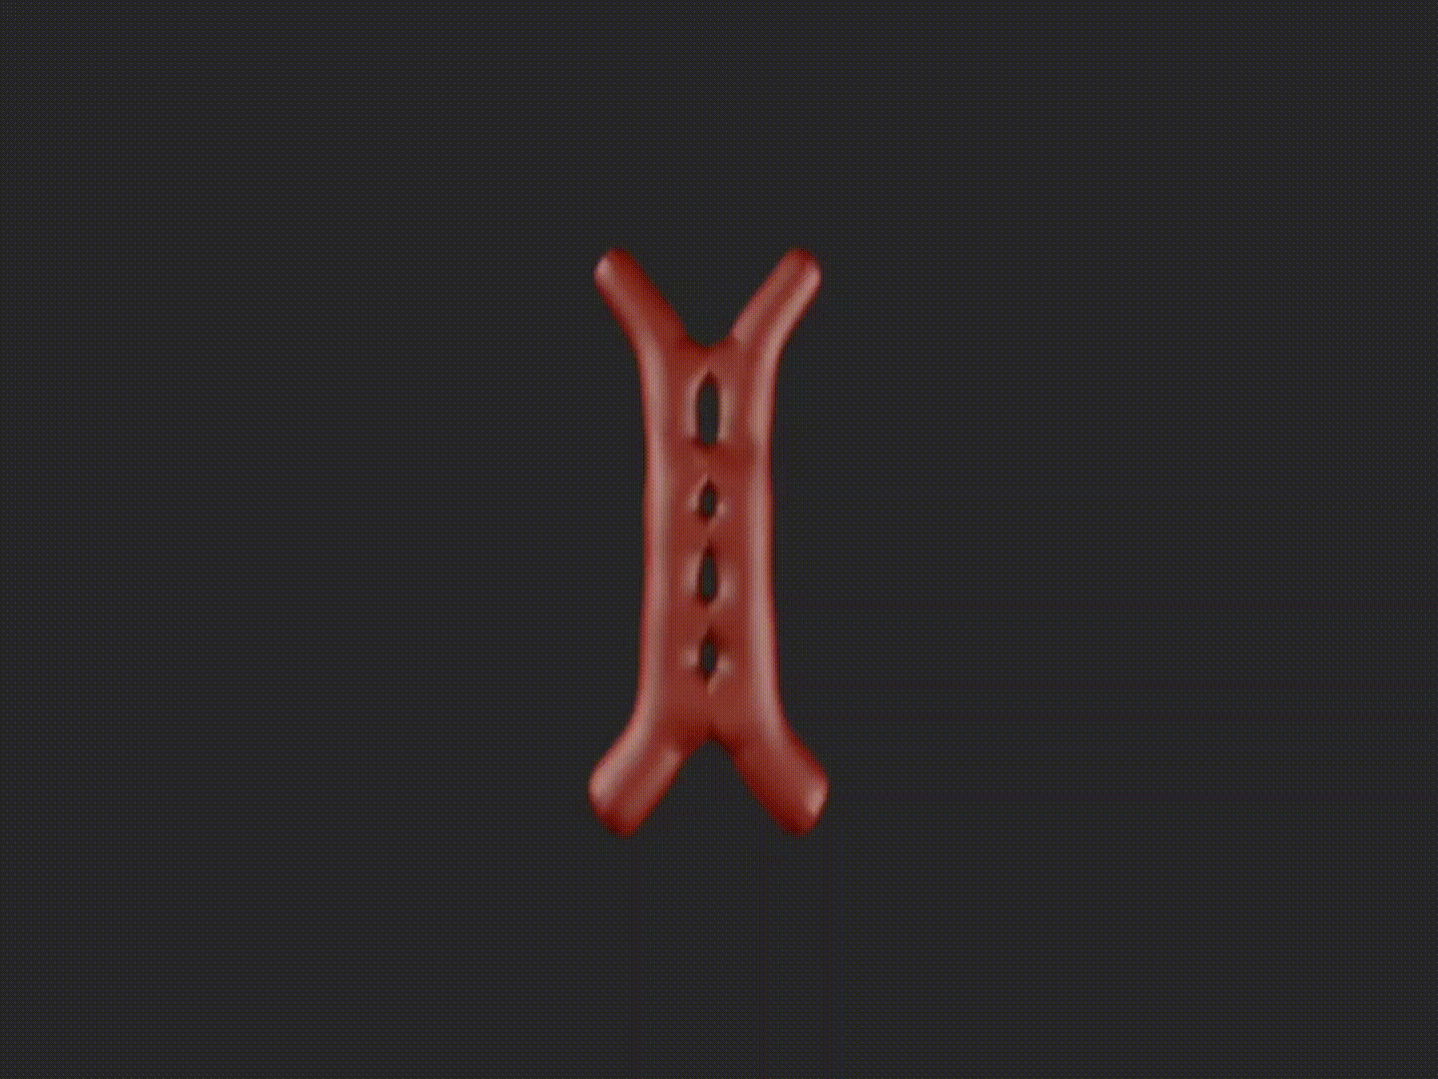

Slide 15
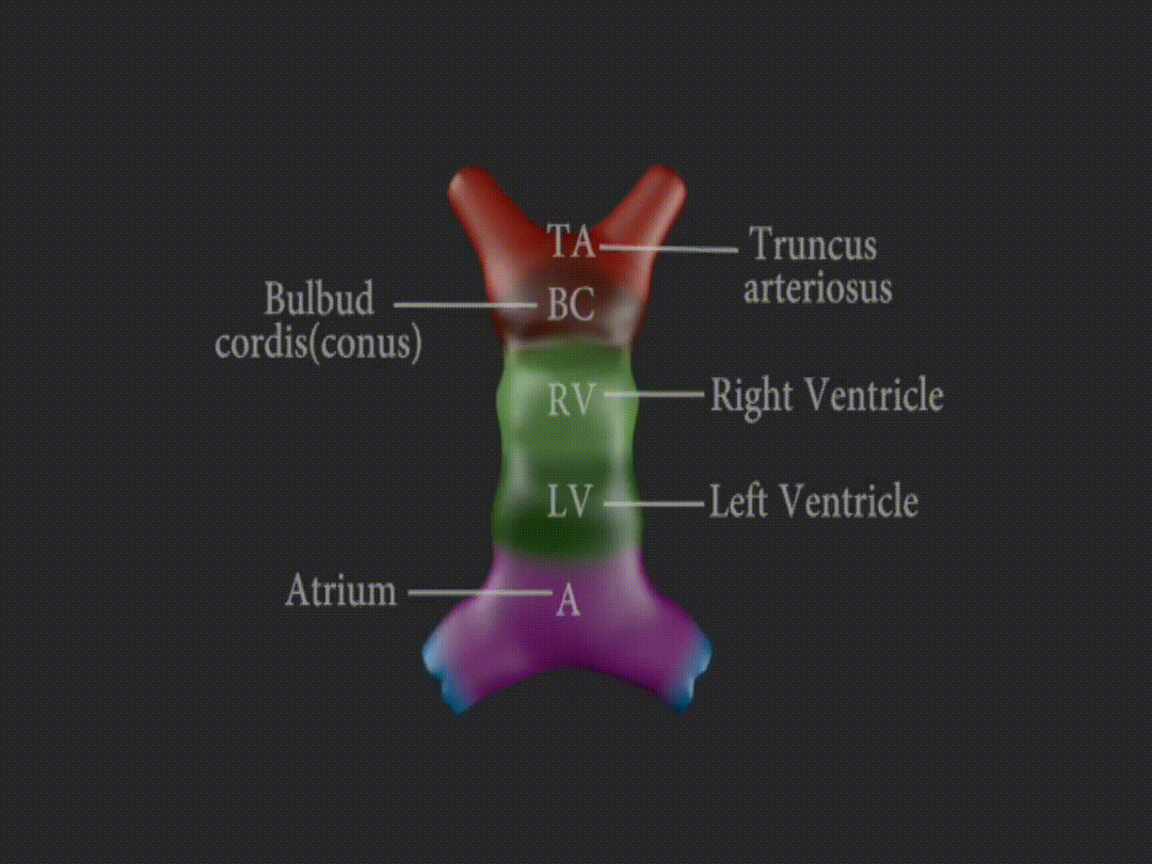

Slide 16
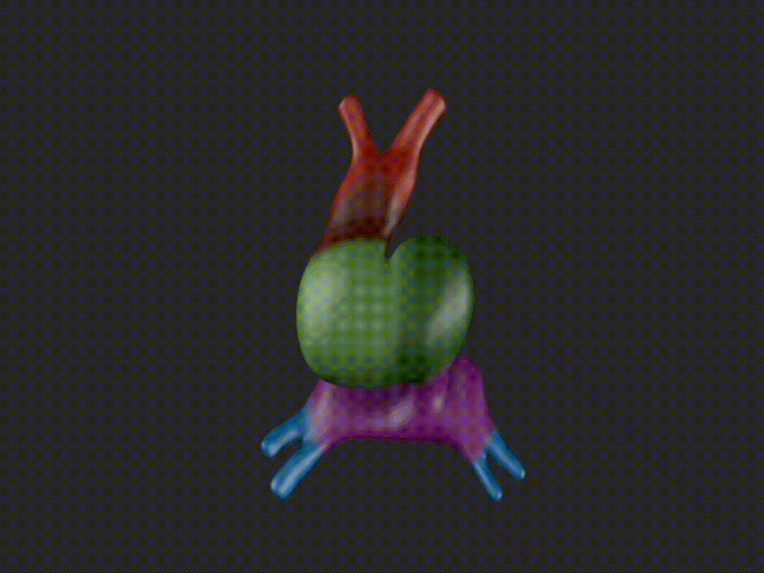

Slide 17
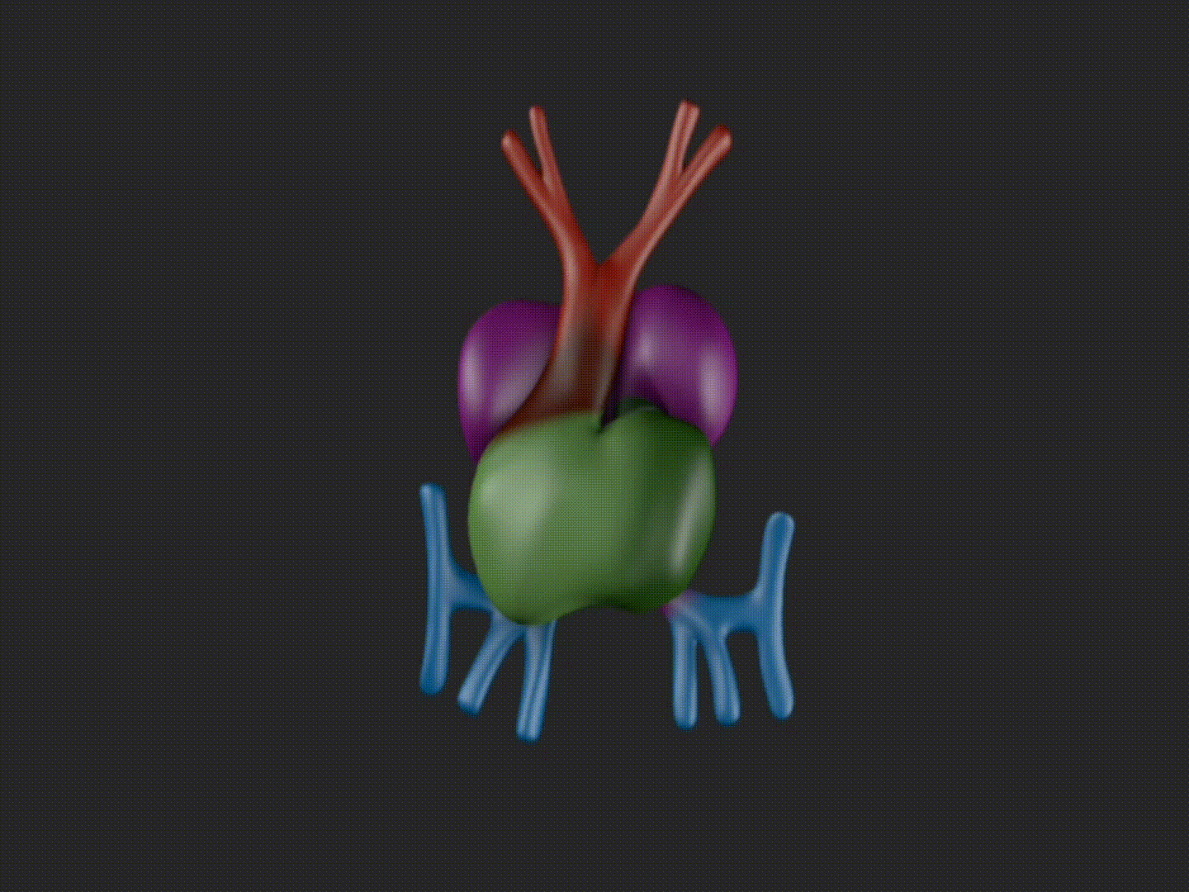

Slide 18
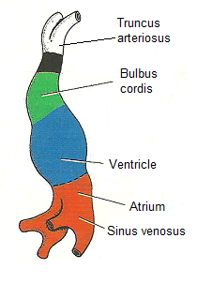

Slide 19
The Conus- also known as Infundibulum The Conotruncus comprises collectively two myocardial sub segments, the Bulbus cordis and the Truncus arteriosus
BULBUS CORDIS –refers to the ventricular outflow tract
TRUNCUS ARTERIOSUS- embryologic precursor of great arteries.

Slide 20
Bulbus cordis- also known as the conotruncus lies ventral to primitive ventricle.
Together with primitive ventricle it forms the ventricle of the adult heart.
The developing two main truncal cushions and the underlying two conal cushions are perfectly aligned and no line of demarcation between the two is identifiable in mammals

Slide 21
The net result is: Proper alignment of the outlet septum with ventricular trabecular septum with membraneous septum in between.
Proper posterior alignment of left outflow tract with left ventricle and aorto mitral continuity.
Mechanism – differential growth and apoptosis.

Slide 22
Secondary heart field
Area of the ventral pharyngeal mesoderm
Pre cardiac Splanchnic Mesodermic region providing myocardial precursor cells, which migrate to the Out flow Tract area of the developing cardiac tube, where they build up the Conotruncal myocardium as well as smooth muscle cells joining the caudal portion of the aortic sac

Slide 23
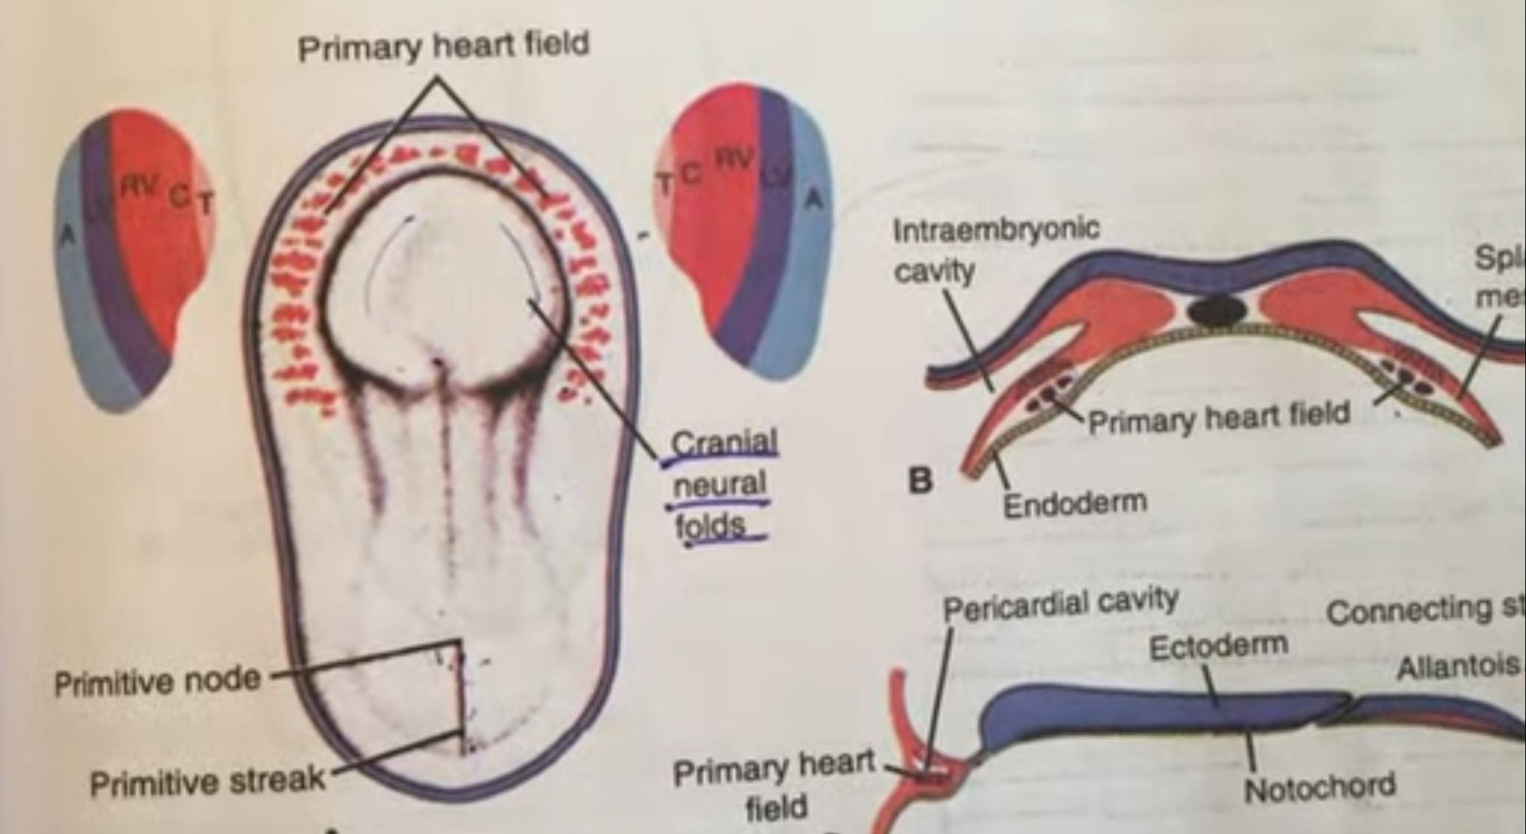

Slide 24
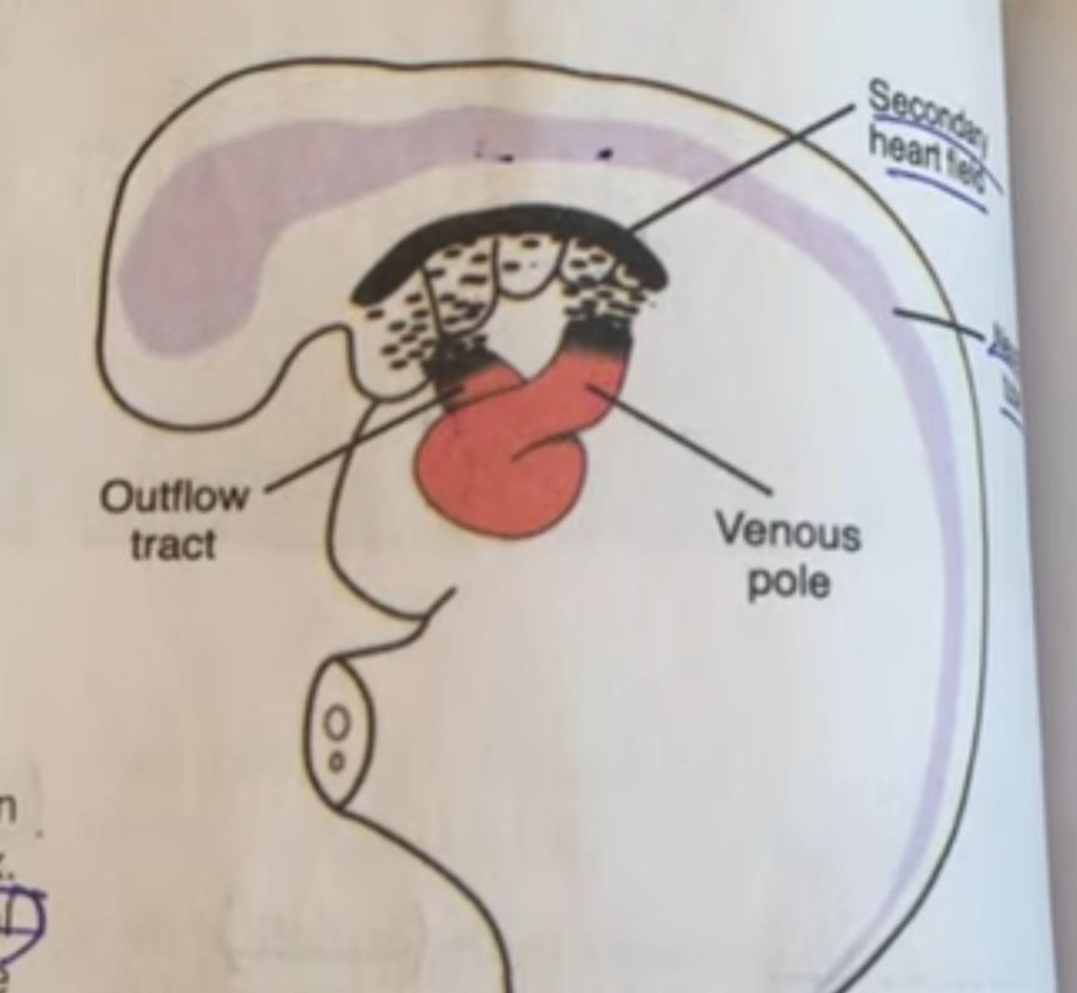

Slide 25
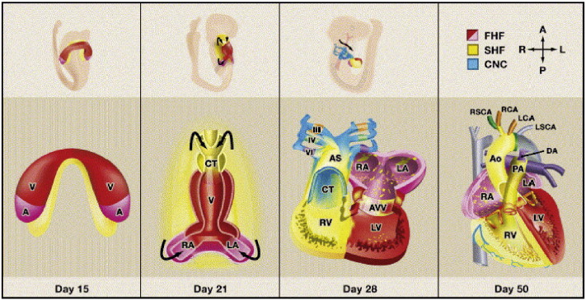

Slide 26
Molecular aspect
SHF expressed NKx2.5 and Gata4 transcription factors.
NKx2.5- and Gata4 SHF-committed cells join and incorporate themselves into the outflow tract of the primary heart tube, these cells undergo terminal myocardial differentiation under the induction of the local primary myocardial Bmp2 factor
Wnt, fibroblast growth factor, bone morphogenetic protein, Hedgehog, and retinoic acid are all involved in signalling.
SHF contributes to the outflow tract (OFT), right ventricle, and inflow region

Slide 27
NEURAL CREST CELLS
Crest develops from - Dorsal neural tube.
It overlaps the vagal neural crest and migrates to populate the pharyngeal arches 3, 4 and 6 (producing structures in the head) and to the heart, forming connective tissue that separates the great vessels of the heart.
Other Migration Locations: Pharyngeal arches and Truncus arteriosus , aorticopulmonary septum and the smooth muscle of great arteries.
Anterior of the aorta to become the four pre-aortic ganglia
(celiac ganglion, superior mesenteric ganglion, inferior mesenteric ganglion and aortical renal ganglia)

Slide 28
Role of neural crest cells
Neural crest cells modulate the SHF cells.
It plays a role in elongation of the Outflow tract.
Ablation of these cells cause failure of migration of SHF cells to conotruncus.
They provide the cells for entire conotruncal septum

Slide 29
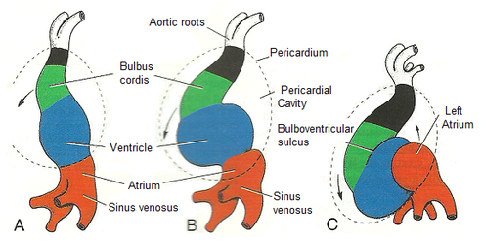

Slide 30
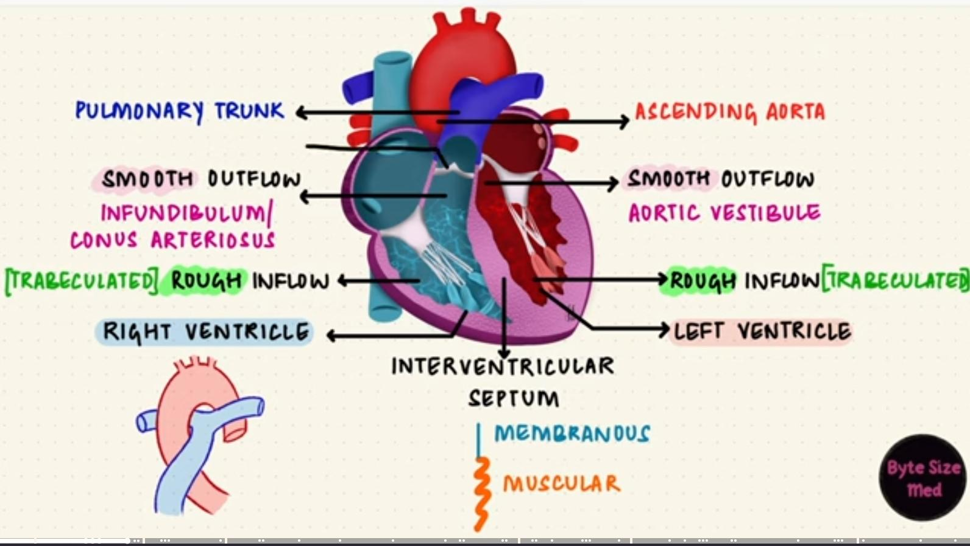

Slide 31
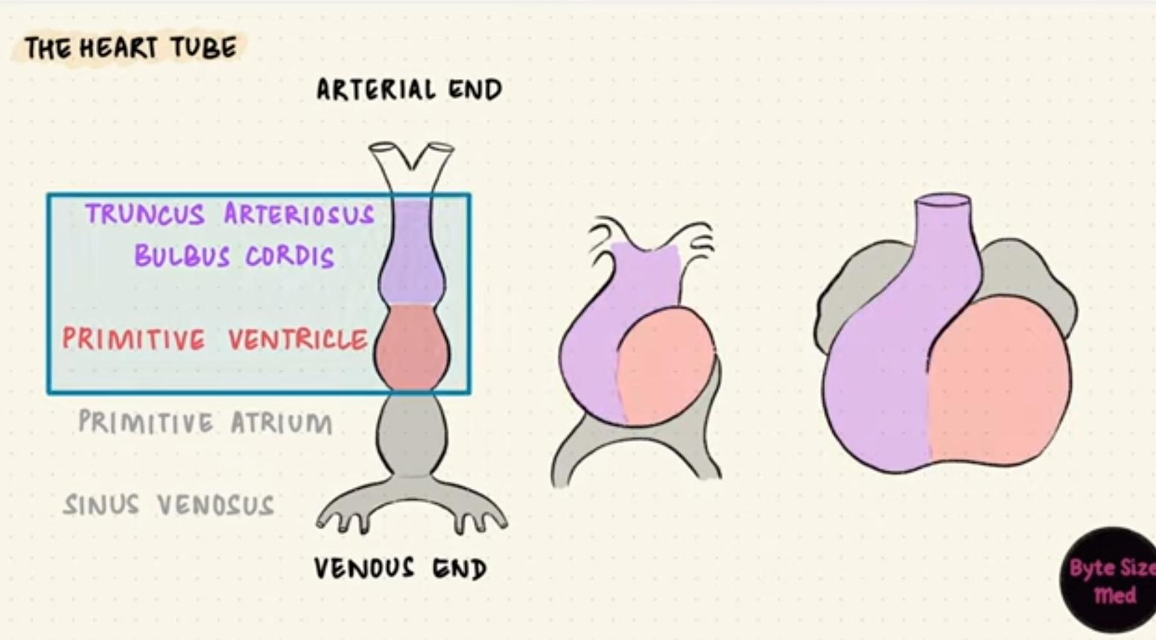

Slide 33
The heart tube is convoluted to forms five straight segments (limbs), and in-between them, four curves.
The proximal segment of the heart tube (starting at the venous end) is the A-V canal. It is oriented posteroanteriorly.
First curve or proximal bend- the heart tube makes a 90 degree turn toward the right to become the proximal transverse limb, or the interventricular foramen.

Slide 34
Curve 2 the heart tube makes a 90° turn cephalically to become the ascending limb .
Curve 3 the heart tube turns in 90 degree medially to form the distal transverse limb.
Curve 4 the heart tube turns in 90 degree toward the back of the embryo to form the terminal limb, which is cephalad and parallel to the A-V canal.
Each curve has a Greater and a Lesser curvature.
The Lesser curvature of curve 2 is the Conoventricular Flange

Slide 35
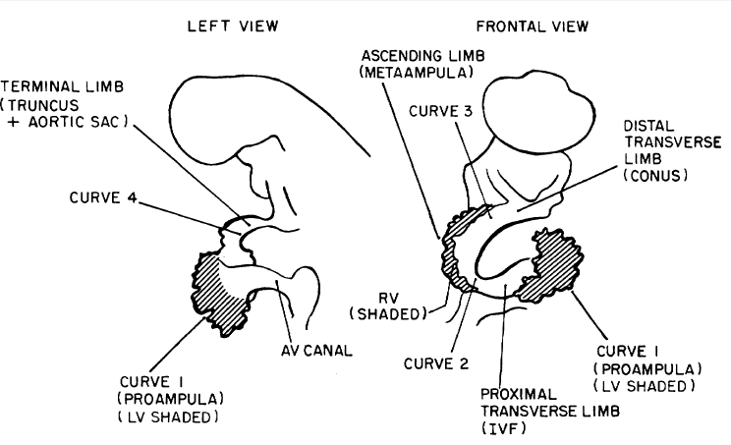
Embryo – Aged 18-22 days

Slide 36
Conotruncus and ostium bulbi
Border between meta ampulla and conus is the Ostium bulbi, or the conoventricular junction.
On the right the Ostium bulbi is the transition from the trabeculated ventricular endocardium to the smooth conal endocardium
On the left the Ostium bulbi is lower edge of conoventricular flange.

Slide 37
Shift or rotation of ostium bulbi
Ostium bulbi shifts toward the left to cephalically and override the IVF.
This critical process provides the conus with an access to the left ventricle.

Slide 38
Cono-truncal ridges
The conotruncal ridges are arranged in a spiral course, like riflings of a gun barrel.

Slide 39
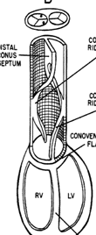
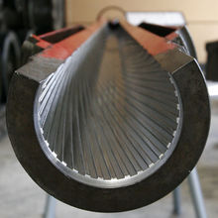

Slide 40
Two main opposing dextrosuperior and sinistroinferior truncal endocardial cushions appear.
Occupying respectively a dorsal and a ventral oblique position, these cushions extend from the junction between the aortic sac and the truncus arteriosus down to the beginning of the conus, where they align with the dextrodorsal and sinistroventral conal cushions, respectively

Slide 41
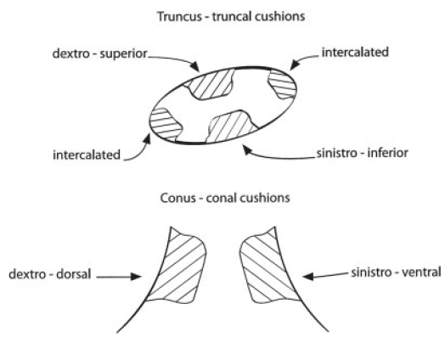
Truncal and conal cushions

Slide 42
Truncal rotation
The truncus rotates about 90-110° in a counterclockwise direction.
This counterclockwise rotation of the truncus, which follows the earlier counterclockwise rotation of the ostium bulbi, unwinds the coiled course of the conotruncal ridges .
As a result, the aortic truncus is transferred to the same side as the aortic conus (left side) and the aortic and pulmonary trunks become coiled, this situation is seen in the definitive heart.

Slide 44
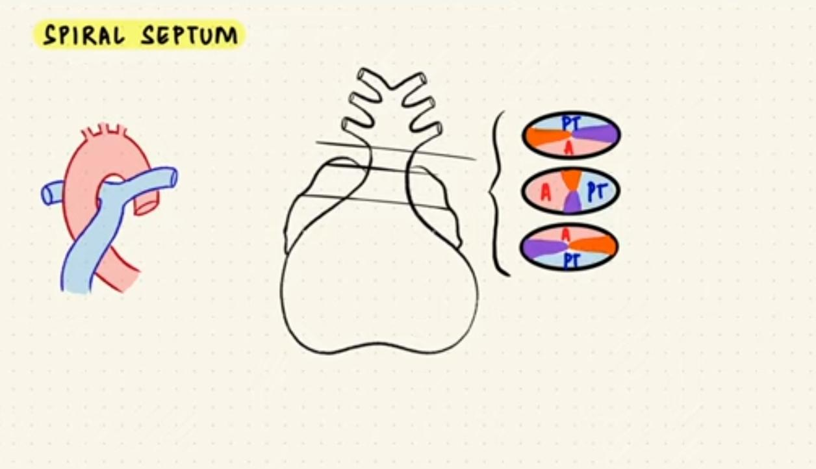

Slide 45
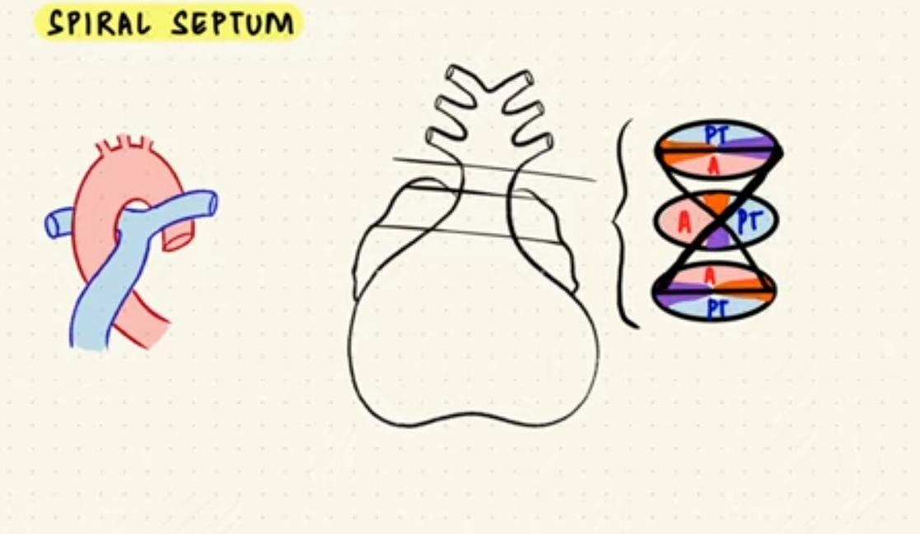

Slide 46
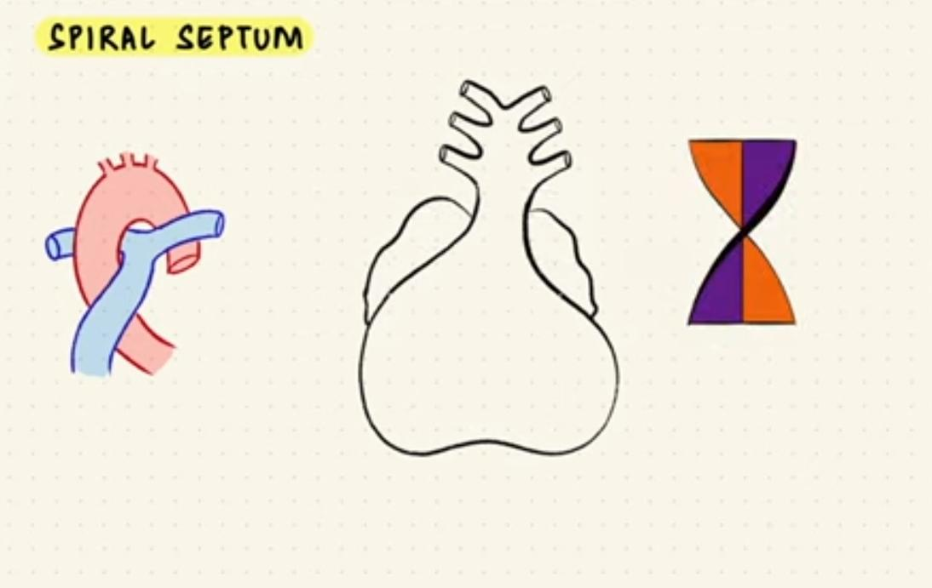

Slide 47
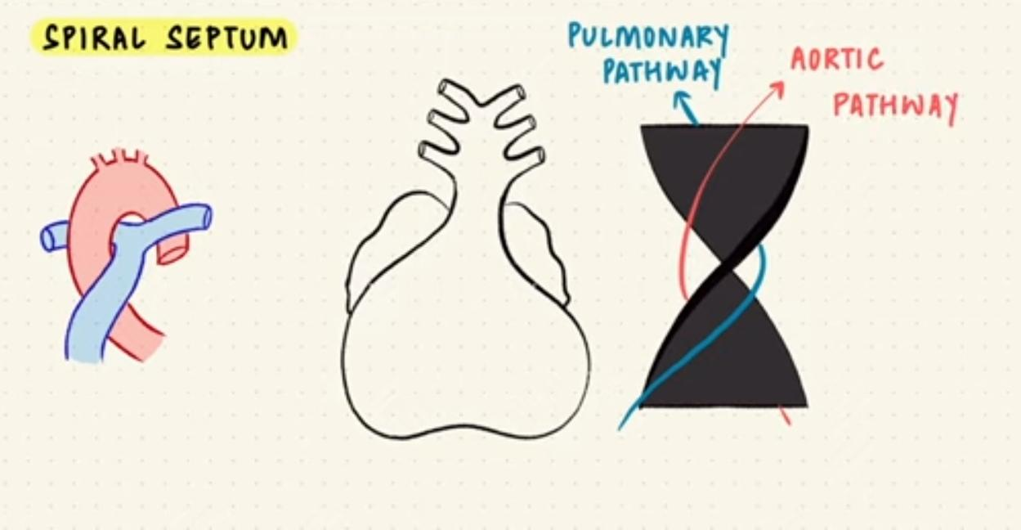

Slide 48
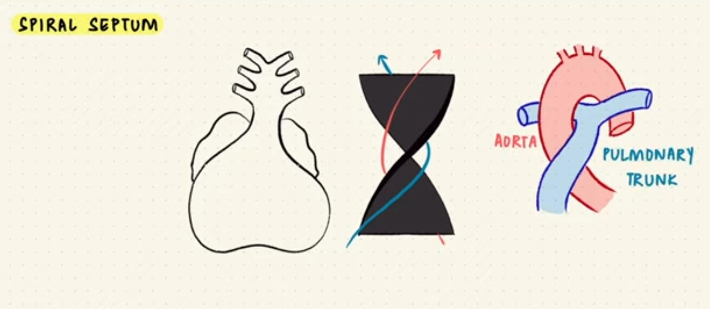

Slide 49
Absorption of conus
Marked shortening of the conus and the equivalent lengthening of the aorta and pulmonary arteries.
The aortic conotruncus is reduced in length from 700 to 400 microns
The length of the pulmonary conotruncus is reduced from 880 microns to 600 microns
Absorption of the bilateral proximal conuses brought the distal conus septum toward the ventricular septum, and absorption of the distal aortic conus accounts for the fibrous continuity between the aortic and mitral valves

Slide 50
The truncus is continuous distally with the aortic sac which is devoid of endocardial cushions.
At the same time, the septum aortopulmonale grows from the dorsal wall of the aortic sac toward the truncal septum to fuse with it.
As a result of the fusion of these two septa the aortic sac is divided into the ascending aorta and the pulmonary artery .

Slide 51
Basis for conotruncal defects
Ward et al. (2005) and Ward and Kirby (2006) emphasize that a short outflow tract, through SHF ablation and through experimental ablation and with consequent low SHF cellular output to the conotruncal region, does not allow a normal conotruncal rotation.

Slide 52
Myocardialisation of the ridges gives a zippering effect resulting in fusion.
Fusion occurs in a distal to proximal direction during the sixth week, allowing for cleavage of the aorta and pulmonary trunk.
The spiralling nature of the ridges causes the pulmonary trunk to twist around the aorta.

Slide 53
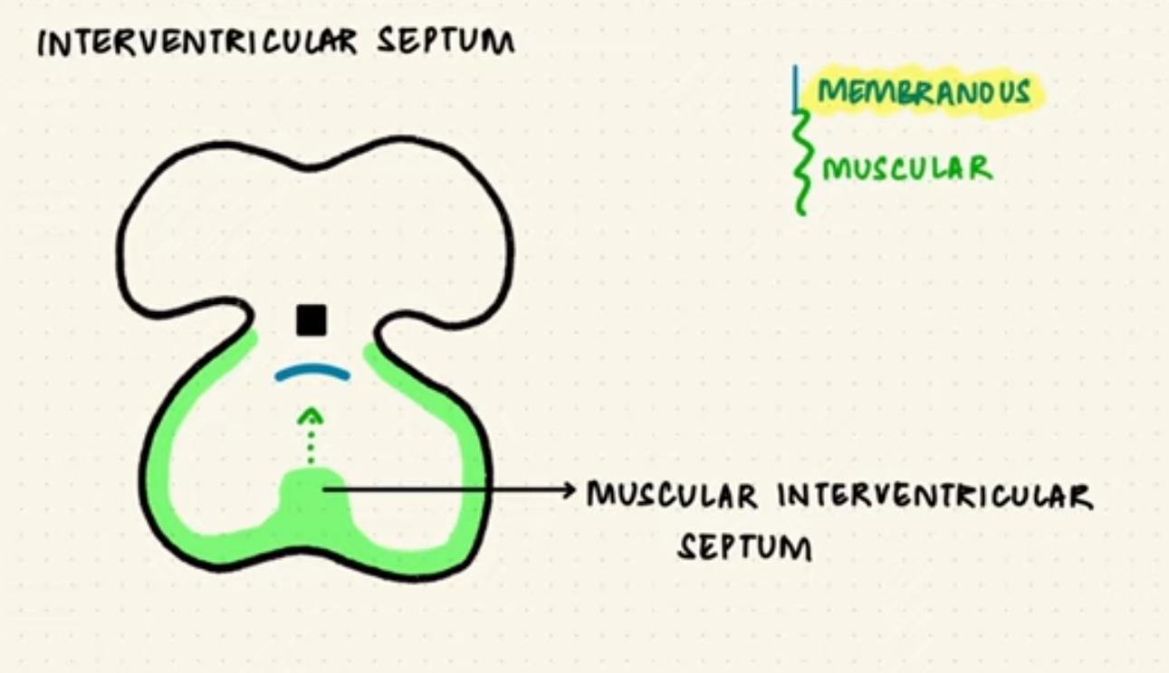

Slide 54
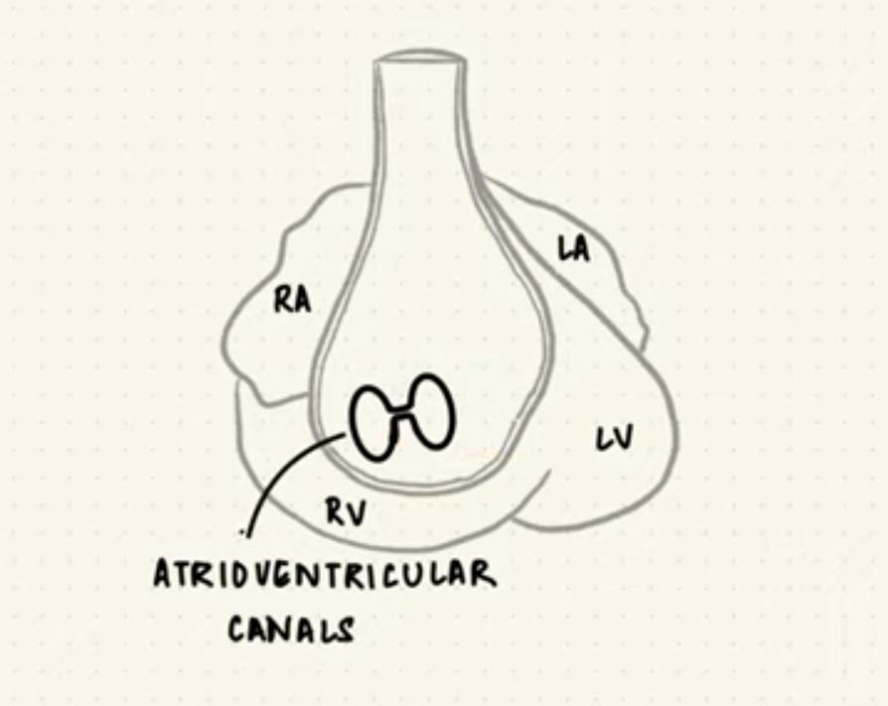

Slide 55
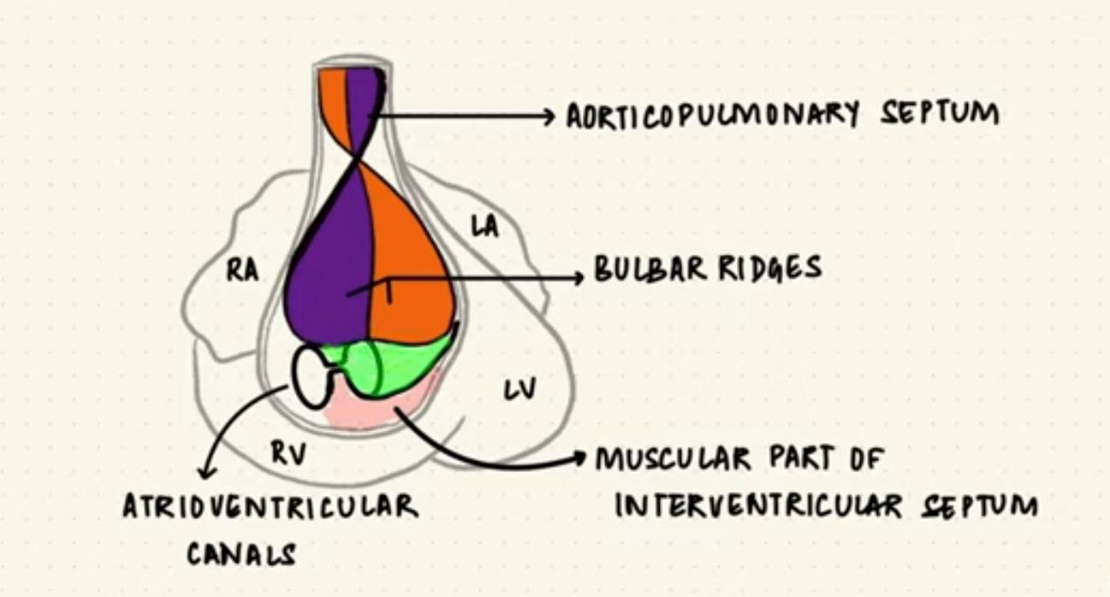

Slide 56
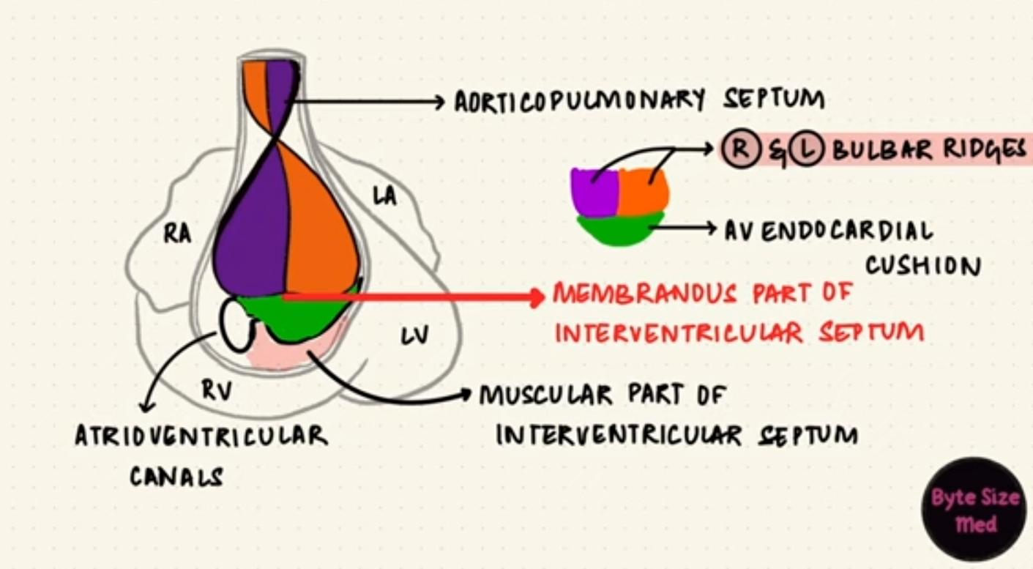

Slide 57
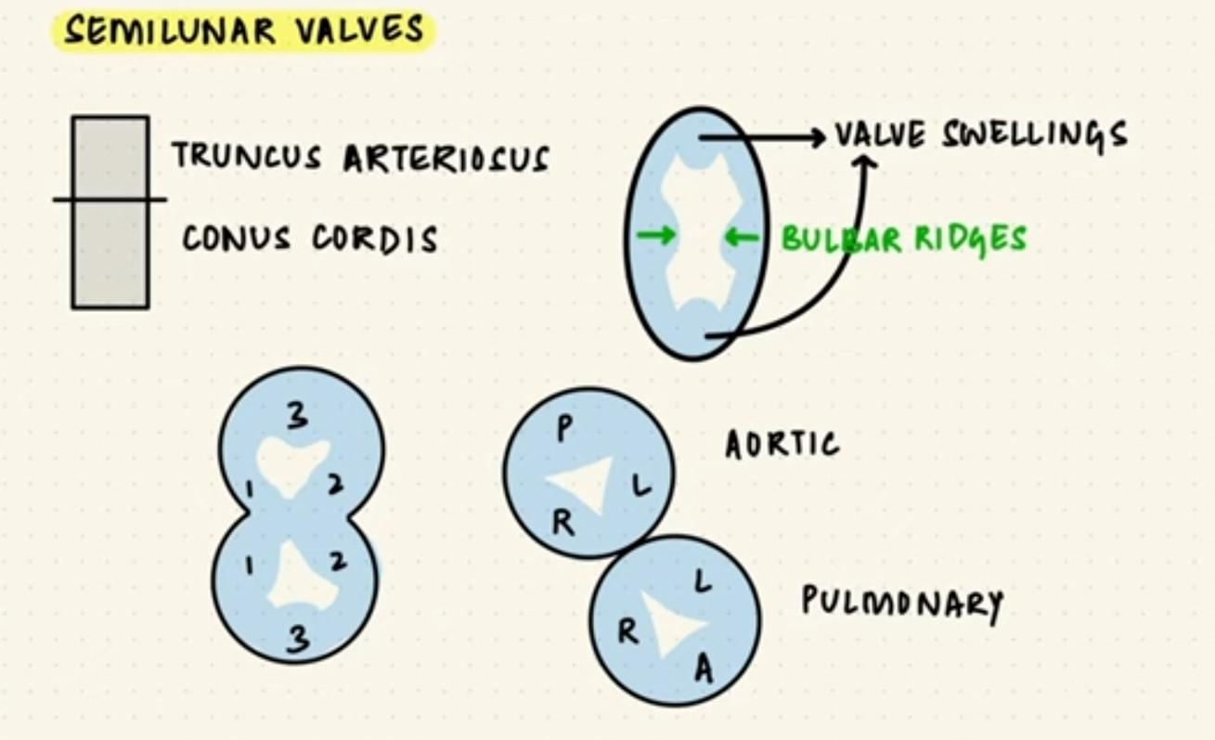

Slide 58
Conotruncal anomalies
TOF
DORV
TGA
PTA

Slide 59
TOF
Conal septum deviates anteriorly- faulty partition of conotruncal septum.
Abnormal conal rotation takes place
Malrotation of trunco-bulbar ridges causes misalignment of septum and straddling of aorta over VSD
Another mechanism- hypoplasia and under development of the pulmonary infundibulum causes infundibular hypoplasia.

Slide 60
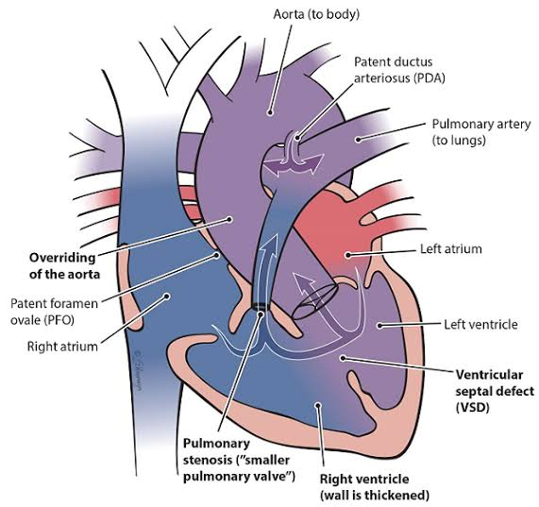

Slide 62
Truncus arteriosus
Due to incomplete or failed septation of the embryonic truncus arteriosus. Aortopulmonary and interventricular defects are believed to represent an abnormality of conotruncal septation.

Slide 63
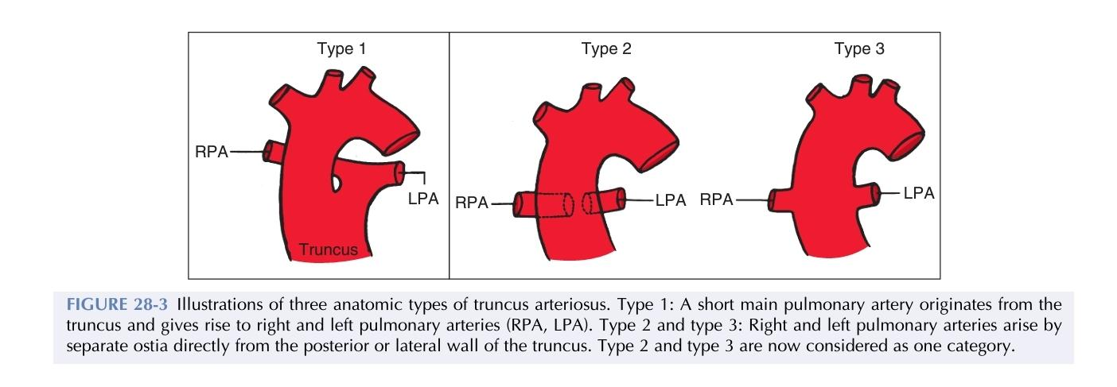

Slide 64
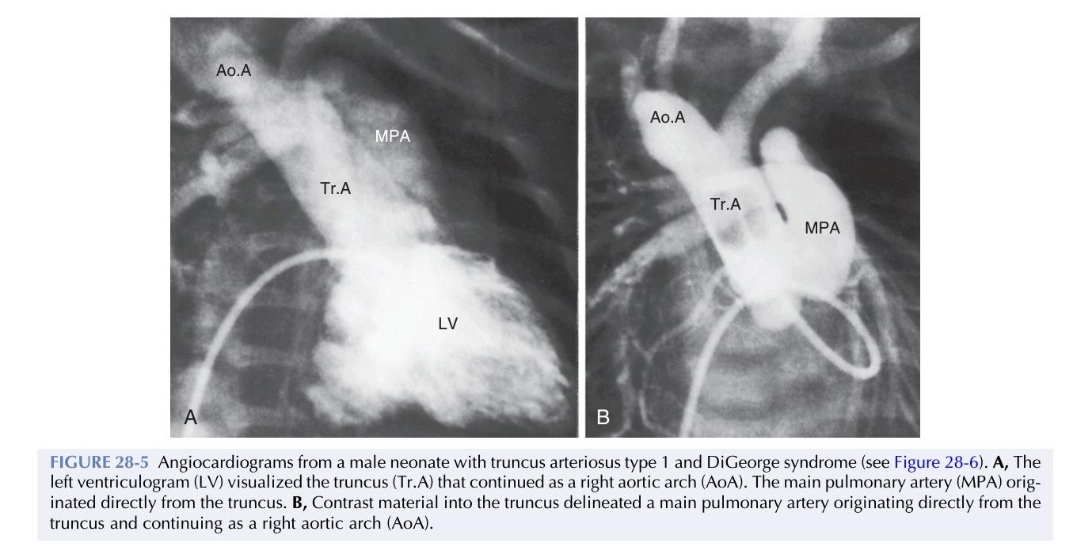

Slide 65
TGA
Arrest of both proximal & distal conal rotation lead to the transposition group of diseases, in which the aorta is dextroposed on the right side of the pulmonary artery & has no continuity with left ventricle

Slide 66
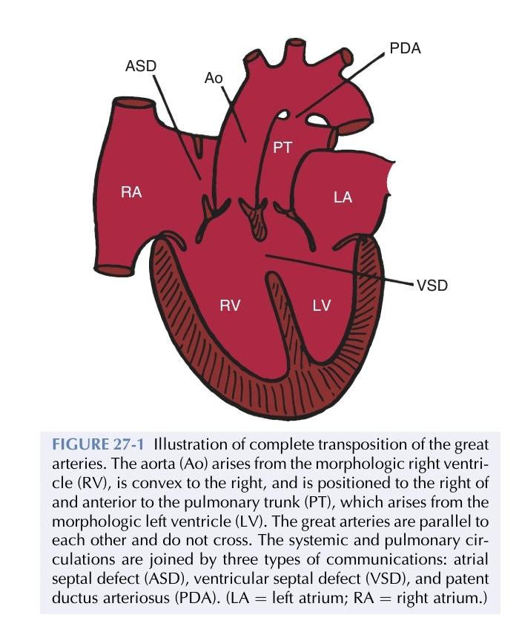

Slide 67
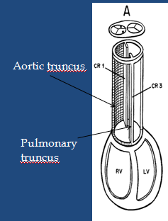

Slide 68
DORV
Impaired morphogenesis of either the outflow portion (conotruncus) or the conoventricular flange
Abnormal connection between the muscular ventricular septum and the conus septum
And hence sub aortic flow path from right ventricle
Originally both vessels arise from RV and if no conoventricular shifting occurs then DORV

Slide 69
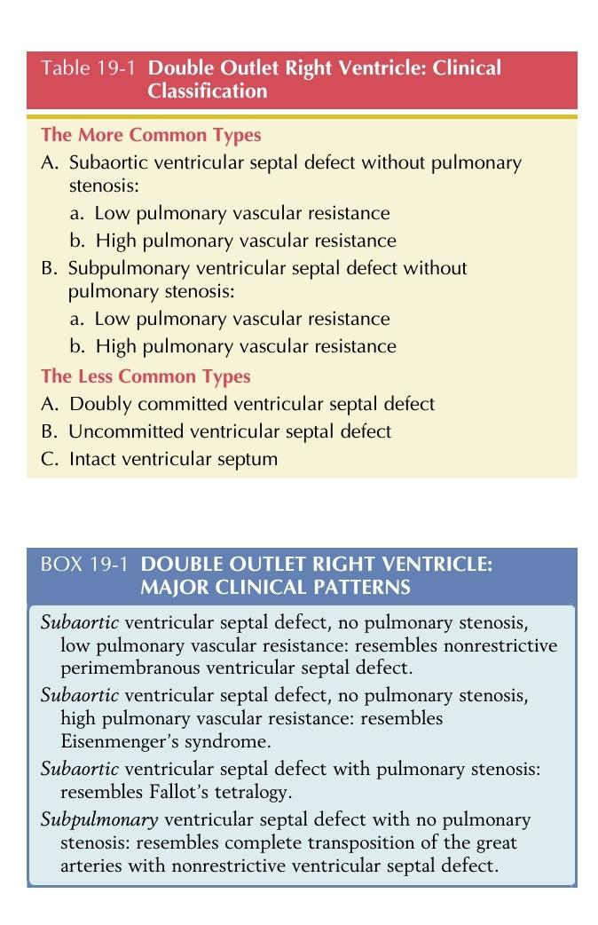

Slide 71
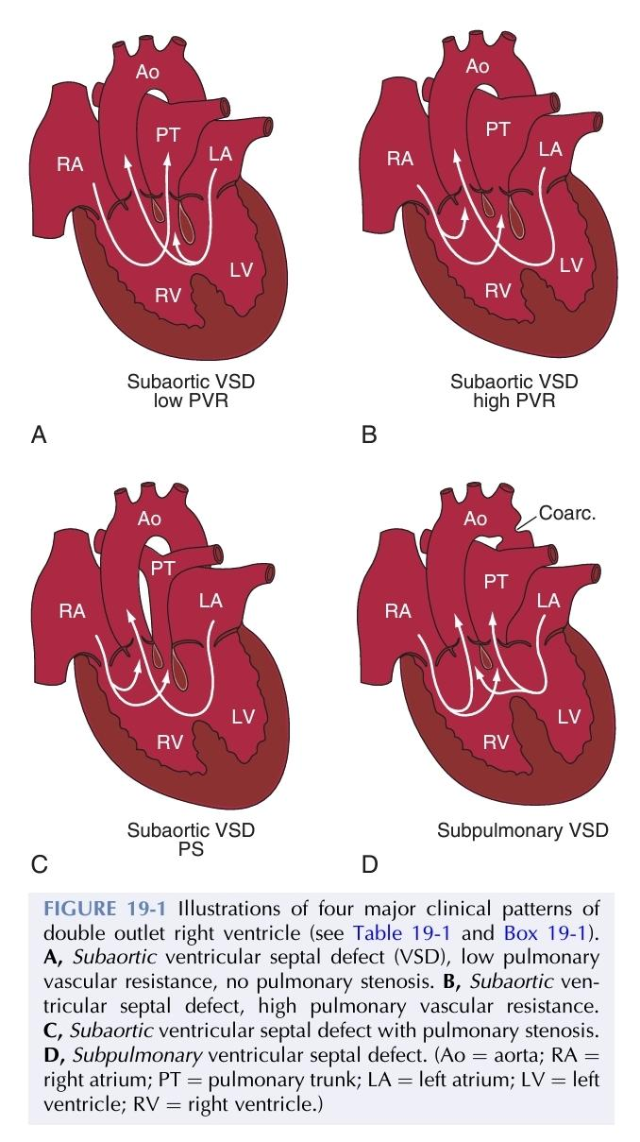

Slide 72
Not a function of SHF
RV formation
Outflow tract formation
Elongation
LV formation

Slide 73
Not a function of SHF
RV formation
Outflow tract formation
Elongation
LV formation

Slide 74
Not involved in signalling cardiac development
FGF
WNT
GATA3
BMP

Slide 75
Not involved in signalling cardiac development
FGF
WNT
GATA3
BMP

Slide 76
Match the cardiac curves leading to which Limb
First curve ascending limb
Second curve terminal limb
Third curve proximal transverse limb
Fourth curve distal transverse limb

Slide 77
Match the cardiac curves leading to which Limb
First curve proximal transverse limb
Second curve ascending limb
Third curve distal transverse limb
Fourth curve terminal limb

