Slide 1
Fetal Circulation
Dr. Aiswarya Ravikrishnan

Slide 2
Fetal Blood Flow Studies:
Defined in fetal lambs using catheters in limb vessels.
In human fetuses, in utero left and right ventricular outputs and flow distributions through the foramen ovale, ductus arteriosus, and pulmonary bed measured via high-resolution color Doppler ultrasound.
Ventricular Function:
The right and left ventricles do not function in series in the fetus, unlike in extrauterine circulation.
Gas exchange occurs in the placenta, not the lungs.

Slide 3
Right Ventricular Output:
About two-thirds is diverted away from the lungs through a widely patent ductus arteriosus into the descending thoracic aorta.
A large portion of this blood enters the umbilical circulation for oxygenation in the placenta.
Pulmonary Blood Flow:
Low, but sufficient to meet nutritional requirements for lung growth.

Slide 4
Inferior Vena Cava Blood Flow:
Composed of blood from the umbilical vein, left and right hepatic veins, ductus venosus, and distal inferior vena cava.
Directed towards the foramen ovale into the left atrium and then into the left ventricle, assisted by the eustachian valve.
Umbilical Venous Return:
About 60% of oxygenated blood from the placenta bypasses the liver through the ductus venosus and enters the inferior vena cava and right atrium

Slide 5
Superior Vena Cava Blood Flow:
Deflected within the right atrium towards the tricuspid valve, reaching the right ventricle.
Left Ventricle Output:
About 70% of the relatively oxygen-rich blood is distributed to the coronary circulation (and thus the myocardium), head and neck (and thus the brain), and forelimbs.

Slide 6
Right Ventricle Output:
Almost 90% of the relatively oxygen-poor blood passes through the ductus arteriosus into the descending aorta for oxygenation in the placenta.
Fetal Circulation Design:
Ensures that blood with higher oxygen saturation preferentially reaches the myocardium and brain.
Less saturated blood is directed towards the placenta.

Slide 7
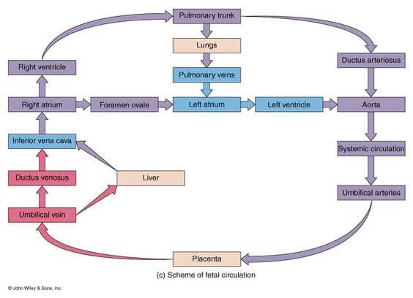

Slide 8
The circulation in the fetus is essentially the same as in the adult except for the following
Placenta: The source of oxygenated blood is the placenta, not the lungs. Gaseous exchange takes place in the placenta.
Umbilical Vein: Oxygenated blood from the placenta reaches the fetus through the umbilical vein, which connects to the left branch of the portal vein. Most of this blood bypasses the liver and flows directly to the inferior vena cava via the ductus venosus.
Ductus Venosus: This structure allows blood to bypass hepatic circulation. A sphincter mechanism in the ductus venosus regulates blood flow.

Slide 9
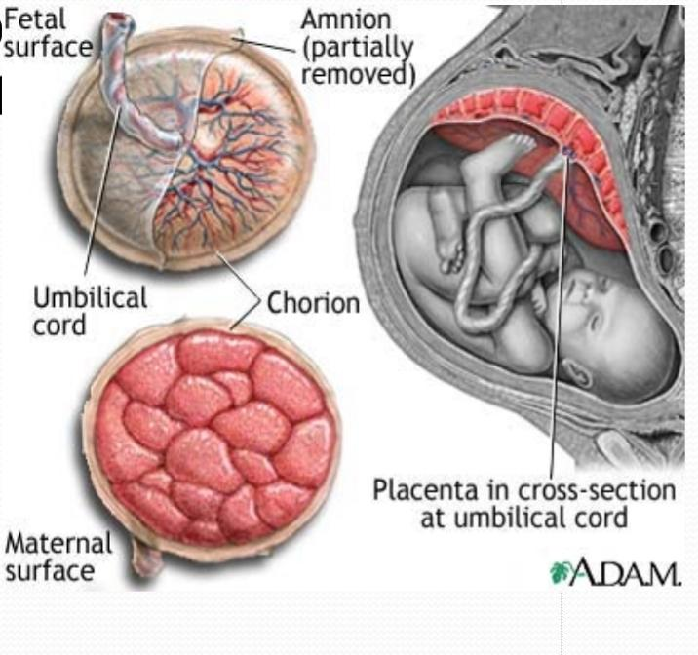

Slide 10
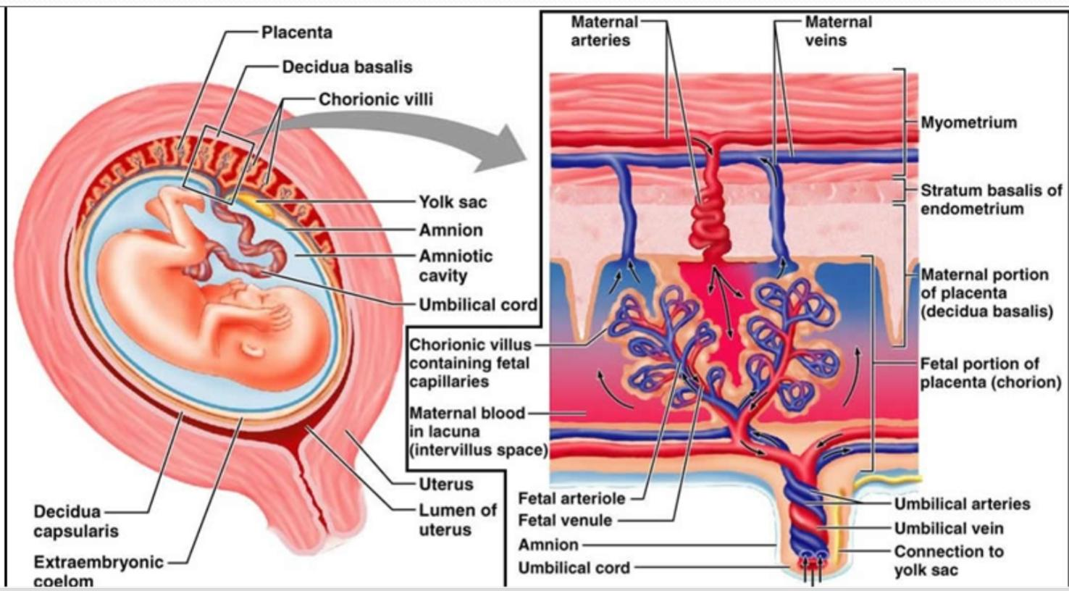

Slide 11
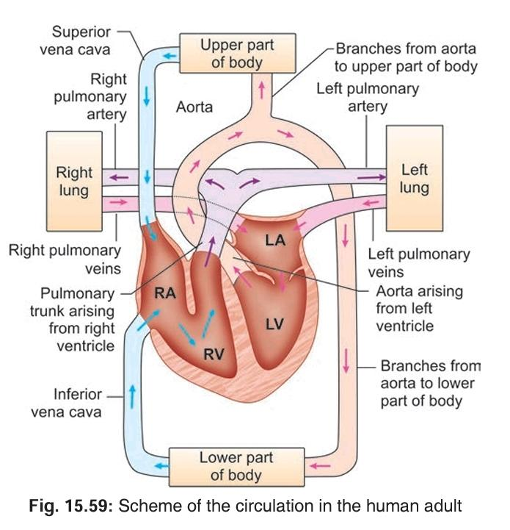

Slide 12
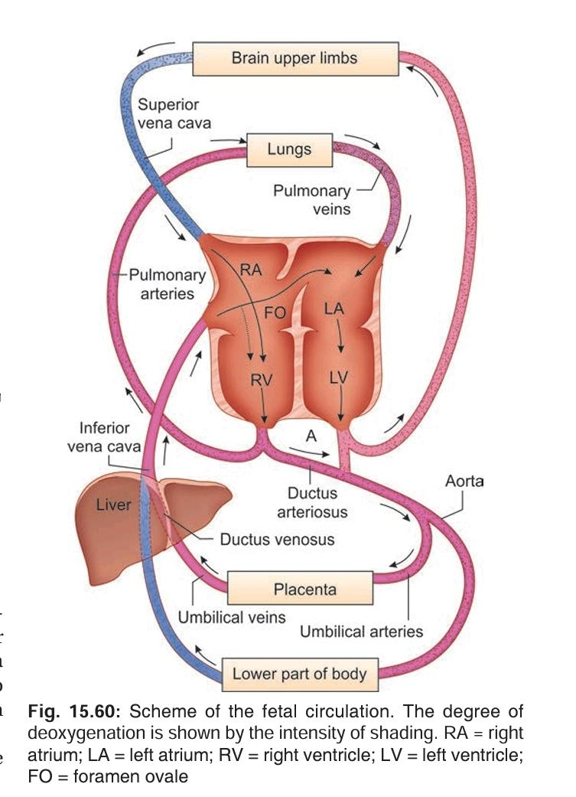

Slide 13
Foramen Ovale: Connects the two atria.
Oxygen-rich blood from the inferior vena cava is directed towards the foramen ovale by the valve of the inferior vena cava.
Crista Dividens (lower edge of the septum secundum) divides the blood:
Most of the blood passes through the foramen ovale into the left atrium.
The remaining blood mixes with blood from the superior vena cava and passes into the right ventricle.
Ductus Arteriosus: Bypasses pulmonary circulation.
Blood from the right ventricle enters the pulmonary trunk.
Only a small portion of this blood reaches the lungs and passes to the left atrium.
The majority is short-circuited by the ductus arteriosus into the aorta.

Slide 14
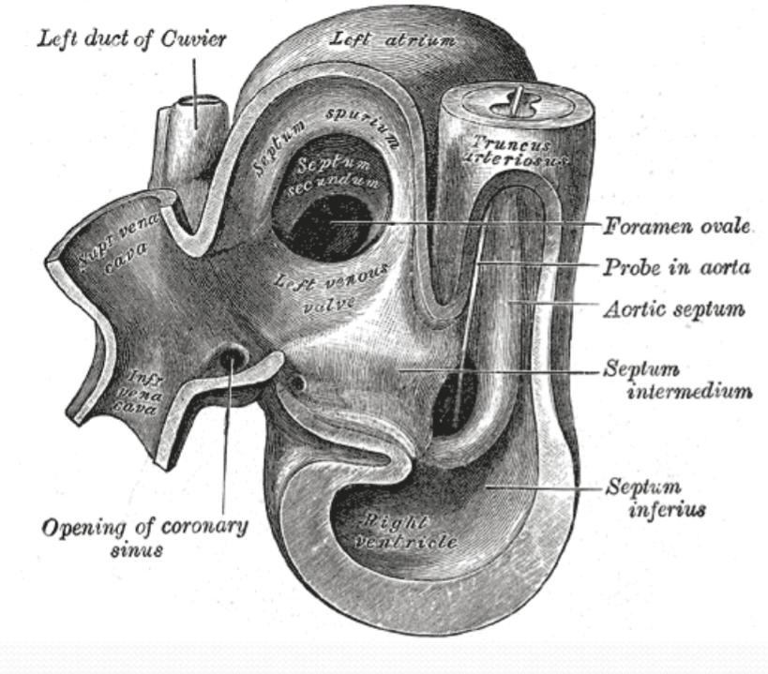

Slide 15
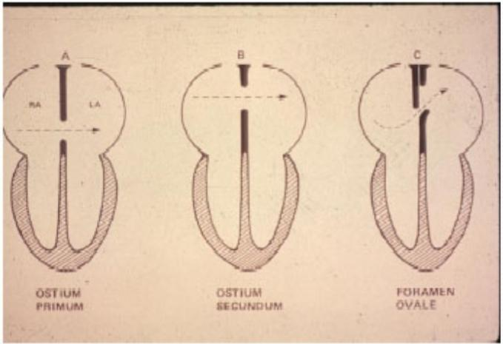

Slide 16
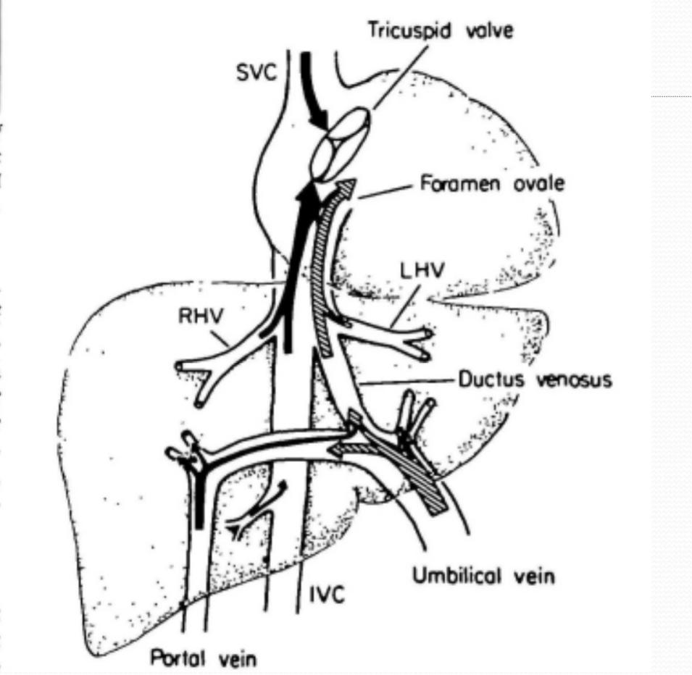

Slide 17
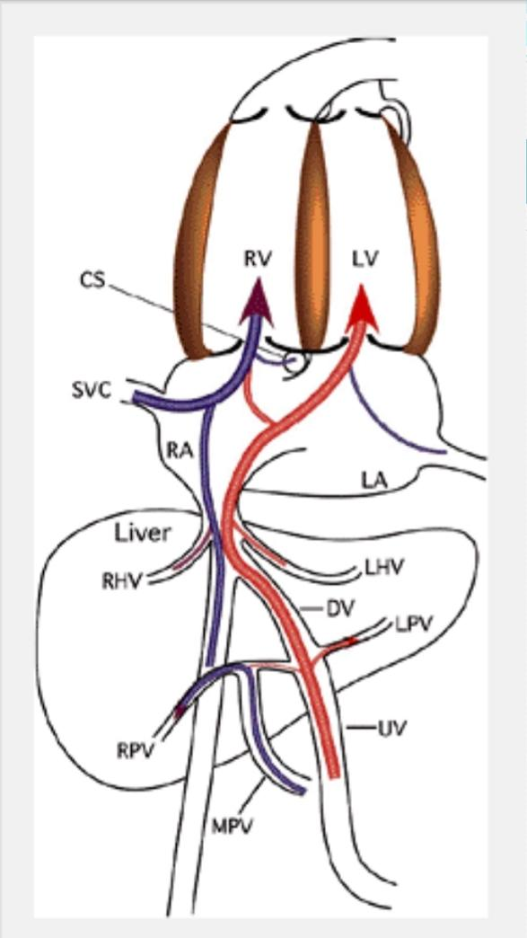

Slide 18
Blood supply to fetus:
Left Atrium Blood Supply:
Receives oxygenated blood from the right atrium and a small amount of deoxygenated blood from the lungs.
The blood in the left atrium is relatively rich in oxygen.
Left Ventricle and Aorta:
Blood from the left atrium passes into the left ventricle and then into the aorta.
Oxygen-rich blood in the aorta supplies the brain, head, neck, and upper extremities via the carotid and subclavian arteries.
The remaining blood mixes with poorly oxygenated blood from the ductus arteriosus.
Aortic Blood Supply:
Parts of the body supplied by branches of the aorta distal to its junction with the ductus arteriosus receive blood with moderate oxygen content.

Slide 19
Umbilical arteries:
They carry deoxygenated blood from fetus. Much of the blood of the aorta is carried by the umbilical arteries to the placenta where it is again oxygenated and returned to the heart.
Pair of umbilical arteries carry deoxygenated blood & wastes to placenta.
Umbilical vein carries oxygenated blood and nutrients from the placenta.

Slide 20
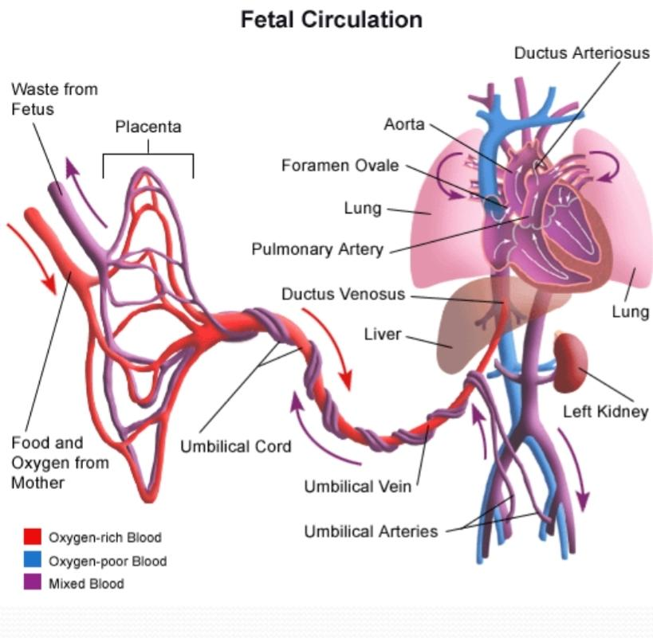

Slide 21
Central venous circulation
upper body - SVC
myocardium – coronary sinus
the lungs – pulmonary veins
the lower body - IVC
placenta → umbilical vein → ductus venosus→ IVC

Slide 22
Umbilical vein gives branches to left lobe of liver and then divides into DV and arcuate vein.
Arcuate vein joins the portal vein and then gives of branches to right lobe of liver.
Left hepatic vein joins the DV at it’s entry to IVC and Right hepatic vein joins the IVC directly.

Slide 23
Right lobe of liver receives poorly oxygenated portal venous blood and left lobe receives well oxygenated umbilical venous blood.
Both lobes receive small contribution of blood from hepatic artery.
Saturation of RHV is lower than that of LHV.

Slide 24
Posterior and left stream of IVC blood carries oxygenated blood while anterior and right stream carries poorly oxygenated blood.
Preferential streaming of DV and LHV blood across the foramen ovale and abdominal IVC and RHV blood across the TV.

Slide 25
Fetal circulation—peculiarities:
– Three times blood shunts along its course at:
Ductus venosus—to direct blood to inferior vena cava by passing liver without losing oxygen content--
Foramen ovale—to equalize distribution to each half of heart and more oxygenated blood to upper half vital organs
Ductus arteriosus—to direct blood to placenta for oxygenation by passing lungs

Slide 26
– More oxygenated blood for upper limb. Hence the length of upper limbs is more than lower limbs in the fetus.
– Sphincteric action at the junction of left umbilical vein and ductus venosus regulates oxygen content of inferior vena cava and excessive load on heart
– Admixture of oxygenated and deoxygenated blood takes place in the liver, terminal part of inferior vena cava, both atria and distal part of arch of aorta.
– Transseptal blood flow throughout fetal life through ostium primum and foramen ovale.

Slide 27
Venous return from lungs
Not well saturated
Preferential flow to RV is not possible because of the normal drainage of pulmonary veins to LA
But pulmonary blood flow only 8% of combined ventricular output
So no appreciable effect on oxygen delivery

Slide 28
Blood oxygen saturations
The highest partial pressure of oxygen (Po2) is found in the umbilical vein (32 mm Hg)
The brain and coronary circulation receive blood with higher oxygen saturation (Po2 of 28 mm Hg) when compared to the saturation in the blood supply to the lower body (Po2 of 24%)

Slide 29
CHANGES IN THE CIRCULATION AT BIRTH
Soon after birth, several changes take place in the fetal blood vessels.
These lead to the establishment of the adult type of circulation.
The changes are as follows:
• Contraction of thick muscle wall:
The muscle in the wall of the umbilical arteries contracts immediately after birth, and occludes their lumen.
This prevents loss of fetal blood into the placenta.

Slide 30
The lumen of the umbilical veins and the ductus venosus is also occluded, but this takes place a few minutes after birth, so that all fetal blood that is in the placenta has time to drain back to the fetus.
• The ductus arteriosus is occluded, so that all blood from the right ventricle now goes to the lungs, where it is oxygenated.
Initial closure of the ductus arteriosus is caused by contraction of muscle in the vessel wall.
Later intima proliferation obliterates the lumen.

Slide 31
Circulatory changes at birth
Elimination of Umbilical/Placental Circulation.
Lung Expansion and commencement of rhythmic ventilation.
Rise in Oxygen Tension: Alveolar fluid is eliminated and ambient air is breathed.
Decrease in Pulmonary Vascular Resistance and a significant increase in pulmonary blood flow (eight to tenfold).
Increase in Venous Return to the left atrium and a rise in left atrial pressure.
Closure of the Foramen Ovale: The valve of the foramen ovale closes.
Closure of the Ductus Arteriosus: Functionally constricts within hours after birth, effectively separating the pulmonary and systemic circulations.

Slide 32
Delayed Events Post-Birth:
Progressive Fall in Pulmonary Vascular Resistance: New resistance arterioles develop throughout gestation.
Regulation of Perinatal Pulmonary Circulation: Complex interplay between vasoconstrictor and vasodilator factors.
Net Effect: Dramatic increase in pulmonary blood flow initiated by lung expansion and rhythmic ventilation.
Shift: From active pulmonary vasoconstriction in the fetus to active vasodilation in the neonate.
Failure: Results in persistent fetal circulation of the newborn.

Slide 33
Pulmonary Arterioles:
Thick-walled to withstand systemic right ventricular pressure when lungs expand.
Sensitive to increased alveolar and systemic arterial oxygen tension, leading to dilation and involution.
Role of Large Pulmonary Arteries:
Play a lesser role in the total drop in pressure across the lungs

Slide 34
In humans by 24 hours of age, mean pulmonary arterial blood pressure may be only half systemic.
After the initial rapid decrease in pulmonary vascular resistance and pulmonary arterial blood pressure, there is a slow, progressive decrease, with adult levels reached after 2 to 6 weeks.
This is due to vascular remodeling, muscular involution, and rheologic changes.

Slide 35
Experiments show fetal PBF increases dramatically in response to increase in maternal PO2.
This response is evident only in latter part of gestation.
Doppler studies indicate similar changes in humans as well.

Slide 36
Modulation of pulmonary vascular tone
Oxygen modulates the production of both prostacyclin and endothelium-derived nitric oxide (EDNO); two potent vasoactive substances that may in part underlie the responses of the developing pulmonary circulation to changes in oxygenation
Vasoconstrictors in the pulmonary circulation of the fetus, such as alpha agonists, thromboxane, and the leukotrienes are other mediators of increased pulmonary vascular tone

Slide 37
Maturational Changes in Neonates:
Pulmonary Arteries: Disparity in size between main and branch pulmonary arteries, and angulation at the origins of the right and left pulmonary arterial branches.
These factors cause a physiological drop in pressure distal to the pulmonary trunk.
Right Ventricle:
Gradual reduction in relative mass as the stimulus of afterload is eliminated.
Decrease in right ventricular wall thickness relative to the ventricular septum and left ventricle.
The neonatal right ventricle does not undergo regression but does not increase its mass as rapidly as the left ventricle.
Normal Physiologic Adaptations at Birth:
Remarkable and significant.
Congenital malformations of the heart or circulation interact with and are modified by extrauterine life to varying degrees.

Slide 38
Post natal Closure of Ductus Arteriosus:
Two Phases:
Immediate Phase:
Contraction and cellular migration of medial smooth muscle in the ductus arteriosus wall.
Results in shortening, increased wall thickness, and protrusion into the lumen (intimal cushions or mounds).
Functional Closure: Typically occurs due to these changes.
Complete Closure:
Commonly occurs within 12 hours after birth in full-term human infants

Slide 39
Second Stage of Ductus Arteriosus Closure:
Timing: Typically completed by 2 to 3 weeks in human infants.
Processes Involved:
Infolding of the endothelium.
Disruption and fragmentation of the internal elastic lamina.
Proliferation of the subintimal layers.
Hemorrhage and necrosis in the subintimal region.

Slide 40
Progression:
Mounds (intimal cushions) enlarge progressively.
Connective tissue formation.
Replacement of muscle fibers with fibrosis.
Permanent sealing of the lumen.
Result: Formation of the ligamentum arteriosus

Slide 41
The increased level of oxygen probably causes vasoconstriction of the ductal musculature, but there are strong suggestions that a reduction in circulating prostaglandins of the E series plays a role
Oxygen, prostaglandin E2 (PGE2) levels, and maturity of the newborn are important factors in closure of the ductus.
Acetylcholine and bradykinin also constrict the ductus.

Slide 42
Closure of the umbilical vein and ductus venosus
As the placental circulation stops at birth the flow to the umbilical vein and hence the ductus venosus stops
It closes by a process of fibrous obliteration of the lumen almost similar to the process involved in the closure of the ductus arteriosus
It completely obliterates by the seventh postnatal day

Slide 43
Closure of the foramen ovale
Closure of the foramen ovale at birth is entirely passive, secondary to alterations in the relative return of blood to the right and left atria
At birth combined ventricular output returning from the lung changes from 8% prenatally to >50%
Left atrial pressure thus exceeds right, and the redundant flap of tissue of the foramen ovale that previously bowed into the left atrium is now pressed against the septum

Slide 44
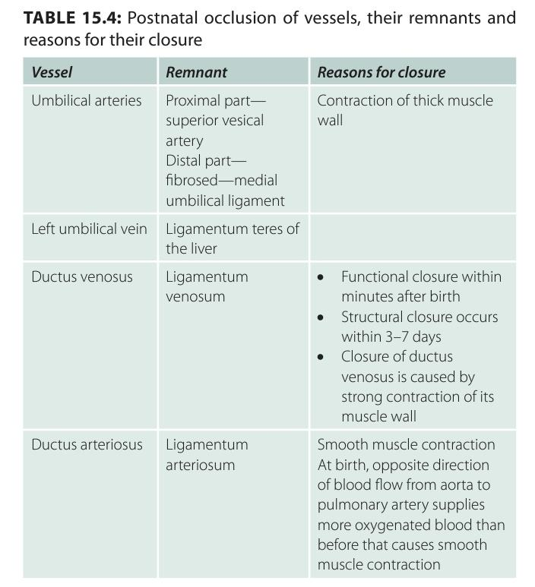

Slide 48
MCQs

Slide 50
Ligamentum teres is the reminder of
Umbilical vein
Umbilical artery
Ductus venosus
Ductus arteriosus

Slide 51
Ligamentum teres is the reminder of
Umbilical vein
Umbilical artery
Ductus venosus
Ductus arteriosus

Slide 52
Match the shunt to the destination of blood flow
Ductus venosus Aorta
Foramen ovale IVC
Ductus arteriosus Left atrium

Slide 53
Match the shunt to the destination of blood flow
Ductus venosus IVC
Foramen ovale Left atrium
Ductus arteriosus Aorta

