Slide 1
LA Thrombus
Sana Muhammed P P

Slide 2
Introduction
• LAA is an embryonic remnant of the primitive atrium originating from the posterolateral aspect of LA.
•LAA contains stretch –sensitive receptors that can influence heart rate and is an important place of natriuretic peptide secretion in response to change in atrial pressure.
• Also plays an important role in cardiac thrombogenesis and arrhythmogenesis.

Slide 3
Many thrombi originate in the LAA owing to its specific predisposing factors-multilobular structure with many trabeculations , a relatively small orifice, and turbulent blood flow , which increases the risk for cardioembolic events
The prothrombogenic properties of LAA are exponentiated by atrial tachyarrthymias.
Thrombi created within the LAA account for 91% of strokes in
non- valvular AF and 15-38% of strokes in non AF patients with a
cardiomyopathy.

Slide 6
DETERMINANTS
Various factors determine the individual risk for the development of LA clot & thromboembolization in patients with rheumatic mitral valve disease which include
▪︎Atrial fibrillation
▪︎LA size
▪︎Duration of symptoms
▪︎Older age
▪︎Severity of MS

Slide 7
However, the presence of moderate to severe MR has a –ve predictive value for the development of clot in the LA

Slide 8
CLASSIFICATION
The thrombus in the LA can be classified as:
Type I
Type Ia: LAA clot confined to appendage( most common)
Type Ib: LAA clot protruding into LA cavity

Slide 10
Type II
Type IIa: LA roof clot limited above the plane of fossa ovalis
Type IIb: LA roof clot extending below the plane of fossa ovalis

Slide 11
Type III
Layered clot over the IAS
Type IV
Mobile clot which is attached to LA free wall or roof or IAS
Type V
Ball valve thrombus (free floating)

Slide 13
DIAGNOSIS
Transesophageal Echocardiography (TEE): The gold standard for detecting LA thrombus, providing a clear image of the atria. Transthoracic Echocardiography (TTE): Non-invasive but less sensitive compared to TEE. Cardiac MRI and CT Scan: Advanced imaging techniques that can also identify thrombi. Electrocardiogram (ECG): To detect underlying arrhythmias like Afib.

Slide 14
ECHOCARDIOGRAPHy

Slide 15
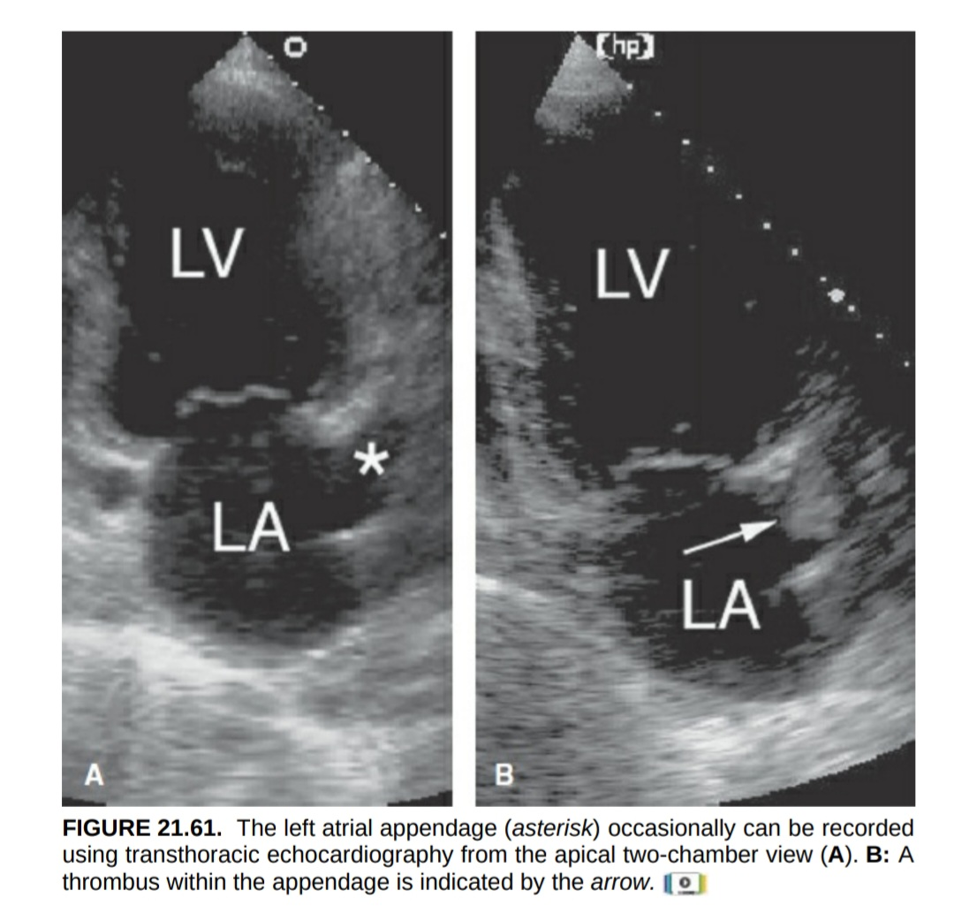

Slide 16
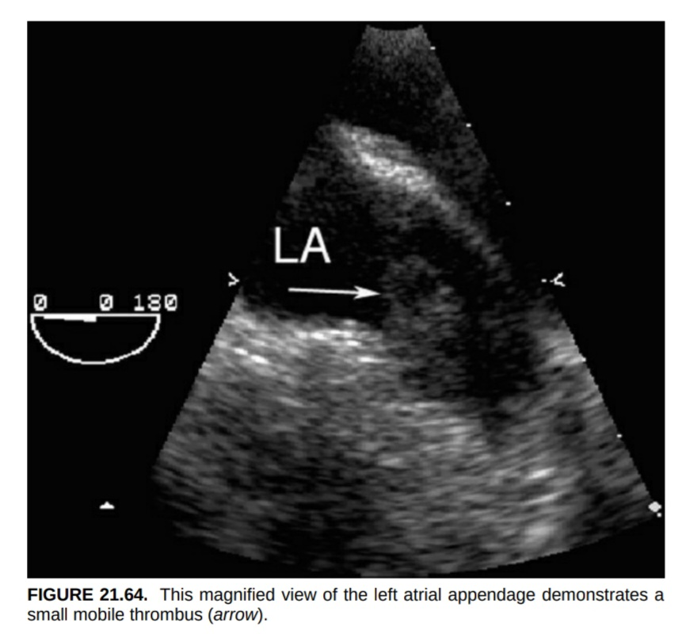

Slide 19
TREATMENT
Anticoagulation Therapy: The primary treatment to prevent clot growth and new clot formation. Warfarin: Traditional anticoagulant requiring regular blood monitoring. Direct Oral Anticoagulants (DOACs): Like rivaroxaban, apixaban, and dabigatran, often preferred due to ease of use. Thrombolytic Therapy: In selected cases, medications to dissolve the clot may be used.

Slide 20
Surgical Intervention: Rarely, surgery may be required to remove the thrombus. Left Atrial Appendage (LAA) Occlusion: A procedure to close off the LAA, where clots often form. Management of Underlying Conditions: Treating Afib, mitral stenosis, or other contributing factors.

Slide 21
MCQs
Which of the following conditions is most commonly associated with the development of LA thrombus ?
1. HTN
2. AF
3. MR
4. Pulmonary Embolism

Slide 22
Ans:
2. AF

Slide 23
Which of the following is a common complications of LA thrombus if it embolizes?
1. Stroke
2. DVT
3. Pulmonary embolism
4. Pulmonary HTN

Slide 24
Ans : 1. Stroke

Slide 25
Which of the following conditions is least likely to be associated with left atrial thrombus formation?
1. RHD
2. Hyperthyroidism
3. Dilated cardiomyopathy
4. MS

Slide 26
Ans: 2. Hyperthyroidism

Slide 27
Which is the gold standard for detecting LA thrombus, providing a clear image of the atria
1. ECG
2. Chest X-ray
3. TTE
4. TEE

Slide 28
Ans: 4. TEE

Slide 29
THANK YOU !!

