Slide 1
Catheters
Nandana S

Slide 2
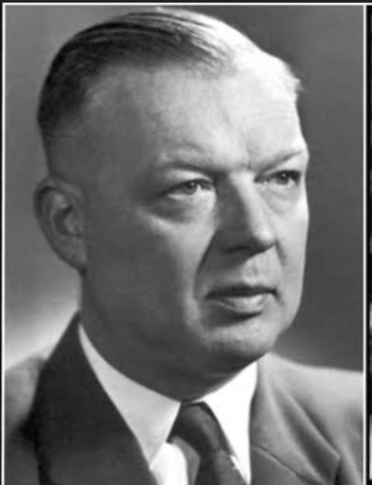
FIRST CARDIAC CATHETERIZATION
→In 1929
→Werner Forssmann
→Rubber catheter
→Through his own antecubital vein up to pulm artery.

Slide 3
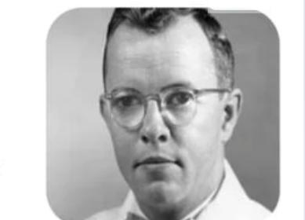
FIRST SELECTIVE CORONARY ANGIOGRAM
Was an accident
Dr.Mason Sones in 1958.
After withdrawaing a catheter after ventriculogram canulated the RCA unknowningly.
When contrast was injected for an aortogram selective opacification of RCA noted.
Designed Sones catheter and popularised the technique.
Several preformed catheter were later designed.

Slide 4
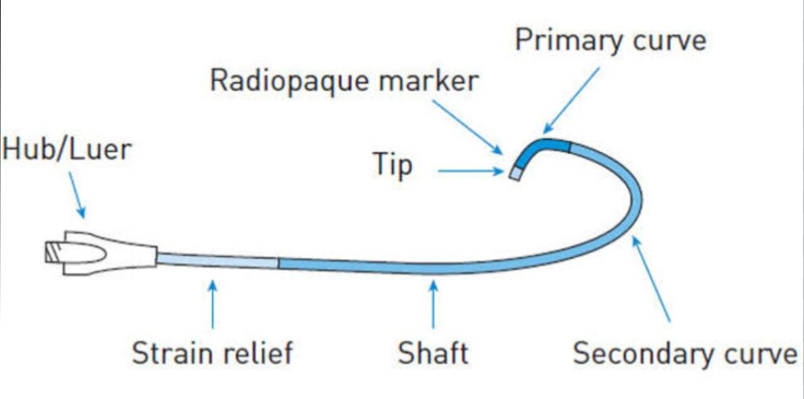
CORONARY CATHETERS
→Hollow flexible tube that can be inserted through a narrow opening into body cavity, duct or vessel to diagnose & treat heart conditions.

Slide 5
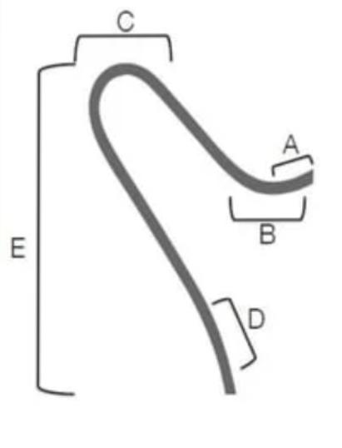
PARTS
A) TIP LENGTH-Increased length offers more stability in target vessel at the cost of maneuverability in the parent vessel. B) PRIMARY CURVE – angle of the target vessel from its parent artery.
C) SECONDARY CURVE – width of the parent vessel. D) TERTIARY CURVE-normal curvature of the parent vessel. E) CATHETER LENGTH – Usually 100 or 110 cm
F) HUB – Metal / plastic, larger than catheter, tapered hubs- easier insertion of GW.

Slide 6
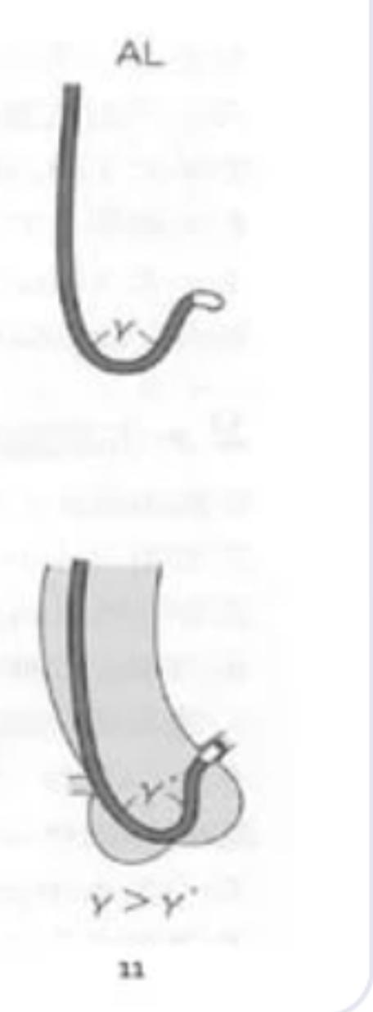
OVER BENT AND UNDER BENT CATHETERS
Over bent catheter :
Angle of catheter tip is smaller outside the body, than inside.
Shape — inside body — easy to predict
Easier to manipulate
Eg: JL
Under bent catheter :
Angle of catheter tip is larger outside the body than inside.
Difficult to manipulate.
Shape — Difficult to predict
Difficult to do deep engagement.
Eg: AL

Slide 7
BASIC FUNCTIONS OF CORONARY CATHETER
→Lead the dilating coronary catheter or device to the ostium of coronary artery or graft.
→Inject contrast agent.
→To provide backup support to pass coronary balloon/stent into coronary artery against resistance and across target stenosis.
→To monitor systemic arterial pressure.

Slide 8
IDEAL CHARACTERISTICS OF CATHETER
1)Better torque control
Increase outer diameter
Reinforced construction
2) Pushability
Increase outer diameter
Stiffer material
Decreasing overall part length
3) Flexibility
Decrease outer diameter
Material with less modulus of elasticity
Increasing overall part length
4) Trackability
5) Radiopacity
6) Atraumatic tip
7) Kink resistance
8) Low surface frictional resistance

Slide 9
WALL THICKNESS
Thick walled
Better pushability and torque transmission Accentuates pressure waveform-systolic overshoot & diastolic dips. ■Thin walled_ Improves monitoring, blood sampling & flushing abilities, decrease thrombogenicity. Disadvantage – less torque control, not suitable for high pressure injection.

Slide 10
CATHETER MATERIALS
Angiographic catheters are made from synthetic and semi synthetic polymers.
1)Dacron
2) Nylon
3) PVC
4) Poly ethylene.
5) Fluropolymers
6) Polyurethane
7) Silicon - most common choice;inactive to body fluids.
→ Radiopacity by Incorporating Ba, Bi, Ir

Slide 11
DACRON
■ Very maneuverable & flexible. ■ Covered by polyurethane coating – reduce vascular trauma.
Some have Nylon core-increase bursting pressure
Nylon-great mechanical & physical strength, reduced friction coefficient – achieve high flow rate of fluids Eg- NIH Catheter, Original Sones Catheter.

Slide 12
POLYURETHANE ■ Excellent memory ■ Softer than polyethylene or Teflon – Less vascular trauma ■ Increased thrombogenicity ■ Reshaped if immersed in boling water. ■ Eg-pigtail angiographic (cordis) catheters & original judkins catheters.

Slide 13
POLYETHYLENE
■Stiffness inbetween Polyurethane & Teflon. ■More Thrombogenic than PVC, polyurethane ■Heat Mouldablity good Eg-pigtail angiographic catheters, judkins catheters

Slide 14
POLYVINYL CHLORIDE
■Softest & flexible among all ■High friction coefficient- spasm ■Increased thrombogenicity. ■Very poor tensile strength (memory) ■Cant be reformed. ■Most hydrophilic. ■Drugs absorbed- NTG, insulin, diazepam, thiopentone. ■Eg-Balloon-tip flow directed catheters.

Slide 15
TEFLON Stiffest- no suitable for selective catheters ■Poor memory. ■Low friction coefficient. ■Eg-Brockenbrough catheters, transducer-tip catheters & introducer sheaths.

Slide 16
SIDE HOLE
→Useful where pressure gets frequently damped as in RCA interventions, CTO interventions or sole surviving artery or LM interventions.
Advantages
→ Prevent catheter damping.
→Allow additional blood flow out of the tip to perfuse the artery.
→Avoid catastrophic dissections in the ostium of artery.
Disadvantages
→False sense of security (Ao pressure ;not the coronary pressure is being monitored).
→Suboptimal opacification.
→Reduction of backup support.
→Kinking at SH.

Slide 17
BACKUP SUPPORT
→Ability of GC to remain in position & provide a stable platform for the advancement of interventional equipment.
→3 major types of backup support :
I) Passive
II) Active
III) Balanced
I)Passive support
→Strong support given by inherent design of catheter with good backup against opp. Ao. wall.
→Additional manipulation is generally not required.

Slide 18
II) Active support
→Typically achieved by
a) manipulation of guide
b) deep seating :intubation with deep engagement of the guide in to coronary artery.
III) Balanced support
→Rely on the inherent property of shaft and shape for coaxiality ;can be manipulated when extra support is required.

Slide 19
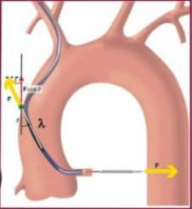
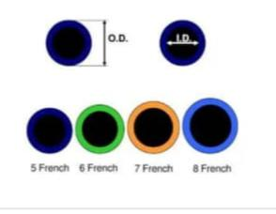
Determinants of backup support
→3 factors :
1) Catheter size
2) Angle θ of the catheter on the reverse side of aorta.
3) Contact area.
→If θ is larger/close to 90°, backup force will be greater.
CATHETER SIZE
→Catheters are named by their Outer diameter in French.
→ 1 Fr = 0.33mm
→ 5 – 10 Fr available
→ Internal diameter is represented in inches.
→Length in cm – 80,100,110cm(125 for very tall)

Slide 20
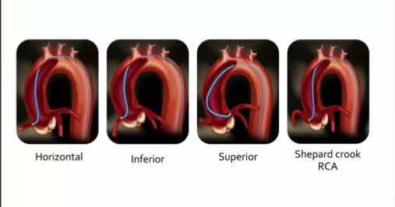
CORONARY ANATOMY VARIATIONS
→Coronary ostial location:
i) High
ii) Low
iii) Anterior
iv) Posterior
→Coronary ostial orientation:
i) Superior
ii) Horizontal
iii) Inferior
iv) Shepherd crook RCA

Slide 21
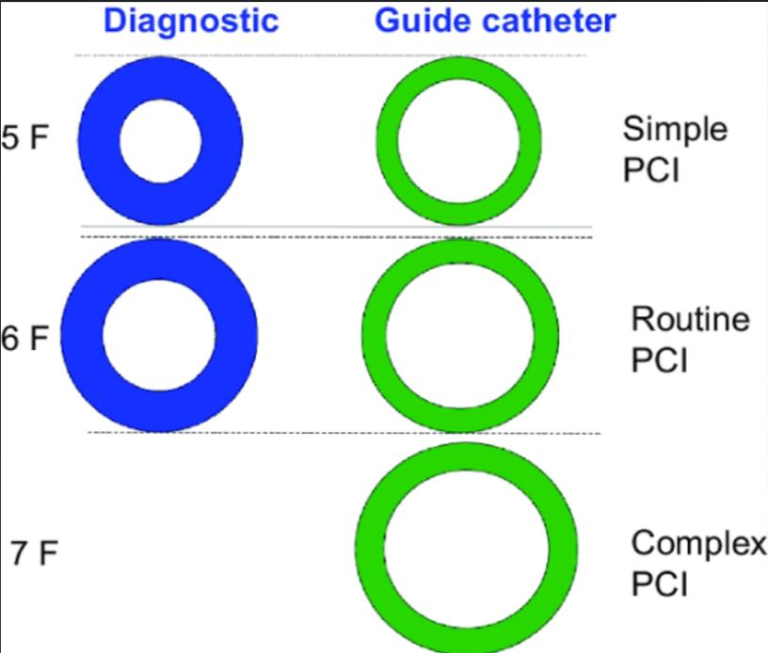
DIAGNOSTIC VS GUIDE CATHETERS
Diagnostic catheters | Guiding catheters
Thicker shaft | Thinner shaft
2. Smaller internal diameter | 2. Larger internal diameter
3. Tapering tip | 3. Non tapering tip
4. 2 layered construction | 4. 3 layered construction

Slide 22
DIAGNOSTIC CATHETERS
→Used to investigate & evaluate patients with suspected/known CAD.
→2layered construction;
i)outer layer(thick) –non thrombogenic &lubricious
ii) inner layer (thick) - lubricious
→Length
•Right heart catheters – 100 to 125 cm
•Left heart catheters – 100 to 110 cm
•125 cm for very tall patients.

Slide 23
GUIDING CATHETERS
→GCs are primarily used to deliver interventional equipments (GW, balloon, stent) during coronary intervention.
→3 layered construction;
i)outer layer – lubricious & non thrombogenic.
ii) middle layer – braided (eg:stainless steel)
iii) inner layer – lubricious (eg:teflon)

Slide 24
Angiographic catheters Preformed coronary
Right heart catheter
Cournand Lehman Goodale-lubin Swan- Ganz | Gensini NIH Eppendorf Pigtail
Judkins Amplatz Schoonmaker MP EBU Coronary bypass catheter Sones

Slide 25
→LMCA – JL, AL
→RCA – JR, AR, 3DRC
→Graft & IMA – IMA, RCB, LCB
→Universal – MP, Sones, Castillo
→Universal radial – Tiger, Jackey, Kimney
→Long tip catheters – Voda, XB, EBU

Slide 26
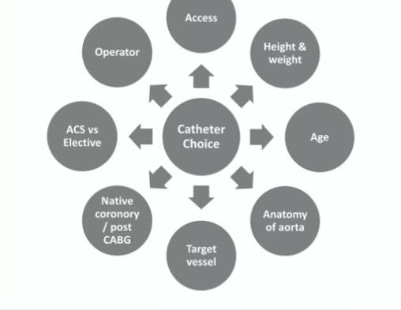
Catheter choice and size selection

Slide 27
LARGE GC | SMALL GC
I) High bleeding risk | I) Lower bleeding risk
II) Greater coronary opacification | II) Less coronary opacification
III) More passive support | III) Less passive support
IV) More complex PCI possible | IV) Less complex PCI possible
V) Better torque transmission | V) Poorer torque transmission

Slide 28
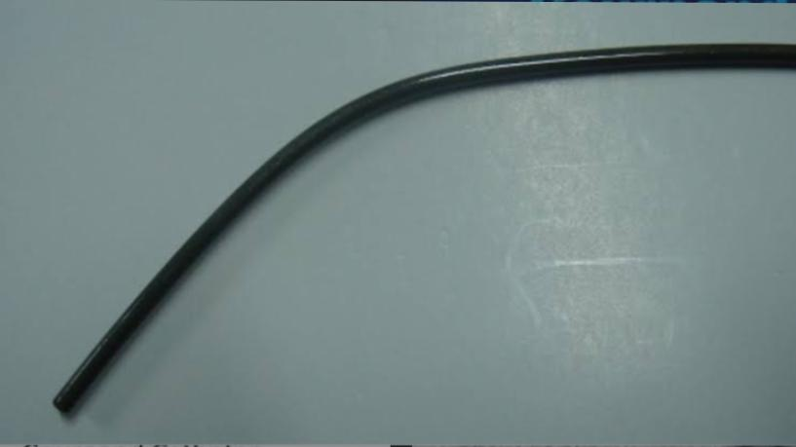
COURNAND CATHETER
→ Designer – Andre Cournand in 1939
→ End hole, no side hole
→Radio opaque Dacron catheter with outer coating of polyurethane.
→Construction – very gradual distal curve, tapered tip.
→Use – all purpose right heart catheter.
- wedge pressure measurements (no side holes)
→Size 5 to 8 Fr ; length 100& 125cm

Slide 29
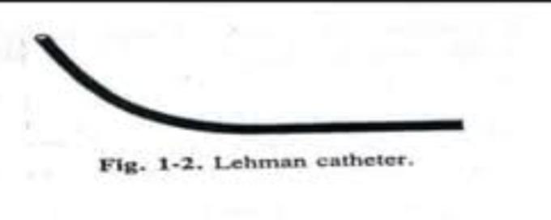
LEHMAN CATHETER
→Thin wall variation of Cournand.
→Ventriculography catheter.
→Multiple SH.
→Tapering tip.
→Short distal curve, increased inner diameter and decreased stiffness.
→Size – 4 to 9 Fr ; length – 50,80,100&125cm

Slide 30
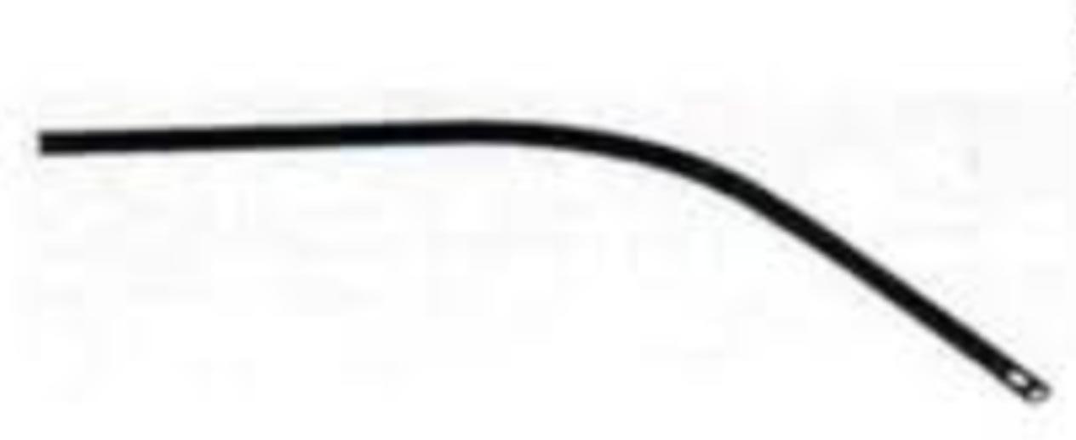
GOODALE LUBIN CATHETER
→ Bird’s eye catheter.
→Construction – Woven Dacron coated with polyurethane.
→Hole – 2 laterally opposed SH near the end hole.
→Use – right heart pressure, including wedge & sampling.
→Size – 4 to 8 Fr ; length – 80,100&125cm
→Variation – standard wall – Cournand
thin wall - Lehman

Slide 31
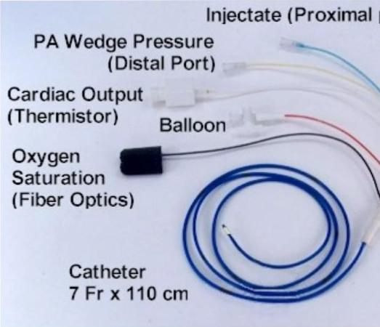
Swan- Ganz catheter
Also known as pulmonary artery catheter.
Swan & Ganz in 1970
4 -5 lumens.
Traditionally has 4 ports. – Proximal port (Blue)= used to measure CVP/RAP and injection port for measurement of cardiac output.
– Distal port (Yellow)= used to measure PAP.
– Balloon port (Red) = used to determine PAWP (special 1.5cc
s. syringe connected).
- Infusion port (White)= used for fluid infusions.
Near the tip is a balloon that can be inflated and thermister to measure temperature.
Gives information about ventricular preload, after load and cardiac output.
Can be positioned using either fluoroscopy or pressure monitor.

Slide 32
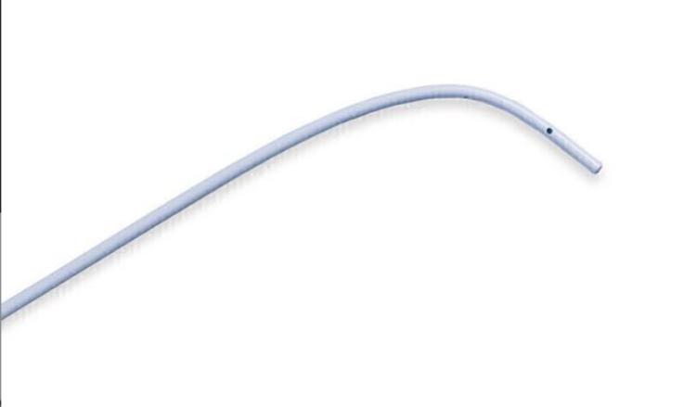
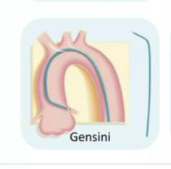
GENSINI CATHETER
→Construction – woven Dacron coated with polyurethane.
→Hole – 3 laterally opposed oval SH within 1.5cm of it’s open tip.
→Use – right or left heart, pulmonary & vena cava angiography studies.
→Size – 5 to 8 Fr ; lenth – 80,100&125cm.
→Disadvantage – more arrhythmogenic.
→Catheter recoil during injection @high flow rates.
→Risk of intramyocardial & myocardial injection.

Slide 33
NIH CATHETER
→Side hole catheter without end hole.
→Construction – USCI version – woven Dacron with nylon reinforcement & is specially stiff.
→ Has 4-6 SH.
→ Use – visualizing RV, LV, arterial, pulmonary vasculature.
→Size – USCI : 5 to 8 Fr ; length – 50,80,100&125cm
- COOK 6.5,7.3,8.2 Fr ; length – all 100cm
→Disadvantage – perforation

Slide 34
EPPENDORF CATHETER
→Construction – wave dacron coated with polyurethane ; area 20cm prox to hub is reinforced with nylon.
→Hole – closed end, 6 SH (laterally opposed) with gentle curve.
→Use – visualising LV, RV, arterial, pulmonary vasculature,
great veins.
→Size – 7 to 8 Fr ; length – 100&125 cm.
→Features – less stiff & more torque control.
Eppendorf Catheter

Slide 35
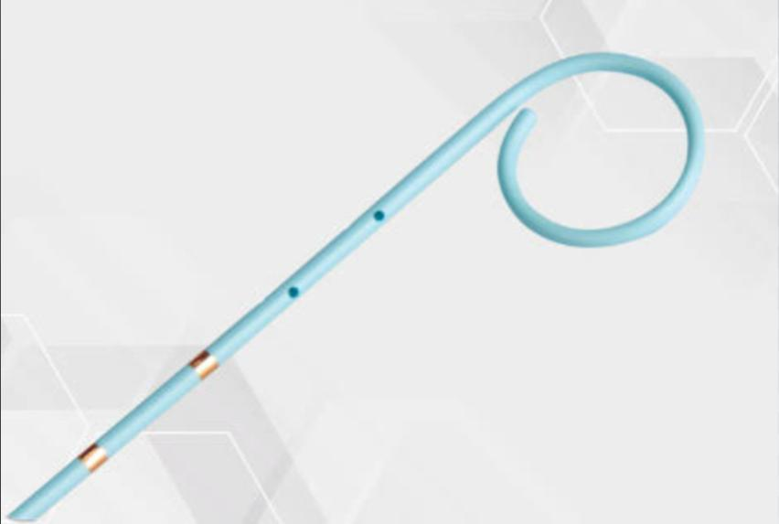
PIGTAIL CATHETER
→Designer – Judkins
→Construction – Woven Dacron coated with
polyurethane or polyethylene.
→Terminal 5cm coiled in a tight loop(pigtail)
→Open/closed end
→4-12 non laterally opposed side holes located in the terminal 5 cm
→Use – most commonly for LV, RV angiography, aortography & pulmonary angiography.
→Size – 3 to 7 Fr ; length – 65,80,100&110cm
→Advantage – atraumatic, less incidences of arrhythmia
→Disadvantages- thrombogenecity, not suitable for prolonged hemodynamic monitoring.

Slide 36
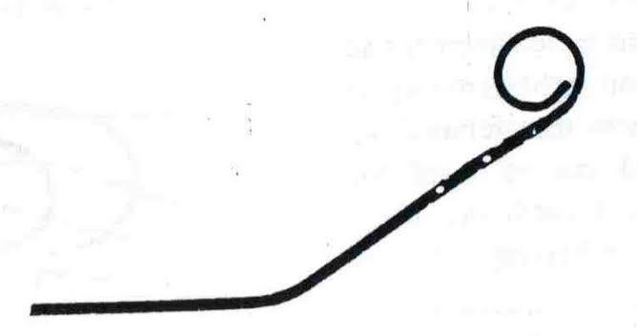
TYPES OF PIGTAIL CATHETER
Cardiomarker pigtail catheter
Van tassel angled pigtail catheter

Slide 37
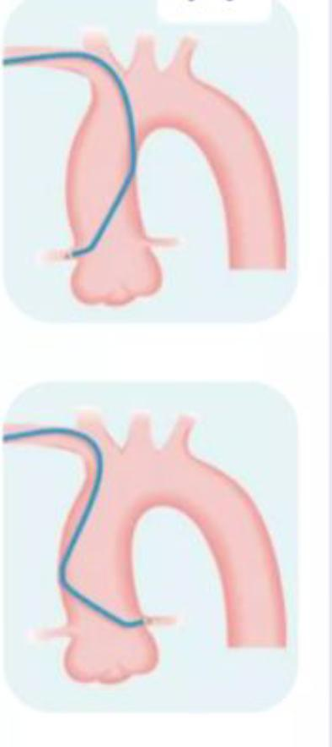
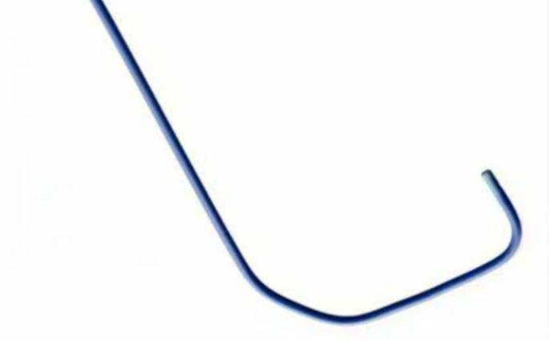
TIGER CATHETER
→Universal radial catheter.
→Enables angiography of both LMCA&RCA with one catheter that enables;
•elimination of catheter exchange step.
•shorten procedure &fluroscopic time.
•lower cost per procedure.
→2 curves –primary & secondary.
→High flexibility.
→Atraumatic tip.
→Hole – 1 end hole & 1 SH
→Length – 100cm

Slide 38
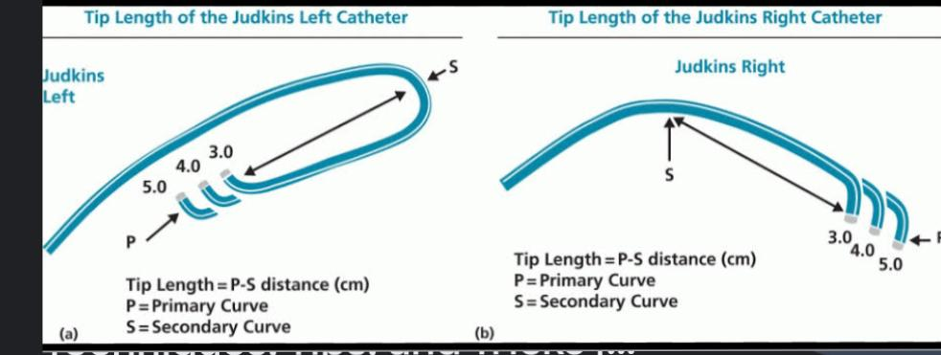
JUDKINS CATHETER
→Designer – Melvin Paul Judkins.
→Construction – polyethylene.
→Preshaped 1°, 2°&3° curves which determines
size of the catheter. (3, 3.5,4.4.5).
→Holes – one end hole & with or w/o SH.
→Size – 4 to 8 Fr ; length – commonly 100cm,
125cm for tall pts.
→2types – JL &JR
→Selected according to –
i)width of Ao.
ii) location of ostium to be cannulated.
→Disadvantage - ↑ed chance of prolapse & dislodgement.
extremely poor support.

Slide 39
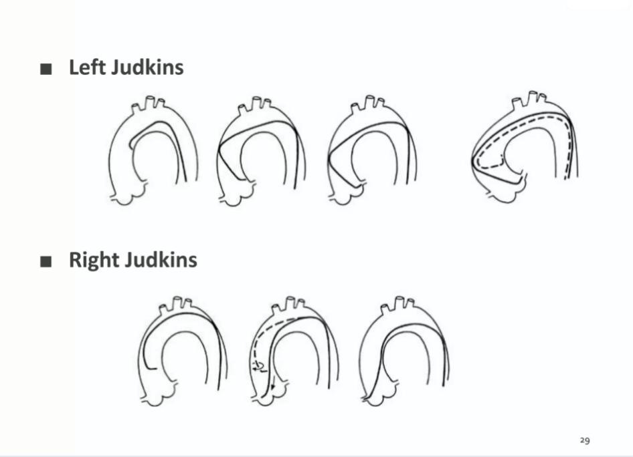
ENGAGEMENT

Slide 40
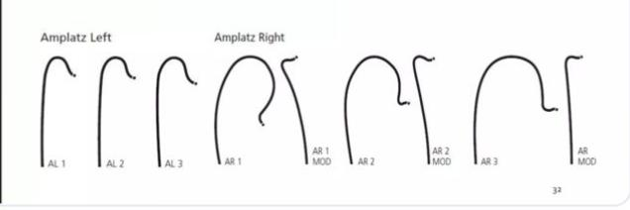
AMPLATZ CATHETER
■Original catheter by Kurt Amplatz
■Austrian Radiologist in 1967 ■Right and Left comes in 3 sizes usually - 1,2,3 with increasing curvature.
■Best in case of short LM with down going LCX.
■Adv – provide good back up support
■Dis adv – increased chance of dissection due to downward tip.
■Use – best choice for calcified lesions, CTO.

Slide 41
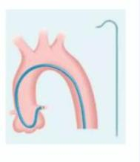
AMPLATZ LEFT
■. Coronory ostia out of conventional judkins Like high and posterior origin
It can selectively canulate LAD or LCX if short left main stem
Separate origins of left anterior descending and left circumflex coronary arteries.
High anterior right coronary arteries (RCAs) or Shepherd’s Crook RCA.

Slide 42
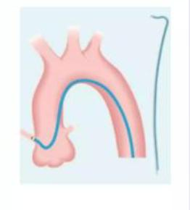
AMPLATZ RIGHT
■Amplatz right coronary catheter can be used to cannulate right coronary arteries with abnormal, usually, an inferior origin or high anterior.

Slide 43
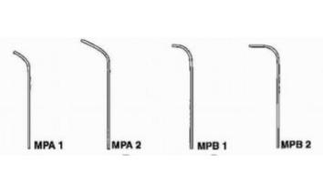
SCHOONMAKER MULTIPURPOSE
→Designer – Dr. Fred W Schoonmaker
→Construction – polyurethane with inner wire braid.
→•MPA – bent hockey stick with straight tip;120° curve
•A -2 MP – 2 SH &1 end hole
• MPB – bent gradual 90° curve
•B-1 MP – 1 end hole
•B -2 MP – 2 SH, 1 end hole
→Use – CAG
PDA & MAPCA coiling
→Size – 6-8 Fr

Slide 44
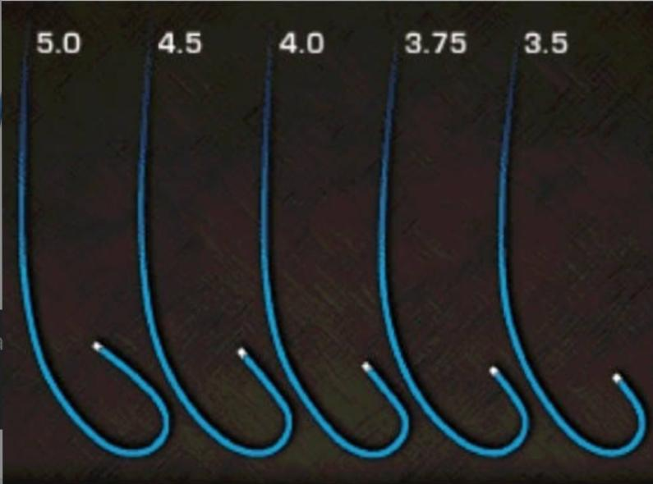
EXTRA BACKUP CATHETER (EBU)
→Designed for LMCA cannulation.
→1°& long 2° curve
→Long 2° curve provide stable platform.
→Coaxial alignment.
→Nylon shaft
→Size – 6 to 8 Fr; length – usually 100cm.

Slide 45
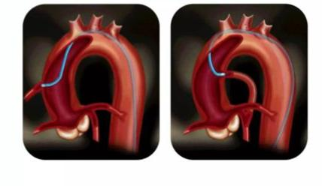
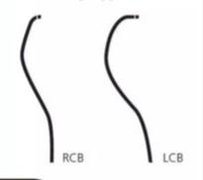
Bypass Catheter
■RCB Resembles JR4 with a tip curved >90 degree.
■LCB Primary curve similar to JR4 (90 degree) but secondary curve more acute (70 degree)

Slide 46
POST CABG
LIMA & RIMA ■Normal-IM, JR4 ■Origin from vertical portion of subclavian artery - JR4 ■If Both LIMA and RIMA is to be canulated - JR4 – can avoid catheter exchange
∆ If radial, left radial approach is more suitable in patients with LIMA graft

Slide 47
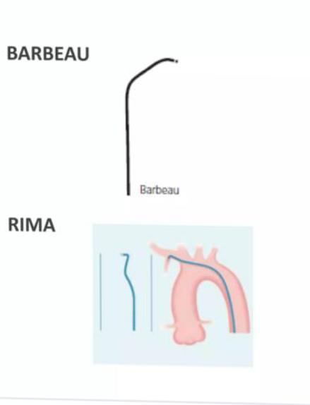
OTHER CATHETER FOR IMA

Slide 48
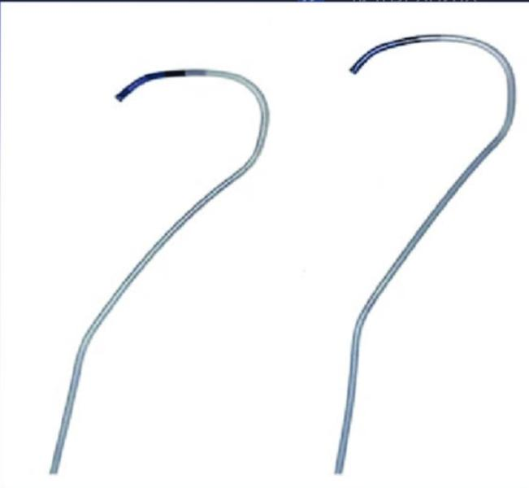
IKARI CATHETER
→Modified JL catheter
→Radial catheter
→Curve proximally to overcome resistance @ subclavian artery.
→Shorter secondary curve.
→Longer straight portion for more support.
→Coaxial alignment.
☆ When IL GC is pushed along the GW, it allows the catheter to sit in appr. Angle for optimal engagement w/o vessel trauma. It is known as power position of IL.

Slide 49
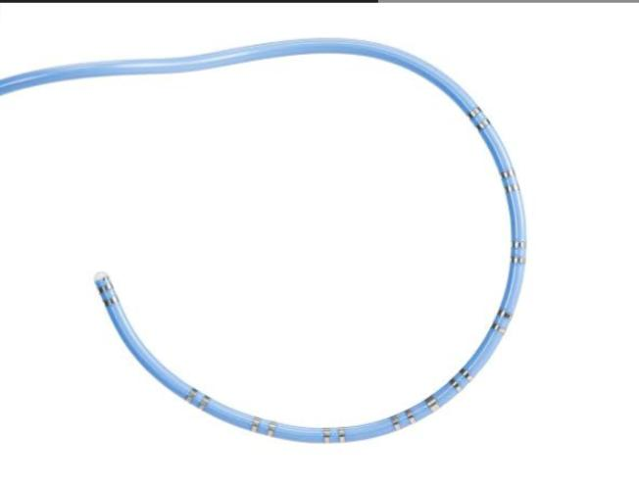
HALO CATHETER
→ Novel 5F catheter
→Perpendicular helical tip which is inwardly and upwardly directed.
→SH located on helix.
→Excellent for measuring distal LV chamber pressure in HCM.

Slide 50
One Fr in mm:
a)0.03mm
b) 0.33mm
c) 3.3mm

Slide 51
2) Which catheter is aka bird’s eye catheter?
a) Gensini
b) Eppendorf
c) Goodale – lubin

Slide 52
3) Catheter without sidehole:
a) Goodale –lubin
b) Gensini
c) NIH
d) Cournand

Slide 53
4) All are Right heart Catheters except:
a) Swan-Ganz
b) Lehman
c) Eppendorf
d) Goodale- Loobin

Slide 54
THANK YOU

