Slide 1
Gp IIb/iiia inhibitors
Akhina C S

Slide 2
GP IIb/IIIa RECEPTORS
• It is an integrin complex on platelet-surface. • Aka integrin αllbβ3
•This dimeric glycoprotein is a receptor for fibrinogen and von Willebrand factor. • It aids in platelet activation and aggregation

Slide 3
Inhibitors ➤ Inhibition of binding to GP IIb/IIIa receptor blocks platelet aggregation induced by any agonist. ➤ GP IIb/IIIa inhibitors are a class of antiplatelet agents that inhibit the glycoprotein IIb/IIIa receptor on platelets
→Prevent platelet aggregation by blocking fibrinogen binding

Slide 5
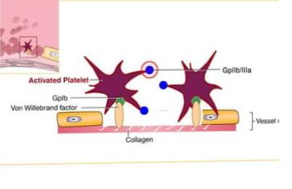
GP IIb/IIIa-receptor antagonists – Mechanism of action
• The glycoprotein llb/IIIa receptor is
exposed on the platelet membrane
after activation and is responsible
for mediating platelet aggregation.

Slide 6
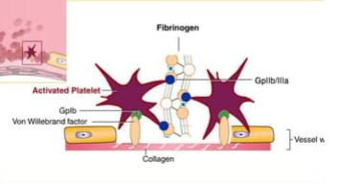
GP llb/Illa-receptor antagonists – Mechanism of action • Once activated, the receptor becomes functional and
binds fibrinogen, leading to the formation of platelet aggregates.
• Glycoprotein Ilb/Illa receptors therefore
mediate the final common pathway of
platelet aggregation.

Slide 7
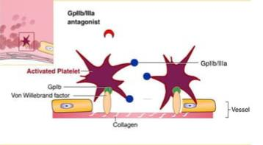
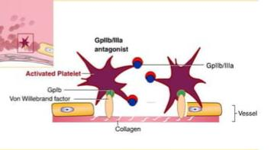
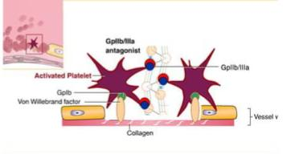
GP llb/Illa-receptor antagonists – Mechanism of action • GPIIb/Illa antagonists hava a high
affinity for the fibrinogen receptor &
when binding is completed, they will
prevent fibrinogen from binding to
receptors.
1
2
3

Slide 8
BENEFITS OF IIb/IIIa INHIBITORS I) Reduce risk of myocardial infarction and death in ACS patients ii) Prevent platelet aggregation during PCI iii) Improve outcomes in patients with unstable angina

Slide 9
ABCIXIMAB
Monoclonal antibody, more potent &longer acting compared to others
GP IIb/IIIa inhibitor →no platelet aggregation→no blood coagulation
Irreversible
INDICATIONS
ACS
PCI
CONTRAINDICATIONS
Active bleeding
Severe hypertension
Recent surgery/trauma

Slide 10
(ABCIXIMAB CONT..)
Administration
0.25mg/kg IV bolus administered 10-60 minutes before start of PCI followed by cont. IV infusion of 0.125mg/kg/min for 12 hrs
Adverse effects
Bleeding
Thrombocytopenia
Allergic reactions
Expensive

Slide 11
EPTIFIBATIDE •Eptifibatide is an antiplatelet drug of the GP IIb/Illa inhibitor class. •Derived from a protein found in the venom of the southeastern pygmy rattlesnake (Sistrurus miliarius barbouri). • Eptifibatide (INTEGRILIN) is a cyclic peptide inhibitor of the fibrinogen binding site on αIIbβ3 (integrin) • It is administered intravenously
•Reversible

Slide 12
Indications
i)Acute coronary syndromes
ii) Unstable angina
iii) Myocardial Infarction
iv) Percutaneous coronary intervention (PCI)
Administration
Bolus of 180 µg/kg followed by 2 µg/kg/min for up to 96 hours. • The duration of action of the drug is relatively short, and platelet aggregation is restored within 6-12 hours after cessation
•Generally administered together with aspirin or clopidogrel and heparin.

Slide 13
A/E
Bleeding
Thrombocytopenia
Renal insufficiency

Slide 14
TIROFIBAN
Belongs to a class of antiplatelet – GP Iib/Illa inhibitors
It is a modified version of an anticoagulant found in the venom of the saw-scaled viper Echis carinatus
Tirofiban (AGGRASTAT) is a nonpeptide
Has short duration of action
Reversible
INDICATIONS
ACS
MI
PCI
UA

Slide 15
Administration
Intravenously at an initial rate of 0.4µg/kg/min for 30 minutes, and then continued at 0.1 mg/kg/min for 12- 24 hours after angioplasty or atherectomy
Generally administered along with aspirin & heparin.
A/E
Bleeding
Thrombocytopenia
Anemia
Hypotension
Nausea

Slide 16
TRIALS OF ORAL IIb/IIIa INHIBITION IN ACS
i) The evaluation of oral xemilofiban in controlling thrombolic events(EXCITE).
ii) Orbofiban in patients with unstable coronary syndromes. Thrombosis in myocardial infarction (OPUS-TIMI).
III) Sibrafiban vs aspirin to yield maximum protection from Ischemic heart events post ACS(SYMPHONY).
IV) 2nd SYMPHONY.
V) Blockade of GP IIb, IIIa receptor to avoid vascular occlusion (BRAVO).
Instead of reducing major ischemic events, long-term oral GP IIb/IIIa inhibitor therapy has uniformly increased fatality rate.

Slide 17
TRIALS OF IV GP IIb/Illa INHIBITION IN ACS
1) The platelet receptor inhibition in Ischemic syndrome management (PRISM). 2)The patient Receptor Inhibition in Ischemic Syndrome Management in Patients Limited by Unstable Signs & Symptoms (PRISM PLUS) 3) Platelet lIb/llIa Antagonism for the Reduction of Acute Coronary Syndrome events in Global Organization Network A (PARAGON A) 4) Platelet IIb/IlIa Antagonism for the Reduction of Acute Coronary Syndrome events in Global Organization Network B (PARAGON B)

Slide 18
5) Platelet glycoprotein Ilb/lla in Unstable angina: Receptor Suppression Using Integrelin Therapy (PURSUIT). 6)The Global Utilization of Streptokinase & Tissue plasminogen activator for Occluded coronary artery – IV (GUSTO – IV). ■Outcomes of these trials have been positive. ■Reduced ischemic events seen after PCI.

Slide 19
MCQs
Find the odd one out :
a) Eptifibatide
b) Tirofiban
c) Roxifiban
d) Abciximab

Slide 20
Ans : c) Roxifiban

Slide 21
2)Find the false statement:
a) Abciximab is a monoclonal antibody
b) Tirofiban is a peptide
c) Abciximab is irreversible
d) Eptifibatide is a peptide

Slide 22
Ans : b) Tirofiban is a peptide;it’s a nonpeptide

Slide 23
3) GP IIb/IIIa Inhibitors are also known as...
a) Integrin αIIaβ3
b) Integrin αIIbβ3
c) Integrin αIIIbβ2

Slide 24
Ans : b) Integrin αIIbβ3

Slide 25
Thank you

