Slide 1
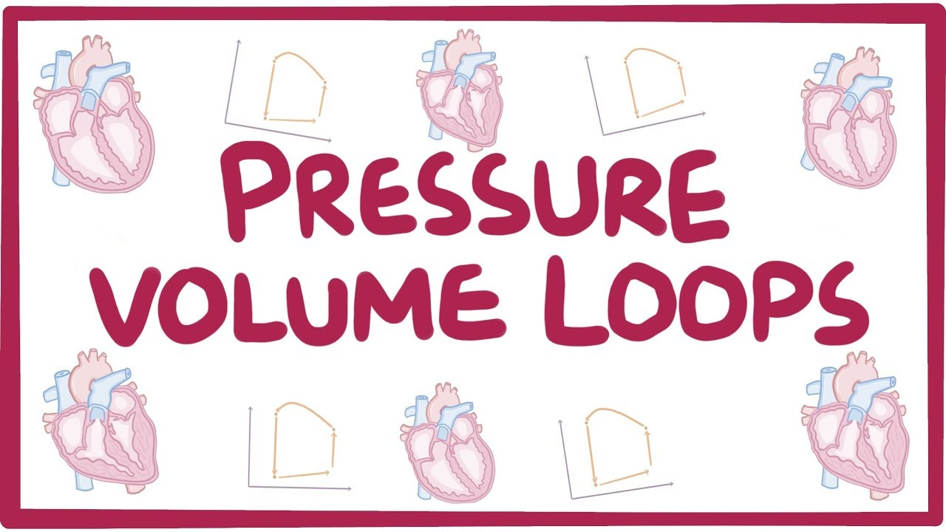
Dr Arun Jude Alphonse
DM Cardiology Resident
Govt TDMC Alappuzha

Slide 2
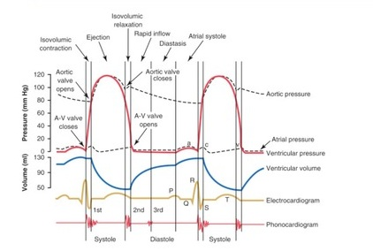

Slide 3
Pressure-volume (PV) loops are derived from pressure and volume information found in the cardiac cycle
Sequentially plot pressure and volume at all
time points in the cardiac cycle

Slide 4
No time in this plot
Distance between two points not proportional to time
Area within the work diagram represents the
pressure/volume work achieved by the left
ventricle during systole
Smaller portion of work is attributable to
passive elastic recoil of the ventricle
Area below the work diagram
Diastolic work by the heart

Slide 5
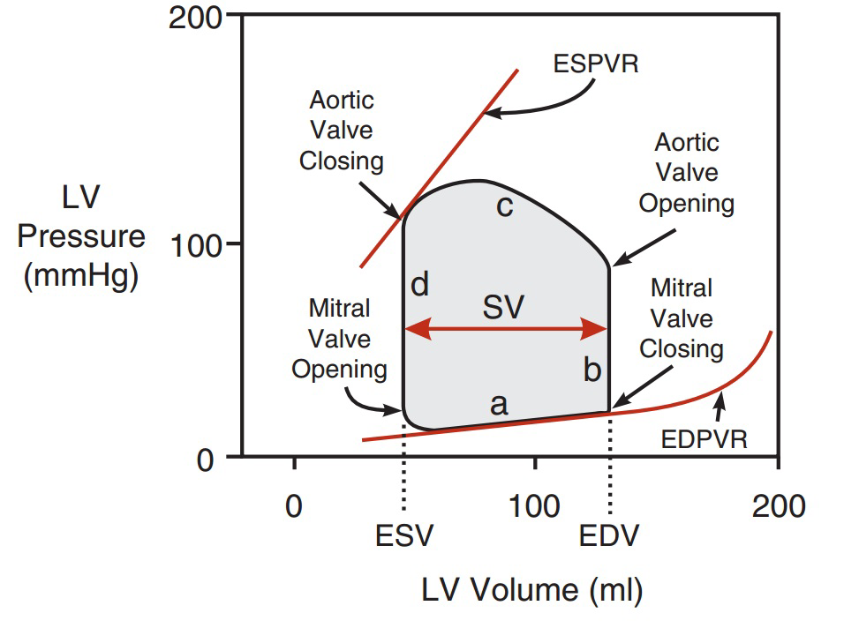

Slide 6
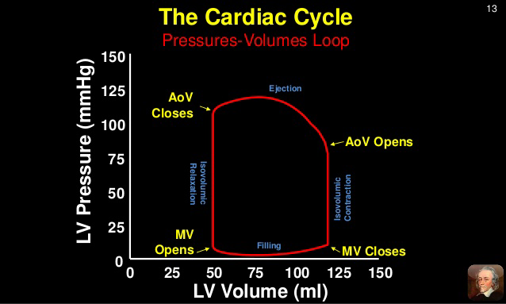

Slide 7
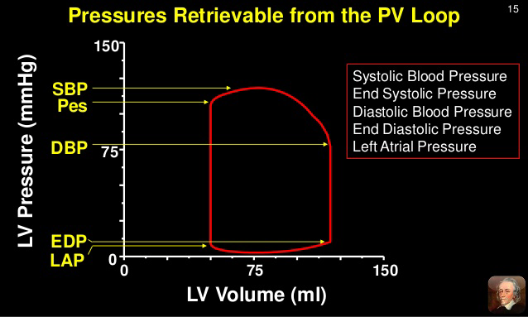

Slide 8

Filling phase moves along the end-diastolic
pressure–volume relationship(EDPVR) or
resting tension curve for the ventricle
Slope of the EDPVR is reciprocal of ventricular
Compliance
Maximal pressure that can be developed by the
ventricle at any given left ventricular volume is
described by the end-systolic pressure–volume
relationship(ESPVR)

Slide 9
PV loop in various conditions
Effect of preload ,afterload, inotropy
Heart failure
Aortic valve disease
Mitral valve disease

Slide 10
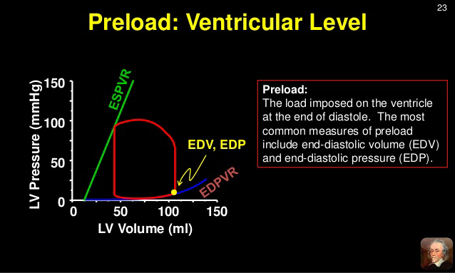
Preload – force that stretches the ventricular wall during diastole(EDV/EDP)

Slide 11
An increase in preload -leads to an increase in stroke volume (width of loop) because of the Frank-Starling mechanism. If afterload and inotropy do not change, then the end-systolic volume will not change and the heart simply ejects all the extra blood that filled it.
However, increased stroke volume leads to an increase in cardiac output and arterial pressure; therefore, the afterload on the ventricle increases. This partially offsets the increased stroke volume by increasing the end-systolic volume. The reason for this is that the increased afterload reduces the velocity of fiber shortening and therefore the ejection velocity
A decrease in preload reduces stroke volume, but this reduction is partially offset by the decreased afterload (reduced aortic pressure) so that the end-systolic volume decreases slightly.

Slide 12
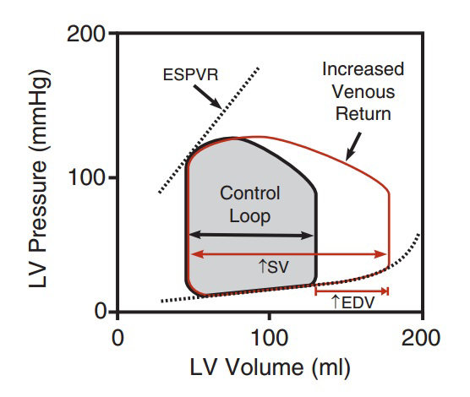

Slide 13
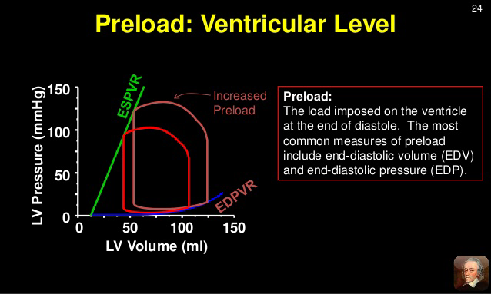

Slide 14
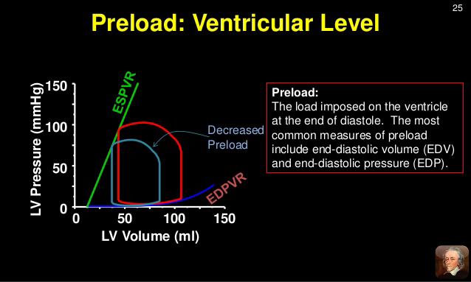

Slide 15
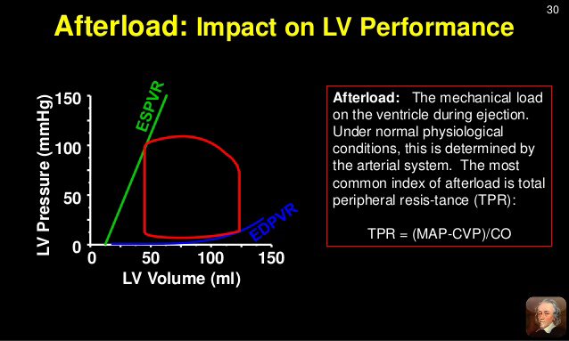
Afterload – load against which myocardial fibres shorten during systole

Slide 16
If afterload is increased the stroke volume is reduced and the endsystolic
volume increased. The increased end-systolic volume, however, leads to a
secondary increase in end-diastolic volume because more blood is left inside the
ventricle following ejection and this extra blood is added to the venous return, thereby
increasing ventricular filling. This secondary increase in preload enables the ventricle to contract with greater force (Frank-Starling mechanism), which partially offsets the
reduction in stroke volume caused by the initial increase in afterload.
In a normal heart,-changes in aortic pressure have relatively little affect on stroke volume.
However, in heart failure patients in which the end-diastolic volume is already maximal,
an increase in aortic pressure may lead to a significant reduction in stroke volume.
If afterload (aortic pressure) is reduced (green loop in figure), the opposite changes
occur - stroke volume increases due to the decrease in end-systolic volume,
accompanied by a smaller reduction in end-diastolic volume.- basis for giving
an arterial dilator to enhance cardiac output in heart failure patients.

Slide 17
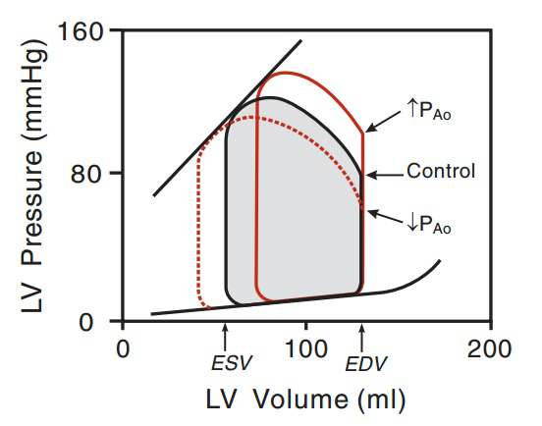

Slide 18
Inotropy
Increased inotropy ( increases the slope and shifts the end-systolic pressure-volume relationship (ESPVR) to the left, which permits the ventricle to generate more pressure at a given LV volume.
Increased inotropy also increases the rate of pressure development and ejection velocity, which increases stroke volume and ejection fraction, and decreases end-systolic volume
With less blood remaining in the ventricle after ejection, the ventricle fills to a smaller end-diastolic volume during diastole
Increased cardiac output and arterial pressure increases ventricular afterload, which independently would increase endsystolic volume; however, the response to increased afterload is overshadowed by the inotropic effects on end-systolic volume and stroke volume.
A patient in acute heart failure due to a loss of inotropy may be given a positive inotropic drug to increase stroke volume and to reduce ventricular preload, both of with are beneficial. Decreasing inotropy has the opposite effects - increases end-systolic volume and decreases stroke volume and ejection fraction, accompanied by a small secondary increase in end-diastolic volume.

Slide 19
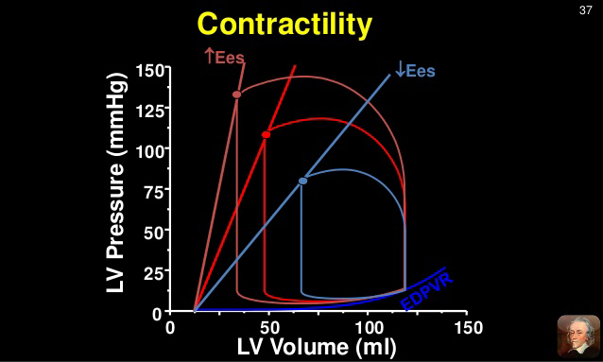

Slide 20
Exercise
During moderate, upright, whole body exercise (e.g., running, bicycling)-
increased venous return to the heart by the muscle and respiratory pump systems - small increase in end-diastolic volume
If heart rate increases to very high rates, reduced diastolic filling time can reduce enddiastolic volume.
Sympathetic activation of the heart increases ventricular inotropy,
which decreases end-systolic volume.
The increased inotropy accompanied by enhanced venous return leads to an increase in stroke volume and ejection fraction,
.
The increase in arterial pressure (increased ventricular afterload) that normally occurs during exercise tends to diminish the reduction in end-systolic volume;
However, the large increase in inotropy is the dominate factor affecting end-systolic volume and
stroke volume.

Slide 21
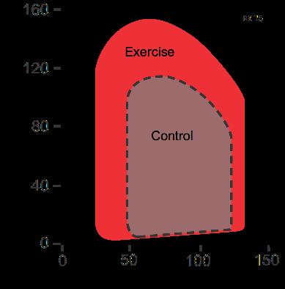

Slide 22
HFrEF
Impaired ventricular contraction (loss of inotropy)
Decreases the slope of the end-systolic pressure–volume relationship-leads to increased ESV
Secondary increase in end-diastolic volume. The rise in preload is a compensatory response that activates the Frank-Starling mechanism to help maintain stroke volume despite the loss of inotropy. If preload did not rise, the decline in stroke volume would be even greater for a given loss of inotropy
Net effect is that stroke volume and ejection fraction decrease
In Chronic systolic failure, the ventricle anatomically remodels by dilating further increasing the EDV

Slide 23
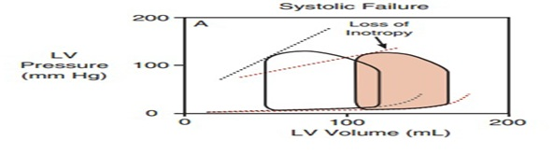

Slide 24
HFpEF
Increases the slope of the end-diastolic pressure–volume relationship due to reducedventricular compliance
Reduced the end-diastolic volume and
increases end-diastolic pressure
End-systolic volume may decrease slightly as a result of reduced afterload – reducing afterload further may further reduce EDV and SV
Net effect is reduced stroke volume
Ejection fraction may or may not change

Slide 25
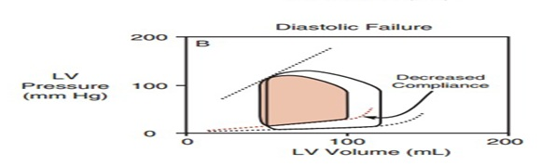

Slide 26
Combined
Reduced enddiastolic volume and increased
end-systolic volume
Stroke volume is greatly reduced leading to
Low EF
End-diastolic pressure may become very high

Slide 27
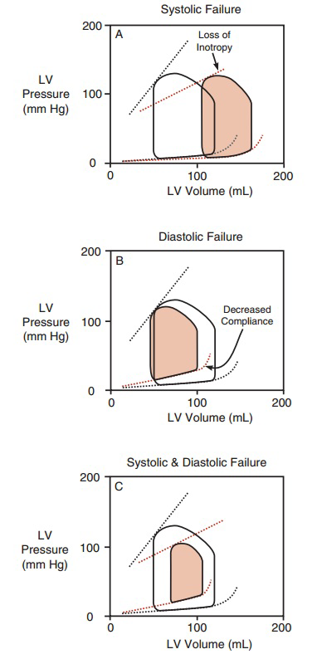

Slide 28
Valvular pathology
AORTIC STENOSIS
Pressure gradient across the valve during ejection leading to ventricular hypertrophy
After load is increased
End-systolic volume is increased due to impaired emptying
May be compensated in mild AS
Ventricular hypertrophy reduces ventricular compliance
Elevates end-diastolic pressure and slope of EDPVR

Slide 29
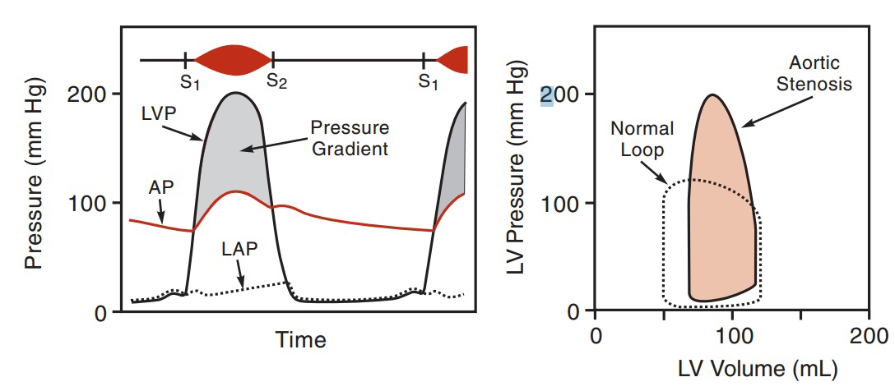

Slide 30
AORTIC REGURGITATION
Valve does not close completely, which permits blood to flow backward
No IVR period
Left ventricle begins to fill with blood from the aorta before mitral valve opens
Enhanced ventricular filling (end-diastolic volume)
Ventricle remodels by dilating, which increases EDV
Ventricular (and aortic) peak systolic pressures are increased because there is an increase in stroke volume
As long as the ventricle is not in failure -normal endsystolic volumes

Slide 31
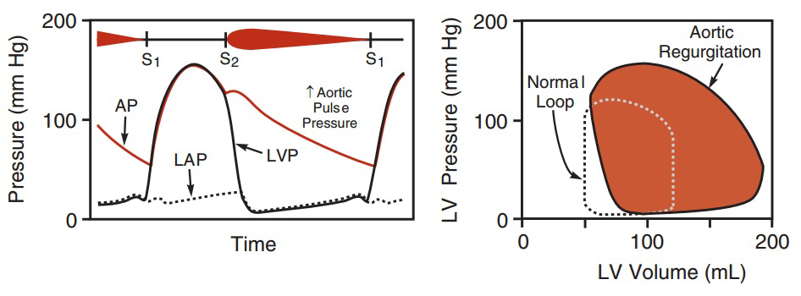

Slide 32
MITRAL STENOSIS
Increased the pressure gradient across the mitral valve during ventricular filling
-reduction in left ventricular filling pressure
-leads to a decrease in stroke volume
-fall in cardiac output and aortic pressure
Reduced afterload enables the end-systolic volume to decrease slightly

Slide 33
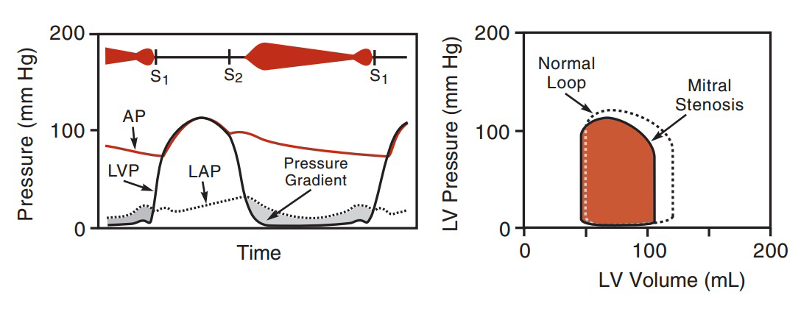

Slide 34
MITRAL REGURGITATION
No true IVC phase at the beginning of systole due to MR
-Reduced afterload on the left ventricle
-Stroke volume is larger and end-systolic volume is smaller
Early rapid filling due to large volume of blood in LA
Elevated left atrial pressure – left ventricular end-diastolic pressure and volume increases
However, ejection into the aorta is reduced by
the regurgitant fraction

Slide 35
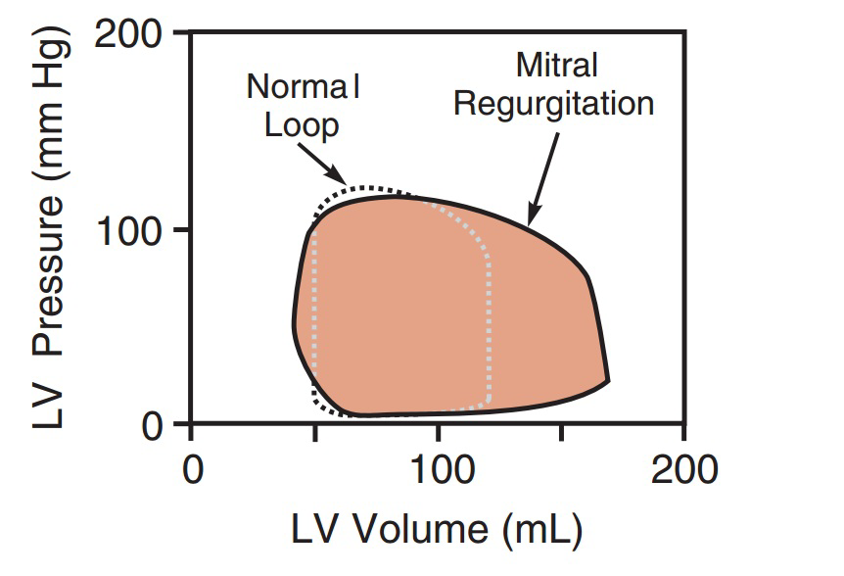

Slide 36
• Pulmonary and tricuspid lesions have similar corresponding loops with lower pressures

Slide 37
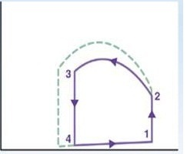
Q1)What does this represent?

Slide 38
Increased contractility

Slide 39
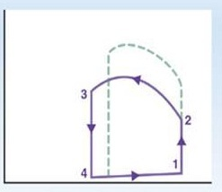
Q2)What does this represent?

Slide 40
Increased afterload

Slide 41
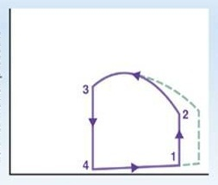
Q3)What does this represent?

Slide 42
Increased preload

Slide 43
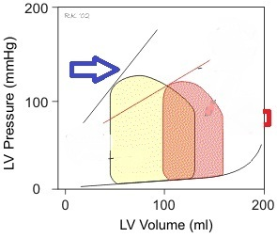
Q4) What does the blue arrow represent?
What does the loop represent?

Slide 44
Blue - the line is the End Systolic Pressure Volume Relationship (ESPVR).
Loop represents loss of inotropy

Slide 45
Q5) Which direction does the pressure-volume loop move during the cardiac cycle?
A)Clockwise
B)Counterclockwise

Slide 46
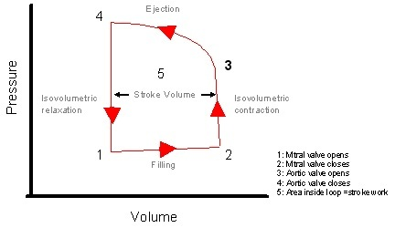
Counterclockwise

Slide 47
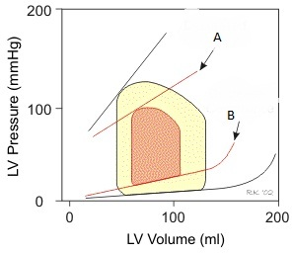
Q6) What does “A” represent?
What does “B” represent?

Slide 48
A: Loss of contractility (change of slope of the ESPVR)
B: Loss of compliance (change of slope of the EDPVR)

Slide 49

THANK YOU

