Slide 1
DIFFERENTIAL DIAGNOSIS OF CONTINOUS MURMUR
Dr Shreyas Samaga Senior Resident Cardiology
GTDMC Alappuzha

Slide 2
DEFINITION
A murmur
Begins in systole
Continues uninterrupted through second heart sound (S2)
Into all or part of diastole
Without the change in character

Slide 3
CHARACTERISTICS OF CONTINUOUS MURMUR
No change in the character from systole to diastole.
S2 or its components are enveloped or masked by the murmur.
No break between the systolic and diastolic components.
May not occupy the whole length of systole or diastole.

Slide 4
PHYSIOLOGICAL CLASSIFICATION (MYERE 1975)
Due to high to low pressure shunts
Due to rapid blood flow
Due to localised arterial obstruction

Slide 5
PDA
AP window
Truncus arteriosus with PA stenosis
Pulmonary atresia
Blalock, Waterston, Potts shunt
ALCAPA
RSOV into RA, RV
Coronary artery fistula into RA, RV
Lutembacher’s syndrome
Mitral atresia with ASD
Post PTMC with ASD
AV fistula
TAPVC into systemic veins
Portosystemic shunt
Due to high to low pressure shunts

Slide 6
Cervical venous hum
Mammary souffle
Hemangioma’
Hyperthyroidism
Hyperemia of neoplasm (hepatoma, Renal cell carcinoma, paget’s disease)
Due to rapid blood flow

Slide 7
Coarctation of aorta
Branch pulmonary artery stenosis
Carotid occlusion
Femoral artery occlusion
Renal artery occlusion
Celiac mesenteric artery occlusion
Due to localised arterial obstruction

Slide 8
Differentiate continuous murmurs from-
To and Fro murmurs
Combined systolic and diastolic murmurs

Slide 9
To and Fro murmurs
Definition: due to flow in one direction during systole and flow in the reverse direction during diastole through the same orifice or valves.
Example:
1. AS and AR
PS and PR
TOF with absent Pulmonary valve
They are not continuous murmurs.

Slide 10
To and Fro murmurs
Murmurs of stenosis are rough, medium pitched, diamond shaped, gets tapered towards the end of systole, ending in or before the aortic component (A2) or pulmonary component (P2).
The diastolic murmur is high pitched, blowing character starting after the A2 or P2. So there is change in character of murmur at the boundary of systole and diastole.
It has a gap at this point with two different picking of the murmurs during systole and diastole.
S2 is well audible unless valves are grossly deormed or damaged.

Slide 11
Combined systolic and diastolic murmurs
How to determine this?
VSD-high pitch PSM at LSB
AR- EDM at left 2nd or 3rd parasternal area
But when the murmurs are traced to infraclavicular area- a gap is heard, losing the continuity.
A2 P2 well heard and the peaking of murmurs are different & donot peak around S2.
Not due to flow through the same orifice or valve.
Combination of systolic murmur of one pathology and diastolic murmur of another.
Example:
1. VSD with AR
2. combined MR with AR
They occupy varying length of systole or diastole.
Different character of murmur in systole and diastole.

Slide 12
Characteristics | Continous murmur | To & fro murmur | Combined systolic & diastolic murmur
Direction of flow | Unidirectional, single murmur | Systolic in one direction. Diastolic in another direction. Separate murmurs from same valve. | Not through same orifice or valve. Combination of different orifices or valves producing two murmurs.
Classic example | PDA | AS+AR | VSD +AR
S2 | Masked in the murmur | Separate | Separate
Peaking of murmur | One peak- either systolic or diastolic or at S2. | Separate peak in systole and diastole | Separate peak in systole and diastole
Source of murmur | Extracardiac or extracardiac to cardiac shunt mostly. | Intracardiac | Intracardiac
Gap at S2 | Absent | Present | present

Slide 14
Thoracic Extra Thoracic
Venous hum
Cruveilhier Baumgarten syndrome
Sever arterial stenosis
Extra thoracic arteriovenous fistula

Slide 15
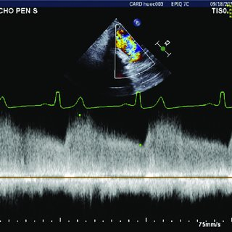
PDA
1st description- George Gibson. Gibson’s murmur
Peaks around S2, continues without interruption through S2 , decreases in intensity during diastole.
Site: Gisons’s area: best heard in left infraclavicular or the 1st or 2nd ontercostal places.

Slide 16
Mod- large restrictive PDA- noisy machinery murmur punctuated with Eddy sounds (multiple clicks) in later systole.
Eddy sounds- randomly distributed in the second half of systole & first half of diastole -Early collision of streams from ductus and pulm artery.
When PH develops, diastolic component of continuous murmur disappears.
Right to left shunt across a PDA doesn’t produce murmur.

Slide 17
Stages of PDA
Mod-large restrictive PDA
As PH develops
Eisenmenger
Early non restrictive PDA
Diastolic
component
decreases
Murmur
disappear
Continuous murmur

Slide 18
Dynamic Auscultation- PDA
Isometric handgrip- SVR Murmur
Valsalva Maneuver- systemic pressure Murmur
Amyl nitrate- decreases diastolic component

Slide 19
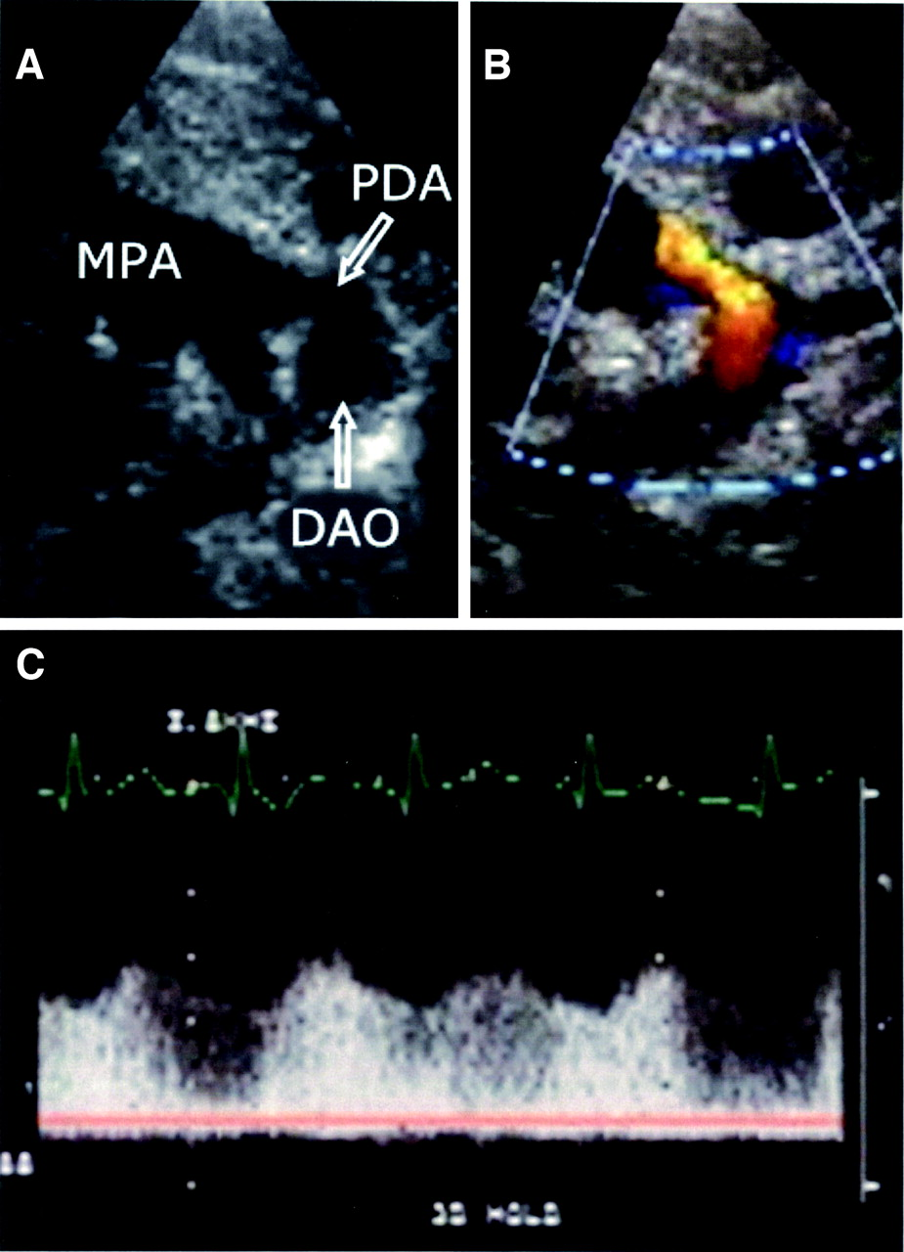
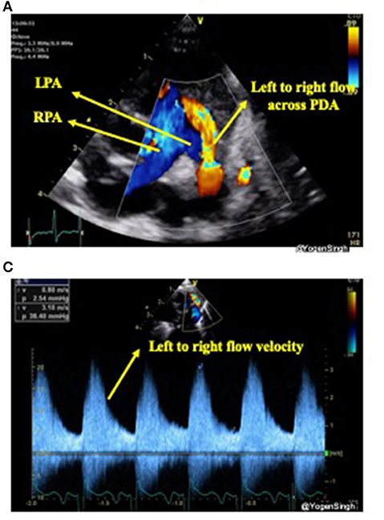
Large PDA with decreased diastolic component

Slide 20
PDA with no continuous mumur
Young neonates
Very small ductus
Very large ductus
With pulmonary hypertension
With Eisenmenger syndrome
When associated with
Preductal coarctation of aorta
Aortic stenosis
Large VSD

Slide 21
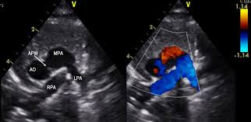
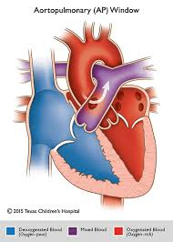
AORTO-PULMONARY WINDOW
Only 20% of AP windows are associated with continuous murmur because most of them are nonrestrictive & pulmonary pressures are elevated which abolishes diastolic component.
When continuous murmur is present it tends to be short.
Site: long continuous murmur identical to PDA but classically best heard in
third left intercostal space

Slide 22
RSOV
Sudden appearance of superficial, loud sawing continuous murmur in a previously healthy individual which doesn’t peak around S2 with accentuation of the diastolic component suggests RSOV.
RSOV to RA, RV, LA- continuous
RSOV to LV- early diastolic
When PH supervenes with high RVSP which shortens/abolishes systolic flow and systolic component – early diastolic

Slide 23
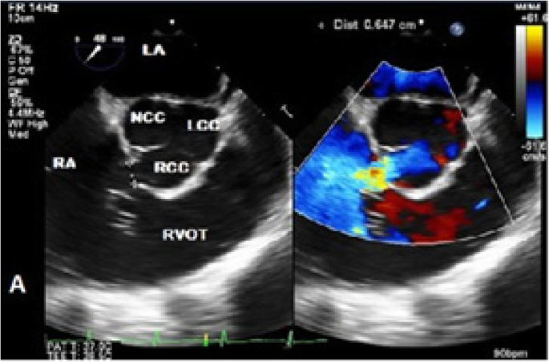
RSOV
More of a superficial murmur with prominent diastolic thrill- purring of a cat
RSOV into RA
Maximal adjacent to the right or left sternal border or lower sternum.
RSOV TO LA
No thrill

Slide 24
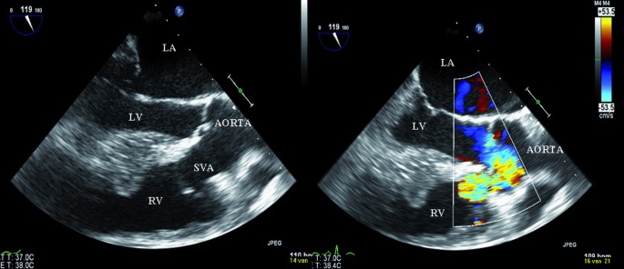
RSOV into RV
Best heard at midto lower LSB. If it is near tricuspid orifice- right sternal edge.
RSOV into RVOT
Higher along the left sternal edge.
Systolic components tends to be higher at higher thoracic levels and diastolic components tends to be louder at lower levels.

Slide 25
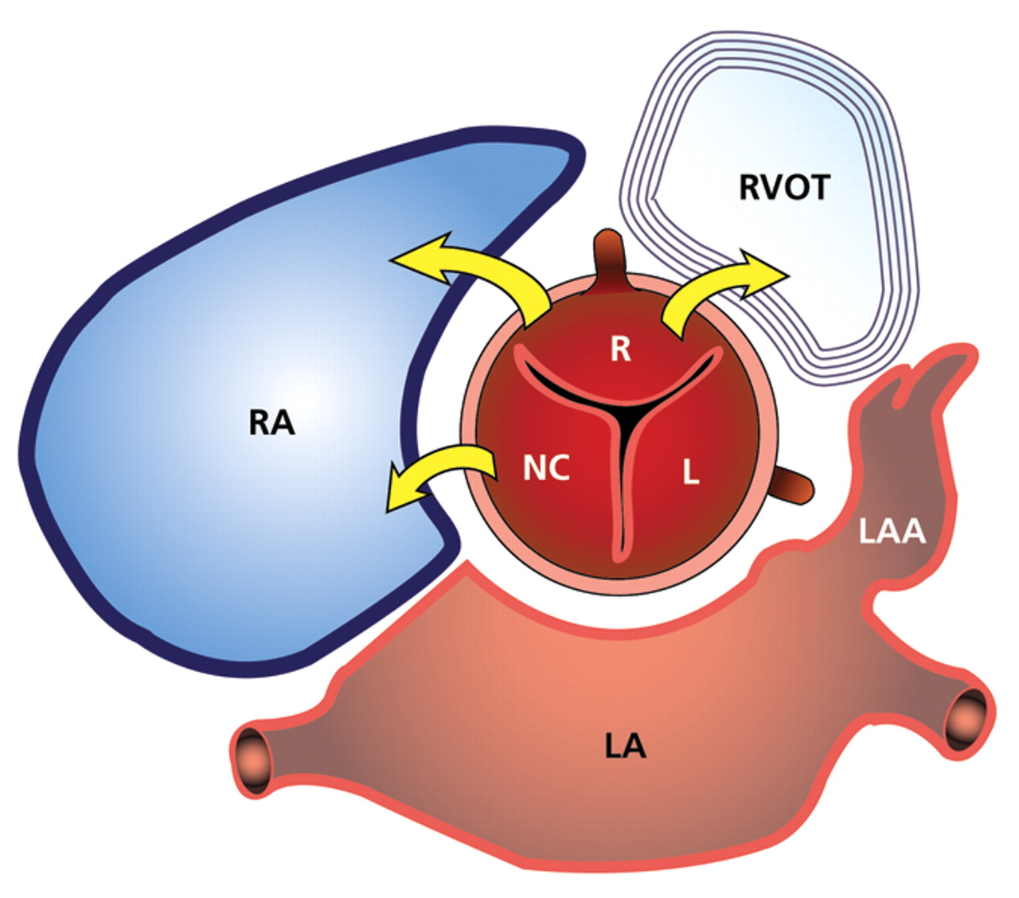
RSOV
Occurs in adolescence or early adulthood.
M:F – 1.7:1 to 4:1
Most common- Right sinus to RV, sometimes RA.
NCS always in RA
LCS- very rare- LV

Slide 26
Clinical findings | RSOV TO RA | RSOV TO RV
Site of murmur | Left and right LSB and over xiphoid | Mid-lower left sternal border
Intensity of continuous murmur | More in systole | More in diastole
Thrill | Very superficial, purring of cat | Diffuse
JVP | Prominent a wave | Prominent v and cv wave depending upon severity of TR
 | `
MDM | Both in tricuspid and mitral area | In mitral area
Hepatic pulsation | Diastolic | systolic

Slide 27
ALCAPA
Anomalous left coronary artery origin from pulmonary artery.
Audible precordial continuous murmur- because of retrograde flow from RCA to LCA and then flows to pulm artery.
Continuous murmur generated by flow through intercoronary anastomoses, doesn’t peak around S2, softer in systole and louder in diastole.
Very rare.
May present with ischemic changes in ECG in the infancy and young adults.
Heart failure in 1st yr of life.

Slide 28
ALCAPA
Absence of continuous murmur in ALCAPA is due to lack of collaterals.
They develop heart failure early (within a week).
Pulmonary artery pressure increases to such an extent that it fills Left coronary. But this is a deoxygenated blood. Myocardium extracts 100% of available oxygen in 1 circulation.
Echo:
visualize anomalous coronary artery
papillary muscle calcification

Slide 29
ALCAPA

Slide 30
ALCAPA

Slide 31
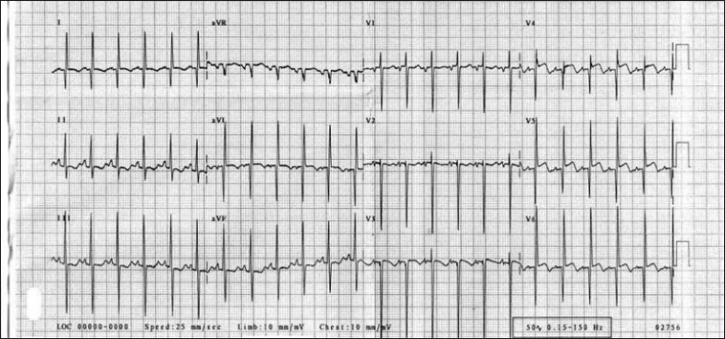
ALCAPA
Site: variably located to left or right of sternum at the base of the heart.
Murmur is generated by the collateral flow between RCA and LCA which decreases due to compression, by increased transmural pressure during LV systole.
Some patients may have associated MR or LVF which elevates pulmonary artery pressure and abolishes the diastolic component of this continuous murmur.
ECG:
Deep narrow Q waves in I and avL
LVH
LAD
Fragmented QRS- sign of scar

Slide 32
ALCAPA
ONE WHICH MAKES NOISE ARE LESS HARMFUL AND ONE WHICH REMAINS SILENT BEHAVE BADLY.
Usually when the patient is having continuous murmur, myocardial damage/ papillary muscle dysfunction leading to MR are much less.
RCA will dilate to such an extent that it’ll be able to supply the oxygen demand of the myocardium of LV and RV. Once revascularization is established, myocardial performance can return to normal.

Slide 33
CORONARY CAMERAL FISTULA
Acyanotic individual with continuous murmur maximal at an atypical site.
50% of these fistulae involve RCA and 45% LCA.
Site of murmur depends on the receiving chamber.
90% drain into right side of heart.
Whenever continuous murmur is heard in 3rd/4th /on right side of sternum and not associated with thrill, ALWAYS THINK OF CORONARY CAMERAL FISTULAE.

Slide 34
CORONARY CAMERAL FISTULA
Usually the continuous murmur of coronary cameral fistula are soft high frequency as they carry a small shunt through a narrow pathway.
Exceptionally they produce coarse rough machinery murmur when the fistula is large.
As it becomes large- coronary steal effect – cause angina.
If it drains to RV, murmur softens during systole( systolic flow decreases due to compression of the fistula during RV contraction)
TMT may be positive. (may be due to coronary steal effect)

Slide 35
CORONARY CAMERAL FISTULA
Murmur is louder in systole as the pressure gradient is more in case of coronary fistula draining into LA, RA.
Murmur is not continuous if it drains to LV.

Slide 36
AORTOCAMERAL FISTULA
Extremely rare.
Vascular channel from any of the three sinuses and most commonly draining into RA.
It can be anterior or posterior location.
May be associated with LSVC/OS-ASD.
May remain asymptomatic or exertional dyspnea/palpitations/recurrent LRTI/HF.
Continuous murmur at right PSB.

Slide 37
AORTOCAMERAL FISTULA

Slide 39
Communication seen between aorta and RA

Slide 41
LUTEMBACHER SYNDROME
When tight MS coexists with restrictive interatrial communication with the left to right shunt leads to continuous murmur.
Murmur is heard at 3rd/4th right ICS/ right sternal border because the murmur is generated with the cavity of the RA. Loud S1. OS present.
Mitral atresia +restrictive ASD can also cause continuous murmur.
Usually continuous murmur is heard when LAP ^25-30 because of MS. RAP ^ 5-6mmHg. If ASD is small, it cannot give large volume to RA. The gradient of 20-25 gives rise to continuous murmur. Very loud murmur.

Slide 42
CONTINUOUS MURMUR AT INTERNAL MAMMARY ARTERY
“Mammary souffle” – 10-15% of women at the end of pregnancy or immediate postpartum.
Maximum intensity during systole in 2nd-6th ICS of the sternal border.
A light compression on breast tends to increase its intensity while a hard compression with finger or steth abolishes.
Standing may diminish intensity.

Slide 43
CONTINUOUS
PRECORDIAL
EXTRA
MURMURS

Slide 44
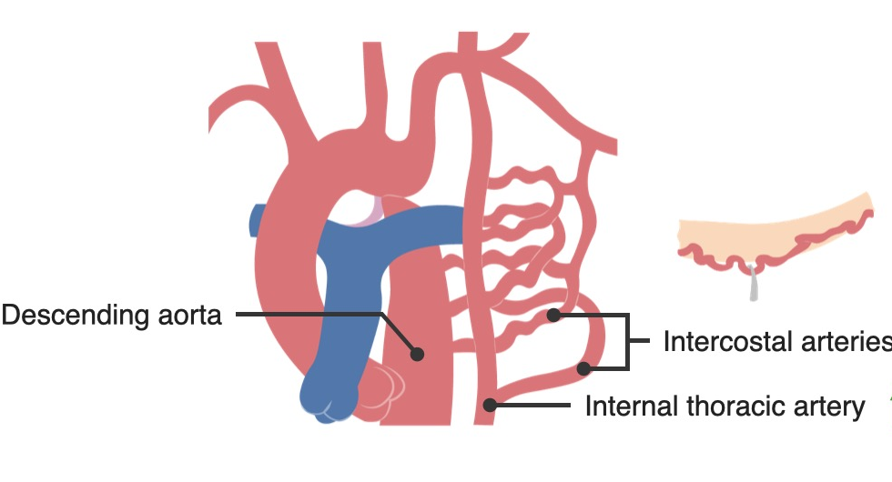
COARCTATION OF AORTA
Only in severe coarctation.
The developed collateral circulation is not sufficient to ensure normal flow in diastole , thus makes a continuous gradient systole - diastole.
Best heard in posterior chest- interscapulovertebral area, maximum intensity in systole.
Continuous murmur is from dilated intercostal collaterals also.

Slide 45
COARCTATION OF AORTA
Sites:
Over the thorax- rapid blood flow through tortuous intercostal collaterals.
Midline interscapular area- at the site of coarctation.
Epigastrium or just below & posteriorly over lower thoracic or lumbar spine- abdominal coarctation.
Coarctation diameter is <2.5mm- continuous murmur throughout the cardiac cycle. ( there will be significant gradient across the coarctation even in diastole)

Slide 47
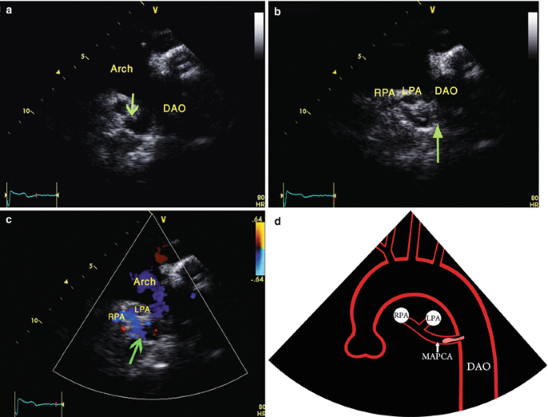
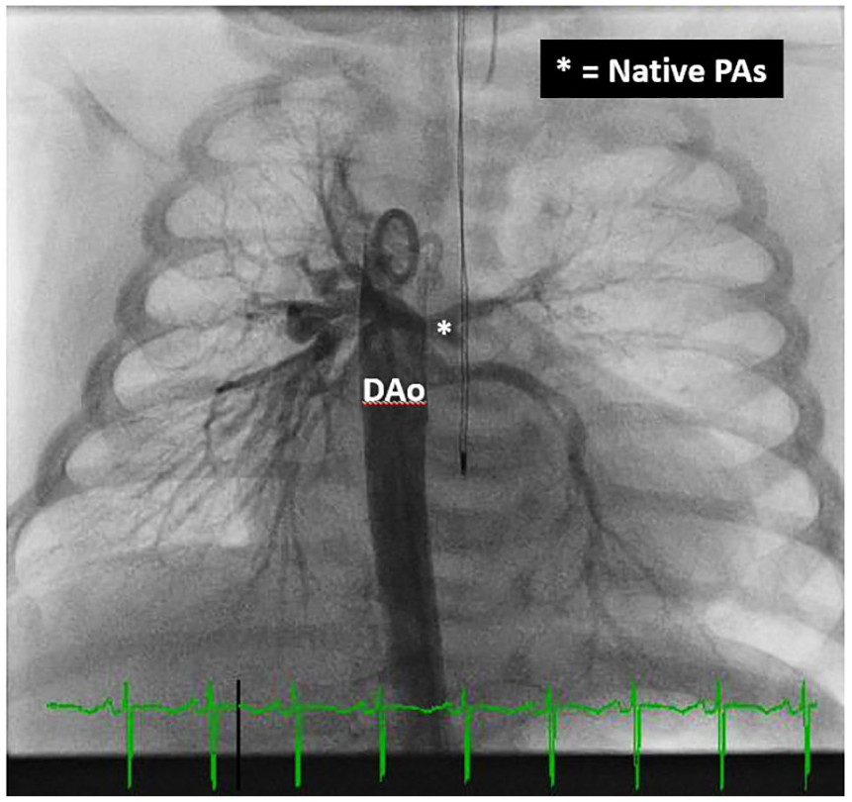
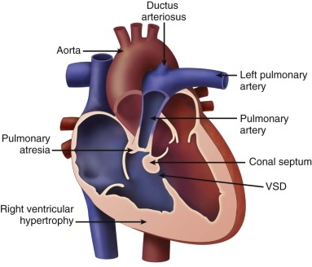
TOF WITH PA WITH LARGE MAPCA
Direct and indirect systemic arterial collaterals produce continuous murmur in 80% cases.
More common in extraprecordial sites.
Intensity varies from soft to readily detectable murmur.
Site: beneath the clavicle, back, infra-axillary, sometimes bilaterally.

Slide 48
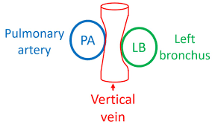
TAPVC
Drainage into a systemic vein may produce a continuous murmur.
Continuous murmur is a noteworthy although uncommon ausculatatory sign that originates in continuous flow through the venous confluence, left vertical vein and left innominate vein.
Site: soft venous hum- maximal at left upper sternal border
Obstructed vertical vein also causes continuous mumur- Hemodynamic Vice.
Symptoms like pulmonary edema.
Supracardiac TAPVC can have stenosis at the site where it opens to SVC- elevates pulmonary venous pressure- continuous murmur

Slide 49
BRANCH PULMONARY ARTERY STENOSIS
Continuous murmur is uncommon. (Because Diastolic pressure is normal)
If present, signifies pressure gradient extending beyond diastole due to narrowing of branch pulmonary artery.
Both upper parasternal, infraaxillary, interscapular areas.
Loud P2 without PAH + systolic murmur over upper sternal border.
Systolic pressure very high and near normal diastolic pressure –in cath study

Slide 50
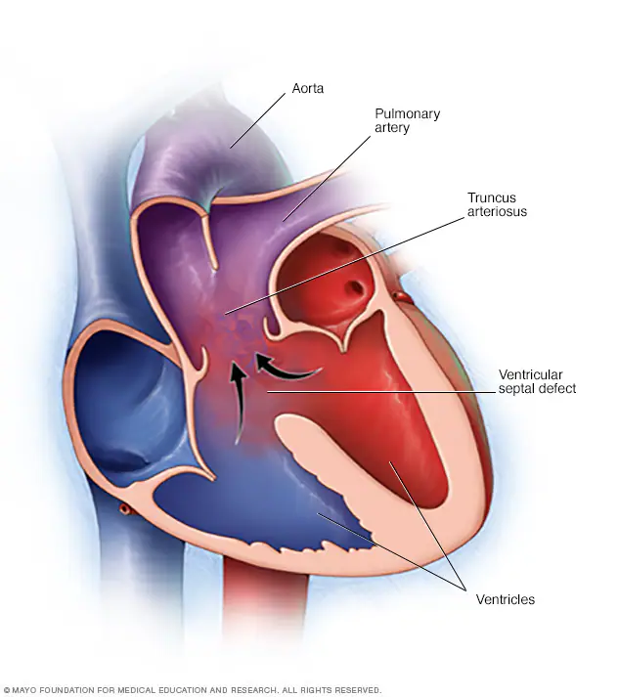
TRUNCUS ARTERIOSUS
Bronchial collaterals to the side of hypoplastic pulmonary arteries rarely cause a continuous murmur.
(In PDA blood flows from Aorta to pulm artery. Here from truncus to pulm artery.)
Narrowed pulmonary ostia can cause continuous murmur.
Stenosed ostia of the PA protects these patients.
Cyanosis with HF early neonatal period.
a/w MDM at Apex Mid systolic murmur in 3rd/4th Left ICS EDM (truncal regurgitation)
ECG: LVH, LAE/BVH

Slide 51
CONTINUOUS MURMUR DUE TO SURGICAL SHUNTS
Blalock Taussig Shunt- best heard in infraclavicular area. Sometimes back.
Waterston shunt- 1st/2nd left ICS
Gortex shunt- infraclavicular area

Slide 52
 | ANATOMY | COMMENT
SYSTEMIC ARTERIAL- PULMONARY ARTERIAL
Classic BT | Subclavian artery to PA | Absent ipsilateral radial pulse, continuous murmur
Modified BT | Subclavian artery to pulmonary artery conduit | Preserved pulse, continuous murmur
Central shunt | Aorta to PA conduit | continuous murmur
Waterston | Ascending aorta to RPA | continuous murmur
Potts | Descending aorta to LPA | continuous murmur
SYSTEMIC VENOUS- PULMONARY ARTERIAL
Glenn | SVC to PA | No murmur, arrhythmias uncommon
Fontan | Total cavopulmonary shunt | No murmur, atrial arrhythmias
OTHER
Rastelli | RV to PA | Valve degeneration can lead to PR murmur

Slide 53
CONGENITAL PULMONARY AV FISTULA
Continuous murmur with a louder systolic component over the lower lobes and middle lobe of the right lung.
Increases on inspiration, standing and muller manoeuvre.
Decreases during Valsalva manoeuvre.
Cyanosis without any other precordial abnormalities.

Slide 54
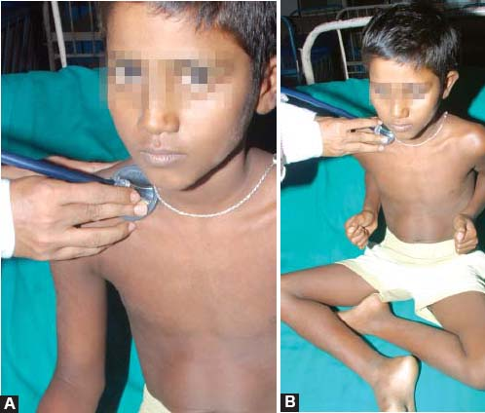
VENOUS HUM
Described by Potain in 1867, most common continuous murmur.
Universal in young children& frequent in young healthy adult esp in pregnancy.
Thyrotoxicosis and anemia reinforces venous hum.
Murmur is typically louder in diastole best heard in Rt supraclavicular fossa lateral to sternocleidomastoid.
Increased by upright position, deep inspiration & during diastole.
If audible in supine position- suspect a hyperdynamic circulatory state.

Slide 55
CRITICAL STENOSIS OF MAJOR ARTERIES
Carotid stenosis
Femoral stenosis
Renal artery stenosis- louder systolic component.
Critical obstruction (80%) + no adequate collaterals – so that a continuous gradient is produced.
With adequate collaterals –only systolic gradient persists.

Slide 56
CONGENITAL OR ACQUIRED AV FISTULA
Acquired- Trauma
Surgically created- Hemodialysis
Loud continuous murmur with systolic accentuation.
Manual compression of fistula can cause reflex bradycardia and reflex tachycardia on release.

Slide 57
CONGENITAL AV MALFORMATIONS
Cerebral- continuous murmur over scalp.
Subclavian artery to vertebral vein – continuous murmur over left supraclavicular area in patient with high output failure.
Newborn baby with HF and no findings on auscultation- AUSCULTATE THE SKULL.
In high output failure, patients can develop pulmonary hypertension. PVR is extremely low. When cardiac output increase from 5L to ^25L, PVR may not reduce, because of high flow the pulm artery pressure goes up causing RV failure.

Slide 58
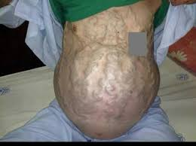
PORTOSYSTEMIC SHUNTS
In portal hypertension- caput medusae- continuous murmur- Cruveinheir Baumgarten syndrome

Slide 59
CONTINUOUS MURMUR WITH CYANOSIS
TOF +PA+MAPCAs
Truncus arteriosus
TAPVC with or without obstruction
PA with intact ventricular septum with PDA
Duct dependent CCHD like HLHS
Post shunt surgery
Congenital pulmonary AV fistula

Slide 60
CONTINUOUS MURMUR BEST HEARD IN LEFT 1ST AND 2ND ICS
PDA
AP WINDOW
POTT SHUNT
WATERSTON SHUNT
MAMMARY SOUFFLE
ALCAPA
RSOV TO PA

Slide 61
CONTINUOUS MURMUR BEST AUDIBLE IN LEFT 3RD /4TH ICS
RSOV TO RV( A/W THRILL)
RSOV TO RA (A/W THRILL)
CORONARY CAMERAL FISTULA (NO THRILL)
MAMMARY SOUFFLE (NO THRILL)

Slide 62
CONTINUOUS MURMUR OVER BACK
SEVERE COA
COLLATERALS IN COA
PULMONARY AV FISTULA
CONTINUOUS MURMUR IN RIGHT 3RD ICS
LUTEMBACHER SYNDROME WITH RESTRICTIVE ASD
MITRAL ATRESIA WITH RESTRICTIVE ASD

Slide 63
CONTINUOUS MURMUR IN RIGHT 2ND ICS
TAPVC INTO SVC
SYSTEMIC AV FISTULA

Slide 64
CONTINUOUS MURMURS WITH ACCENTUATED DIASTOLIC COMPONENT
RSOV
ALCAPA
VENOUS HUM

Slide 65
THANKYOU

