Slide 1
RESISTANT HYPERTENSION
Dr Shreyas samaga
Senior resident, cardiology
Gtdmc alappuzha

Slide 2
Agenda
Introduction
pathogenesis
diagnosis
treatment
Summary

Slide 3
Introduction
WHO report states that 1.28 billion people between age of 30-79y are affected by HTN worldwide & 2/3rd are from low-middle income countries.
Global prevalence: 34% (men) & 32% (women).
Amongst hypertensives, its important to identify & treat “true resistant HTN” as they are at much greater risk of premature CV events, CKD & other end organ damages.

Slide 4
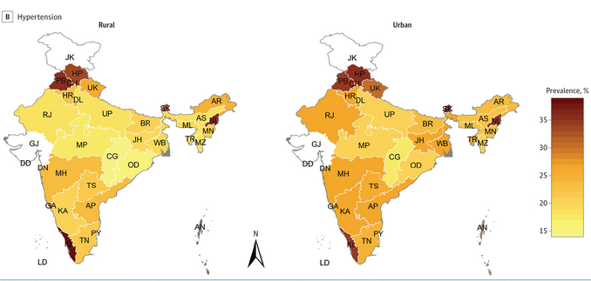
Primary goals
Prevalence of hypertension in india
Ref: Diabetes and Hypertension in India: A Nationally Representative Study of 1.3 Million Adults. JAMA Intern Med. 2018;178(3):363–372.

Slide 5
HYPERTENSION- INDIA
In 2017, prevalence of HTN in India is 20% (women) & 24.5% (men).
>20 crore hypertensives lived in India.
Alarming!!!!!- 2018 data: prevalence in age group of 18-25y is
12.1%!!!!!!!!!!!
By 2025, India’s target is to achieve 25% relative reduction in the prevalence of HTN.

Slide 6
AFTER 2017…
The 2017 guideline reduces both the BP threshold for initiating antihypertensive therapy to ≥130/80 mm Hg for adults with existing CVD or 10-year atherosclerotic CVD risk ≥10% and the BP goal of treatment to <130/80 mm Hg for most individuals.
These recommendations affect the BP threshold for diagnosis of RH and thus will increase its prevalence in the hypertensive population.

Slide 7
RH
19.7% in USA, with 3% taking thiazide like diuretic & 9 % taking MRA.
In India, JIPMER- 11% ( 2018-20)

Slide 8
TRUE RESISTANT HYPERTENSION
RESISTANT HTN
Defined as BP that remains above goal
despite 3 antihypertensive drugs of different classes
with one of them being a diuretic appropriate for renal function &
all drugs are used at a maximally tolerable doses. Or
Require 4 or more medications to achieve goal.
(goal: <130/80mmHg – ACC/AHA, <140/90 ESC/ESH)
prerequisites
Rule out pseudoresistence
White coat HTN
(appropriate technique/ABPM/Home BP monitor)
Compliance
Secondary causes of HTN
LIMITATION OF THE DEFINITION
Duration of therapy before labelling RH?

Slide 9
Importance….
To identify
More likely
More chances of
includes
excludes
Risk for morbid CV events & death
To have medication adverse effects
Having secondary cause of HTN
Both controlled & uncontrolled RH.
Medication nonadherence
(50-80% TAKE SUBOPTIMAL MEDICATIONS)

Slide 10
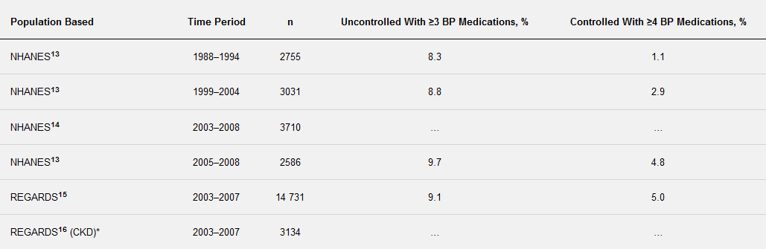

Slide 11
PROGNOSIS
In a retrospective study of >200 000 patients with incident hypertension, those with RH were 47% more likely to suffer the combined outcomes of death, myocardial infarction, heart failure, stroke, or CKD over the median 3.8 years of follow-up.
A study of >400 000 patients, compared with patients without RH, patients with RH had
a 32% increased risk of developing end-stage renal disease
a 24% increased risk of an ischemic heart event,
a 46% increased risk of heart failure,
a 14% increased risk of stroke, and
a 6% increased risk of death.
In the REGARDS study (Reasons for Geographic and Racial Differences in Stroke), uncontrolled RH was associated with a 2-fold increased risk of coronary heart disease compared with controlled RH.

Slide 12
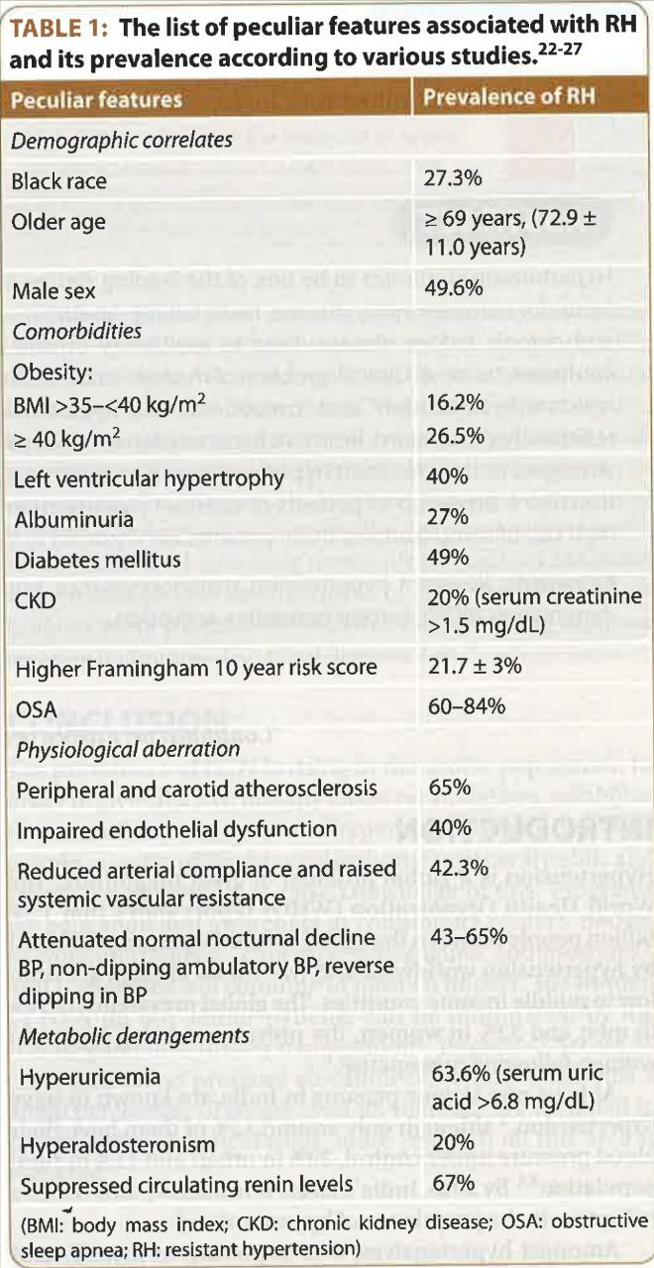

Slide 13
GENETICS IN RH
2 beta &gamma ENaC gene varients
11 beta hydroxysteroid dehydrogenase II
INVEST STUDY
ATP2B1
CACNB2
PDE5A
AGT
ADRB1
GenHAT study

Slide 14
PATHOGENESIS
FLUID RETENTION
SYMPATHETIC ACTIVATION
ARTERIAL STIFFNESS

Slide 15
Excessive fluid retention
Increased aldosterone production
Impaired renal natriuresis
Excessive salt intake

Slide 16
Diagnosis & Treatment

Slide 17
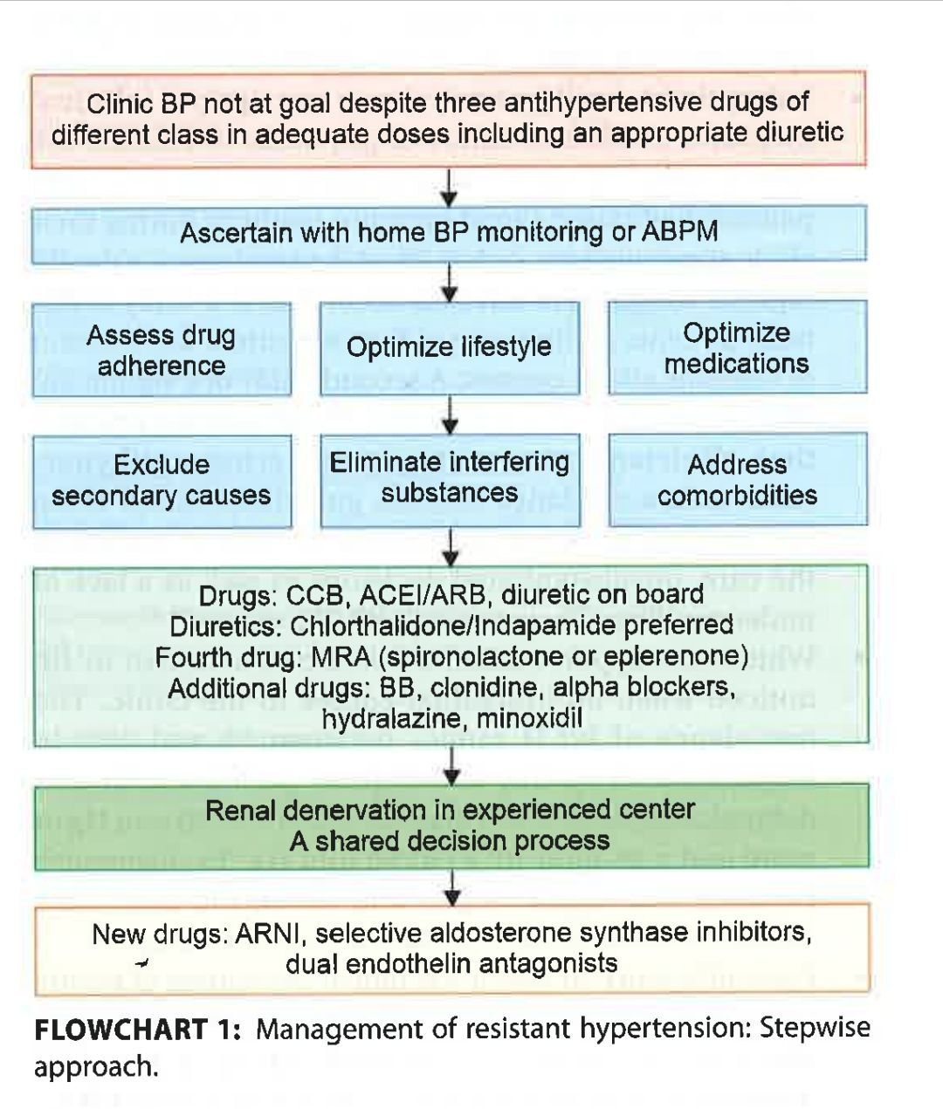
TREATMENT ALGORITHM

Slide 18
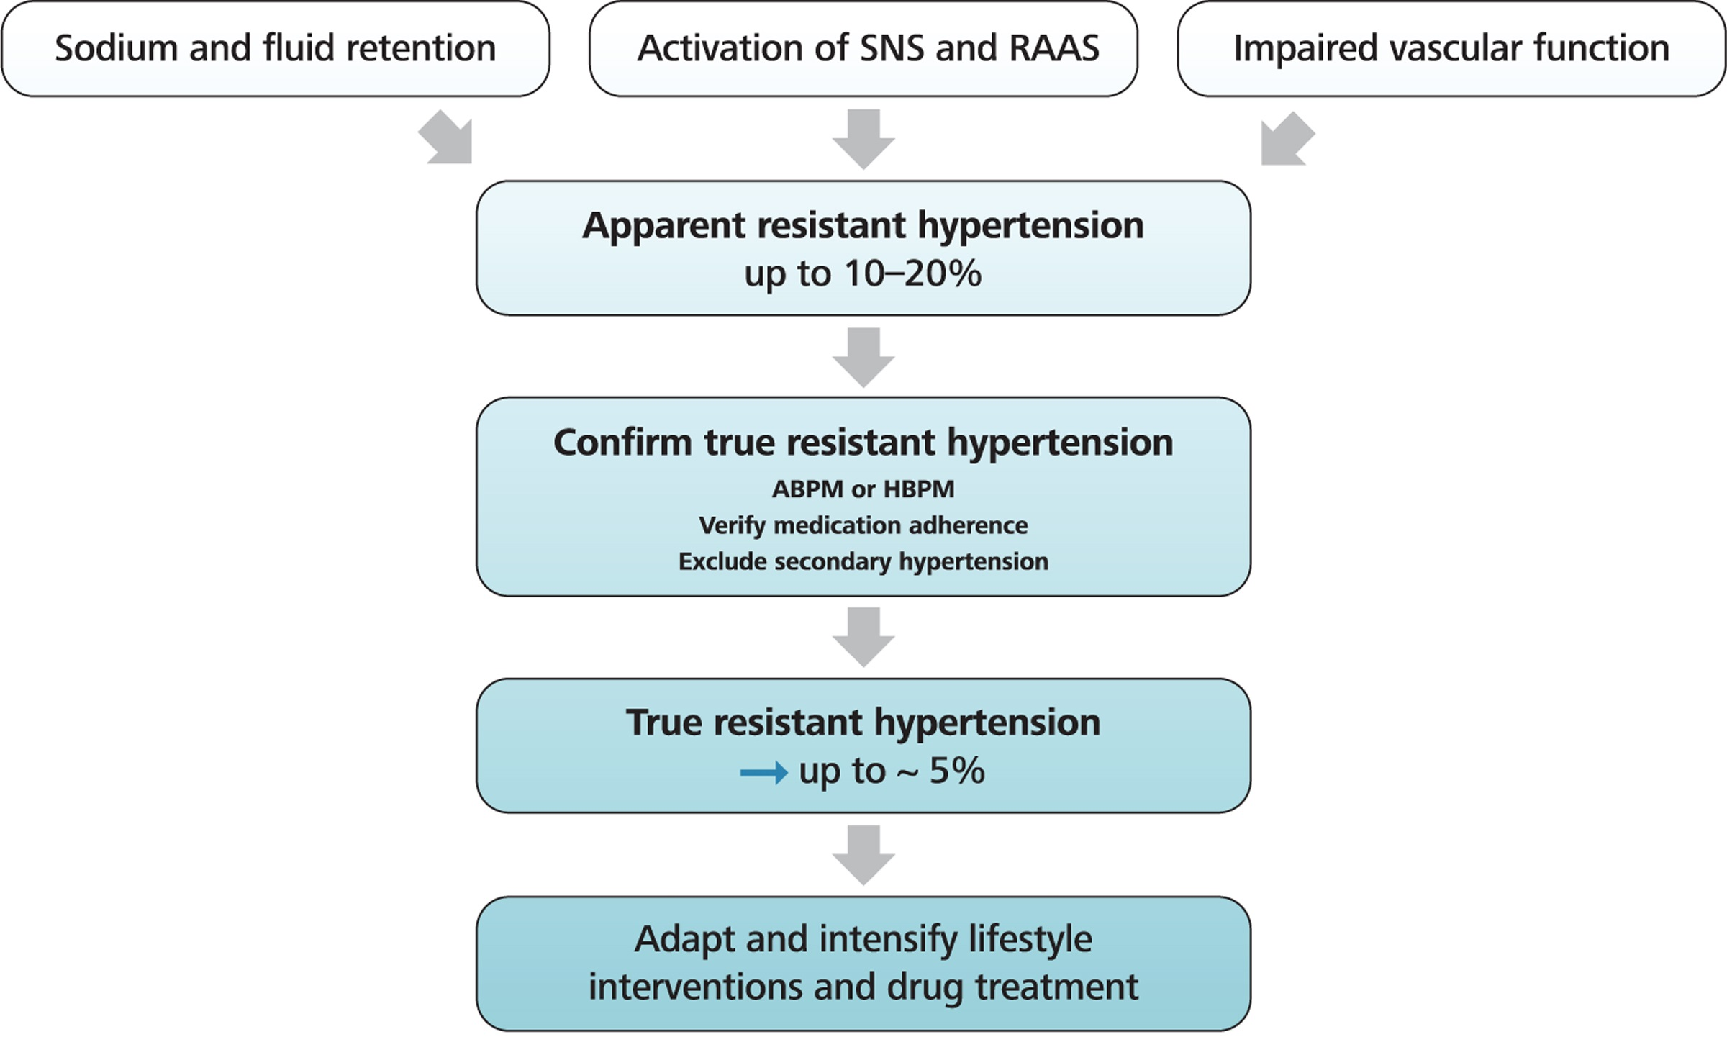
Journal of hypertension dec 2023
-2023 ESH Guidelines for the management of arterial hypertension The Task Force for the management of arterial hypertension of the European Society of Hypertension

Slide 19
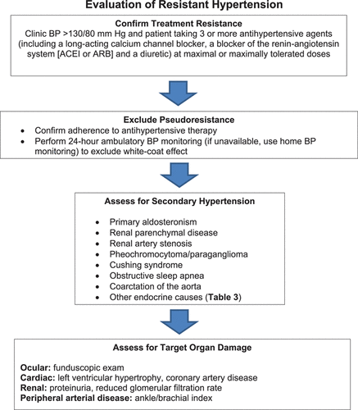
Resistant Hypertension: Detection, Evaluation, and Management: A Scientific Statement From the American Heart Association 2018

Slide 20
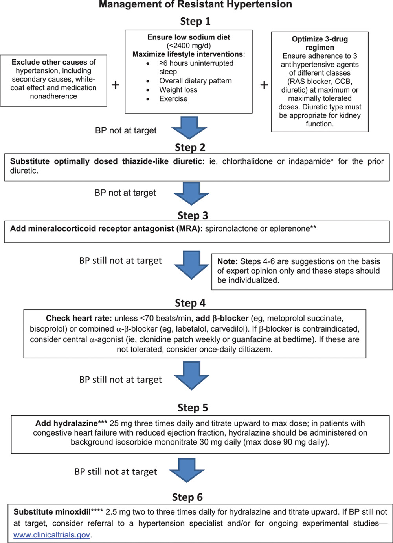
Resistant Hypertension: Detection, Evaluation, and Management: A Scientific Statement From the American Heart Association 2018

Slide 21
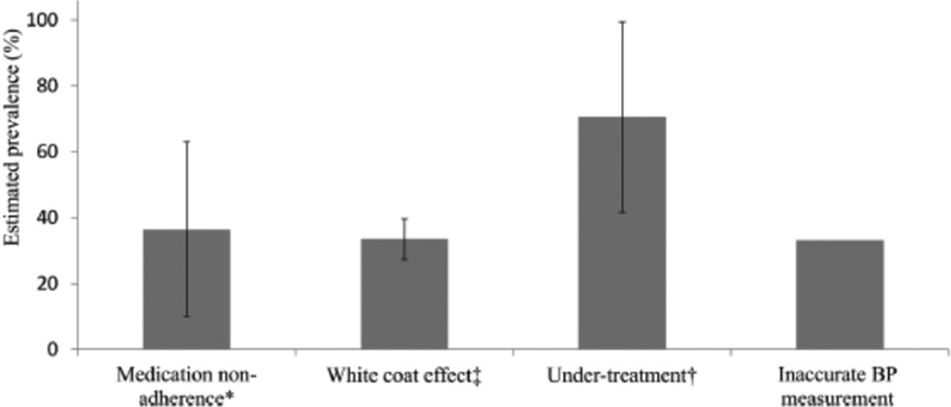
PSEUDORESISTANT HTN

Slide 22
ASSESSMENT OF ADHERENCE
ADHERENCE
Effective strategies for improving adherence to antihypertensive medications
There is no gold standard for measuring adherence.
Indirect methods such as pill count, self-report, and prescription refill data are simple, inexpensive, and widely used.
educate patients, their families, and caregivers about hypertension, the consequences of hypertension, and the possible adverse effects of medications.
An informed patient is better able to collaborate to establish shared goals of therapy and a plan of care.
using agents that are dosed once daily over those that require multiple daily doses and using fixed-dose combination agents when available
using low-cost and generic antihypertensives, particularly when cost of care is a barrier(patients with RH often have multiple chronic conditions requiring pharmacotherapy)
consolidating refills, that is, minimizing the number of trips to the pharmacy to obtain all prescribed medications.

Slide 23
Poor BP Measurement Technique
BP MEASUREMENTS
Proper BP measurement technique entails
Inaccurate measurement of BP can result in the appearance of treatment resistance.
Severe arterial stiffness or medial calcification of the brachial artery may result in an inaccurate detection of Korotkoff sounds when BP is measured with the auscultatory method.
preparing the individual by emptying a full urinary bladder and then sitting with legs uncrossed and back, arm, and feet supported in a quiet room, ideally 5 minutes before the first reading is obtained.
choosing a BP cuff with a bladder length of at least 80% and width of at least 40% of the arm circumference.
placing the cuff directly on the skin of the upper arm at the level of the heart on the supported arm
obtaining a minimum of 2 readings 1 minute apart

Slide 24
LIFE STYLE FACTORS
OBESITY
PHYSICAL INACTIVITY
Dietary sodium
alcohol
Both reduced physical activity and lower physical fitness are independent risk factors for hypertension.
Sedentary lifestyle itself independently promotes the onset of hypertension.
Thrice-weekly treadmill walking exercise program for 8 to 12 weeks significantly lowered daytime ambulatory BP (6±12/3±7 mm Hg; P=0.03) among 50 treated patients with RH. #
BMI ≥30 kg/m² approximately doubles the risk.
MECHANISM: enhanced salt sensitivity, vascular dysfunction, activation of the sympathetic nervous system and renin-angiotensin system, high mineralocorticoid activity.
MECHANISM: excess volume retention, including vascular dysfunction, arterial stiffness, sympathetic activation, impaired renin-angiotensin axis suppression, mineralocorticoid receptor activation, and immune cell modulation.
The dose-response association may differ between men (linear) and women (J shaped)& can be modified by metabolic genes.
Heavy alcohol intake (>30–50 g/d) is a well-established risk factor for hypertension.
#- Dimeo F, Pagonas N, Seibert F, Arndt R, Zidek W, Westhoff TH. Aerobic exercise reduces blood pressure in resistant hypertension. Hypertension. 2012 Sep;60(3):653-8. doi: 10.1161/HYPERTENSIONAHA.112.197780.

Slide 25
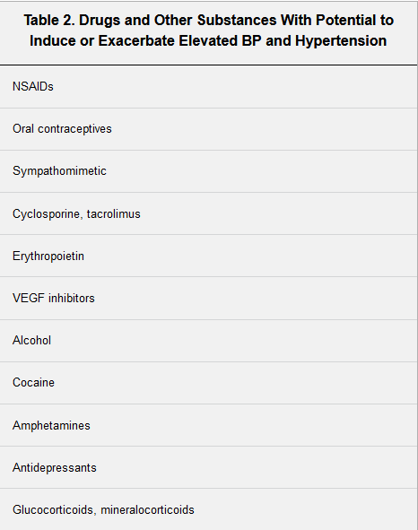
LIFE STYLE FACTORS
Other factors
Dietary Pattern
Drug-Related RH
Psychosocial stressors (eg, occupational stress, low social support),
negative personality traits (anxiety, anger, depression),
reduced sleep duration/quality
loud noises (eg, traffic),
colder temperatures,
higher altitudes
air pollutants
The Dietary Approaches to Stop Hypertension (DASH) eating pattern is well established to reduce BP, by 6.7/3.5 mm Hg in a recent meta-analysis.
Highly individualized- little effect to severe BP elevations.

Slide 26
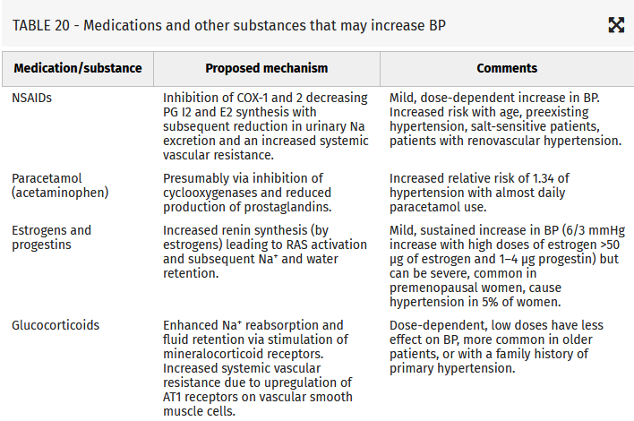

Slide 27
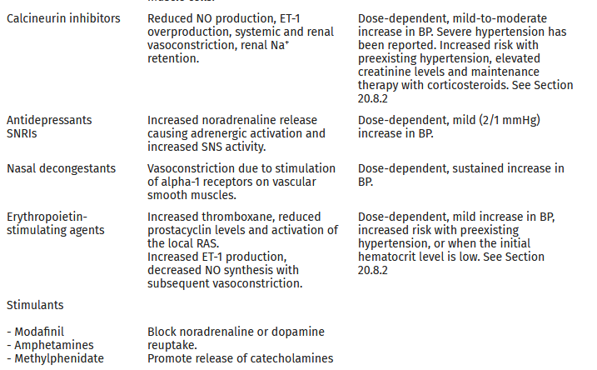

Slide 28
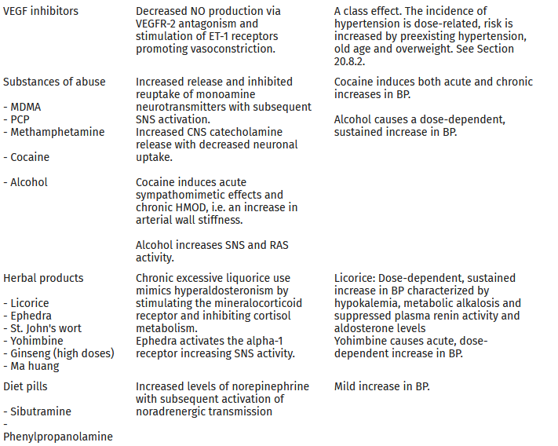

Slide 29
Sleep disorders & pseudopheochromocytoma
The term, which originated in 1999, describes a pheochromocytoma-like syndrome.
Once true pheochromocytoma is excluded, one should consider pseudopheochromocytoma, a syndrome characterized by the presence of paroxysmal hypertension with 3 distinct features:
abrupt elevation of BP,
equally abrupt onset of distressful physical symptoms, and
absence of reported fear or panic at the onset of attacks.
The original description involved patients with a history of emotional trauma from an event that they had denied; many improved with antidepressant therapy, β-blockers, and counseling.

Slide 30
A related problem in many people with pseudopheochromocytoma is poor sleep quality.
The mechanism of poor sleep quality contributing to elevated BP and paroxysmal bouts of very high BP relates to activation of both the sympathetic nervous system and the renin-angiotensin-aldosterone system.
Data from a post hoc analysis of the SYMPLICITY HTN-3 trial evaluated the effect of renal denervation versus sham control on office and ambulatory (including nocturnal) SBP in patients with OSA. Compared with sham control, renal denervation reduced the 6-month office SBP in subjects with OSA.

Slide 31
Sleep deprivation
defined as less than a minimum of 6 hours of uninterrupted sleep, also have increased sympathetic activity.
In this case, it is a consequence of reduced time in non–rapid eye movement or slow-wave sleep that also affects the nocturnal dip in BP.
This supports the hypothesis that disturbed non–rapid eye movement sleep quantity or quality is a mechanism by which sleep deprivation or restless leg syndrome leads to an increase in sympathetic tone.

Slide 32
Obstructive sleep apnea
OSA is extremely common in patients with RH, with prevalence rates as high as 70% to 90%, and when present, OSA is often severe.
Attributed to increased fluid retention and accompanying upper airway edema,
The increase in sympathetic activity associated with OSA is a function of intermittent hypoxia; the short-term rise in BP parallels the severity of oxygen desaturation at night.
Poor BP control is strongly associated with OSA, especially in those patients with an apnea/hypopnea index of at least 30 events per hour.
OSA-associated hypertension is only slightly reduced(2-5mmHg) by continuous positive airway pressure (CPAP) treatment.

Slide 33
Obstructive sleep apnea
Excessive accumulation of fluid centrally, including in the neck, as an important contributor to OSA severity in patients with RH by demonstrating increased shifting of fluid from the lower extremities into the upper body during supine sleep.
The role of aldosterone in promoting OSA is additionally supported by studies demonstrating that mineralocorticoid receptor antagonists reduce the severity of OSA in patients with RH.
This effect is blunted by intensification of diuretic therapy, including the use of spironolactone.

Slide 34
U-shaped relation hypertension & duration of sleep
sleep quality and duration are critically important in the control of BP in RH.
Many of these patients will have elevated heart rate disproportionate to their BP, a clinical clue that may be related to sleep quality.
If the patient is receiving diuretics and is not adherent to a low-sodium diet, this will produce nocturnal micturition and result in interrupted sleep. Moreover, diuretics increase sympathetic tone; spironolactone blunts this activation, but ARBs do not.
prevalence

Slide 35
Esh guidelines 2023:

Slide 37
Thank you
References:
CSI Cardiology update 2023, volume 1
ESH Guidelines for the management of arterial hypertension The Task Force for the management of arterial hypertension of the European Society of Hypertension: Endorsed by the International Society of Hypertension (ISH) and the European Renal Association (ERA). Journal of Hypertension 41(12):p 1874-2071, December 2023.
Resistant Hypertension: Detection, Evaluation, and Management: A Scientific Statement From the American Heart Association 2018

