Slide 1
CARDIAC CONDUCTION SYSTEM: ANATOMY AND BASIC PHYSIOLOGY
Dr. Sanjeev

Slide 2
Topics
Cardiac Action Potential
ANS control of Conduction system
Anatomy of Conduction system
Impulse conduction through the Heart
Control of Excitation and conduction of Heart

Slide 3
INTRODUCTION
Autorhythmicity- Heart beats rhythmically as result of action potentials it generates by itself
The heart is having with a system for
(1) generating rhythmical electrical impulses to cause rhythmical contraction of the heart muscle
(2) conducting these impulses rapidly through the heart.

Slide 4
When this system functions normally, the atria contract about one sixth of a second ahead of ventricular contraction, which allows filling of the ventricles before they pump the blood through the lungs and peripheral circulation.
Importance of the system is that it allows all portions of the ventricles to contract almost simultaneously, which is essential for most effective pressure generation in the ventricular chambers.

Slide 5
Two specialized types of cardiac muscle cells
1.Contractile cells(Atrial and ventricular muscles)
-99% of cardiac muscle cells
-Do mechanical work of pumping
- Normally do not intitiate own action potentials.
2.Autorhythmic cells( conductive tissue)
- Do not contract
-Specialized for initiating (excitation) and conduct action potentials responsible for contraction of working cells.

Slide 6
Characteristics of Cardiac Conduction Cells
• Automaticity: ability to initiate an electrical impulse
• Excitability: ability to respond to an electrical impulse
• Conductivity: ability to transmit an electrical impulse from one cell to another

Slide 7
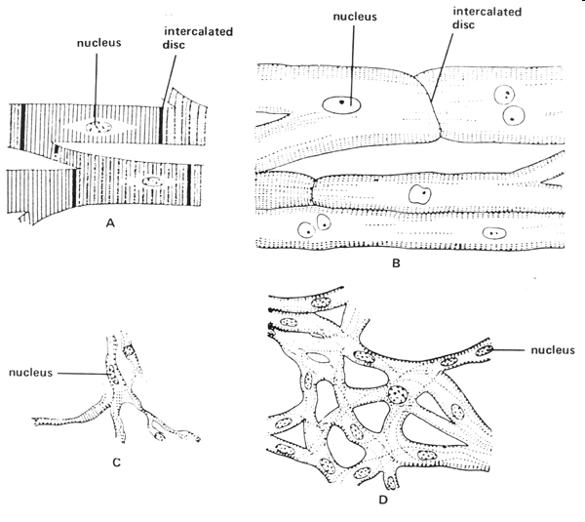
Myocardial Physiology Autorhythmic Cells (Pacemaker Cells)
Characteristics of Pacemaker Cells
Smaller than contractile cells
Don’t contain many myofibrils
No organized sarcomere structure
do not contribute to the contractile force of the heart
conduction myofibers
normal contractile myocardial cell
SA node cell
AV node cells

Slide 8
CARDIAC ACTION POTENTIAL
2 TYPES: Myocyte & Pacemaker potential
Typical 5 Phases
Phases 0–4 are the
0.Rapid upstroke
1.Early repolarization
2.Plateau
3.Late repolarization
4.Resting Membrane Potential and Diastolic depolarization
The currents that underlie the action potentials vary in atrial and ventricular myocytes.

Slide 9
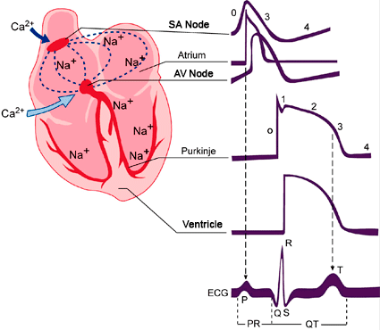
S

Slide 10
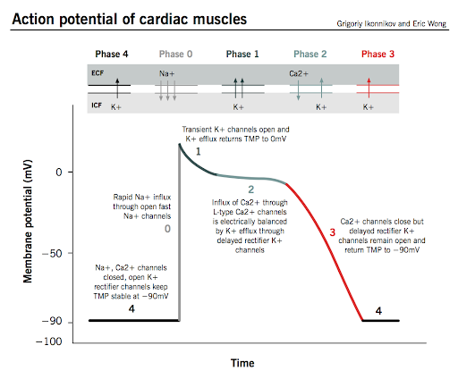

Slide 11
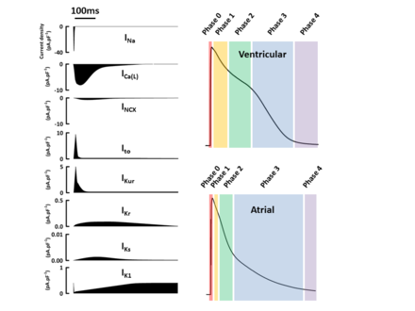

Slide 12
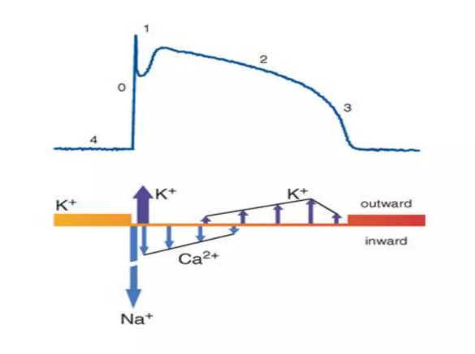
Potassium current (IK1) is the principal current during phase 4 and determines the resting membrane potential of the myocyte.
• Sodium current generates the upstroke of the action potential (phase 0)
Activation of Ito with inactivation of the Na current inscribes early repolarization (phase 1).
• The plateau (phase 2) is generated by a balance of repolarizing potassium currents and depolarizing calcium current.
Inactivation of the calcium current with persistent activation of potassium currents (predominantly IKr and IKs) causes phase 3 repolarization

Slide 13
Characteristics of Pacemaker Cells
Unstable membrane potential
“bottoms out” at -60mV
“drifts upward” to -40mV, forming a pacemaker potential
Myogenic
The upward “drift” allows the membrane to reach threshold potential (-40mV) by itself
This is due to
1. Slow leakage of K⁺ out & faster leakage Na⁺ in
Causes slow depolarization
Occurs through I_{f} channels (f=funny) that open at negative membrane potentials and start closing as membrane approaches threshold potential
2. Ca²⁺ channels opening as membrane approaches threshold
At threshold additional Ca²⁺ ion channels open causing more rapid depolarization
These deactivate shortly after and
3. Slow K⁺ channels open as membrane depolarizes causing an efflux of K⁺ and a repolarization of membrane

Slide 14
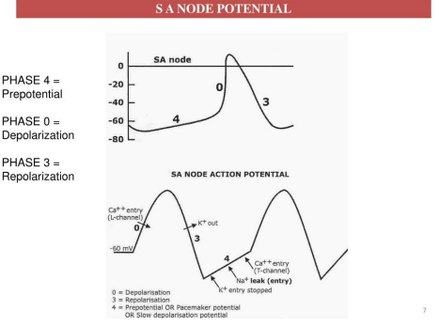

Slide 15
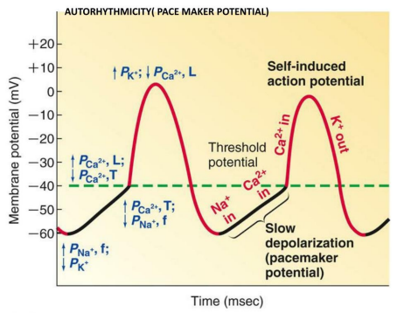

Slide 16
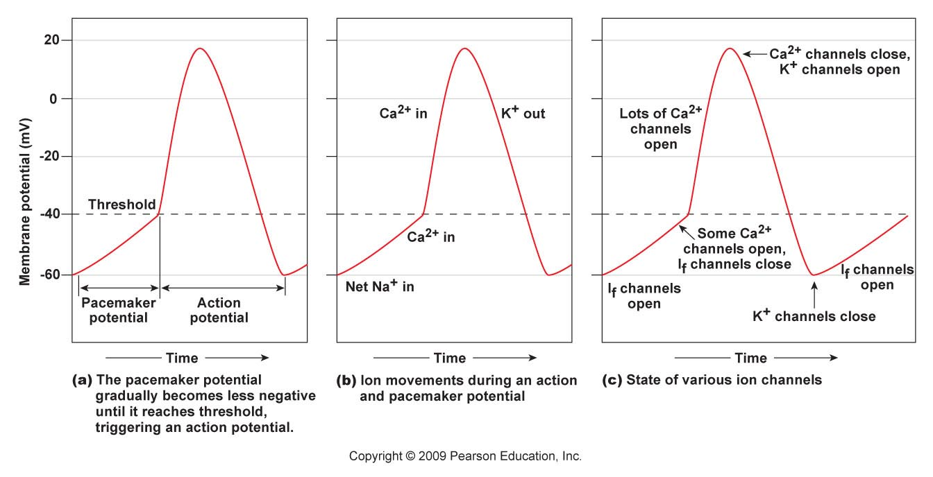

Slide 17
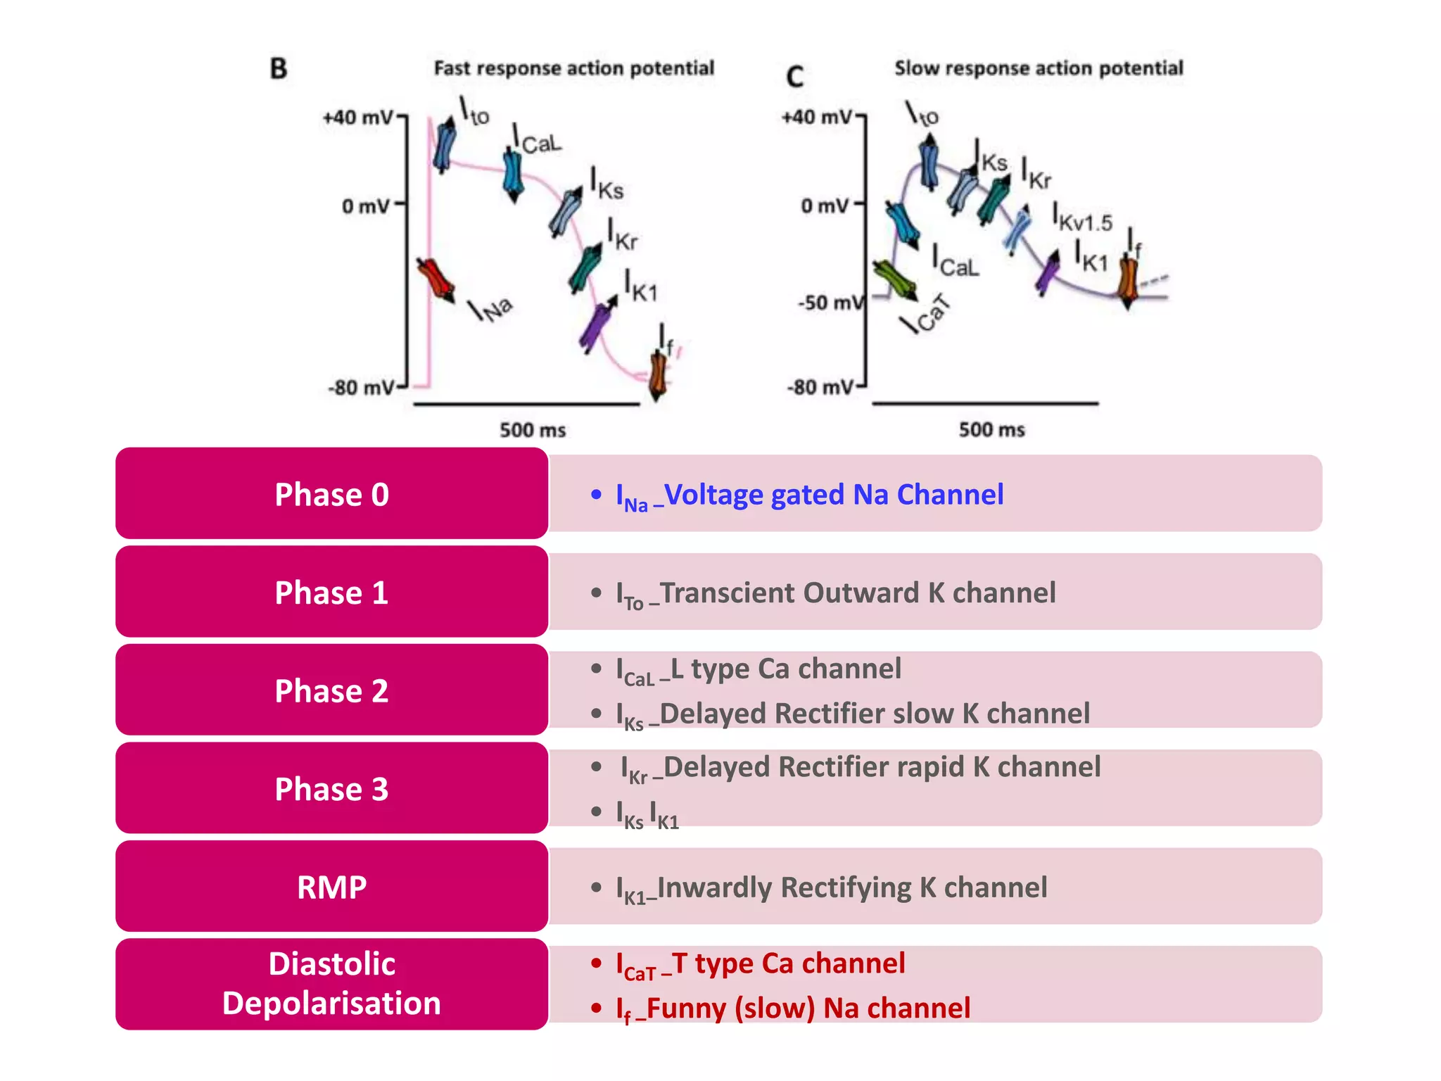

Slide 18
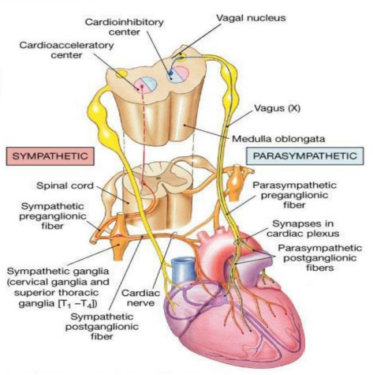
AUTONOMIC INNERVATION OF HEART

Slide 19
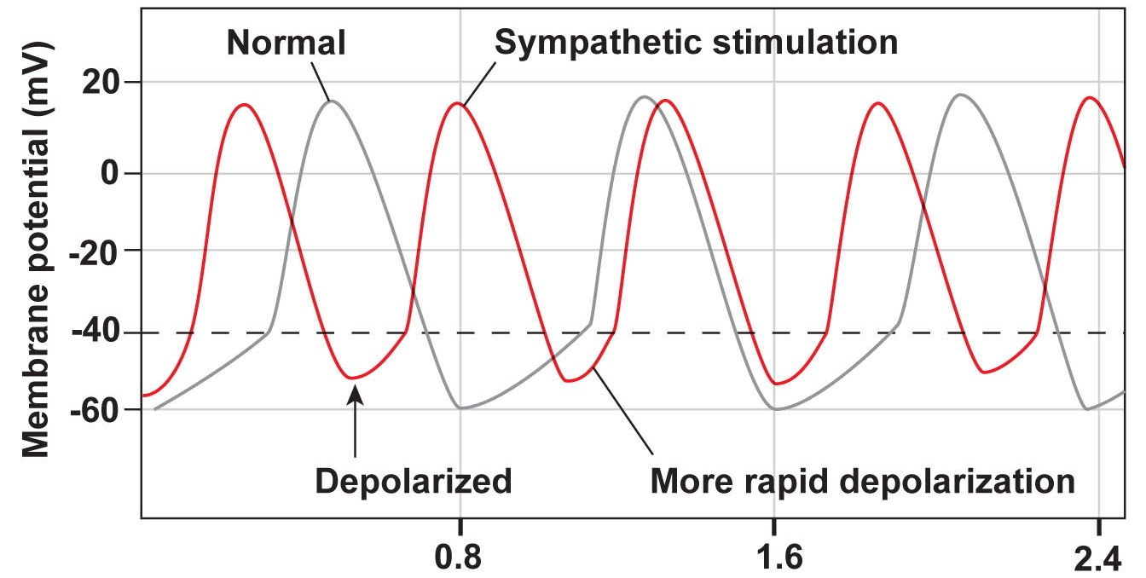
Myocardial Physiology Autorhythmic Cells (Pacemaker Cells)
Altering Activity of Pacemaker Cells
Sympathetic activity
NE and E increase I_{f} channel activity
Binds to β₁ adrenergic receptors which activate cAMP and increase I_{f} channel open time
Causes more rapid pacemaker potential and faster rate of action potentials
Sympathetic Activity Summary:
increased chronotropic effects ↑heart rate
increased dromotropic effects ↑conduction of APs
increased inotropic effects ↑contractility

Slide 20
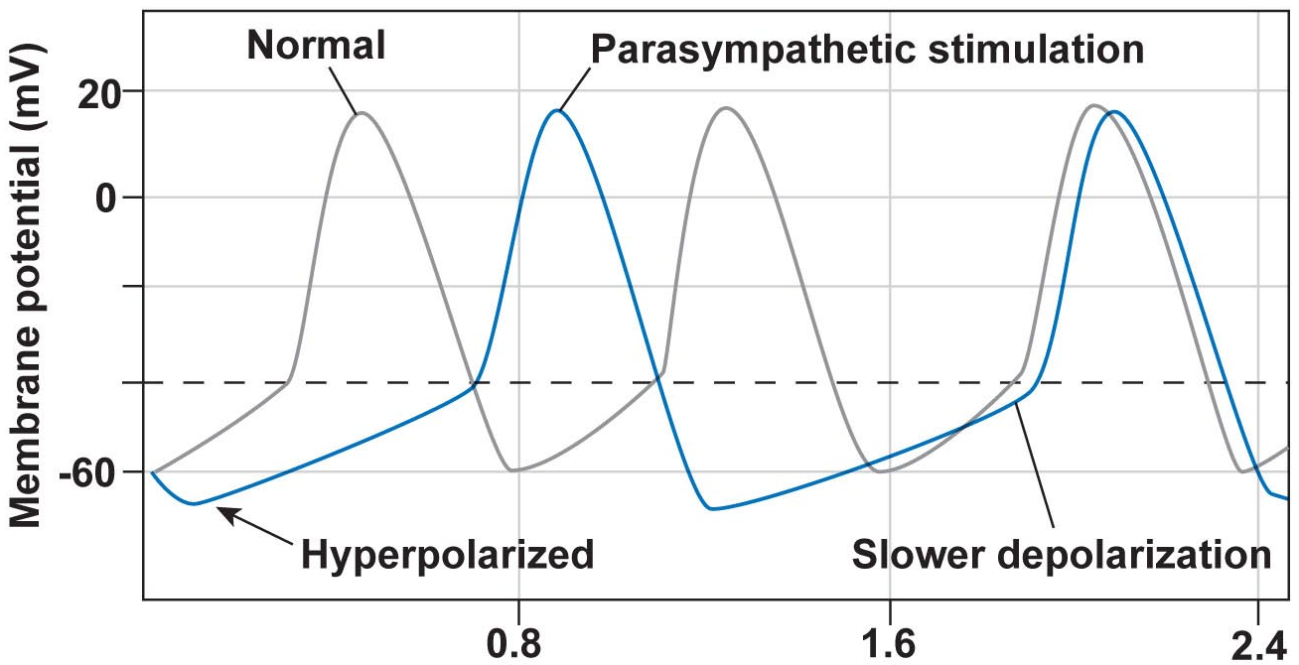
Myocardial Physiology Autorhythmic Cells (Pacemaker Cells)
Altering Activity of Pacemaker Cells
Parasympathetic activity
ACh binds to muscarinic receptors
Increases K⁺ permeability and decreases Ca²⁺ permeability = hyperpolarizing the membrane
Longer time to threshold = slower rate of action potentials
Parasympathetic Activity Summary:
decreased chronotropic effects ↓heart rate
decreased dromotropic effects ↓ conduction of APs
decreased inotropic effects ↓ contractility

Slide 21
FACTORS AFFECTING PACEMAKER POTENTIAL
• Hypokalemia and ischemia may reduce the activity of Na, K-ATPase, thereby reducing the background repolarizing current and enhancing phase 4 diastolic depolarization.
• The end result would be an increase in the spontaneous firing rate of pacemaking cells.

Slide 22
• Modest increases in extracellular potassium may render the maximum diastolic potential more positive, thereby also increasing the firing rate of pacemaking cells.
• A more significant increase in [K+]o, however, renders the heart inexcitable by depolarizing the membrane potential
• Normal or enhanced automaticity of subsidiary latent pacemakers produces escape rhythms in the setting of failure of more dominant pacemakers.

Slide 23
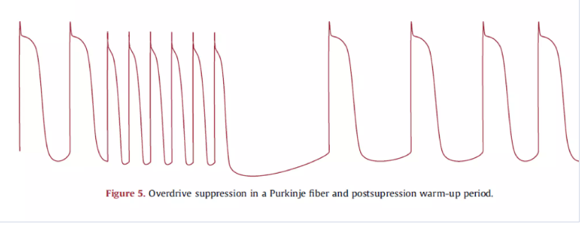
• Suppression of a pacemaker cell by a faster rhythm leads to an increased intracellular Na+ load ([Na+]i), and extrusion of Na+ from the cell by Na, K-ATPase produces an increased background repolarizing current that slows phase 4 diastolic depolarization.
• At slower rates, [Na+]i is decreased, as is the activity of the Na-K-ATPase, resulting in progressively more rapid diastolic depolarization and warm-up of the tachycardia rate.
• Overdrive suppression and warm-up are characteristic of, but may not be observed in, all automatic tachycardias.

Slide 24
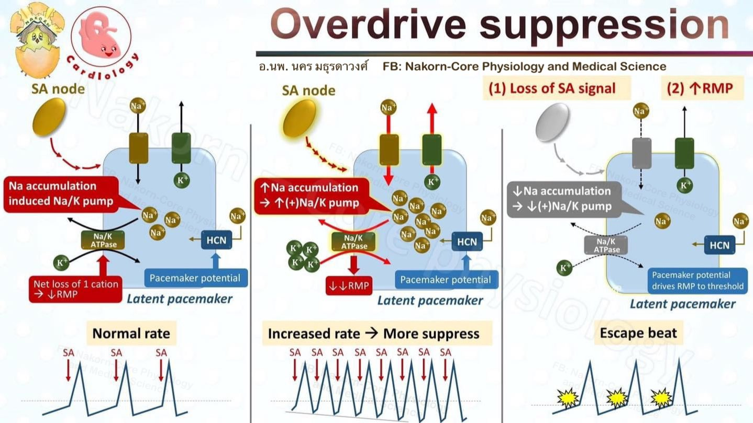

Slide 25
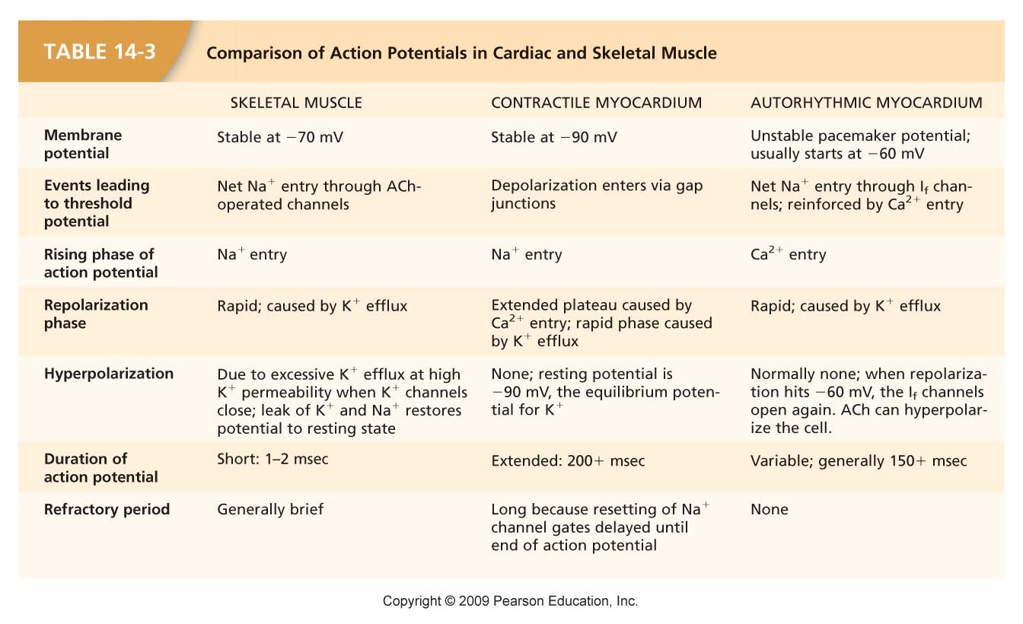

Slide 26
CONDUCTION SYSTEM OF THE HEART
1. SINO ATRIAL NODE
2. INTERNODAL ATRIAL PATHWAY
3. ATRIOVENTRICULAR NODE
4. BUNDLE OF HIS
5. PURKINJEE SYSTEM

Slide 27
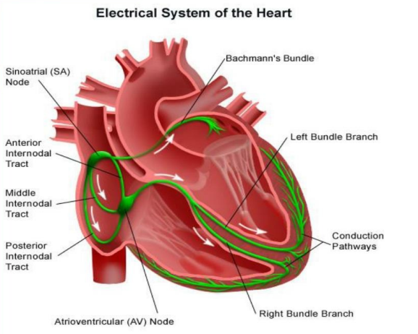
CONDUCTION SYSTEM OF HEART

Slide 28
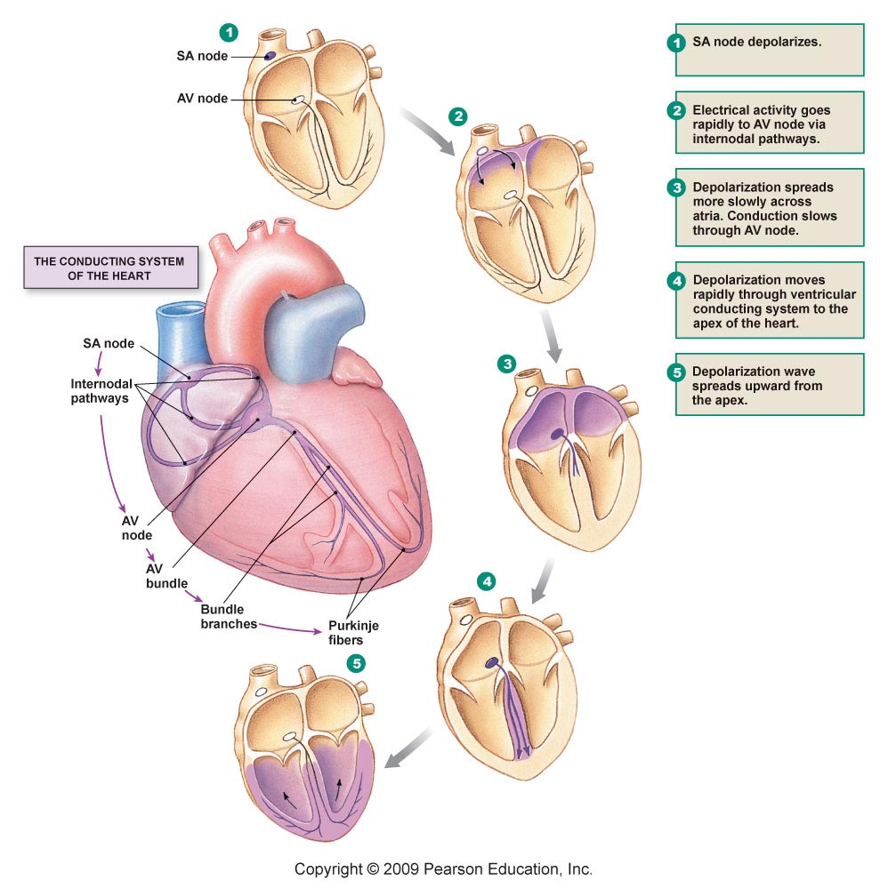

Slide 29
SA Node
The sinus node (also called sinoatrial node) is a small, flattened, ellipsoid strip of specialized cardiac muscle about 3 millimeters wide, 15 millimeters long, and 1 millimeter thick.
• The “head” of the sinus node is located at the superior margin of the terminal groove near the
anterolateral aspect of the junction between the right atrium and superior vena cava

Slide 30
The “tail” of the sinus nodal tissue can extend down
more than 50% of the length of the crista terminalis toward the inferior vena cava

Slide 31
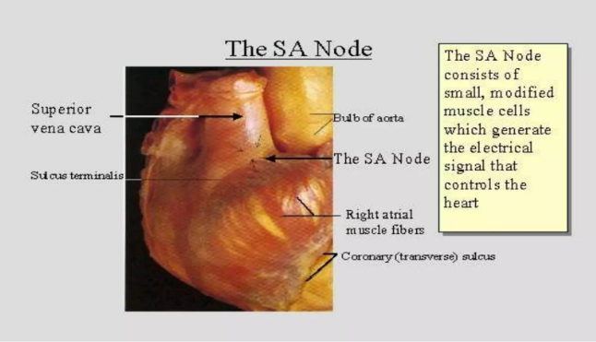

Slide 32
Pacemaker of the heart
• Lies- Junction of right atrial appendage with SVC - underlies uppermost part of Sulcus terminalis
• Dimensions – 10 to 20 mm X 1 mm X 3mm wide
• Composition – Specialised branching myocardial fibres embedded in dense matrix of fibrous tissue.
• Artery to SA node – 55% - Right coronary artery - 45% - Circumflex branch of LCA

Slide 33
Bachmann’s bundle is a prominent interatrial muscle bridge that extends across the roof of the atria anterosuperior to the fossa ovalis
The borders of the node are irregular with frequent interdigitations between nodal and ordinary atrial myocytes, facilitating communication between the node and right atrial wall

Slide 35
Clinical Significance of SA Node
During surgical operations such as the Mustard and Fontan procedures, the sinus node and its artery are susceptible to injury.
Electrophysiological studies support the concept of functional preferential pathways that travel along the crista terminalis and atrial septum including the limbus but not the valve of the fossa ovalis.
Internodal conduction disturbances therefore are not expected in transseptal procedures.

Slide 36
With the Mustard operation for complete transposition of the great arteries, there can be severe disturbance of internodal conduction because the entire septum is resected, and the surgical atriotomy can disrupt the crista terminalis.
Lipomatous hypertrophy of the atrial septum can interfere with internodal conduction and induce a variety of atrial arrhythmias.
Ventricular preexcitation is most commonly associated with aberrant bypass tracts that span the annulus of the tricuspid or mitral valve

Slide 37
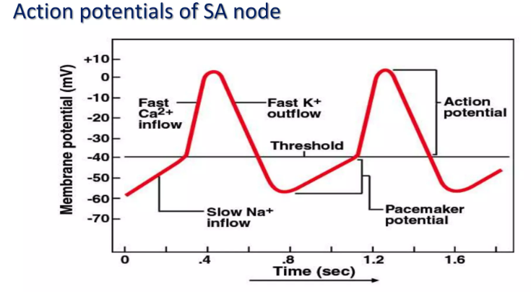

Slide 38
Spontaneous (phase 4) Diastolic depolarization underlies the property of automaticity (pacemaking) characteristic of cells in the sinoatrial (SA) and atrioventricular (AV) nodes, His-Purkinje system, coronary sinus, and pulmonary veins.
• Phase 4 depolarization results from the concerted action of a number of ionic currents, including K+ currents, Ca2+ currents, electrogenic Na-K-ATPase, the Na-Ca exchanger, and the so-called funny, or pacemaker, current (If).

Slide 39
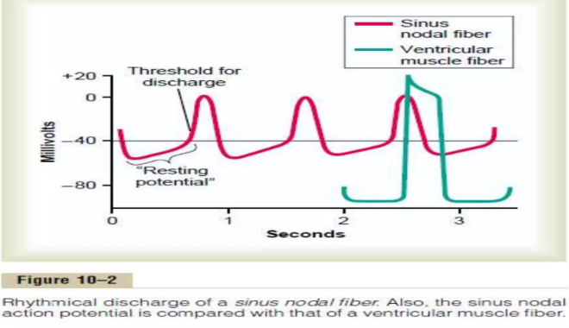

Slide 40
Depolarization of SA Node
• SA node - no stable resting membrane potential
• Pacemaker potential – gradual depolarization from -60 mV, slow influx of Na+
• Action potential
– at threshold -40 mV, fast Ca+2 channels open, (Ca+2 in)
– depolarizing phase to 0 mV, K+ channels open, (K+ out)
– repolarizing phase back to -60 mV, K+ channels close
• Each depolarization creates one heartbeat – SA node at rest fires at 0.8 sec, about 75 bpm

Slide 41
Self-Excitation of Sinus Nodal Fibers
• Because of the high sodium ion concentration in the extracellular fluid outside the nodal fiber, as well as a moderate number of already open sodium channels, positive sodium ions from outside the fibers normally tend to leak to the inside.
• Therefore, between heartbeats, influx of positively charged sodium ions causes a slow rise in the resting membrane potential in the positive direction.
• Thus, the “resting potential gradually rises between each two heartbeats”.
• When the potential reaches a threshold voltage of about -40 millivolts, the sodium-calcium channels become “activated,” thus causing the action potential.

Slide 42
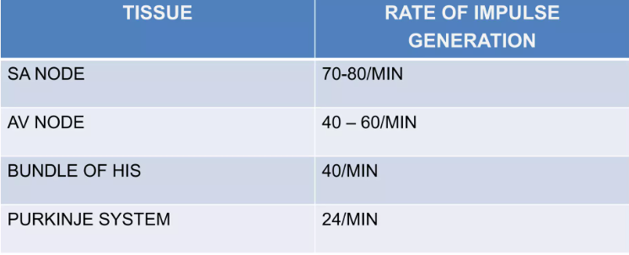

Slide 43
INTERNODAL CONDUCTION PATHS
• Special pathways in atrial wall
• Mixture of purkinje fiber and ordinary cardiac muscle cells
• Function to transmit impulses rapidly from SA node to AV node
• ANTERIOR-------- BACHMAN
• MIDDLE-------------WENCKEBACH
• POSTERIOR-------THOREL

Slide 44
ANTERIOR INTERNODAL TRACT
Bachmann’s Bundle
• BEGINNING -leaves the anterior end of the sinuatrial node
• COURSE -passes anterior to the superior vena caval opening -descends on the atrial septum
• TERMINATION - in the atrioventricular node.
• Tract composed of both ordinary Myocardial & Purkinje fibres

Slide 45
MIDDLE INTERNODAL PATHWAY
PATHWAY of Wenkebach
• BEGINNING -leaves the posterior end of the sinuatrial node
• COURSE - passes posterior to the superior vena caval opening descends on the atrial septum
• TERMINATION - upper end of atrioventricular node.

Slide 46
POSTERIOR INTERNODAL PATHWAY of Thorel
PATHWAY of Thorel
• BEGINNING -Leaves the posterior part of the sinuatrial node
• COURSE -descends through the crista terminalis and the valve of the IVC
• TERMINATION - Atrioventricular node.
• Formed mainly of Purkinje type fibres

Slide 47
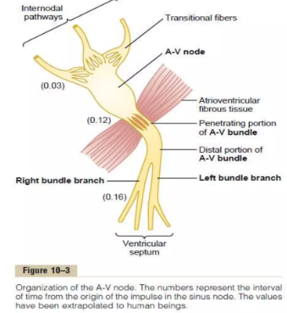
The ends of the sinus nodal fibres connect directly with surrounding atrial muscle fibres. Therefore, action potentials originating in the sinus node travel outward into these atrial muscle fibres.
• The velocity of conduction in most atrial muscle is about 0.3 m/sec, but conduction is more rapid, about 1 m/sec, in several small bands of atrial fibres.

Slide 48
Sinoatrial (SA) node is the pacemaker of the heart because of:
A. Location in the right atrium.
B. Neural control.
C. Natural leakiness to Na+
D. Natural leakiness to K+

Slide 49
If the S-A node discharges at 0.00 seconds, when will the action potential normally arrive at the AV bundle
A. 0.22 sec.
B. 0.18 sec.
C. 0.16 sec.
D. O.12 sec.
E. 0.09 sec.

Slide 50
Which one of the structure connects directly with surrounding atrial muscle fibers?
A. (SA) node.
B. Internodal pathways.
C. Purkinje fibers.
D. (AV) node.

Slide 51
Which among the following is false??
A) ischemia may increase the activity of Na, K-ATPase
B) Pacemaker potential – gradual depolarization from -60 mV, fast influx of Na+
C) SA node is 2 millimeter thick.
D) both A and C
E) all the above

Slide 52
AV Node
• Node of Tawara
• Lies- Subendocardially in medial wall of Rt atrium
- 1cm above the opening of coronary sinus
- basal attachment of septal cusp of tricuspid valve
• Histologically – “An entanglement ” – fine poorly striated branching specialized myocardial fibres. No dense fibrous matrix.
• Artery to AV node – 90% - Right coronary artery - 10 % - Circumflex branch of LCA
Delay of about 0.12 sec in conduction through AV node

Slide 53
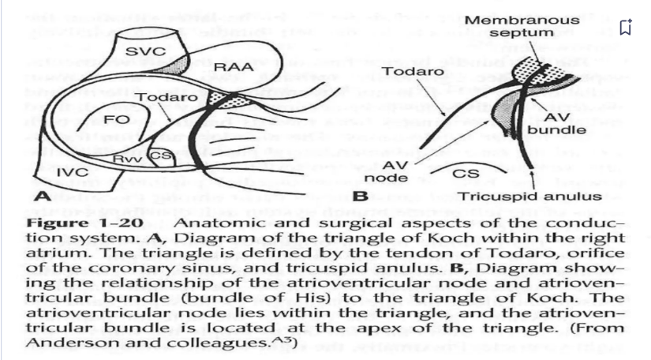

Slide 54
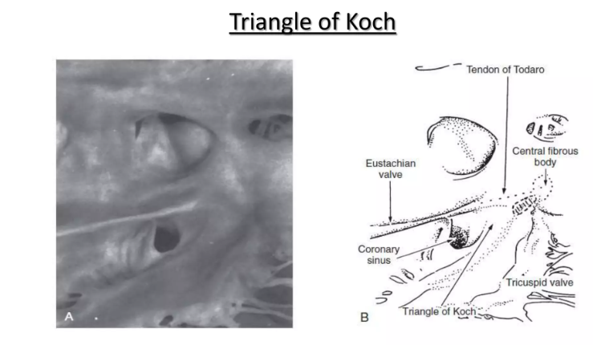

Slide 55
Anatomical importance
Because of its right atrial location near the tricuspid annulus, the AV node is susceptible to injury during tricuspid annuloplasty and during plication procedures for Ebstein anomaly.

Slide 56
• As with the SA node, the AV node has extensive autonomic innervation and an abundant blood supply.
• The AV node consists of three regions— distinguished by functional and histologic differences
1) the transitional cell zone
2) compact node
3) penetrating bundle

Slide 57
The transitional cell zone, which consists of cells constituting the atrial approaches to the compact AV node, has the highest rate of spontaneous diastolic depolarization..
• The compact node is composed of groups of cells that have extensions into the central fibrous body and the annulus of the mitral and tricuspid valves. These cells appear to be the site of most of the conduction delay through the AV node.
• The penetrating bundle consists of cells that lead directly into the His bundle and its branching portion

Slide 58
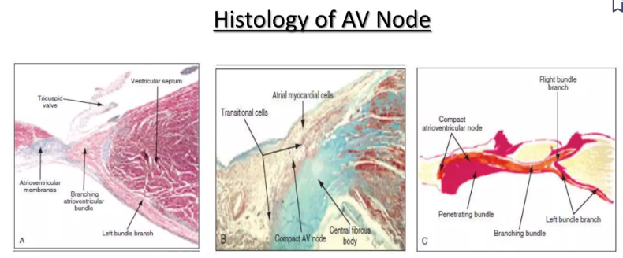

Slide 59
Cause of the Slow Conduction
diminished numbers of gap junctions between successive cells in the conducting pathways, so that there is great resistance to conduction of excitatory ions from one conducting fibre to the next.

Slide 60
BUNDLE OF HIS
• The AV nodal tissue merges with the His bundle, which runs through the inferior portion of the membranous interventricular septum, and then in most cases, continues along the left side of the crest of the muscular interventricular septum.
• The proximal part of the His bundle rests on the right atrial-left ventricular (RA-LV) part of the membranous septum and the more distal part travels along the right ventricle-left ventricular (RV-LV) part of the membranous septum immediately below the aortic root

Slide 61
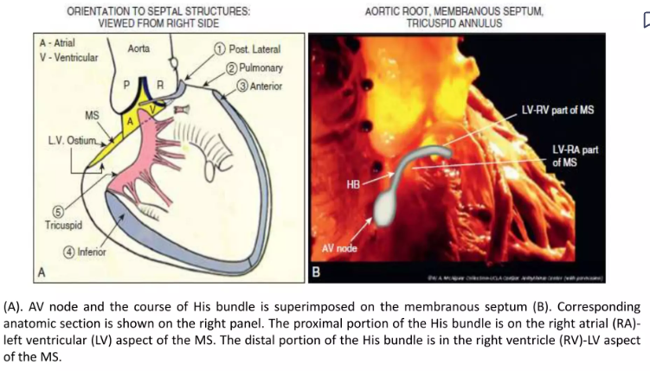
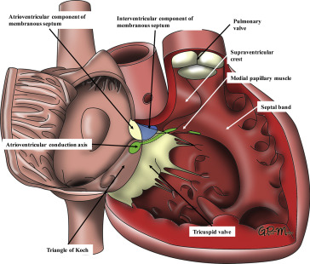

Slide 62
Anatomical importance
The AV bundle travels through the central fibrous body (right fibrous trigone) and therefore is closely related to the annuli of the aortic, mitral, and tricuspid valves.
Thus, during operative procedures involving these valves or a membranous ventricular septal defect, care must be taken to avoid injury to the His bundle.

Slide 63
TYPES OF HIS BUNDLE
• Based on locational variations of the His bundle relative to the membranous part of the ventricular septum.
• In type I (46.7% ), His bundle consistently coursed along the lower border of the membranous part of the interventricular septum but was covered with a thin layer of myocardial fibers spanning from the muscular part of the septum

Slide 64
In type II (32.4%), the His bundle apart from the lower border of the membranous part of the interventricular septum ran within the interventricular muscle

Slide 65
In type III (21%), the His bundle immediately beneath the endocardium and coursed onto the membranous part of the interventricular septum (naked AV bundle)

Slide 66
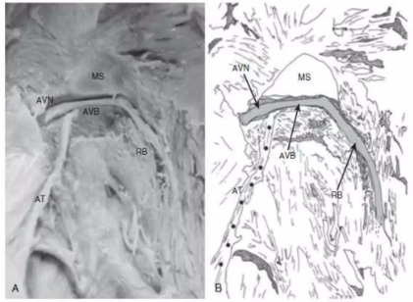
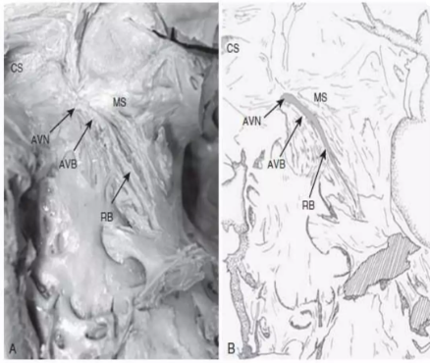
TYPE I
TYPE II

Slide 67
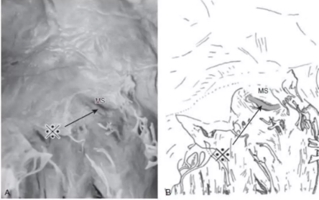
TYPE III

Slide 68
These anatomic variations of the His bundle may have clinical implications for permanent His bundle pacing and to avoid His bundle injury during surgical reconstruction of the membranous part of a ventricular septal defect.

Slide 69
Blood supply-his bundle
The His bundle usually receives a dual blood supply from both the AV nodal artery and branches of the LAD.
• Unlike the SA and AV nodes, the bundle of His and Purkinje system have relatively little autonomic innervation.

Slide 70
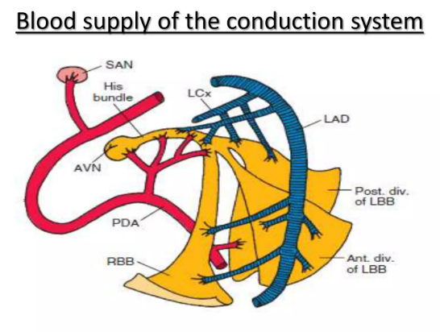

Slide 71
Right Bundle Branch(RBB)
• The right bundle branch (RBB) originates from the His bundle.
• It is a narrow compact structure
• crosses to the right side of the IVS
extends along the RV endocardial surface to the region of the anterolateral papillary muscle of the RV,
where it divides to supply the papillary muscle, the parietal RV surface, and the lower part of the RV surface.
• The proximal portion of the RBB is supplied by branches from the AV nodal artery or the LAD artery, whereas the more distal portion is supplied mainly by branches of the LAD artery.

Slide 72
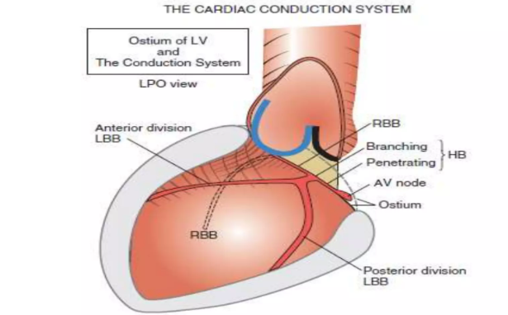

Slide 73
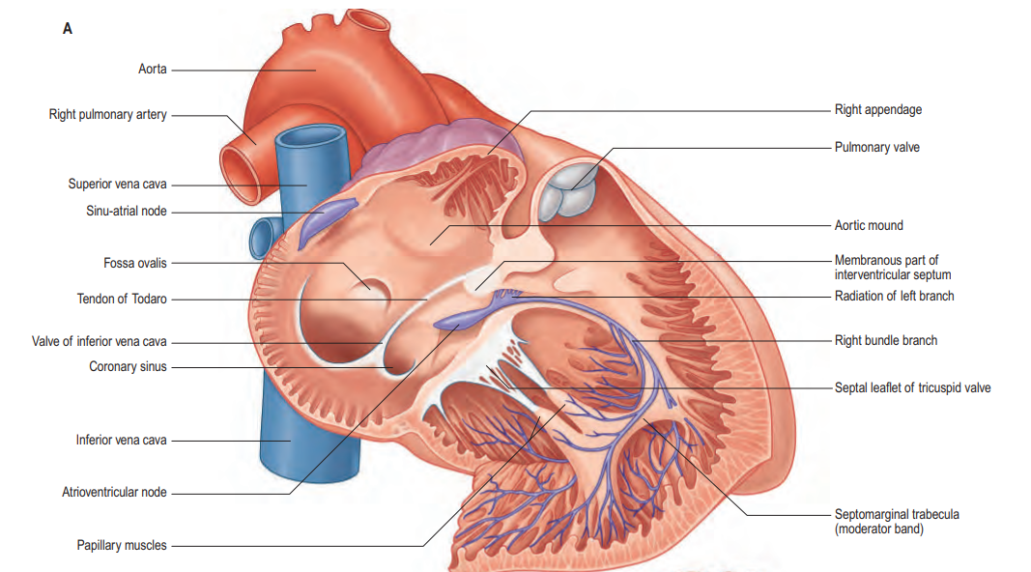

Slide 74
Left Bundle Branch(LBB)
• Anatomically much less discrete than the RBB.
• The LBB may divide immediately as it originates from the bundle of His or may continue for 1 to 2 cm as a broad band before dividing.
• The LBB fibers spread out over the left ventricle in a fan-like manner, a “cascading waterfall,” with many subendocardial interconnections that resemble a syncytium rather than two anatomically discrete distinct branches or fascicles.

Slide 75
• As originally proposed by Rosenbaum it is clinically useful to consider the LBB as dividing into an anterior branch or fascicle and a larger and broader posterior branch or fascicle, both of which radiate toward the anterior and posterior papillary muscles of the left ventricle respectively.
• The LBB and its anterior fascicle have a blood supply similar to that of the proximal portion of the RBB; the left posterior fascicle is supplied by branches of the AV nodal artery, the posterior descending artery, and the circumflex coronary artery.

Slide 76
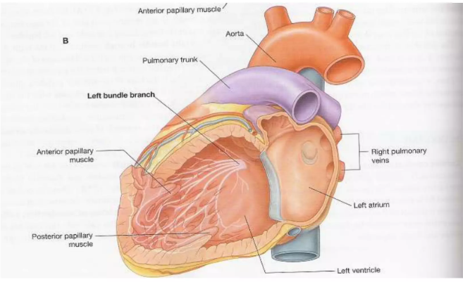

Slide 77
Bundle branches Anatomical Imporance
Left ventricular pseudotendons can contain conduction tissue from the left bundle branch.
The left bundle branch can be disrupted following surgical myectomy, whereas the right bundle branch can be damaged during percutaneous alcohol septal ablation.
Following right ventriculotomy for reconstruction of the right ventricular outflow tract, the electrocardiogram shows a pattern of right bundle-branch block even though the right bundle is not disrupted.

Slide 78
Rapid Transmission in the Ventricular Purkinje System
• Special Purkinje fibres lead from the A-V node through the A-V bundle into the ventricles.
• They are very large fibres, even larger than the normal ventricular muscle fibres,
transmit action potentials at a velocity of 1.5 to 4.0 m/sec, a velocity about 6 times that in the usual ventricular muscle and 150 times that in some of the A-V nodal fibres.
• This allows almost instantaneous transmission of the cardiac impulse throughout the entire remainder of the ventricular muscle

Slide 79
• Therefore, ions are transmitted easily from one cell to the next, thus enhancing the velocity of transmission.
• The Purkinje fibres also have very few myofibrils, which means that they contract little or not at all during the course of impulse transmission.

Slide 80
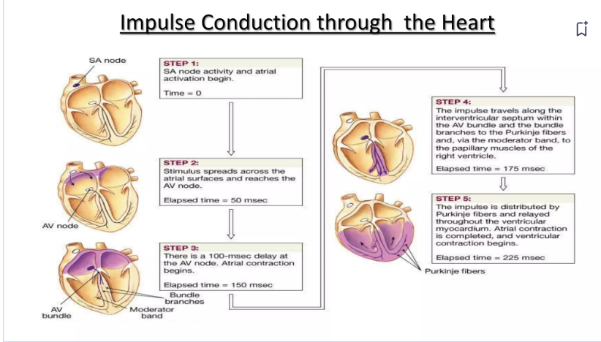

Slide 81
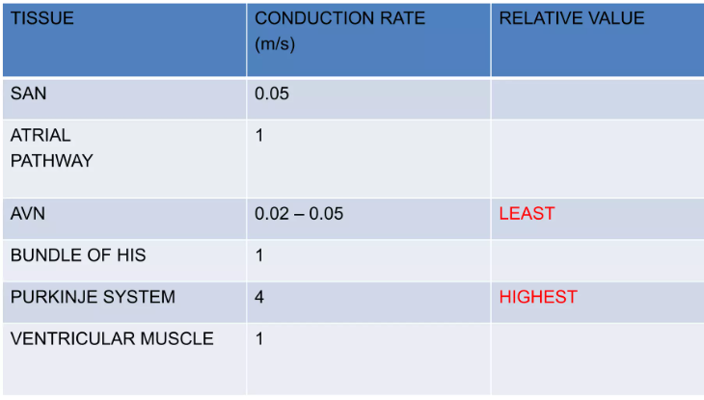

Slide 82
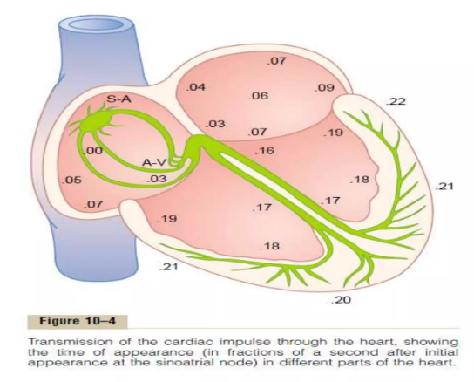

Slide 83
ATRIAL DEPOLARIZATION COMPLETES in 0.1 S
AV NODAL DELAY 0.1 SEC
SPREADING OF DEPOLARIZATION PURKINJE FIBERS – VENTRICLE 0.08 – 0.1 S
DEPOLARIZATION WAVE MOVES FROM LEFT TO RIGHT THROUGH SEPTUM
THE LAST PART OF THE HEART TO BE DEPOLARIZED
1.POSTERO BASAL PORTION OF THE LV
2. PULMONARY CONUS
3.UPPER MOST PORTION OF THE SEPTUM

Slide 84
Control of Excitation and Conduction in the Heart
The Sinus Node as the Pacemaker of the Heart:
• The impulse normally arises in the sinus node
• In some abnormal conditions, a few other parts of the heart can exhibit intrinsic rhythmical excitation in the same way that the sinus nodal fibers do;
• This is particularly true of the A-V nodal and Purkinje fibers.
• The A-V nodal fibers, when not stimulated from some outside source, discharge at an intrinsic rhythmical rate of 40 to 60 times per minute, and the Purkinje fibers discharge at a rate somewhere between 15 and 40 times per minute.
• These rates are in contrast to the normal rate of the sinus node of 70 to 80 times per minute.

Slide 85
Why does the sinus node rather than the A-V node or the Purkinje fibers control the heart’s rhythmicity?
• The discharge rate of the sinus node is considerably faster than the natural self- excitatory discharge rate of either the A-V node or the Purkinje fibers.
• Each time the sinus node discharges, its impulse is conducted into both the A-V node and the Purkinje fibers, also discharging their excitable membranes.
• But the sinus node discharges again before either the A-V node or the Purkinje fibers can reach their own thresholds for self-excitation.
• Therefore, the new impulse from the sinus node discharges both the A-V node and the Purkinje fibers before self-excitation can occur in either of these.

Slide 86
Abnormal Pacemakers—“Ectopic” Pacemaker
. • Occasionally some other part of the heart develops a rhythmical discharge rate that is more rapid than that of the sinus node.
• For instance, this sometimes occurs in the A-V node or in the Purkinje fibers when one of these becomes abnormal.
• The pacemaker of the heart shifts from the sinus node to the AV node or to the excited Purkinje fibers.
• Under rarer conditions, a place in the atrial or ventricular muscle develops excessive excitability and becomes the pacemaker

Slide 87
• A pacemaker elsewhere than the sinus node is called an “ectopic” pacemaker.
An ectopic pacemaker causes an abnormal sequence of contraction of the different parts of the heart and can cause significant debility of heart pumping.
• Another cause of shift of the pacemaker is blockage of transmission of the cardiac impulse from the sinus node to the other parts of the heart.
• The new pacemaker then occurs most frequently at the A-V node or in the penetrating portion of the A-V bundle on the way to the ventricles

Slide 88
• When A-V block occurs
—>cardiac impulse fails to pass from the atria into the ventricles through the A-V nodal and bundle system
—>the atria continue to beat at the normal rate of rhythm of the sinus node
--->while a new pacemaker usually develops in the Purkinje system of the ventricles and drives the ventricular muscle at a new rate somewhere between 15 and 40 beats per minute.

Slide 89
STOKES ADAMS SYNDROME
• After sudden A-V bundle block, the Purkinje system does not begin to emit its intrinsic rhythmical impulses until 5 to 20 seconds later because, before the blockage, the Purkinje fibres had been “overdriven” by the rapid sinus impulses and, consequently, are in a suppressed state.
• During these 5 to 20 seconds, the ventricles fail to pump blood, and the person faints after the first 4 to 5 seconds because of lack of blood flow to the brain.
• This is called Stokes-Adams syndrome.

Slide 90
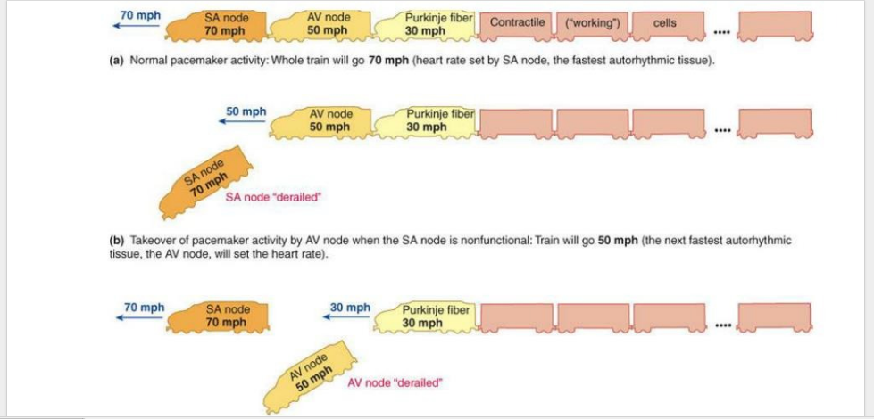
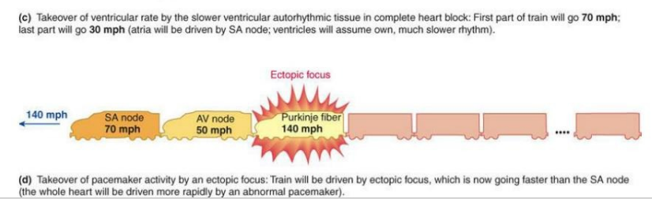

Slide 91
MCQS

Slide 92
AV NODAL REGION with highest rate of spontaneous diastolic depolarisation is
Transitional cell zone
compact node
Penetrating bundle

Slide 93
Which part of conduction system conducts the slowest
SA NODE
AV NODE
BUNDLE OF HIS
PURKINJE FIBRES

Slide 94
Which part of the conduction system conducts the fastest
SA NODE
AV NODE
BUNDLE OF HIS
PURKINJE FIBRES

Slide 95
Rate of discharge of purkinje fibres is
1.15-40
2.70-80
3.40-60
4.100-150

Slide 96
The part of the conduction system likely to be damaged during ebsteins anomaly surgery is mainly
1.SANODE
2.AV NODE
3.BUNDLE OF HIS
4.PURKINJE FIBRES

Slide 97
TYPE OF HIS BUNDLE THAT runs immediately beneath the endocardium and coursed onto the membranous part of the interventricular septum (naked AV bundle)
1.Type 1
2.Type 2
3.Type 3

Slide 98
THANK YOU!

Slide 99
References
_{Hurst’s The Heart,15th edition}
Braunwald’s Heart diseases,a textbook of Cardiovascular Medicine ,12th edition
_{Gray’s Anatomy,41st edition}
Netter’s Cardiology 3rd edition
Handbook of Cardiac Anatomy, Physiology, and Devices, Paul A. Iaizzo 3rd edition
Human Physiology by Lauralee sherwood 7th edition
Textbook of Physiology by Guyton and Hall 11th edition
Textbook of Physiology by Linda.S.Contanzo 3rd edition
ITACA-CM: Translational research on Inherited Cardiac arrythmias:Correlation between the cardiac action potential in the surface electrocardiogram Pacemaker activity
Bifurcations and Proarrhythmic Behaviors in Cardiac Electrical Excitations by Kunichika TsumotoORCID andYasutaka Kurata *Biomolecules 2022,

