Slide 1
MECHANISMS OF CARDIAC ARRHYTHMIAS AND CONDUCTION DISTURBANCES
Dr. Aiswarya Ravikrishnan

Slide 2
Overview of Cardiac Activation & Autonomic Influence
Cardiac activation and repolarization involve ionic movement across cardiomyocyte membranes.
These processes are heavily influenced by the autonomic nervous system.
Disruption in ionic activity contributes significantly to cardiac arrhythmogenesis.

Slide 3
Classification of Arrhythmic Activity
Passive arrhythmia: e.g., Atrioventricular (AV) block.
Active arrhythmia mechanisms:
Abnormal or enhanced impulse formation
Reentry

Slide 4
Reentry Mechanism in Arrhythmias
Occurs when a propagating impulse persists after the refractory period.
Implicated in both atrial and ventricular tachyarrhythmias.
Supported by multichannel mapping studies.
Key concepts:
Phase 2 reentry
Spiral waves
Mother rotors
Fibrillatory conduction

Slide 5
Abnormal Impulse Formation
Automaticity:
Normal automaticity
Abnormal automaticity
Triggered activity types:
Early afterdepolarizations (EADs)
Late phase 3 EADs
Delayed afterdepolarizations (DADs)

Slide 6
Emerging Insights
Traditional distinction between automaticity and triggered activity is being reconsidered.
New evidence suggests overlapping mechanisms in arrhythmogenesis.

Slide 7
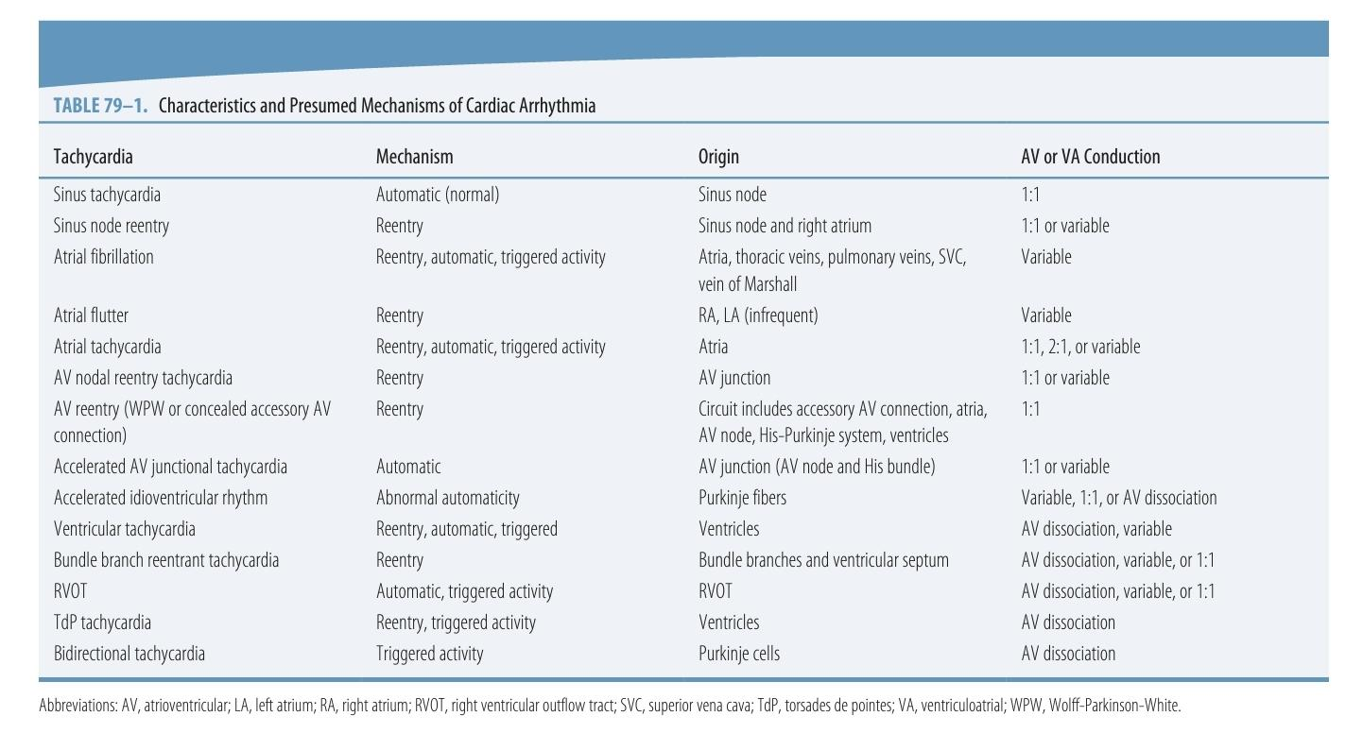

Slide 8
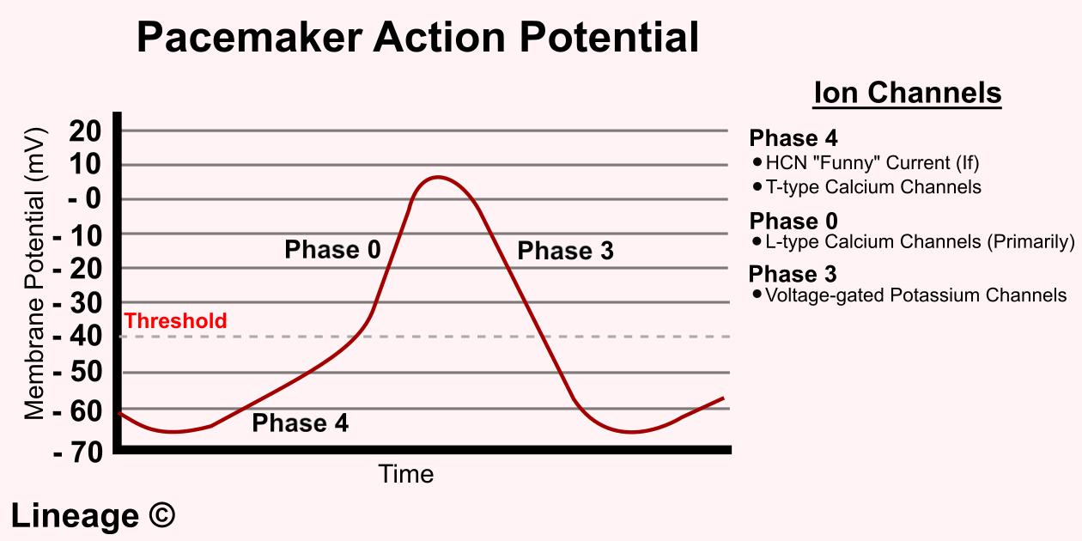

Slide 9
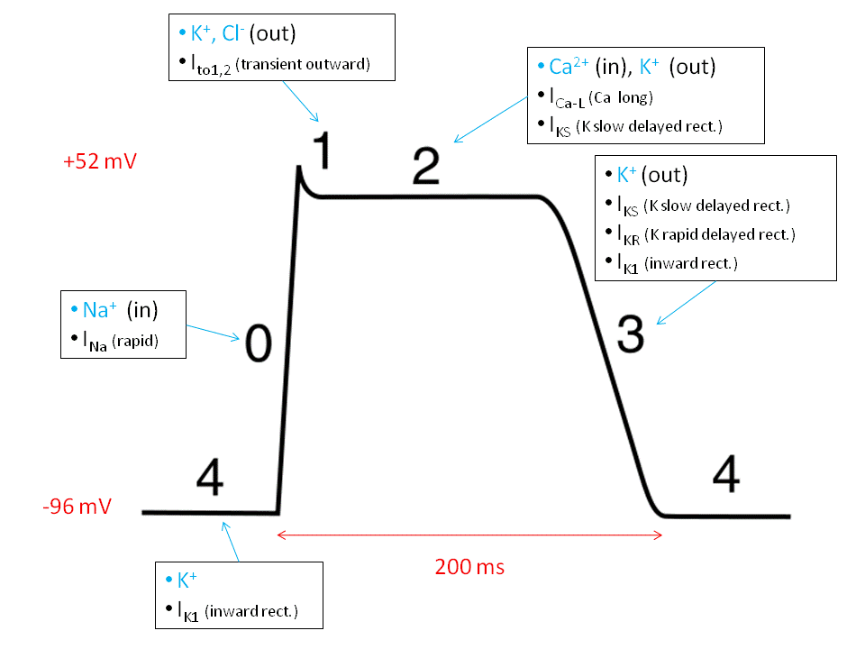

Slide 10
Definition of Automaticity
Automaticity: The ability of cardiac cells to spontaneously generate action potentials.
Caused by diastolic depolarization during phase 4 of the action potential.
Results from a net inward current that gradually brings the membrane potential to threshold.

Slide 11
Role of the Sinoatrial (SA) Node
The SA node has the highest intrinsic firing rate.
Acts as the primary pacemaker of the heart.
Subsidiary (latent) pacemakers take over only if the SA node fails:
When SA node doesn't generate impulses.
When SA node impulses fail to propagate.

Slide 12
Hierarchy of Pacemaker Automaticity
Atrial pacemakers: Faster intrinsic rate than AV junctional pacemakers.
AV junctional pacemakers: Faster than ventricular pacemakers.
Establishes a hierarchy of backup pacemaking based on intrinsic firing rates.

Slide 13
Automaticity vs. Triggered Activity – Definitions
Wit & Cranefield’s Definitions:
Automatic activity: Arises spontaneously without external stimulation.
Example: SA node spontaneous firing.
Triggered activity: Initiated by preceding driven action potentials.
Seen in fibers that remain quiescent until stimulated at high rates.

Slide 14
Evolving Understanding
Triggered activity involves:
Non-driven action potentials that are induced by prior stimulation.
Shared mechanism suggested:
Sodium-calcium exchange current (I_{NCX}) may contribute to both automatic and triggered activity.
Blurred distinction between classical definitions of automaticity and triggered mechanisms.

Slide 15
The Voltage Clock and Automaticity
Coupled Clock System in SA Node Automaticity
Lakatta et al. described two interacting mechanisms:
Membrane clock: Voltage-sensitive membrane currents.
Calcium (Ca) clock: Intracellular calcium cycling.
These two clocks are mutually entrained, forming a robust coupled system driving pacemaker automaticity.

Slide 16
Membrane Clock Mechanism
Key current: Hyperpolarization-activated pacemaker current (I_{f}) or “funny” current.
Activated by hyperpolarization (−40/−50 mV to −100/−110 mV).
Responsible for early diastolic depolarization.
Mixed Na⁺/K⁺ inward current modulated by autonomic input:
↑ by sympathetic stimulation (via cAMP/isoproterenol).
↓ by parasympathetic stimulation (via acetylcholine).
Plays a central role in heart rate regulation.

Slide 17
Calcium Clock & Excitation-Contraction Coupling
Depolarization activates L-type Ca²⁺ current (I_{Ca,L}).
Triggers RyR2-mediated Ca²⁺ release from the sarcoplasmic reticulum.(type 2 (cardiac) ryanodine receptor)
Ca²⁺-induced Ca²⁺ release leads to myocardial contraction.
Ca²⁺ reuptake by SERCA2a (sarcoplasmic reticulum Ca-ATPase) completes the Ca²⁺ cycling process.

Slide 18
Role of SK Currents in Automaticity
Small-conductance Ca²⁺-activated K⁺ current (I_{SK}) modulates pacemaker activity.
SK2 channels:
Overexpression → ↑ Firing frequency, shortened APs.
Ablation → ↓ Firing frequency, prolonged APs.
SK current, being Ca²⁺-activated, may link the Ca clock to membrane clock.

Slide 19
Role of Na⁺-Ca²⁺ Exchanger (I_{NCX}) in Pacemaking
I_{f} is not the only depolarizing current in phase 3/4.
Na⁺-Ca²⁺ exchanger current (I_{NCX}) operates in forward mode:
3 Na⁺ in / 1 Ca²⁺ out → net inward depolarizing current.
Active during late phase 3 and phase 4 due to prolonged Ca²⁺ decay post-AP.

Slide 20
Ca²⁺ Cycling & Activation of I_{NCX}
Sequence:
Spontaneous Ca²⁺ release from sarcoplasmic reticulum (SR).
Intracellular Ca²⁺ elevation.
Activation of I_{NCX}.
Membrane depolarization.
This mechanism underlies normal pacemaker activity.
Tightly regulated by:
cAMP signaling
Autonomic nervous system

Slide 21
Sympathetic Modulation of Ca²⁺ Clock
Sympathetic stimulation:
↑ Heart rate via phosphorylation of Ca²⁺ handling proteins:
Phospholamban (regulator of SERCA2a) (inhibitor when dephoshorylated)
L-type Ca²⁺ channels
RyR2 (SR Ca²⁺ release channels)
Controls timing and magnitude of SR Ca²⁺ release.
Critical for basal and reserve pacemaker function.

Slide 22
Multicentric Origin of SA Node Rhythm
SA node is not a uniform structure — has multicentric impulse origins.
Activation maps show shifting pacemaker sites within right atrium.
Sympathetic stimulation causes cranial (superior) shift of leading pacemaker site.

Slide 23
Experimental Evidence for Ca²⁺ Clock in Intact SA Node
Langendorff-perfused canine heart studies:
Showed late diastolic Ca²⁺ elevation precedes AP upstroke.
Confirms role of Ca²⁺ clock in impulse generation.
Isoproterenol (β-agonist) enhances:
Spontaneous SR Ca²⁺ release
Heart rate acceleration
Cranial shift in pacemaker site

Slide 24
Clinical Implications
Multicentric pacemaker origin confirmed in human sinus rhythm.
Heart failure:
Associated with SA node dysfunction
Fewer early activation sites
Atrial fibrillation (AF) and symptomatic bradycardia:
Superior SA node shows impaired response to sympathetic stimulation.
Diagnostic and therapeutic relevance in sinus node disease.

Slide 25
Automaticity Beyond the SA Node
SA node, AV node, and Purkinje fibers all exhibit automaticity.
Membrane potential ranges:
SA/AV nodes: –70 to –35 mV
Purkinje fibers: –90 to –65 mV
Ionic current contribution (I_{f}, I_{K}) varies with cell type.
AV node, like SA node, has significant Ca²⁺ clock contribution.
SA node has fastest intrinsic rate, thus primary pacemaker.

Slide 26
Subsidiary Pacemakers & Latent Sites
If SA node fails, latent pacemakers take over → bradycardia.
Subsidiary atrial pacemaker sites:
Junction of inferior RA and IVC (Eustachian ridge)
Crista terminalis, coronary sinus orifice
Atrial extensions into tricuspid & mitral valves
Myocardial sleeves in pulmonary veins and venae cavae

Slide 27
AV junctional pacemakers generate junctional rhythms.
These pacemakers are modulated by autonomic tone:
↑ Sympathetic → ↑ rate
↑ Parasympathetic → ↓ rate

Slide 28
His-Purkinje System & Autonomic Regulation
Slowest pacemaker: His-Purkinje fibers in ventricles.
Weak parasympathetic effect; sympathetic tone dominates.
Accentuated antagonism: ACh indirectly reduces automaticity by inhibiting sympathetic activity.
Adenosine has no baseline effect but:
↓ activation rate during adrenergic stimulation (e.g., isoproterenol)
Acts via antiadrenergic (not direct parasympathetic) pathway
This mechanism is protective during ischemia or adrenergic stress, preventing excessive ventricular automaticity.

Slide 29
Gene-Based Engineering of Cardiac Pacemakers
Goal: Convert non-pacemaker myocytes into pacemaker cells.
Approach 1:
Suppress inward rectifier K⁺ current (I_{K1})
Reduces membrane stability → enhances automaticity in ventricular cells.
Approach 2:
Insert HCN (hyperpolarization-activated cyclic nucleotide-gated) channels
Methods: viral gene transfer, stem cell tech, or cell fusion
HCN expression → activates I_{f} → induces pacemaker activity

Slide 30
Approach 3:
Reprogram embryonic stem cells to express pacemaker gene profile
Leads to upregulation of automaticity pathways during development
Key Insight:
Confirms central role of I_{f} current in generating automaticity
Clinical utility still under development; human application not yet established

Slide 31
AUTOMATICITY AS A MECHANISM OF CARDIAC ARRHYTHMIAS
Abnormal Automaticity – Bradycardia & Tachycardia
Abnormal automaticity includes:
↓ Automaticity → Bradycardia
↑ Automaticity → Tachycardia
Mechanisms include:
Disease or dysfunction of the SA node
Enhanced automaticity in subsidiary pacemaker sites
Autonomic imbalance (e.g., ↑ vagal tone)

Slide 32
Shift in pacemaker origin:
From central SA node to other atrial or junctional sites
SA Node Dysfunction:
Slowed impulse generation or conduction block
May result in sinus bradycardia or sinus pauses

Slide 33
AV Junctional Rhythms:
Occur when:
AV junctional pacemakers (AV node or His bundle) become faster than SA node
Or SA node is too slow to suppress these latent pacemakers
Clinical Implication:
Bradyarrhythmias often require pacemaker support
Tachyarrhythmias may respond to rate control or antiarrhythmic therapy

Slide 34
Genetic Bradycardia – Role of HCN4 Mutation
Bradycardia can occur in structurally normal hearts due to genetic mutations affecting pacemaker mechanisms.
HCN4 Channel Mutation:
Affects HCN4 subtype responsible for carrying I_{f} current (membrane clock)
Leads to altered expression and kinetics of I_{f}
Causes familial bradycardia

Slide 35
Clinical Characteristics:
Bradycardia may be asymptomatic
Exercise response:
Suboptimal in some: Max HR ~100 bpm
Normal in others: Max HR >150 bpm
Explanation for normal HR response:
Ca²⁺ clock remains intact
During sympathetic stimulation, Ca clock can sufficiently increase sinus rate

Slide 36
Secondary Node Dysfunction: in Heart Failure & AF
Common diseases like heart failure and AF are frequently linked to SA node dysfunction.
Dual Mechanism Involvement:
Malfunction of membrane clock (e.g., HCN4/I_{f})
Malfunction of Ca²⁺ clock (intracellular Ca regulation)

Slide 37
Heart Failure:
↓ HCN4 expression → impaired sinus node function
↑ Atrial HCN4 expression → may promote atrial arrhythmias
Defective Ca²⁺ handling also contributes to dysfunction
Atrial Fibrillation (AF):
Associated with disturbed membrane and Ca clocks
SA node dysfunction is often reversible after successful catheter ablation
Key Insight:
SA node dysfunction in these diseases is multifactorial and may be partially reversible

Slide 38
Depolarization-Induced Abnormal Automaticity
Atrial and ventricular myocytes normally lack automaticity, but can acquire it when depolarized.
This phenomenon is called depolarization-induced automaticity.

Slide 39
Key Characteristics:
Develops when membrane potential is between –70 to –30 mV.
Faster than normal automaticity and strongly depends on resting potential:
More depolarized → faster firing rate
Enhanced by:
β-adrenergic agonists
Hypokalemia (↓ extracellular K⁺)

Slide 40
Mechanisms Leading to Depolarization:
↑ Extracellular K⁺ → ↓ outward I_{K1} current → membrane depolarization
↓ Number/function of I_{K1} channels (due to disease or mutation)
Electrotonic depolarization from neighboring diseased tissue
KCNJ2 gene mutations → ↓ Kir2.x current → enhanced Purkinje automaticity

Slide 41
Clinical & Experimental Implications:
Purkinje system is particularly susceptible to abnormal automaticity.
Paradoxical effect:
β-adrenergic stimulation → ↑ I_{K1} → may suppress ectopy
Biological pacemaker strategy:
Suppressing I_{K1} (e.g., Kir2.x) to induce automaticity in ventricular myocytes

Slide 42
Enhanced Pacemaker Activity & Autonomic Triggers of Atrial Tachycardia
Sinus tachycardia or ectopic atrial tachycardia may arise from:
Enhanced normal or subsidiary pacemaker activity
Often due to increased autonomic nervous system activity

Slide 43
Sympathetic Influence – Stellate Ganglion Nerve Activity (SGNA):
SGNA accelerates heart rate; no latency between onset and P-P interval shortening
Two SGNA patterns:
Low-amplitude bursts – common and frequent
High-amplitude spikes – rare in normal dogs (<10/day), but ↑ frequency in HF or MI
SGNA directly correlates with sinus rate acceleration and atrial tachycardia initiation

Slide 44
Parasympathetic Influence – Vagal Nerve Activity:
Vagal activation → sinus bradycardia
Example: ↑ vagal activity causes prolonged P-P interval
Combined Effects:
Simultaneous sympathovagal discharges are potent triggers of atrial tachyarrhythmias
Seen commonly in ambulatory animal models (dogs)

Slide 45
Overdrive Suppression of Pacemaker Activity
Overdrive suppression = Inhibition of automaticity in pacemaker cells when they are overdrive-paced by a faster rhythm
Physiological Role:
Under normal conditions, SA node overdrive-suppresses all subsidiary pacemakers
Prevents ectopic activity and maintains stable cardiac rhythm

Slide 46
Mechanism of Overdrive Suppression:
Increased pacing rate → ↑ intracellular Na⁺ and Ca²⁺ accumulation
↑ Na⁺ → activates Na⁺/K⁺ ATPase (sodium pump)
Na⁺/K⁺ ATPase generates hyperpolarizing current
Opposes phase 4 depolarization
Results in temporary suppression of pacemaker activity

Slide 47
Key Characteristics:
Suppression duration ∝ rate and duration of overdrive pacing
Faster or longer overdrive → greater suppression effect
Important in maintaining dominance of the SA node

Slide 48
Parasystole & Entrance Block in Latent Pacemakers
Normal Control of Latent Pacemakers:
Latent pacemakers are usually reset by impulses from the dominant SA node
This prevents them from initiating spontaneous activity

Slide 49
Exception – Parasystolic Focus:
Occurs when a latent pacemaker is protected by entrance block
Entrance block: Prevents sinus impulse from depolarizing the pacemaker focus
Exit conduction: Spontaneous impulses from the focus can still activate the myocardium
Typically arises in regions surrounded by ischemic/infarcted/damaged tissue

Slide 50
Key Features of Parasystole:
Ectopic activity escapes normal suppression and leads to:
Premature ventricular complexes (PVCs) with variable coupling intervals
Fusion beats
Interectopic intervals that are multiples of a common denominator (reflecting the independent pacemaker rhythm)

Slide 51
MCQs

Slide 52
Choose the wrong statement
Isoproterenol (β-agonist) enhances:
Spontaneous SR Ca²⁺ release
Heart rate acceleration
Caudal shift in pacemaker site

Slide 53
Choose the wrong statement
Isoproterenol (β-agonist) enhances:
Spontaneous SR Ca²⁺ release
Heart rate acceleration
Caudal shift in pacemaker site

Slide 54
Choose the wrong statement
HCN4 Channel Mutation:
Affects HCN4 subtype responsible for carrying If current (membrane clock)
Leads to altered expression and kinetics of If
Causes familial tachycardia

Slide 55
Choose the wrong statement
HCN4 Channel Mutation:
Affects HCN4 subtype responsible for carrying If current (membrane clock)
Leads to altered expression and kinetics of If
Causes familial tachycardia

Slide 56
Choose the wrong statement
Heart Failure:
↓ HCN4 expression → impaired sinus node function
↓ Atrial HCN4 expression → may promote atrial arrhythmias
Defective Ca²⁺ handling also contributes to dysfunction

Slide 57
Choose the wrong statement
Heart Failure:
↓ HCN4 expression → impaired sinus node function
↓ Atrial HCN4 expression → may promote atrial arrhythmias
Defective Ca²⁺ handling also contributes to dysfunction

Slide 58


Slide 59
Afterdepolarizations & Triggered Activity
What Are Afterdepolarizations?
Oscillatory depolarizations that occur during or after an action potential
Depend on preceding transmembrane activity for initiation

Slide 60
Two Types:
Early Afterdepolarizations (EADs)
Occur during phase 2 or phase 3
Interrupt or delay repolarization
Delayed Afterdepolarizations (DADs)
Occur after full repolarization
Arise during diastole (phase 4)

Slide 61
Triggered Activity:
If EAD or DAD reaches threshold → spontaneous action potential (triggered response)
Can cause:
Extrasystoles
Tachyarrhythmias
Clinical Significance:
Common in conditions predisposing to cellular Ca²⁺ overload or prolonged AP duration (e.g., ischemia, HF, drug toxicity)
Triggered activity is a key mechanism in arrhythmogenesis

Slide 62
Early Afterdepolarizations (EADs) – Mechanisms & Implications
Triggers of EADs:
Observed in cardiac tissues exposed to:
Hypoxia, acidosis, electrolyte imbalance
Catecholamines, antiarrhythmic drugs
Ventricular hypertrophy, heart failure
More likely with prolonged repolarization or reduced repolarization reserve

Slide 63
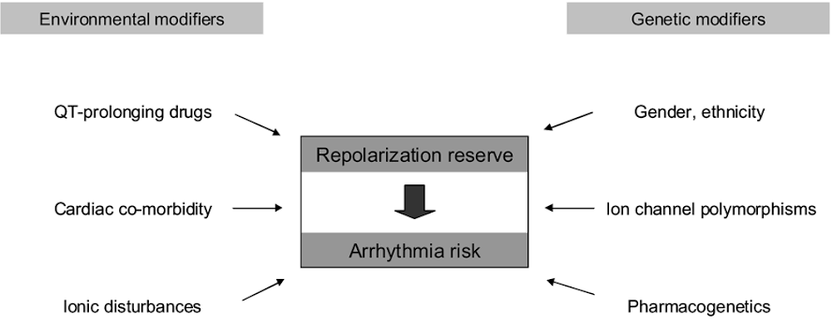

Slide 64
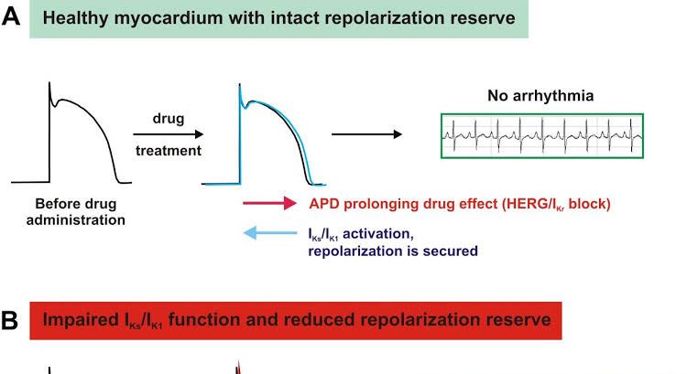

Slide 65
Mechanism & Requirements:
EADs may not propagate unless:
Thousands of myocytes depolarize synchronously
Overcome source-sink mismatch
Gap junction coupling may help form "EAD islands"
Leads to focal activity + reentry
Can trigger torsades de pointes or polymorphic VT

Slide 66
Types of EADs:
Phase 2 EADs: Occur at membrane potentials > -30 mV
Phase 3 EADs: Occur at more negative potentials
Both may occur in same tissue (e.g., Purkinje fibers)

Slide 67
Rate & Drug Sensitivity:
Class III antiarrhythmics:
Promote EADs at slow rates
Suppress EADs at high rates
β-adrenergic agonists:
Induce EADs at fast rates
Especially in M cells, rarely in Purkinje or epicardium

Slide 68
Biphasic Effect of Rate Acceleration:
Initial phase: Activates inward Na-Ca exchange (I_{NCX}), prolongs APD → facilitates EAD
Late phase: I_{Ks} (slow K⁺ current) shortens APD → suppresses EAD

Slide 69
Cellular Susceptibility to EADs – Role of Ion Currents
Greater EAD Susceptibility in:
Midmyocardial M cells
Purkinje fibers
Key Reasons:
Weaker I_{Ks} (slow delayed rectifier K⁺ current) in M cells
Deficient apamin-sensitive SK current (I_{KAS}) (small conductance Ca activated K current) in M-cell layer of failing hearts
M cells cannot adequately shorten APD in high intracellular Ca²⁺ states

Slide 70
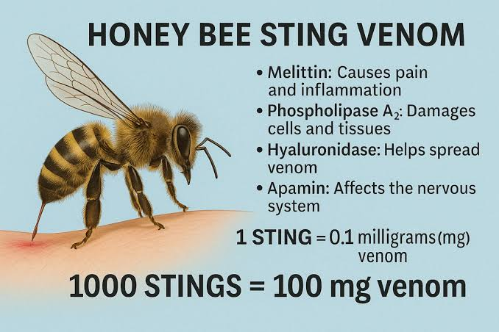

Slide 71
APD-prolonging drugs (e.g., sotalol) can trigger EADs, especially in these cells
• Heart failure & cardiomyopathy - ion channel changes - EADs possible in any
ventricle layer
• Blocking both I_{Kr} and l_{SK} can induce EADs even in typically
resistant cells

Slide 72
Mechanisms Underlying Early Afterdepolarizations (EADs)
Key Principle:
EADs arise when inward currents exceed outward repolarizing currents during phase 2 or 3 of the cardiac action potential.

Slide 73
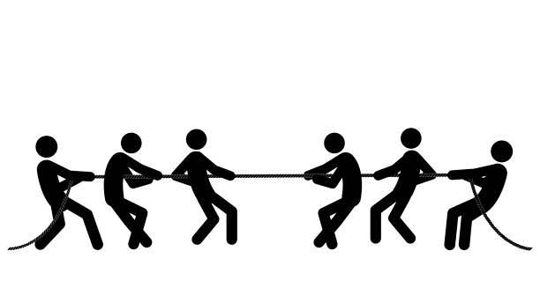

Slide 74
Main Mechanisms Facilitating EADs:
↓ Repolarizing K⁺ Currents
Eg: ↓ IKr, IKs by:
Class IA & III antiarrhythmics
Chromanol 293B: selective IKs blockade
↑ Ca²⁺ Current Availability
Eg: Bay K8644 (L type Ca channel agonist, structural analog of nifedipine), catecholamines
Enhances I_{CaL} during plateau phase

Slide 75
↑ Na⁺–Ca²⁺ Exchange Current (I_{NCX})
Triggered by ↑ intracellular Ca²⁺ or I_{NCX} upregulation
↑ Late Na⁺ Current (I_{NaL})
Eg: Aconitine, Anthopleurin-A, ATX-II
Leads to prolonged plateau & increased APD

Slide 76
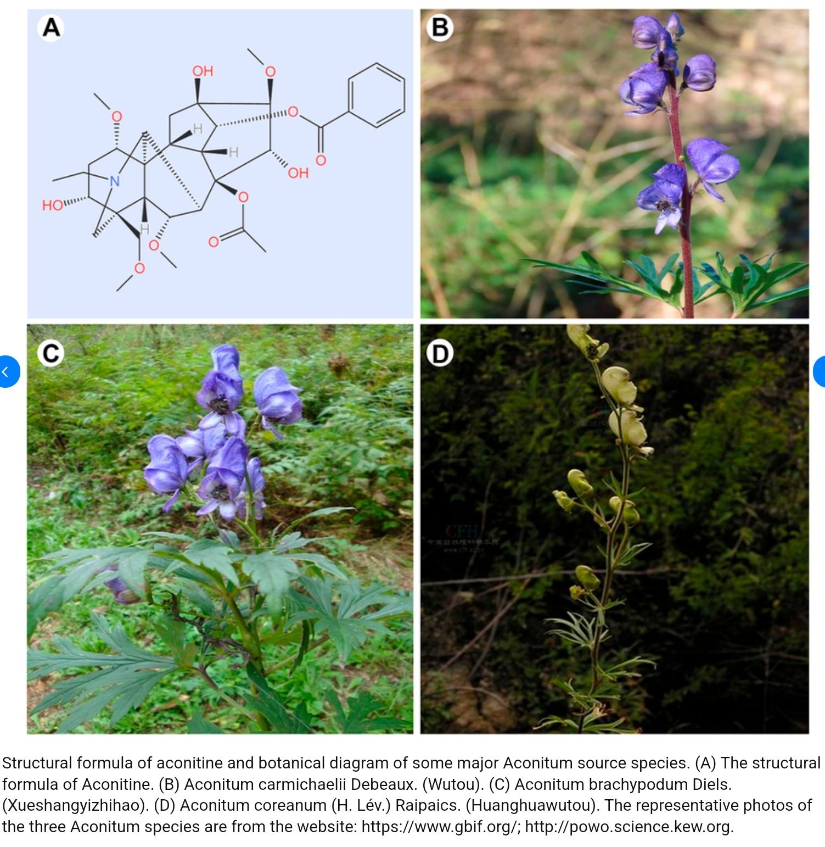
Aconitum genus, commonly called monkshood or wolfsbane

Slide 77
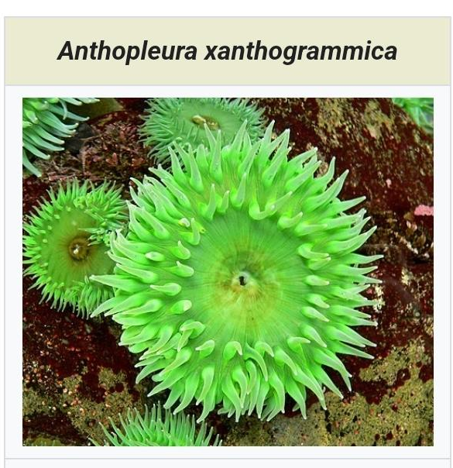
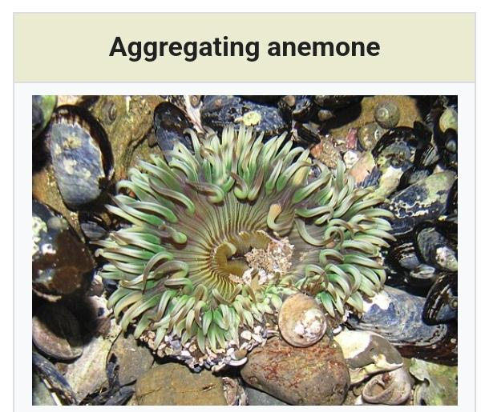
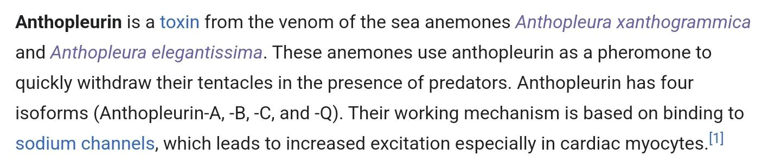

Slide 78
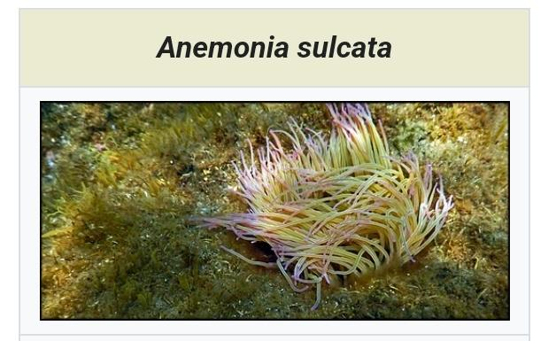
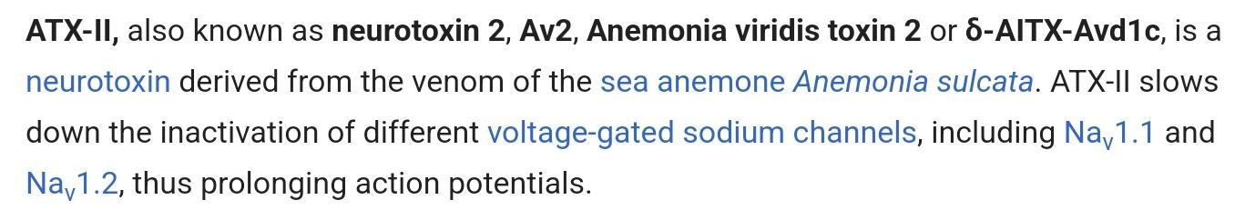

Slide 79
Other Contributing Factors:
Persistent late Na⁺ current (from inactivation failure or reactivation)
Reactivation of I_{CaL} when repolarization reserve is low
CaMKII activation in hypertrophied hearts (↑ arrhythmogenicity): enhances late Na & Ca currents
Calcium/Calmodulin-dependent protein kinase II:
a family of enzymes
play a crucial role in cellular signaling, in response to calcium influx.
serine/threonine-specific protein kinase
Amplifier of EAD risk in stress

Slide 80
Therapeutic Insight:
Ranolazine: blocks late I_{Na}; shows antiarrhythmic promise, particularly in atrial arrhythmias

Slide 81
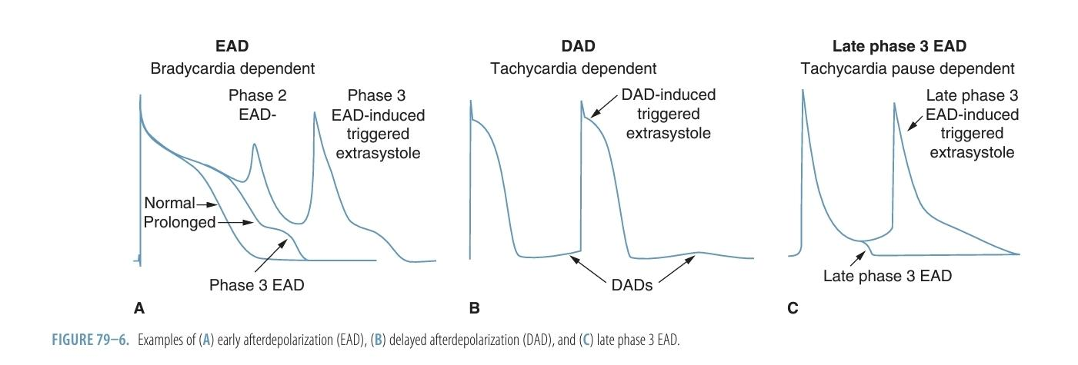

Slide 82
Mechanisms of Delayed Afterdepolarizations (DADs)
Definition:
DADs are oscillatory depolarizations that occur after full repolarization (phase 4) of the action potential.
Core Mechanism:
Triggered by spontaneous Ca²⁺ release from the sarcoplasmic reticulum (SR)
SR Ca²⁺ release → activates Na⁺–Ca²⁺ exchanger (I_{NCX}) → net inward current → membrane depolarization

Slide 83
Outcome:
If DAD amplitude reaches threshold → Triggered Activity
May result in extrasystoles or tachyarrhythmias
Determinants of DAD Generation:
Depends on cell type
Purkinje fibers more prone due to low I_{K1} → higher diastolic Ca-voltage coupling gain
Epicardial cells are less susceptible

Slide 84
Physiologic Role:
SA Node Automaticity also involves rhythmic SR Ca²⁺ release
Functions as the “Ca clock”
Generates DAD-like activity that contributes to sinus rhythm
Key Insight:
DADs are pro-arrhythmic in working myocardium but physiologic in SA node pacemaking.

Slide 85
DAD-Induced Arrhythmias – Focus on CPVT
Core Mechanism:
DADs occur due to spontaneous SR Ca²⁺ release → activates I_{NCX} → inward current → triggered activity
Common in conditions with Ca²⁺ overload, especially during adrenergic stimulation

Slide 86
Catecholaminergic Polymorphic Ventricular Tachycardia (CPVT)
Genetic Basis:
Mutations in RyR2, CASQ2, CALM1/2
Result: "Leaky" RyR2, worsened by catecholamines
Phenotype:
Polymorphic VT, Bidirectional VT
Also seen in digitalis toxicity and Long QT7 (KCNJ2 mutation)

Slide 87
Key Findings in Models:
RyR2[R4496C] mice: Show DADs, bidirectional VT, and polymorphic VT
CASQ2[D307H] mice: Prolonged SR Ca²⁺ release → frequent DADs
Therapeutic Insights:
Stabilization of RyR2:
Drugs like JTV519 enhance calstabin2 binding → prevent SR Ca²⁺ leak
Flecainide effective in humans with RYR2/CASQ2 mutations (Na⁺ channel & RyR2 effects)

Slide 88
Clinical Implications Beyond CPVT:
Heart Failure & Post-MI:
Structural/electrophysiological remodeling → ↑ I_{NCX}, Ca²⁺ dysregulation → DADs
↑ risk of premature ventricular complexes, VF, sudden cardiac death
Diagnostic Clue:
DADs often seen post-tachycardia, especially after defibrillation in failing hearts

Slide 89
Late Phase 3 EADs – A Unique Proarrhythmic Mechanism
Definition & Distinction:
Occur at the end of repolarization (late phase 3) of AP
Triggered by normal SR Ca²⁺ release, not spontaneous (as in DADs)
Represent a hybrid mechanism incorporating elements of both EADs and DADs

Slide 90
Mechanism:
Marked APD abbreviation (e.g., acetylcholine, post-defibrillation) →
Ca²⁺ release now coincides with late phase 3 instead of plateau
High intracellular Ca²⁺ → activates I_{NCX} and Ca²⁺-activated Cl⁻ current (I_{Cl(Ca)})
These inward currents during repolarization → generate late phase 3 EAD
Can lead to closely coupled extrasystoles → triggered activity

Slide 91
Postshock period shows shortened APD
Ectopic beat arises from late phase 3, initiating spontaneous VF
Seen in Langendorff-perfused failing hearts after defibrillation

Slide 92
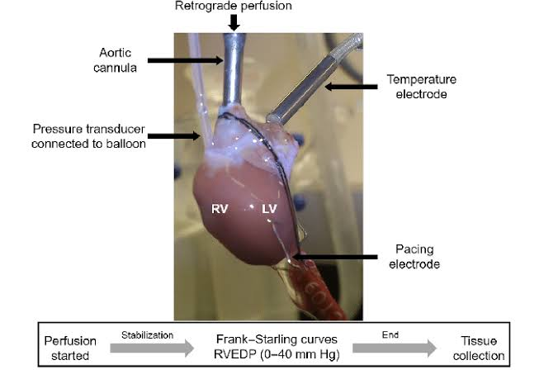

Slide 93
Clinical & Experimental Implications:
Atrial Fibrillation (AF):
In isolated canine atria, late phase 3 EADs initiate AF post-acetylcholine
Pulmonary veins (naturally short APD) are prone sites
Triggered by simultaneous sympathovagal discharge
Heart Failure & VF:
Ca²⁺ overload + APD shortening (via upregulated I_{KAS}) post-defibrillation
Late phase 3 EAD → recurrent VF
Apamin, an SK channel blocker, prevents VF recurrence by blocking I_{KAS}

Slide 94
Takeaway:
Late phase 3 EADs play a pivotal role in both AF and recurrent VF
They represent a distinct arrhythmogenic mechanism in conditions with short APD and high intracellular Ca²⁺
Targeting I_{KAS} may offer therapeutic benefit in postshock VF and heart failure-related arrhythmias

Slide 95
Reentry – A Distinct Mechanism of Arrhythmogenesis
Reentry is different from automaticity and triggered activity.
Involves re-excitation of cardiac tissue by a circulating wavefront.
Key feature: self-sustaining electrical circuit.

Slide 96
Types of Reentry
1. Circus Movement Reentry
Wavefront circles an anatomical/functional core.
Cells recover in sequence and are re-excited in a loop.
Seen in organized reentrant arrhythmias like atrial flutter.

Slide 97
2. Reflection & Phase 2 Reentry
Caused by heterogeneous recovery of excitability.
Delayed recovery site acts as a virtual electrode.
No true circular pathway involved.

Slide 98
Anatomical vs Functional Reentry
Anatomical Reentry:
Circuit depends on fixed structures (e.g., scar tissue).
Functional Reentry:
Determined by electrophysiological properties (e.g., refractoriness).
Gray Zone exists:
Many reentrant arrhythmias involve both anatomical and functional features.

Slide 99
Ring Model – Prototypical Anatomical Reentry
The ring model is a classic example of anatomical reentry.
Originated from experiments on jellyfish (Sychomedusa cassiopeia) subumbrella tissue by Mayer.
Ringlike cuts and stimulation led to regular, rhythmic contractions resembling clockwork.
Similar findings were replicated in turtle ventricular rings.

Slide 100
Key Conditions for Circus Movement Reentry
Mayer’s experiments revealed two essential requirements:
Unidirectional block – Impulse must propagate in only one direction.
Sufficient circuit length – Ensures tissue has time to recover before being re-excited.
These findings laid the foundation for understanding circus movement excitation in cardiac tissue.

Slide 101
Historical and Clinical Significance
G.R. Mines first proposed that circus movement reentry could cause cardiac arrhythmias (e.g., tachycardia).
Clinical validation came with discovery of Kent bundle (accessory AV pathway).
Surgical ablation of accessory pathways demonstrated that eliminating reentry circuits can cure arrhythmias (e.g., PSVT).

Slide 102
Mines’ Criteria for Identifying Reentry
Three classical criteria for circus movement reentry (still valid today):
Presence of an area of unidirectional block.
The impulse travels a defined pathway, re-exciting its origin repetitively.
Interrupting the pathway at any point terminates the reentrant circuit.

Slide 103
Electrophysiologic Basis of Reentry
Successful reentry requires:
Delayed conduction in the alternative pathway.
Recovery of excitability (expiration of refractory period) at the origin of the block.
Key determinants:
Conduction velocity.
Refractory period.

Slide 104
Wavelength and Path Length
Wavelength = Conduction Velocity × Refractory Period.
Reentry is possible if:
Circuit length ≥ Wavelength.
Shorter APD or slowed conduction:
→ Reduced wavelength.
→ Smaller path length needed.
→ Increased reentry risk.

Slide 105
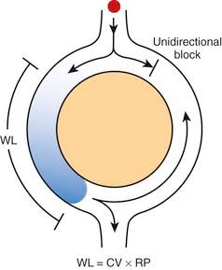

Slide 106
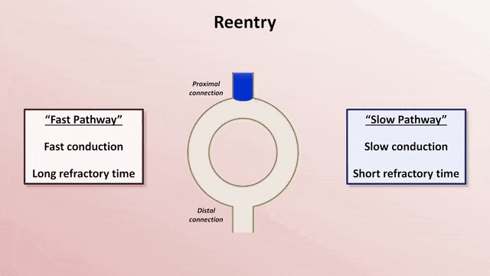

Slide 107
Functional Reentry Without Anatomical Barriers
Garrey (1914) first proposed that anatomical rings are not essential for circus movement.
Allessie et al. provided experimental support using rabbit left atrial tissue.
Tachycardia was induced via timed premature stimuli, without anatomical obstacles.
Premature impulses propagated only where refractory periods were shorter, creating an arc of block.

Slide 108
• Normal impulses spread evenly.
• Premature beats only go where the tissue has shorter refractory period.
• This creates a functional block (temporary, not structural)
• The wave loops around this block -> reentry.

Slide 109
The Leading Circle Model
Coined by Allessie et al. to explain functional reentry.
Features of the model:
A functionally refractory core at the center.
Wavefront circulates around this core without short-circuiting.
Centripetal wavelets collide at the center and help maintain the refractory zone.
Reentry occurs without a fully excitable gap.

Slide 110
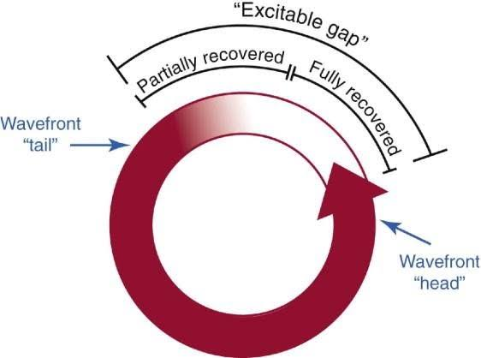

Slide 111
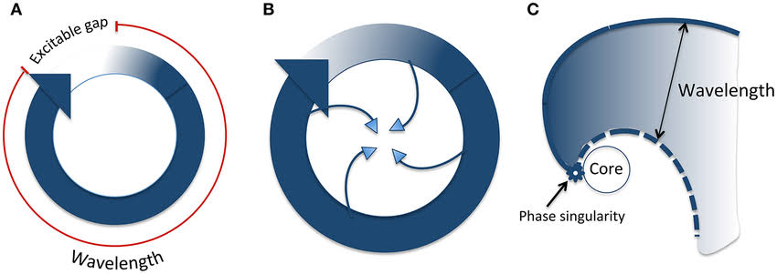

Slide 112
Limitations of the Leading Circle Model
Difficult to entrain with impulses from outside the circuit.
The refractory core is not structurally fixed, unlike anatomical reentry.
Centripetal wavelets maintaining the core were hard to demonstrate:
Challenging to detect via high-resolution mapping.
Lacked support from computer simulation studies.
Later models (e.g., rotors or spiral wave reentry) offered more detailed explanations.

Slide 113
Spiral Wave (Rotor) Reentry – Introduction & Origins
Introduced by Wiener and Rosenblueth (1946).
Initially used to describe reentry around anatomical obstacles, later expanded to functional reentry without obstacles.
Spiral wave reentry is now a widely accepted concept in excitable media, including cardiac tissue.
Helped clarify mechanisms of functional reentry, including fibrillation dynamics.

Slide 114
The wavefront curves into a spiral due to refractory tissue nearby.
• The tip or core of the spiral is unexcitable because there's a source-sink mismatch

Slide 115
Mechanisms – Source-Sink Mismatch & Wave Curvature
Spiral wave curvature creates a core due to source-sink mismatch:
Source = current from activated cells.
Sink = excitable cells ahead that must be depolarized.
High curvature = fewer source cells vs. many sink cells → conduction failure.
Wavebreak forms when wavefront meets the refractory tail of a previous wave:
Leads to slow conduction and formation of new spiral waves (rotors).
Confirmed via 3D simulations and optical mapping in swine VF models.

Slide 116
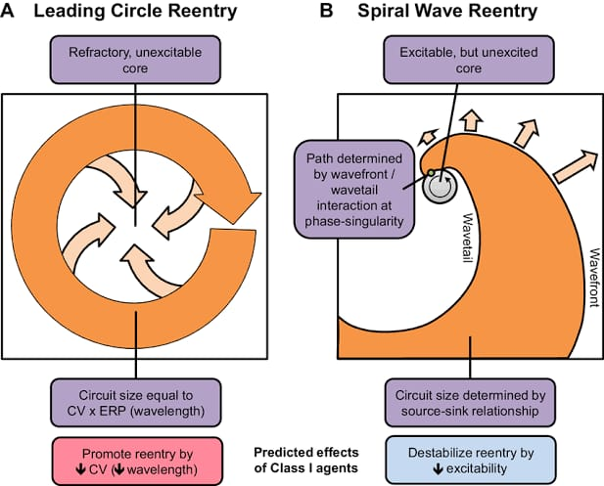

Slide 117
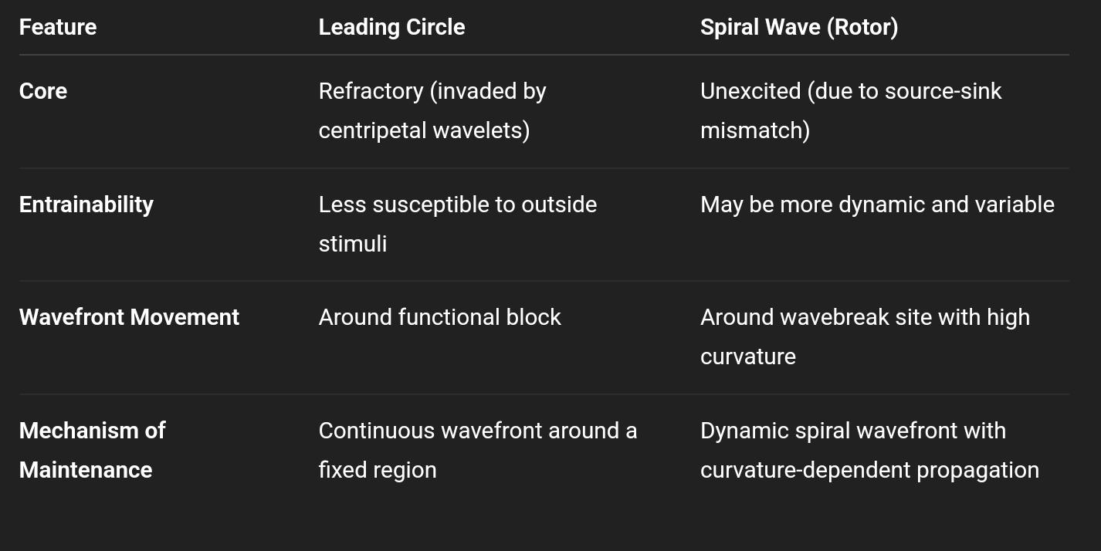
Spiral Wave vs Leading Circle Reentry

Slide 118
Spiral Waves in 2D vs Scroll Waves in 3D
Spiral wave: Reentrant activity in 2D, with a central core.
Scroll wave: 3D extension of spiral waves.
The core becomes a filament in 3D.
Basic scroll wave has a straight filament (epicardium to endocardium).
Filament configurations:
Theoretical shapes include L-, U-, and O-shaped filaments.
Real cardiac tissue shows many dynamic filament variations.

Slide 119
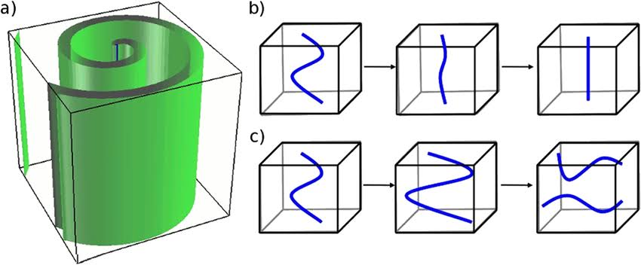

Slide 120
Scroll Wave Behavior & Arrhythmias
Scroll waves explain various arrhythmic ECG patterns:
Monomorphic VT:
Occurs when the spiral wave is anchored (stationary).
Polymorphic VT / VF:
Caused by drifting or meandering spiral waves.
Ventricular fibrillation (VF):
Represents the most chaotic form of spiral wave activity.
Often preceded by VT.

Slide 121
Spiral Wave Breakup and VF Onset
One proposed mechanism of VF:
Starts with a single spiral wave (VT).
Under unstable conditions, spiral breaks up into multiple spiral waves.
These waves are repeatedly extinguished and re-formed, creating chaotic VF.
Explains the transition from organized VT to disorganized VF seen clinically.

Slide 122
Importance of Reentry Stability
Stability of reentry is key to understanding ECG patterns in arrhythmias.
A stable reentrant wavefront leads to consistent ECG morphology.
Instability or multiple circuits result in polymorphic or fibrillatory ECG patterns.

Slide 123
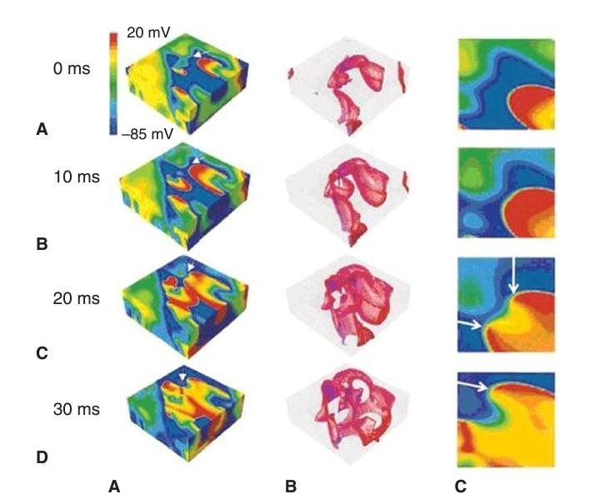

Slide 124
Panel A – Surface Activation (Left Column)
Red = wavefront (active depolarization)
Green = waveback (repolarizing tissue)
White arrows = where the wavebreak happens

Slide 125
At 0 ms, a wavefront is moving normally.
By 10–20 ms, the wave encounters an area that hasn’t fully recovered (still refractory).
This leads to wavebreak at that point → the wave can’t go straight, so it splits and curls.
By 30 ms, the split wave forms two spiral wavelets that continue rotating → circus movement.

Slide 126
Panel B – 3D Scroll Waves (Middle Column)
This shows the scroll waves forming in 3D tissue.
Red/pink areas = zones of active depolarization forming twisting scroll waves.
Over time (top to bottom), the spiral waves expand through the tissue after wavebreak.

Slide 127
Panel C – Close-up (Right Column)
A zoomed-in view of the wavebreak site.
White arrows = new breaks in the wavefront.
Red wavefront meets green refractory zone → curvature increases.
When the wavefront meets tissue that’s still refractory, it can’t go forward → it bends back and curls, forming a spiral.

Slide 128
Why does the wave break?
The curvature becomes very high at the point of block.
This causes a source-sink mismatch:
Source = current from active cells.
Sink = the surrounding inactive cells.
If the source can’t generate enough current to excite the sink → conduction fails → wave breaks.
A wavebreak at a refractory zone causes the electrical wave to split and form spiral waves, which then maintain reentry by rotating in place — this is a critical mechanism behind VF.

Slide 129
ECG Manifestations Based on Reentry
Single stable reentry:
Monomorphic VT → consistent QRS morphology.
Cavotricuspid isthmus-dependent atrial flutter → consistent P-wave morphology.
Unstable or multiple reentries:
Meandering circuits or multiple wavelets → polymorphic ECG.
Breakdown into fibrillatory conduction → fibrillation.

Slide 130
Determinants of Reentry Stability
Several independent factors influence the stability of circus movement reentry.
These factors can alter the trajectory, consistency, or fragmentation of the reentrant wavefront.
Understanding these can guide diagnosis and treatment of arrhythmias.

Slide 131
Anatomical vs Functional Reentry – A Spectrum
Reentry is classically divided into anatomical and functional types.
However, a gray zone exists where both features coexist.
Ikeda et al. studied reentry in isolated superfused canine atria using tissue with central holes.
Goal: observe how anatomical obstacles affect spiral wave behavior.

Slide 132
Key Findings – Spiral Wave Behavior and Obstacle Size
No obstacle:
Functional spiral wave meandered irregularly and terminated at the edge (fibrillation-like).
Small holes (2–4 mm):
No significant change; spiral still meandered.
Larger holes (6–10 mm):
Spiral wave anchored to the obstacle → became stationary.
Activation pattern changed to regular monomorphic activity (like VT).

Slide 133
Implications for Arrhythmia Mechanisms
Transition from functional to anatomical reentry is gradual, not abrupt.
Functional reentries are usually unstable and short-lived in the whole heart.
For sustained arrhythmias to occur:
Spiral waves must anchor to a large anatomical barrier → VT.
Or break down into multiple spirals → VF.

Slide 134
Introduction to Figure-Eight Reentry
First described by El-Sherif et al. in the 1980s using canine infarct models.
Observed in the surviving epicardial layer after LAD occlusion.
Similar activation patterns induced:
By artificial anatomical obstacles.
Via functional reentry after premature ventricular stimulation.

Slide 135
Mechanism of Figure-Eight Reentry
Reentrant wavefront circulates bidirectionally around a line of conduction block.
Wavefronts reunite distally, then reenter proximally by breaking through the block.
Produces two loops (clockwise & counterclockwise) → pretzel-like pattern.
Circuit size varies:
Small as a few mm, or
Large up to several cm depending on substrate.

Slide 136
Stability and Substrate Dependence
Short, functional blocks → unstable reentry, often self-terminating.
Large anatomical barriers → support more sustained figure-eight reentry.
Clinical relevance:
Seen in post-infarct VT.
Helps explain macroreentrant ventricular arrhythmias.

Slide 137
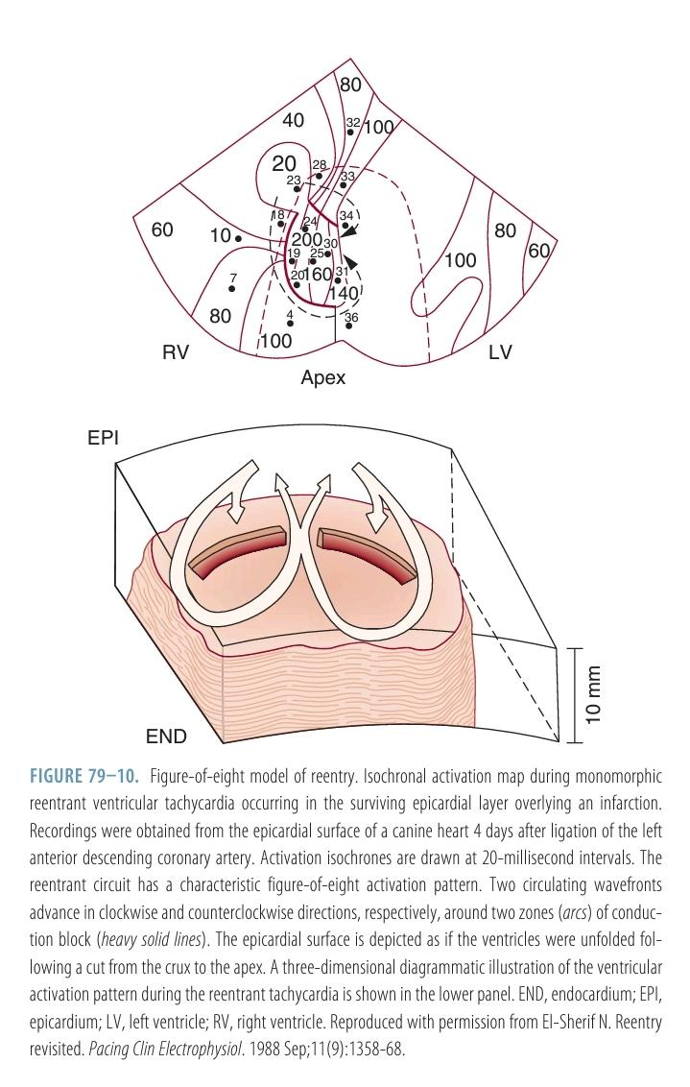

Slide 138
Isochronal Activation Map

Slide 139
Role of Tissue Size in Reentry Stability
Tissue mass is a key factor in the sustainability of reentry and VF.
Garrey’s principle: Below a critical mass, VF cannot be sustained.
Kim et al.:
VF induced in swine RV free wall.
Sequential cutting reduced mass.
Critical mass ~20g needed to sustain VF.

Slide 140
Effects of Progressive Tissue Mass Reduction
As tissue mass decreased:
Fewer reentrant wavefronts.
Increased wavefront lifespan.
Cycle length, diastolic interval, and APD all lengthened.
VF transitioned to VT (anchoring to papillary muscle).
Activation rate slowed progressively.

Slide 141
Transition from Chaos to Order
Reduced tissue mass → decreased VF complexity:
Measured by Kolmogorov entropy and Poincaré plots.
Clear quasiperiodic phase appeared before transition from VF to VT.
Quasiperiodicity → Periodicity → VF termination.
Clinical implication:
Supports antifibrillatory effect of Maze procedure in AF.

Slide 142
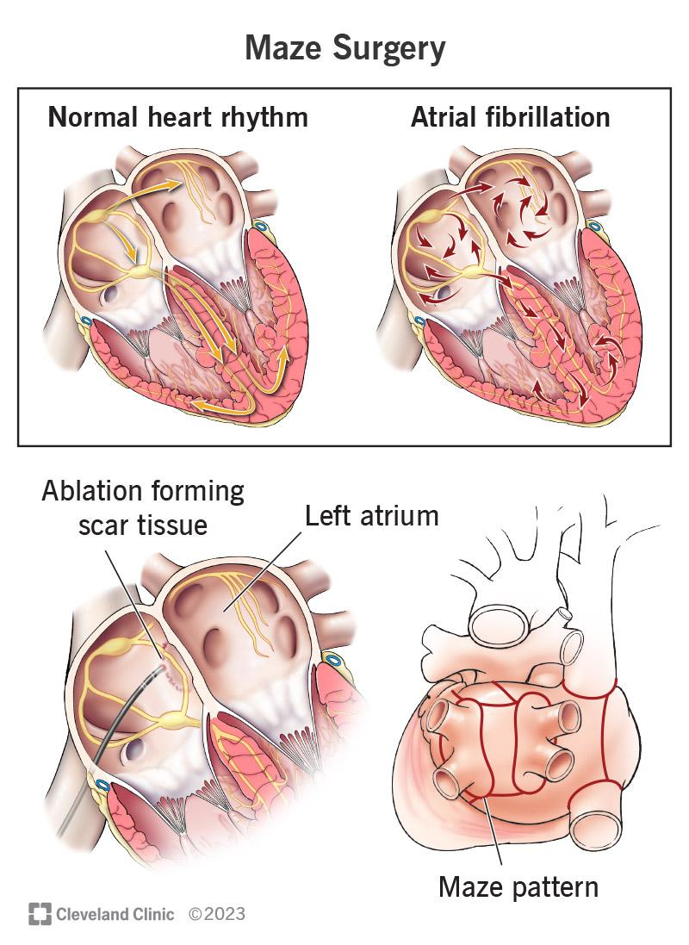

Slide 143
MCQs

Slide 144
False statement regarding EADs
Class III antiarrhythmics promote EADs in slower rate
Midmyocardial cells are less susceptible
Caused by increased calcium current availability
Occurs in phase 2 & 3

Slide 145
False statement regarding EADs
Class III antiarrhythmics promote EADs in slower rate
Midmyocardial cells are less susceptible
Caused by increased calcium current availability
Occurs in phase 2 & 3

Slide 146
Bay K8644: all true except
L type Ca channel agonist
Structural analogue of Nifedipine
Decreases calcium current availability
Causes EADs

Slide 147
Bay K8644: all true except
L type Ca channel agonist
Structural analogue of Nifedipine
Decreases calcium current availability
Causes EADs

Slide 148
Not true regarding leading circle model
Model to explain reentry
Difficult to entrain with impulses from outside the circuit.
The refractory core is not structurally fixed, unlike anatomical reentry.
Centripetal wavelets maintaining the core were easy to demonstrate

Slide 149
Not true regarding leading circle model
Model to explain reentry
Difficult to entrain with impulses from outside the circuit.
The refractory core is not structurally fixed, unlike anatomical reentry.
Centripetal wavelets maintaining the core were easy to demonstrate

Slide 150
Not a component of Mine’s criteria
Presence of an area of bidirectional block.
The impulse travels a defined pathway, re-exciting its origin repetitively.
Interrupting the pathway at any point terminates the reentrant circuit.

Slide 151
Not a component of Mine’s criteria
Presence of an area of bidirectional block.
The impulse travels a defined pathway, re-exciting its origin repetitively.
Interrupting the pathway at any point terminates the reentrant circuit.

Slide 153
APD Restitution and Reentry Stability
APD restitution: Relationship between action potential duration (APD) and preceding diastolic interval (DI).
A steep restitution slope (>1) → leads to APD alternans, instability, and fibrillation.
A flattened restitution slope (<1) → promotes stability, can convert VF to VT.
Shown in:
Computer simulations and
Rabbit heart Langendorff experiments

Slide 154
Atrial ERP and Susceptibility to Reentry
ERP ≈ APD70 in atria and APD90 in ventricles.
ERP abbreviation:
Increases AF vulnerability, especially in structurally normal atria.
ERP prolongation (via APD prolongation or postrepolarization refractoriness):
Can prevent or terminate reentry.
Forms the basis for pharmacologic AF treatment.

Slide 155
Conduction Velocity (CV) Restitution and Wave Stability
CV restitution: Sensitivity of conduction velocity to diastolic interval.
Steep APD restitution → instability due to waveback sensitivity.
Broad CV restitution → instability due to wavefront sensitivity, especially in heterogeneous tissue.
D600 experiments:
Flattened APD restitution → VF → VT.
Higher D600 doses (block Na⁺ & Ca²⁺) → slow VF (type II) with reduced excitability and broader CV restitution.

Slide 156
Electrical Activation–Calcium Coupling
Electrical activation and Ca²⁺ dynamics are tightly but variably coupled.
This variability affects APD restitution and reentry stability.
Two main coupling directions:
Voltage → Ca²⁺: Longer APD → larger Ca²⁺ transient (positive coupling).
Ca²⁺ → Voltage: Can be positive or negative.

Slide 157
Ca²⁺→Voltage Coupling: Positive vs Negative
Positive Ca²⁺→Voltage Coupling:
Larger Ca²⁺ transient prolongs APD.
Due to enhanced inward I<sub>_{NaCa}</sub> (I<sub>cx</sub>) > Ca-induced inactivation of I<sub>CaL</sub>.
Negative Ca²⁺→Voltage Coupling:
Larger Ca²⁺ transient shortens APD.
Reduction of I<sub>CaL</sub> outweighs I<sub>cx</sub> enhancement.

Slide 158
Pathophysiology & Arrhythmogenesis
Discordant alternans arise from unstable Ca²⁺–voltage interactions during rapid pacing.
Can cause:
Ectopic activity,
Spiral wave destabilization,
Degeneration of VT into VF.
Mismatch between APD and Ca²⁺ transient duration is common in pathological states.
This dynamic feedback loop increases arrhythmia vulnerability.

Slide 159
What Is Reflected Reentry?
A non–circus movement form of reentry.
First described in K⁺-depolarized Purkinje fibers.
Involves a retrograde wavefront following slow anterograde conduction.
Originally attributed to longitudinal dissociation, but later evidence supported reflection as a distinct mechanism.

Slide 160
Experimental Model – The Sucrose Gap
Developed by Antzelevitch et al. in early 1980s.
Model setup:
Unbranched Purkinje fiber placed in 3-chamber bath.
Central chamber filled with ion-free sucrose solution → creates an inexcitable gap (1.5–2 mm).
Mechanism:
Stimulus generates AP in proximal segment.
No active conduction across sucrose gap.
Electrotonic current flows across → slowly depolarizes distal tissue.

Slide 161
Mechanism of Reflection
Delayed reactivation of distal segment can produce:
Subthreshold response or
Foot potential reaching threshold.
If proximal tissue recovers excitability by the time the impulse returns → retrograde excitation occurs.
Thus, reentry is completed without anatomical circuit or circus movement.
Reflection = electrotonically mediated, to-and-fro conduction across an inexcitable segment.

Slide 162
Second Experimental Model of Reflection
Central inexcitable zone created by superfusing a Purkinje segment with an ischemia-mimicking solution.
This created a non-conductive cable-like region.
Impulse conduction occurred electrotonically across this region, enabling delayed conduction and reexcitation.

Slide 163
Additional Experimental Evidence for Reflection
Reflection observed in various cardiac tissues:
Atrial and ventricular myocardium (isolated preparations).
Purkinje fibers with:
Focal depolarization via long-duration current pulses.
Global depression with high K⁺ solution.
Branched normal Purkinje fibers (without structural alterations).

Slide 164
Key Concepts and Clinical Relevance
Reflection does not require anatomical circuits or circus movement.
It is purely an electrotonic phenomenon through inexcitable zones.
Reflection can:
Trigger extrasystoles.
Contribute to non-circus movement reentry and arrhythmogenesis.
Highlights the role of electrotonic conduction and recovery timing in reentrant arrhythmias.

Slide 165
What Is Phase 2 Reentry?
A non–circus movement reentry mechanism.
May appear as focal origin on ECG or mapping.
Caused by local reexcitation due to heterogeneity in action potential dome propagation, especially in epicardial tissue.

Slide 166
Mechanism of Phase 2 Reentry
Action potential dome:
Maintained at some epicardial sites.
Absent at adjacent regions due to early repolarization.
The dome propagates from areas of preserved AP to areas of loss of dome, triggering reentry-like excitation.
Results in a closely coupled extrasystole.

Slide 167
Prerequisite – Spatial Dispersion of Repolarization
Accentuated dispersion of repolarization across epicardial sites is essential.
Occurs in conditions like:
Brugada syndrome,
Ischemia,
Or after drug-induced modulation of repolarization.
Phase 2 reentry contributes to:
Ventricular extrasystoles,
Initiation of polymorphic VT/VF.

Slide 168
Transmural Heterogeneity in Ventricular Myocardium
Ventricular tissue comprises three electrophysiologically distinct cell types:
Epicardial, M cells (midmyocardial), and Endocardial.
These cells differ in phase 1 and phase 3 repolarization characteristics.
Epicardial and M cells show a prominent phase 1 notch due to large transient outward K⁺ current (I<sub>to</sub>).
Notched "spike and dome" AP configuration prominent in epicardial and M cells.

Slide 169
Functional Properties and Ionic Basis of M Cells
M cells:
Have longest APD, especially in response to slow rate or APD-prolonging agents.
Act as proarrhythmic substrates due to their delayed repolarization.
Ionic mechanisms in dogs:
Smaller I<sub>Ks</sub> (slow delayed rectifier K⁺ current).
Larger late Na⁺ current and Na⁺-Ca²⁺ exchanger current (I<sub>NaCa</sub>).
I<sub>Kr</sub> and I<sub>K1</sub> are similar across all three cell types.

Slide 170
Clinical Implications and Channelopathies
Amplified transmural heterogeneity can lead to:
Brugada syndrome, early repolarization, long QT, short QT, catecholaminergic VT.
Brugada syndrome is predominantly a right ventricular disease due to greater I<sub>to</sub> in RV epicardium.
M-cell islands confirmed in human hearts via optical mapping (normal & failing hearts).
APD gradient between M cells and surrounding tissue contributes to arrhythmia vulnerability.
Genetic mutations → Gain or loss of function in ion channels → create arrhythmogenic substrate & triggers.

Slide 171
J Waves and Early Repolarization – Overview
J waves historically linked to hypothermia and hypercalcemia.
Seen as J-point elevation, often buried in QRS in healthy individuals.
Early Repolarization (ER) pattern:
Includes J-point elevation, notch/slur on terminal QRS, with or without ST elevation.
Once considered benign, now linked to malignant arrhythmias.

Slide 172
ERS and BrS – Clinical Relevance
Studies (Haïssaguerre, Rosso, Nam) linked ER pattern with:
Polymorphic VT, VF, and sudden cardiac death (SCD).
Brugada Syndrome (BrS):
Marked J waves with coved ST elevation in V₁–V₃ (right precordial leads).
Affects the RV outflow tract.

Slide 173
Early Repolarization Syndrome (ERS):
Affects inferior LV region, shows:
J waves, J-point elevation, and notched/slurred QRS.
Three types:
Type I: Lateral leads
Type II: Inferolateral leads
Type III: Inferolateral + anterior or RV leads

Slide 174
Diagnosis and Risk Stratification
Consensus criteria for ER (MacFarlane et al.):
J<sub>peak</sub> ≥ 0.1 mV in ≥2 contiguous inferior/lateral leads.
Define:
J<sub>onset</sub> = start of notch/slur
J<sub>peak</sub> = peak of notch or onset of slur
J<sub>termination</sub> = end of J wave

Slide 175
ER pattern common in:
Young black individuals, athletes, hypothermia, ischemia.
Both ERS and BrS are linked to:
VT/VF, SCD in young adults, and sudden infant death syndrome.

Slide 176
J-Wave Syndromes – Mechanisms and ECG Features
J-wave syndromes include Brugada Syndrome (BrS) and Early Repolarization Syndrome (ERS).
Result from accentuated J waves due to transmural repolarization differences, especially enhanced I<sub>to</sub> in epicardium.
ECG findings:
BrS: Coved ST elevation (V₁–V₃), anterior RVOT focus.
ERS: J waves/slurs in inferolateral or lateral leads (Types I–III).
Both can lead to VT/VF and sudden cardiac death.

Slide 177
Competing Hypotheses for Brugada Syndrome
Repolarization Hypothesis:
Outward shift in current balance in RV epicardium → phase 2 reentry.
Explains J waves, ST elevation, and arrhythmias.
Depolarization Hypothesis:
Conduction delay due to fibrosis, Cx43 loss, and structural defects in RVOT.
Based on presence of fractionated late potentials.

Slide 178
Evidence Favoring Repolarization Hypothesis
Ablation studies (Nademanee, Patocskai) show that:
Eliminating epicardial repolarization abnormalities suppresses BrS phenotype.
Fractionated potentials stem from desynchronized epicardial APs, not conduction delay.
Experimental BrS models (Szél, Park):
Lack of I<sub>to</sub> in pigs prevents BrS phenotype → supports repolarization basis.

Slide 179
ERS and BrS share mechanisms:
Accentuation of transmural AP gradients (esp. I<sub>to</sub>).
ERS arrhythmias often arise from inferolateral LV.
Antiadrenergic agents worsen, while quinidine, isoproterenol reverse defects.
ECG Imaging:
Shows steep repolarization dispersion, not major conduction block.
VF rotors in ERS patients anchored in inferolateral LV wall.

Slide 180
Shared Features of ERS and BrS
Phenotypic Similarities Suggest Common Mechanisms:
Male predominance in both syndromes.
Sudden cardiac arrest (SCA) may be the first manifestation.
Peak incidence of VF/SCD in 3rd decade, possibly linked to testosterone.
J waves and ST elevations often appear during bradycardia or rest, explaining nocturnal VF episodes.

Slide 181
Shared genetic mutations/variants in ion channel-related genes (e.g., SCN5A).
β-adrenergic agonists (e.g., isoproterenol) suppress electrical storms and J-wave changes.
Chronic drug therapy (quinidine, cilostazol, denopamine, bepridil) prevents VT/VF via I<sub>to</sub> inhibition and I<sub>Ca</sub> / I<sub>Na</sub> augmentation.

Slide 182
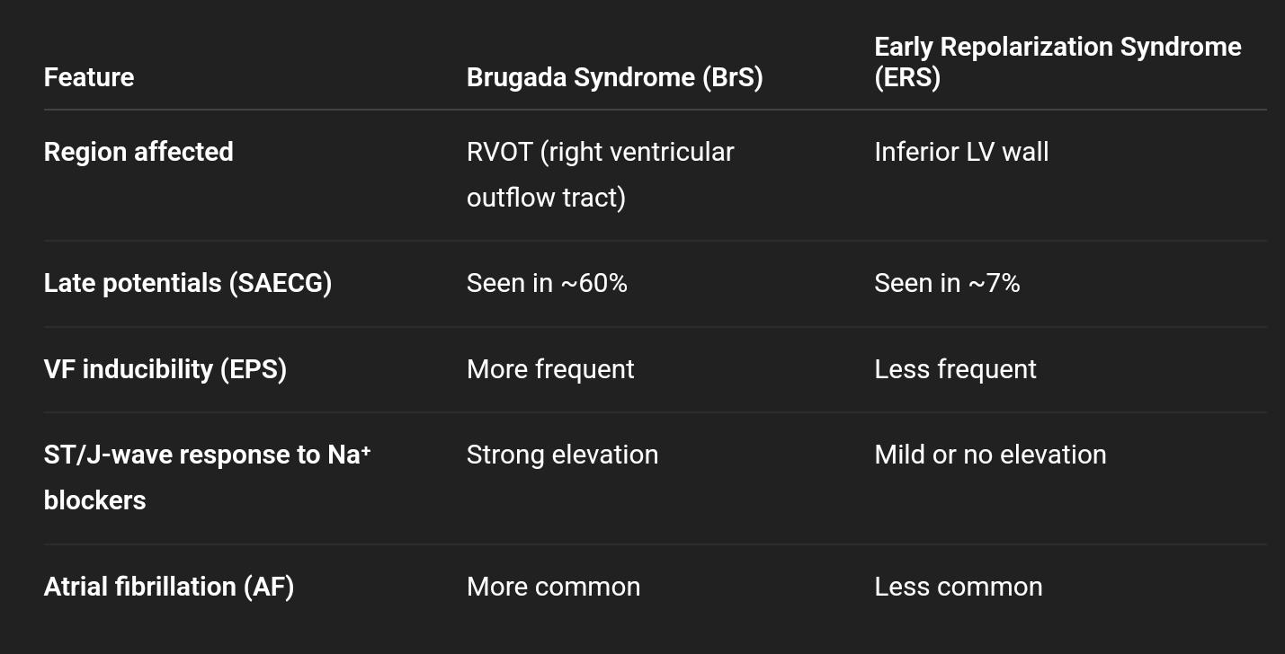
Key Differences Between BrS and ERS

Slide 183
Clinical Implications & Risk Stratification
Despite overlap, differentiating BrS and ERS is key for:
Risk assessment,
EPS-guided decision-making, and
Therapeutic approach.
BrS more frequently requires ICD implantation and aggressive EPS monitoring.
ERS may be managed conservatively in low-risk individuals unless high-risk markers (e.g., syncope, family history, VF) are present.
Personalized therapy based on genotype, ECG phenotype, and inducibility remains crucial.

Slide 184
J Wave vs Conduction Delay – ECG Presentation
Notch in rising phase of R wave → typically indicates ventricular conduction delay.
Terminal QRS notch resembling J wave → may arise from:
Repolarization abnormality (e.g., BrS, ERS), or
Conduction delay (e.g., fibrosis, infarction).
Clue: J waves often occur in inferolateral leads, while conduction delays may appear diffusely or in areas of infarction.

Slide 185
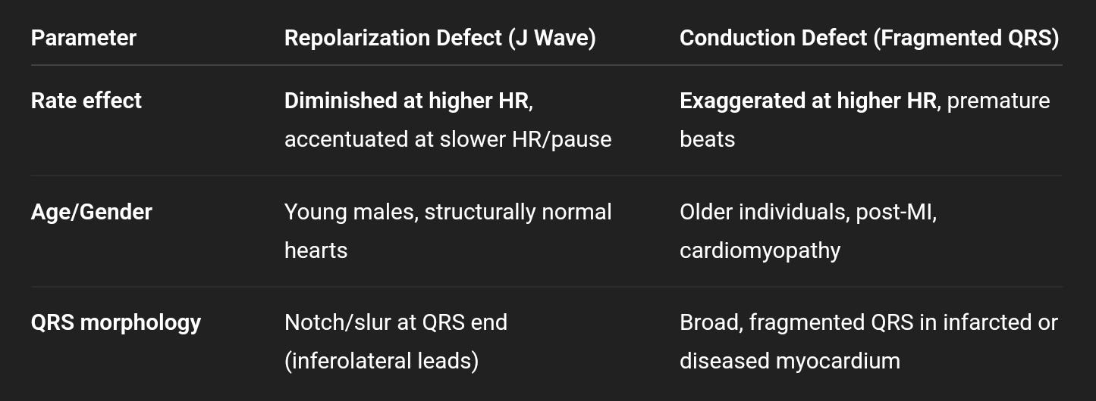
Rate Response as a Diagnostic Tool

Slide 186
Clinical and Prognostic Implications
J Waves:
Common in young males without structural disease.
May indicate Brugada or ER syndromes → associated with VF/SCD risk.
Intraventricular Conduction Delays:
Often linked to ischemia, cardiomyopathy, or fibrosis.
In BrS, fragmented QRS is a marker of poor prognosis.
However, in absence of heart disease, not prognostically significant.
Diagnostic Strategy:
Assess ECG morphology, rate response, age, gender, and clinical context.
Use EPS or imaging if differentiation remains unclear.

Slide 187
Pulmonary Veins – Key Role in AF Initiation
Pulmonary veins (PVs) are major sources of AF triggers.
Other thoracic veins like the superior vena cava and vein of Marshall also contribute.
Mechanisms include:
Triggered activity (via EADs, automaticity)
Reentry (due to conduction block, fibrosis)
Embryologic origin of PVs is linked to sinus venosus, known for automaticity.

Slide 188
Cellular and Structural Basis of PV Arrhythmogenicity
Independent electrical activity and contractions observed in PVs (Brunton & Fayer).
Multiple electrically active cell types found in PVs:
Node-like cells
Purkinje-like cells
Cajal-like interstitial cells
Melanocyte-like cells

Slide 189
Glass microelectrode recordings (Chen et al.) show:
Spontaneous fast/slow action potentials
EADs, especially after chronic rapid pacing
Short APD in PVs increases susceptibility to late phase 3 EADs and triggered arrhythmias.

Slide 190
Structural Substrate and Clinical Implications
Fiber disarray at PV-LA junction promotes:
Conduction block
Microreentry circuits
Fibrosis (esp. in heart failure) enhances reentry potential and AF maintenance.
Key implications:
PVs are a primary ablation target in AF therapy.
Both focal and reentrant mechanisms must be addressed.
Understanding cellular heterogeneity helps explain AF recurrence after ablation.

Slide 191
Role of Remodeling in Cardiac Arrhythmias
While genetic arrhythmias (e.g., BrS, LQTS) occur in normal hearts,
most common arrhythmias (AF, VF, SCD) occur in diseased hearts.
Cardiac remodeling is a key contributor to arrhythmogenesis in these cases.
Remodeling types:
Structural remodeling
Electrophysiologic remodeling
Neural remodeling

Slide 192
Types of Cardiac Remodeling
🔸 Structural Remodeling
Fibrosis, chamber dilation, hypertrophy
Alters conduction pathways → slowed conduction, block, reentry circuits
🔸 Electrophysiologic Remodeling
Changes in ion channel expression/function
Affects APD, ERP, conduction velocity
Promotes EADs, DADs, triggered activity
🔸 Neural Remodeling
Denervation (e.g., post-MI) → increases heterogeneity of autonomic input
Nerve sprouting → enhances sympathetic activity, promotes arrhythmia triggers

Slide 193
Clinical Implications
Remodeling amplifies arrhythmic substrate → increased risk of AF, VT/VF, SCD.
Therapies target:
Fibrosis control (e.g., RAAS blockers)
Modulation of autonomic tone (e.g., β-blockers, renal denervation)
Reversal of electrophysiologic remodeling (e.g., antiarrhythmic drugs)
Early intervention in heart failure or MI may help reduce arrhythmic risk by limiting remodeling.

Slide 194
Structural Remodeling – Fibrosis and Reentry
Fibrosis is a hallmark of remodeling in ischemic & nonischemic cardiomyopathies.
Histology and mapping in human DCM hearts:
Myocardial scars strongly associated with VT.
Fibrotic areas → conduction block → stable reentrant circuits and scroll waves.
Uneven fibrosis distribution → anisotropic conduction.
In atria, fibrosis promotes:
Decreased conduction safety
Anisotropic reentry → sustains AF

Slide 195
Role of Fibroblasts in Arrhythmia
Fibroblasts aren't just passive: they:
Respond to mechanical, electrical, and chemical cues.
Can electrically couple to myocytes → modulate conduction.
Atrial fibroblasts show:
Resting Vm ≈ –37 mV, oscillates during contraction.
Oscillations can raise diastolic potential, promoting automaticity & triggered activity.
K⁺-current remodeling in fibroblasts contributes to AF dynamics.

Slide 196
Electrophysiologic Remodeling & Proarrhythmia
Key ionic changes in HF, MI, AV block:
↓ Iₖ₁ → ↑ DADs
↑ I_NCX → ↑ DADs
↑ I_Ca,L → ↓ repolarization reserve → EADs
↓ I_Kr, I_Ks** → prolonged repolarization

Slide 197
Adaptive mechanism: ↑ I_KAS (small-conductance Ca²⁺-activated K⁺ currents)
Preserves repolarization reserve
Blocking I_KAS (e.g., with apamin) worsens EADs/VAs
Net result: enhanced risk of VT/VF/AF via triggered and reentrant mechanisms

Slide 198
Cardiac Nerve Sprouting After Myocardial Infarction
Static myocardial remodeling ≠ trigger for arrhythmia
Autonomic remodeling, especially nerve sprouting, contributes to arrhythmia initiation.
Histologic and animal studies:
Myocardial infarction leads to denervation, followed by sympathetic nerve sprouting.
Sprouting seen in human myocardial scars, animal infarct models, and VT origin sites.
Increased nerve density correlates with clinical ventricular arrhythmias and SCD.
Confirmed by I-123 MIBG scans: show denervation + reinnervation post-MI.

Slide 199
Mechanisms of Nerve Sprouting and Sympathetic Hyperinnervation
Neurotrophic factors, especially nerve growth factor (NGF), upregulated post-MI:
NGF promotes sympathetic neuron survival, catecholamine phenotype, and axonal sprouting.
NGF ↑ in myocardium and left stellate ganglion → retrograde axonal signaling.

Slide 200
GAP43 (growth-associated protein) ↑ with NGF → marker of active nerve sprouting.
Transgenic mice with NGF overexpression show:
↑ sympathetic neurons
Enlarged ganglia
Elevated cardiac catecholamines

Slide 201
Clinical and Experimental Insights
Cardiac transplantation patients show variable nerve sprouting post-surgery:
Can improve hemodynamics, but excessive sprouting = proarrhythmic.
Stellate ganglion involvement:
MI in LAD territory → sprouting in stellate ganglia → global sympathetic remodeling.
Even non-ischemic atria show increased arrhythmic vulnerability post-MI.
Implications:
Prolonged sympathetic overactivity post-MI (≥2 months) increases risk of:
AF, VT, VF, SCD
Suggests potential therapeutic targets: NGF inhibition, sympathetic modulation, ganglion ablation

Slide 202
Neuromodulation and Autonomic Control of Cardiac Arrhythmias
Autonomic nervous system plays a key role in arrhythmia initiation and maintenance.
Reducing sympathetic outflow or autonomic innervation has shown promise in reducing atrial arrhythmias (AF).
Ganglionated plexi (GP) ablation may improve outcomes in AF ablation (preliminary data).
Elimination of vagal responses ≠ guaranteed freedom from AF recurrence.
A recent RCT showed no added benefit of GP ablation over pulmonary vein isolation (PVI) alone.
Further studies are needed before routine clinical implementation of autonomic neuromodulation.

