Slide 1

MYOCARDIAL INFARCTION OR ISCHEMIA WITH NO OBSTRUCTIVE CORONARY ATHEROSCLEROSIS
DR RESHMA TANIA NOUSHAD
FIRST YEAR DM RESIDENT

Slide 2
MINOCA
clinical syndrome characterized by evidence of MI with
Myocardial infarction or ischemia with no obstructive coronary atherosclerosis coronary arteries on angiography (stenosis severity ≤50 percent)
absence of obvious noncoronary causes of MI such as severe hemorrhage or severe respiratory failure.

Slide 3
DIAGNOSTIC CRITERIA
fulfilling the universal definition for MI
having non-obstructive coronary arteries on angiography (<50% stenosis) and
no clinically overt specific cause for the acute presentation.

Slide 4
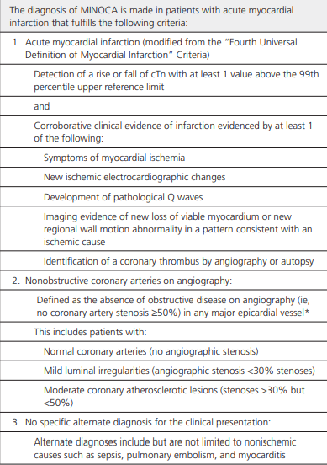

Slide 5

Epidemiology
Prevalence:
  Occurs in 1–15% of acute MI cases
  Mean prevalence: ~6%
  Meta-analysis (23 studies, >800,000 MI patients): 8.1%
  Global incidence: 2.9%–10.2%

Slide 6
Epidemiology
Patient Profile:
  More common in females (up to 50% of MIs in women <55 years)
  Younger patients (median age ~61 years)
  Higher prevalence in Black and Hispanic populations
  Fewer traditional risk factors like hypertension, dyslipidemia, diabetes and smoking

Slide 7
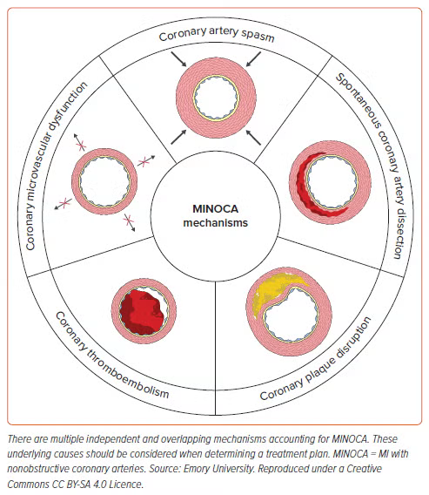
Mechanism of minoca

Slide 8
Causes
A syndrome with multiple etiologies, involving:
Epicardial vessels
Coronary microcirculation
Causes divided into:
Epicardial causes
Microvascular causes

Slide 9
Epicardial causes
1. Coronary Artery Spasm
Intense vasoconstriction (ie, >90%) of an epicardial coronary artery resulting in compromised myocardial blood flow.
Either in response to drugs or toxins (eg, cocaine, fluorouracil) that result in hyperreactivity of vascular smooth muscles or spontaneously because of disorders in coronary vasomotor tone.
Vascular smooth muscle hyperreactivity - central pathophysiological mechanism
Can be localized, multifocal, or diffuse
Prevalence in MINOCA varies widely: 3%–95%

Slide 10
Diagnosis →requires the documentation of coronary artery spasm by provocative testing
Gold standard technique → administration of high-dose intracoronary acetylcholine boluses (20-100 μg) administered as 5-mL bolus over 20 seconds, with the epicardial coronary artery response evaluated by invasive contrast angiography
Provocative testing during which acetylcholine is used, spasm is documented angiographically and intracoronary nitrates are rapidly administered.

Slide 11
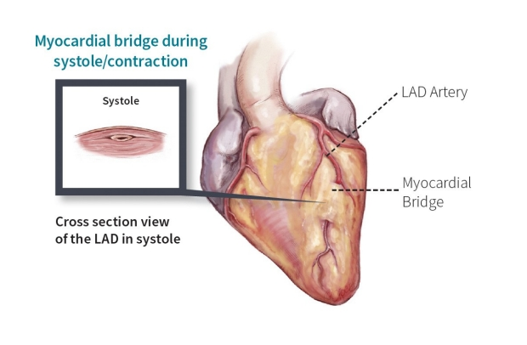
2. Myocardial Bridging
Muscle overlying a coronary artery segment (usually LAD)
Predisposes to spasm; rarely the primary cause

Slide 12
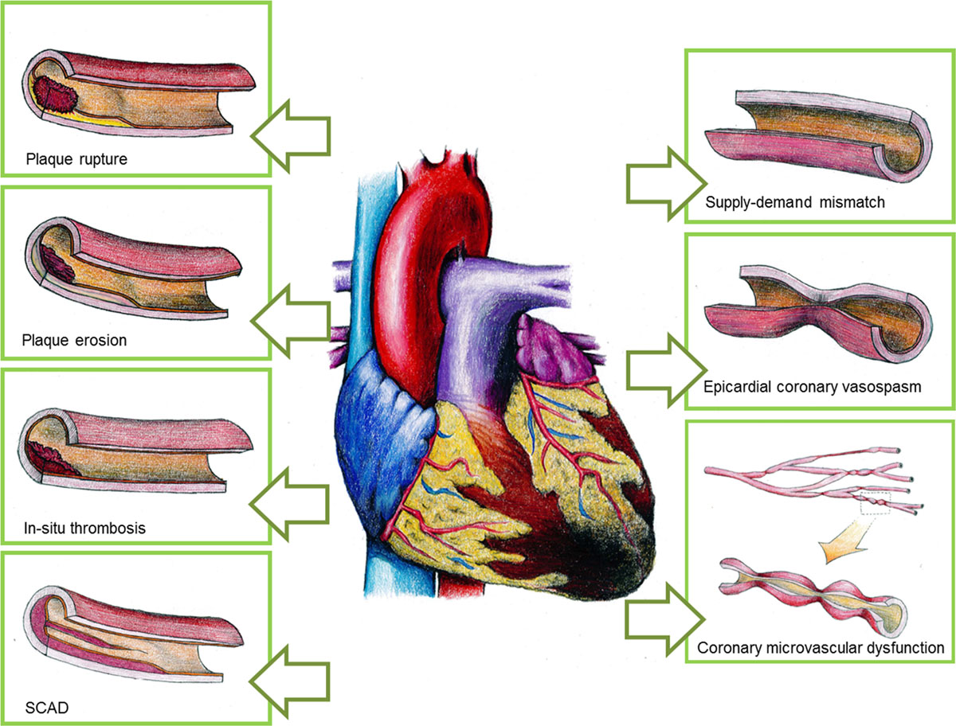
Epicardial causes
3. Acute Thrombosis at Nonobstructive Plaque
Can occur due to plaque rupture/erosion, or independently
Can be in situ thrombosis over:
•A ruptured/eroded plaque (atherosclerotic)
•An area of spasm or dissection (non-atherosclerotic)
•May also occur in hypercoagulable states without plaque involvement.
•If the thrombus is non-occlusive or transient, it can cause MINOCA.
So, thrombosis can be the result of plaque events or independent (e.g., in antiphospholipid syndrome, DIC).

Slide 13
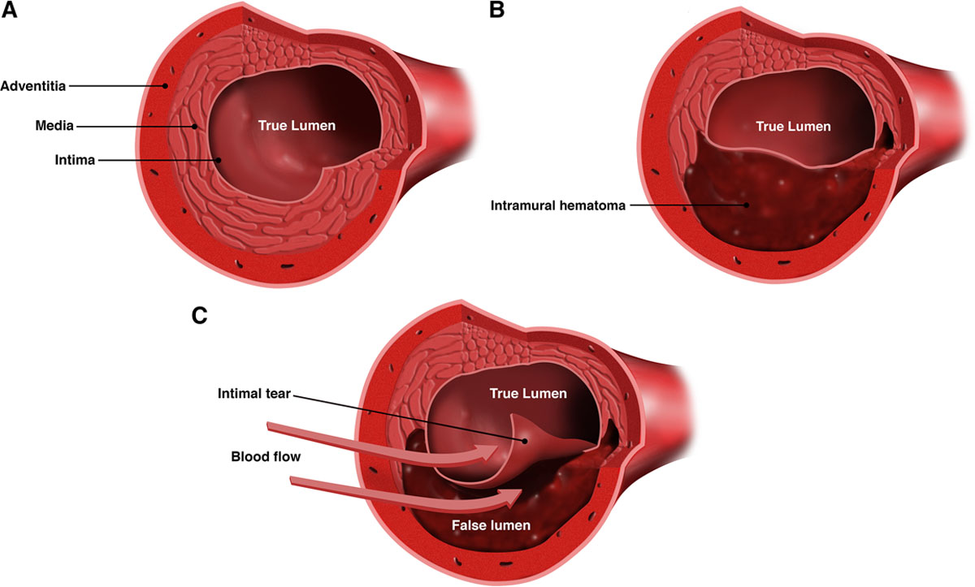
4. Spontaneous coronary artery dissection
Non-atherosclerotic, non-traumatic, non-iatrogenic tear or separation of the coronary artery wall, resulting in myocardial ischemia or infarction — without significant coronary obstruction on angiography.
Major cause of MINOCA, particularly in young to middle-aged women
SCAD occurs due to the formation of a false lumen within the coronary artery wall.
•

Slide 14
Compression of the true lumen by:
•An intramural hematoma (IMH), or Intimal tear and blood entering the vessel wall
•↓ Coronary blood flow → myocardial ischemia/infarction

Slide 15
There are two main pathological variants:
1.Intimal tear: Blood enters through a flap → dissects along media
2.Medial hemorrhage: Bleeding within vessel wall (vasa vasorum rupture) → forms hematoma → compresses true lumen
Who Gets SCAD?
90% are women, especially ages 30–60
Often peripartum, postpartum, or associated with emotional or physical stress
Associated conditions:
  Fibromuscular dysplasia (FMD)
  Connective tissue disorders (e.g., Marfan, Ehlers-Danlos)

Slide 16
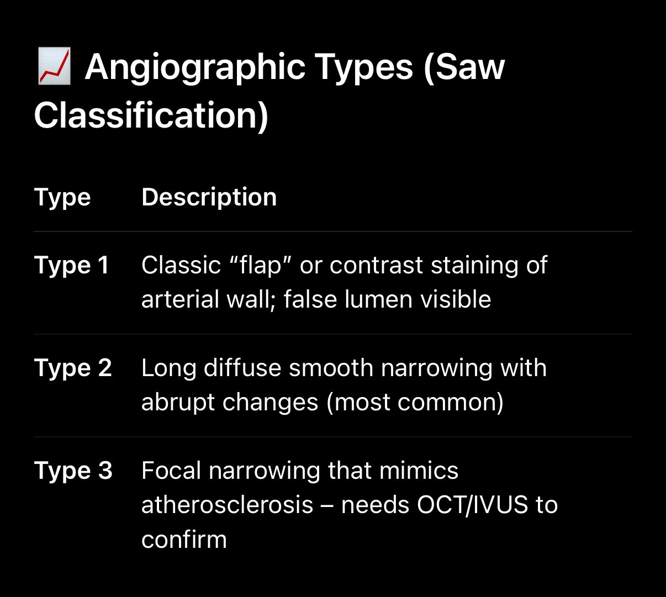
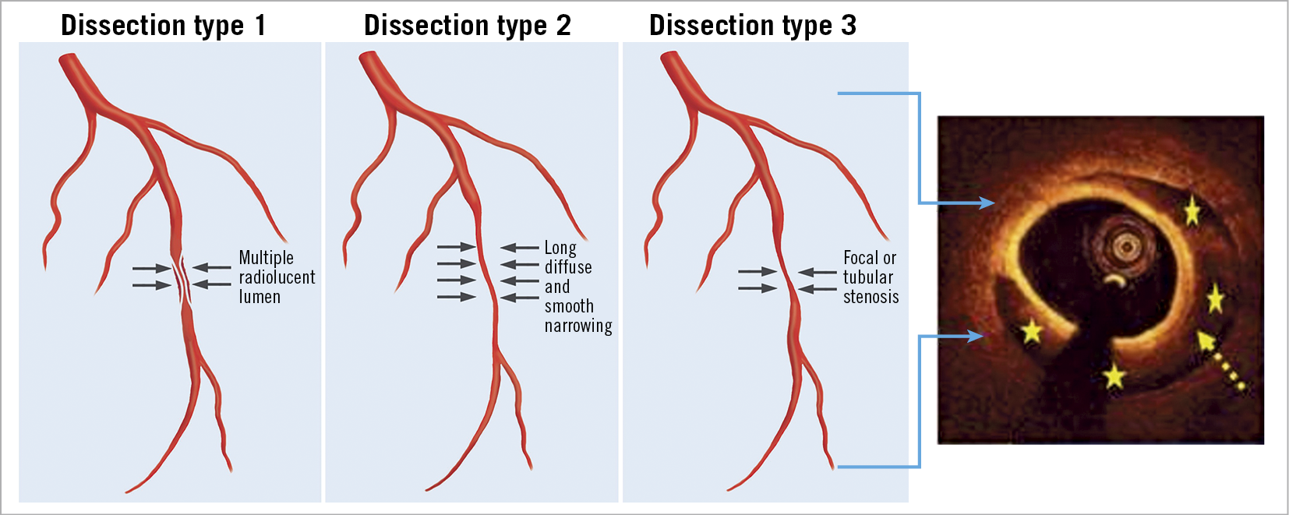

Slide 17
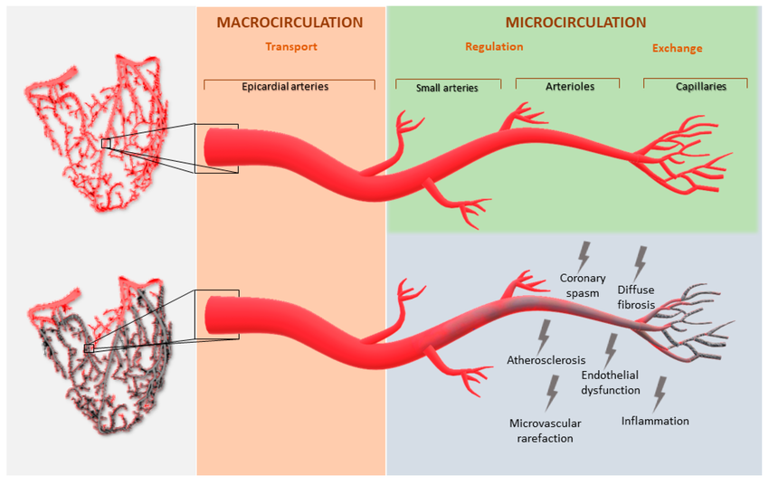
Microvascular causes
1. Coronary Microvascular Dysfunction
Coronary microcirculation (vessels <0.5 mm diameter) - not easily visualized yet accounts for ≈70% of the coronary resistance in the absence of obstructive CAD.
Microvascular dysfunction - endothelium-dependent/independent dysfunction
Clinical disorders of coronary microvascular dysfunction have largely been described in patients presenting with stable angina.

Slide 18
Impaired coronary flow
coronary flow reserve <2.0 in response to vasodilator stimuli such as adenosine
evidence of microvascular spasm diagnosed during provocative spasm testing, when chest discomfort and ischemic electrocardiographic changes are induced by acetylcholine provocation in the absence of epicardial coronary spasm
impaired coronary blood flow, as measured with a corrected TIMI frame count →delayed passage of angiographic contrast [requiring ≥3 beats to fill a vessel] at rest
30% to 50% of patients with chest discomfort and nonobstructive CAD on invasive coronary angiography.
More commonly seen in women and patients with cardiovascular risk factors (eg, increasing age, diabetes mellitus, hypertension, smoking, or dyslipidemia).

Slide 19
Microvascular causes
2. Coronary Embolism
Non-atherosclerotic cause
Involves embolization from a distant source into a coronary artery:
Atrial fibrillation, valvular vegetations, LV thrombus, myxomas
May lead to sudden blockage of a previously normal coronary artery
Can result in transient or partial occlusion, fitting the MINOCA definition
No underlying plaque is necessary

Slide 20
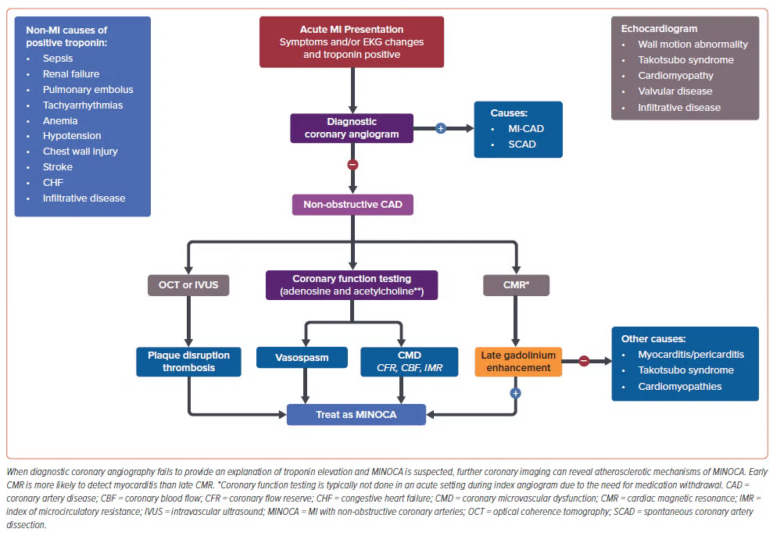

Slide 21
Management strategies
Emergency supportive care
Working diagnosis approach for patient evaluation
Cardioprotective therapies irrespective of the cause of the MINOCA
Cause-targeted therapies.

Slide 22
Emergency supportive care
Life-threatening arrhythmias or cardiogenic shock
Revascularization - not a therapeutic option in patients with MINOCA.
Consider the possible causes for MINOCA, especially in the initial setting, and immediately address the underlying mechanism responsible for a patient’s compromised condition.
Ventricular arrhythmias as a result of refractory spasm → coronary vasodilator drugs - treatment of choice and should be initiated promptly

Slide 23
Cardioprotective therapies
Atherosclerotic burden is low or minimal→ calls into question the value of routine use of DAPT, statin, ACEI/ARB & beta blockers
Therapies considered on an individual basis
No randomized controlled trials on secondary prevention treatment for MINOCA.
SWEDEHEART registry study - more than 9,000 MINOCA patients followed for 4 years- reduced MACE in patients treated with statins or angiotensin-converting enzyme inhibitors/angiotensin receptor blockers.
Notes:
Due to pleotropic effect of statin,endothelium stabilization,anti inflammatory action, plaque stabilization,improved microvascular function

Slide 24
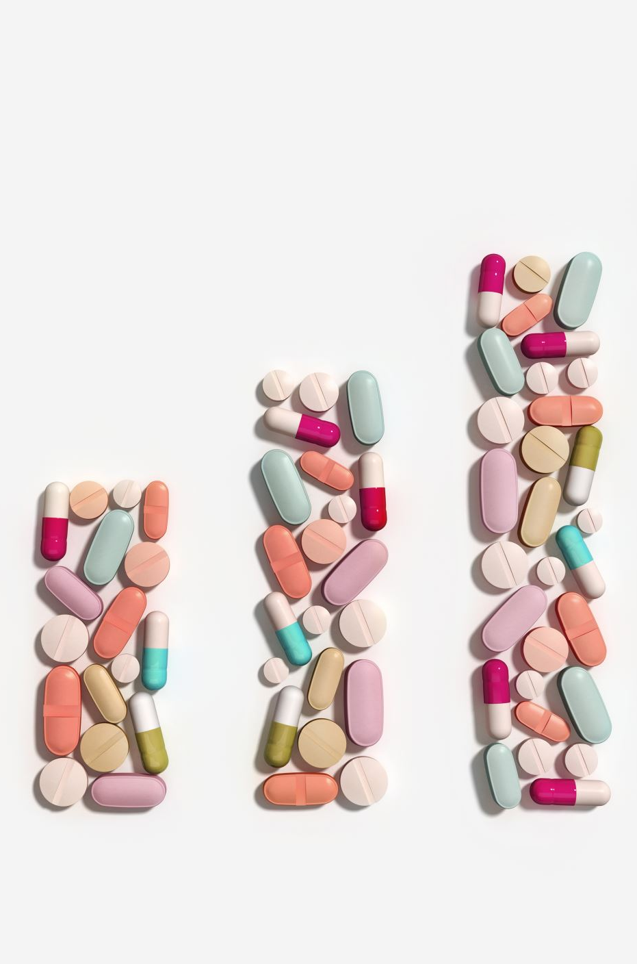
Cardioprotective therapies
Statin treatment has mostly been shown to be associated with lower mortality and a lower rate of MACE
A relative decrease of the same level as was shown in randomized trials of secondary prevention with statins in MI patients.
Similarly, mostly positive results have been shown for angiotensin-converting enzyme inhibitors (ACEI) or angiotensin receptor blockers (ARB).
On the other hand, most studies on beta-blockers have not found significant association with outcome

Slide 25
Any MINOCA patient with any evidence of atherosclerosis, modifiable CAD risk factors should be treated aggressively.
Since patients experience angina pain after an episode of MINOCA, symptomatic anti-anginal treatment with beta-blockers, calcium channel blockers or long-acting nitrates is often needed.
Vasospasm, underlying mechanism--- calcium channel blockers are the most effective symptomatic therapy; nitrates represent another option.
Reduced left-ventricular function---treatments such as ACEI or ARB, beta-blockers and other evidence-based treatments for heart failure should be initiated in patients with MINOCA

Slide 26
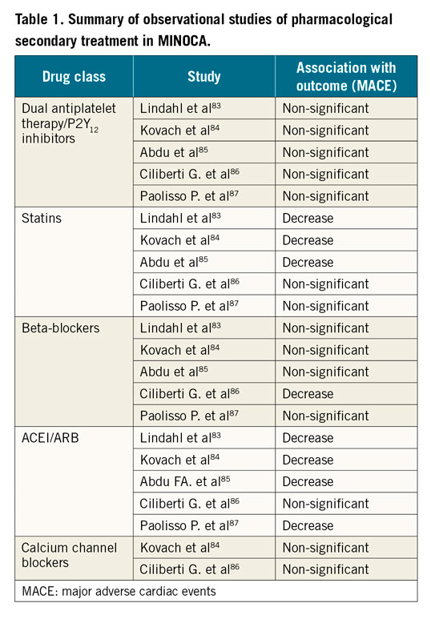
Observational studies
Notes:
Endothelial stabilization
• Anti-inflammatory action
• Plaque stabilization (even if the lesion is <50%)
• Improved coronary microvascular function
• May reduce risk of plaque rupture, erosion, or progression • Statins may benefit patients even in non-atherosclerotic MINOCA subtypes like coronary spasm, by improving endothelial function

Slide 27
Plaque disruption
Cardioprotective therapies in accordance with the AMI guidelines
Aspirin - mainstay initial therapy
Treatment identical for plaque rupture & erosion
2nd antiplatelet –reasonable
Stenting – not advisable

Slide 28
Epicardial coronary spasm
Calcium channel blockers - cornerstone therapy for patients with coronary spasm
Refractory vasospastic angina → Use of 2 calcium channel blockers (operating via different receptors) has been shown to alleviate symptoms.
Short-acting sublingual and intracoronary nitrates are beneficial in acutely alleviating coronary spasm
Benefits of long-acting nitrates less clear
Other agents beneficial - nicorandil and cilostazol

Slide 29
CORONARY MICROVASCULAR DYSFUNCTION
Revascularization therapies not an option
Conventional antianginal vasodilator drugs are less effective on the microvasculature
Among the conventional antianginal therapies, calcium channel blockers and β-blockers beneficial in alleviating symptoms, whereas nitrates are less effective.

Slide 30
CORONARY EMBOLISM/THROMBOSIS
Role of lifelong anticoagulant or antiplatelet therapies - unclear
Coronary thrombosis is usually treated with antithrombotic therapies and sometimes antiplatelet therapies
TTP is treated with plasma infusions supported by apheresis to allow plasma exchange, along with adjunctive therapies including steroids and rituximab
HIT → avoid subsequent exposure to heparin molecules

Slide 31
SPONTANEOUS CORONARY ARTERY DISSECTION
No randomized prospective study for the treatment of SCAD in the acute phase.
Acute phase : avoid the use of percutaneous coronary intervention or stenting unless the patient is unstable or presenting with STEMI with a completely occlusive coronary artery.
Recommendation based on observations that in most cases, coronary segments with SCAD heal spontaneously
Revascularization is associated with high complications, such as propagation of the dissection and intramural hematoma.
Use of anticoagulant and dual antiplatelet therapy in the immediate management of medically treated SCAD - controversial.

Slide 32

THANK YOU

Slide 33
Which of the following is not a common cause of minoca?
A.Coronary vasospasm
B.Plaque Erosion
C.Spontaneous coronary artery dissection
D.Critical left main artery stenosis

Slide 34
SPONTANEOUS CORONARY ARTERY DISSECTION AS A CAUSE OF MINOCA IS MORE COMMONLY SEEN IN ?
A.Elderly man with multiple risk factors
B.Middle aged women in pregnancy
C.Young men with cocaine use
D.Patients with HOCM 08

Slide 35
In a patient with suspected minoca which of the following investigation is most helpful in differentiating btwn plaque rupture and coronary spasm?
A. ECHO
B.CARDIAC MRI
C.OCT
D.TROPONIN I LEVELS

