Slide 1
Echocardiographic Evaluation of Systolic Function of the Left Ventricle

Slide 2
INTRODUCTION
Should be part of virtually all echocardiographic examinations.
Prognostic information, plays a crucial role in selection of medical therapy, and is instrumental in determining the timing of surgery for valvular heart disease.
Evaluation of both global and regional left ventricular systolic function

Slide 3
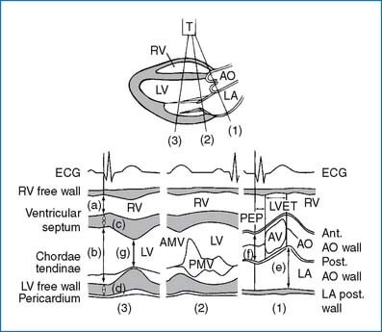
M Mode
The first attempts to quantify left ventricular function involved linear measurements of the minor-axis dimension from a dedicated M-mode echocardiogram.

Slide 4
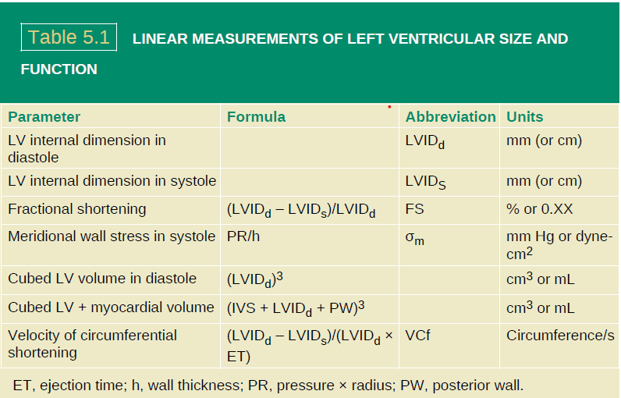

Slide 5
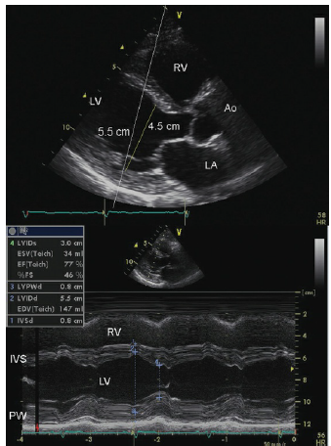
The temporal resolution of a dedicated M-mode beam is superior to that of two-dimensional echocardiography.
Provides information regarding dimension and contractility only along a single line. This may either underestimate or overestimate the abnormality.
If M-mode beam traverses the ventricle in a tangential manner it overestimates the true internal dimension
M-mode echocardiography provides a slight advantage for timing of events but confers no real advantage over direct two-dimensional measurements for chamber dimensions.

Slide 6
Indirect M-Mode Markers of Left Ventricular Function
Descent of the base
EPSS
Aortic valve opening pattern

Slide 7
Descent of the base
During ventricular contraction, the base (annulus) of the heart moves toward the apex.
In the presence of global left ventricular dysfunction, the magnitude of this motion is directly proportional to systolic function.
This technique is rarely used today, having given way to direct measures of ventricular volume and ejection fraction.

Slide 8
EPSS
E-point to septal separation
The magnitude of opening of the mitral valve, is reflected by E-wave height, correlates with the volume of transmitral flow and, in the absence of significant mitral regurgitation, with left ventricular stroke volume.
The internal dimension of the left ventricle correlates with diastolic volume.

Slide 9
Aortic valve opening pattern
If left ventricular forward stroke volume is decreased, there may be a gradual reduction in forward flow in late systole.
This results in a rounded appearance of aortic
valve closure in late systole

Slide 10
This same principle is used in Doppler tissue imaging of the annulus for determination of systolic velocities and excursion of the mitral annulus as a marker of ventricular function.
Doppler tissue imaging relies on adjustment of Doppler gains and filters to selectively record velocities from within the myocardium itself rather than the blood pool.
A sample volume can be placed within the mitral annulus and quantitative information extracted regarding annular velocity
In a uniformly contracting ventricle, annular systolic velocity is a marker of global left ventricular function.

Slide 11
Doppler tissue imaging of the lateral annulus performed in two patients. The upper panel was recorded in a patient with normal systolic function
and an ejection fraction of 60%. Notice the S wave of 9 cm/s. Also noted are the diastolic e′ and a′ velocities. The lower panel was recorded in a patient with a dilated cardiomyopathy and ejection fraction of 27%. Notice the annular systolic velocity of 4 cm/s consistent with reduced global function.

Slide 12
MEASUREMENTS FROM STANDARD TWO DIMENSIONAL IMAGING
Two-dimensional echocardiography provides inherently superior spatial resolution for determining left ventricular size and function.
Most often, apical images are used to determine ventricular volumes in diastole and systole, from which stroke volume and ejection fraction are calculated.

Slide 13
Simpsons rule (“rule of discs”)
This technique requires recording an apical, four- and/or two-chamber view from which the endocardial border is outlined in end-diastole and end-systole.
The ventricle is mathematically divided along its long axis into a series of discs of equal height
Individual disc volume is calculated as the product of height and disc area.
disc height is assumed to be the total length of the left ventricular long axis divided by the number of segments or discs.
The surface area of each disc is determined from the diameter of the ventricle at that point (area = πr2).

Slide 14
For accurate volume determination, the transducer must be at the true apex and the ultrasonic beam must be through the center of the left ventricle.

Slide 15
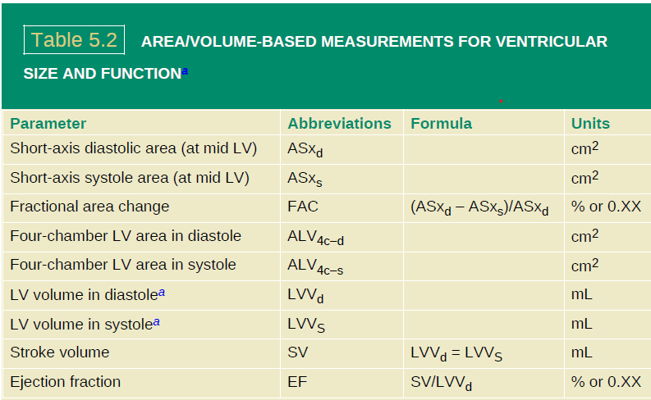

Slide 16
For determination of left ventricular volume, the endocardial border is traced with papillary muscles and trabeculae excluded from the cavity
The well-recognized underestimation of left ventricular volume by echocardiography, compared to a standard such as cardiac magnetic resonance imaging, is in part due to failure to exclude trabeculae from the cavity tracing.
If there is asymmetry of ventricular geometry or a systolic wall motion abnormality, a single-plane view will have reduced accuracy for the reasons previously alluded to. In this instance, averaging of volumes from multiple views or use of three-dimensional echocardiography will increase accuracy

Slide 17
Once the diastolic and systolic volumes have been determined, stroke volume can be calculated as the difference between these two volumes.
Assuming the absence of mitral or aortic insufficiency, forward cardiac output then equals the product of heart rate and stroke volume. Ejection fraction can be calculated from these volumes as: stroke volume ÷ end-diastolic volume.
Because the difference between the diastolic and systolic left ventricular volume represents the total volume pumped by the ventricle, it represents the sum of forward-going stroke volume plus the volume of mitral and aortic regurgitation, if present.

Slide 18
Automated Edge Detection
Most currently available instrumentations incorporate algorithms to automatically identify and track the endocardial border of the left ventricle.
The basic principle is that the acoustic boundary between the blood pool and tissue is identified and then tracked throughout the cardiac cycle.
The degree to which this is automated is highly variable and ranges from fully automated systems in which there is no user interaction, to systems in which multiple points of the ventricular contour are manually defined, after which the boundary between points is extrapolated.

Slide 19
One of the more common techniques is to identify the apex of the left ventricle and then the lateral and medial mitral annulus after which automatic detection algorithms identify the endocardial boundary.
After the initial approximation of the endocardial boundary, operator interaction is often required to adjust the boundary to fit the visually identified cavity.

Slide 20
After the endocardial boundary has been identified, various algorithms are utilized to determine the volume.
Modern systems typically determine the left ventricular volume from an actual pixel count bounded by the endocardial boundary.
Ventricular volume can then be calculated continuously through the cardiac cycle and graphically displayed over time. Stroke volume and ejection fraction can be calculated from the maximal and minimal volumes.

Slide 21
SPECKLE TRACKING
An additional methodology for tracking the myocardium is “speckletracking.” This technique relies on creating an “acoustic signature” of multiple regions of interest within the myocardium.
The acoustic signature of any given region remains stable throughout the contraction sequence and therefore the region can be tracked over the cardiac cycle.
The speckle tracking technology provides a mechanism for tracking discreet myocardial segments from which deformation measurements of strain and strain rate can be calculated.

Slide 22
It also provides definition of the myocardial boundary from which the myocardial blood pool and ventricular volumes can be extrapolated.
An apicalfour-chamber view is presented from which a section of the ventricular septum has been expanded (bordered area). Within the expanded area, two circular regions of interest are identified. Note the distinctly different acoustic signature
within these regions.

Slide 23
For patients with significant degradation of overall visual image quality automated edge detection systems may consistently fail and will provide erroneous information which should not be used.
At all times the automatically detected border should be scrutinized for accuracy against the known location of the endocardial border when analyzed in real time and appropriately adjusted.
Intravenous contrast for left ventricular opacification is also a valuable technique for enhancing endocardial border definition. It has been recommended that if two or more ventricular segments are poorly visualized , there is incremental yield of intravenous contrast for left ventricular opacification both for regional wall motion assessment and for reproducibility of volume determination.

Slide 24
ASSESSMENT OF REGIONAL LEFT VENTRICULAR FUNCTION

Slide 25
Coronary artery disease, with its sequelae of myocardial ischemia, infarction, and chronic remodeling is the most common form of acquired heart disease encountered in adults.
Coronary artery disease typically results in regional rather than global abnormalities, which requires a different approach to analysis from that used for assessment of global function.

Slide 26
Contraction events
Myocardial fibers are oriented in a spiral fashion around the left ventricle.
Contraction results in myocardial thickening and excursion of the endocardium toward the center of the ventricle.
Simultaneous with this motion toward the center and cavity shrinkage is a twisting or wringing motion of the left ventricle
When viewed from the apex, there is initially a slight clockwise rotation of the entire heart after which the base of the left ventricle continues to rotate in a clockwise fashion and the apex rotates in a counter clockwise fashion.
This systolic wringing motion of the left ventricle is an intrinsic component to myocardial contractility and efficiency.
Indiastole, the twisting motion of the heart is reversed and the early untwistingis largely responsible for early diastolic suction.

Slide 27
Using M-mode or standard two-or three-dimensional echocardiography, only myocardial thickening and endocardial motion toward the center of the ventricle are appreciated.
Abnormalities of thickening and endocardial motion are reliable indicators of myocardial ischemia or infarction and their detection remains the mainstay of diagnosis of ischemic syndromes.
Most commonly, abnormal regional wall motion is the result of coronary artery disease which interrupts perfusion to fairly well-defined territories and hence results in abnormal motion in those segments.

Slide 28
Quantitative Techniques
Rarely used in routine clinical practice
These include measurement of radian or area shrinkage in the short axis of the left ventricle.
This is accomplished by describing a series of radians from the center of mass of the ventricle.
The number of radians can range from 8 to 100, with each radian defined as the length from the center of mass to the endocardial border in diastole and subsequently in systole.

Slide 29
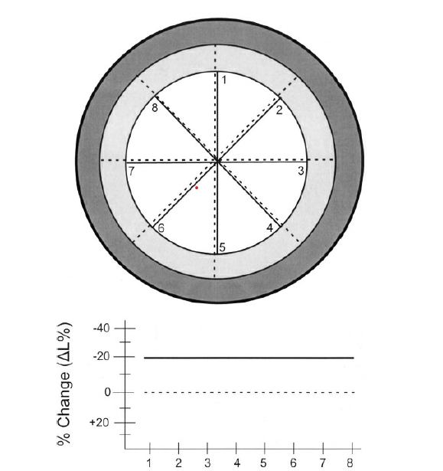
Schematic diagram of normal endocardial wall motion without
translational motion.
The outer dark circle represents the diastolic thickness
of the left ventricle and the inner lighter shaded circles represent the extent of systolic contraction. Eight radians from the center of mass have been drawn for both the diastolic (dotted line) and systolic (solid line) endocardial boundaries.
The percentage of change in length from diastole to systole is
schematized. The dotted line represents zero change in length and the solid line represents the actual percentage of change in length for the normally contracting ventricle, which in this example is a 20% reduction in length. This diagram is
subsequently repeated for demonstration of wall motion abnormalities and algorithms for correction of translation motion. In each subsequent similar figure, the darker outer ring represents the normal diastolic contour and the solid line represents the systolic endocardial contour.

Slide 30
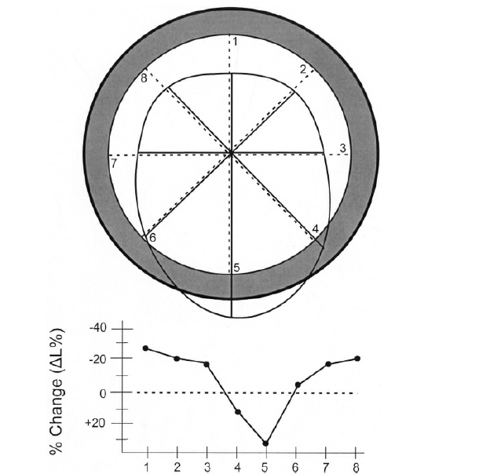
Schematic demonstration of posterior dyskinesis with no
translational or rotational motion using the diastolic center of mass for both systole and diastole.
The dark outer ring represents the contour of the ventricle in diastole and the inner circle represents the endocardial contour in systole. Note the maximal area of dyskinesis at segment five with less dyskinesis at segment four and akinesis at segment six.
The change in radianlength from diastole to systole is graphed. Note the apparent hyperkinesis of the noninvolved segments with increased radian shortening compared with normal
contraction

Slide 31
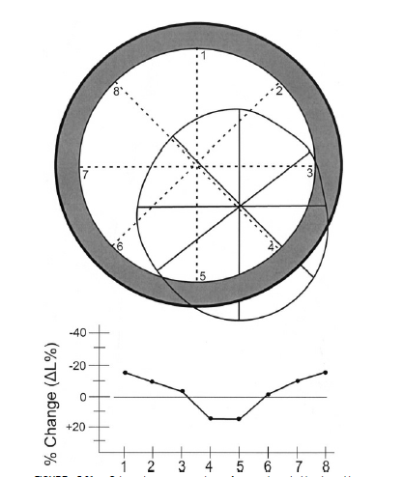
Schematic representation of posterior dyskinesis with
posterolateral translation, using separate diastolic and systolic centers of mass for determining radian length

Slide 32
Determination of Left Ventricular Mass
Echocardiography was one of the first imaging modalities used clinically for determination of left ventricular mass.
It has seen widespread acceptance in epidemiologic studies of hypertension in which the presence of hypertrophy has been associated with worsened outcomes and its regression has been agoal of therapy.
The earliest methodology for determining left ventricular mass was based on M-mode measurement of septal and posterior wall thickness and the leftventricular internal dimension.
M-mode calculations assume a predefined ventricular geometry, and their accuracy will diminish in instances in which the left ventricular shape is abnormal.

Slide 33
One of the methods for determining left ventricular mass is the cubed (Teichholz) formula, which assumes that the left ventricle is a sphere.
The diameter of this sphere is the interior dimension of the left ventricle and the sphere wall thickness is that of ventricular myocardium.
The formula calculates the outer dimensions of the sphere and then the inner dimension, the difference being the presumed leftventricular myocardial volume.

Slide 34
The cubed formula is expressed as
leftventricular mass = (interventricular septum + left ventricular interiordimension + posterior wall)3 – left ventricular interior dimension3
This then gives the volume of the stylized sphere of the myocardium, which, when multiplied by the specific gravity of muscle (1.05g/cm3), provides an estimate of left ventricular mass.

Slide 36
The cubed volume approach has the obvious limitation of determining ventricle size and wall thickness only along a single line and incorrectly assuming spherical ventricular shape.
As it is common for the M-mode dimension to exceed the true minor-axis dimension, further error is introduced.
The cubed methodology has been widely used, especially in serial evaluations, because for any given patient, the magnitude and direction of the error is expected to remain constant .
In theory a more accurate determination of left ventricular mass can be obtained with two-dimensional echocardiography.

Slide 37
When using two dimensionalechocardiography, geometric assumptions of the ventricular shape are typically still employed but the assumption is that of a bullet shaped ventricle rather than a sphere.
In addition, mean left ventricular wall thickness is determined rather than wall thickness at only one point on the septum and posterior wall.
Mean wall thickness can be calculated by determining the epicardial and endocardial areas of the short axis of the left ventricle at the midcavity level.

Slide 38
The difference between these two areas then represents myocardial area.
Left ventricular mass can then be calculated either by an area length method or by assuming a truncated ellipse geometry

Slide 39
Physiologic Versus Pathologic Hypertrophy
Left ventricular hypertrophy can be characterized as concentric, eccentric, or physiologic
It should be emphasized that calculation of left ventricular mass is a determination of the mass of the left ventricular muscle and may not relate to overall cardiac enlargement.

Slide 40
Increases in left ventricular mass can occur with chamber enlargement and relatively normal wall thickness (eccentric hypertrophy), as is seen in regurgitant valvular lesions, or secondary to a predominant increase in wall thickness with normal chamber sizes, as is seen in the pressure overload of systemic hypertension.
When evaluating patients for left ventricular hypertrophy, it is important to characterize the hypertrophy as being due to either chamber enlargement or increased wall thickness.

Slide 41
One additional index of hypertrophy is relative wall thickness which is defined as (posterior wall thickness + interventricular septal thickness)/left ventricular internal dimension.
Relative wall thickness of ≥0.42 has been used as a threshold of pathologic left ventricular hypertrophy.

Slide 42
An additional form of hypertrophy is the physiologic hypertrophy seen in highly trained athletes.
this is a physiologic adaptation in which there is a slight increase in both wall thickness and chamber dimension
Wall thickness more than 13 mm is unusual in physiologic hypertrophy. Because the hypertrophy is a physiologic adaptation to physical training, wall stresstends to be normal.
Physiologic hypertrophy seen in athletes regresses relatively quickly after cessation of vigorous training and, as such, can be differentiated from pathologic hypertrophy seen in hypertrophic cardiomyopathy if imaging is repeated after a period of deconditioning.

Slide 43
Tissue Doppler Color M-Mode
Using colorized Doppler tissue imaging an M-mode line can be directed through the ventricle and a color Doppler M-mode of tissue motion acquired
This technique has shown utility in describing the timing of wall motion abnormalities.
In the presence of a left bundle branch block, clear alternation in blue-red colorization of the septum is seen in patients with multiphasic septal motion related to conduction disturbances

Slide 44
Color tissue Doppler M-mode echocardiograms recorded in a
normal patient in the upper panel and in a patient with anteroseptal dyskinesis inthe lower panel. Notice in the upperpanel, the abrupt blue colorization timed withthe QRS (downward-pointing arrow) of the ventricular septum as it movesposteriorly followed by an abrupt change to red colorization representing anteriormotion at the end of systole (upward-pointing arrow). Notice in the posterior wall
the red colorization representing anterior motion of the normally moving posteriorwall (double-headed arrow). The lower panel was recorded in a patient with an
anteroseptal infarct and septal dyskinesis. Notice the similar appearance of theposterior wall colorization with normal red coloring encoding in systole (doubleheadedarrows) but the similar red encoding for the ventricular septum
representing dyskinesis (small arrows). PW, posterior wall.

Slide 45
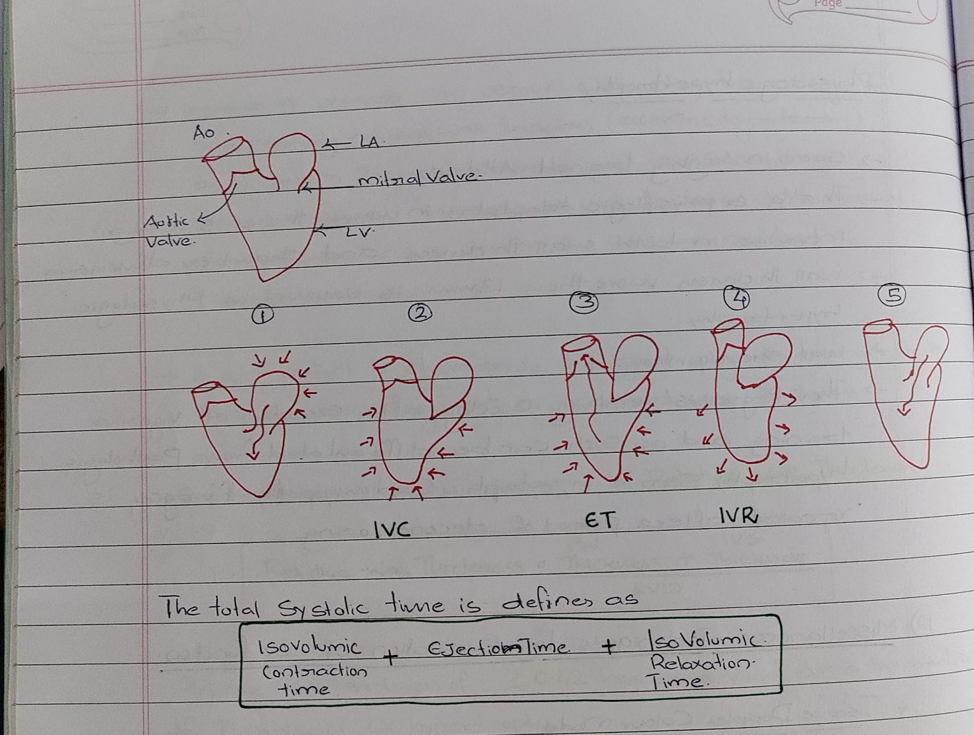
Myocardial Performance Index /“Tei index”
A rapidly determined index of ventricular function has been derived by comparing the total systolic time from mitral valve closure to mitral valve opening with the systolic time involved in actual aortic flow (ejection time).

Slide 46
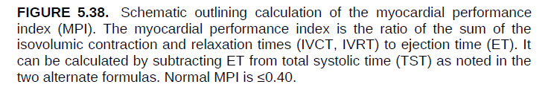

Slide 47
The total systolic time is defined as isovolumic contraction time (IVCT) ± ejection time +isovolumic relaxation time (IVRT).
The myocardial performance index (MPI) essentially divides the total isovolumic times (IVCT + IVRT) by the ejection time.
This index, referred to as the MPI or “Tei index,” combines features of both systolic and diastolic function and has been shown to correlate with outcome in ischemic and nonischemic disease states.
Normal MPI is less than 0.40 with progressively greater values implying progressively worse ventricular function.

Slide 48
Determination of Left Ventricular dP/dt
dP/dt represents the rate of increase in pressure within the left ventricle.
If confined to early systole, during isovolumic contraction, it is a relatively load-independent measure ofventricular contractility.
Using the spectral display of a mitral regurgitation jet, it is possible to derive similar information regarding the rate of pressure development within the left ventricle.

Slide 49
If this measurement is undertaken in early systole while the increasing ventricular pressure is less than the aortic pressure, it is relatively load independent.
The method by which this is performed is to record the mitral regurgitation spectral profile at a high sweep speed (typically 100mm/s)
To determine the dP/dt, one calculates the time difference in milliseconds from the point at which the velocity is at 1 m/s and at 3 m/s.
The time between these two points represents the time that it takes for a pressure change of 32mm Hg to occur in the left ventricular cavity.

Slide 50
Left Ventricular Wall Stress
Most clinically used parameters of ventricular function including stroke volume and ejection fraction are afterload dependent, that is, they are dependent on the pressure developed and impedance against which the left ventricle must contract.
Several methods have been proposed for correcting afterload or creating afterload-independent indices of left ventricular performance, including calculating ventricular wall stress and creation of pressure volume loops.

Slide 51
These calculations have been used as a measure of myocardial contractility in the investigation of cardiomyopathy and valvular heart disease. Because it accounts for wall thickness and pressure generation, wall stress is more afterload-independent than parameters such as fractional shortening or ejection fraction.
Left ventricular stress can be calculated either globally or regionally.There are three different regional stress calculations : radial, circumferential, and meridional, each of which is mutually orthogonal.

Slide 52
In its simplest form, meridional stress is defined by the formula:
stress =(pressure × radius) ÷ h (where h = wall thickness)
This formula assumes spherical geometry, which obviously is not the case in the leftventricle.
As such, while correlating with other measures of left ventricular stress, it may not truly represent the actual value

Slide 53
Because of left ventricular–right ventricular interaction and changes in the radius of curvature of the ventricle, regional stress varies from apex to base and around the circumference of the left ventricle.
Calculation of stress indexed to ventricular volume has been used as an index of ventricular performance in valvular heart disease and cardiomyopathy.

Slide 54
Doppler Evaluation of Global Left Ventricular Function
The earliest, conceptually simplest, and still probably one of the more clinically useful methods for following left ventricular function with Doppler is to evaluate the time velocity integral(TVI) of the left ventricular outflow tract or ascending aorta.
Basically, the principle is that if the cross-sectional area of flow is known, then the product of that cross-sectional area and the mean velocity of flow equals thevolumetric flow

Slide 55
Typically, the area evaluated for determination of systolic flow, and hence global left ventricular performance, has been the left ventricular outflow tract.
The calculated stroke volume can be multiplied by the heart rate to obtain cardiac output

Slide 56
Although measurement of the actual outflow tract area may be subject to significant error, there are no commonly encountered disease states in which the area of the outflow tract would be expected to change over a short period
With this in mind, the outflow tract area can be considered a constant over time in most patients.
In theory, these same principles can be applied to any of the four cardiac valves or outflow or inflow tract dimensions
The right ventricular outflowtract, just below the pulmonic valve, provides information analogous to thatfor the left ventricular outflow tract

Slide 57
Comparison of the TVI-outflow tract area product at these two sites has been successfully used in congenital heart disease to compare right and left ventricular stroke volume and hence determine shunt ratios in patients with intracardiac shunts.

Slide 58
MCQ’S

Slide 59
1. What is the most commonly used echocardiographic method for calculating left ventricular volumes and ejection fraction? A. Teichholz method B. M-mode C. Simpson’s rule D. Speckle tracking

Slide 60
Answer: C. Simpson’s rule

Slide 61
2. What is considered a normal annular systolic velocity on tissue Doppler imaging? A. 3 cm/s B. 5 cm/s C. 9 cm/s D. 12 cm/s

Slide 62
Answer: 9 cm/s

Slide 63
3.What value of relative wall thickness suggests pathological LV hypertrophy? A. ≥0.30 B. ≥0.35 C. ≥0.40 D. ≥0.42

Slide 64
Answer: D. ≥0.42

Slide 65
THANK YOU

