Slide 1
Hepatic Vein Doppler
Dr. Aiswarya Ravikrishnan

Slide 2
Components of a Normal Multiphasic Spectral Doppler of Hepatic Veins
Normal waveform is triphasic / multiphasic, reflecting pressure changes in the right atrium (RA) transmitted to the hepatic veins.
S wave (systolic forward flow):
Blood flows from hepatic veins to RA during atrial relaxation + tricuspid descent in ventricular systole.
→ Normally dominant wave.
V trough:
Small dip after S wave; corresponds to end-systole/atrial overfilling.

Slide 3
D wave (diastolic forward flow):
Blood flows into RA during early ventricular diastole (tricuspid opening, RA emptying).
A wave (atrial reversal):
Retrograde flow into hepatic veins during atrial contraction.

Slide 4
Physiologic Factors Causing Artifacts in Hepatic Vein Doppler
Respiration
Inspiration → Increased forward flow (S, D waves more prominent).
Expiration → Reduced flow, more phasicity loss.
Patient position (supine vs. sitting).
Transducer angle / Doppler gain setting.
Valsalva maneuver → reduces venous return → dampens S & D.
Cardiac arrhythmias (e.g., AF) → irregular waveforms.
Normal anatomic variants (different vein orientation, smaller tributaries).

Slide 5
Hepatic Vein Anatomy
Three major hepatic veins:
Right hepatic vein → drains right lobe.
Middle hepatic vein → drains medial segments (separates right & left lobes).
Left hepatic vein → drains left lobe.
→ Together, they divide the liver along cranio-caudal planes.

Slide 6
Right inferior hepatic vein
Present in 30–60% of people.
Acts as an additional drainage channel for the right lobe.
Venous confluence pattern:
Left & middle hepatic veins often merge before entering the IVC.
This confluence is seen in 60–85% of individuals.

Slide 7
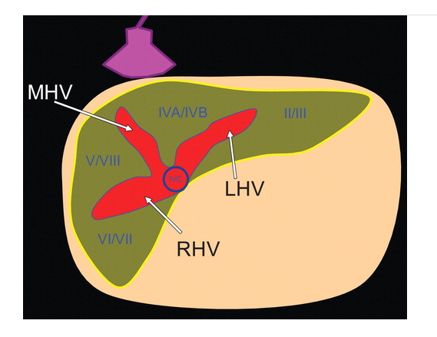

Slide 8
Hemodynamics of Hepatic Vein Flow
Drainage:
Hepatic veins (HVs) drain into the right atrium (RA) via the inferior vena cava (IVC).
Correlation with RA pressure:
HV pressure and flow patterns mirror RA pressure changes.
This happens because pressure changes in the RA are transmitted directly to the HVs.

Slide 9
Transmission characteristics:
Even with a well-developed Eustachian valve, RA pressure changes still pass clearly into the IVC and HVs.
The close proximity of HVs to the RA means pressure changes are transmitted without time delay.

Slide 10
Effect of respiration:
HV Doppler waveforms also show respiratory variations in RA pressure.
Superiority over SVC study:
Compared to the superior vena cava, HV Doppler more clearly reflects RA pressure dynamics.

Slide 11
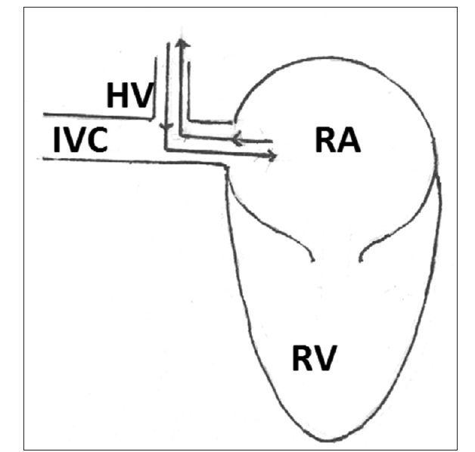

Slide 12
How to Record Hepatic Vein Doppler (from Subcostal Long-Axis View)
Start with IVC long axis:
From the subcostal long-axis view, first visualize the IVC.
Identify hepatic veins:
With small probe adjustments, visualize hepatic veins draining into the IVC (most often middle and/or left HV).
Select the best HV:
Choose the HV that runs parallel to the ultrasound beam → this ensures accurate Doppler sampling.

Slide 13
Optimize alignment:
Slight angulation of the transducer improves alignment with the vein’s long axis.
Sample volume placement:
Use a small sample volume (≈2 mm).
Place it inside the HV, away from the IVC junction to avoid contamination from IVC flow.
Avoid pitfalls:
If sample is too close to IVC → waveforms get distorted by IVC flow and can shift with respiration.
Excessive respiratory movement may also displace the sample volume out of the HV, giving poor signals.

Slide 14
During apnea (no breathing movement):
Waveforms are cleaner and more stable.
Avoids respiratory artifacts and sample volume displacement.
Sweep speed:
50–100 mm/s: Best for analyzing waveform morphology (S, D, A reversal waves).
25 mm/s: Best for analyzing respiratory variation (because you capture more cardiac & respiratory cycles in one frame).
Apnea + fast sweep (50–100 mm/s) → fine detail of the wave.
Normal breathing + slow sweep (25 mm/s) → effect of respiration.

Slide 15
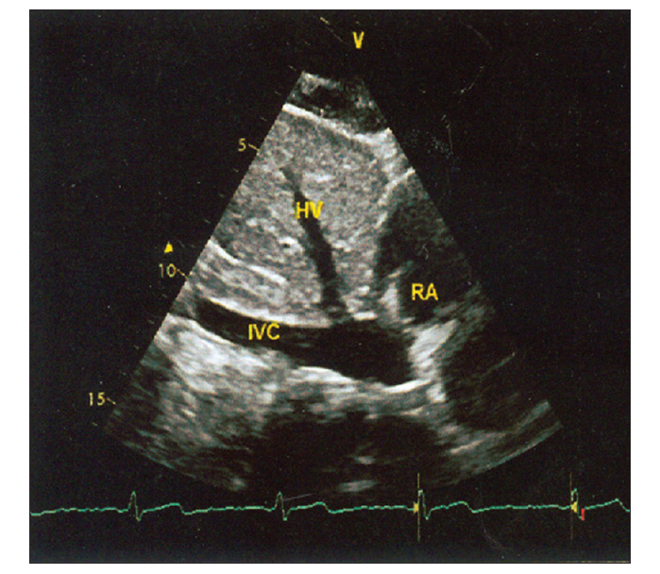

Slide 16
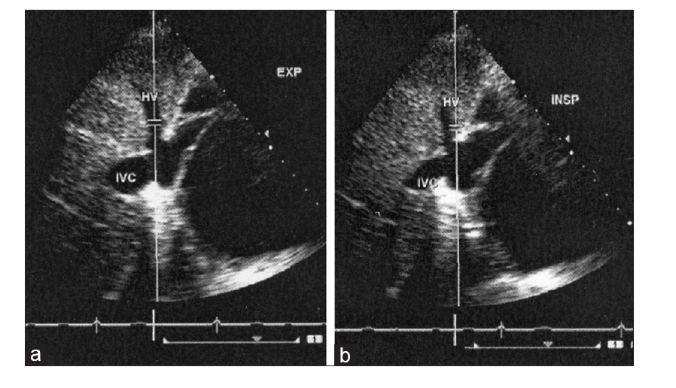

Slide 17
Goal: Doppler beam should be parallel to hepatic vein (HV) flow for accurate waveform.
Step 1: Start with subcostal (subxiphoid) view → usually shows middle/left HV.
Step 2: If alignment poor → move probe from subxiphoid toward right midclavicular line → may improve middle HV alignment.
Step 3: If still poor → turn patient to left lateral position and repeat subxiphoid → right midclavicular approach.
Step 4: In obese patients → HVs may not be visible in subxiphoid or midclavicular windows.
Step 5: Try right axillary view (patient in left lateral position, probe marker toward feet) → may reveal right HV better aligned.

Slide 18
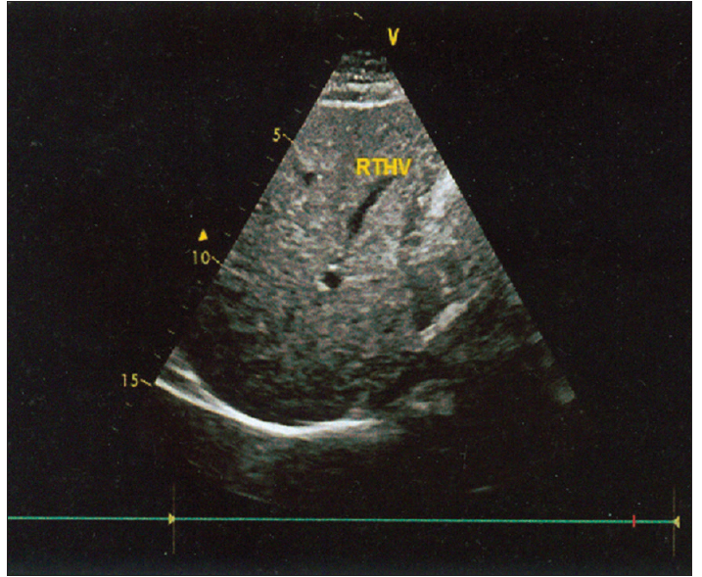
Hepatic vein in Left Lateral Position in Axillary Line

Slide 19
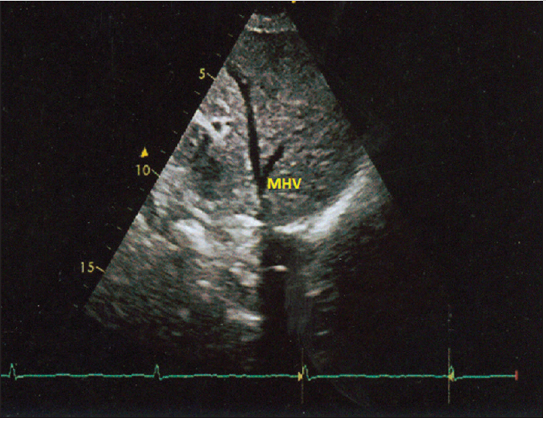
Hepatic vein in Right Midclavicular line

Slide 20
Problem: From right midclavicular or right axillary views, the HV–IVC continuity may not be clear.
Solution: Differentiate HV from hepatic artery (HA) and portal vein (PV) using Doppler flow patterns:
Hepatic vein (HV): Flow away from transducer → shown below baseline (blue), multiphasic.
Portal vein (PV): Flow toward transducer → above baseline (red), monophasic, low velocity.
Hepatic artery (HA): Flow toward transducer → above baseline (red), pulsatile (high in systole, lower in diastole).

Slide 21
Components of Normal Hepatic Vein Doppler Waveform
Systolic Forward Flow (S):
Flow towards RA during ventricular systole (because RA pressure falls as the atrium relaxes and empties into RV).
Usually a big single wave.
Sometimes split into S1 (early systolic descent of atrial base) and S2 (later systolic filling).
Systolic Reversal (SR):
Small reversal wave (above baseline) at the end of systole.
Caused by brief rise in RA pressure when tricuspid valve closes/ventricle contracts.

Slide 22
Diastolic Forward Flow (D):
Forward flow into RA during ventricular diastole (when tricuspid valve opens and RA empties).
Usually second positive wave after S.
Diastolic Reversal (DR):
Small reversal after D-wave.
Due to transient rise in RA pressure at the end of rapid filling.
Atrial Reversal (AR):
Reversal wave during atrial contraction (end-diastole).
RA contraction pushes a little blood back into hepatic veins.

Slide 23
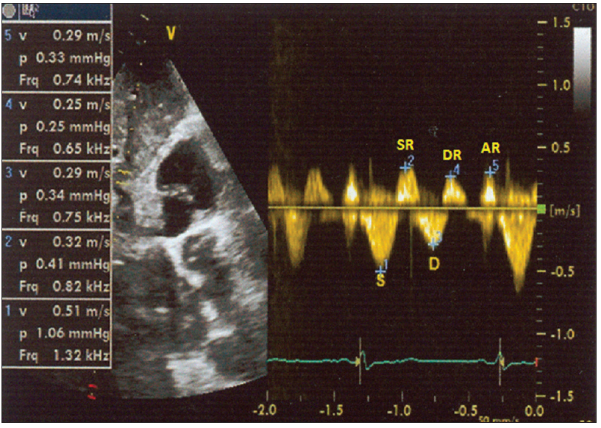
Normal Hepatic vein Doppler waveforms

Slide 24
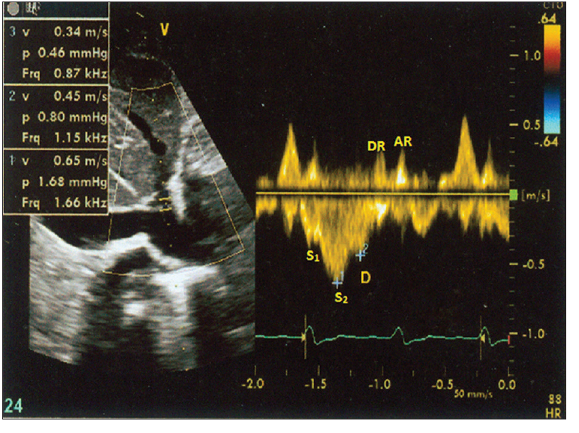
Normal Hepatic vein Doppler waveforms

Slide 25
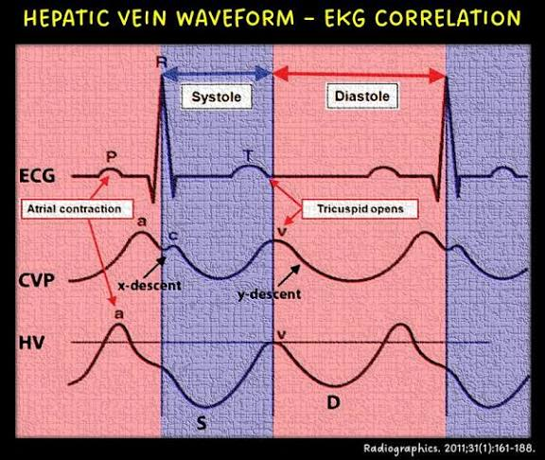

Slide 26
Normal Hepatic Vein Doppler Physiology
Systolic vs Diastolic Forward Flow
S wave (systolic forward flow) is slightly larger than D wave under normal conditions.
Diastolic Reversal (DR)
Usually not prominent at normal HR.
Becomes more visible at slow heart rates (because filling phases are prolonged).
Effect of Respiration
Inspiration → forward flows (S & D) become stronger.
Expiration → reversal waves (SR, DR, AR) become more prominent.

Slide 27
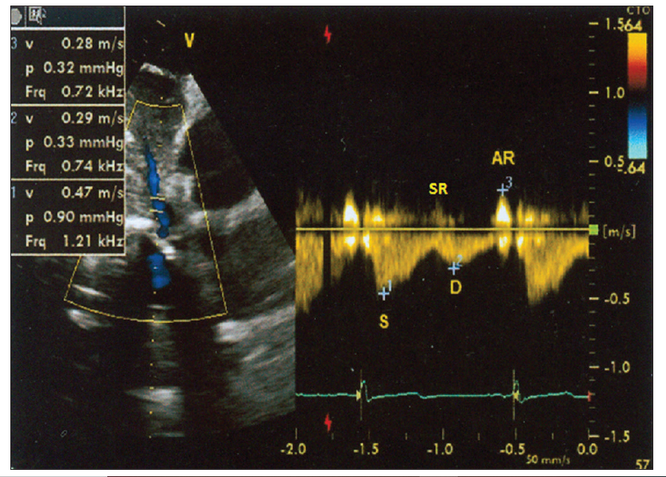
Normal Hepatic vein Doppler waveforms

Slide 28
Hepatic Vein Doppler Waves & Corresponding Events
Atrial Contraction → AR (Atrial Reversal Wave)
When the RA contracts at end-diastole, blood is pushed backward briefly → small retrograde flow into IVC & hepatic vein.
RA Relaxation → S1 Wave (Forward Flow)
As the RA relaxes, pressure drops in RA → blood from hepatic vein flows forward into RA.
This produces the early systolic forward wave (S1).

Slide 29
Tricuspid Valve Closure → Small Backflow Notch
When the tricuspid valve snaps shut, there is a brief rebound backflow into hepatic vein.
This separates S1 from S2.
Ventricular Systole (Tricuspid Annular Descent) → S2 Wave (Forward Flow)
During RV systole, the tricuspid valve ring is pulled downward toward the apex → enlarges RA cavity.
This creates suction and enhances forward flow from hepatic vein to RA → S2 wave.

Slide 30
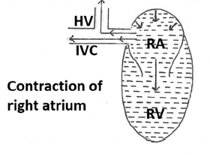
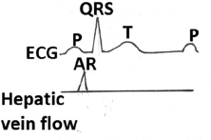

Slide 31
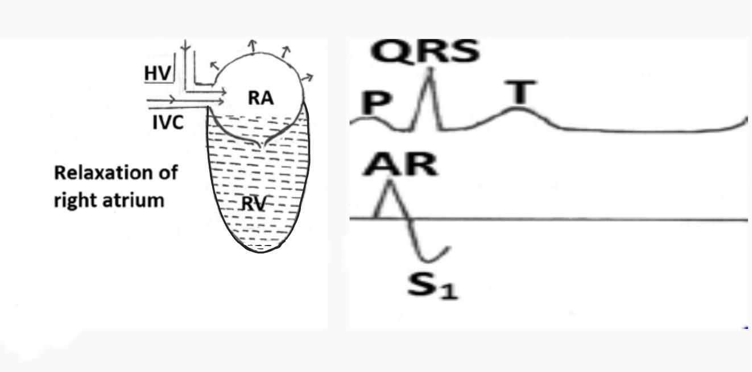

Slide 32
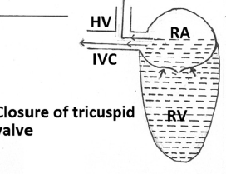
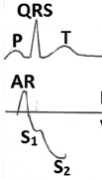

Slide 33
Systolic reversal (SR): Right atrial filling → backflow into hepatic vein.
Diastolic forward flow (D): Ventricular relaxation + tricuspid valve opening → right atrium empties into right ventricle → forward flow in hepatic vein.
Diastolic reversal wave: Right ventricle filling + tricuspid valve closure → transient backflow into hepatic vein.

Slide 34
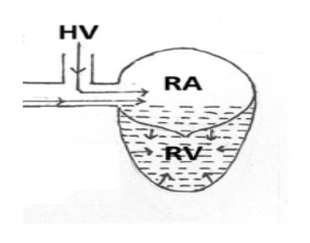
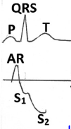

Slide 35
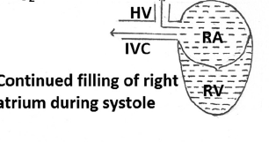
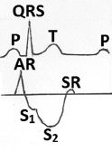

Slide 36
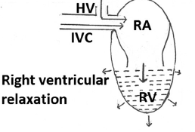
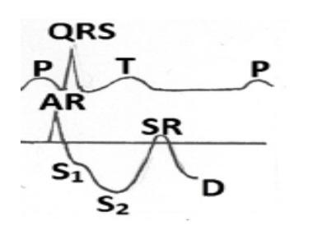

Slide 37
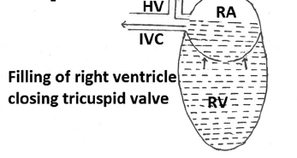
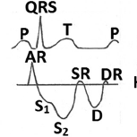

Slide 38
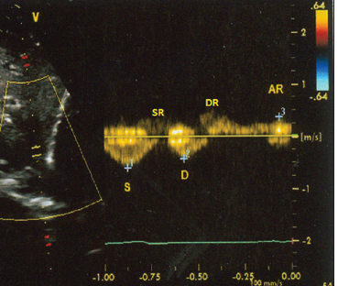

Slide 39
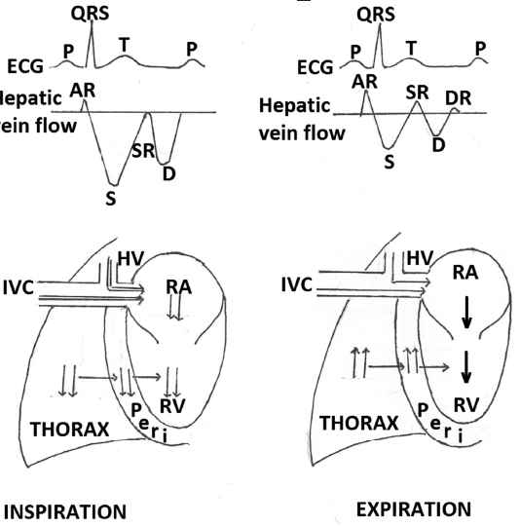
EFFECT OF RESPIRATION

Slide 40
Inspiration
Inspiration → fall in intrathoracic pressure
In a normal pericardium, this pressure drop is transmitted to intrapericardial chambers.
Right atrial & right ventricular pressures fall.
Fall in RA pressure → increased venous return from IVC to RA.
Blood flow from hepatic vein (HV) to IVC increases.
Net effect:
Forward flow velocities ↑
Retrograde flow velocities ↓

Slide 41
Expiration
Expiration → rise in intrathoracic pressure
Right atrial pressure increases
Flow from IVC to RA decreases
Forward flow in hepatic vein decreases
Slight increase in reversal velocities

Slide 42
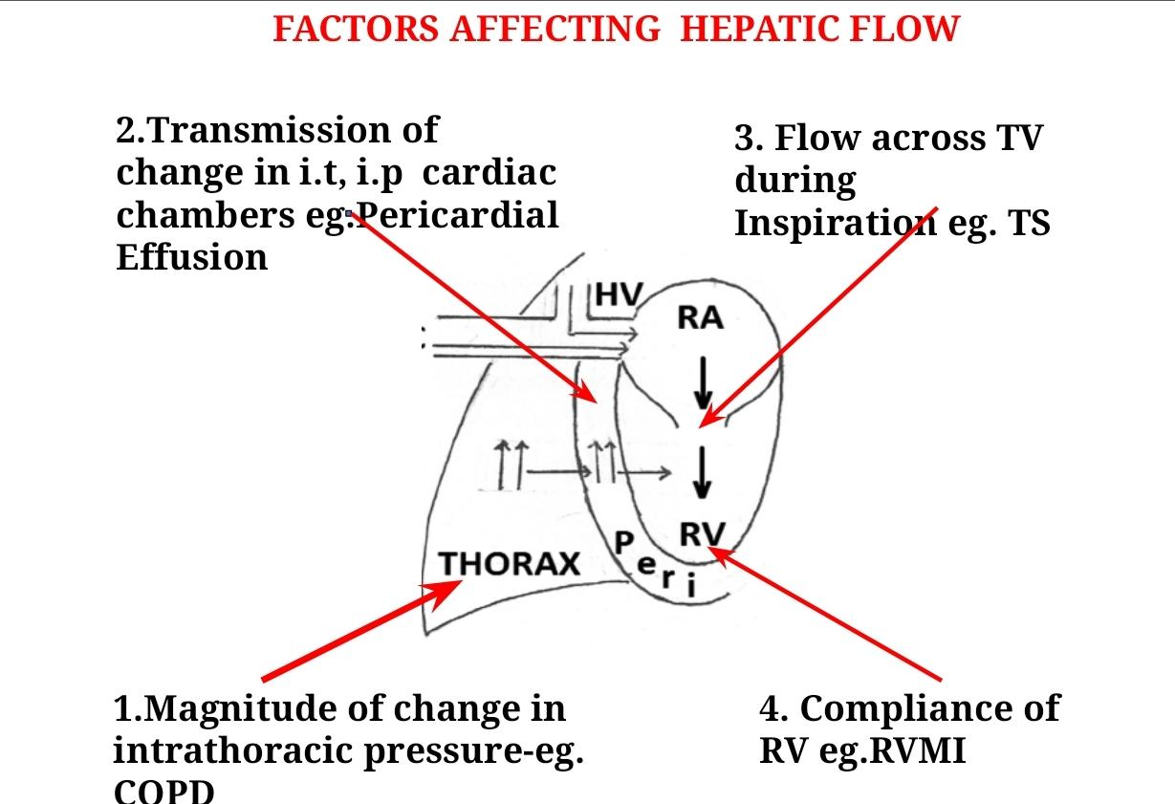

Slide 43
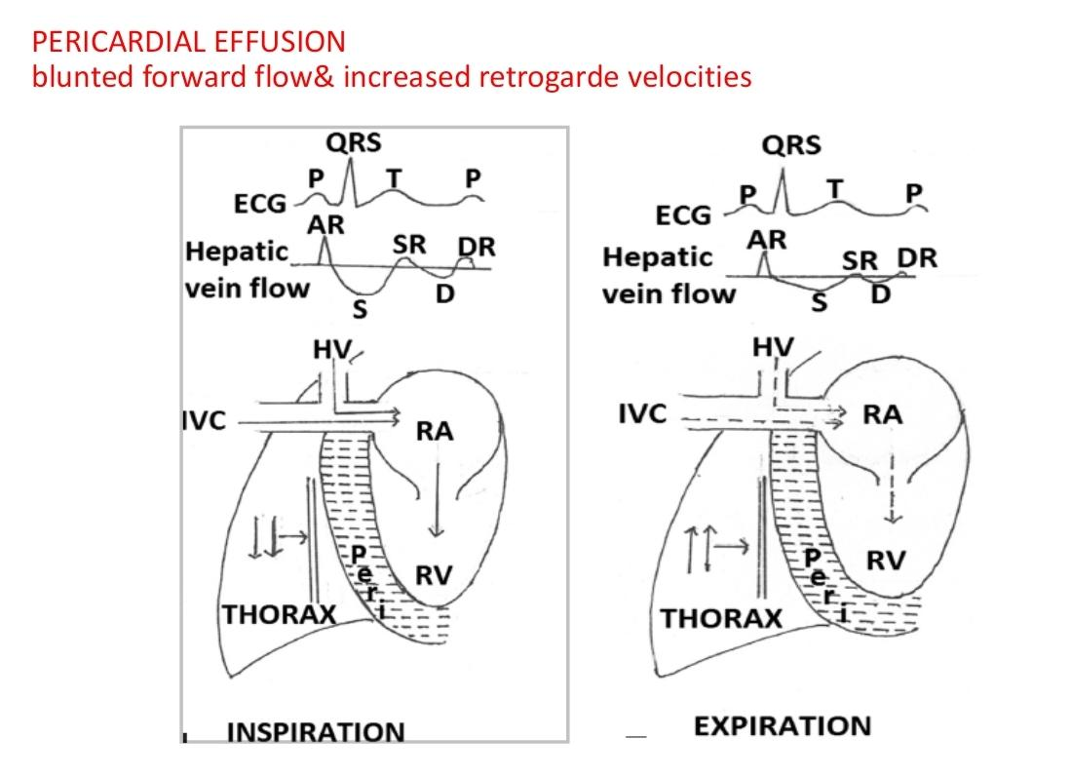

Slide 44
IVC obstruction (above HV junction):
Prevents normal inspiratory increase in blood flow to RA.
Hepatic vein obstruction:
Prevents inspiratory augmentation of flow from HV.
Reduced hepatic vein compliance (due to liver disease):
Seen in fatty infiltration, fibrosis (cirrhosis), tumors.
Leads to blunted flow variations and abnormal Doppler patterns.

Slide 45
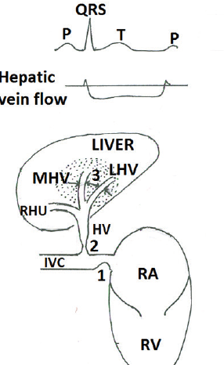
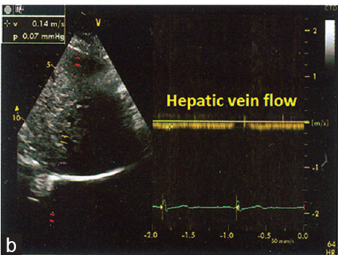
Obstruction

Slide 46
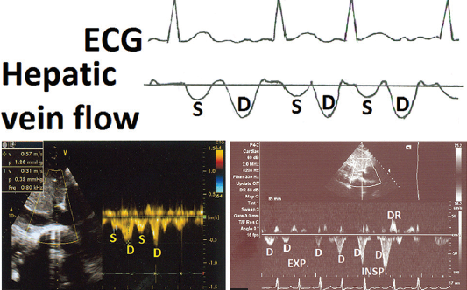
AR wave abnormalities:
Atrial fibrillation- absent AR wave

Slide 47
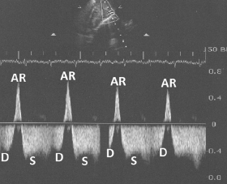
Tricuspid atresia - prominent AR

Slide 48
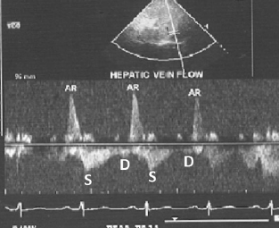
Tricuspid Stenosis

Slide 49
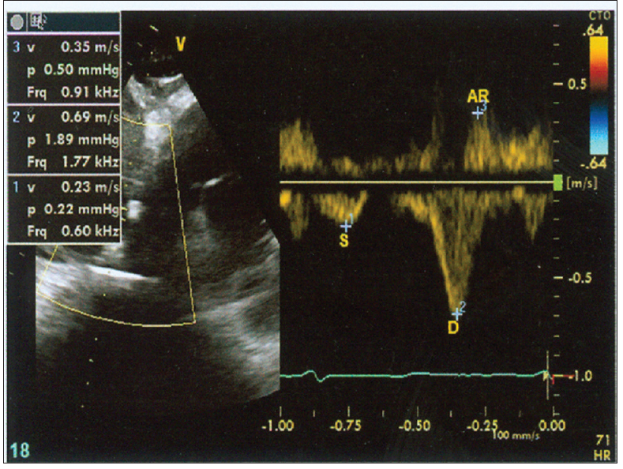
Factors affecting Systolic Foreward Flow

Slide 50
Atrial fibrillation → no effective atrial contraction/relaxation → the atrial (AR) wave is lost on hepatic venous Doppler.
Right ventricular systolic dysfunction (from RV infarction, massive PE, or dilated RV cardiomyopathy) → the systolic forward wave (S wave) is reduced because the normal “downward pull” of the tricuspid annulus during RV contraction is weak.
Tricuspid regurgitation (TR) → during RV systole, blood leaks back into RA → extra volume in RA during systole → produces a large systolic reversal wave (SR) in hepatic vein Doppler.

Slide 51
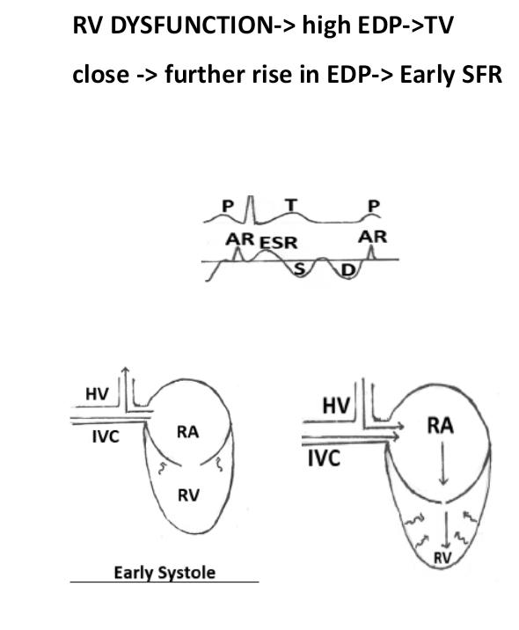
SYSTOLIC REVERSAL

Slide 52
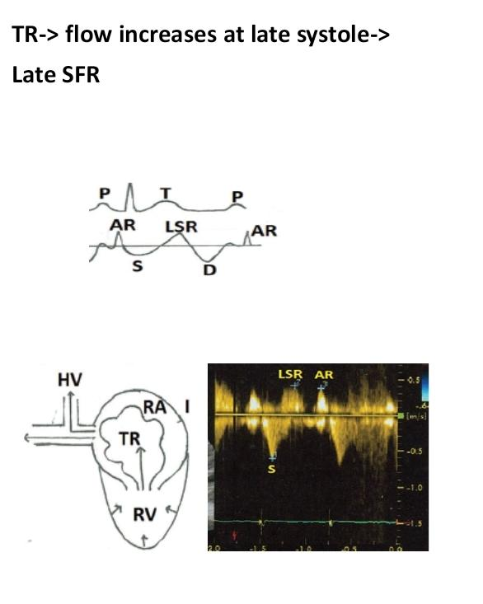
SYSTOLIC REVERSAL

Slide 53
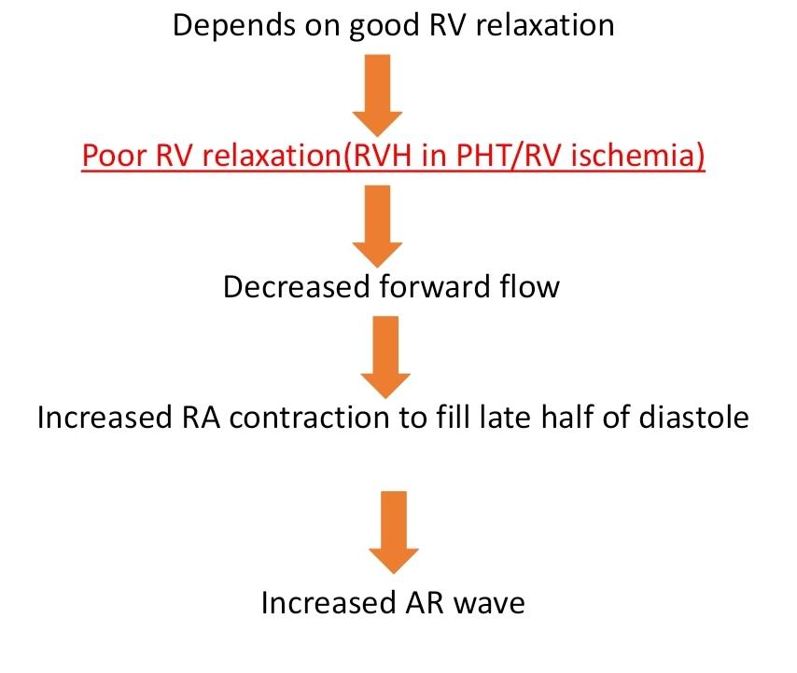
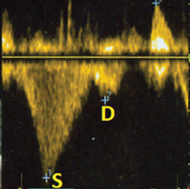
DIASTOLIC FORWARD FLOW

Slide 54
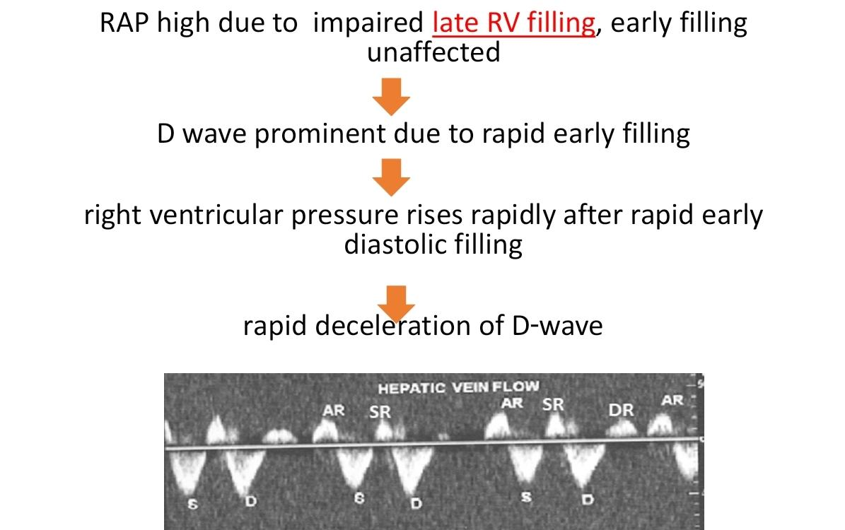
CONSTRICTVE PERICARDITIS

Slide 55
Normal: Inspiratory fall in intrathoracic pressure → transmitted to RV → RV accepts more venous return.
Constrictive pericarditis:
Inspiratory fall in pressure not transmitted to RV.
Inspiration: RV accommodates venous return by leftward shift of interventricular septum (IVS).
Expiration: IVS shifts right → RV filling restricted.
Venous blood backs up → expiratory diastolic flow reversal in IVC & hepatic veins.

Slide 56
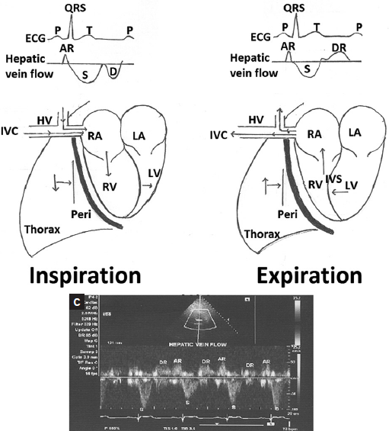

Slide 57
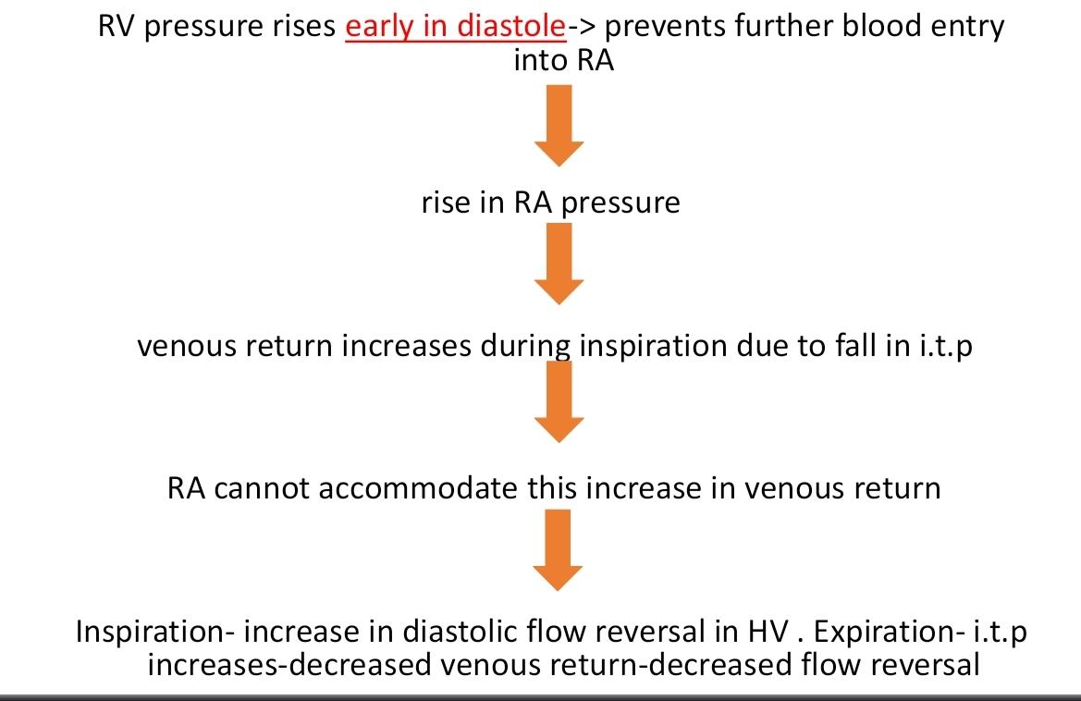
RCM

Slide 58
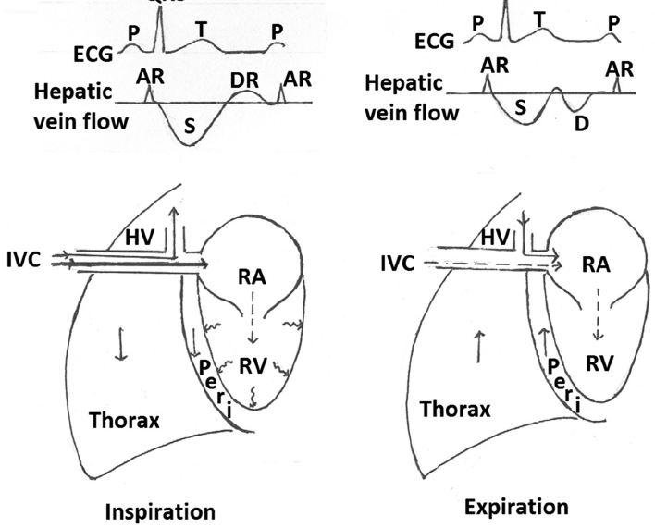

Slide 59
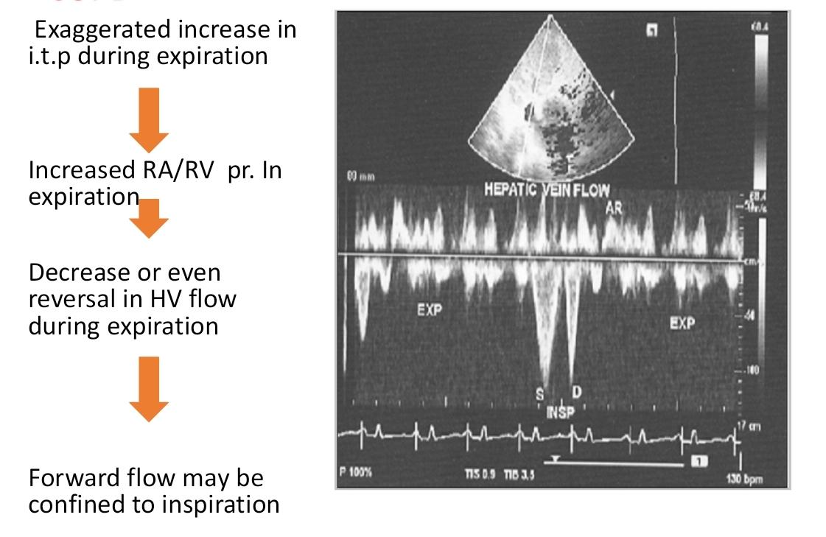
COPD

Slide 60
Positive Pressure Ventilation
Positive pressure ventilation → raises intrathoracic pressure
↑ Pressure on RA + intrathoracic IVC → ↑ back pressure on abdominal IVC & hepatic veins
Result: reduced forward flow in hepatic veins
Doppler changes:
Systolic & diastolic forward flow velocities ↓
Reversal waves mildly ↑

Slide 61
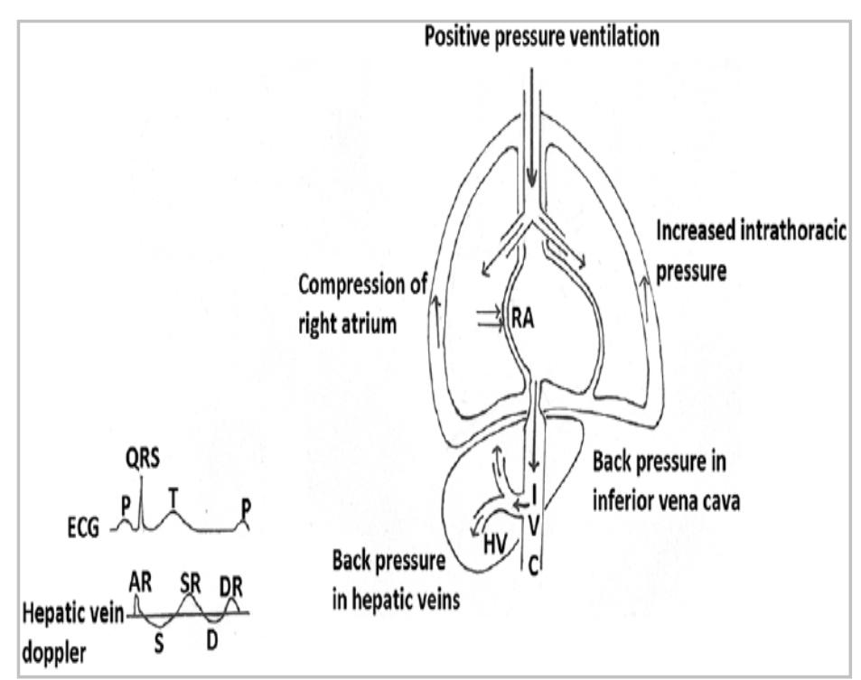

Slide 62
Not true about Physiologic Factors Causing Artifacts in Hepatic Vein Doppler
Inspiration → decreases forward flow (S, D waves less prominent).
Patient position (supine vs. sitting) plays a role.
Transducer angle / Doppler gain setting can alter assessment.
Valsalva maneuver → reduces venous return → dampens S & D.

Slide 63
Not true about Physiologic Factors Causing Artifacts in Hepatic Vein Doppler
Inspiration → decreases forward flow (S, D waves less prominent).
Patient position (supine vs. sitting) plays a role.
Transducer angle / Doppler gain setting can alter assessment.
Valsalva maneuver → reduces venous return → dampens S & D.

Slide 64
Not true regarding recording hepatic vein Doppler
Slight angulation of the transducer improves alignment with the vein’s long axis.
Use a small sample volume (≈2 mm). Place it inside the HV, away from the IVC junction.
During apnea: Waveforms are cleaner and more stable.
Sweep speed: 25 mm/s: Best for analyzing waveform morphology (S, D, A reversal waves).

Slide 65
Not true regarding recording hepatic vein Doppler
Slight angulation of the transducer improves alignment with the vein’s long axis.
Use a small sample volume (≈2 mm). Place it inside the HV, away from the IVC junction.
During apnea: Waveforms are cleaner and more stable.
Sweep speed: 25 mm/s: Best for analyzing waveform morphology (S, D, A reversal waves).

Slide 66
False about Differentiating HV from hepatic artery (HA) and portal vein (PV) using Doppler flow patterns:
Hepatic vein (HV): Flow away from transducer → shown below baseline (blue), multiphasic.
Portal vein (PV): Flow toward transducer → above baseline (red), monophasic, low velocity.
Hepatic artery (HA): Flow away from transducer → below baseline (blue), pulsatile (high in systole, lower in diastole).

Slide 67
False about Differentiating HV from hepatic artery (HA) and portal vein (PV) using Doppler flow patterns:
Hepatic vein (HV): Flow away from transducer → shown below baseline (blue), multiphasic.
Portal vein (PV): Flow toward transducer → above baseline (red), monophasic, low velocity.
Hepatic artery (HA): Flow away from transducer → below baseline (blue), pulsatile (high in systole, lower in diastole).

Slide 68


Slide 69
## 1. Basics
* **Technique:** Duplex Doppler US (intercostal / subcostal / transabdominal).
* **Normal anatomy:** Right, middle, and left hepatic veins → drain into retrohepatic IVC.
* **Display:** B‑mode + color Doppler + spectral tracing.
---

Slide 70
## 2. Normal Hepatic Vein Waveform
Although often described as *triphasic*, there are **four waves**:
* **A wave (retrograde):** atrial contraction → small reversal toward liver.
* **S wave (antegrade):** ventricular systole + tricuspid annular descent → dominant forward flow.
* **V wave (transitional):** atrial filling → may be antegrade, retrograde, or neutral.
* **D wave (antegrade):** passive flow during diastole (tricuspid opening).
👉 **Normal:** Multiphasic, with **S ≥ D**.

Slide 71
## 3. Factors Affecting Waveform
* **Respiration:**
* Quiet inspiration / end inspiration → triphasic.
* Valsalva / end expiration → blunted or monophasic.
* **Other influences:** ascites, pregnancy, peritonitis, mechanical ventilation.
* Exercise ↑ velocities but morphology preserved.

Slide 72
## 4. Systematic Analysis (Algorithm)
Ask four questions:
1. **Direction of flow?** Normal = hepatofugal. Reversal = obstruction (Budd–Chiari, compression).
2. **Regular or irregular?** Irregular → arrhythmia, turbulence, ventilation.
3. **Phasicity?** Multiphasic (normal) vs dampened/monophasic (cirrhosis, fatty liver, metastases, ↑ IAP).
4. **S vs D ratio?** Normally S ≥ D. If reversed (S < D) → right heart pathology.

Slide 73
## 5. Abnormal Patterns in Disease
* **Tricuspid Regurgitation:**
* Mild: S < D, still antegrade.
* Severe: S absent or reversed → retrograde.
* Often biphasic pattern (retrograde A/S/V vs antegrade D).
* **Right Heart Failure:** Similar to TR; S wave blunted, S/D reversed.
* **Constrictive Pericarditis:** Extra retrograde wave between D and A.
* **Cirrhosis / Fatty Liver / Metastases:** Dampened or monophasic.
* **Budd–Chiari / Obstruction:** Reversed or absent flow.

Slide 74
## 6. Special Situations
* **Liver Transplant:**
* Triphasic waveform → rules out stenosis/rejection (high negative predictive value).
* Blunted waveform → nonspecific (may be edema, rejection, cholangitis, fibrosis).
* **Pregnancy:** Temporary blunting; usually normalizes postpartum.

Slide 75
## 7. Key Take‑Home
* Normal HV Doppler is multiphasic with dominant S wave.
* Waveform = interplay of cardiac physiology + hepatic compliance + intra‑abdominal pressure.
* Abnormal patterns help differentiate **cardiac vs hepatic vs obstructive causes**.
* Use a **systematic algorithm**: Direction → Regularity → Phasicity → S/D ratio.

